Slide 1
AGS Status and Plans
RHIC Spin Collaboration Meeting
2/18/11

Slide 2
Update
Jump quads have been on for every RHIC fill since Wednesday evening (first physics fill Thursday evening, fill no. 15190)
Benefit to polarization clearly seen at RHIC injection over the course of the last week.
Emittance and intensity with the jump quads on is slowly improving as we gain experience.
Target positioning incident (2/18 and 2/24) still not well understood.

Slide 3
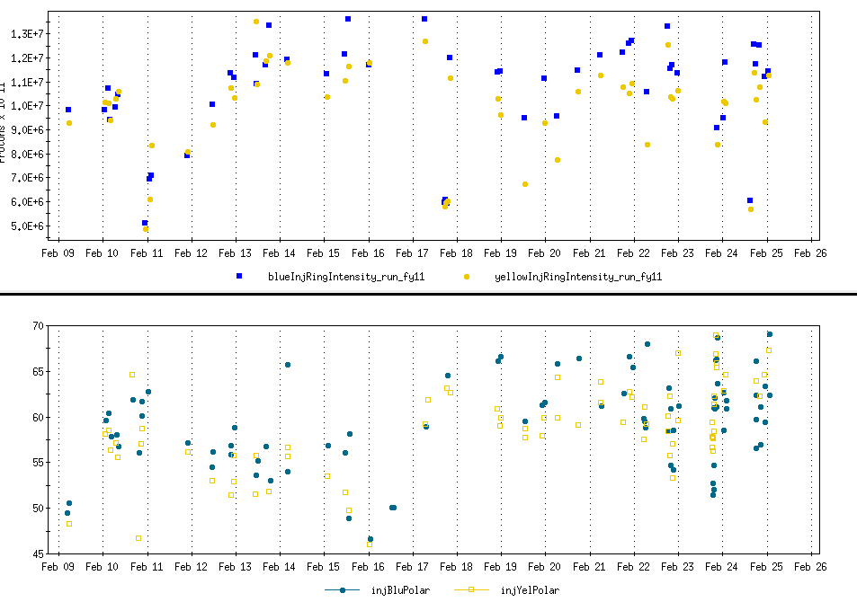
Intensity and Polarization at RHIC Injection
Intensity (1e4 particles)
Polarization

Slide 4
Plans
Still trying to verify tracking prediction that last few jumps contribute a measureable effect to the overall polarization gain (needs good statistics)
Will try to optimize resonance timing empirically with timing scans of many jumps (whole function, first half, second half)
Get to a state where we can ‘turn off’ resonance jumping without turning off the quads (the timing has to be good enough that a global shift of times misses ~all the resonances)
  Measure effect of such a shift on the polarization profiles.

