Slide 1
RHIC Status
Haixin Huang
RSC Meeting
02/11/2011

Slide 2
Blue Dump Kicker Noise Seen on BBQ Signals

Slide 3
Blue Dump Kicker Noise Effect on Beam Size
Each point corresponded to beam size with additional bunch injected.
Beam sigma (mm)

Slide 4
Emittance In Three Overnight Stores

Slide 5
Status
We have a new ramp which is more forgiven to chromaticity variation, drift. Polarization transmission efficiency is as good as the old one.
Experienced noise problem in blue beam (poor intensity life time and luminosity life time). The source has not be found yet, but localized to blue abort kicker.
Polarization at injection agreed with AGS numbers.
Ready to push bunch intensity.

Slide 6
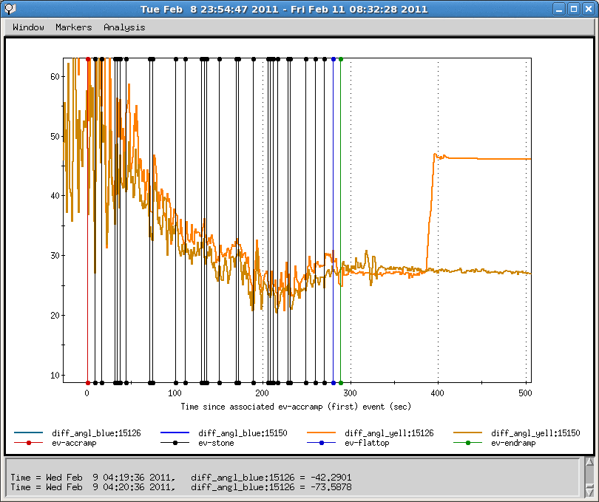
Snake Angle Difference Meet Specs
Ready for snake current scan

Slide 7
Unfinished Business (Besides the noise problem)
Clean up a few ramp related issues (tune feedback settings, collimator settings, injection drift compensation).
Need snake current scan to set spin tune close to 0.5.
Higher bunch intensity.
Procedure and impact of adding IP2.
9MHz cavity for physics run. Ready for high intensity and bunch number test.
Rotator ramp needs to be worked on as the energy ramp has evolved.

Slide 8
Polarization Through Ramp with Qy=0.68

Slide 9
Polarization Through New Ramp with Qy=0.675

