Slide 1
ZDC Online Monitoring at STAR online.star.bnl.gov/zdc
Oleksandr Grebenyuk, LBNL
4 February 2011

Slide 2
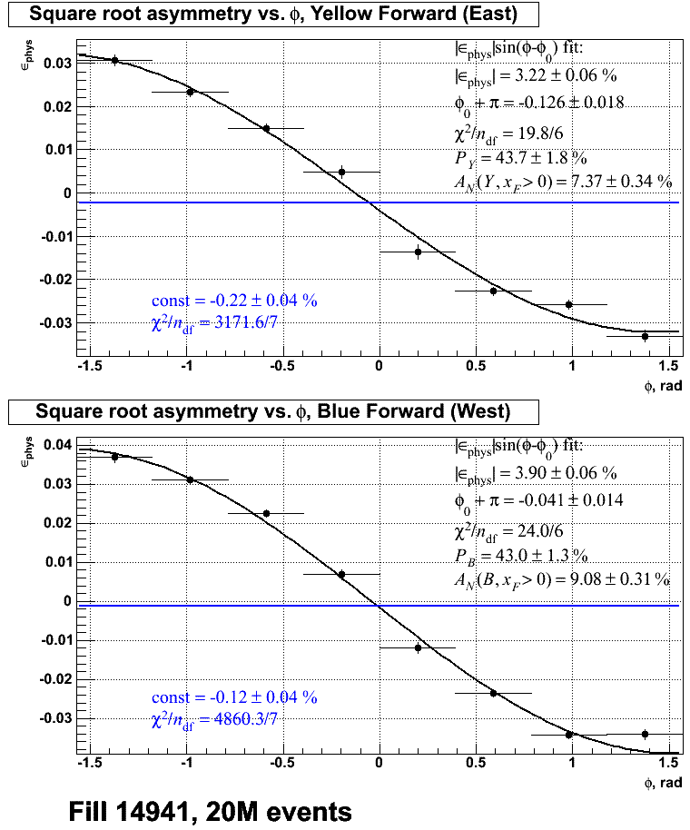
ZDC Online Monitoring
  Calculates “square root”
  asymmetry from the φ
  modulation of SMD hits
  for each beam
  Uses bunch and spin
  patterns, and CNI
  polarizations from CDEV

Slide 3
Asymmetries in Run 9 and Run 11
Run | Fill | Raw asymmetry |  |  |  | Polarization
 |  | Yellow | +/- err | Blue | +/- err | Yellow | +/- err | Blue | +/- err
2009 | 10364 | 2.61% | 0.09% | 2.54% | 0.09% | 38.9% | 3.6% | 31.6% | 2.3%
 | 10368 | 2.71% | 0.10% | 2.74% | 0.11% | 45.4% | 1.3% | 36.1% | 1.2%
 | 10371 | 2.52% | 0.11% | 2.49% | 0.12% | 44.6% | 1.3% | 40.6% | 1.2%
 | 10373 | 2.84% | 0.09% | 3.31% | 0.10% | 45.7% | 1.0% | 50.4% | 0.8%
 | 10375 | 3.27% | 0.10% | 2.57% | 0.11% | 43.8% | 1.1% | 37.3% | 1.1%
2011 | 14941 | 3.22% | 0.06% | 3.90% | 0.06% | 43.7% | 1.8% | 43.0% | 1.3%
 | 15004 | 3.99% | 0.11% | 3.77% | 0.11% | 52.0% | 1.9% | 48.2% | 1.5%

