Slide 1
AGS Status and Plans RHIC Spin Collaboration Meeting 2/4/11

Slide 2
Polarization profiles
Measured polarization profiles in the AGS
Horizontal profile steeper than in previous runs
Vertical profile is flat
Completed intensity scan with J10 scrape
Consistent with a horizontal profile
Steeper dependence than any Booster scraping method

Slide 3
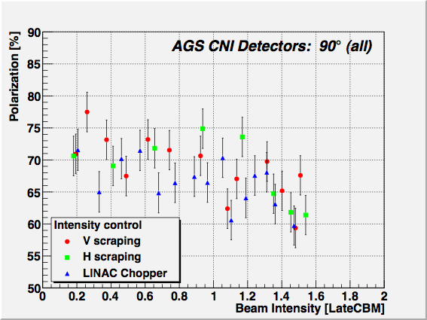

Slide 6
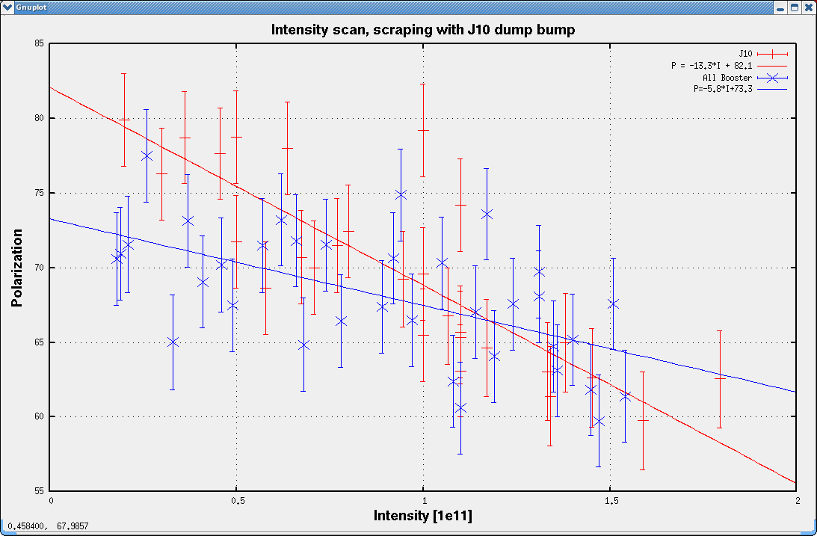

Slide 7
But not at RHIC Injection
Single measurement at RHIC injection
Blue (sweep, fixed) = (51.4 +/- 1.7, 52.7 +/- 1.3)
Yellow (sweep, fixed) = (48.2 +/- 1.5, 52.1 /- 1.2)
Questions:
Where does the steeper profile come from?
Where does it go between AGS and RHIC?
How is it affected by the jump quads?

