Slide 1
RHIC Status
Haixin Huang
RSC Meeting
01/28/2011

Slide 2
Status as of 1/28/2011
The beam loss in early ramp has been removed by moving gamma_tr quad off time ten second later.
The sextupole ramping speed are with the limit, and the limit can be pushed up a little bit more.
Transmission efficiency on the ramp is typically close to 99%.
Provided 28x28 stores for three nights then failed in the following two nights when trying 56x56.
Various reasons: Orbit on the ramp (feedback on/off), abort kicker prefire, collimator positions.
9MHz cavity commissioning continues. Ramped with 10^11 intensity. 111 bunch injected without instability.
Polarization ~>40% at store.
Most instrumentation have been operational. Exceptions: blue IPM, and jet.
Rotator ramp development started yesterday. Found many issues (how deal with two ramps in tape sequencer, copy stones from ramp to ramp).

Slide 3
Plan for next A Few Days
  9MHz cavity development. With successful ramp, try rebuketing with 28MHz cavity.
  Provide overnight stores with 56x56 bunches or more.
  Chromaticity feedback development on Saturday. We will see if we need slower ramp after this.
  Rotator ramp development on Sunday.
  Increase bunch number on ramp.
  Push vertical tune closer to 2/3 (0.675->.672) and check polarization transmission efficiency.

Slide 4
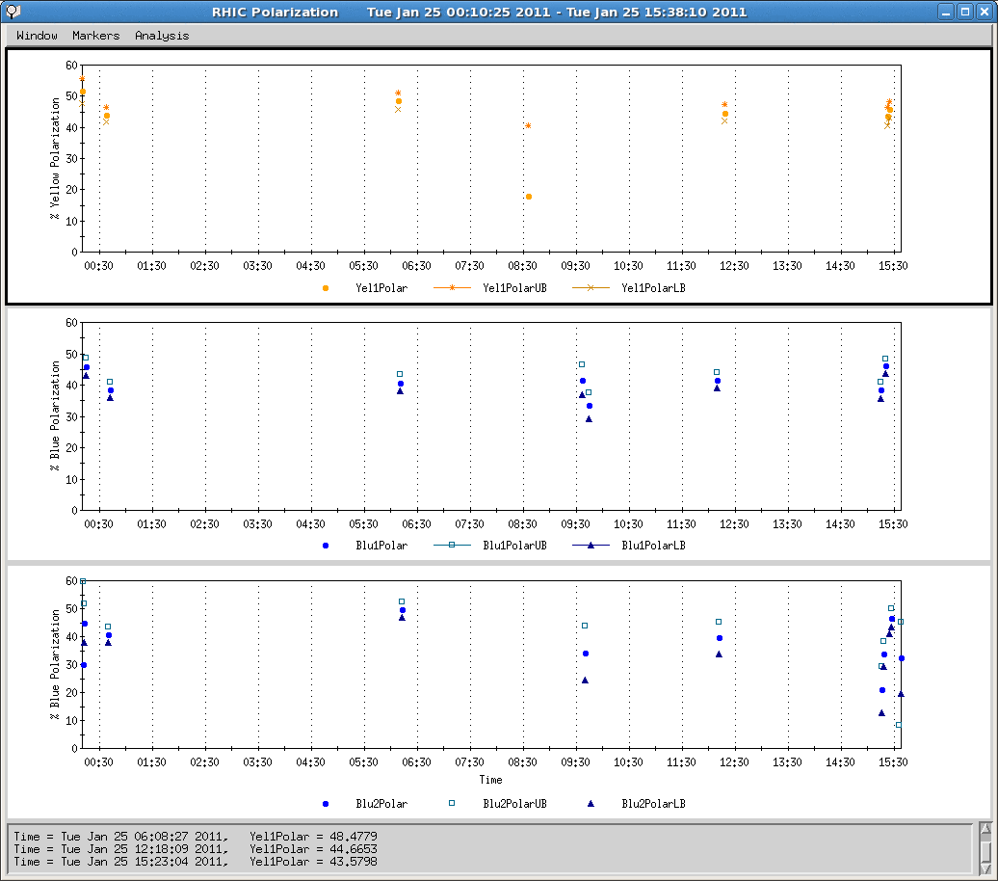
Polarization over 14934 (Tuesday)
Sweep and fixed target measurements: the difference indicates polarization profiles

Slide 5
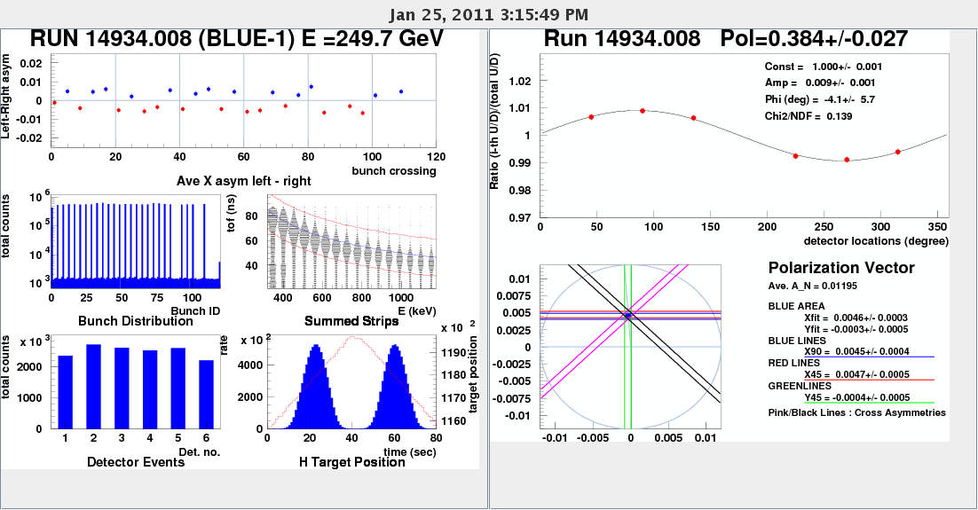
Beam Profile Reasonable in Blue (end of store)

Slide 6
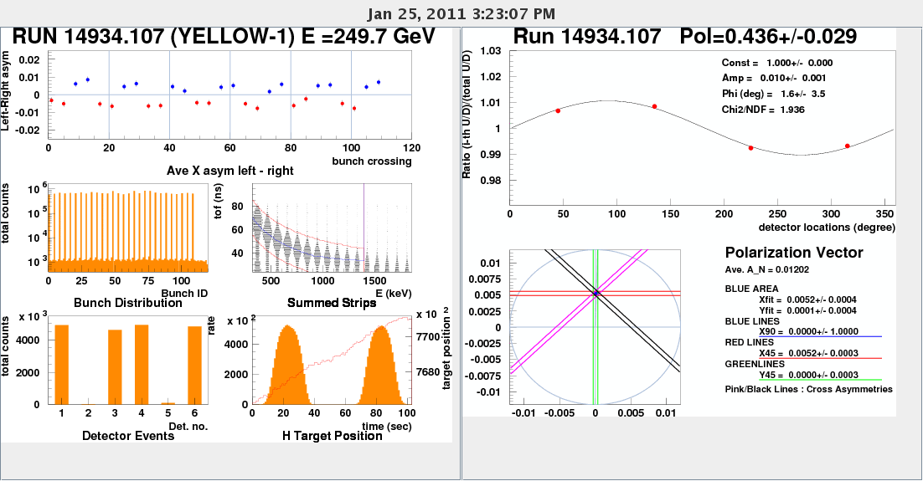
Beam Profile Reasonable in Yellow (end of store)

Slide 7
Overall Schedule
Cool-Down Mode : one week (01/03-01/09)
Injection setup (6 days: first 4 days are blue only) (01/10-01/15).
Ramp development (6 days) (01/16-01/21)
Commissioning 9MHz at injection and on the ramp (5 days) (01/19-01/23)
Store development (6 days) (01/22-01/27)
Ramp development with intense beam (7 days) (01/28-02/03).

