Slide 1
AGS Status Update
RHIC Spin Collaboration Meeting
1/28/11
V. Schoefer

Slide 2
Developments
Trying to understand jump quad effect on emittance
  Scraping near transition: horizontal, longitudinal
    Can the scraping we see account for any polarization gain?
Intensity scan with scraping at the J10 dump at AGS extraction.
Planned:
  Polarization profiles (account for backlash)
  Scan of Gauss clock calibration parameter for jump quad timing
  Polarization as function of longitudinal scrape

Slide 3
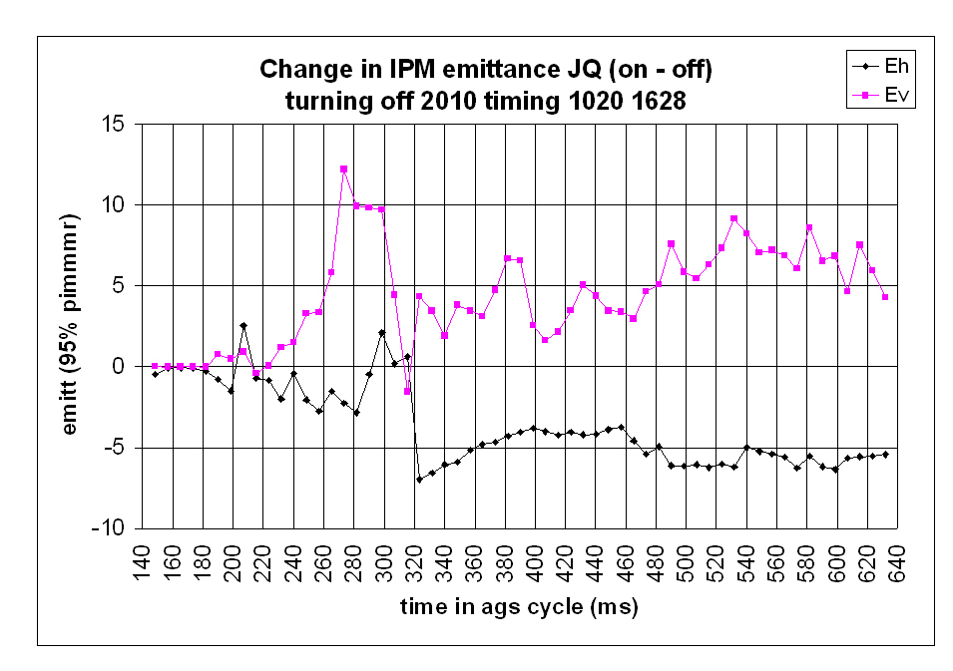
Plot courtesy of L. Ahrens

Slide 4
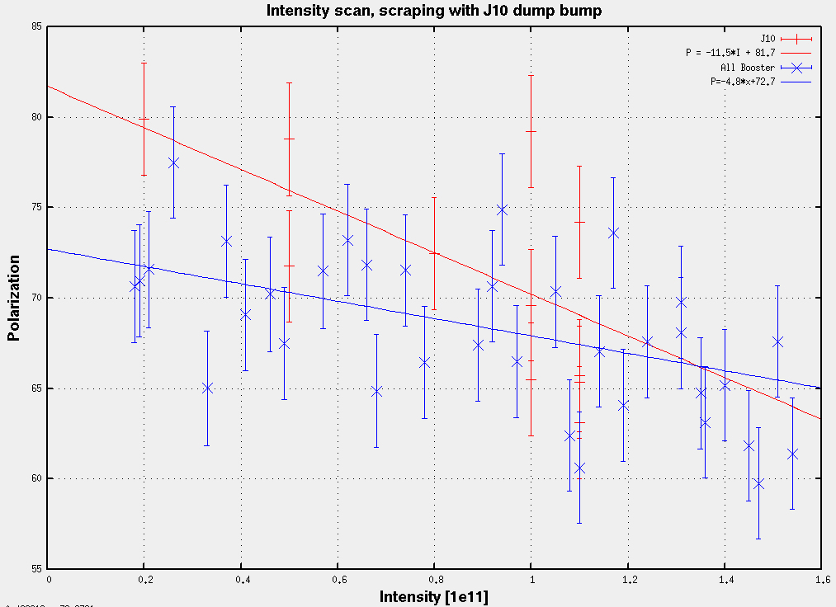
Need more data (over greater intensity range) to determine whether scraping late in
AGS is more effective than Booster scraping.

Slide 5
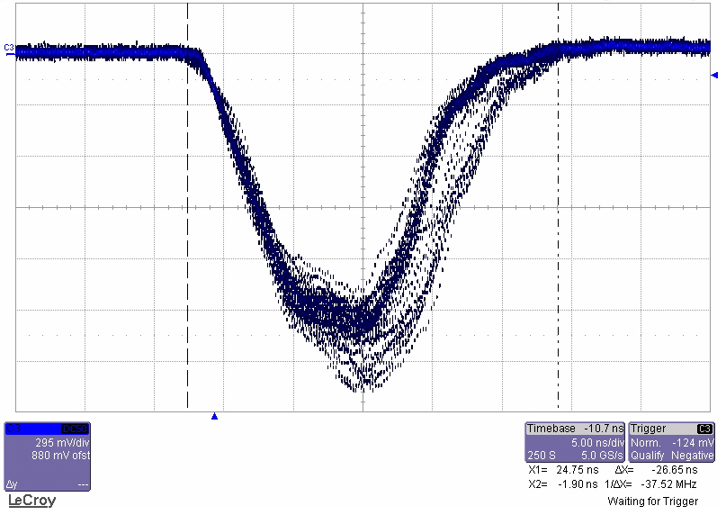
A preliminary look at longitudinal scraping
5 ns
AGS WCM at flattop
Scraping with radial steering, 0.8e11 protons
No scraping, 1e11 protons

Slide 6
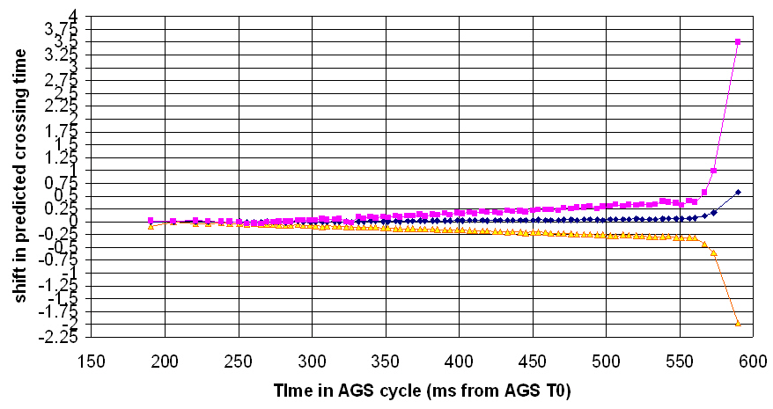
Change in jump timing with GC calibration change
(ms)
(ms)

