Slide 1
RHIC Status
Haixin Huang
RSC Meeting
01/21/2011

Slide 2
Status as of 1/21/2011
6X6 ramp development continues. Tune/coupling/orbit feedback works. There are beam losses at very beginning. It is believed to be chromaticity related. We will continue to address the chromaticity issue in the ramp development. The chromaticity feedback development will continue tonight.
Some collisions seen at IR8.
9MHz cavity commissioning continues. Instability at injection has been worked on.
Radial feedback works well in blue (<100um), but not as well as in yellow (300um).
Most instrumentation have been operational. Exceptions: blue IPM, polarimeters.
Polarimeters in blue and yellow1 are in reasonable shape. We have not tuned yellow2 well enough to see carbon bananas. Polarization measurement was done at 250GeV with Blue2 polarimeter.

Slide 3
Plan for next A Few Days
Continue ramp development to reduce losses at first a few stones. It maybe chromaticity related. We need to increase the transmission efficiency to 90% before increase bunch numbers.
Setup collisions at IP6 and IP2.
Continue chromaticity feedback development.
Polarimeter setup work at injection, still need to check the new configuration files (when it is ready).
Polarimeter setup at store.
As soon as the polarimeter setup is finished, we need to evaluate the polarization transmission efficiency on the ramp, preferred to be done with more than six bunches.
9MHz cavity development.

Slide 4
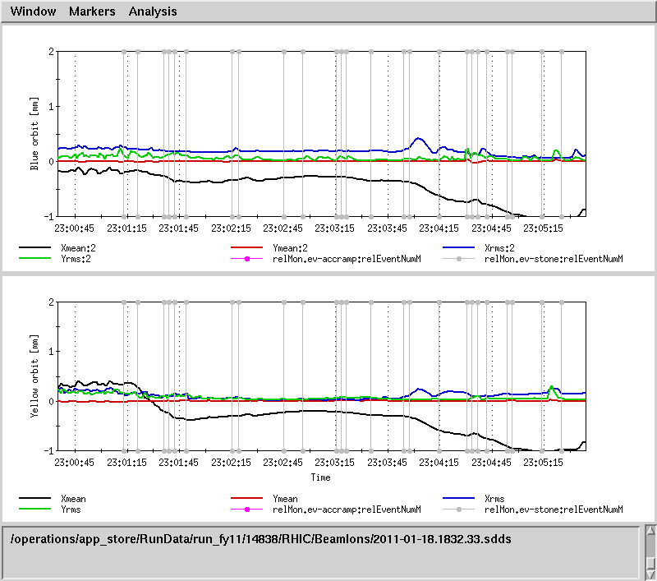
Before Radial Feedback

Slide 5
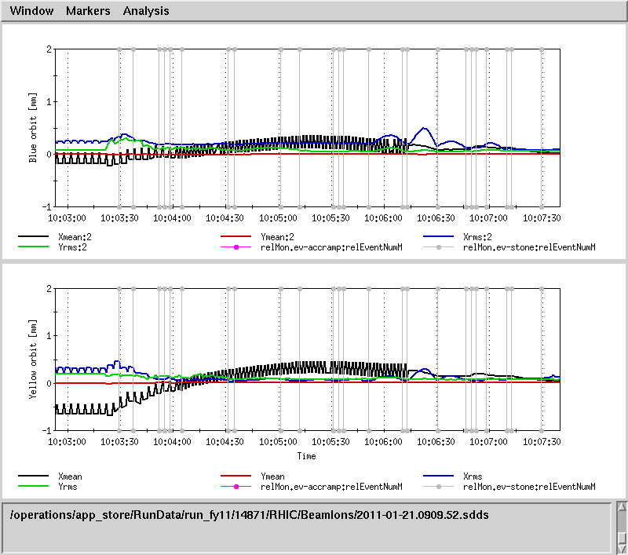
After Radial Feedback

Slide 6
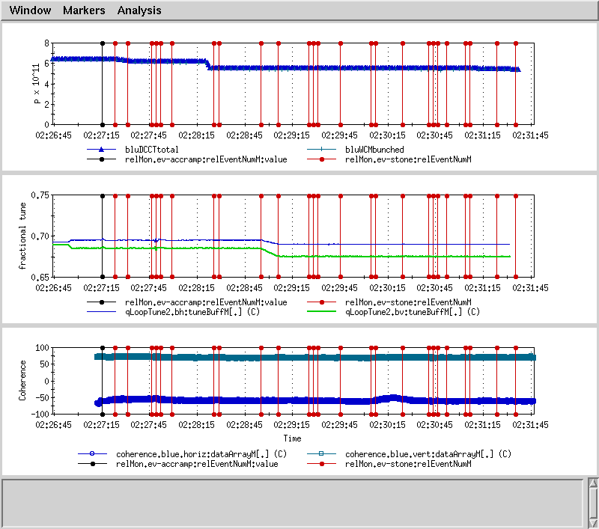
Straight Tunes on Ramp with Tune/Coupling Feedback

Slide 7
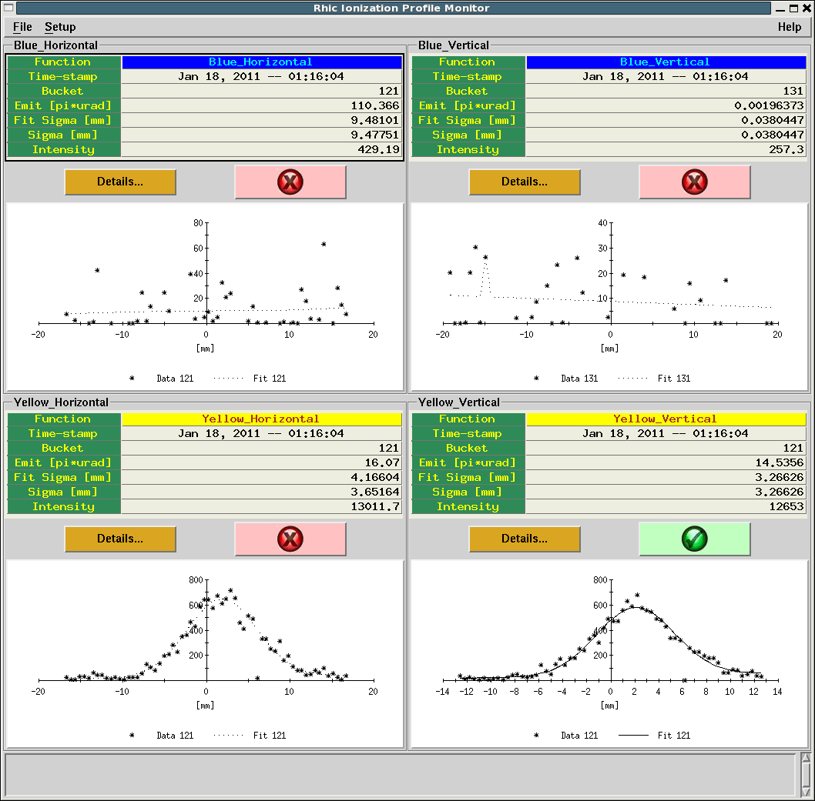
Yellow IPM Gives ~15pi Emittance

Slide 8
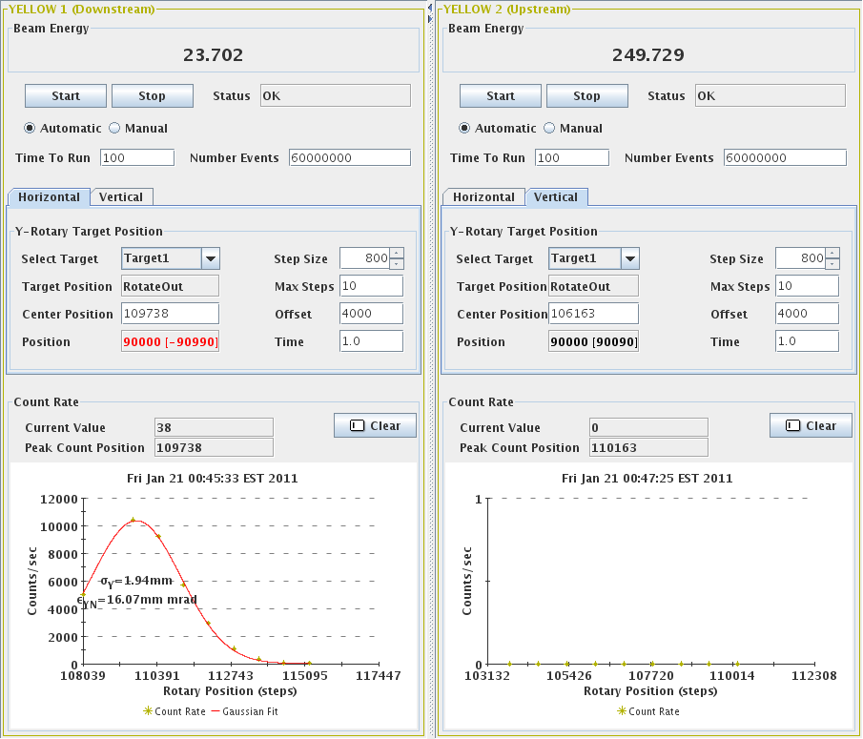
Yellow Vertical Emittance from CNI~16pi @25GeV

Slide 9
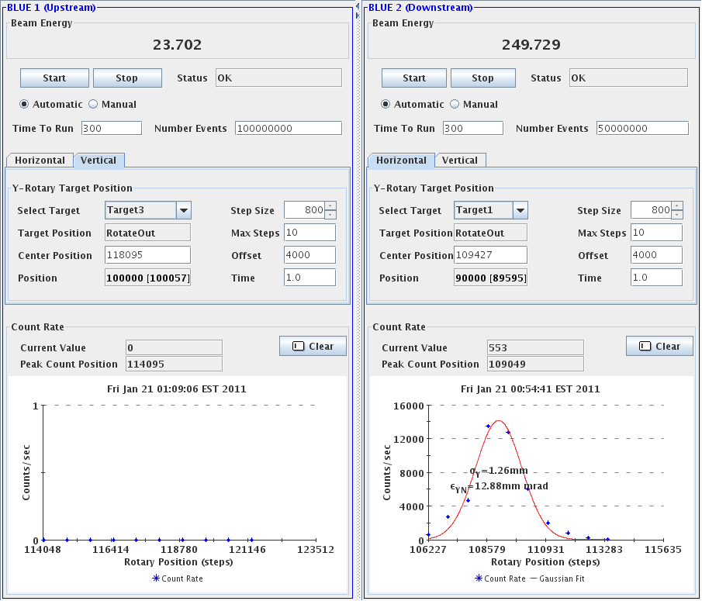
Blue Vertical Emittance from CNI~13pi @250GeV

Slide 10
Overall Schedule
Cool-Down Mode : one week (01/03-01/09)
Injection setup (6 days: first 4 days are blue only) (01/10-01/15).
Ramp development (6 days) (01/16-01/21)
Commissioning 9MHz at injection and on the ramp (5 days) (01/19-01/23)
Store development (6 days) (01/22-01/27) (already started some activities such set up collisions, DX BPM timing, optics measurement)
Ramp development with intense beam (7 days) (01/28-02/03).

