Slide 2
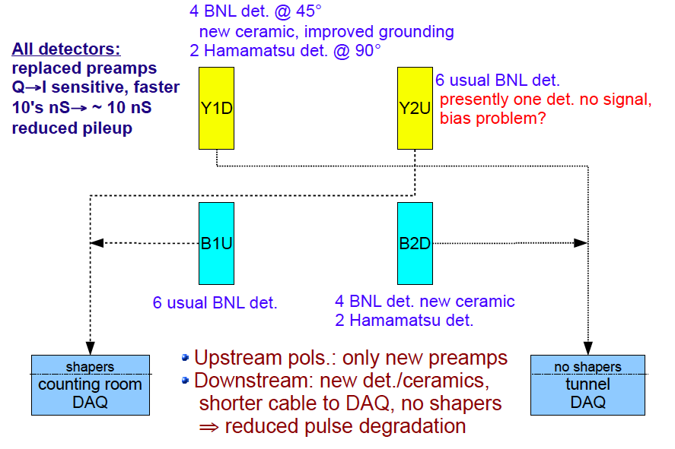
RHIC pC Setup Run11

Slide 3
Polarimeter Status
111 bunch injection
studies
Work during access on Wednesday:
  fixed problem with readout of yellow-1-downstream polarimeter
  investigated problem with current monitoring of Y2U
    spares of modules involved located
    can hopefully fix the problem at the next access day
Hardware status okay
Change in operational procedure:
  turn off Si bias voltage during beam studies, tune-up, APEX
    keep radiation damage at a minimum

Slide 4
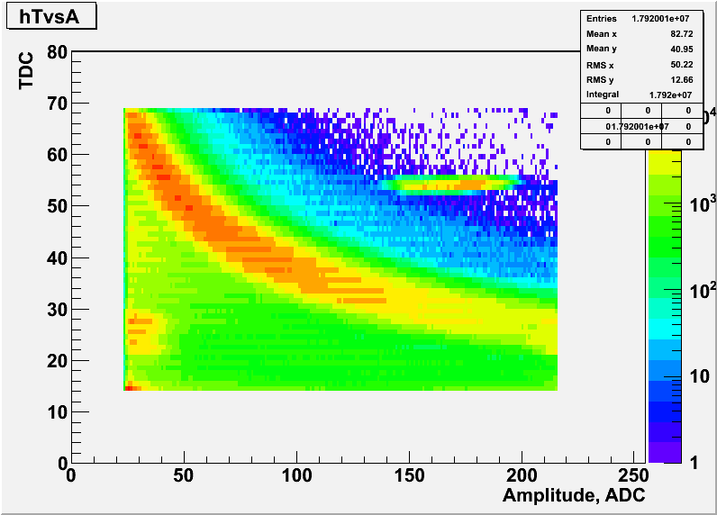
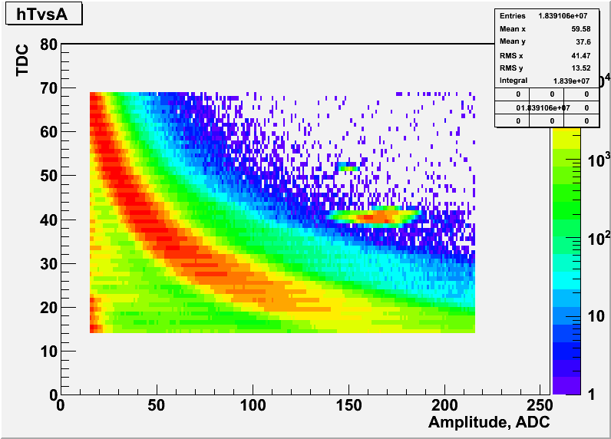
First Data from B1 & B2 Polarimeters
Blue-1 Upstream
Raw Data:
bananas clearly visible
calibration ADC -> energy
  alpha calibrations
need to correct for Si – dead layer
Blue-2 Downstream

Slide 5
α-Calibration
Blue-1 Upstream
factor 2 in position comes from the
fact that downstream polarimeters
don’t use shapers,
which also amplify
Remember
α’s penetrate much deeper into Si
than carbons
Plan for upcoming shutdown:
install 2nd source with different
- energy
install different foils to attenuate
α – energy (tests in lab planned)
Blue-2 Downstream

Slide 6
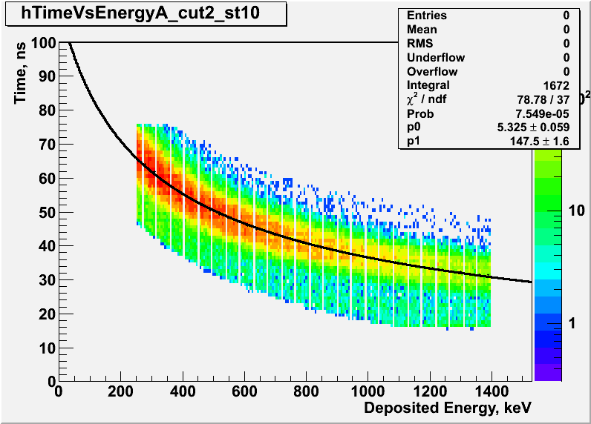
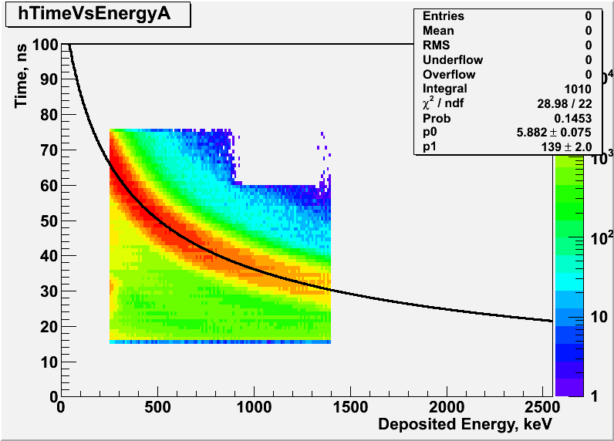
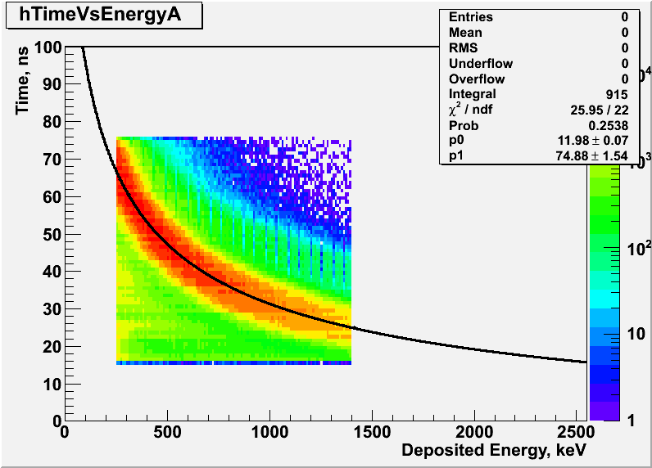
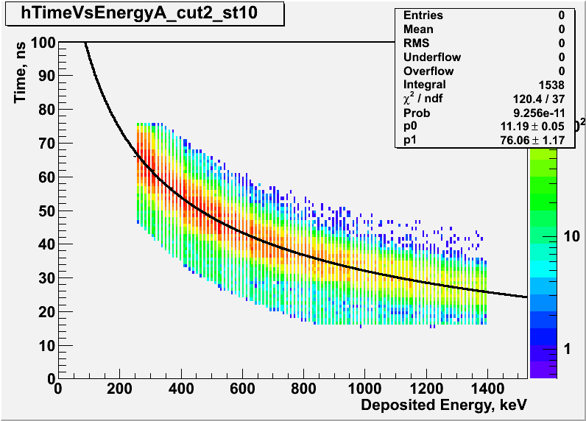
Data after Corrections
t₀
Blue-1 Upstream
Blue-1 Upstream
energy-scale correction
based on Si dead layer
Energy-Scale
Blue-2 Downstream
Blue-2 Downstream
Current Puzzle:
difference between t0 and
energy scale correction factor

Slide 7
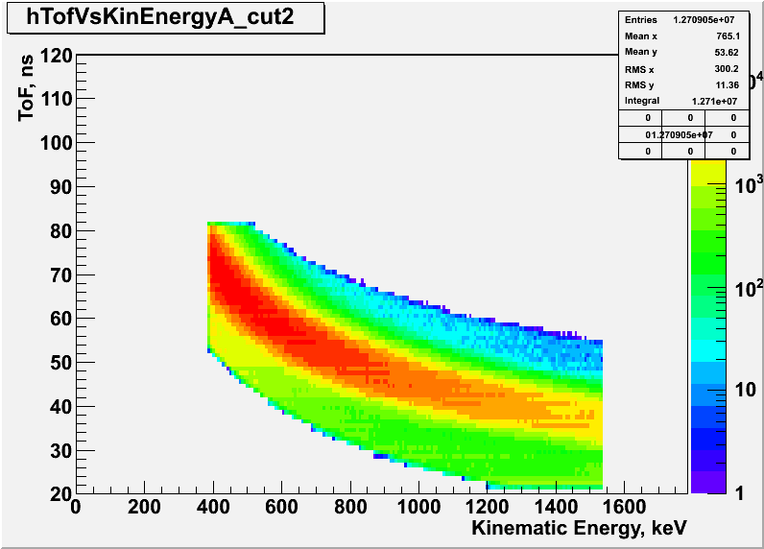
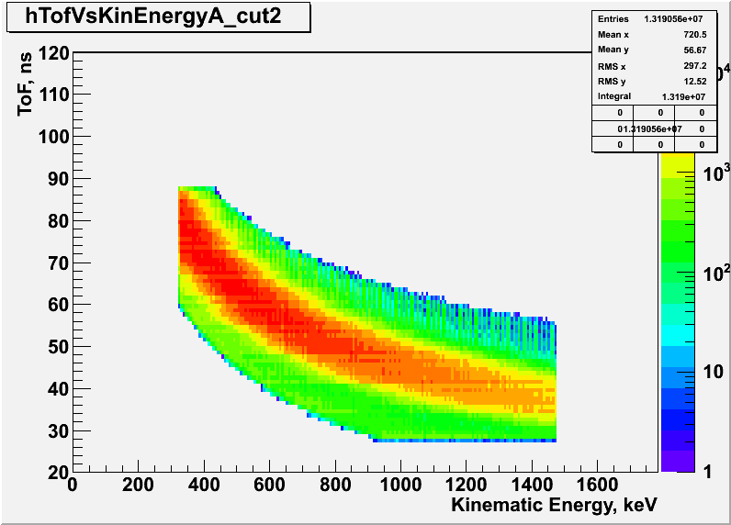
Data after all Corrections
Blue-1 Upstream
After all corrections both
polarimeters look very similar
Are you ready ????
Fasten your seat belts
the secret will be revealed
Blue-2 Downstream

Slide 8
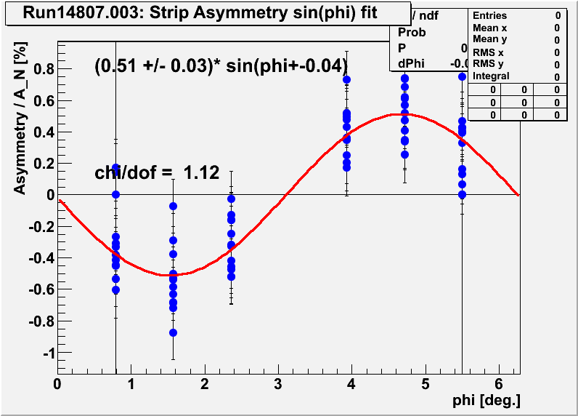
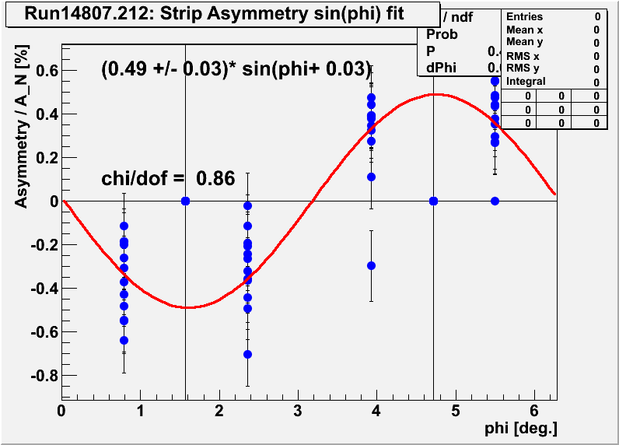
Polarization at Injection for Blue Ring
14807.003: blue1 upstream P = 51 +/- 3 % (stat only)
14807.212: blue2 downstream P = 49 +/- 3 % (stat only)

Slide 9
To Do
Update parameters in online polarization calculation to get reasonable numbers
Investigate the difference in energy-scale constant between B1 and B2
  see we get the same result for Y1 and Y2 (just collected the data last night)
  measure linearity of energy response of different systems
    vary pulser amplitude → latest during the next access day
Need good data for Y1 and Y2 polarimeters to determine parameters for online, most likely the ones from last night will do.
Analyze the polarization at flat top for B2
Next access-day
  fix bias voltage readout
  bring hopefully one detector back to live in Y2U by changing pre-amp box

