Slide 1
RHIC pp Setup Status
Haixin Huang
RSC Meeting
01/14/2011

Slide 2
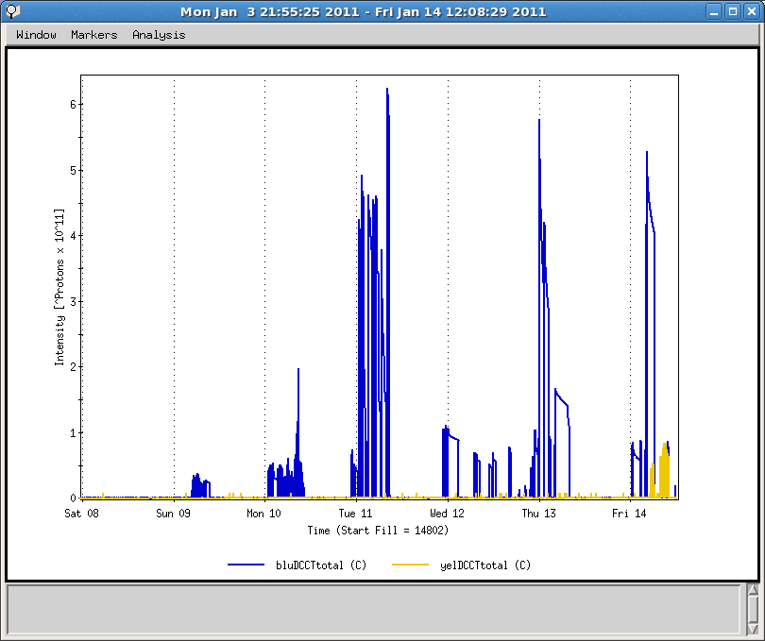
Overview of the week
Yellow injection setup started
First circulating beam with snakes
Blue polarimeter setup measurements done
RF capture with 28MHz cavity
First turn seen in blue
Instrumentation setup, feedback setup
First circulating yellow beam with snakes

Slide 3
Status
Blue
Injection setup is almost done. Most of the instrumentations were timed in and operational.
CNI polarimeter in Blue setup is almost done. Experts are working on making the device operational
Blue Tune/decoupling feedback system was tested.
Yellow
Circulating beam with snake on this morning
Need to do RF capture and instrumentation setup in following two nights.

Slide 4
Plan
We will work in next two owl shifts on yellow injection setup (RF capture and instrumentation setup).
Finish all the P/S works. This will take two shifts tomorrow
Yellow instrumentation setup
Tune/decoupling feedback system
CNI polarimeter
Others…
RF group will finish the loop setup tonight.
Fine tune blue and yellow injection with STAR magnet on. This should be quick
The near term goal is to start ramp development on Sunday.
9MHz setup at injection is scheduled for Tuesday.

Slide 5
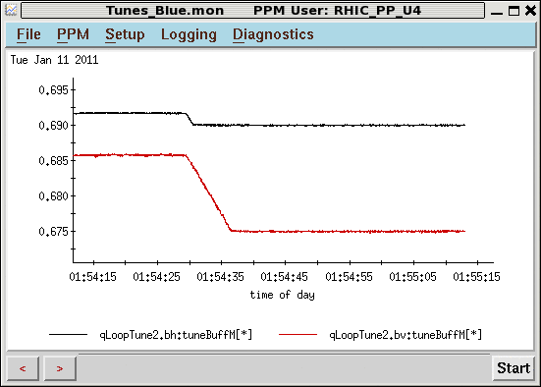
Tune/Coupling Feedback Works
The working point at injection was too close to 2/3. It has been changed.

Slide 6
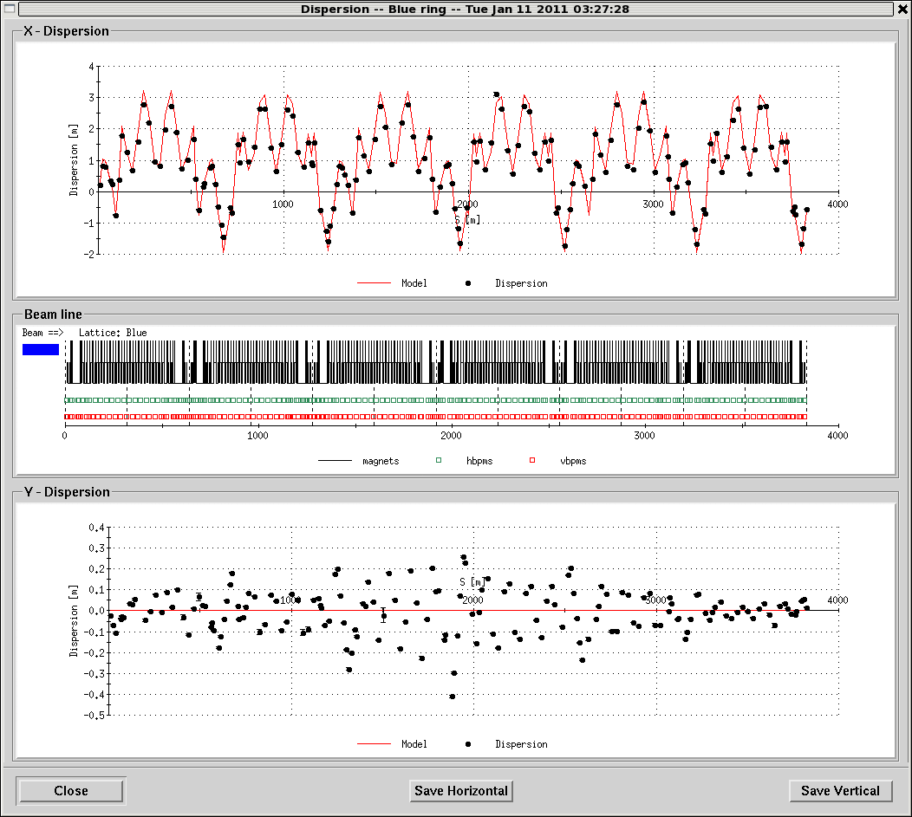
Dispersion Function Measured

Slide 7
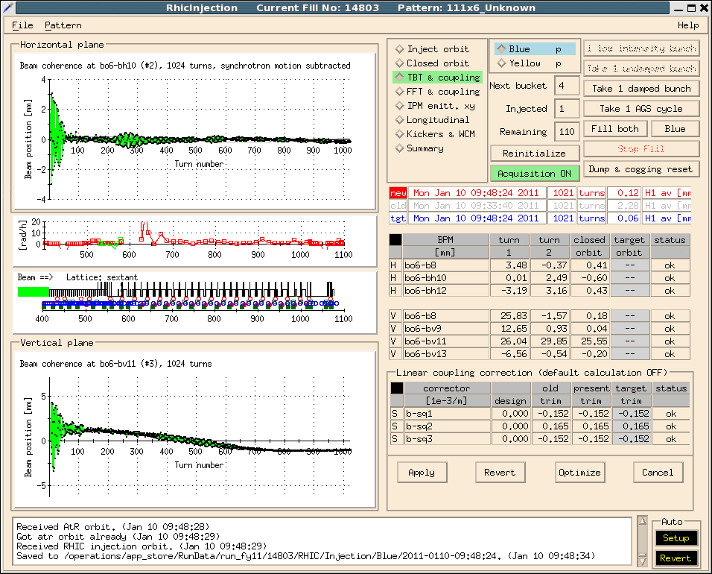
Injection Damper Done

Slide 8
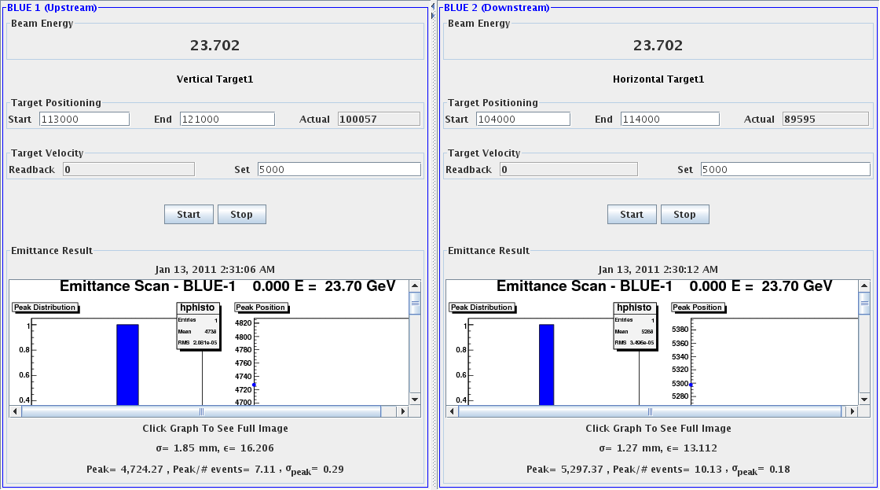
Emittance from CNI: 16,13 (H,V)

Slide 9
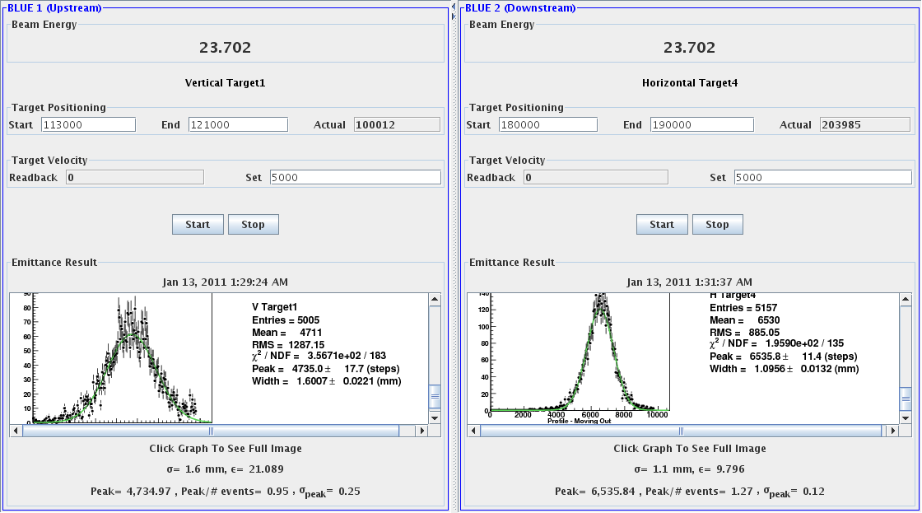
Example of Profiles: Reasonable Shapes

