Slide 1
PHENIX Run-11 Startup Status
Takao Sakaguchi, BNL
Run-11 PHENIX Run Coordinator
Personnel Status
Physics Goal of Run-11
Detector Status
Startup Plan for next one month

Slide 2
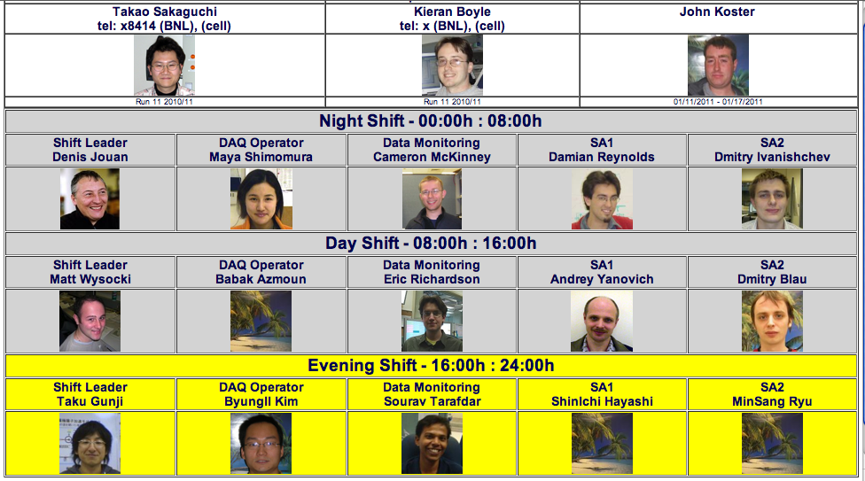
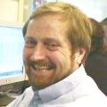
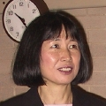
Personnel
Spin coordinator: Kieran Boyle
Trigger coordinator: Sasha Bazilevsky
PHENIX Focus seminar coordinator(s): Baldo Sahlmueller and Yoshi Fukao
  Organize seminars on physics topics and detectors
Two weeks Period coordinator(s): John Koster (this week), John Haggerty (next week)
Five person shift now: Shift leader, DAQ, Gas/Power/Data monitoring
Current shift crews
Shift Coordinators

Slide 3
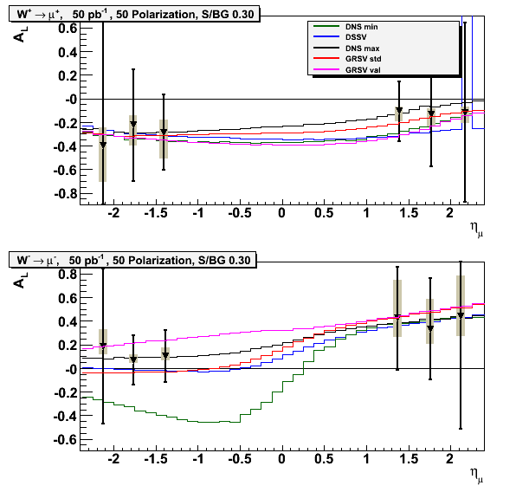
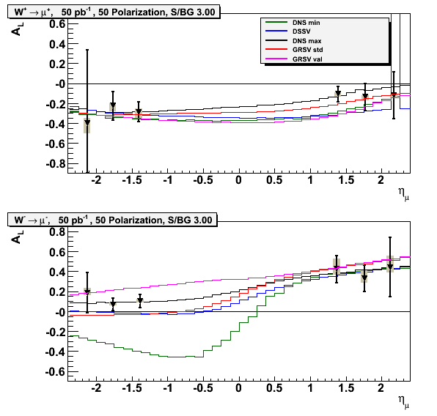
Physics Goal of Run-11 (p+p)
  4-7 times Run9 luminosity
W physics using north arm
  RPC3, muon trigger, Absorber
Central arm A_{LL} physics and VTX commissioning.
  VTX will be retracted until it is fully tested
Expected asymmetry on W->μ from Run11, based on two bkgd scenarios.
Worst case
Best case
Kieran, RSC meeting, Nov 19

Slide 4
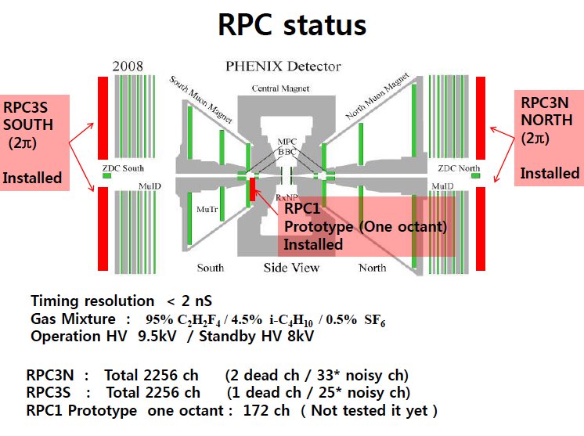
Flammable gas in the detector.
Training the detector by applying 9kV.
Accessing tunnel today for DAQ hardware setup and gas flow adjustment.

Slide 5
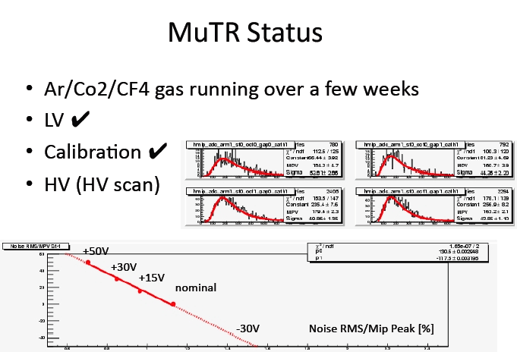
Commissioning using Cosmic Ray

Slide 6
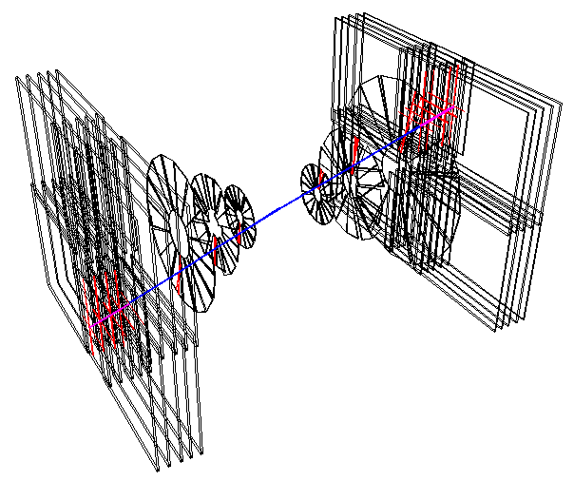
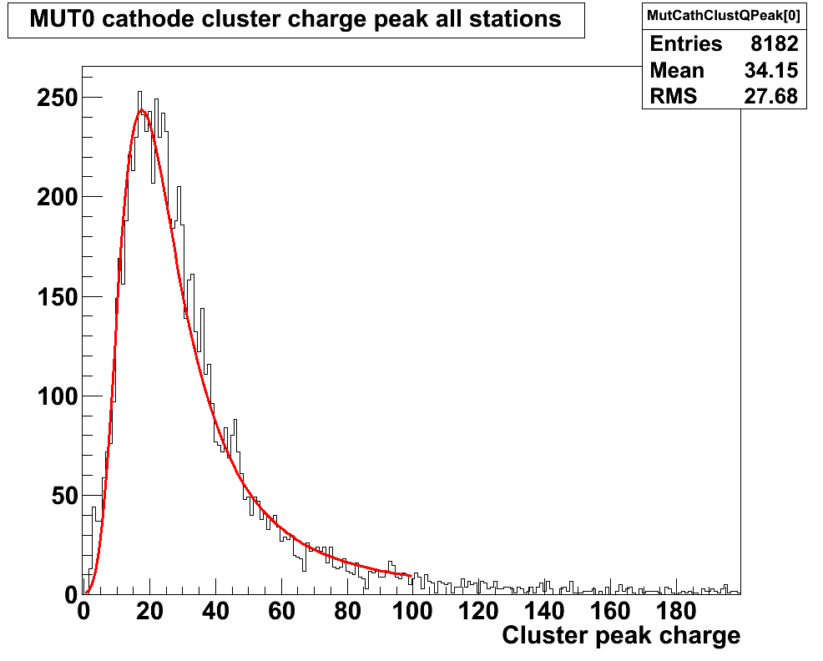
Nice Track from Run325529
evt159
Cluster Charge Distribution

Slide 7
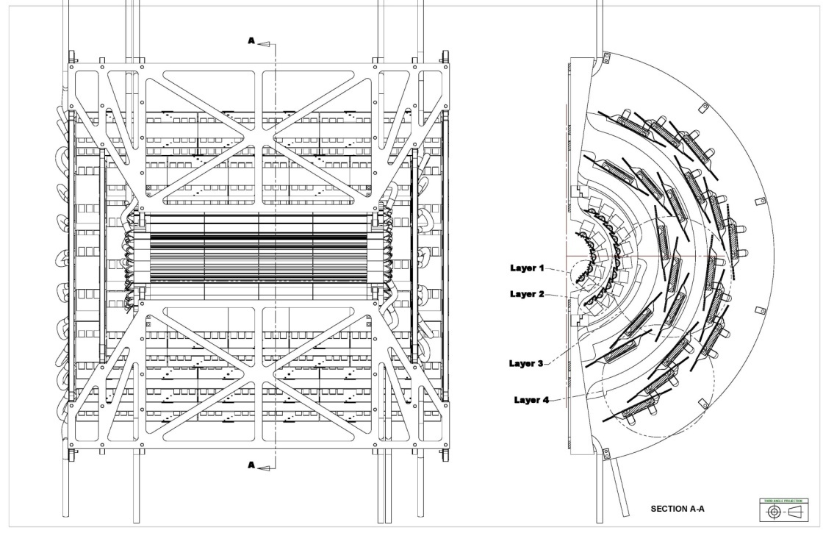
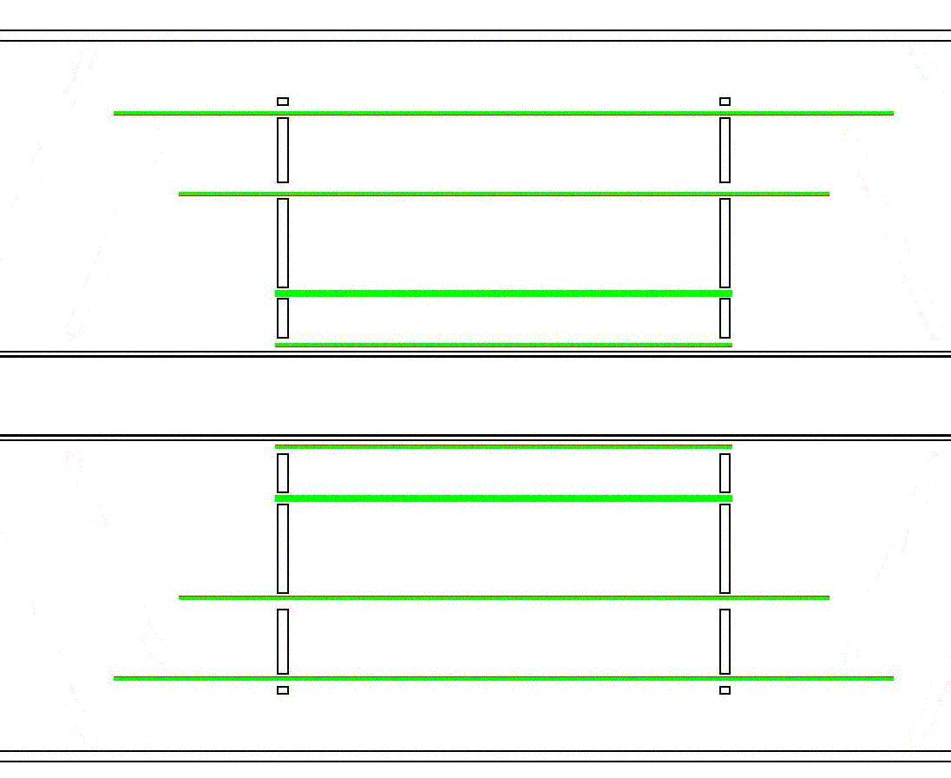

VTX detector in commissioning
Fine granularity, low occupancy
50μm×425μm pixels for L1 and L2
R1=2.5cm and R2=5cm
Stripixel detector for L3 and L4
80μm×1000μm pixel pitch
R3=10cm and R4=14cm
Large acceptance
|η|<1.2, almost 2π in φ plane
Stand-alone tracking capability
Pixel
Strip
Performance check using p+p
z plane
φ plane
Notes:
7
It consists of two type sensors , one is …

Slide 8
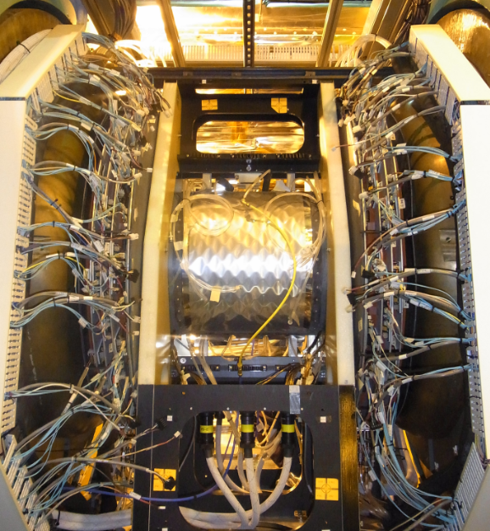
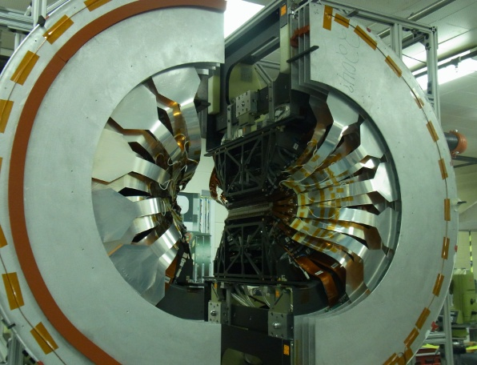
Completed VTX in the IR

Slide 9
Other 1008 Activities
We solicited presentations from subsystems to figure out if there is any issue or remaining work in IR
  All the subsystems are basically ready for beam
DAQ – running as previous years. Currently working hard for integrating VTX into DAQ (dealing with new data collection module)
HV controlling system updated.
Online monitoring and calibration effort organized

Slide 10
Plan for next one month
This week (Jan10-17)
  Finish IR works (RPC, VTX)
  Yellow beam commissioning on accelerator side.
Next week(Jan18-Jan25)
  Online monitoring/calibration preparation
  Setup Special production for detector performance check
Once we see collisions(~Jan21)
  Get ZDC/BBC timed in, followed by other subsystems
  Zero-field run for alignment check
  Muon arm low field run
  Other special runs (which can cope with low intensity)
  Vernier scan

Slide 11
Draft plan on trigger
Expected logged event rate will be about 6 kHz
  Up to ~3-4 MHz for BBCLL1 with no vertex cut can be expected
Use new μ trigger at this moment. Will move to MUON&RPC
W->e uses highest threshold EMCal-RICH(ERT) trigger(4x4b): ~5.6 GeV
π⁰/photon in central arm will use lowest threshold ERT4x4c: ~3.7 GeV
π⁰/photon in MPC will use MPC triggers (no prescale)
Electrons uses ERT2x2, threshold 2.2 GeV
BBCLL1 with 15cm vertex cut in addition to BBCLL1 with "usual" 30 cm cut
BBCLL1 trigger may see more than one collisions. Any trigger may not want to coincide with BBCLL1
Relative luminosity, local polarimetry and vernier scan task will use Clock, BBCLL1 and ZDC triggers

Slide 12
Status of service tasks
Local Polarimetry: Sses SMD strips. Scalers are written every five minutes. Ready for data when ZDC is up (needs some tuning on HV). Two offline codes prepared to double check the numbers.
Vernier Scan: To be discussed next week
Relative Luminosity: Two GL1P boards. Plan to use several combination of triggers. Need to tune with collisions
Spin Monitor: Working for coding. Expect tuning once Spin Flipper is included. May need to coordinate with Mei.
W->μ trigger: See next slide.
W->μ,e: Fast production of all data (incl. VTX) at PHENIX counting house, and transfer to CC-J. Check health of triggers and detectors.
W->e: Use |vtx|<10cm with more statistics. Plan Reversed mag. field running for systematic check. EMCal calib to be done.

Slide 13
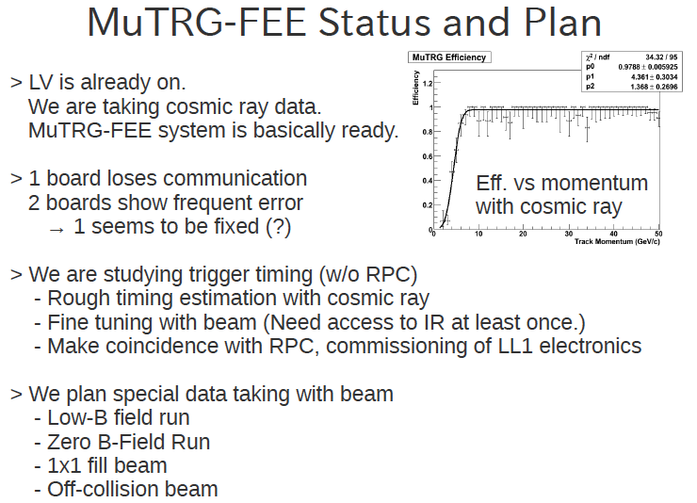

Slide 14
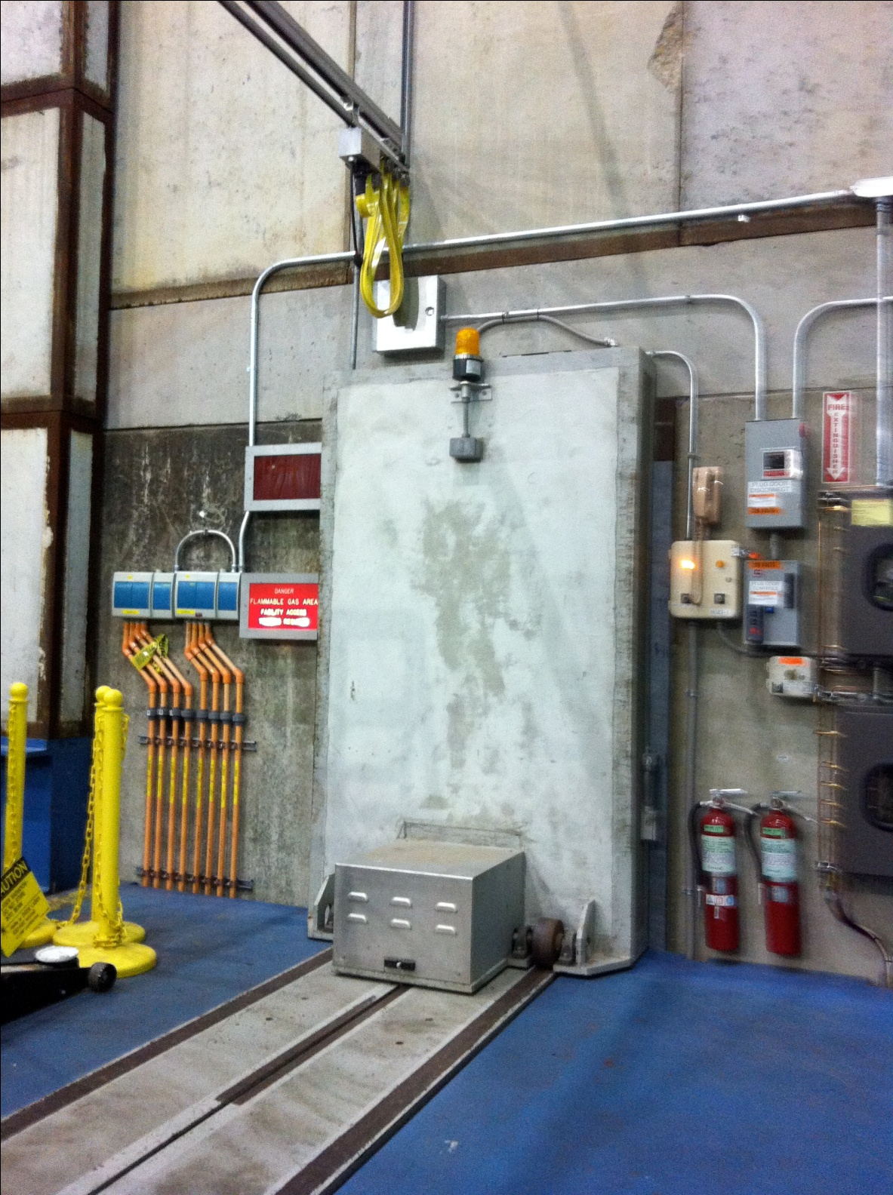
Final words
Run-11 preparation is in very good shape
  Many people have been working very hard
  Accelerator people and BNL management are very much cooperative to us.
Getting ready for data taking in p+p
  Service tasks on-going for getting physics results ASAP.

Slide 15
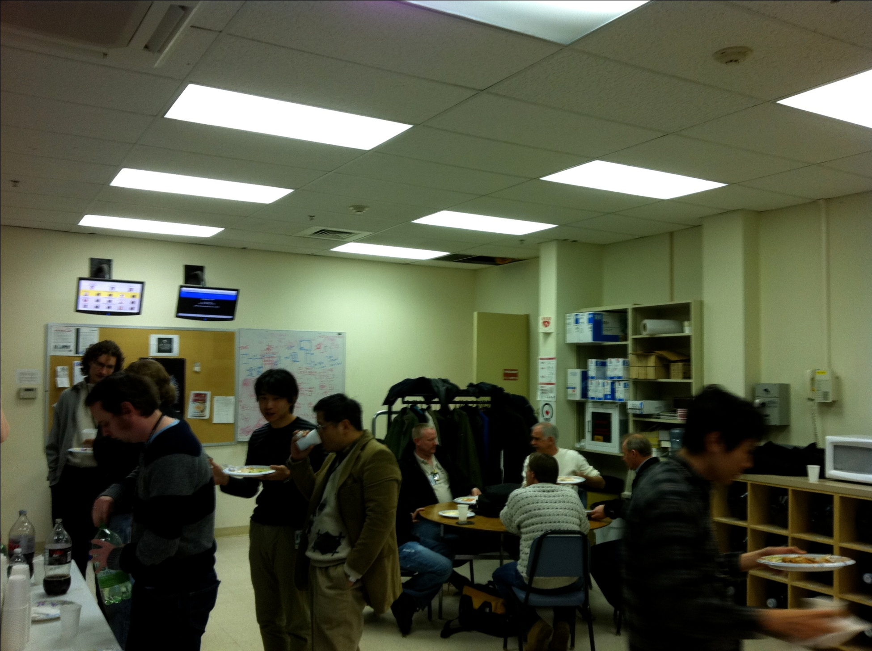
End of Shutdown party (Jan 7)

Slide 16
Backup

Slide 17
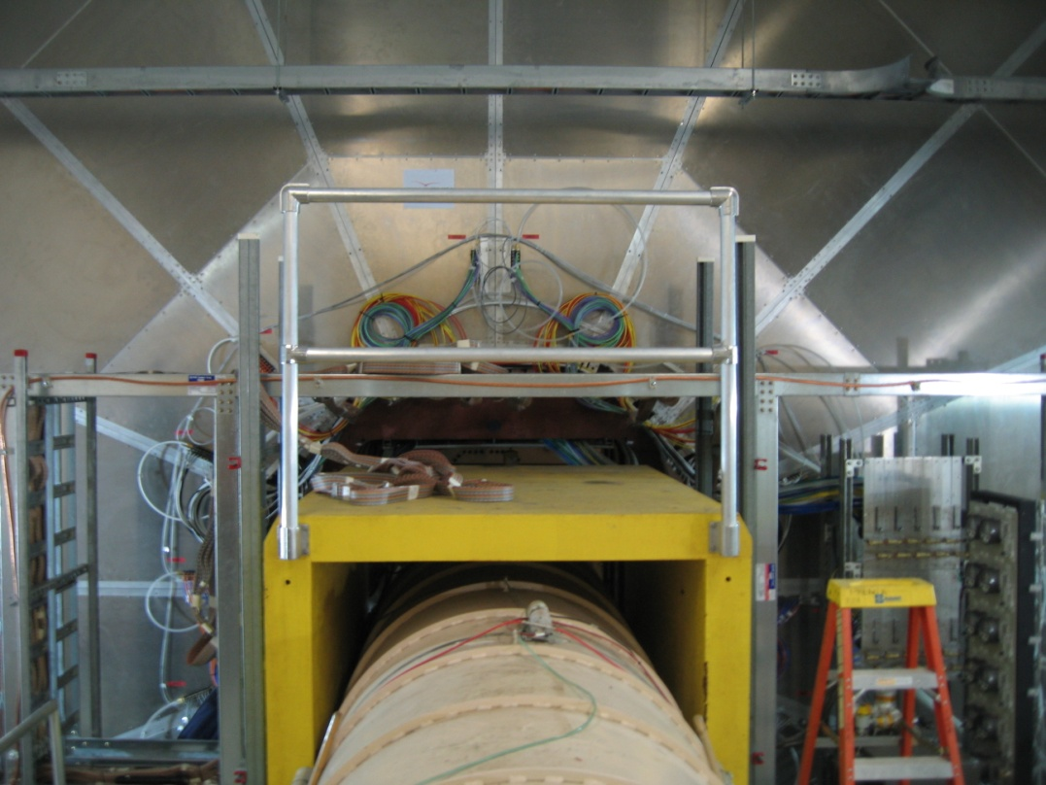
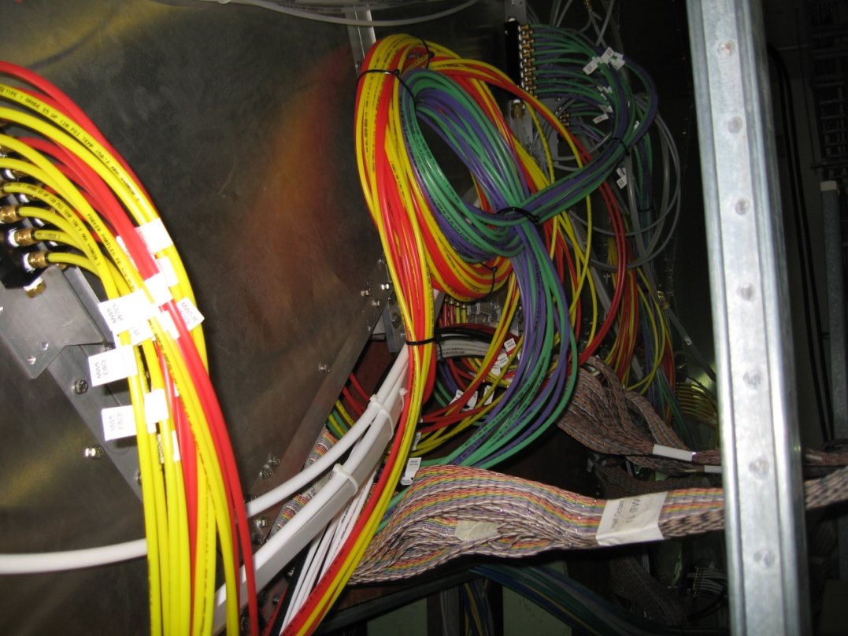
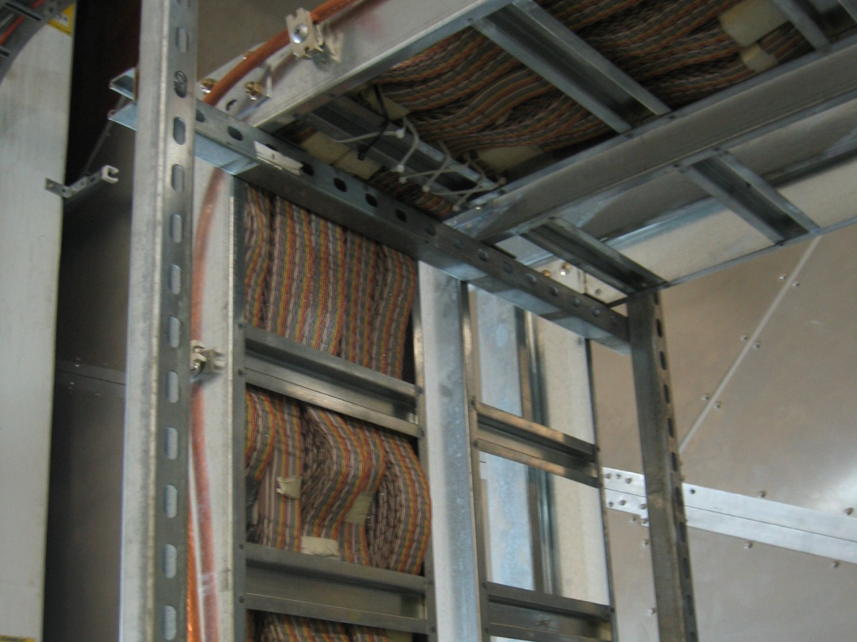
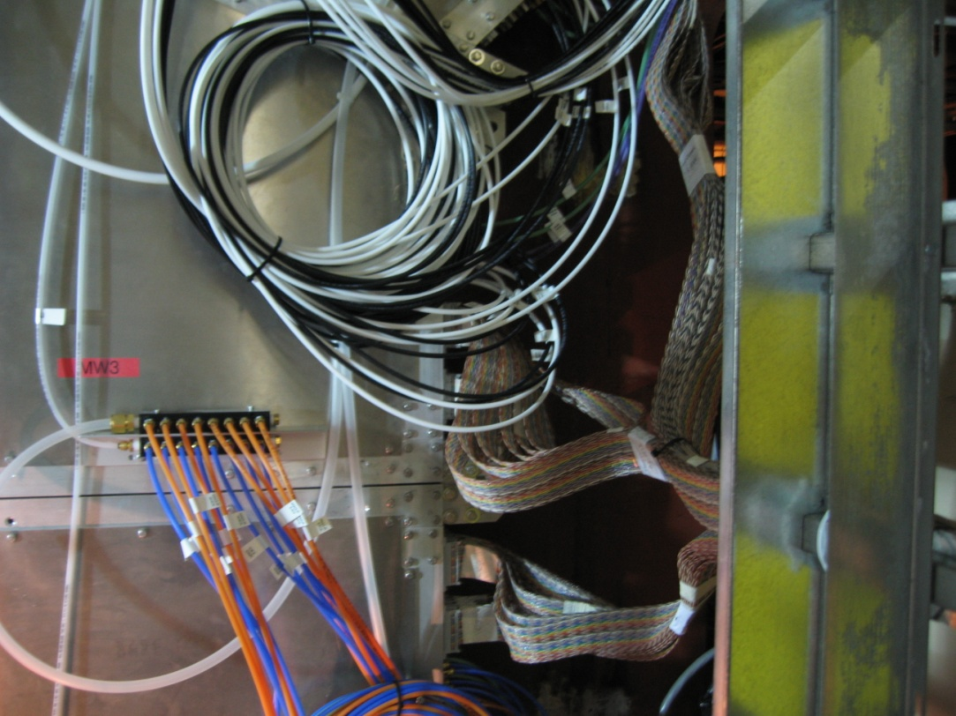

Slide 18
Current Machine Schedule
Free IR access lost on Jan7
3 Jan, Begin cool-down to 4.5K
9 Jan, Cool-down to 4.5K complete in both rings
11 Jan, 2 ⅟₂ weeks beam setup for √s = 500 GeV pp in RHIC begins.
27 Jan (Thursday), 1 week Ramp-up with 8 hr/night beam to experiments
3 Feb, begin 10 week physics run (√s = 500 GeV pp)
3 March – Continuing Resolution Ends
28 March – 1 April, PAC 2011
14 Apr, end 10 week physics run at √s = 500 GeV pp run
14 Apr, begin 1 week setup for √s = 200 AuAu
21 Apr, begin 1 week Ramp-up with 8 hr/night beam to experiments
28 Apr, begin 8 week physics run at (√s = 200 AuAu)
23 Jun, end 8 week √s = 200 AuAu run
23 Jun, begin setup for √s = 192 GeV UU
30 Jun, begin 1⅟₂ week physics run (√s = 192 UU)
4 July – completed 26 weeks of cryo operation, may be out of $$’s
10 Jul, end 1⅟₂ week physics run at √s = 192 GeV
10 Jul, begin setup for √s = 18 GeV AuAu
11 Jul, begin 1 week physics run (√s = 18 AuAu)
18 Jul, end 1 week physics run at √s = 18 GeV
20 Jul, warm-up complete (28.3 weeks)
p+p Commisioning,
66% pol. 1.6e11 at AGS, now
500GeV p+p Spin
200GeV Au+Au heavy ion
New APEX schedule: 12 hour sessions (0800-2400) every other week away from maintenance days.
Taken from Phil’s slides

Slide 19
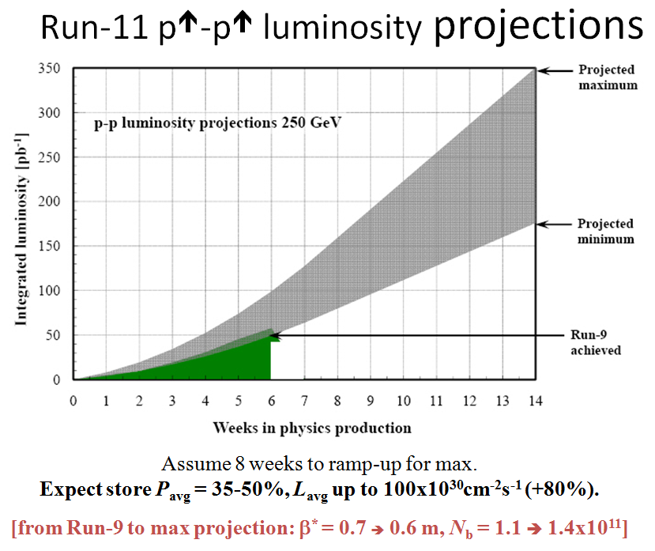
Goals to be updated/corrected
PHENIX Goal (50% pol)
STAR Goal (50% pol)

Slide 20
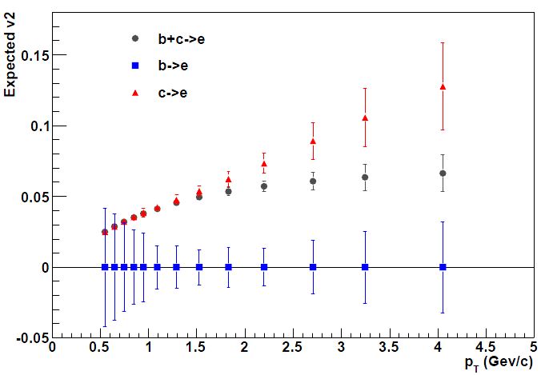
Heavy quark flow in Run-11
PHENIX Beam Use Proposal for RUN11
Assumption:
Full 8 weeks data taking in RUN11
Good sensitivity for v₂ for wide p_{T} range

Slide 21
Trigger discussion started
500GeV p+p run
A factor 1.8-2.5 higher collision rates
Narrow vertex cut for central arm physics due to VTX (10cm, 15cm, 20cm?) while keeping wider vertex cut for Muon Arm physics
Limited number of trigger slots available for different task forces (MuTrig will need many at least for commissioning)
Will VTX affect DAQ rates?
Sasha, EC meeting, Dec 7.

Slide 22
Physics defines triggers
W->μ
  commission the MuTrig and evaluate performance; needs to be unprescaled
W->e
  ERT_4x4a (highest threshold), no prescale, <5% of bandwidth
π⁰/γ in central arms for ΔG
  ERT_4x4c (lowest threshold) to get unbiased yields, but prescaled ERT_4x4c&BBCLL1(narrow) to get unprescaled enriched data
π⁰/γ in MPC for ΔG
  MPC trigger: set energy threshold as high as to keep it unprescaled Possibly MPC&ERT: forward-central correlations
Electrons
  ERT_E&BBCLL1(narrow); would be also good to have ERT_E
Muons and di-muons
  Usual MuID triggers: 1D, 2D, 1H in coincidence with BBCLL1(noVtx)
Draft plan of the trigger is now designed
Sasha, EC meeting, Dec 7.

