Slide 1
Preparation for RHIC PP Run in 2011
Haixin Huang
RUN website: http://www.cadops.bnl.gov/AP/Spin2009
RUN website: http://www.cadops.bnl.gov/AP/Spin2011
November 19, 2010
RHIC Spin Collaboration Meeting

Slide 2
Schedule and Run Plan
Goal: 18 – 32 pb⁻¹/week, P = 35 – 50%. The possible gain of polarization is based on the new working point, orbit and D’ control, new vertical survey and BPM offset sign reversal.
Major beam parameters: β∗=0.65m, 1.4*10¹¹/bunch
Dry run: December 6-10
AGS starting time will be between Dec. 6-10 (later than what we like to have)
4.5 weeks of machine setup
  Injection setup: 1.5 weeks
    Trim quad P/S tuning after cool down 2-3 days.
    Set up injection in each ring (beam + instrumentation)
    Set up polarimeters
  Commissioning the 9MHz cavity: 1 week
  Ramp development: 2 weeks
    250 GeV ramp development
    Store setup
    Expect overnight stores after 3-3.5weeks

Slide 3
Run-11 main upgrades for p⬆-p⬆ performance
AGS horizontal tune jump system
(up to 5% more polarization if successful)
9 MHz rf system (including 2 longitudinal dampers)
(preservation of both longitudinal and transverse emittance, ramp transmission)
RHIC MMPS flattop-to-ramp and ramp-to-flattop switchover
(transients lead to beam loss and problems with 9 MHz system)
Ramp feedbacks (orbit, tune, coupling, chromaticity)
Different working point for Blue (28.695, 29.675) and yellow (28.18,29.19) (avoid pi mode in beam-beam, weaker spin resonances)
Global 1 Hz orbit feedback (tighter tolerances at IPs and collimators)
10 Hz orbit feedback at store (orbit stabilization in triplets, background reduction)
CNI Polarimetry (new electronics, mitigates rate dependence)
β* reduction from 0.70 m to 0.65 m (perhaps lower)
Beam dump modification (Q4 quenched with high intensity dumps, pipe inserts)

Slide 6
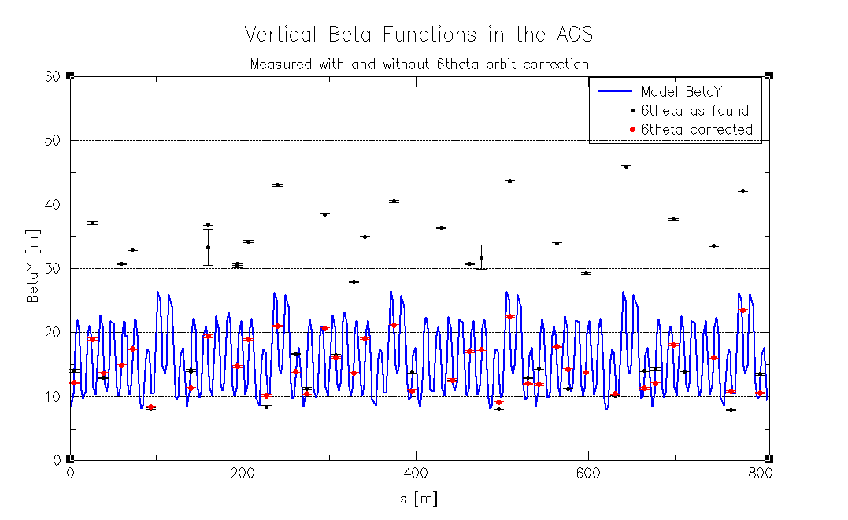
Beta Functions with and without sin6θ
(V. Schoefer)
The beta functions were derived from ORM data.

Slide 7
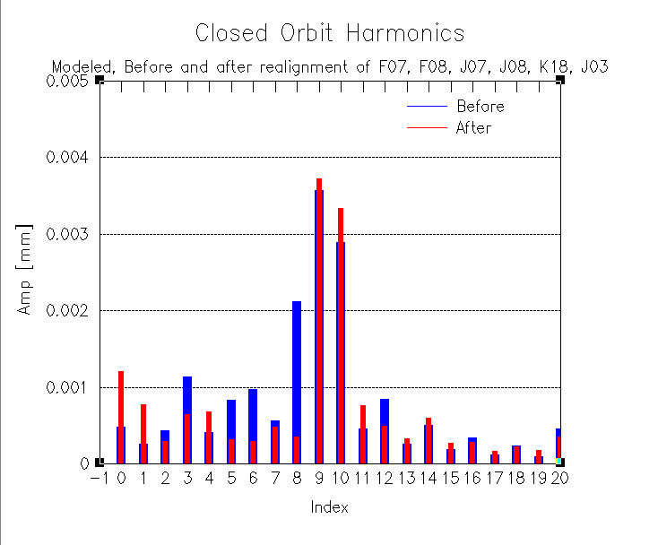
Modeled Harmonics Before and After Realignment
The amplitude of 6th harmonics agreed with the one needed to eliminate
Emittance growth.
(V. Schoefer)
Amplitude [m]

Slide 8
Plan for the AGS Setup
Set up Booster and AGS as the end of run9 ( Booster with near half integer tune injection to reduce emittance growth at injection).
Given the improvement on magnet alignment, we will revisit the injection matching, pushing vertical tune higher at injection. Modeling effort is on going.
Tune jump will be the main job for the coming run. The main tasks are:
  set up tune jump timing accurately based on the energy and tune information;
  control the emittance growth;
  measure polarization with jump quads on/off ;
  measure polarization as function of jump quads timing (shift all the timing together).
A feed-forward system to maintain the 9th harmonics will be used to control the harmonics drift with time and harmonics variation due to jump quads.

Slide 9
Why Different Working Point?
We do have the capability to run two rings with different working points.
Both rings have better life time if working point is under the Qx=Qy Resonance. But this will enhance beam-beam effect.
Maximize polarization transmission efficiency
It was not done earlier because the poor tune control in early days. With tune/coupling feedback working, control the tune along the desired values are not a problem any more.

Slide 10
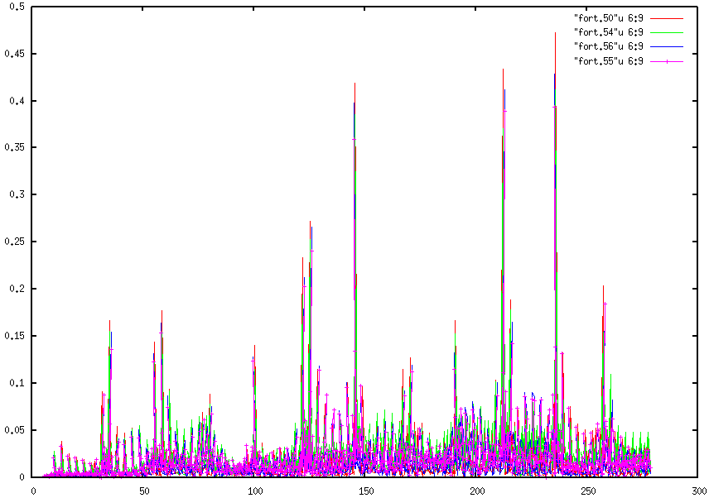
Intrinsic Resonance Strength Weaker at Qy=29.18
(M. Bai)
Maximize polarization transmission efficiency
  Original RHIC design working point at 28.19 and 29.18
  Weaker intrinsic resonances
Qx=28.83, Qy=29.965
Qx=28.695, Qy=29.685
Qx=28.170, Qy=29.040
Qx=28.190, Qy=29.180
Intrinsic resonance strength
Beam Energy [GeV]

Slide 11
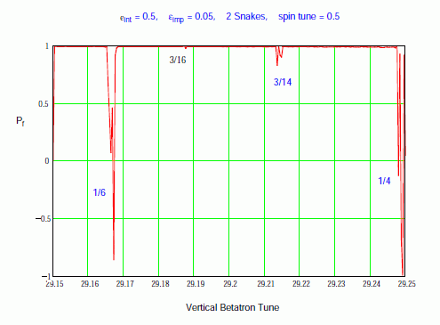
Snake Resonance Spectra Near 0.2
1/6 resonance is stronger than 7/10

Slide 12
Lattice Development Status
The new lattices with working point near 2/3 for blue and near 0.2 for yellow have been developed. In addition, the fractional part of the phase advance between IP6 and IP8 for blue ring has been adjusted near a quarter for nonlinear chromaticity compensation. This requires power supply upgrade.
Injection and store lattices are developed:
    Injection: beta* 7.5m
    Store: beta*@IP6&8: 0.65m, others: 7.0m¹
Ramp lattice have been done for both blue and yellow. The blue lattice has been used for dynamic aperture simulation.
The injection energy remains the same. As the instability threshold could be lower with 9MHz cavity due to longer bunch, the gamma_tr is lowered by ½ unit using gamma_tr quads.
1. It is possible to squeeze beta* at IP2 to 3m.

Slide 13
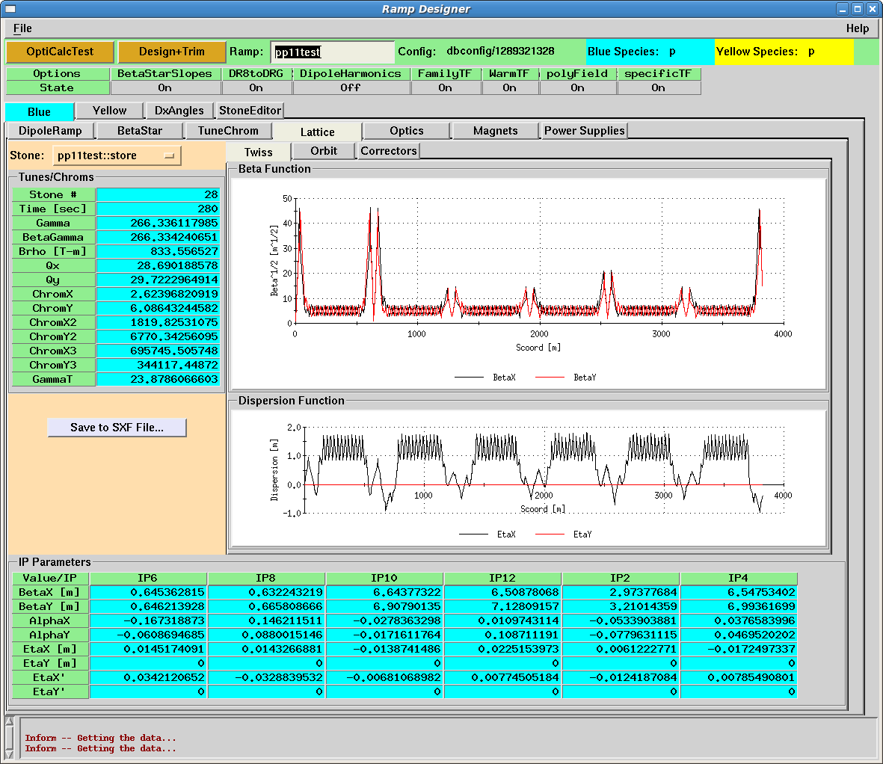
RHIC Blue Lattice(Preliminary)
(S. Tepikian)

Slide 14
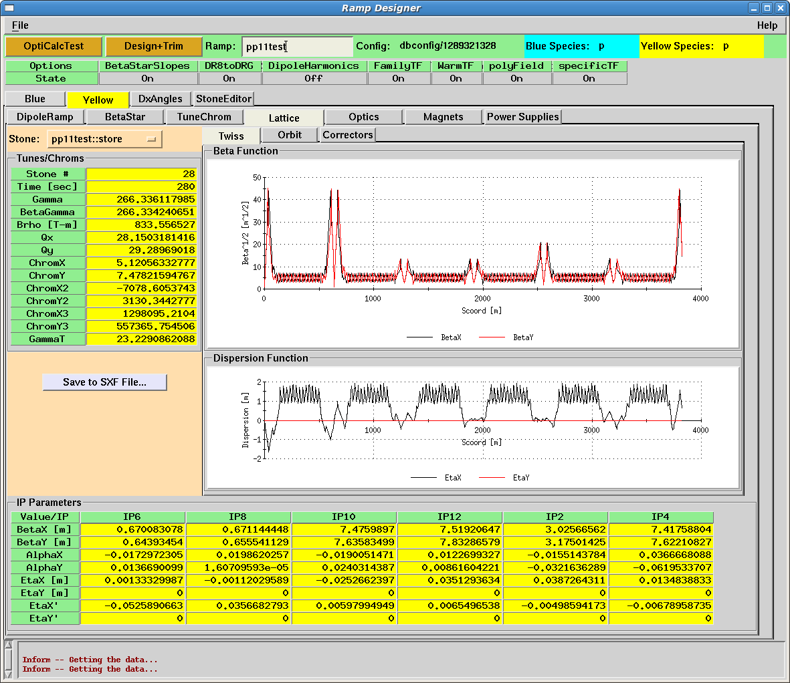
RHIC Yellow Lattice (Preliminary)
(S. Tepikian)
Still under development

Slide 15
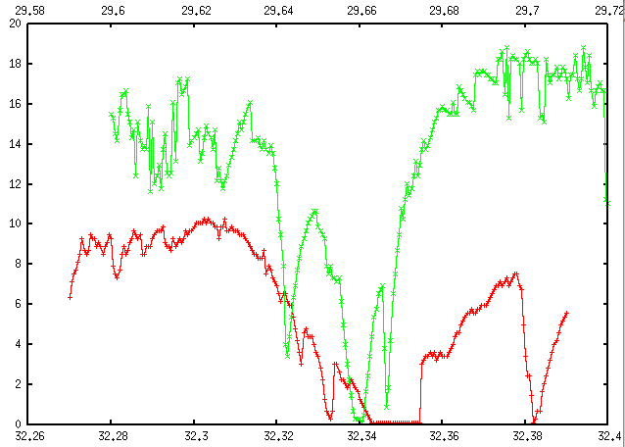
DA Comparison of Au Lattice vs. pp Lattice
pp tune
Better DA for pp lattice. No problem with intensity up to 1.8*10¹¹
Au tune
(X. Gu and Y. Luo)

Slide 16
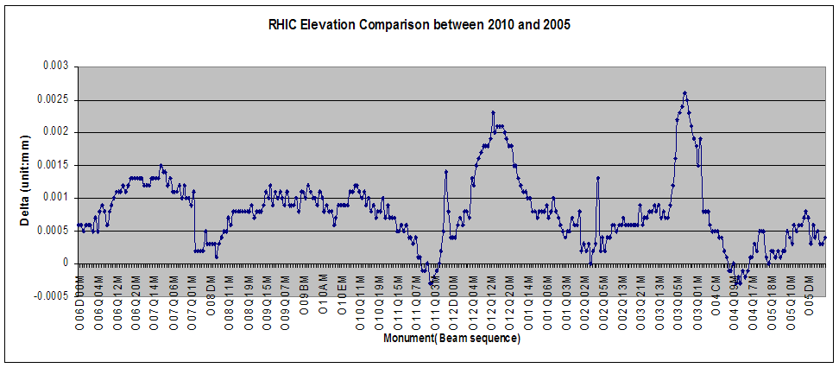
RHIC Vertical Survey Results
(from Frank Karl)
2.5mm
Realignment is underway. The effects on spin dynamics have not been estimated yet.

Slide 17
Spin Tune Shift Due to Orbit Errors
The following effects are important and have been considered:
Difference of horizontal orbit angles in snake locations.
This is present on ramp and may lead to large spin tune shifts.
Difference of horizontal or vertical orbit angles in the rotator locations.
The rotators are off on the ramp. Thus it is less important factor.
Difference of dispersion angles in snake and rotator locations.
Small spin tune shift, but the important contribution to the spin tune spread.
Spin tune shift due to imperfection resonance strength.
It was found to be the important contribution.
Interplay of horizontal an vertical orbit bumps (in IR12 for H-jet) (~xy²)
Should be taken into account for large bumps (~ 10mm).

Slide 18
Summary of Most Important Orbit Effects on Polarization
(Vadim Ptytsin)
 |  | Effect | Tolerance | Comment
Difference of X orbit angles at Snakes | ramp and store | spin tune shift | ± 30 μrad | Under control
Difference of dispersion angles at Snakes | ramp and store | spin tune shift | radial shift < 1mm
 |  | spin tune spread |  | It can be reduced by 40%, work in progress
Closed orbit rms, mm | ramp and store | spin tune shift even-order resonances, enhancement of odd-order resonances | < 0.3 mm ε_{imp} < 0.07 | BPM offset reversal did not result dramatic change in corrector strength during run10. Vertical realignment underway Should be verified by simulations
Difference of X orbit angles at rotators | store | spin tune shift | ± 60 μrad | Requires several stores to set them correctly.
Difference of Y orbit angles at rotators | store | spin tune shift | ± 60 μrad | 3 mm IR separation bump: δQ_{sp} up to 0.013

Slide 19
Modelling Efforts
V. Ranjabar has joined us to carry the SPINK simulation going. The goal is to understand the effects of vertical tunes (at two working points) and orbit errors on polarization.
F. Meot is working on another spin tracking code called ZGOUBI. The code is slow and will be mostly to crosscheck SPINK for RHIC, to do simulation for AGS and RHIC spin flipper.
C. Montag is searching for D’ knob to maintain them the same value at both snakes. Working in progress.
X. Gu and Y. Luo are working on dynamic aperture simulation. First pass with blue lattice showed no problem for beta*=0.65m.

Slide 20
Summary
The main job for AGS is tune jump system. The potential delay of AGS start is a challenge for us to provide high polarization beam on time.
We may need longer setup time, due to 9MHz cavity and trim quad power supply upgrade.
Two different working points for blue and yellow are planned.
9MHz cavity commissioning is another key for run11.
Vertical alignment of RHIC magnets are in progress.
Spin tracking will focus on vertical tune scan (at two working points) and orbit effect.
DA calculation for blue ring is done. Calculation for yellow ring is waiting for the final lattice. Searching for D’ knob to maintain them the same value at both snakes is also in progress.
Since last run, we have better control (tune/coupling feedback, slow orbit feedback, 10Hz orbit oscillation feedback); more understanding on spin dynamics (importance of D’, orbit error effect on both even and odd snake resonances); better knowledge on RHIC (vertical realignment, BPM offset sign reversal). Expect to benefit on polarization and luminosity.

Slide 21
Backup Slides

Slide 22
9MHz RF Cavity Commission Plan
(from M. Brennan)
9MHz requires upgrade to main PS + bouncer cavity for both rings + longitudinal damper or Landau cavity for each ring.
Establish ramps with 28 MHz
Set up injection and timing (h=120)
  ATR synchro
  Phase detector data for INJECTION_TUNING application
  Beam Sync clock and WCM application
Six-bunch ramps
  Low level for Bouncers and feedback
  Check glitch and its ramp-to-ramp variations
  28 MHz offset and phasing
  Develop rebucketing
  Step up bunch intensity (feedback at injection)
Step up number of bunches

Slide 23
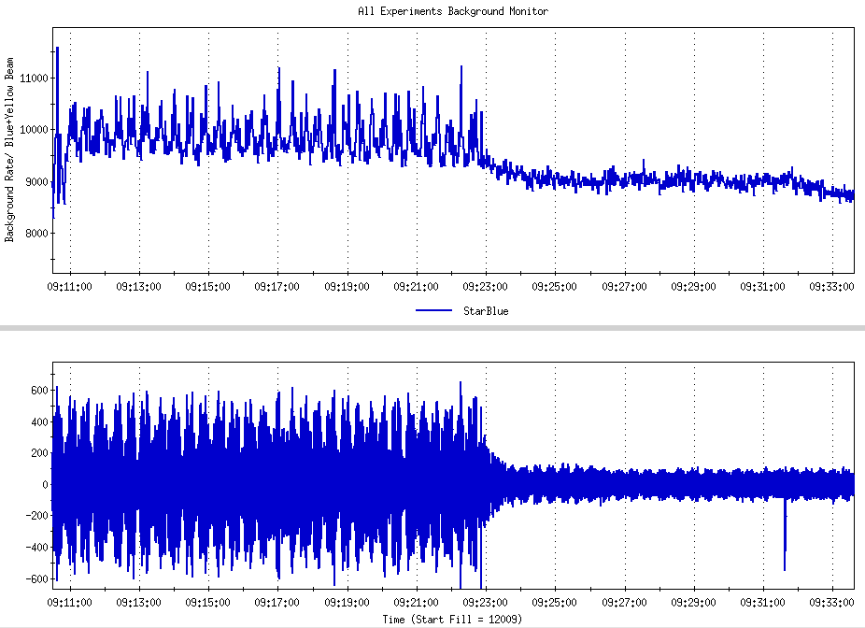
10Hz Orbit Feedback Reduced STAR background
M. Minty)
Star backgrounds decreased when feedback engaged
BPM position : bi8-bh1
Microns
Feedback engaged during 31.2 GeV physics store
March 26, 2010

Slide 24
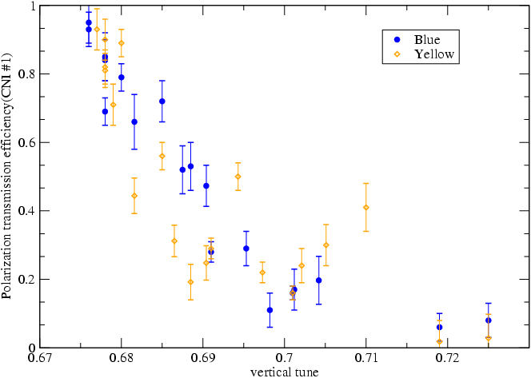
Snake Resonance Spectrum
CNI analyzing power at 250 GeV is ~0.9 of its online analyzing power at the time
0.9
Not able to accelerate below 0.68 for production store due to the glitch in the RHIC power supply for main quadrupoles at the change of acceleration rate
0.72
11/16 resonance
3/4 resonance
0.54
Ratio of CNI measurement at store vs. injection
Working pt for 250 GeV run in 2009
7/10 resonance
0.36
0.18

