Slide 1
H-jet Polarimeter
100GeV Summary
S. Lee
Jun 26, 2009

Slide 2
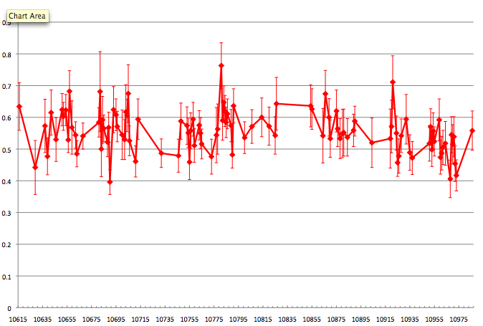
Yellow beam Polarization

Slide 3
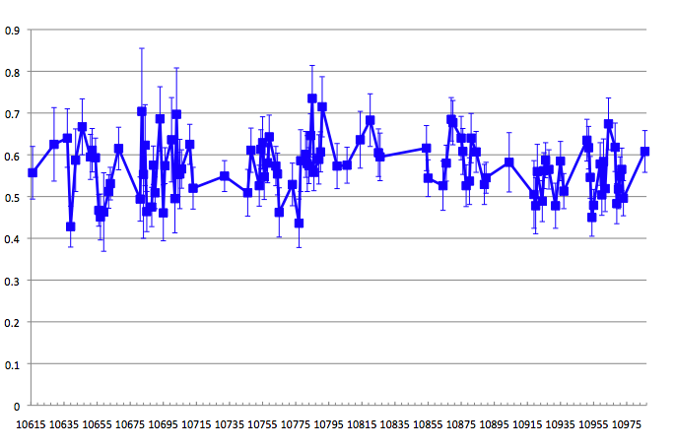
Blue beam Polarization

Slide 4
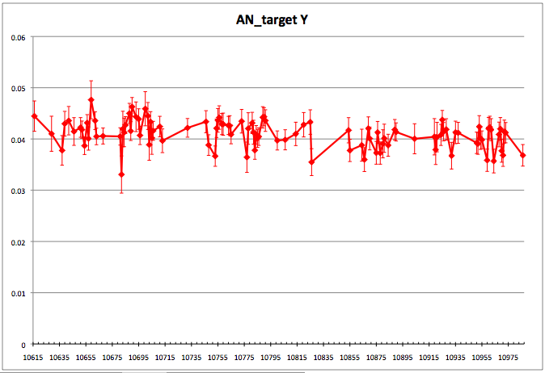
Yellow Target An

Slide 5
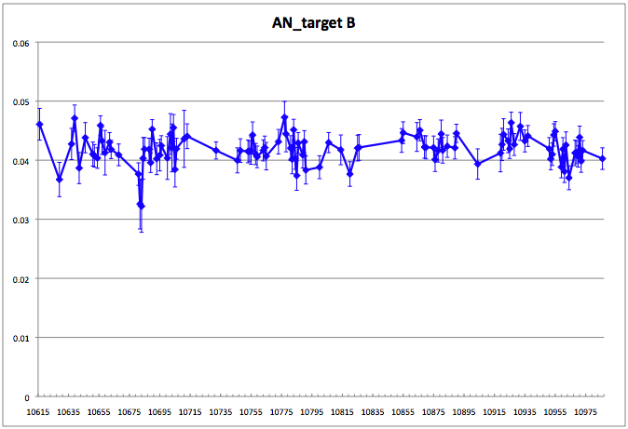
Blue Target An

