Slide 1
PHENIX Beam Use Proposal for Runs 13 & 14
Species | √s_{NN} (GeV) | weeks | |z|<30cm | |z|<10cm | delivered | Polariz.
Run13: p+p | 500 | 10-15 | 250 pb⁻¹ | 97 pb⁻¹ | ~750 pb⁻¹ | 55%
p+p | 200 | 4 | 16 pb⁻¹ | > 5.5 pb⁻¹ | 48 pb⁻¹ | 60%
or p+p | 39 | 1 | 0.2-0.3 pb⁻¹ |  | 0.9 pb⁻¹
Run-14:
Au+Au | 200 | 6-8 | 1.7 nb⁻¹ | 1 nb⁻¹ | 5 nb⁻¹
d+Au | 200 | Rest of run
Barbara Jacak for the PHENIX Collaboration
http://www.phenix.bnl.gov/WWW/publish/jacak/sp/presentations/BeamUse12/BUP12.pdf

Slide 2
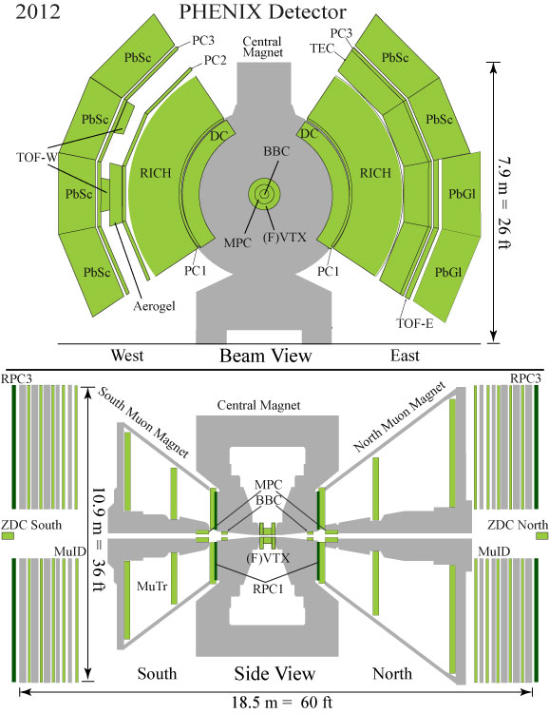
PHENIX and our upgrades
VTX (2011)
FVTX (2012)
W trigger (’11 & ’12)
RPC’s & MuTR FEE
HBD (2009 & 2010)
DAQ2010
MPC-EX (2014)
With DAQ2010, PHENIX
maintains high DAQ rate
w/VTX & FVTX!
~5kHz (AuAu), ~7kHz(p+p)

Slide 3
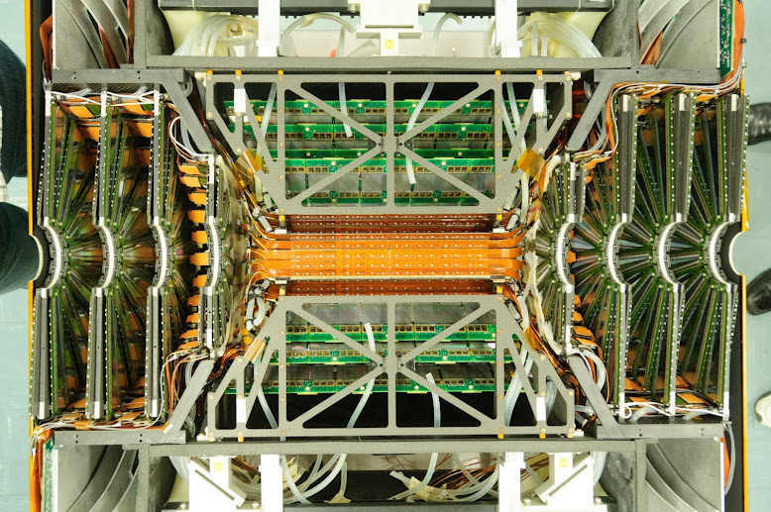
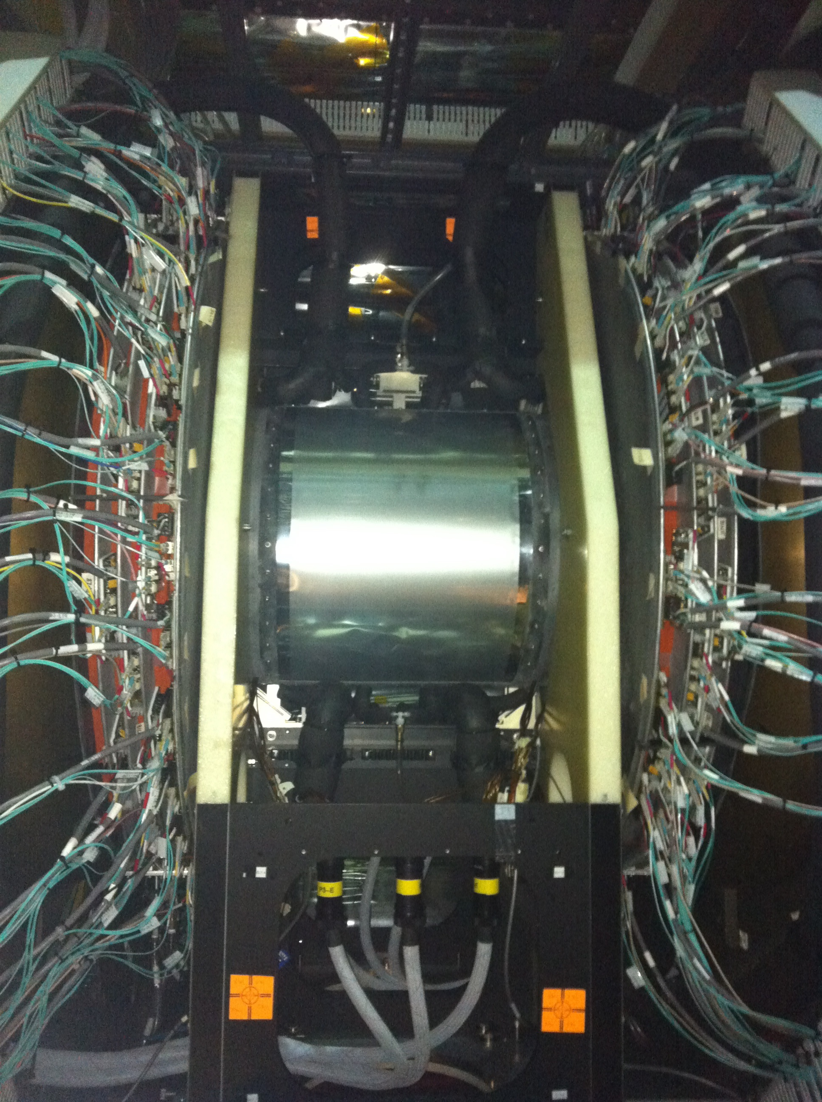
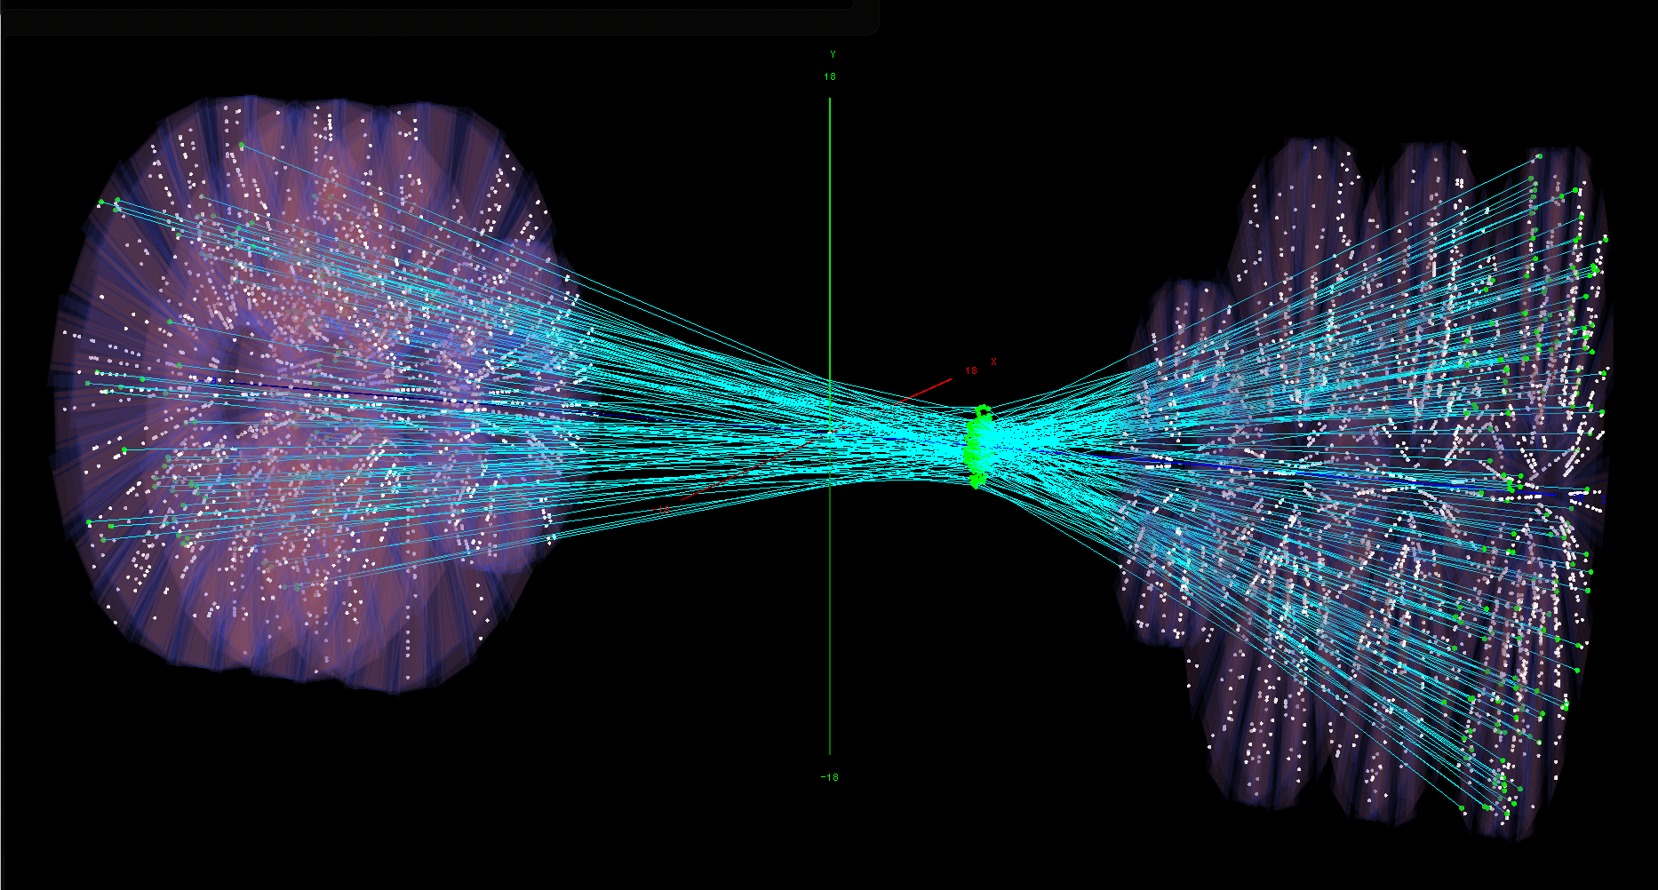
FVTX and VTX both in place!

Slide 4
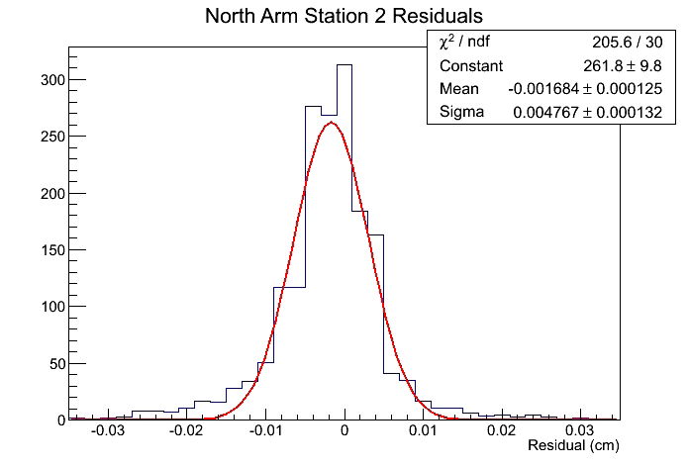
FVTX
Successfully commissioned in 2012 run
Good data sets in 500 GeV p+p and 200 GeV Cu+Au
Sample of U+U collisions
90% of channels operational
2 boards, 2 fibers out
Performing to spec, e.g.
430 electrons noise
Software in place
Alignment & tracking
tuning underway
Track residual: 48μ
As expected for 75μ
strip pitch

Slide 5
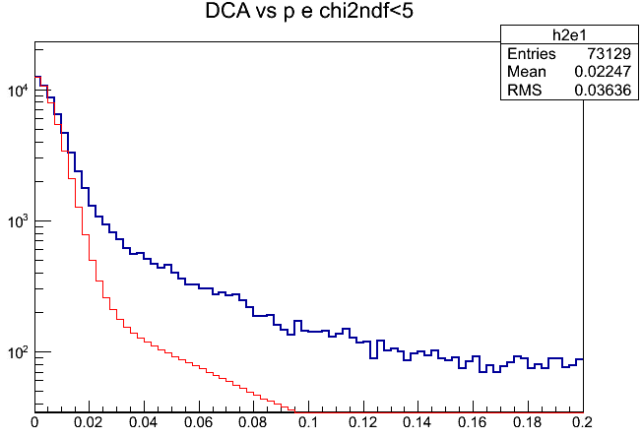
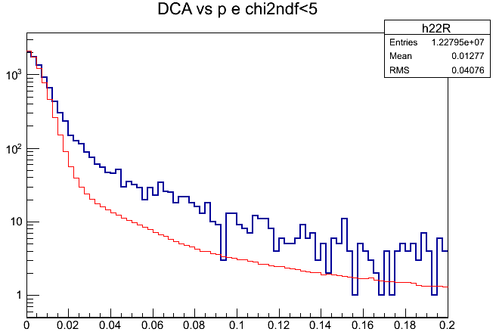
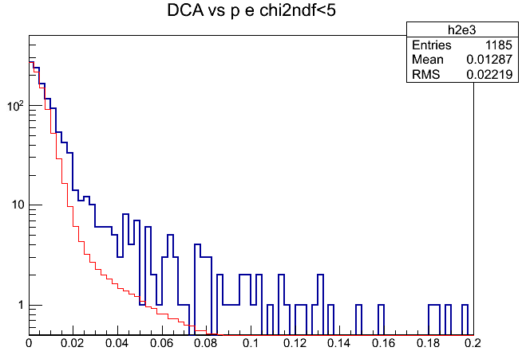
VTX working in Run-11 Au+Au and in Run-12
P>1 GeV
P>2 GeV
Blue: e
Red: charged (0.6x 10⁻³)
Blue: e
Red: charged ( 10⁻³ )
P>3 GeV
Matched central arm-VTX tracks
DCA distributions of electrons are broader than those of all charged
Broadened by heavy flavor decays
Large DCA tail - b-signal?
MC study of other decays in DCA shape underway
Blue: e
Red: charged (0.6x 10⁻³)

Slide 6
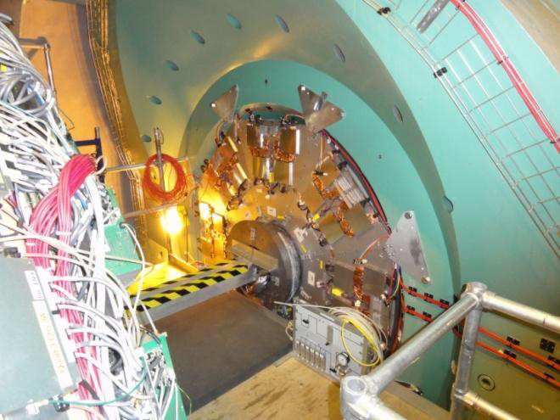
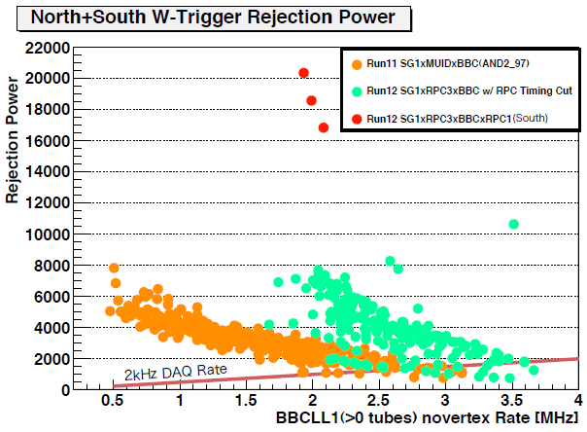
W Trigger is complete
RPC1 installed for 2012
both RPC stations in trigger

Slide 7
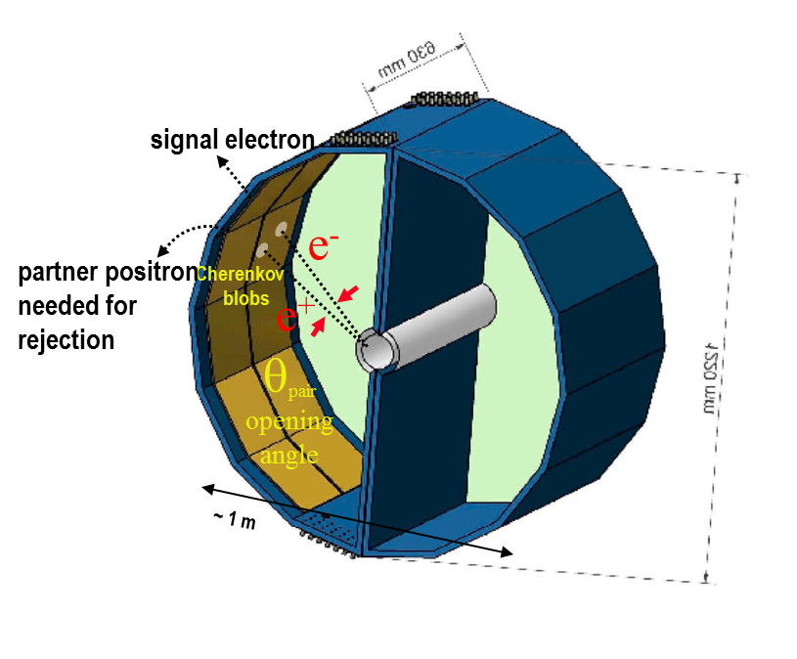
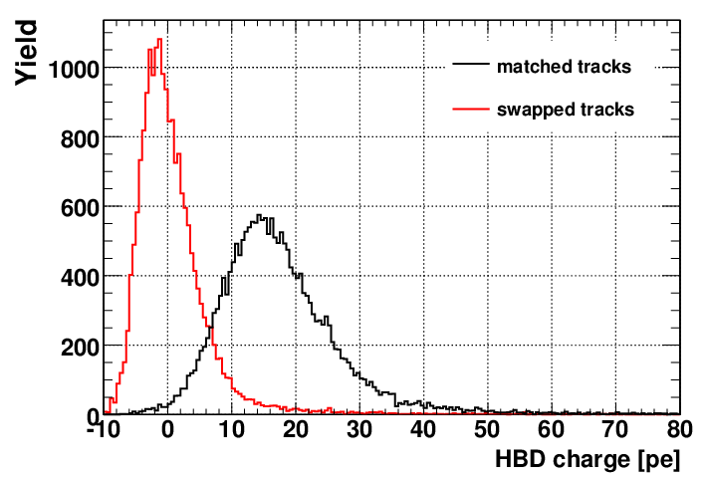
HBD for Dalitz rejection in 2009/10
Window less CF4 Cherenkov detector
GEM/CSI photo cathode readout
Operated in B-field free region
HBD was operational:
Single electron ~ 20 P.E.
Conversion rejection ~ 90%
Dalitz rejection ~ 80%
S/B x 5 vs. published results
10% central, 62 GeV:
efficiency 60%
Rejection 90%

Slide 8
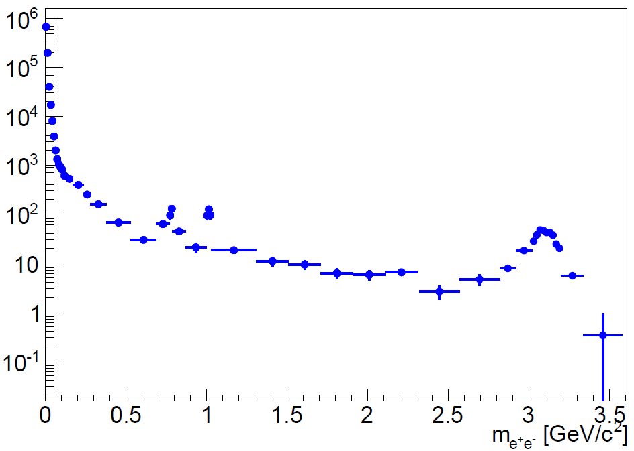
Analysis is in progress
p+p with HBD
uncorrected
40-100% central
Au+Au

Slide 9
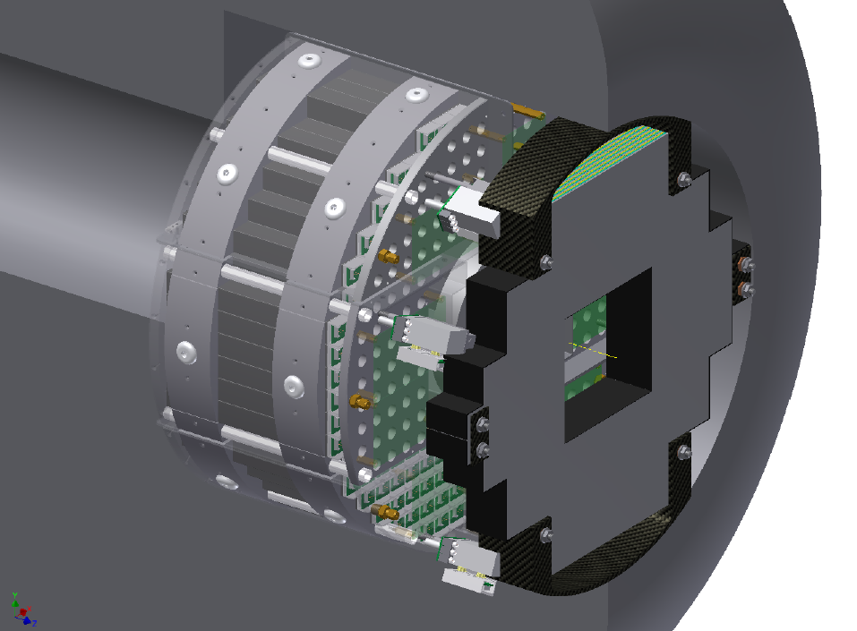
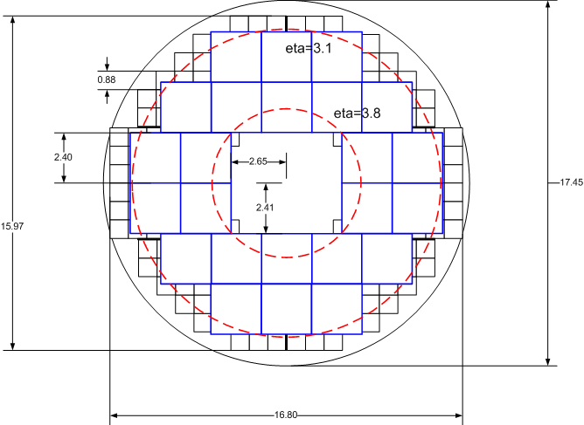
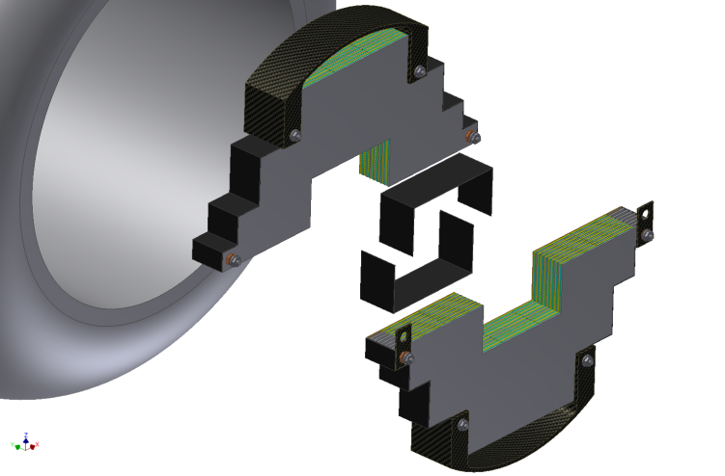
MPC-Extension Detector
Charged particle tracker and EM preshower detector
Dual gain readout: sensitive to MIPS + EM showers.
Charged track identification
π⁰ reconstruction to >80GeV
3.1<η<3.8
To be ready for Run-14

Slide 10
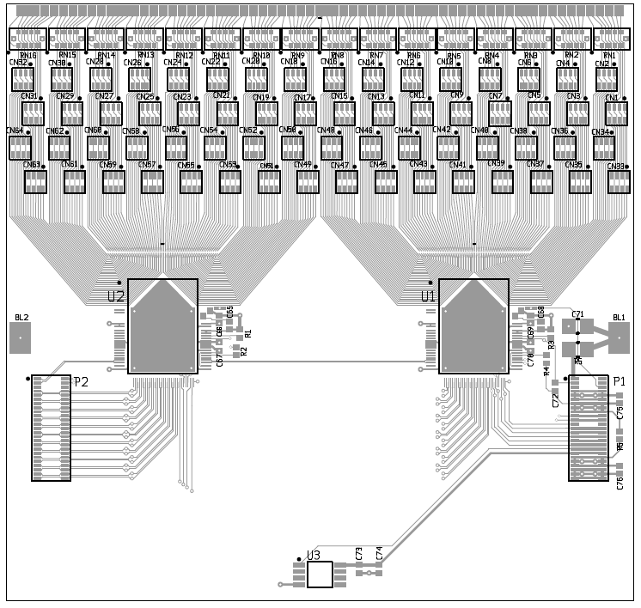
Minipad Sensors
~50mm
Detector elements are Si “minipad” detectors, one per tungsten gap, oriented in X and Y (alternating layers).
2mm tungsten
Minipad micromodule (X or Y)
1.8mm x 15mm “minipad” sensor
Dual SVX-4 Readout Card

Slide 11
Recent Accomplishments

Slide 12
PHENIX Productivity is High
132 Ph.D’s and 27 M.S.
Pipeline implies more in 2012 than 2011
109 papers published
8 in referee review
4 in internal review
12637 citations
2600 in past year
Higher citation rate than previous years!

Slide 13
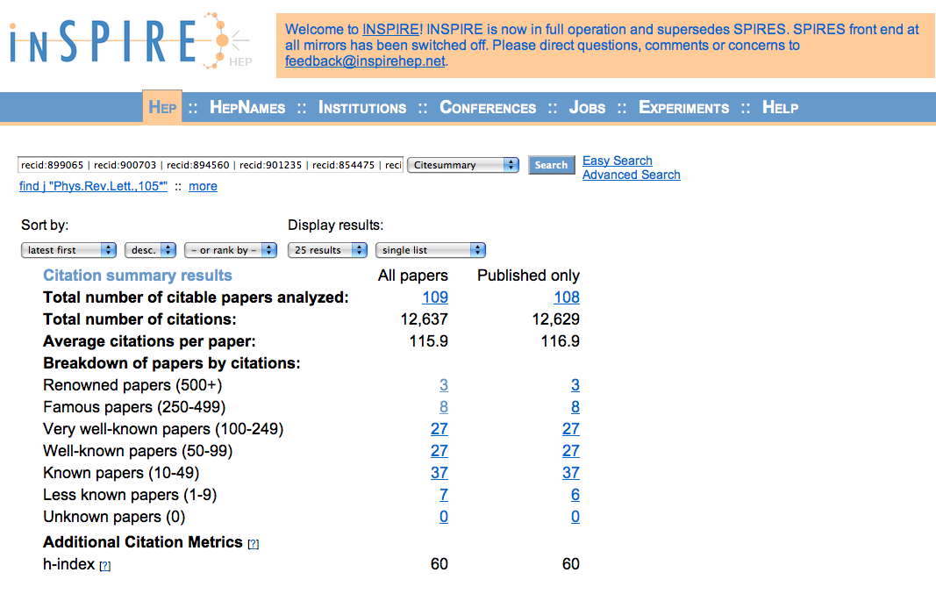
Impact is truly impressive
:) π⁰ suppression paper has >490 cites

Slide 14
Physics Questions addressed recently*
Are direct photons at high p_{T} affected by QGP?
How much do thermal photons flow?
How do cold nuclear matter affects hard probe production?
How much color screening in the QGP?
Use d+Au, pathlength & √s dependence to help sort it out
How does T_{initial} affect high p_{T} suppression/energy loss?
Are there features in √s dependence of particle production & fluctuations? How does energy loss vary with √s?
What is the rapidity dependence of heavy quark energy loss?
Under what conditions does hadron flow scale with the number of quarks?
What is A_{LL} for charged
hadrons?
* Details on selected highlights

Slide 15
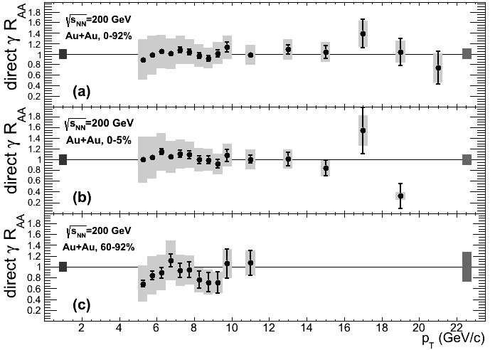
Direct photons in Au+Au collisions
PHENIX photon data
High p_{T} (4 to 25 GeV) from calorimeter
Nuclear Modification Factor
Consistent with binary scaling of p+p
No evidence for cold nuclear matter or hot medium effects out to 20 GeV/c . Isospin?
(or else they cancel exactly…)
PHENIX arXiv:1205.5533
Axel Drees, HP2012
PHENIX arXiv:1205.5533

Slide 16
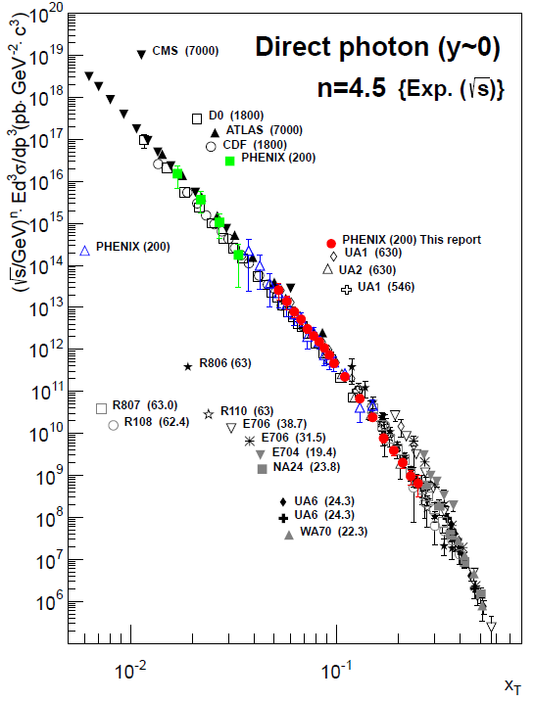
p+p and d+Au: reference & additional physics
PHENIX arXiv:1205.5533
PHENIX photon data
High p_{T} (4 to 25 GeV) from calorimeter
Low p_{T} (<4 GeV) from virtual photons
p+p data consistent with pQCD
x_{T} scaling of cross section
NLO calculation agree well with data
d+Au consistent with N_{coll} scaling
Axel Drees, HP2012

Slide 17
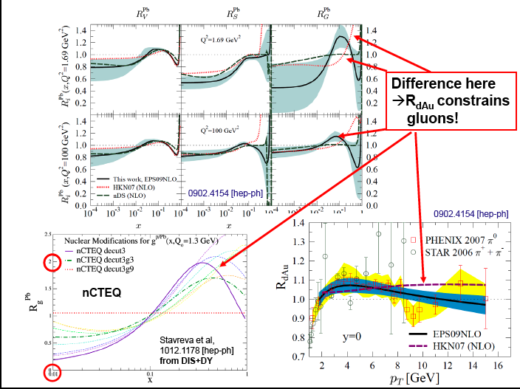
Kari Eskola at Hard Probes 2012 conference:
Direct γ R_{dAu} will constrain further!
PHENIX 2008 data being analyzed

Slide 18
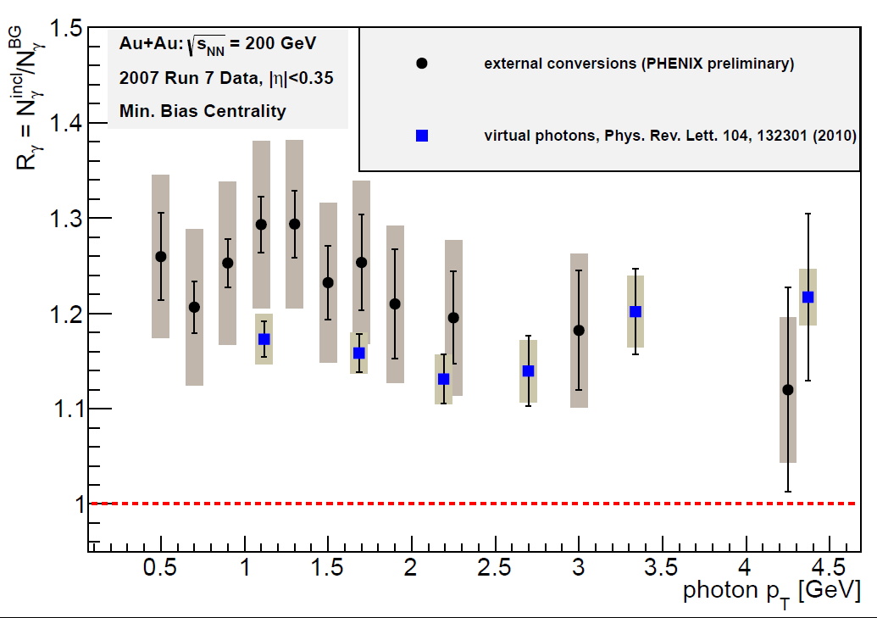
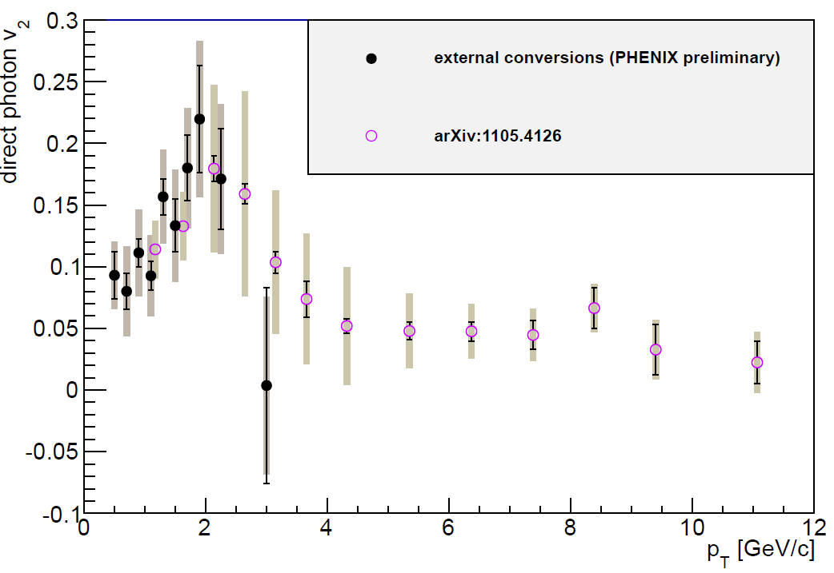
New measurement of thermal photons
PHENIX has developed new method to detect direct photons:
Use photon conversions to e⁺e⁻
Tag contribution from π⁰ decays & compare to MC
Independent systematic uncertainties
measured
raw yields
conditional
tagging efficiency
reaction plane: 1< |η|<2.8
Au+Au 200 GeV min. bias
PHENIX preliminary
simulated based
On hadron data

Slide 19
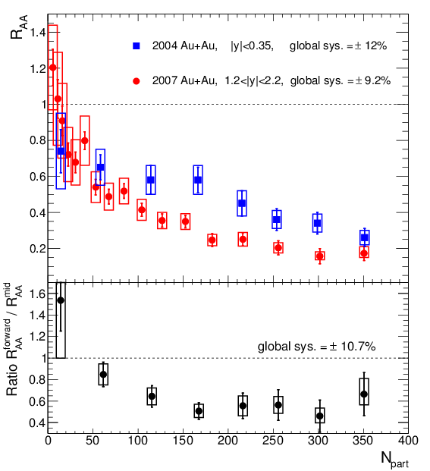
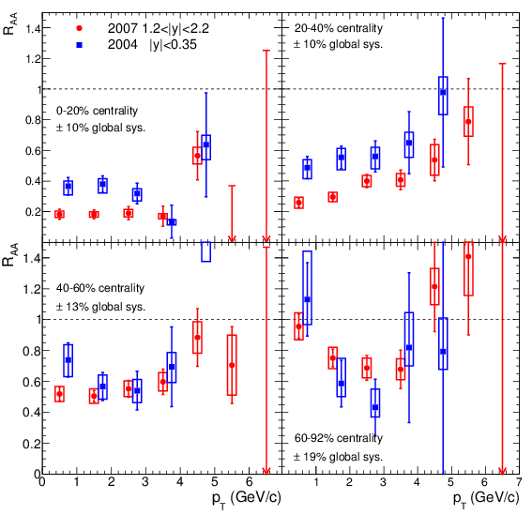
J/ψ suppression: the plot thickens
PRC84, 054912 (2011)
More suppressed at forward rapidity
Unexpected for QGP screening
Trends upward at higher p_{T}
Expected for QGP screening

Slide 20
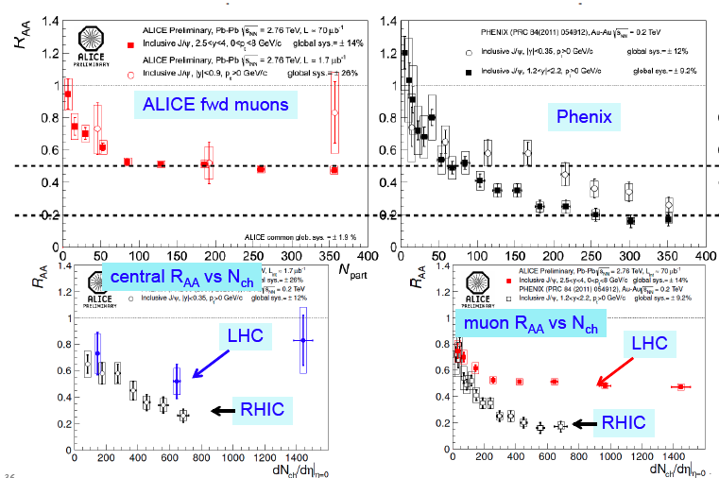
√s dependence: compare to LHC
J/ψ less suppressed at LHC! Final state recombination...

Slide 21
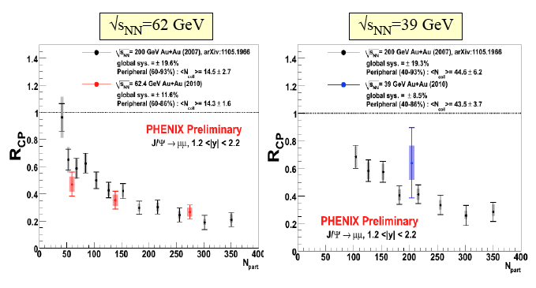
Lower energies at RHIC
Similar to 200 GeV, but comparison suffers from lack of precision – longer runs needed!

Slide 22
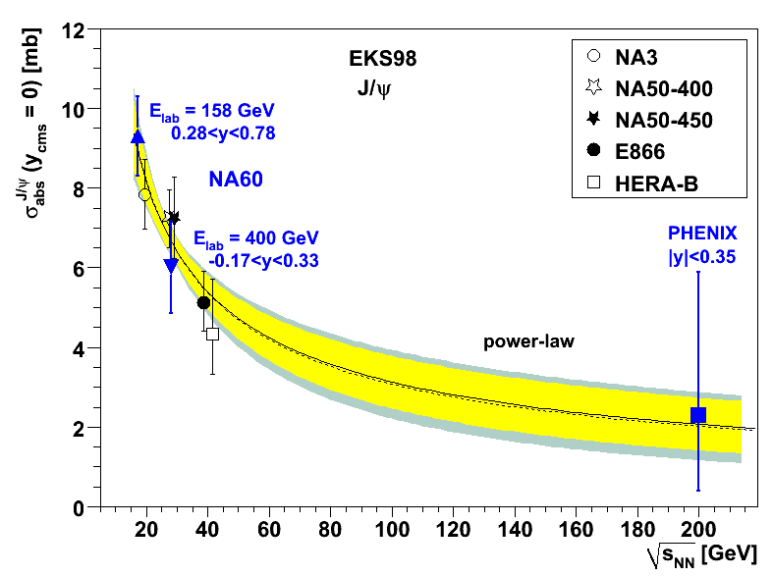
suppression ingredients: √s dependence is key!
Shadowing in CNM
Measure with other hard probes in d/p+A
Suppression
Cold matter
effective absorption
√s
Final state recombination
Screening in QGP
LHC data say yes!
the goal!
Suppression
Suppression
√s
√s

Slide 23
d+Au -> J/ψ
rapidity & p_{T} dependence
Help pin down cold nuclear matter effects
Also measure open heavy flavor
Muons
Electrons
Compare to Cu+Cu and Au+Au
arXiV:
1204.0777
arXiV: 1204.0754

Slide 24
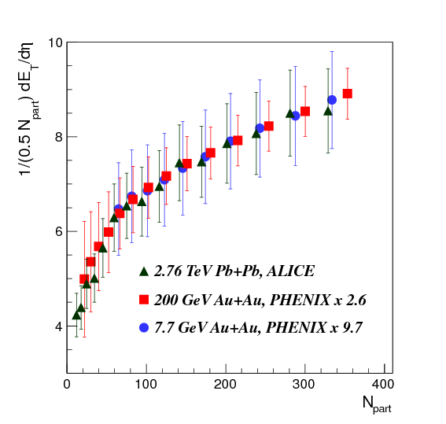
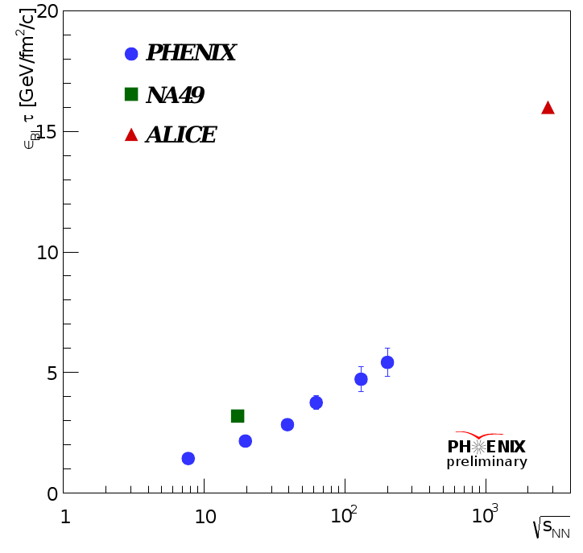
Energy scan for soft particle production

Slide 25
Cu+Au!
J/ψ yields from the PHENIX Muon Arms for Cu+Au Collisions – taking data right now
For about 0.4 nb⁻¹ from the Counting House fast production – 5.3k J/ψ from sum of two muon arms
Run12 Cu+Au expectation: 62k
J/ψ - for PHENIX wide-vertex (±30 cm) luminosity goal of 4.6 nb⁻¹
Allows study vs. reaction plane to control path length
Well controlled initial state v3 for flow study; help pin down η/s
μ⁺μ⁻ signal
Yield
μ±μ± like-sign bkgd
Yield
5281 J/ψ’s
signal after background subtraction
Dimuon Mass (GeV/c)

Slide 26
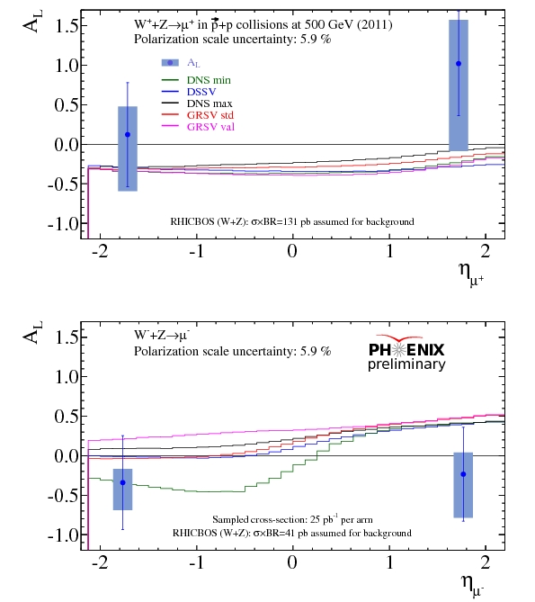
First W -> μ result
Run-11
first use of RPC3
sampled 25 pb⁻¹
polarization ~ 50%
Proof of principle
Clearly needs more statistics
Statistics ⬆ also =
systematics ⬇

Slide 27
Compelling physics questions in Run-13 & 14
What are the light antiquark polarizations inside a polarized proton?
Precision measurement of W± in polarized 500 GeV p+p
What is the gluon asymmetry at smaller x?
Forward π⁰/cluster A_{LL} in polarized 500 GeV p+p
How much are B mesons suppressed by QGP?
c/b separation in 200 GeV Au+Au and p+p w/VTX & FVTX
What is π⁰ A_{N} at forward rapidity?
What is the gluon shadowing at x~10⁻² - 10⁻³ in a Au nucleus?
Install and commission MPC-EX
Measure forward direct photon yield in 200 GeV d+Au (or p+Au) and p+p reference
NB: if isospin effects require p+Au, need dedicated Run-15

Slide 28
PHENIX beam use proposal
Species | √s_{NN} (GeV) | weeks | |z|<30cm | |z|<10cm | delivered | Polariz.
Run13: p+p | 500 | 10-15 | 250 pb⁻¹ | 97 pb⁻¹ | ~750 pb⁻¹ | 55%
p+p | 200 | 4 | 16 pb⁻¹ | > 5.5 pb⁻¹ | 48 pb⁻¹ | 60%
or p+p | 39 | 1 | 0.2-0.3 pb⁻¹ |  | 0.9 pb⁻¹
Run-14:
Au+Au | 200 | 6-8 | 1.7 nb⁻¹ | 1 nb⁻¹ | 5 nb⁻¹
d+Au | 200 | Rest of run

Slide 29
PHENIX Efficiency & vertex cut effects
DAQ livetime = 91% for high lumi/high rate conditions
PHENIX uptime
75% for ion running
70% for polarized p+p running
due to polarization measurements & HV ramp for them
Penalty for commissioning new detector: 10% in uptime
Vertex cuts vary with physics goal (detector systems)
No cut (MPC): 65% of delivered pp luminosity, 68% for ions
± 30cm cut (muon arms)= 50%: sample 1/3 of delivered lumi
± 10cm cut (VTX/FVTX) = 20% in p+p (13% of delivered lumi)
30% in ions (stochastic cooling!!)
(20% of delivered lumi)
We are working on the 75/70% number e.g.
improve HV control, longer run between DAQ resets

Slide 30
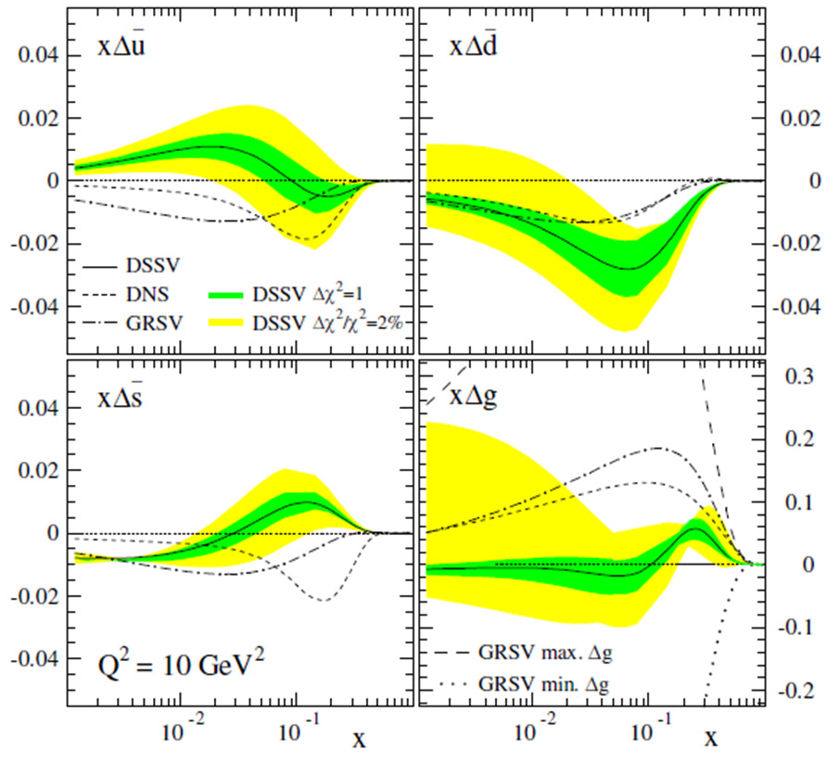
gluon & sea quark polarization
Current best knowledge from global fits
Still surprisingly small
500 GeV p+p: π⁰ A_{LL} to constrain Δg (0.01<x<0.3)
central/forward correlations tag kinematics
W A_{L} at forward, backward, mid rapidity for Δu, Δu, Δd, Δd
NSAC milestone HP12
NSAC milestone HP8

Slide 31
Run-13 top priority: finish W measurement!
inclusive high p_{T} leptons
∫Ldt=300pb⁻¹ in 30cm, P≥0.55
Need 250pb⁻¹ in Run-13
valence/sea combine
Curves => sea uncertainty
Δu/u
Δd/d
Requires ∫Ldt=900pb⁻¹
Combined Run-11,12,13

Slide 32
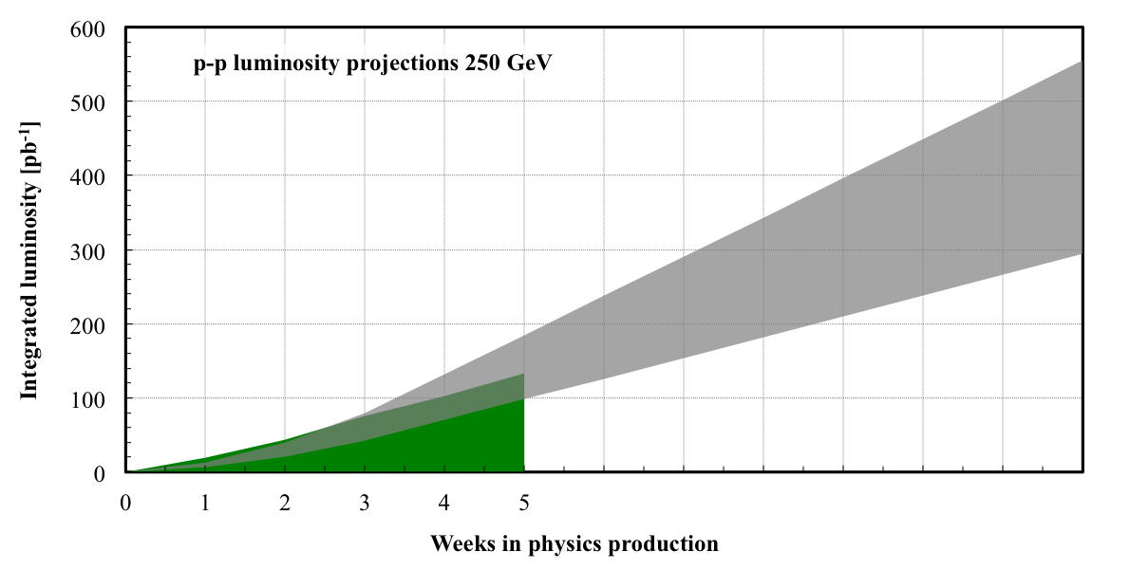
A concern
Can this program be completed in 2013?
NSAC milestone HP8 is set for 2013, RIKEN milestone in 2014
Curtailed running weeks also preclude stretch-out
300 pb⁻¹ in 30 cm is necessary for impactful measurement!
Plots are for 55% polarization, RHIC will match/exceed
The issue is integrated lumi – must optimize ops approach
PHENIX working to improve efficiency & vertex cut impact
12

Slide 33
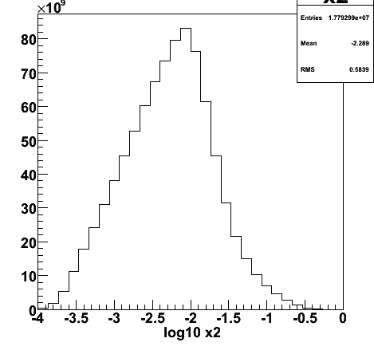
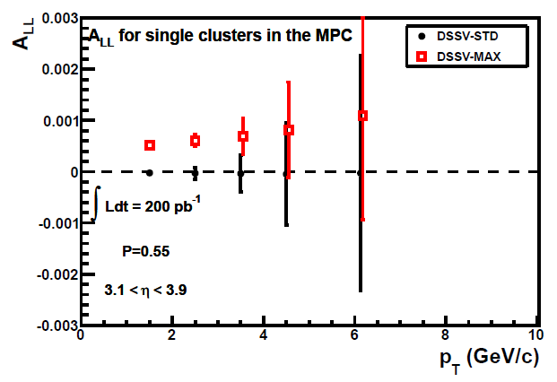
Δg : π⁰ A_{LL}
Δg is small! 500 GeV offers
lower x, higher luminosity
x gluon
for π⁰ in
MPC
Run-13 no vertex cut
Run-13 in ±30cm

Slide 34
Drell Yan proof of principle
50 pb⁻¹ into ±10cm, assuming 50% matches in FVTX

Slide 35
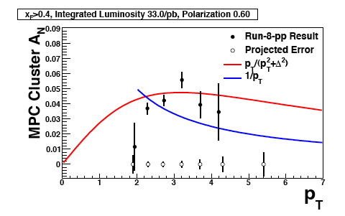
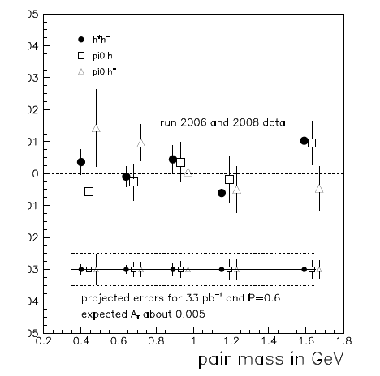
2nd priority for Run-13: 200 GeV p+p
Double duty:
reference for c,b in AuAu + transverse spin physics
Assume ∫Ldt=33pb⁻¹ in 30cm (Run 8+12+13)
(4 x existing lumi, better polarization)
Hadron pairs: IFF in
central arms
➔ isolate transversity !
Expand to Collins using mid-
-MPC hadron correlations
characterize p_{T} dependence
Single particles at 3.1 < η < 3.8

Slide 36
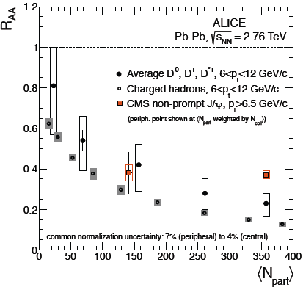
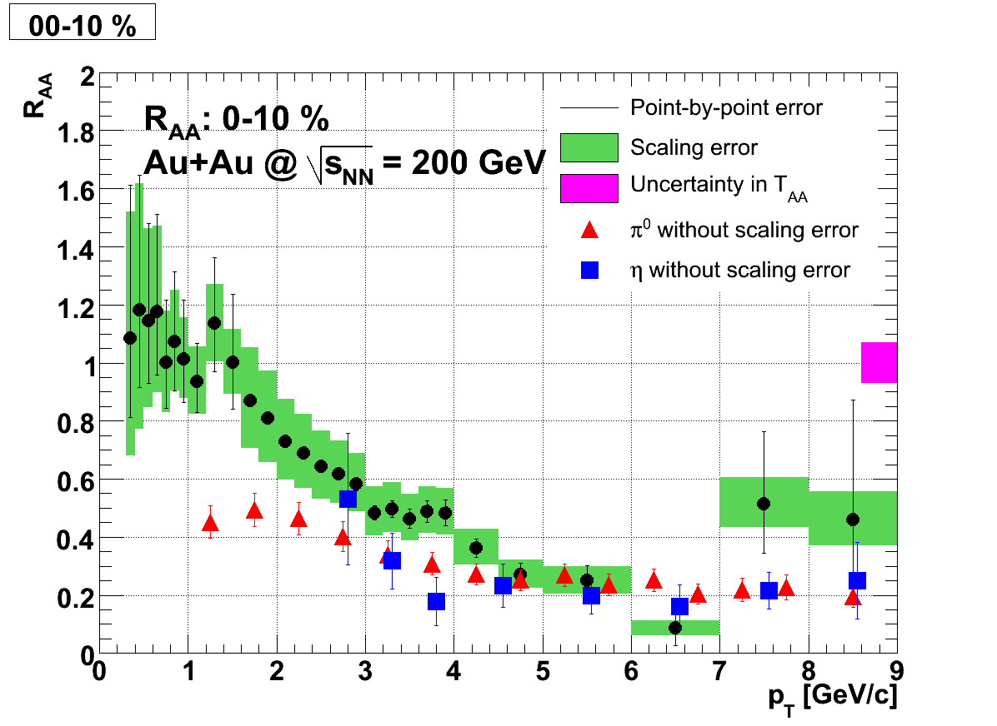
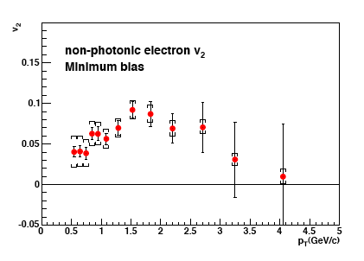
Heavy quark energy loss: a wakeup call
PRC 84, 044905 (2011)
Non photonic electrons
π⁰, η
► more energy loss than gluon radiation can explain!
► charm quarks flow along with the liquid
Mix of radiation + collisions (diffusion)
but collisions with what?
Drag force of strongly coupled plasma on moving quark?
Test with b quarks…

Slide 37
Run-14 highest priority: 200 GeV Au+Au
Separate charm and bottom measurements
Constrain energy loss mechanism
radiative energy loss differs; role of collisions?
compare with AdS/CFT picture
Heavy quark diffusion: different, sensitive probe of η/s
Also important to measure ψ’ at forward rapidity
help sort out initial state effects vs. dissociation
Utilize our new silicon detectors
Key data set with VTX – Au+Au and p+p comparison
First Au+Au with FVTX at forward rapidity
2rd priority: 200 GeV p+p comparison for c, b R_{AA}
Hopefully this is already done in Run-13…

Slide 38
FVTX physics
The goal
Run-14 alone
NB: plots account for trigger rejection (non)power

Slide 39
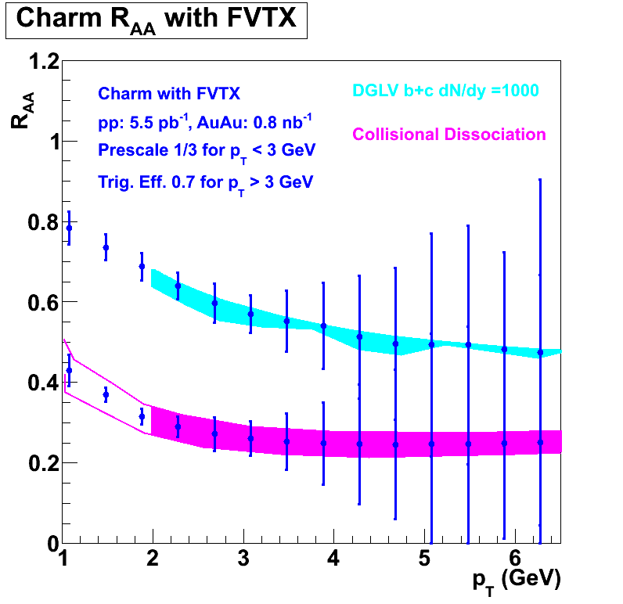
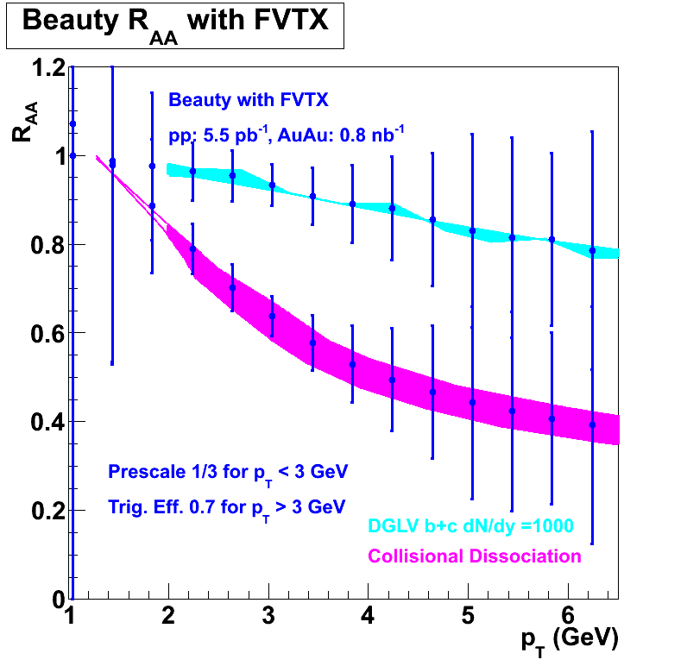
D vs. B meson decays via DCA in FVTX
goal
Run-14

Slide 40
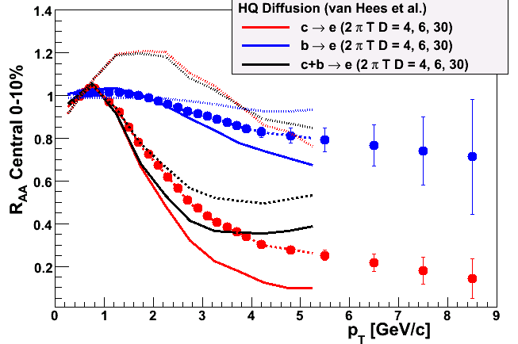
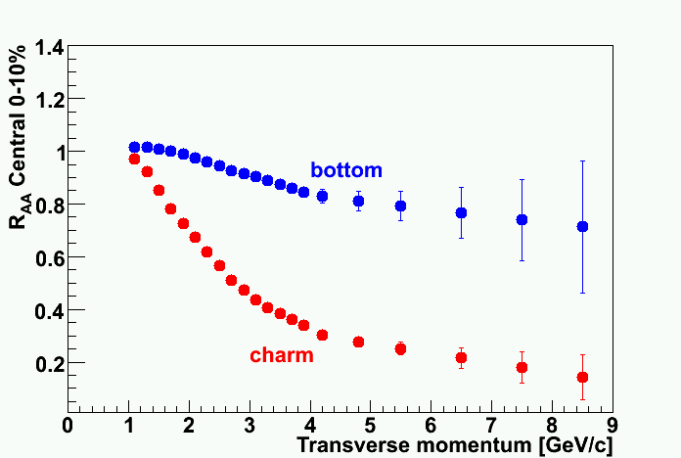
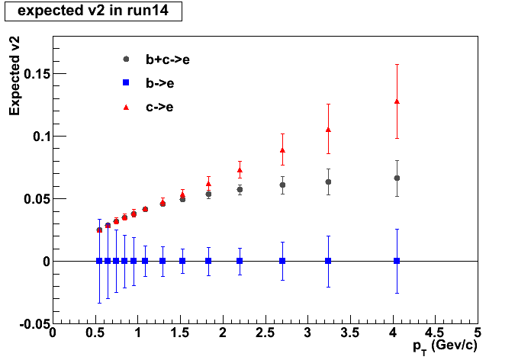
VTX expected performance
Run-14

Slide 41
3rd priority: Direct photons in MPC-EX in CNM
Anticipated performance with direct γ in MPC-EX
49 pb⁻¹ of p+p and 0.35 pb⁻¹ of d+Au (full vertex)
~ 12 weeks of d+Au and p+p. Start in Run-14
May require p+Au instead, due to dilution from isospin effect on q+g -> q+γ. If so, will request dedicated p+Au run in 2015
Issue is being investigated…

Slide 42
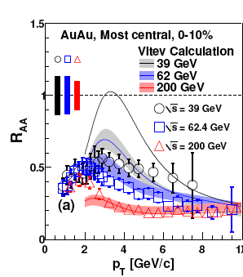
low E p+p comparison
39 GeV requirements
R_{AA} for J/ψ: 0.72 pb⁻¹ in 30 cm
R_{AA} for π⁰
p_{T}=6.5 GeV/c: 0.28 pb⁻¹ in 30 cm
RHIC can deliver
0.6 pb⁻¹ per week, or 86 nb⁻¹/ day
Recorded in 30 cm: 28 nb⁻¹/ day
10 days would yield 280 nb⁻¹
7 days would yield 196 nb⁻¹
Request 1 week of comparison running
But if feasible to deliver 2.2 pb⁻¹, PHENIX would deliver
R_{AA} instead of R_{CP} for J/ψ

Slide 43
PHENIX beam use proposal
Species | √s_{NN} (GeV) | weeks | |z|<30cm | |z|<10cm | delivered | Polariz.
Run13: p+p | 500 | 10-15 | 250 pb⁻¹ | 97 pb⁻¹ | ~750 pb⁻¹ | 55%
p+p | 200 | 4 | 16 pb⁻¹ | > 5.5 pb⁻¹ | 48 pb⁻¹ | 60%
or p+p | 39 | 1 | 0.2-0.3 pb⁻¹ |  | 0.9 pb⁻¹
Run-14:
Au+Au | 200 | 6-8 | 1.7 nb⁻¹ | 1 nb⁻¹ | 5 nb⁻¹
d+Au | 200 | Rest of run

Slide 44
backup slides

Slide 45
MPC Damage in Run-12
APD/Preamp had seen beam-loss damage in the past but not on such a large scale
The last significant loss occurred during Run-10 where we lost in each of two unexpected beam dumps.

Slide 46
MPC North Damage Before and After Beam Dump
Damage by Au beam

Slide 47
MPC South Damage Before and After Beam Dump
We lost 300/416 readout channels total
Repair must wait until the summer shutdown
Work will take ~ 2 additional weeks beyond the pre-accident scheduled MPC maintenance time
We will add diode protection to the preamp hybrid. Requires making 400+ new hybrids
C-AD agrees to add collimators between beam dump near 10 o’clock and the PHENIX IR

Slide 48
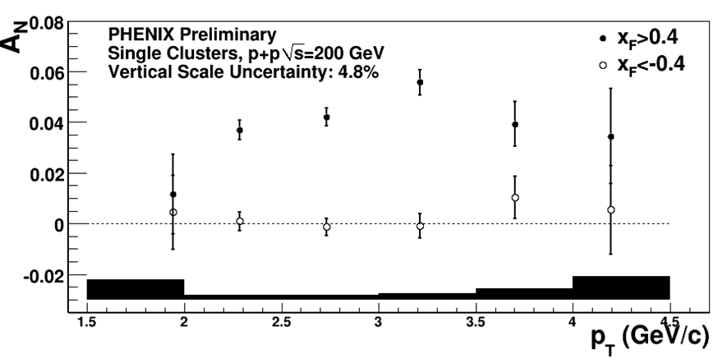
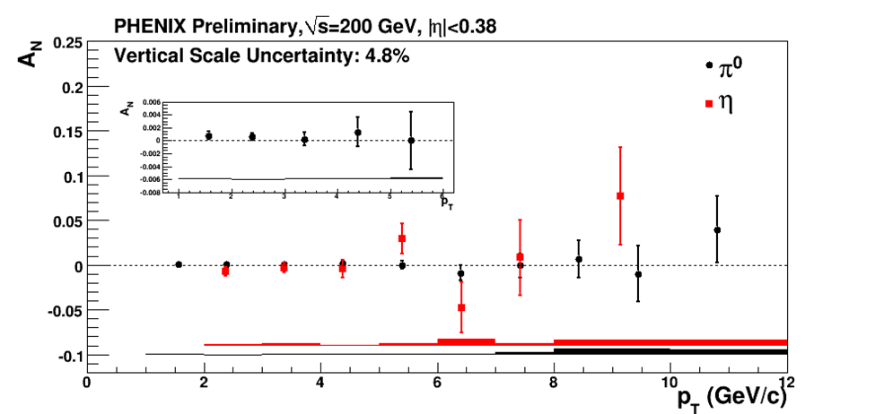
Transverse single spin asymmetries
A_{N} ~ 0 at mid-y, large at forward rapidity. Why??
Initial state correlations between k_{T} & p spin? (Sivers)
Spin dependent fragmentation functions? (Transversity x Collins)
Effects at sub-leading twist? (Qiu, Sterman)
Past measurements statistics limited ➔more 200 GeV data!
midrapidity
Pol. beam direction
NSAC milestone HP13 (sign change in Sivers asymm. in DY) requires 125 pb⁻¹ in PHENIX

Slide 49
Future HI Milestones
Requires upgrade

Slide 50
Spin Physics Milestones
Year | # | Milestone
2013 | HP8 | Measure flavor-identified q and‾q contributions to the spin of the proton via the longitudinal-spin asymmetry of W production.
2013 | HP12 | Determine if gluons have appreciable polarization over any range of momentum fraction between 1 and 30% of the momentum of a polarized proton.
2015 | HP13 | Test unique QCD predictions for relations between single-transverse spin phenomena in p-p scattering and those observed in deep-inelastic lepton scattering.

Slide 51
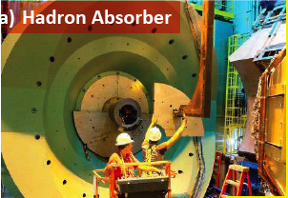
Muon arm background reduction
Stainless steel SS-130 absorbers, 12 tons each side (!)
2 interaction lengths, based upon simulations
Installed on both muon arms during 2010 shutdown

Slide 52
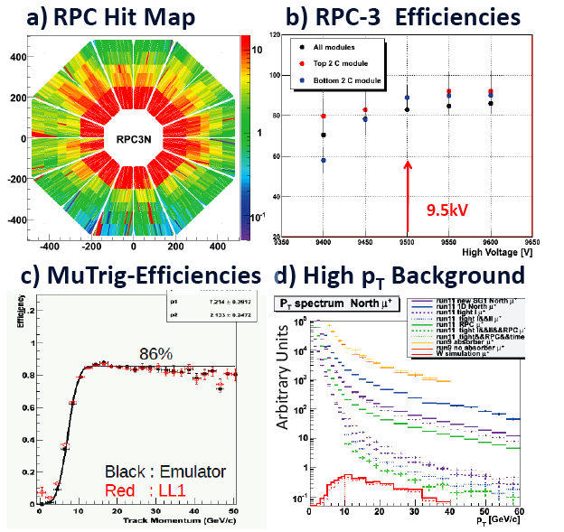
Muon trigger status, first look at Run-11 data
Rejection power ~1100 @ 2.7MHz
S/B~1/2 first look
Anticipate 3/1 after tuning

Slide 53
W decay muon spectra

Slide 54
Status: Thermal Radiation at RHIC Energies
PHENIX measured thermal e⁺e⁻ and γ from √s_{NN} = 200 GeV
Soft low mass dilepton puzzle
larger excess beyond contribution from hadronic phase with medium modified ρ-meson properties… not from hadronic phase
soft momentum distribution … not from hot partonic phase
Thermal photon puzzle
Large thermal yield with T > 220 MeV (10-20% of decay photons)
… suggests early emission
Large elliptic flow (v2) … suggests late emission
PHENIX data on E&M probes seems INCONSISTENT with standard hydro space-time evolution!
And exhibits UNKOWN additional sources!
Speculation: look between impact (t=0) and τ₀
Axel Drees, HP2012

Slide 55
Beauty & charm separation at different muon p_{T}
Extracted b/(c+b)
True b/(c+b) in PYTHIA
with 1 pb⁻¹ stat
10 pb⁻¹
100 pb⁻¹

Slide 56
Cold Nuclear Matter (CNM) and Low-x Partons in Nuclei
other probes of shadowing & gluon saturation – forward hadrons
Dilute parton system (deuteron)
P_{T} is balanced by many gluons
Dense gluon
field (Au)
Mono-jets in the gluon saturation (CGC) picture give suppression of pairs per trigger and some broadening of correlation
Kharzeev, NPA 748, 727 (2005)

Slide 57
ΔG not large: sea quarks polarized? d vs. u?
Probe Δq-Δq via W production
p
u
p
unpol.
100% Parity-violating:
Start: 2009(tests)/2010(trigger) with 500 GeV p+p

Slide 58
Barrel VTX Detector
Specifications:
Large acceptance (Δφ ∼ 2 π and |η| < 1.2)
Displaced vertex measurement σ < 40 μm
Charged particle tracking σ_{p}/p ~ 5% p at high pT
Detector must work for both HI and pp collisions.
Technology Choice
Hybrid pixel detectors developed at CERN for ALICE
Strip detectors, sensors developed at BNL with FNAL’s SVX4 readout chip
Hybrid Pixel Detectors (50 μm x 425 μm) at R ~ 2.5 & 5 cm
Strip Detectors (80 μm x 3 cm) at R ~ 10 & 14 cm
strip layers
|η|<1.2
~ 2π
z ∼ ± 10 cm
pixel layers
beam pipe

Slide 59
Forward Silicon Vertex Detector - FVTX
FVTX Specifications:
2 endcaps
4 pixelpad layers/endcap
~550k channels/endcap
Electronics a mod of BTeV readout chip
Fully integrated mech design w/ VTX
2π coverage in azimuth and 1.2 < | η | < 2.4
Better than 100 μm displaced vertex resolution

