Slide 1
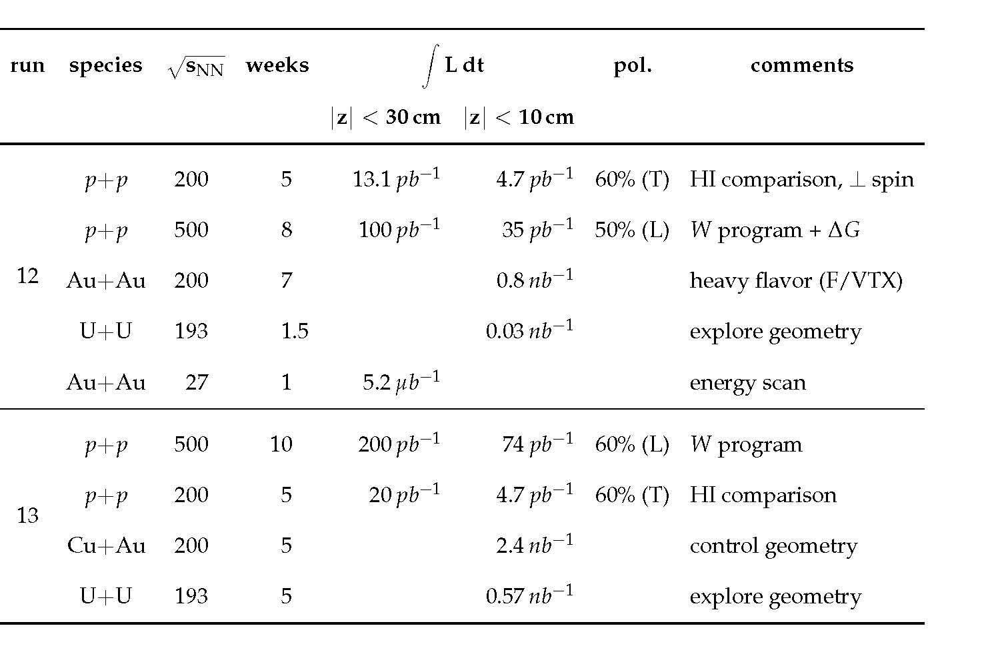
PHENIX Beam Use Proposal for Runs 12 & 13
Barbara Jacak for the PHENIX Collaboration
http://www.phenix.bnl.gov/WWW/publish/jacak/sp/presentations/BeamUse11/BUP11.pdf

Slide 2
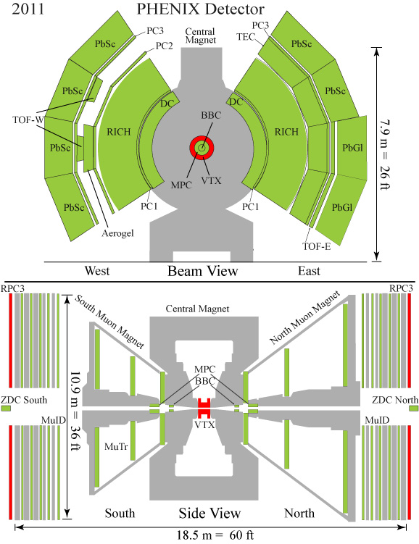
The PHENIX Experiment
An excellent track record for
Major upgrade(s) most years
Sustained scientific productivity
Handling >1pbyte data sets
Fully utilize RHIC luminosity
Data rate maintained w/VTX
~5kHz (AuAu), ~7kHz(p+p)
Timely reconstruction
calibrate within ~1-2 days
data sets produced by next run

Slide 3
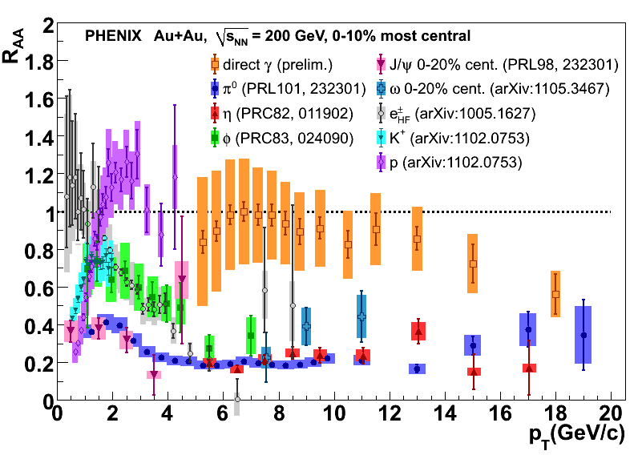
Unprecedented Reach and Precision
Superb particle ID, high rate capability and excellent trigger: broad physics
capabilities over a large kinematic range

Slide 4
Recent Physics Accomplishments

Slide 5
New papers and preliminary results*
Pin down initial state using d+Au collisions
First new constraints on η/s
Discovery of direct photon flow
Measure W cross section, first look at A_{L}
J/ψ suppression at 62 GeV
PHENIX submitted 16 papers for publication in the past 12 months
We published 12 + 1 in proofs
~35-40 preliminary analysis results
* More details to follow

Slide 6
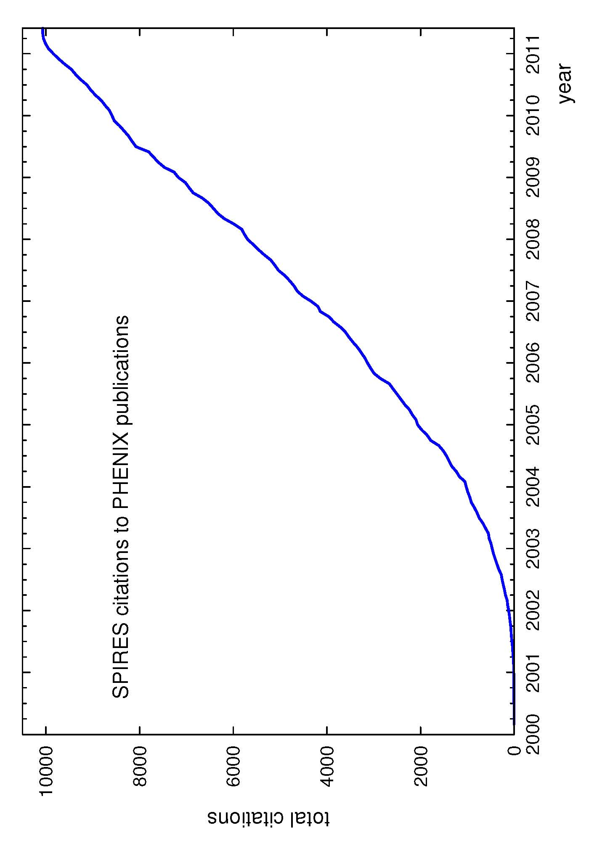
Over 10K citations of PHENIX papers
Citation rate remains high, as in past years
NB: White paper has 1079 citations; jet quenching discovery paper has 584

Slide 7
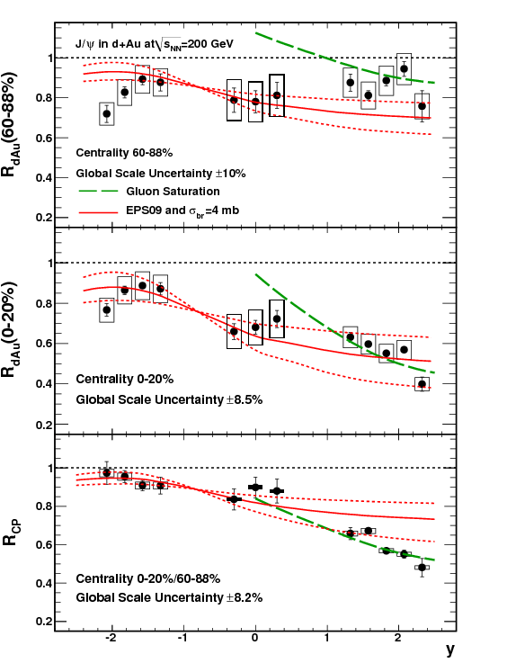
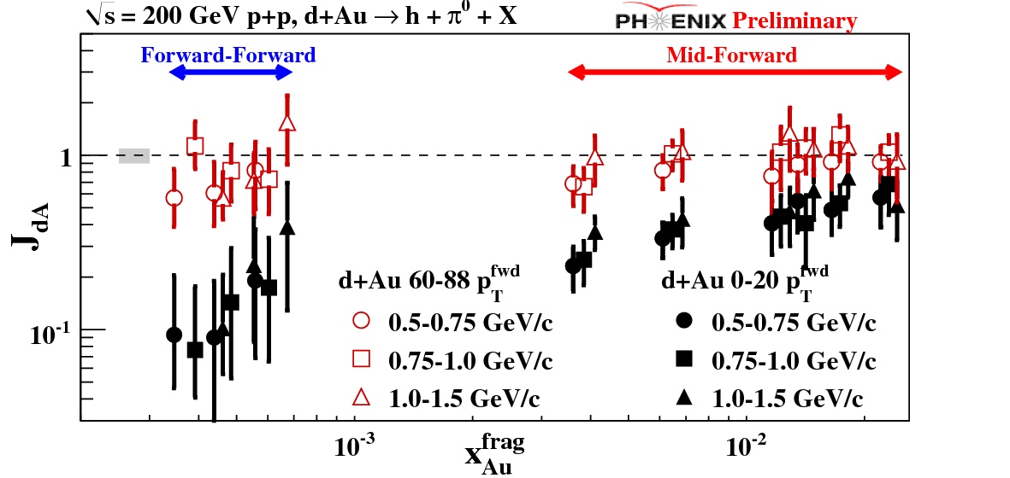
Dense gluonic matter (d+Au, forward y): large effects observed
arXiv:1010.1246
arXiv:1105.5112
Di-hadron suppression at low x
pocket formula (for 2➔2):
Shadowing/absorption stronger than linear w/nuclear thickness
Toward NSAC milestone DM8
trend as, e.g. in CGC …

Slide 8
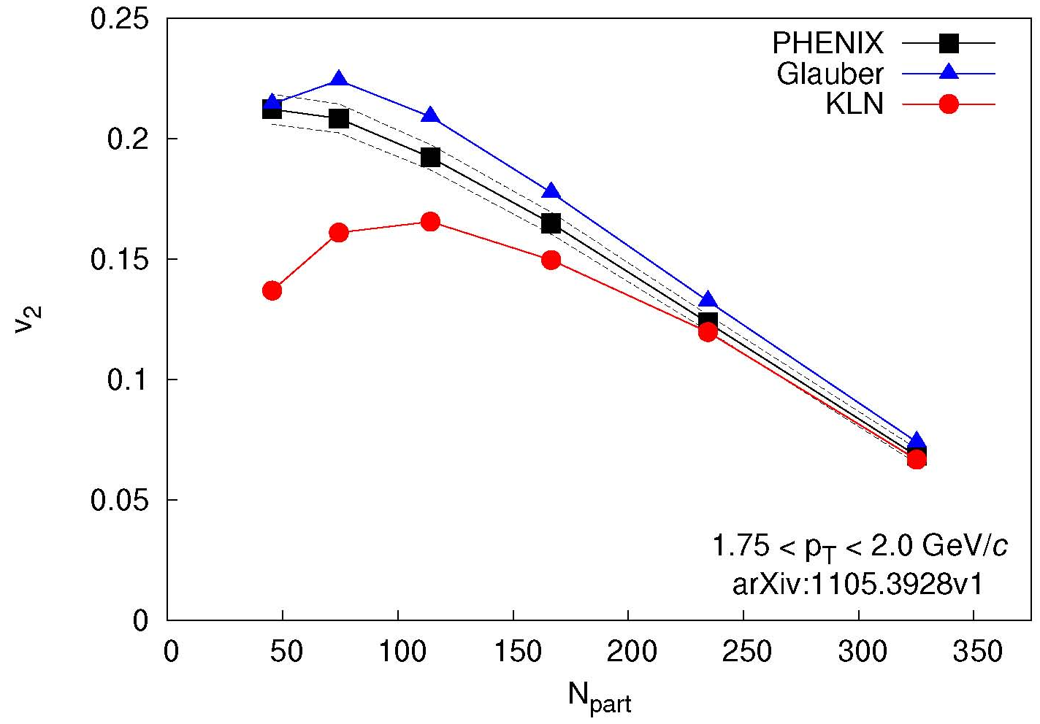
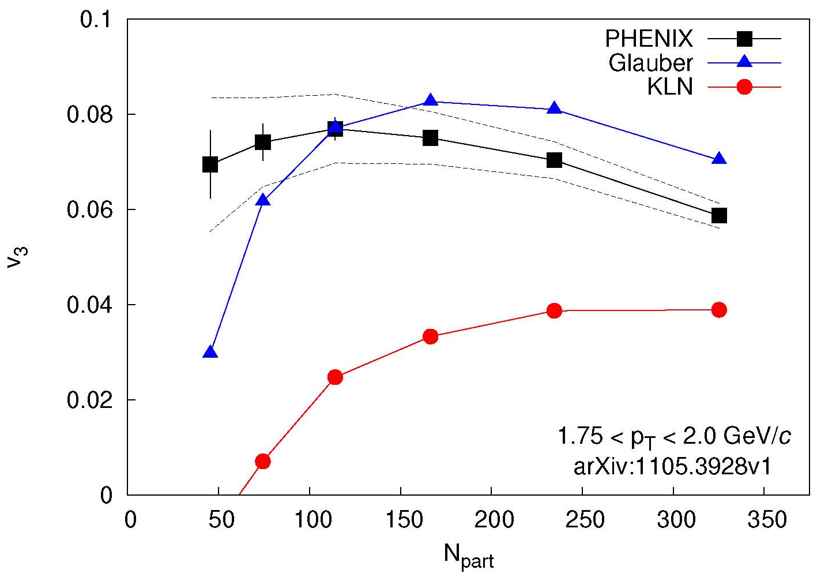
Fluctuations, flow and the quest for η/s
arXiv:1105.3928
v₂ described by Glauber and CGC
different values of η/s
v₃ described only by Glauber
breaks degeneracy
Theory calculation:
Alver et al.
PRC82,034913
arXiv:1105.3928
Theory calculation:
Alver et al.
PRC82,034913
200 GeV Au+Au
Lappi, Venugopalan, PRC74, 054905
Drescher, Nara, PRC76, 041903
Glauber
  Glauber initial state
  η/s = 1/4π
MC-KLN
  CGC initial state
  η/s = 2/4π
Two models
Stefan Bathe for PHENIX, QM2011

Slide 9
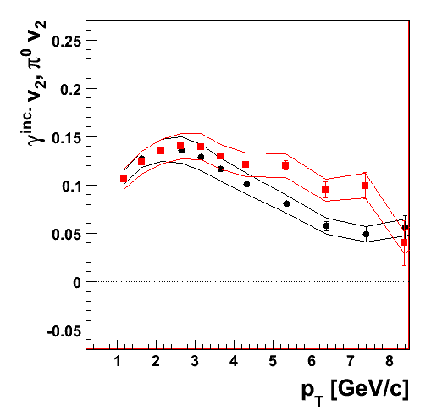
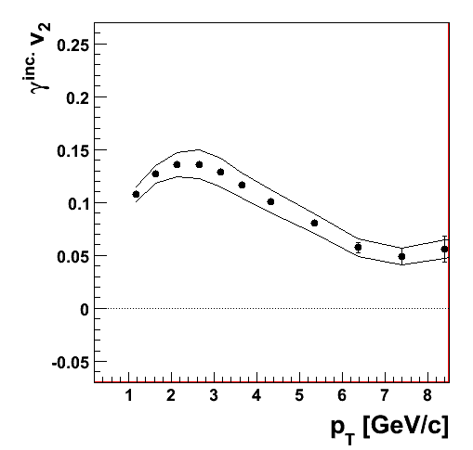
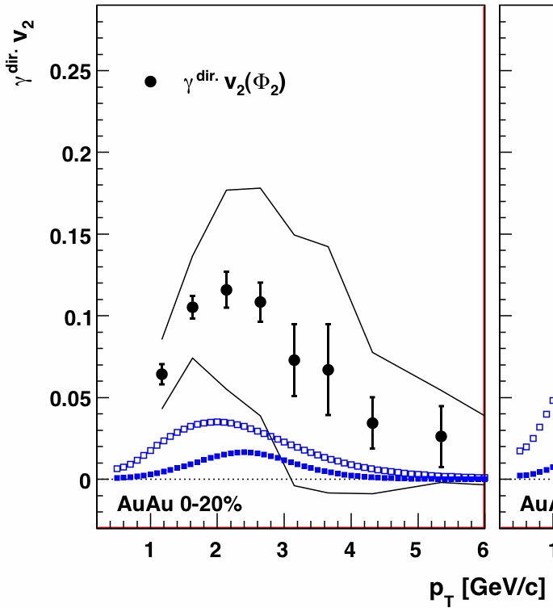
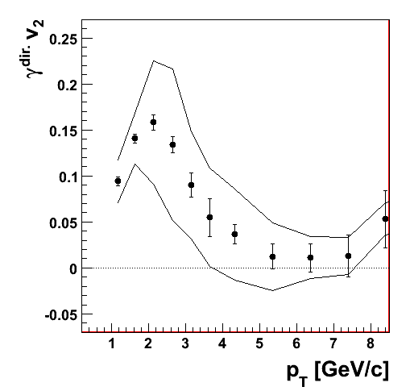
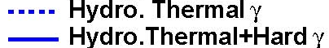
Direct photons flow!
arXiv:1105.4126
Au+Au@200 GeV
minimum bias
Au+Au@200 GeV
minimum bias
Au+Au@200 GeV
minimum bias
Statistical subtraction
inclusive photon v₂
- decay photon v₂
= direct photon v₂
π⁰ v₂
Direct photon v₂
inclusive photon v₂
inclusive photon v₂
π⁰ v₂ similar to inclusive photon v₂
Flow magnitude is a real surprise!
Stefan Bathe for PHENIX, QM2011

Slide 10
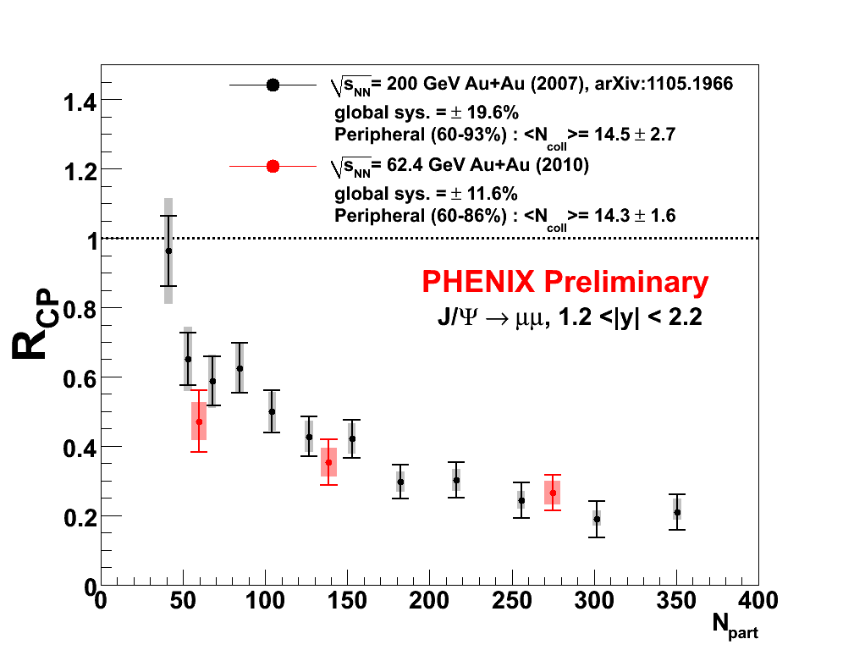
J/ψ suppression at 62 GeV!
arXiv:1103.6269
SPS J/ψ suppression
No obvious pattern of the suppression with energy density.
To understand color screening:
see as function of √s, p_{T}, r_{onium} +
d+Au to disentangle cold matter effects

Slide 11
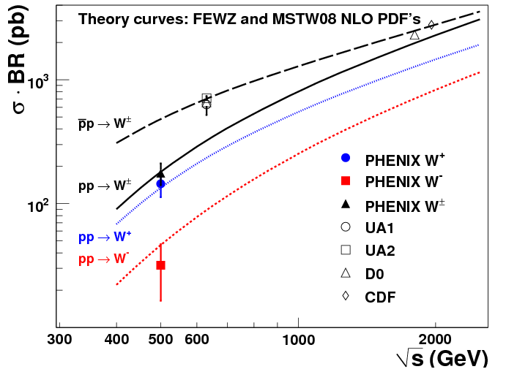
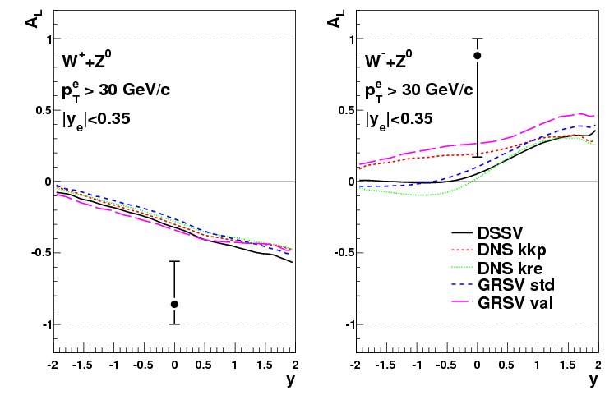
First publication of W’s at RHIC
PRL106, 062001(2011)
Measure σ, first look at A_{L} with electrons in Run-9
Starting with Run-11: precision W-> μ

Slide 12
Other papers in the past year
J/ψ, ψ’, χ_{c} 1105.1966
ω production in pp,dAu, CuCu, AuAu 1105.3467
J/ψ suppression at high p_{T} 1103.6269
Identified hadron spectra in p+p 1102.0753
Away jet suppression vs. reaction plane 1010.1521
J/ψ supression in cold nuclear matter 1010.1246
hadron cluster ALL 1009.4921
electron-hadron correlations PRC83, 044912 (2011)
meson m_{T} scaling in p+p PRD83, 052004 (2011)
φ R_{AA} PRC83, 024909 (2011)
η σ and ALL PRD83, 032001 (2011)
J/ψ A_{N} PRD82, 112008 (2010)
γ-h correlations in p+p PRD82, 012001 (2010)
π⁰ vs. reaction plane PRL105, 142301 (2010)

Slide 13
Where we are now?

Slide 14
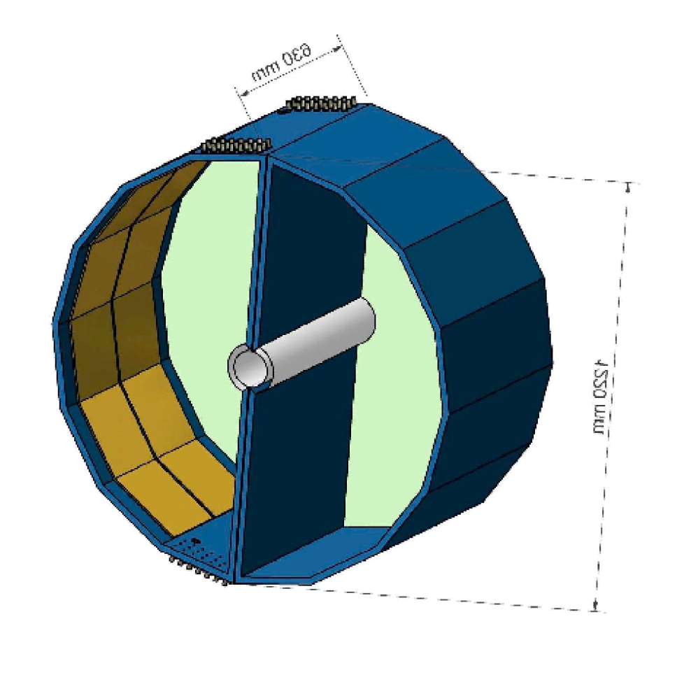
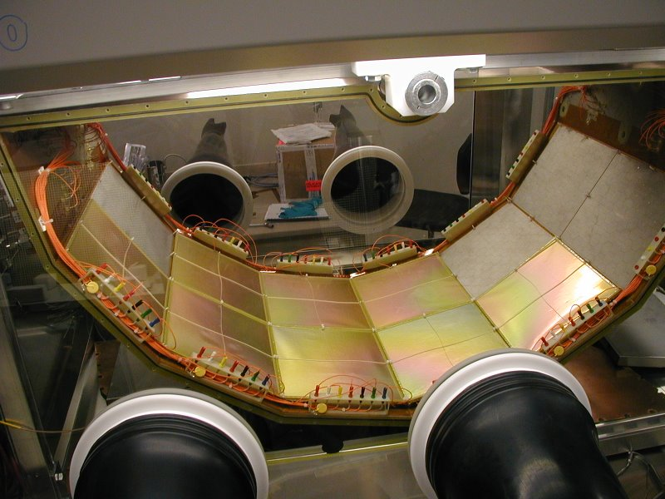
HBD analysis is underway
N₀ ideal value | 714 cm⁻¹
Optical transparency of mesh | 88.5 %
Optical transparency of photocath. | 81.0 %
Radiator gas transparency | 89.0 %
Transport efficiency | 80.0 %
Reverse bias and pad threshold | 90.0 %
N₀ calculated | 328 +/- 46 cm⁻¹
N_{pe} expected | 20.4 +/- 2.9
N_{pe} measured | 20
N₀ measured value | 330 cm⁻¹
signal electron
e⁻
partner positron
needed for rejection
Cherenkov
blobs
e⁺
θ_{pair}
opening
angle
~ 1 m
The highest ever measured N₀!
Maintained for 2 years
Single electron charge peaks at 20 pe
Double electron charge peaks at ~40 pe
Good single to double separation
M. Makek, QM2011

Slide 15
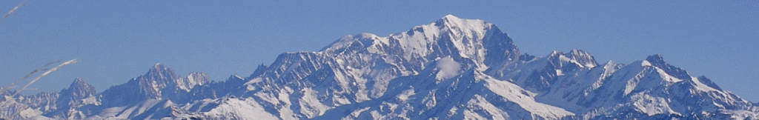
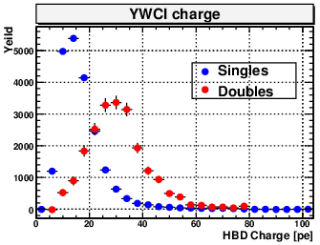
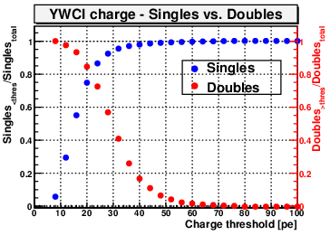
In central Au+Au, must deal with scintillation light. rejection of π⁰ Dalitz electrons and upstream conversions
Subtract <pe> to reject scintillation γ
Then, can reject upstream conversions and π⁰ Dalitz pairs with single/double charge cut
This requires good gain calibration throughout the entire run
Single electron hits studied w/ MC
φ->e⁺e⁻ emebedded in Au+Au data
Double electron hits studied using MC π⁰−>γγ emebedded in Au+Au data
Background normalization is underway
Single vs. double charge
Single efficiency vs. double rejection
Singles efficiency
Doubles rejection
Run 10 Au+Au e+e- pair spectrum soon

Slide 16
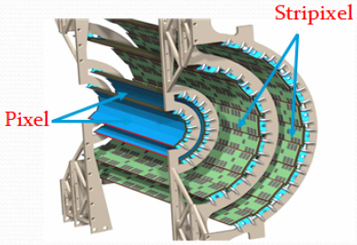
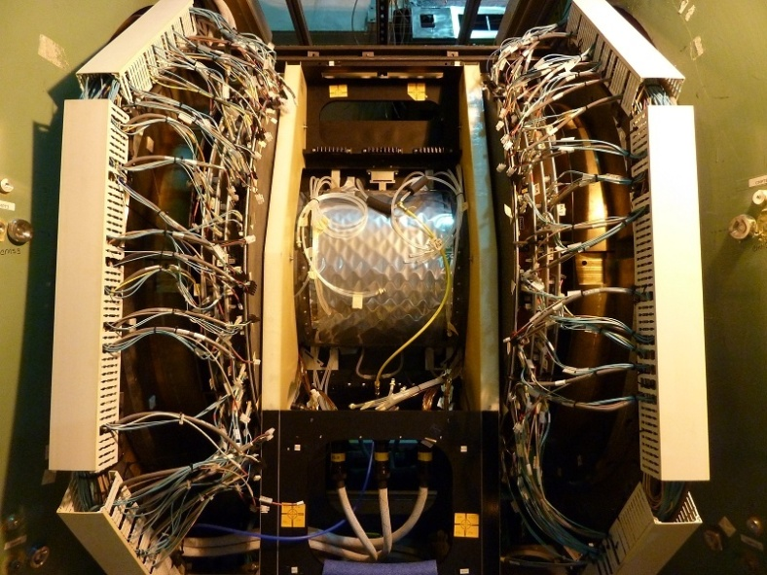
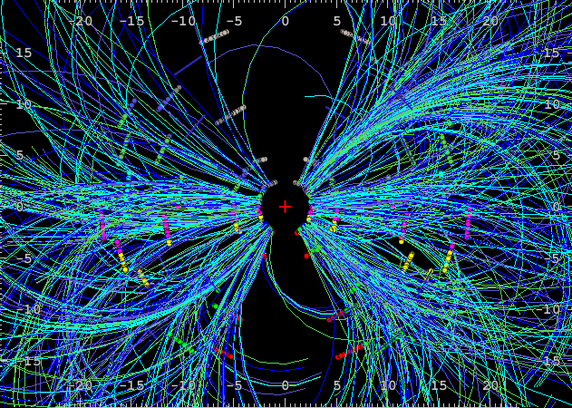
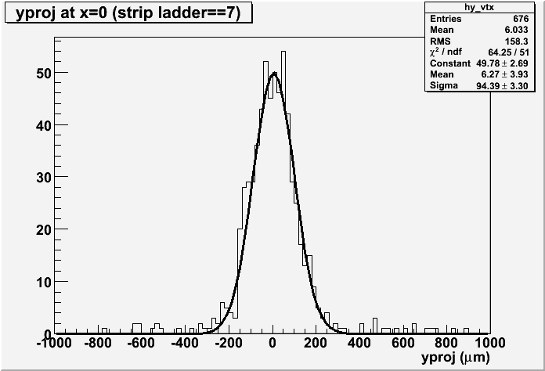
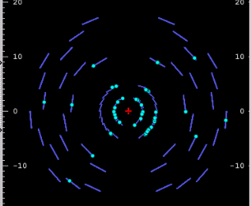
VTX is installed and commissioned
Successfully commissioned in 2011 p+p run
Taking data in Au+Au now
  Opens era of c/b separated R_{AA}, v₂ at RHIC !
DAQ upgrades (incl. DCMII, new EVB switch):
maintain same data rate! ~7 kHz p+p and 5 kHz Au+Au
Au+Au@200 GeV, 2011
p+p@500 GeV, 2011
σ ~ 100μm

Slide 17
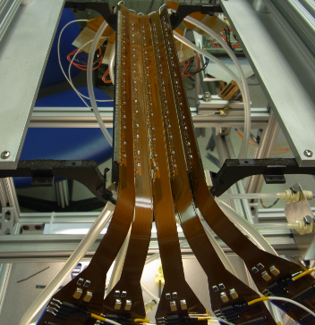
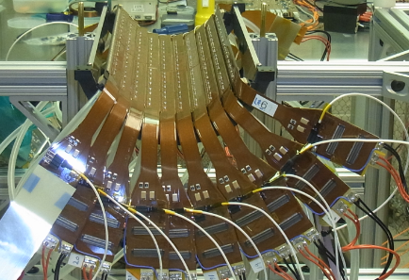
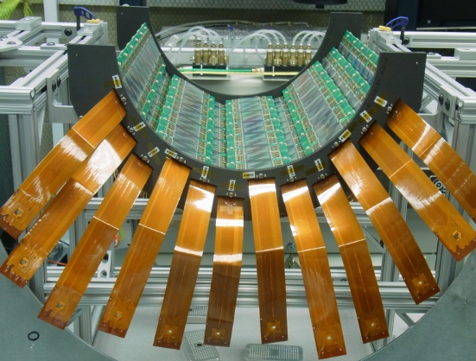
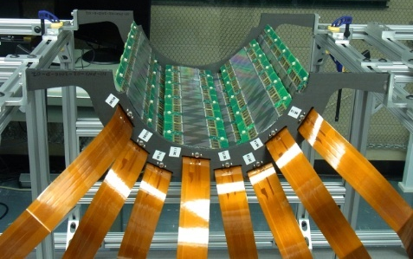
A peek inside the VTX
Barrel 0 (Pixel)
5 ladders
Barrel 1 (Pixel)
10 ladders
Barrel 2 (Stripixel)
8 ladders
Barrel 3 (Stripixel)
12 ladders

Slide 18
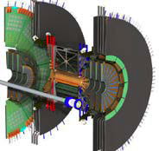
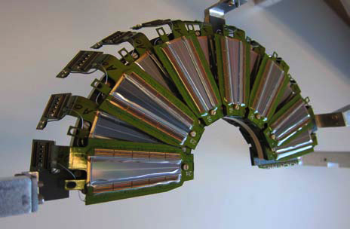
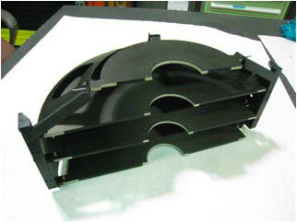
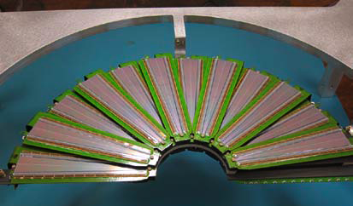
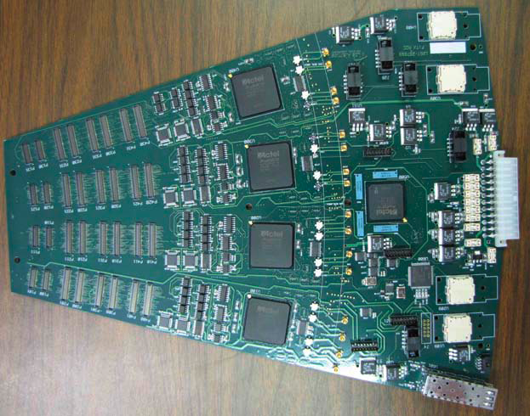
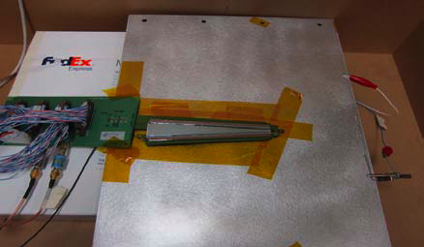
FVTX construction underway
Fully Populated Small Disk
C fiber structure
➔ Forward y
open heavy
flavor physics
ψ’in AuAu & dAu
Fully Populated Large Disk
Wedge test
Read Out
Card
On track
to install for Run-12

Slide 19
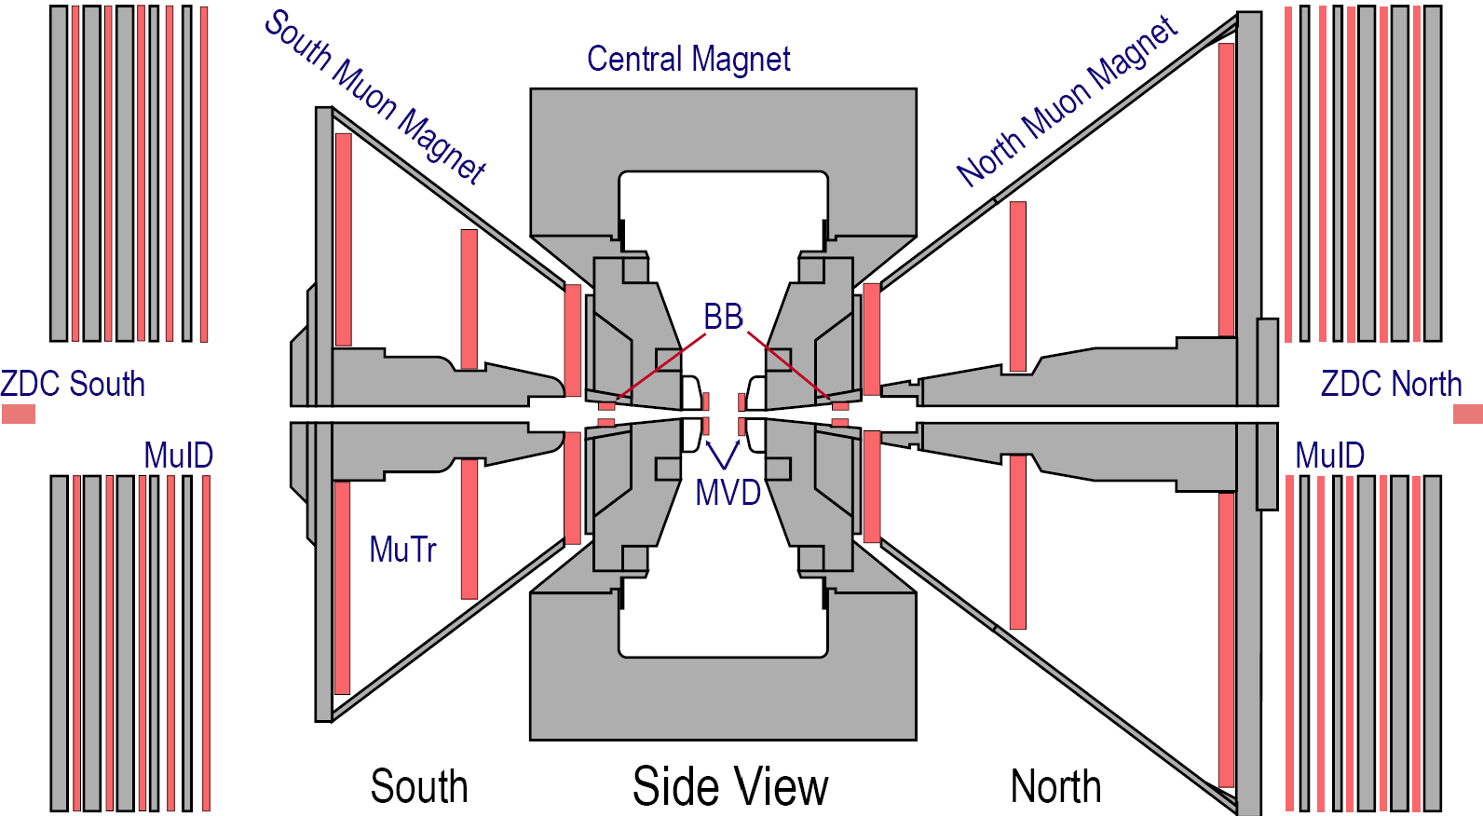
Muon Trigger Upgrade
Trigger idea:
Reject low momen-
tum muons
Cut out-of-time
beam background
muTr south
Existing Muon Arms:
o muID (triggering)
o muTr (tracking)
o trigger rejection
~ 200 - 500
muTr north
muID
south
muID
north
RPC1(a,b)
RPC3
RPC3
muTr-trigger
Upgrade:
o muTr trigger electronics: muTr 1-3 ➔ send tracking info to level-1 trigger
o RPC stations: RPC 1+3 ➔ tracking + timing info to level-1 trigger
muTr FEE + RPC3 took data in Run-11
RPC1’s to be installed for Run-12

Slide 20
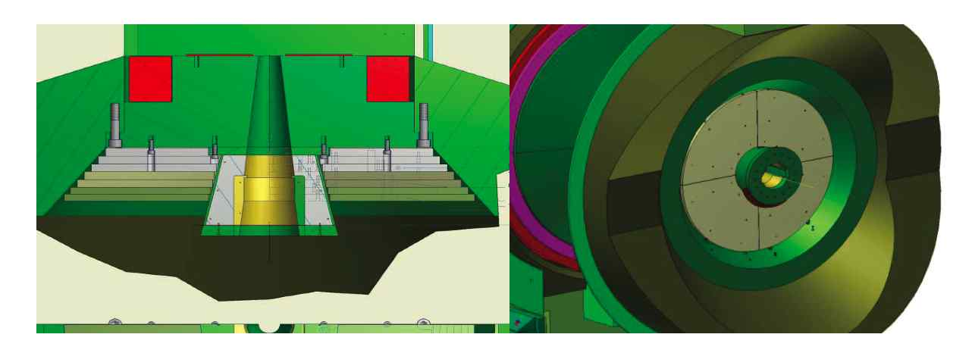
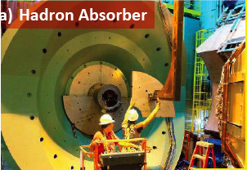
Muon arm background reduction
Stainless steel SS-130 absorbers, 12 tons each side (!)
2 interaction lengths, based upon simulations
Installed on both muon arms during 2010 shutdown

Slide 21
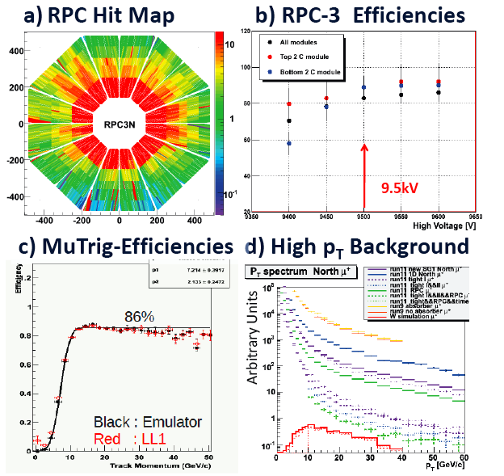
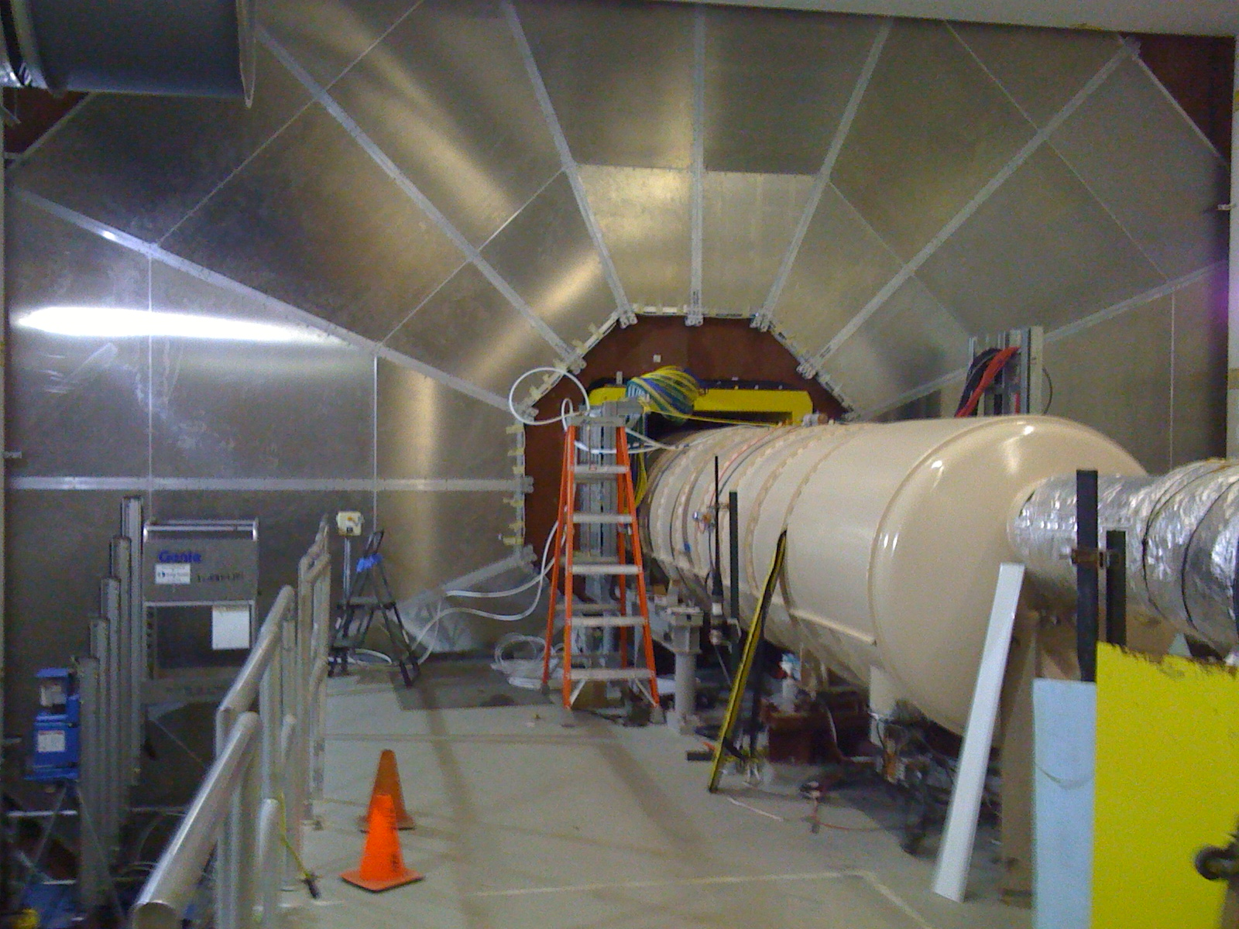
Muon trigger status, first look at Run-11 data
Rejection power ~1100 @ 2.7MHz
S/B~1/2 first look
Anticipate 3/1 after tuning

Slide 22
Compelling physics questions*
* utilizing new PHENIX capabilities
+ RHIC luminosity (stochastic cooling)
* informed by new insights from RHIC & LHC

Slide 23
Mysteries in heavy ion physics
Energy loss mechanism
  @ LHC 40 GeV jets opposing 100 GeV jets look “normal”
  no broadening or decorrelation
  no evidence for collinear radiation from the parton
  @ RHIC low energy jets appear to show medium effects
  but, “jet” is defined differently
  c & b to probe role of collisional energy loss VTX, FVTX
  quantify path length dependence U+U, Cu+Au
J/ψ suppression and color screening
  amazingly similar from √s=17-200 GeV; but initial states differ
not SO different at LHC
  Other states y & √s dependence (e.g. ψ’) FVTX, statistics
  d+Au for initial state; 130 GeV Au+Au eventually?
NSAC milestone DM11, 12
NSAC milestone DM5

Slide 24
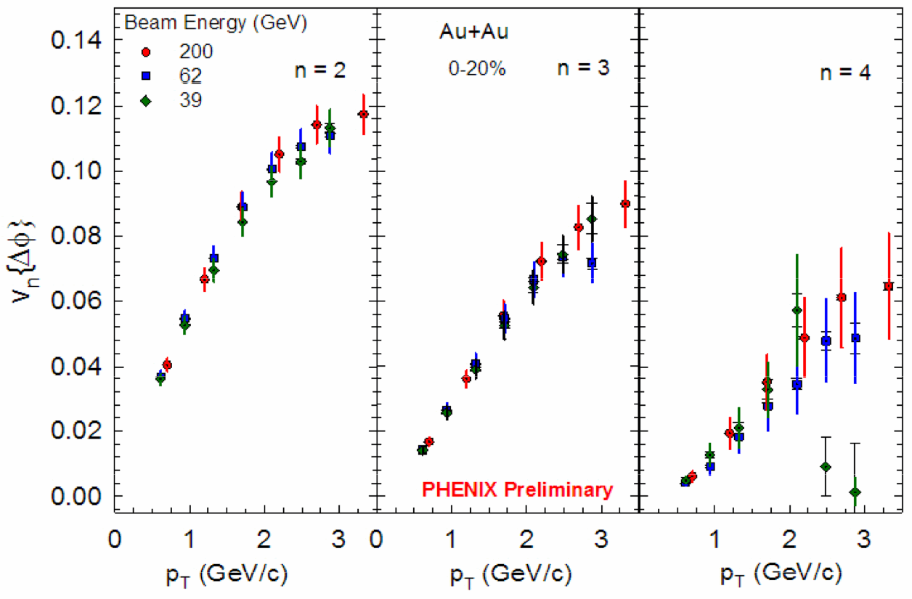
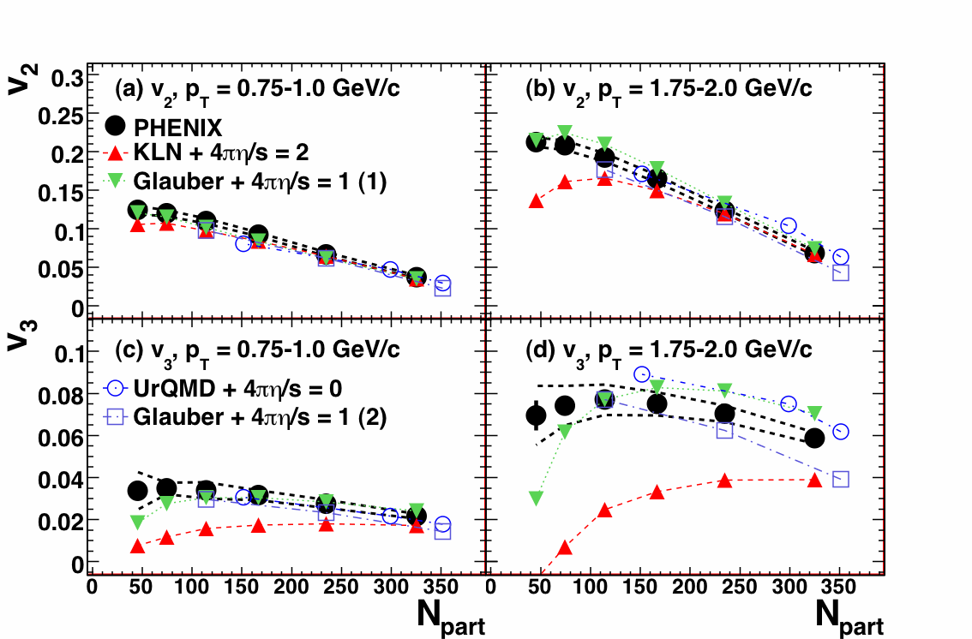
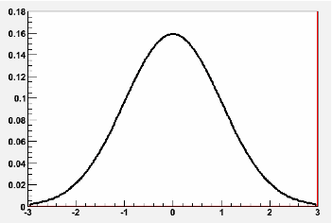
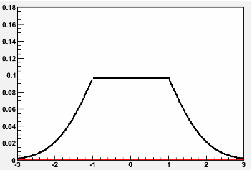
η/s vs. √s, using v₂ + v₃ + hydro
Energy scan driver for PHENIX
Will also need help from theory
arXiv:1105.3928
v₂
Glauber
CGC
Smaller eccentricity
Larger eccentricity
v₃
NSAC milestone DM9

Slide 25
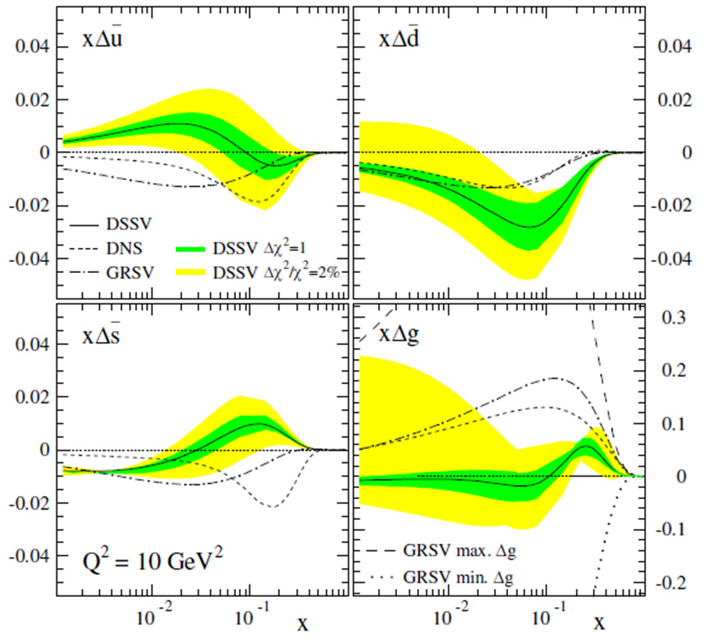
gluon & sea quark polarization
Current best knowledge from global fits
Still surprisingly small
500 GeV p+p: π⁰ A_{LL} to constrain Δg (0.01<x<0.3)
  central/forward correlations tag kinematics
W A_{L} at forward, backward, mid rapidity for Δu, Δu, Δd, Δd
NSAC milestone HP12
NSAC milestone HP8

Slide 26
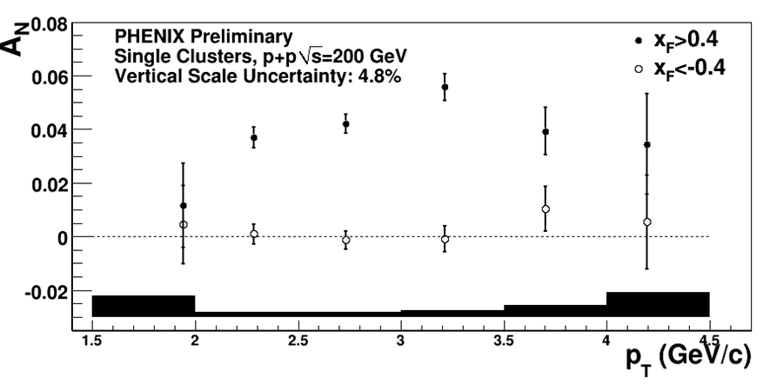
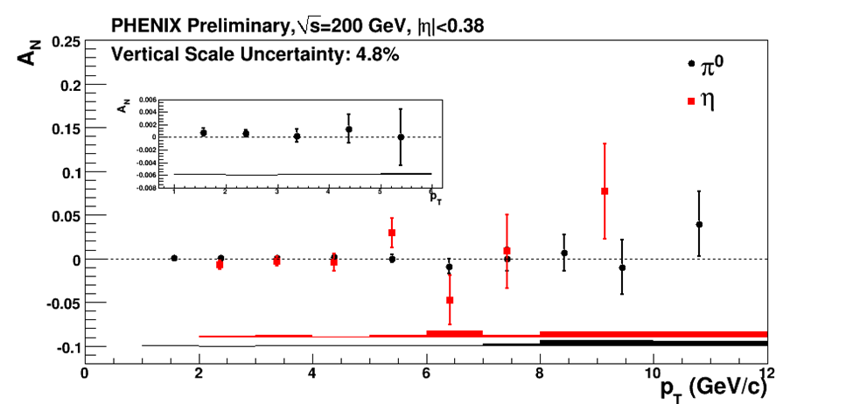
Transverse single spin asymmetries
A_{N} ~ 0 at mid-y, large at forward rapidity. Why??
  Initial state correlations between k_{T} & p spin? (Sivers)
  Spin dependent fragmentation functions? (Transversity x Collins)
  Effects at sub-leading twist? (Qiu, Sterman)
Past measurements statistics limited ➔more 200 GeV data!
midrapidity
Pol. beam direction
NSAC milestone HP13 (sign change in Sivers asymm. in DY) requires 125 pb⁻¹ in PHENIX

Slide 27
PHENIX beam use proposal
If less than 30 cryo weeks:
NB for Run-13 (Adds up to 30 cryo weeks)
Relative priority of CuAu, UU, more AuAu TBD by Run-12 results

Slide 28
PHENIX beam use proposal
Additions if we get a longer Run-12 (in priority order)
1.5 week of 62.4 GeV p+p for J/ψ & open heavy q R_{AA}
1.5 week of 39 GeV p+p for π⁰ R_{AA}
Add 1 week to 27 GeV Au+Au to improve reach
If less than 30 cryo weeks:

Slide 29
Ordering request
We request to run 200 GeV p+p first
  FVTX commissioning
  avoid letting any downtime affect W program
  RPC1 commissioning
  be ready for the W measurement
  Polarization development time (?)
  may help optimize machine performance for 500 GeV
Then 500 GeV p+p
  Followed by low energy comparison running, if $ permit
Switch to ions
  Do 200 GeV Au+Au first
  Probably should follow with 27 GeV Au+Au
  lower priority for PHENIX than U+U test

Slide 30
How well will we do?

Slide 31
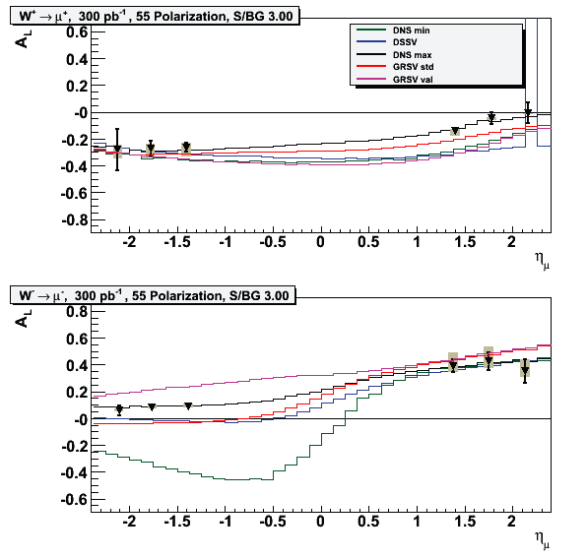
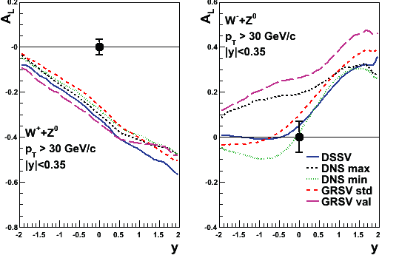
Run-12 top priority: progress on W program
inclusive high p_{T} leptons
∫Ldt=300pb⁻¹ in 30cm, P=0.55
Run-12 (100pb⁻¹) + Run-13
Δd/d
W⁺ -> e⁺ + ν_{e}
W⁻ -> e⁻ + ν_{e}
Δu/u
Δu/u
Δd/d
Requires ∫Ldt=900pb⁻¹
delivered in Run-12+13

Slide 32

50% polarization performance

Slide 33

Constrain dbar/ubar with W+/W- ratio
symmetric q sea
asymmetric

Slide 34
A concern
RHIC performance for 500 GeV polarized p+p
  Not up to the usual RHIC standards
  We only got ∫Ldt=18pb⁻¹ within our vertex cut of 30cm
  Polarization was ~ 50%
300 pb⁻¹ in 30 cm is necessary for impactful measurement!
  Plots are for 55% polarization; current performance is close to what’s needed
Can this program be completed in 2 years?
  NSAC milestone HP8 is set for 2013
  If we do not reach in 2 years, will request one more run

Slide 35


for Δg : π⁰ A_{LL} at 500 GeV
2-2.5 GeV
Small ΔG: a challenge!
500 GeV reaches lower x
with higher luminosity
Uncertainties for Run-12
only; vertex cut of 10cm

Slide 36


For Δg: MPC π⁰ and dihadron A_{LL}
For Run-12 + Run-13 500 GeV p+p run
Plot: A_{LL} for single cluster in 3.1 < η < 3.8
  will use dihadrons as in d+Au analysis, also
X gluon

Slide 37


200 GeV p+p in Run-12+13
Double duty:
  reference for c,b in AuAu + transverse spin physics
Assume ∫Ldt=33pb⁻¹ in 30cm with P=0.6
  (4 x existing lumi, better polarization)
Hadron pairs: IFF in
central arms
➔ isolate transversity !
Expand to Collins using mid-
-MPC hadron correlations
characterize p_{T} dependence
Single particles at 3.1 < η < 3.8

Slide 38
Run-12 next priority: 200 GeV Au+Au
Utilize our new silicon detectors
  Key data set with VTX – Au+Au and p+p comparison
  First run with FVTX to look at forward rapidity
The era of separated charm and bottom measurements
  Help constrain energy loss mechanism
  radiative energy loss differs; role of collisions?
  compare with AdS/CFT picture
  Heavy quark diffusion: different, sensitive probe of η/s
  Also important to measure ψ’ at forward rapidity
  help sort out initial state effects vs. dissociation
  (I don’t believe in accidental cancellations…)
3rd priority: 200 GeV p+p comparison for c, b R_{AA}

Slide 39


Run-12 next priority: 200 GeV Au+Au w/VTX
For 29M mb Au+Au events
7 weeks in Run-12: 0.8 nb⁻¹ (~4B events) in 10cm
Error bars Run-12 alone x √6
c, b R_{AA} to ~ 5GeV/c
b v₂ to ~ a few GeV/c
NB: Statistical power of VTX data from Run-11 is not yet known

Slide 40

Run-12 FVTX physics
Run-12 Goals:
Commission
Collect first part of the data set at left
~1/6 of 4.6 nb⁻¹ minbias
One run already has discriminating power for energy loss models

Slide 41



FVTX performance simulations
prompt
c,b coverage
π→μ
Simulation
Fit DCA distribution in each p_{T} bin with sum of individual c, b contributions.
Iterate to constrain D and B p_{T} distributions.

Slide 42



4th priority: U+U “engineering” run: 0.5 + 1.5 wk
Glauber MC simulations show:
Goal: vary ε₀, eccentricity
The problem
The solution: 200M evt
~ 400k tip-tip events
mb
body-body
0º E
tip-tip
0.6%
0.2% of N_{ch}
0.04%
N_{ch}

Slide 43


5th priority: 27 GeV Au+Au
Preliminary, STAR, PHENIX and E895 data
PHENIX beam energy scan goals:
v₂ saturates where?
Constituent quark scaling?
v₃ vs √s?
√s dependence of η/s?
R_{AA} reaches 1.0 where?
ALICE
at 1.7GeV/c
at 0.7GeV/c
10³
10⁴

Slide 44


v₂ performance
√s=27 GeV
√s=27 GeV
vertex in ± 30cm
vertex in ± 10cm
1 week of running
(~11M events)
uncertainty at p_{T} = 3.5 GeV:
~14% at 27 GeV
Marginal for n_{q} scaling
Vertex cut
± 10 cm

Slide 45
5th priority: low E p+p comparison
Currently we rely upon extrapolation for 62 GeV
  Considerable uncertainty for R_{AA}
  Unavailable for heavy flavor electrons or J/ψ
62 GeV requirements
  4.5 pb⁻¹ p+p equiv. Au+Au * R_{AA}=0.25 ➔1.1 pb⁻¹
  4.8 x10³⁰ /cm²/sec ➔0.124 pb⁻¹ per day ➔ 9 days
39 GeV requirements
  Rate is half as large; π⁰ R_{AA}=0.4 @ p_{T}=3.5 GeV/c
  1.6 pb⁻¹ p+p equiv. Au+Au * R_{AA}=0.4 ➔0.64 pb⁻¹ ➔ 10 days
NB: It may be preferable to live with interpolating 39 (and 27) GeV p+p if we pin down at 20 GeV

Slide 46
Run-13 Physics goals
Reach 300 pb-1 sampled for W in 500 GeV p+p
200 GeV p+p for VTX, FVTX comparison and transverse spin physics
Control geometry to quantify path length dependence
  U+U if successfully demonstrate selection cuts
  5 weeks for ∫Ldt=0.57nb⁻¹ in 10cm (4B mb U+U events)
  First Cu+Au collisions
May replace one of these with full energy Au+Au
  Depends on FVTX commissioning in Run-12

Slide 47



Cu+Au: 2.4 nb⁻¹ into 10 cm vertex cut
Cu buried inside Au for most central collisions
  Minimize effects of the surface on hard probes
  select top 3% centrality for this (300M events)
Eccentricity without left/right symmetry for non-central collisions
  Non-fluctuation source of odd harmonics

Slide 48
PHENIX beam use proposal
Additions if we get a longer Run-12 (in priority order)
1.5 week of 62.4 GeV p+p for J/ψ & open heavy q R_{AA}
1.5 week of 39 GeV p+p for π⁰ R_{AA}
Add 1 week to 27 GeV Au+Au to improve reach
If less than 30 cryo weeks:

Slide 49
backup slides

Slide 50


Direct photon flow ingredients
200GeV Au+Au 20-40%
PHENIX Preliminary
Key cross checks:
  γinc are really γ’s:
  check using γ-> e+e-
  Rγ for virtual vs. real γ
γ^{inc.} v₂
(Φ₂^{BBC})
γ^{inc.} v₂ with external conversion method

Slide 51

Ph.D. theses

Slide 52

Basis for time estimates
Projections from W. Fischer

Slide 53
HBD performance: figure of merit N₀ and single electron detection efficiency
The average number of photo-electrons N_{pe} in a Cherenkov counter:
with:
  bandwidth: 6.2 eV (CsI photo-cathode threshold) - 11.5 eV (CF₄ cut-off)
N₀ ideal value | 714 cm⁻¹
Optical transparency of mesh | 88.5 %
Optical transparency of photocath. | 81.0 %
Radiator gas transparency | 89.0 %
Transport efficiency | 80.0 %
Reverse bias and pad threshold | 90.0 %
N₀ calculated | 328 +/- 46 cm⁻¹
N_{pe} expected | 20.4 +/- 2.9
N_{pe} measured | 20
N₀ measured value | 330 cm⁻¹
Quantum efficiency kept constant during the two years of operation!
The highest ever measured N₀!
The high photoelectron yield →excellent single electron detection efficiency:
→ Single electron efficiency using a sample of open Dalitz decays: ε ~ 90 %
→ Single electron efficiency derived from the J/Ψ region: ε = 90.6 ± 9.9 %
Notes:
N0 is a figure of merit depending on the detector properties (radiator and system
transparency, geometrical acceptance of photons (area and
angle), quantum efficiency, photoelectron collection efficiency…)
for ideal detector it is obtained by integrating the detector response over Cherenkov energy spectrum
gamma_th is the average Cherenkov threshold over the sensitive bandwidth of the detector
L is the radiator length
Generally for Cherenkov counters N0 is the figure of merit, defined by:
N = N0 L sin(th_c)^2

Slide 54


CF₄: good N₀ but it also scintillates
Analysis steps (being optimized now):
Subtract underlying event
Reject electrons created downstream of the HBD
Reject π⁰ Dalitz, conversions created upstream
MC study: Matching to HBD only:
S/B → 8.4 S/B
Origin of electrons | Electrons/event Central Arms | Electrons/event Central Arms + HBD | Efficiency | Rejection
Signal | 0.17 | 0.14 | 0.83
Downstream convers. | 0.85 | 0.09 |  | 9.7
Misidentified hadrons | 0.33 | 0.07 |  | 4.7
Other electrons | 0.22 | 0.15 |  | 1.5
Plots by Y. Watanabe
M. Makek, QM2011

Slide 55


Beauty & charm separation at different muon p_{T}
Extracted b/(c+b)
True b/(c+b) in PYTHIA
with 1 pb⁻¹ stat
10 pb⁻¹
100 pb⁻¹

Slide 56


Low energy p+p comparison running
Measurement way better than fit!
But, p+p data run out at 7 GeV/c p_{T} so we request new run
Arleo & d’Enterria, Phys.Rev.D78:094004,2008
Key: p+p data at √s = 22.4 GeV
For Cu+Cu statistics, require 0.01 pb⁻¹
  I.e. 6 days + changeover

Slide 57



heavy quark suppression & flow?
PRL.98: 172301,2007
arXiV: 1005.1627
Collisional energy loss?
v₂ decrease with p_{T}?
role of b quarks?

Slide 58



Jet suppression in Run-10
Run-10
Raw π⁰ yields
62 GeV
Previous p_{T} reach (Run-4)
Enhanced p_{T} reach (Run-10)
39 GeV

Slide 59


Cold Nuclear Matter (CNM) and Low-x Partons in Nuclei
other probes of shadowing & gluon saturation – forward hadrons
Dilute parton system (deuteron)
P_{T} is balanced by many gluons
Dense gluon
field (Au)
Mono-jets in the gluon saturation (CGC) picture give suppression of pairs per trigger and some broadening of correlation
Kharzeev, NPA 748, 727 (2005)

Slide 60


Slide 61

Future HI Milestones
Requires upgrade

Slide 62
Spin Physics Milestones
Year | # | Milestone
2013 | HP8 | Measure flavor-identified q and‾q contributions to the spin of the proton via the longitudinal-spin asymmetry of W production.
2013 | HP12 | Determine if gluons have appreciable polarization over any range of momentum fraction between 1 and 30% of the momentum of a polarized proton.
2015 | HP13 | Test unique QCD predictions for relations between single-transverse spin phenomena in p-p scattering and those observed in deep-inelastic lepton scattering.

Slide 63





ΔG not large: sea quarks polarized? d vs. u?
Probe Δq-Δq via W production
p
u
p
unpol.
100% Parity-violating:
Start: 2009(tests)/2010(trigger) with 500 GeV p+p

Slide 64



Barrel VTX Detector
Specifications:
  Large acceptance (Δφ ∼ 2 π and |η| < 1.2)
  Displaced vertex measurement σ < 40 μm
  Charged particle tracking σ_{p}/p ~ 5% p at high pT
  Detector must work for both HI and pp collisions.
Technology Choice
  Hybrid pixel detectors developed at CERN for ALICE
  Strip detectors, sensors developed at BNL with FNAL’s SVX4 readout chip
Hybrid Pixel Detectors (50 μm x 425 μm) at R ~ 2.5 & 5 cm
Strip Detectors (80 μm x 3 cm) at R ~ 10 & 14 cm
strip layers
|η|<1.2
~ 2π
z ∼ ± 10 cm
pixel layers
beam pipe

Slide 65

Forward Silicon Vertex Detector - FVTX
FVTX Specifications:
2 endcaps
4 pixelpad layers/endcap
~550k channels/endcap
Electronics a mod of BTeV readout chip
Fully integrated mech design w/ VTX
2π coverage in azimuth and 1.2 < | η | < 2.4
Better than 100 μm displaced vertex resolution

Slide 66





Forward Silicon Vertex Detector - FVTX
Enhanced x coverage
Physics Program of FVTX includes
Resolving J/ψ and ψ’ in Muon arms
Resolving ϒ at y=0 using Muon arms
Direct measure of B meson through displaced J/ψ
Drell-Yan Measurements in dAu at both forward and midrapidities
c, b ID for both HI physics & ΔG spin measurements
Nuclear modification factor (CGC effects) in dAu using hadrons, c, b, and J/ψ
Direct measure of B
B→ J /ψ → μ μ
Prompt
J /ψ
J/ψ, ψ’ separation
c, b suppression at forward η
Au+Au

