Slide 1
Exploring Hadronization: An Experimentalist’s Perspective
Christine A. Aidala
University of Michigan
Trento Workshop:
From 1D Fragmentation to 3D Correlated Fragmentation
October 26, 2015

Slide 2
Hard scattering and “traditional,” “vacuum” fragmentation

Slide 3
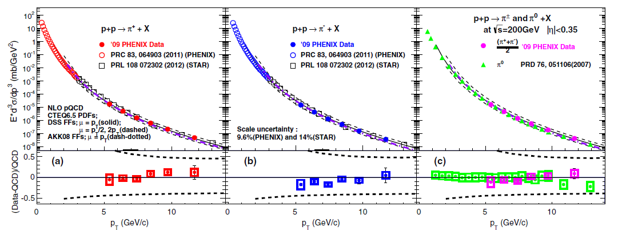
Inclusive pion production in
200 GeV p+p
PRD91, 032001 (2015)
Easiest hadron to produce—lots of data. Where are we?
Data points themselves 10-14% normalization uncertainty.
NLO pQCD calculations within ~+-20% for scale choice of p_{T}, p_{T} ~5-15 GeV/c.
Scale uncertainties ~+-50% for scale choice from p_{T}/2 to 2p_{T}. “Good” agreement.

Slide 4
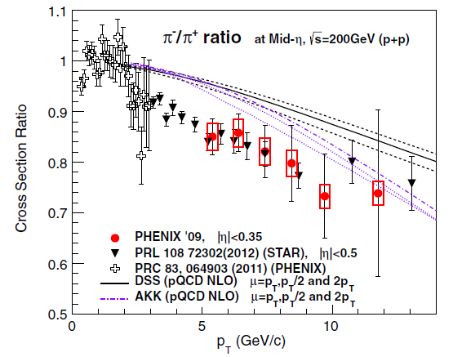
Charged pion ratio, 200 GeV p+p
Measured π-/π+ ratio significantly below NLO calculations for p_{T} ~3-10 GeV/c
  Data: Normalization uncertainties on cross sections cancel completely
  Calculation: Scale uncertainty greatly reduced
More powerful constraint to fit ratio directly in the future?
PRD91, 032001 (2015)

Slide 5
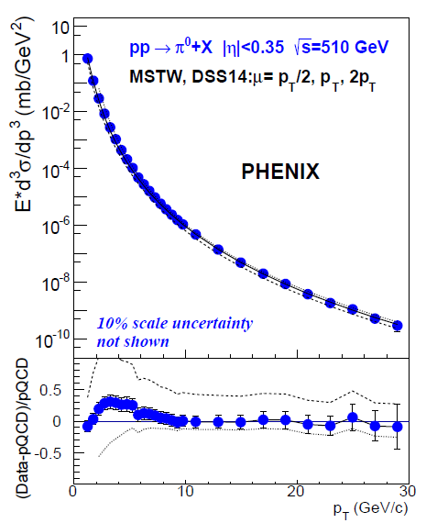
Scale uncertainty remains large for single-particle p+p cross sections even for
√s =510 GeV and p_{T} up to 30 GeV
Good agreement with NLO, but variation up to ~10-20% for scale choice p_{T}
Scale uncertainty ~+50%, -20%
Measured π-/π+ ratio at 200 GeV within ~15% of NLO calculation, but less “good” because of greatly reduced scale uncertainties
  Evidently other uncertainties relevant
What are most appropriate uncertainties to use in each case?
arXiv:1510.02317
Notes:
I’ve heard statements that the pT/2 to 2pT range of scale choices is unrealistically large for single-particle cross section calculations, but the measured ratio compared to the calculation indicates that there are significant uncertainties other than the scale uncertainty.

Slide 6
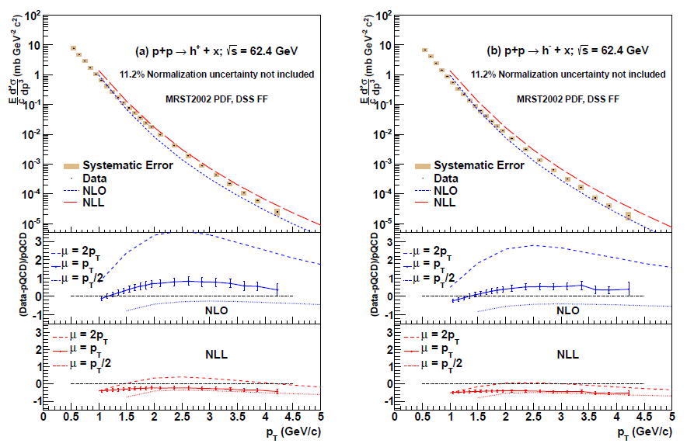
Midrapidity charge-separated hadrons in 62.4 GeV p+p: Reining in scale uncertainties with NLL resummation
Useful when appropriate…
PRD86, 092006 (2012)

Slide 7
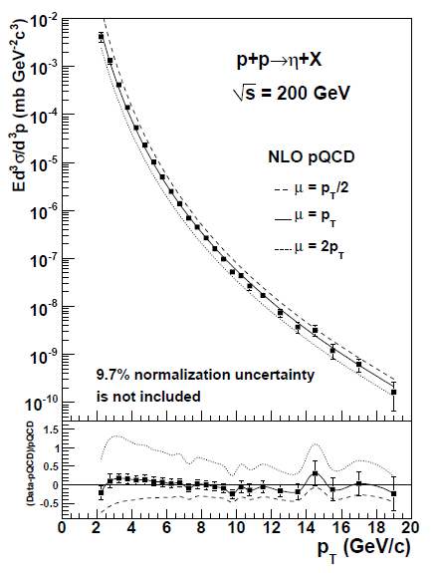

Eta mesons in 200 GeV p+p
Cross section data used in FF fit
NLO calculation for η/π⁰ ratio ~15% too low (no uncertainties shown)
PHENIX eta data and (earlier but consistent) π⁰ data were used in respective FF fits, but in π⁰ fit, PHENIX data normalization scaled within uncertainty in one direction, and in eta fit, scaled in other direction
Again, fitting ratio directly would provide stronger constraint
PRD83, 032001 (2011)

Slide 8
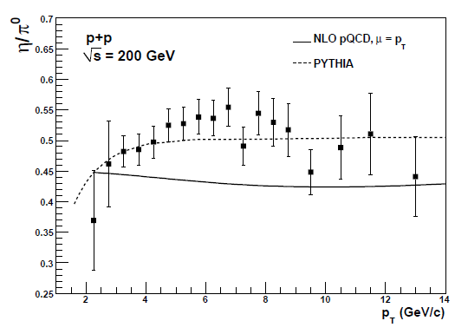
Eta mesons in 200 GeV p+p
Cross section data used in FF fit
NLO calculation for η/π⁰ ratio ~15% too low (no uncertainties shown)
PHENIX eta data and (earlier but consistent) π⁰ data were used in respective FF fits, but in π⁰ fit, PHENIX data normalization scaled within uncertainty in one direction, and in eta fit, scaled in other direction
Again, fitting ratio directly would provide stronger constraint
PRD83, 032001 (2011)

Slide 9
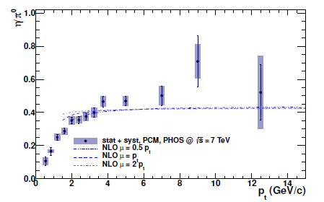

ALICE η/π⁰ ratio, p+p at 7 TeV
Same p_{T} range as PHENIX data
Calculated ratio again below data
Scale uncertainty on NLO calculation shown (nearly cancels!)
PLB717, 152 (2012)

Slide 10
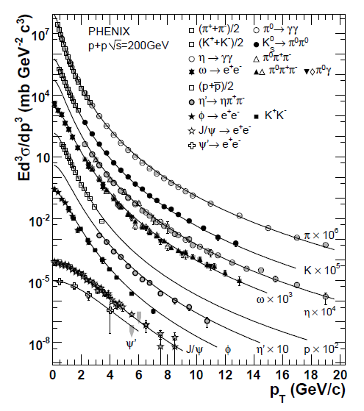
Eventually even more global global fits?
Perform FF parameterizations for even more particles simultaneously?
  Will constrain relative normalizations well!
  Eventually simultaneous pdf and FF extractions?
Can we learn by comparing similar mass states? E.g. about gluon FFs?
  Is a gluon any more or less likely to fragment into a kaon vs. an eta? Eta’ vs. phi vs. proton?
PRD83, 052004 (2011)

Slide 11
Eventually even more global global fits?
Perform FF parameterizations for even more particles simultaneously?
  Will constrain relative normalizations well!
  Eventually simultaneous pdf and FF extractions
Can we learn by comparing similar mass states? E.g. about gluon FFs?
  Is a gluon any more or less likely to fragment into a kaon vs. an eta? Eta’ vs. phi vs. proton?
PRD83, 052004 (2011)

Slide 12
Reflecting on assumptions:
What do we really know about lambdas?
uds: Could assume SU(3) symmetry, i.e. lambda has equal probability of fragmenting from u, d, or s
But a scattering u or d has lots of other “options.” Could assume decreased likelihood of lambda coming from u or d
(Lambda polarization coming later . . .)

Slide 13
Actually, what’s going on with baryons in general?
Are we satisfied with our “vacuum fragmentation” picture for high-p_{T} baryon production?
For high-p_{T} mesons usually think of single scattered quark, with partner coming from q-qbar pair
Can thinking about gluon fragmentation to mesons help us think about baryon production?

Slide 14
Even more global global fits: Probabilities/Sum rules
FFs and probabilities: given a particular flavor parton, the FF related to the probability it’ll fragment into a particular final-state hadron (as a function of z)
But in a sense they’re parameterized the other way around: in all the data that are fit, you’re given a particular final-state hadron
At some point, if (nearly) all particles measured within reconstructed jet, could you potentially constrain sum of probabilities for each flavor parton to be (nearly) 1?

Slide 15
Even more global global fits: Probabilities/Sum rules
FFs and probabilities: given a particular flavor parton, the FF related to the probability it’ll fragment into a particular final-state hadron (as a function of z)
But in a sense they’re parameterized the other way around: in all the data that are fit, you’re given a particular final-state hadron
At some point, if (nearly) all particles measured within reconstructed jet, could you potentially constrain sum of probabilities for each flavor parton to be (nearly) 1?

Slide 16
Even more global global fits: Probabilities/Sum rules
FFs and probabilities: given a particular flavor parton, the FF related to the probability it’ll fragment into a particular final-state hadron (as a function of z)
But in a sense they’re parameterized the other way around: in all the data that are fit, you’re given a particular final-state hadron
At some point, if (nearly) all particles measured within reconstructed jet, could you potentially constrain sum of probabilities for each flavor parton to be (nearly) 1?

Slide 17
Even more global global fits: Probabilities/Sum rules
FFs and probabilities: given a particular flavor parton, the FF related to the probability it’ll fragment into a particular final-state hadron (as a function of z)
But in a sense they’re parameterized the other way around: in all the data that are fit, you’re given a particular final-state hadron
At some point, if (nearly) all particles measured within reconstructed jet, could you potentially constrain sum of probabilities for each flavor parton to be (nearly) 1?
Don’t currently have data with all particles identified within a fully reconstructed jet, but plenty to do in the meantime . . .

Slide 18
Going beyond “traditional” 1D, collinear fragmentation to single hadrons
(but still in “vacuum”)
Recent advances via
  Dihadron (interference) FF
  Collinear twist-3 functions to describe hadronization
  Transverse-momentum-dependent FFs

Slide 19
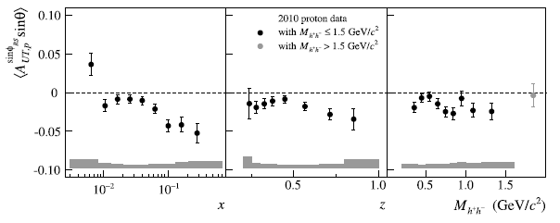
Dihadron interference FF
COMPASS, PLB736, 124 (2014)
Pion pair hadronizes from same quark; correlation with quark transverse spin; chiral-odd
Clear nonzero effects in e+e- and semi-inclusive DIS
  Transversity x IFF in SIDIS

Slide 20
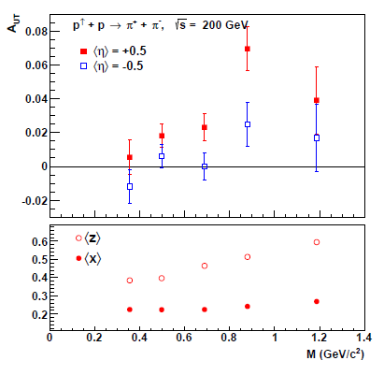
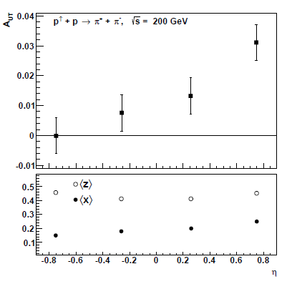
Transverse single-spin asymmetry in dihadron production, 200 GeV p+p
STAR, arXiv:1504.00415
Clear nonzero asymmetry observed; pseudorapidity dependence
Sensitive to transversity x IFF

Slide 21
Collinear, twist-3 multiparton correlations in hadronization
Interference between a (quark+gluon) hadronizing and only a quark
Similarly, interference between (gluon+gluon) and only a single gluon
Can generate transverse single-spin asymmetries
Increasing phenomenology efforts in recent years . . .

Slide 22
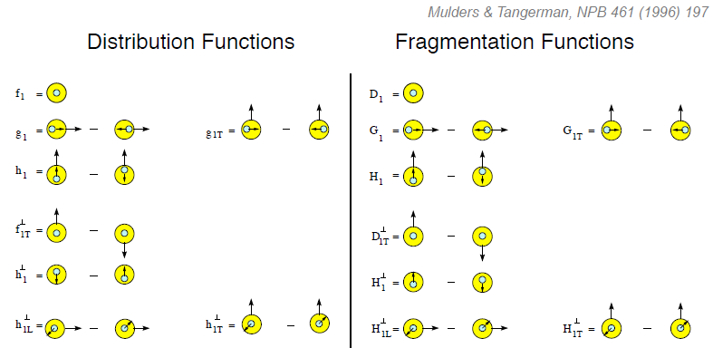
Twist-2 fragmentation functions
Unpolarized
Spin-spin correlations
Polarizing FF
Spin-momentum correlations
Collins

Slide 23
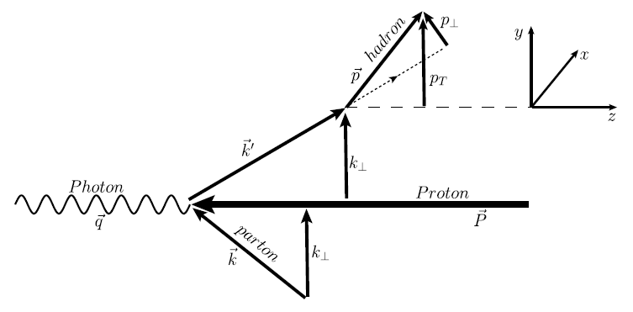
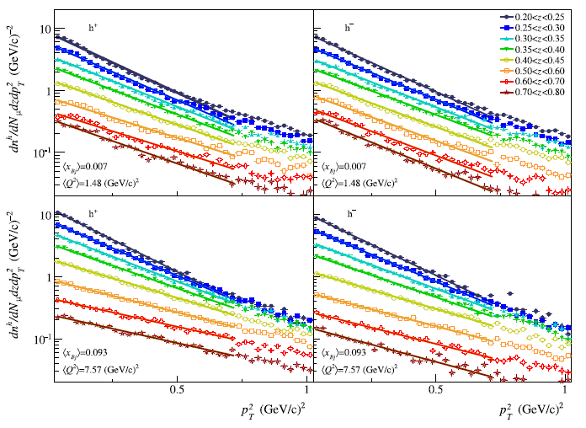
Semi-inclusive DIS TMD multiplicities
COMPASS, EPJ C73, 2531 (2013)
Nonidentified h+, h-multidifferential in p_{T}², x, z, Q²

Slide 24
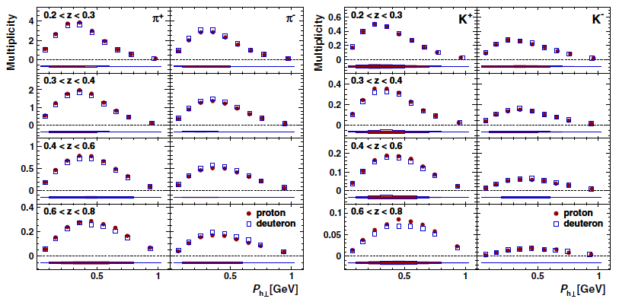
Semi-inclusive DIS TMD multiplicities
HERMES, PRD87, 074029 (2013)
Identified π+-, K+-, multidifferential in p_{T}, z; x, z; Q², z

Slide 25
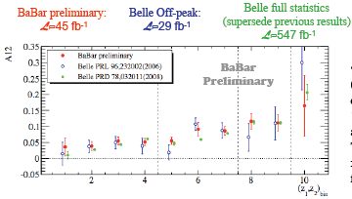
TMD spin-momentum correlation in hadronization: Collins FF
BaBar published ref. PRD90, 052003 (2014)
Collins x Collins
e⁺e⁻
Measured for pions in e+e- by BELLE and BaBar: 5-20% effect

Slide 26
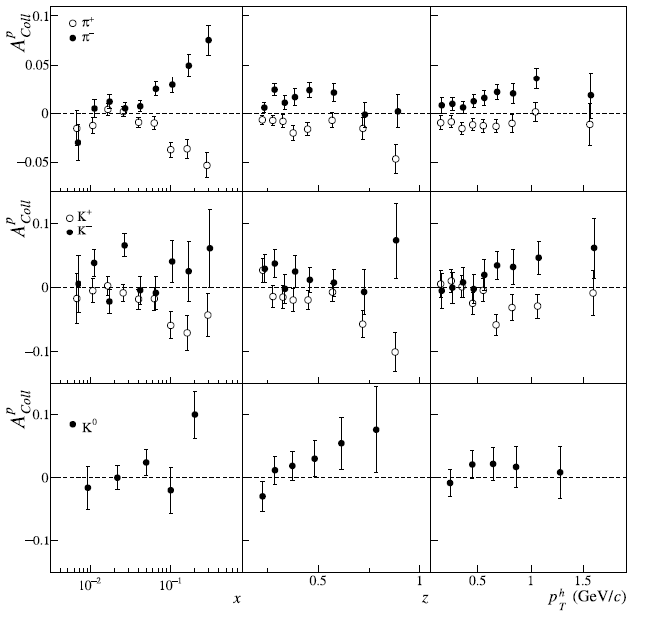
Collins asymmetries in semi-inclusive DIS
COMPASS,
PLB744, 250 (2015)
Non-zero for π⁺, π⁻ .
More data needed for kaons.
Transversity x Collins

Slide 27
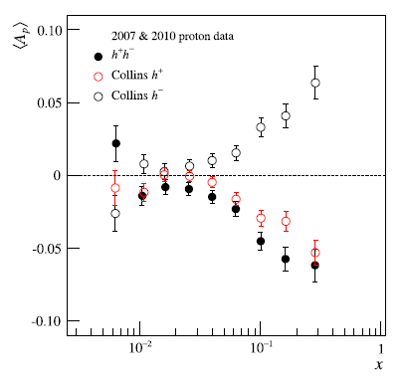
Similarity of Collins and dihadron FF asymmetry
COMPASS, PLB736, 124 (2014)

Slide 28
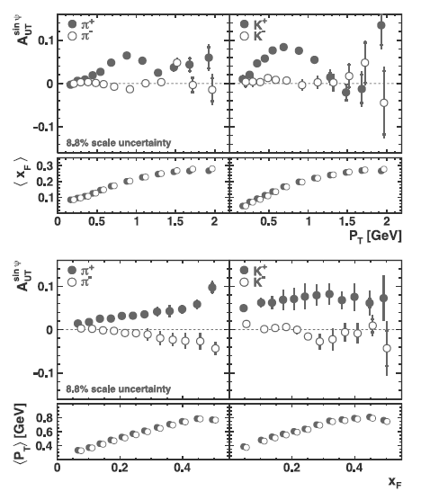
Inclusive hadron transverse single-spin asymmetries in e+p
No scattered electron measured
Shown here as function of p_{T} and x_{F}
Also measured doubly differentially
Clear nonzero asymmetries with interesting dependencies
HERMES, PLB728, 183 (2014)

Slide 29
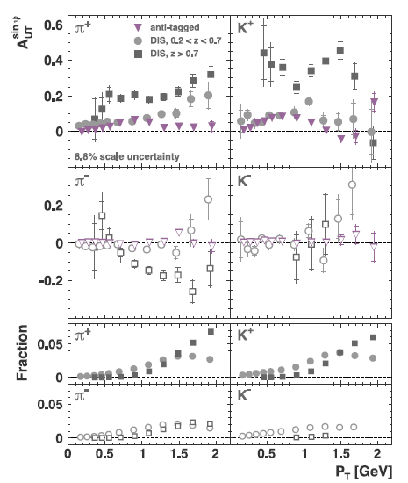
Inclusive hadron transverse single-spin asymmetries in e+p
Striking enhancement if measure scattered electron
HERMES, PLB728, 183 (2014)

Slide 30
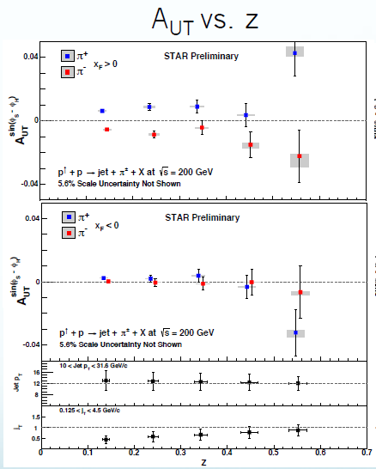
Collins-type measurement in 200 GeV polarized p+p
Angular distribution of neutral pions within jet
Nonzero for x_{F}>0 (but x_{F} not large here)
STAR preliminary

Slide 31
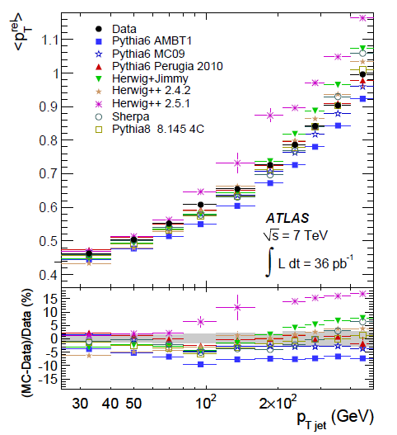
Mean relative p_{T} of hadrons in a jet versus hard scale, 7 TeV p+p
What can be learned about TMD FFs from these kinds of single-jet measurements?
  E.g. Collins FF rigorously defined in terms of relative particle distributions within 2 jets (as I understand it)
And—can we learn any physics from comparison to Monte Carlo generators??
  Is the fact that they can be successfully tuned (or not) to experimental data useful information?
arXiv:1109.5816

Slide 32
Hyperon polarization from unpolarized collisions
PRL36, 1113 (1976)
1976 lambda polarization discovery: p+Be, 300 GeV beam
Polarization transverse to production plane up to ~20% for forward-angle lambda production; Polarizing TMD FF?
Confirmed 1977 at CERN, p+Pt, 24 GeV beam (and by various proton-nucleus and proton-proton experiments afterwards . . .)

Slide 33
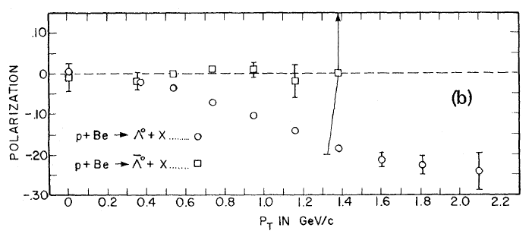
No observed antilambda polarization
p+Be, 400 GeV beam
PRL41, 607 (1978)
1978: No antilambda polarization
And lambda polarization now measured up to p_{T} = 2.2 GeV, polarization ~25% (Different sign convention)

Slide 34
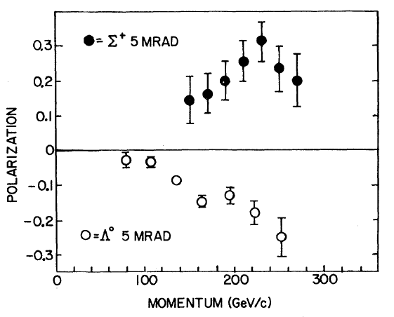
Σ⁺ polarized with opposite sign
PRL46, 803 (1981)
1981: p+Be, 400 GeV beam

Slide 35
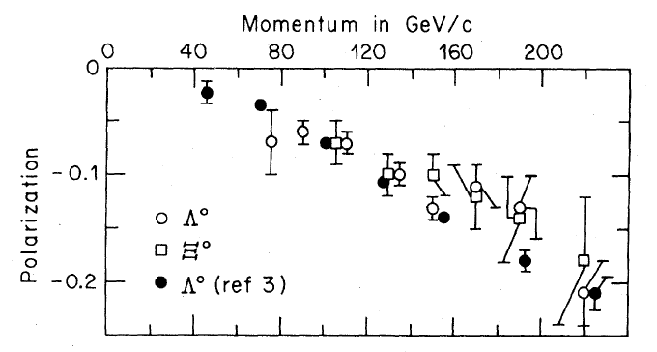
Ξ ⁰polarization similar to Λ⁰
PRL51, 2025 (1983)
1983: p+Be, 400 GeV beam
Similar results for p+Cu and p+Pb

Slide 36
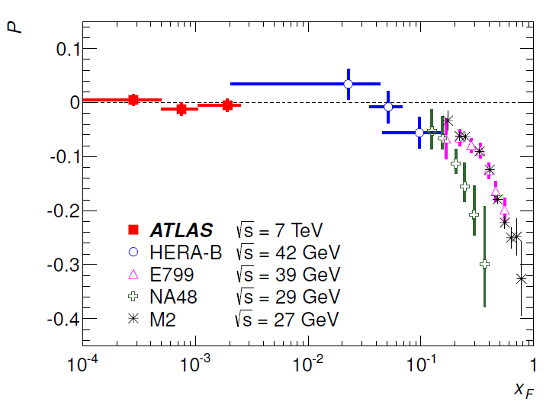
x_{F} dependence of lambda polarization in hadronic collisions
Same sign and general x_{F} dependence for neutron beams
But for K- and Σ- beams, positive polarization at positive x_{F}
And for π- beam, positive polarization but at negative x_{F}!
Consistent with zero for π+ and K+ beams
Proton beams
PRD91, 032004 (2015)

Slide 37
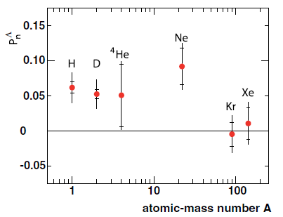
Lambda polarization observed in semi-inclusive DIS
Nonzero in both forward and backward directions
But consistent with zero in e+e- . . .
HERMES, PRD90, 072007 (2014)

Slide 38
Testing TMD-factorization breaking/ color entanglement: p+p → hadrons
2010 prediction by Rogers and Mulders that nonperturbative objects no longer factorize from one another when have p+p → hadrons and observable sensitive to nonperturbative transverse momentum
  PRD 81, 094006 (2010)
Try to test by measuring out-of-plane momentum component in nearly back-to-back particle production in p+p

Slide 39
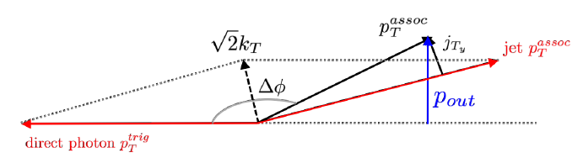
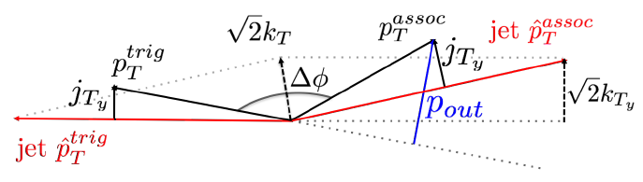
Direct photon – hadron and π⁰ – hadron correlations in p+p
Additional nonperturbative transverse momentum in π⁰ – charged hadron correlations

Slide 40
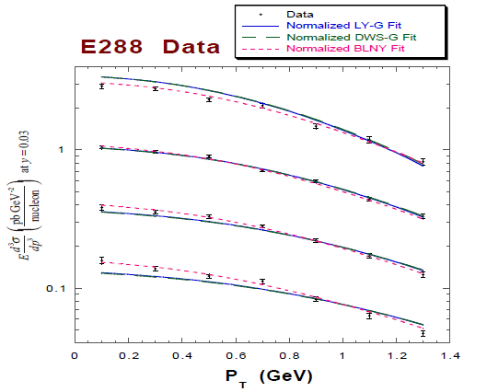
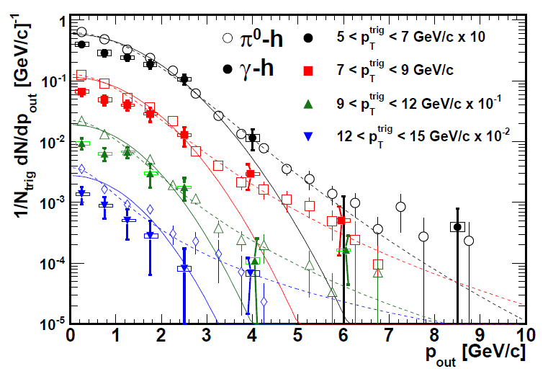
Testing TMD-factorization breaking/ color entanglement: p+p → hadrons
PRD 67, 073016 (2003)
PRD82, 072001 (2010)
Quark-antiquark annihilation to lepton pairs
Out-of-plane momentum component
Drell-Yan p_{T} for different hard scales:
no entanglement expected
π⁰-charged hadron and γ-charged hadron correlations for different hard scales: entanglement expected. Gaussian shape at low p_{out}
Look for different evolution with hard scale. . . In progress!

Slide 41
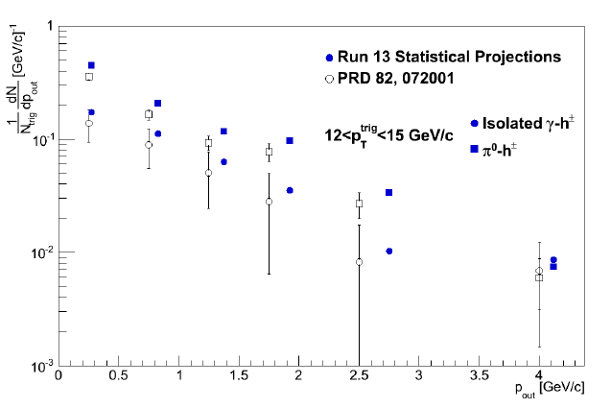
Much better data coming soon from 510 GeV p+p

Slide 42
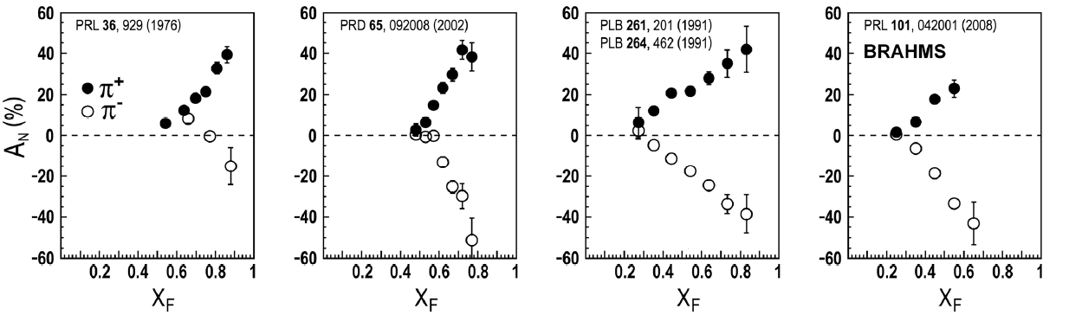
Huge spin asymmetries in p+p → hadrons: Does color entanglement play a role??
ANL
√s=4.9 GeV
BNL
√s=6.6 GeV
FNAL
√s=19.4 GeV
RHIC
√s=62.4 GeV
left
right

Slide 43
Higher-density partonic environments
No longer (only) “vacuum” fragmentation → Additional hadronization mechanism(s)!

Slide 44
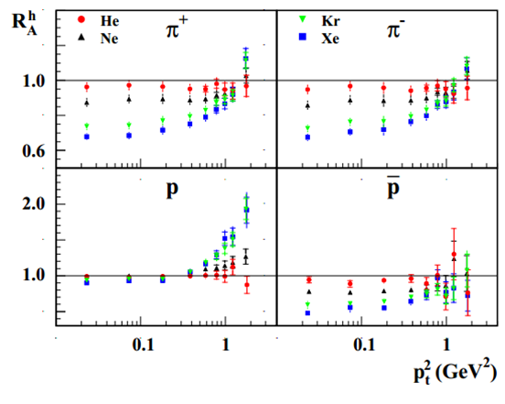
Nuclear semi-inclusive DIS
Nuclear modification of particle production
Enhancement of protons compared to pions in e+A with respect to scaled e+p
HERMES, NPB780, 1 (2007)

Slide 45
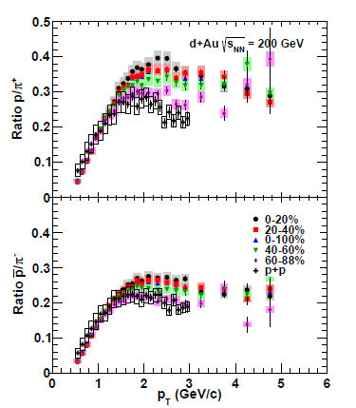
Centrality-dependent baryon enhancement in d+Au compared to p+p
Precision d+Au data for identified charged hadrons in bins of centrality
New hadron production mechanism enabled by presence of additional partons/ nucleons
  Parton recombination?
Strong centrality dependence despite small range of N_{part} and N_{coll} values in d+Au
Well-known centrality-dependent baryon enhancement in Au+Au
PRC88, 024906 (2013)

Slide 46
Centrality-dependent baryon enhancement in d+Au compared to p+p
Precision d+Au data for identified charged hadrons in bins of centrality
New hadron production mechanism enabled by presence of additional partons/ nucleons
  Parton recombination?
Strong centrality dependence despite small range of N_{part} and N_{coll} values in d+Au
Well-known centrality-dependent baryon enhancement in Au+Au
PRC88, 024906 (2013)

Slide 47
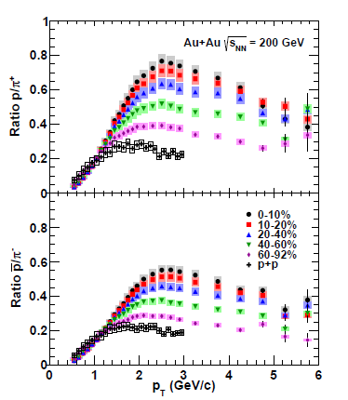
Centrality-dependent baryon enhancement in d+Au compared to p+p
Precision d+Au data for identified charged hadrons in bins of centrality
New hadron production mechanism enabled by presence of additional partons/ nucleons
  Parton recombination?
Strong centrality dependence despite small range of N_{part} and N_{coll} values in d+Au
Well-known centrality-dependent baryon enhancement in Au+Au
PRC88, 024906 (2013)

Slide 48
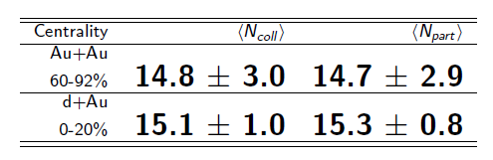
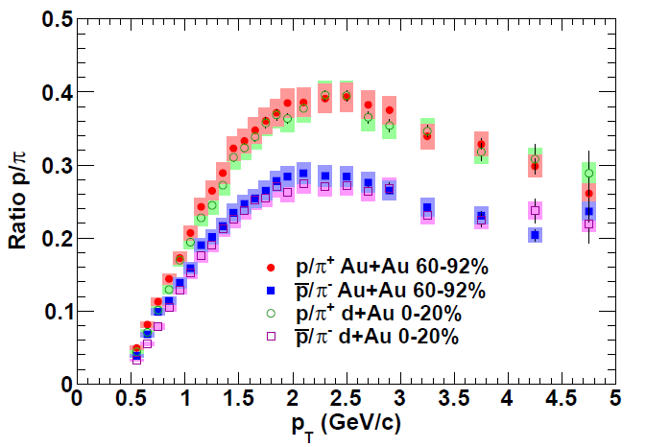
Comparing central d+Au with peripheral Au+Au
Both shape and magnitude identical!
Suggests common mechanism(s) for baryon production in the two systems
PRC88, 024906 (2013)

Slide 49
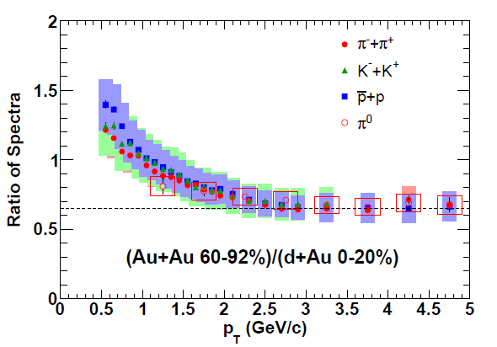
Comparing central d+Au with peripheral Au+Au
Direct ratio of spectra is flat above 2.5 GeV and species independent
  Baryon enhancement is quantitatively the same
  Ratio significantly less than unity—suggests energy loss for all species in peripheral Au+Au
PRC88, 024906 (2013)
No scaling applied

Slide 50
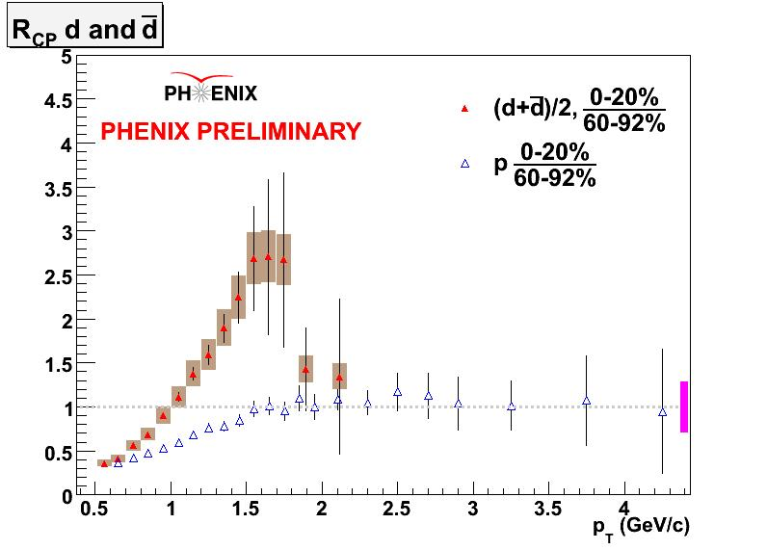
Bound states of hadronic bound states:
Creating nuclei!
Au+Au at 200 GeV
(Deuteron p_{T} divided by 2)

Slide 51
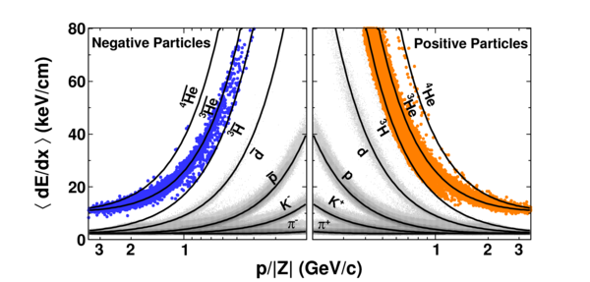
Bound states of hadronic bound states:
Creating nuclei!
STAR
Nature 473, 353 (2011)

Slide 52
Bound states of hadronic bound states:
Creating nuclei, and building up the world…
Heavy ion collisions let us create nuclei—and antinuclei!—up to ⁴He
  Big Bang Nucleosynthesis in the lab . . .
  Building up the antiworld as well . . .
  Cosmological implications?
Do we understand enough by now about QCD bound states—and nucleons specifically—to start to think more about going from first principles to the “van der Waals” forces that bind color-neutral nucleons into nuclei??

Slide 53
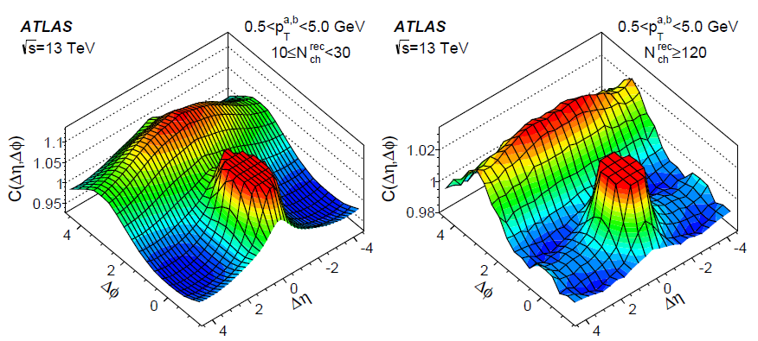
High-multiplicity p+p shows features similar to p+A and A+A collisions
arXiv:1509.04776
Long-range Δη correlation in 0.5<p_{T}<5 GeV charged hadron production in away-side “jet”, enhanced at even higher multiplicities

Slide 54
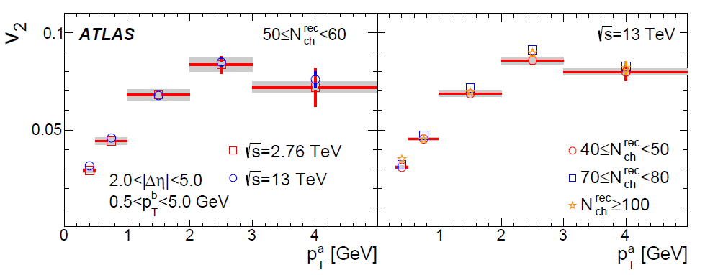
High-multiplicity p+p: p_{T}-dependent cos 2φ modulation
arXiv:1509.04776
v₂ = amplitude of cos 2φ modulation
Heavy ion community thinks of hydrodynamic flow . . .

Slide 55
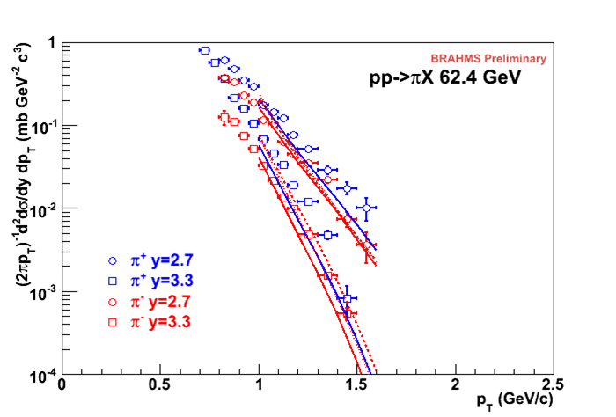
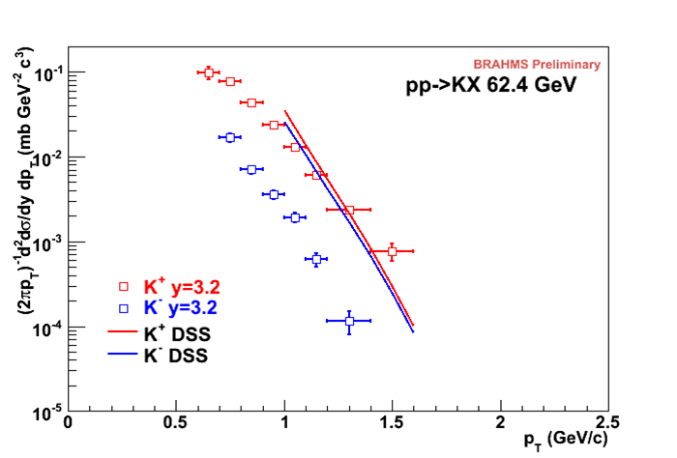
Moderate-p_{T} forward charged hadron production in 62.4 GeV p+p:
Also moving away from vacuum fragmentation?

Slide 56
“Target fragmentation” region
Electron-Ion Collider will map out well
  Collider geometry
Connections to
  “Underlying event” in hadronic collisions
  Forward hadron production in p+p
  Cosmic ray physics
  Fracture functions
  Low-z region in e+e-??

Slide 57
Other thoughts: Heavy flavor
Open heavy flavor—vacuum fragmentation picture
Heavy quarkonium states—different thinking
  Handles on production via p_{T} dependence, polarization, in-medium modification
  For very high p_{T} production in hadronic collisions, return to vacuum fragmentation picture? How to handle multiple hard scales in calculations?

Slide 58
Other thoughts: Hadron spectroscopy; Diffractive hadron production
Different ways of thinking about hadron production
Can we learn from these ways of thinking, and move toward unifying spectroscopy and hard scattering/fragmentation pictures??
Physics and community links through diffraction??

Slide 59
A cyclical process
Proliferation of observations and ideas
Synthesis

Slide 60
Final remarks
Efforts on hadronization ramping up! (And thus this workshop . . .)
Wealth of data available / potentially available from wide variety of facilities
  e+e- from BELLE, BaBar. Higgs factory would provide complementary scale to B factories! 3-jet events to study hadronization from gluons?
  SIDIS on proton and nuclei at JLab, COMPASS, HERMES. EIC will provide first-ever e+A and polarized e+p collider data → many opportunities!
  p+p, p+A, A+A at RHIC and LHC. Very forward hadronic collisions at LHCb and NA61. Cosmic ray data?

Slide 61
Final remarks
Efforts on hadronization ramping up! (And thus this workshop . . .)
Wealth of data available / potentially available from wide variety of facilities
  e+e- from BELLE, BaBar. Higgs factory would provide complementary scale to B factories! 3-jet events to study hadronization from gluons?
  SIDIS on proton and nuclei at JLab, COMPASS, HERMES. EIC will provide first-ever e+A and polarized e+p collider data → many opportunities!
  p+p, p+A, A+A at RHIC and LHC. Very forward hadronic collisions at LHCb and NA61. Cosmic ray data?
Looking forward to lots of good discussion this week, and lots of progress over next 5-10 years!

Slide 62
Extra

Slide 63
Charge-separated hadrons in 62.4 GeV p+p: Reining in scale uncertainties with NLL resummation

Slide 64
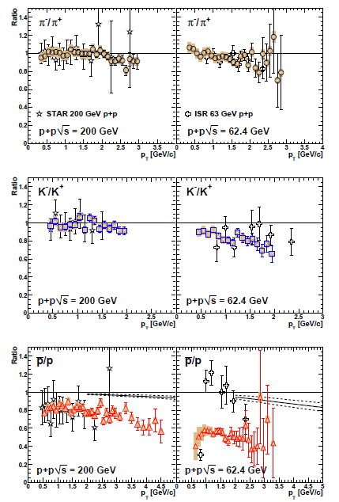
π, K, p charge ratios in 200 and 62.4 GeV p+p
For antiproton-to-proton ratio, comparison shown to NLO calculations using DSS FFs
PRC83, 064903 (2011)

Slide 65
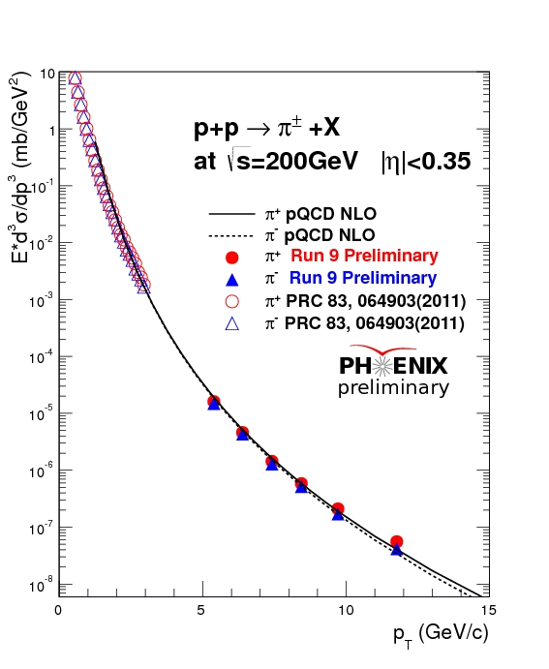
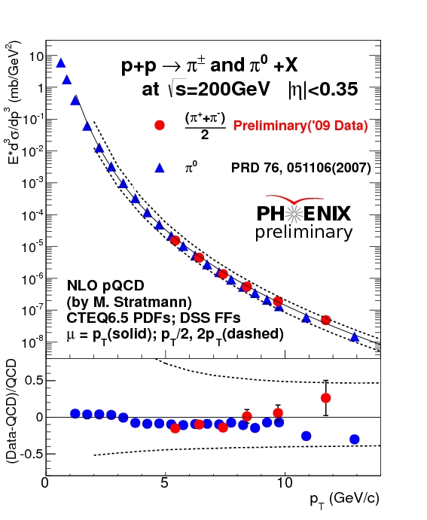
PHENIX pions, 200 GeV p+p

Slide 66
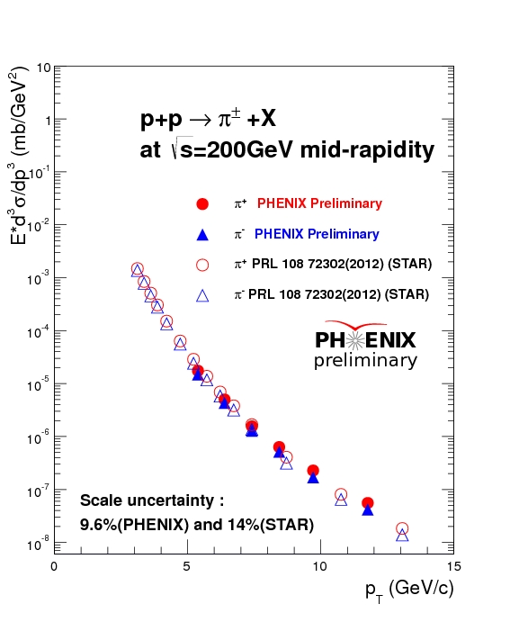
Charged pions at PHENIX and STAR

Slide 67
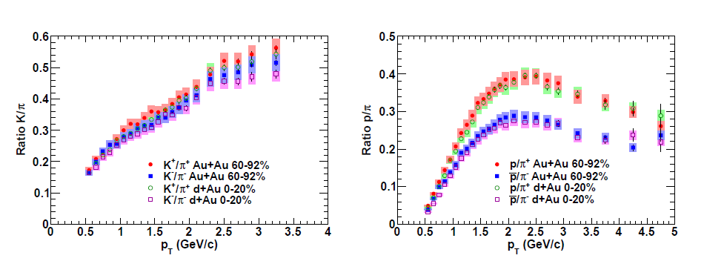
Comparing central d+Au with peripheral Au+Au
PRC88, 024906 (2013)
Both shape and magnitude identical!

Slide 68



Electron-Ion Collider
A facility to bring this new era of quantitative QCD to maturity!
How can QCD matter be described in terms of the quark and gluon d.o.f. in the field theory?
How does a colored quark or gluon become a colorless object?
Study in detail
  “Simple” QCD bound states: Nucleons
  Collections of QCD bound states: Nuclei
  Hadronization

Slide 69

Enhancement of strange meson production in central Au+Au
K/π ratio higher in more central Au+Au than p+p, increases with centrality
K/π ratio in d+Au same as p+p for all centralities

Slide 70

Enhancement of strange meson production in central Au+Au
K/π ratio higher in more central Au+Au than p+p, increases with centrality
K/π ratio in d+Au same as p+p for all centralities

Slide 71

Strange meson production in Au+Au
In Au+Au, kaon and pion most separated in central events
Phi seems to stay between kaon and proton
In d+Au, charged pions and kaons consistent with each other, and phi exhibits minimal modification
Suggests additional strange meson production mechanism in central Au+Au compared to d+Au or p+p

Slide 72

Strange meson production in Au+Au
In Au+Au, kaon and pion most separated in central events
Phi seems to stay between kaon and proton
In d+Au, charged pions and kaons consistent with each other, and phi exhibits minimal modification
Suggests additional strange meson production mechanism in central Au+Au compared to d+Au or p+p

Slide 73
How can we use hadronic collision data to help us understand more about partons turning into hadrons from . . .
Hard scattering and “traditional” fragmentation
A denser partonic environment and partonic recombination(?)
A thermalized, deconfined environment
Bound states of hadronic bound states: nucleon coalescence(?)

Slide 74

Testing TMD-factorization breaking/color entanglement: p+p → hadrons
Look for contradiction with predictions for the case of no color entanglement
But first need to parameterize (unpolarized) transverse-momentum-dependent pdfs from world data
  Better constraints on unpolarized predictions because more available data
CDF Z production
PRD86, 052010 (2012)

Slide 75


Testing TMD-factorization breaking/color entanglement: p+p → hadrons
Look for contradiction with predictions for the case of no color entanglement
But first need to parameterize (unpolarized) transverse-momentum-dependent pdfs from world data
  Better constraints on unpolarized predictions because more available data
CDF Z production
PRD86, 052010 (2012)
dσ/dp_{T}
CAA,
T.C. Rogers, in progress
dσ/dp_{T}
p+p → μ⁺+μ⁻+X
√s = 1.96 TeV
√s = 0.039 TeV
p_{T} (GeV/c)
p_{T} (GeV/c)

Slide 76
Testing TMD-factorization breaking/color entanglement: p+p → hadrons
Quark-antiquark annihilation to lepton pairs
p+A → μ⁺+μ⁻+X
for different invariant masses:
No color entanglement expected
Landry, Brock, Nadolsky, Yuan, PRD 67, 073016 (2003)
Get predictions from fits to data where no entanglement expected

Slide 77

COMPASS multiplicity data

Slide 78

Bose-Einstein correlations for nuclear semi-inclusive DIS
Sensitive to spatial separation of production of the two particles
No nuclear dependence found within uncertainties
HERMES, arXiv:1505.03102

Slide 79

Charged hadron production within jet, 7 TeV p+p
ATLAS, jet p_{T} 25-500 GeV

Slide 80

Relative p_{T} of charged hadrons in a jet, 7 TeV p+p

Slide 81

p+p → hadron asymmetries persist up to
√s=0.5 TeV and p_{T} = 7 GeV!
Effects persist to kinematic regimes where perturbative QCD techniques clearly apply
p_{T} = 8 GeV
→ Q² ~ 64 GeV²!
Note x_{F} = 0.24-0.32 here, where asymmetries approached zero on lower-energy plots—need more-forward measurements at high energies!
π⁰

