Slide 1

Transversity 2014 Closing Remarks:
Moving Forward in the Era of Quantitative QCD
Christine A. Aidala
University of Michigan
Chia, Italy
June 13, 2014

Slide 2
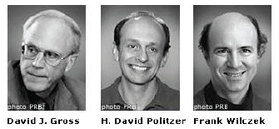
QCD: How far have we come?
“You can’t anticipate all the things nature will do with that Lagrangian.” – L. Bland
Three-decade period after initial birth of QCD dedicated to “discovery and development”
→ Symbolic closure: Nobel prize 2004 - Gross, Politzer, Wilczek for asymptotic freedom
Now early years of second phase:
quantitative QCD!
Notes:
[While some a generation or so ahead of me have enjoyed very exciting careers [centered on][based around] the discovery and development of QCD, …]

Slide 3
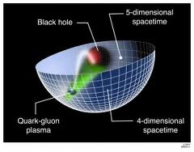
Advancing into the era of quantitative QCD: Theory has been forging ahead!
In perturbative QCD, since 1990s starting to consider detailed internal QCD dynamics that parts with traditional parton model ways of looking at hadrons—and perform phenomenological calculations using these new ideas/tools!
E.g.:
  Various resummation techniques
  Non-linear evolution at small momentum fractions
  Non-collinearity of partons with parent hadron
  Spatial distributions of partons in hadrons
Non-perturbative methods:
  Lattice QCD less and less limited by computing resources—since 2010 starting to perform calculations at the physical pion mass (after 36 years!). Plus recent new ideas on how to calculate previously intractable quantities.
  AdS/CFT “gauge-string duality” an exciting recent development as first fundamentally new handle to try to tackle QCD in decades!

Slide 4
Effective field theories
QCD exhibits different behavior at different scales—effective field theories are useful approximations within these different regimes
  Color Glass Condensate – high energies, high densities
  Soft-Collinear Effective Theory – new insights into performing complicated perturbative calculations very quickly
  Heavy Quark Effective Theory, Non-Relativistic QCD, . . .
  Many effective theories for nonperturbative QCD – chiral symmetry breaking, . . .

Slide 5
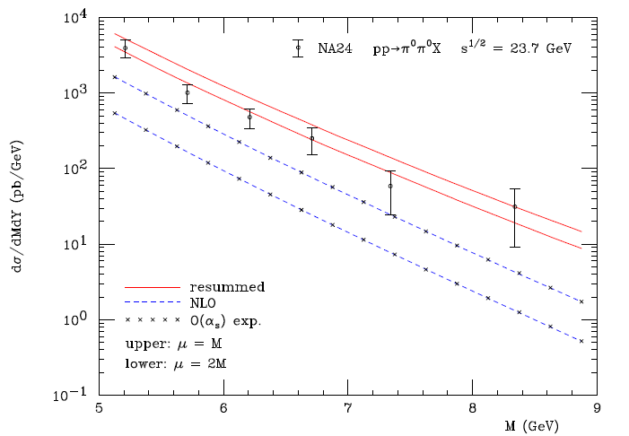
Example: Threshold resummation to extend pQCD to lower energies
For observables with two different scales, sum logs of their ratio to all orders
pp→π⁰π⁰X
M (GeV)
Almeida, Sterman, Vogelsang PRD80, 074016 (2009)

Slide 6
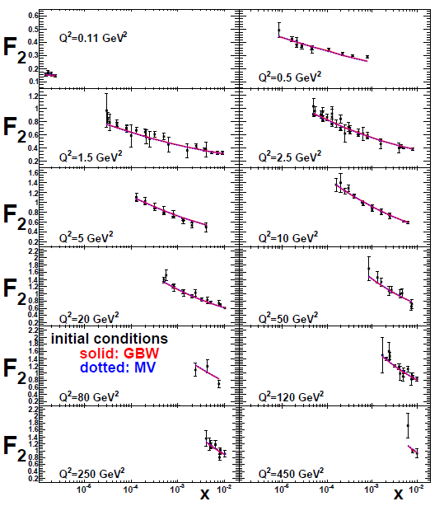
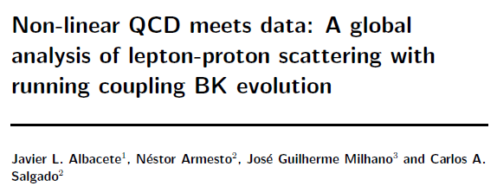
Example: Phenomenological applications of a non-linear gluon saturation regime at low x
Phys. Rev. D80, 034031 (2009)
Basic framework for non-linear QCD, in which gluon densities are so high that there’s a non-negligible probability for two gluons to combine, developed ~1997-2001. But had to wait until “running coupling BK evolution” figured out in 2007 to compare directly to data!
Fits to proton structure function data at low parton momentum fraction x.

Slide 7
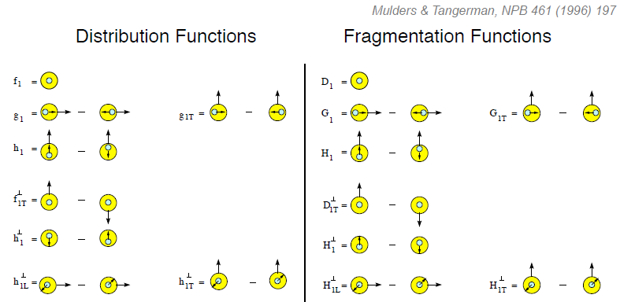
Example: Dropping the simplifying assumption of collinearity
Collinear
Worm gear
Collinear
Transversity
Sivers
Polarizing FF
Boer-Mulders
Pretzelosity
Collins
Worm gear
Many describe spin-momentum correlations: S•(p₁×p₂)

Slide 8
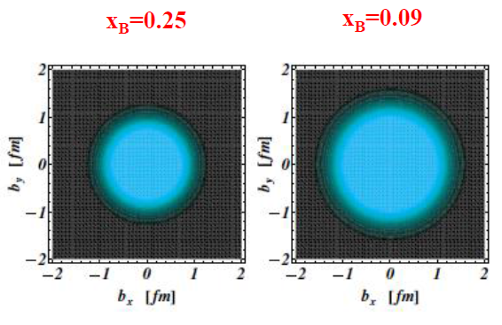
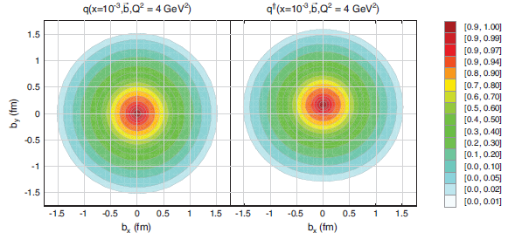
Example: Exploring spatial distributions
Guidal, Moutarde,
Vanderhaeghen,
Rept. Prog. Phys. 76 (2013) 066202
CLAS HERMES
Related talks by N. d’Hose, P. Kroll, G. Goldstein, A. Mukherjee, S. Pisano, A. Kim, A. Movsisyan, O. Eyser
Sea quark polarized sea quark
X_{B} =0.001
Mueller, 2011
Slide from N. d’Hose (backups)

Slide 9
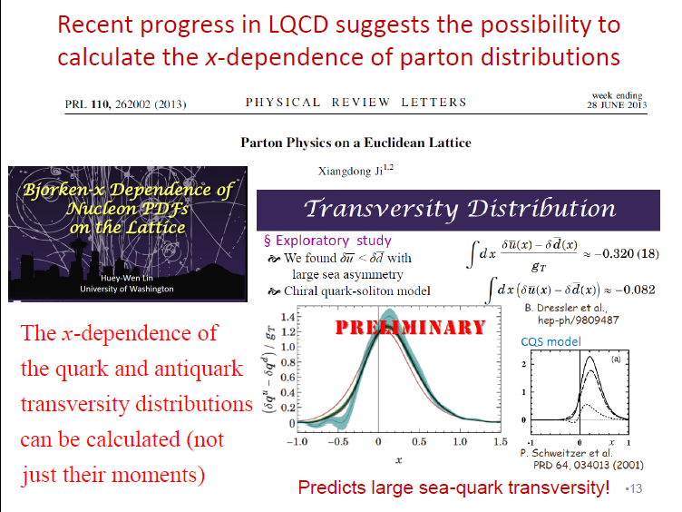
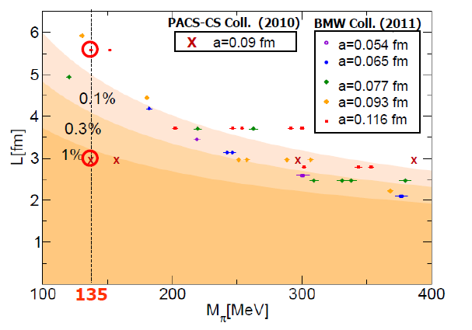
Example: Progress in lattice
Slide from J.-C. Peng
T. Hatsuda,
PANIC 2011
PACS-CS: PRD81, 074503 (2010)
BMW: PLB701, 265 (2011)

Slide 10
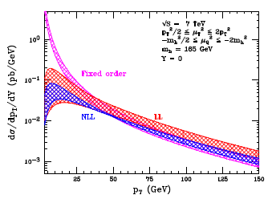
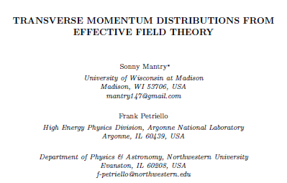
Example: Effective field theories
Soft Collinear Effective Theory
– p_{T} distribution for gg→Higgs
Higgs vs. p_{T}
arXiv:1108.3609
“Modern-day ‘testing’ of (perturbative) QCD is as much about pushing the boundaries of its applicability as about the verification that QCD is the correct theory of hadronic physics.”
– G. Salam, hep-ph/0207147 (DIS2002 proceedings)
Related talks by I. Scimemi, M. Echevarria, A. Idilbi

Slide 11
Experimental advances
More sophisticated observables
  E.g. angular distributions, spin dependence, multiparticle final states, . . .
  Often sensitive to parton dynamics
Multidifferential measurements
  E.g. simultaneously in x, Q², p_{T}
→ Demand more of theoretical calculations!

Slide 12
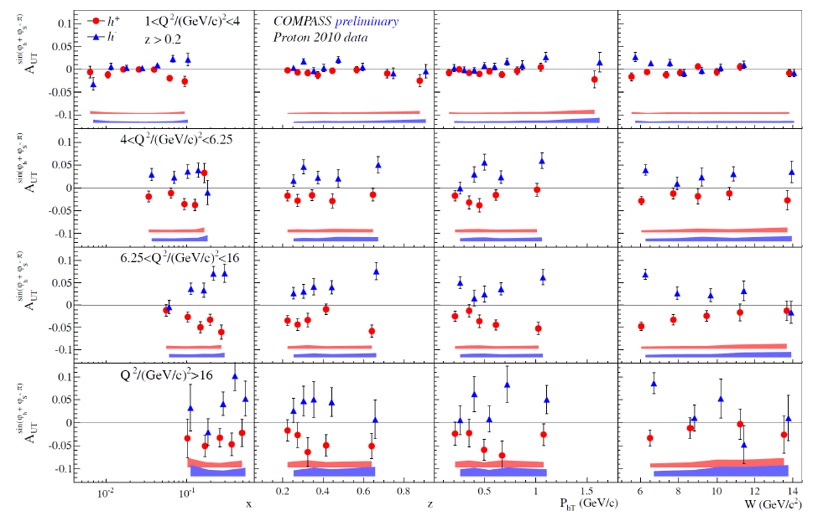
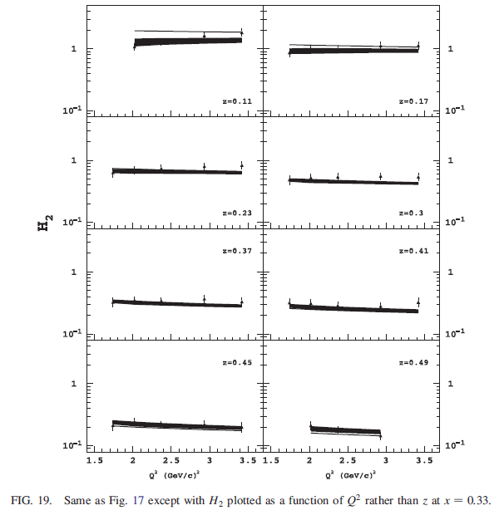
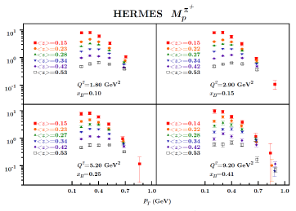
Multidifferential data: SIDIS
Talks by M. Contalbrigo, A. Bressan, G. Karyan, N. Makke, B. Parsamyan, C. Braun, C. van Hulse, A. Puckett, S. Pisano; O. Eyser
JLab Hall B
O. Gonzalez Hernandez SIDIS phenomenology talk:
1341 points HERMES, 5385 points COMPASS!

Slide 13
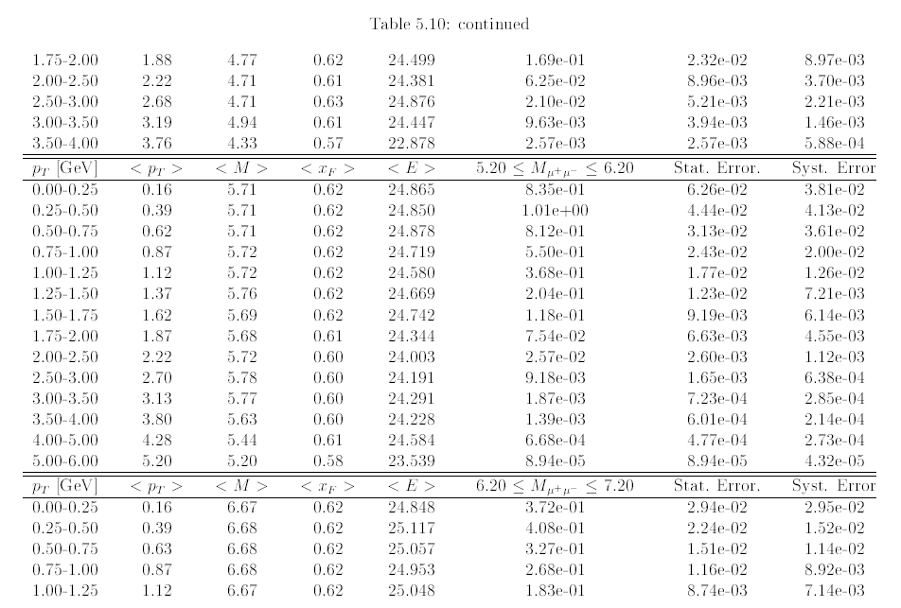
Multidifferential data: E866 D-Y
From J. Webb thesis.
1 of 26 pages(!) of similar tables.
D-Y cross section for p+p, p+d multidifferential in M, x_{F}, p_{T}

Slide 14
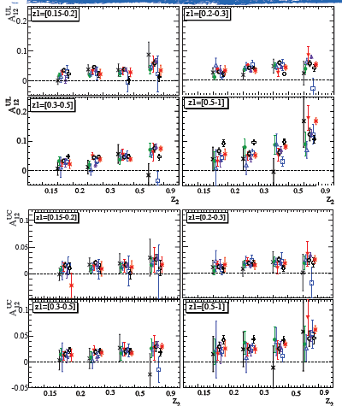
Multidifferential data: e+e-
Talks by I. Garzia, M. Grosse Perdekamp, F. Giordano
BABAR
BELLE
(Okay, the BELLE hadron multiplicities aren’t multidifferential (yet), but they’re still quite impressive!)

Slide 15
Understanding the theory doesn’t mean knowing how to do phenomenology
Current example: TMD evolution . . .
  Talks by S. Melis, J. Collins, W. Vogelsang, L. Gamberg, I. Scimemi, M. Echevarria, A. Prokudin, A. Signori, O. Gonzalez Hernandez, O. Teryaev (9 presentations—only 1 at Transversity 2011!)
Lots of (sometimes animated!) debates
  Means we’ve now advanced to the point of worrying about things we didn’t even consider several years ago → Progress!

Slide 16

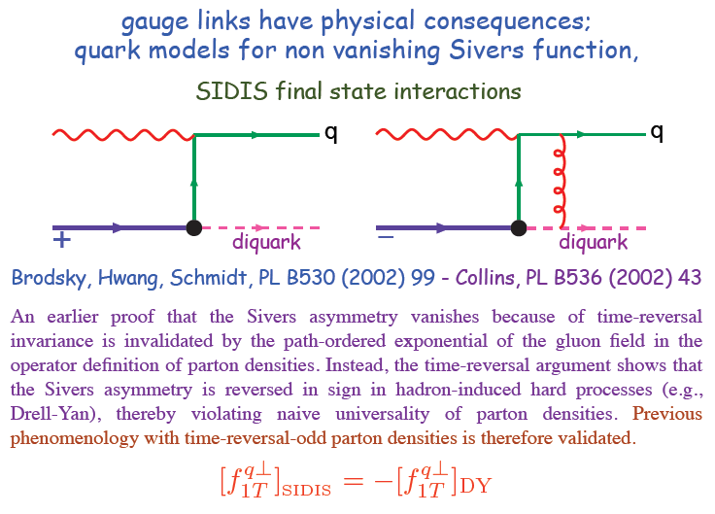
Gauge links have physical consequences
Collins, 1993
From M. Anselmino
Talks on polarized D-Y by L. Bland, A. Vossen, J.-C. Peng, M. Chiosso, + SIDIS Sivers talks . . .
Talks related to Wilson lines by M. Buffing, F. van der Veken

Slide 17
Physical consequences of a gauge-invariant quantum theory:
Aharonov-Bohm (1959)
Wikipedia:
“The Aharonov–Bohm effect is important conceptually because it bears on three issues apparent in the recasting of (Maxwell's) classical electromagnetic theory as a gauge theory, which before the advent of quantum mechanics could be argued to be a mathematical reformulation with no physical consequences. The Aharonov–Bohm thought experiments and their experimental realization imply that the issues were not just philosophical.
The three issues are:
whether potentials are "physical" or just a convenient tool for calculating force fields;
whether action principles are fundamental;
the principle of locality.”

Slide 18
Physical consequences of a gauge-invariant quantum theory:
Aharonov-Bohm (1959)
Physics Today, September 2009 :
The Aharonov–Bohm effects: Variations on a subtle theme,
by Herman Batelaan and Akira Tonomura.
“Aharonov stresses that the arguments that led to the prediction of the various electromagnetic AB effects apply equally well to any other gauge-invariant quantum theory. In the standard model of particle physics, the strong and weak nuclear interactions are also described by gauge-invariant theories. So one may expect that particle-physics experimenters will be looking for new AB effects in new domains.”

Slide 19
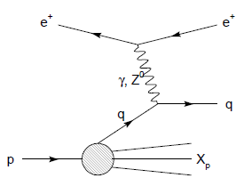
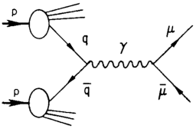
Physical consequences of a gauge-invariant quantum theory:
Aharonov-Bohm effect in QCD!!
Deep-inelastic lepton-nucleon scattering:
Attractive final-state interactions
Quark-antiquark annihilation to leptons:
Repulsive initial-state interactions
Simplicity of these two processes:
Abelian vs. non-Abelian nature of the gauge group doesn’t play a major qualitative role.
BUT: In QCD expect additional, new effects due to specific non-Abelian nature of the gauge group
See e.g. Pijlman,
hep-ph/0604226
or Sivers,
arXiv:1109.2521
As a result:

Slide 20
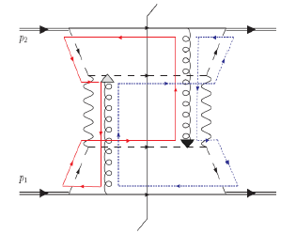
QCD Aharonov-Bohm effect:
Color entanglement
  2010: Rogers and Mulders predict color entanglement in processes involving p+p production of hadrons if quark transverse momentum taken into account
  Quarks become correlated across the two protons
  Consequence of QCD specifically as a non-Abelian gauge theory!
We need to refine how we communicate this fundamental physics to other communities… Every Ph.D. physicist has studied the Aharonov-Bohm effect!
PRD 81:094006 (2010)
Color flow can’t be described as flow in the two gluons separately. Requires simultaneous presence of both.

Slide 21
Some thoughts on future directions . . .
4 areas I expect to come into increasing focus:
Sea quarks
Multiparton correlations
Partonic structure of nuclei
Hadronization
Notes:
Enough on advances of the last 10-15 years. Where I see underexplored territory that looks to me like fertile ground

Slide 22
Diving into the sea
There’s a lot going on in there . . .
Sometimes we focus our attention on the sea, often we neglect it
Notes:
I think there’s a lot more going on with sea quarks than we often talk about.

Slide 23
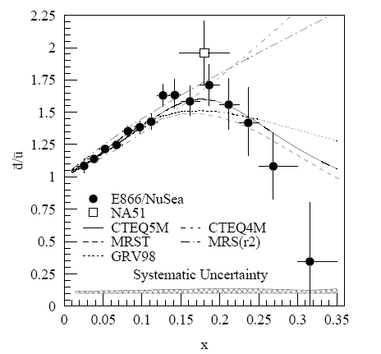
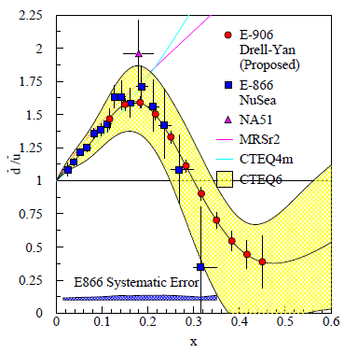
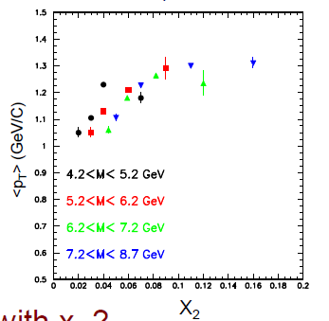
Light quark sea:
Not simply gluon splitting
E866
Mean p_{T} rises with x of sea quark?
E866: PRD64, 052002 (2001)
Projections for E906: Results soon!
Talk by J.-C. Peng

Slide 24
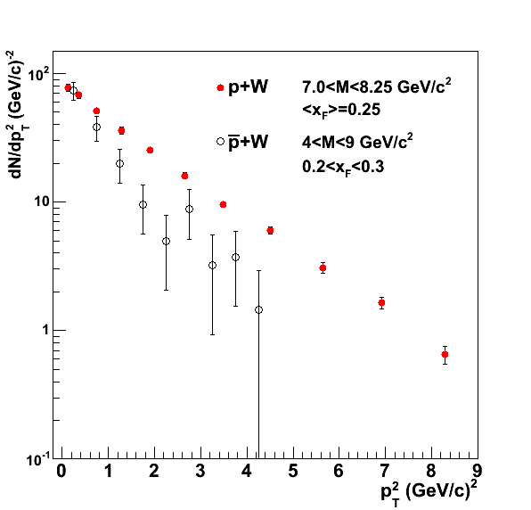
Drell-Yan: Transverse momentum of valence vs. sea quarks
Plot from
CAA, Field, Gamberg, Rogers, PRD 89, 094002 (2014)
p+W: (Valence) quark from p, (sea) antiquark from W
pbar+W: (Valence) quark from W, (valence) antiquark from pbar
Different slope, although not (quite) apples-to-apples kinematics.
(Valence x sea) spectrum harder → Larger mean k_{T} for sea than valence quarks?
(Normalization scaled)
Data:
AIP Conf. Proc. 45, 93 (1978)
PRD 38, 1377 (1988)

Slide 25
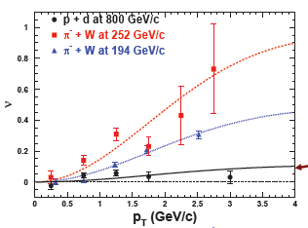
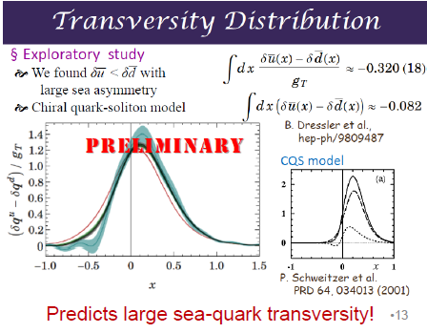

Boer-Mulders for sea quarks small?? Transversity for sea quarks large??
E866, PRL 99, 082301 (2007);
PRL 102, 182001 (2009)
From J.-C. Peng
E866
Also P. Zavada - k_{T} of sea quarks in covariant approach
Need more data . . .

Slide 26
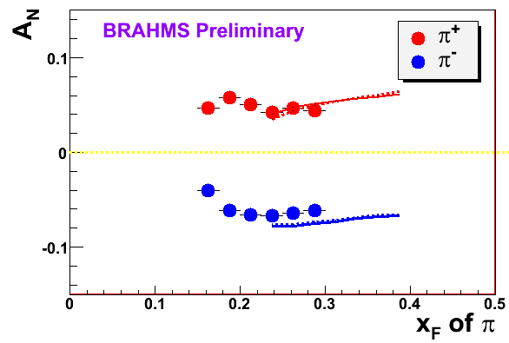
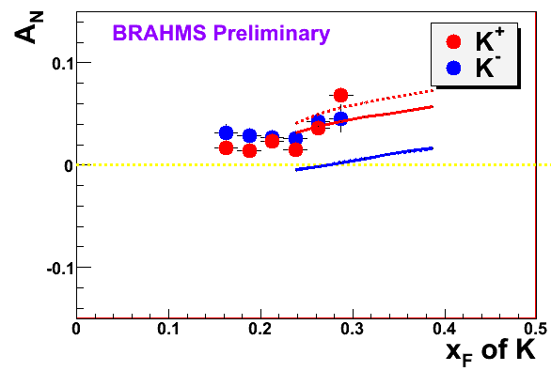

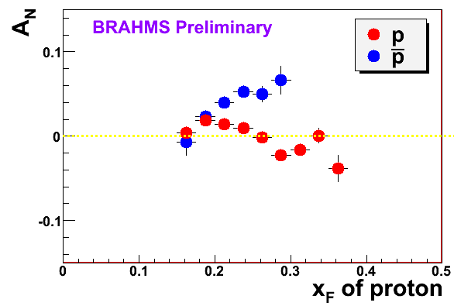
π
π
π, K, p
at 200 and 62.4 GeV
200 GeV
62.4 GeV
Note different scales
K
K
K- asymmetries
underpredicted
Pions suggest valence quark effect.
Kaons and (anti)protons don’t!
200 GeV
62.4 GeV
p
p
PRL 101, 042001 (2008)
Large antiproton asymmetry?? Unfortunately no 62.4
GeV measurement
200 GeV
62.4 GeV

Slide 27
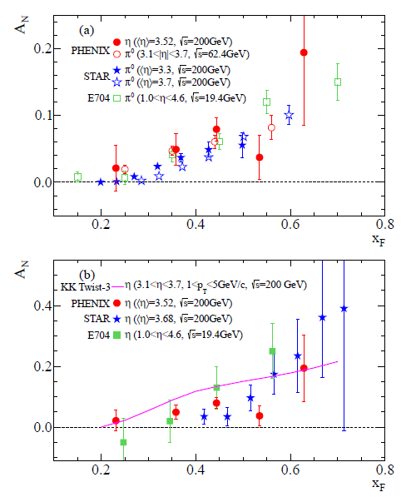
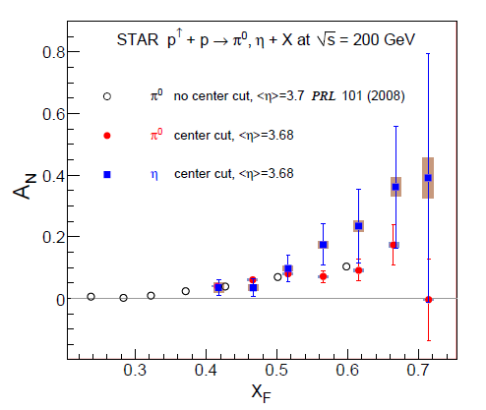
p+p η A_{N} larger than π⁰?? Same?
In addition to sea quarks, need to explore dynamics of gluons in more depth—talks by M. Echevarria, M. Schlegel, A.Szabelski, Y. Koike
arXiv:1406.3541
Related talks by L. Bland, D. Kleinjan,
A. Vossen, A. Ogawa, Y. Koike, D. Pitonyak, C. Pisano

Slide 28
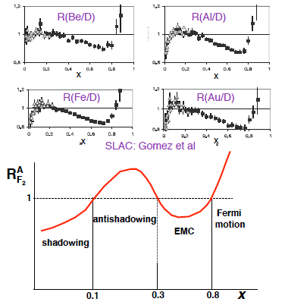

Partonic structure of nuclei
Nuclei: Not simple superpositions of nucleons!
Rich and intriguing differences compared to free nucleons, which vary with the linear momentum fraction probed (and likely transverse momentum, impact parameter, . . .).
Related talks by E. Pace, A. Puckett
Understanding the nucleon in terms of the quark and gluon d.o.f. of QCD does NOT allow us to understand nuclei in terms of the colored constituents inside them!

Slide 29
Upcoming opportunities at JLab
Tritium target approved - talk by A. Puckett
  Can perform same measurements on mirror nuclei ³H and ³He
JLab Hall A will take DIS data on tritium target in 2015
  Same experiment will measure DIS on ³He
  Explore nuclear effects, isospin symmetry assumptions, neutron structure, . . .
Other tritium experiments to follow
We need many similar apples-to-apples comparison experiments as we move ahead—keep ~everything the same except for one variable

Slide 30
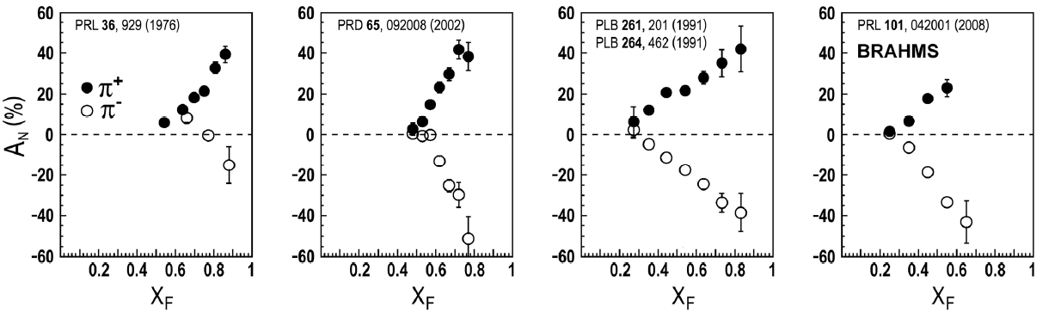
Multiparton correlations
Similar effects across energies → Continuum between non-perturbative/non-partonic and perturbative/partonic descriptions of this non-perturbative structure??
Extend our ideas about (single-parton) pdfs to correlation functions that can’t be associated with a single parton . . .
Talk by D. Sivers

Slide 31
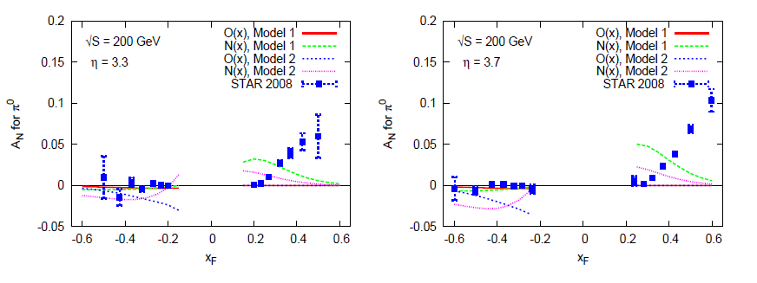
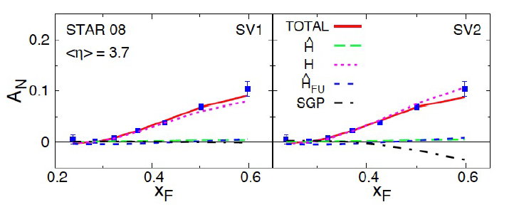
Twist-3 multiparton correlations to interpret inclusive A_{N} data from RHIC
Talks by Y. Koike, D. Pitonyak
Making progress!

Slide 32
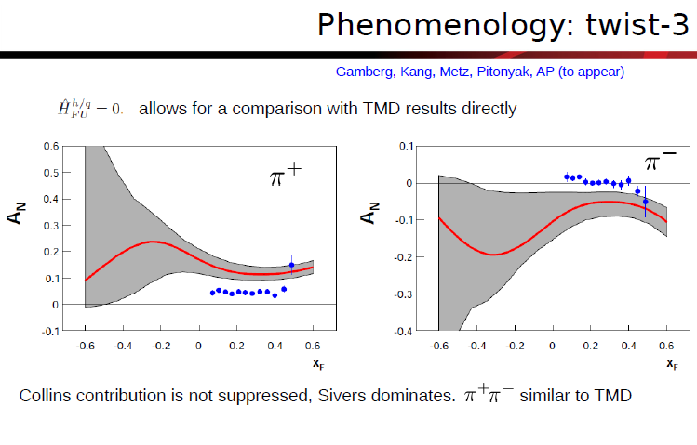
Inclusive hadron A_{N} in e+p
Talk by A. Prokudin

Slide 33
Hadronization
Not as far along as nucleon structure—less of a focus in earlier years
Recent advances via
  TMD FFs
  Collinear twist-3 functions to describe hadronization
  Dihadron (interference) FF
  Hadronization from nuclei
Related talks by M. Radici, A. Kotzinian, I. Garzia, M. Grosse Perdekamp, F. Giordano, M. Contalbrigo, Y. Guan, O. Eyser, A. Vossen, + other p+p talks and all SIDIS talks . . .

Slide 34
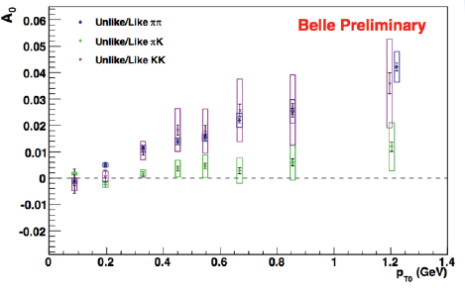
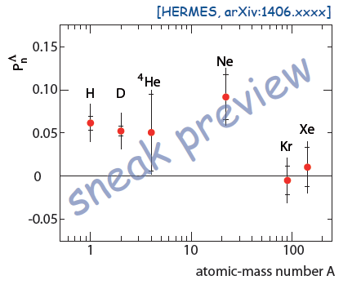
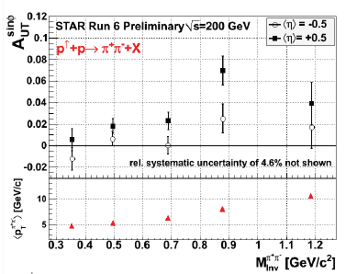
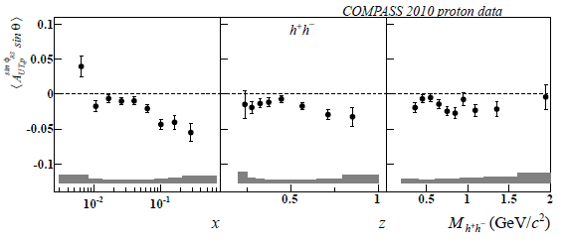
Now arXiv:1406.3236!
From talks by C. van Hulse, A. Vossen, C. Braun, F. Giordano

Slide 35
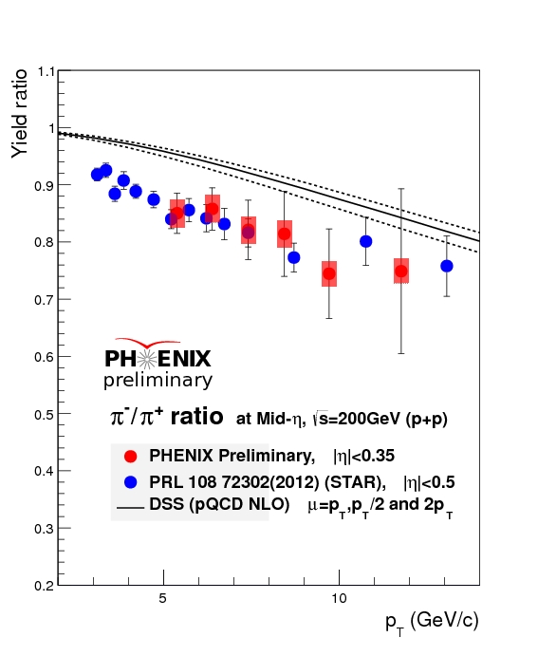
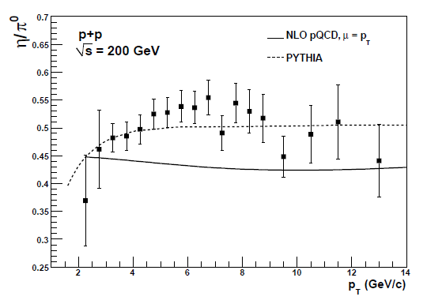

Identified hadron production: Ratios
Measured π-/π+ ratio significantly below NLO calculation in lower range of p_{T}
  Data: Normalization uncertainties cancel completely
  Calculation: Scale uncertainty greatly reduced
PHENIX ratio consistent with STAR points, which lie many sigma below NLO calculation out to ~10 GeV
More powerful to fit ratios directly in the future where available
pQCD uncertainties only from (FF) scale uncertainty
Similar issue for eta/pi0 ratio . . .
PRD83, 032001 (2011)

Slide 36
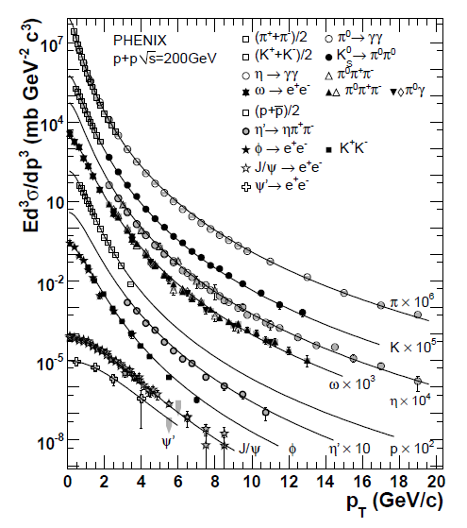
Eventually even more global global fits?
Perform FF parameterizations for even more particles simultaneously?
  Will constrain relative normalizations well
Ultimate goal: Measure jet and all particles within it!
Fit pdfs and FFs simultaneously . . .
PRD83, 052004 (2011)

Slide 37
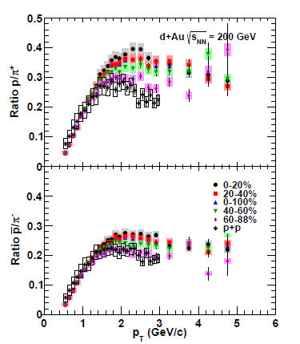
Mechanisms of hadronization other than “fragmentation”:
Baryon enhancement in d+Au and Au+Au
Precision d+Au data for identified charged hadrons in bins of centrality
New hadron production mechanism enabled by presence of additional partons/nucleons
  Parton recombination?
Strong centrality dependence despite small range of # participants
Well-known centrality-dependent baryon enhancement in Au+Au
  Previously explained by recombination of thermalized partons
PRC88, 024906 (2013)

Slide 38
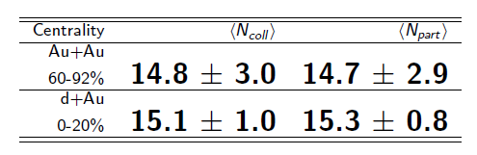
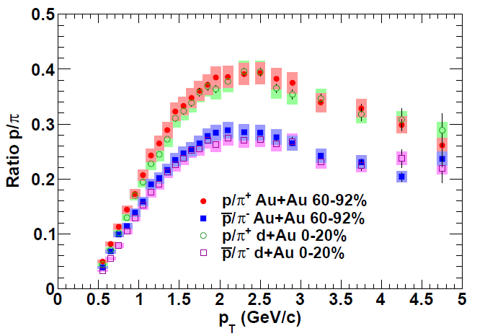
Comparing central d+Au with peripheral Au+Au
Both shape and magnitude identical!
Suggests common mechanism(s) for baryon production in the two systems—partons nearby in phase space bind? Don’t need thermalized medium
PRC88, 024906 (2013)

Slide 39
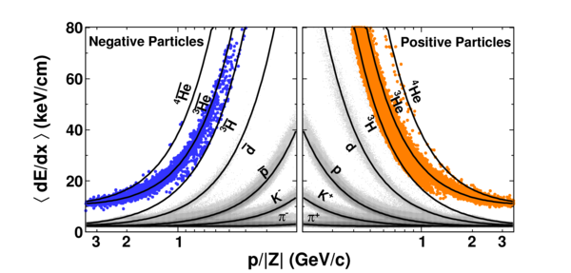
Bound states of hadronic bound states:
Creating nuclei!
STAR
Nature 473, 353 (2011)

Slide 40
A cyclical process
“Starting out, you take the simplest ansatz.” – P. Kroll
“We must not give up our intuition.” – M. Anselmino
Proliferation of observations and ideas
Synthesis

Slide 41
Increasing connections among
(historically disparate) areas of QCD
As we advance, we’re building more connections among the various areas of QCD
TMD and HEP theory communities – SCET, Q_{T} resummation
Jet substructure in HEP and TMD, higher-twist, or dihadron FFs
TMDs at the LHC – M. Schlegel, J.P. Lansberg talks
Multiparton Interactions (MPI) in HEP community and multiparton correlations
Nucleon structure, HEP, and heavy ion low-x communities – gluon saturation
Heavy ion and nucleon structure communities - Nuclear pdfs, mainly “vanilla” collinear so far, but starting to consider TMD – E. Pace talk
Heavy ion and neutron star communities – dense, hot vs. dense, cold corners of QCD phase diagram

Slide 42
Increasing connections among
(historically disparate) areas of QCD
Heavy ion and hadronization - “fragmentation” vs. nearby partons in phase space; parton energy loss in hot or cold nuclear matter (M. Contalbrigo talk)
Heavy ion (quark-gluon plasma) physics and low-energy nuclear reactions; cosmology
  “Little Bang Nucleosynthesis”
Diffractive physics in heavy ion collisions and GPDs; Impact-parameter-dependent nuclear distributions and collision geometry in heavy ion physics; GPDs and proton radius puzzle via form factors
OAM (E. Leader and M. Burkardt talks) and GPDs, TMDs (A. Mukherjee talk)
Hadron spectroscopy and OAM – D. Sivers talk
Hadron spectroscopy and hadronization/FFs—B factories as common facilities
Hadronic vs. partonic dof in JLab program and moving beyond single-parton functions in hadrons

Slide 43
We should make every effort to strengthen these links
E.g. stronger links to mainstream HEP experimental community
  There’s lots of QCD physics to be done in p+p collisions at the LHC!
  Share more Monte Carlo tools? (G. Schnell, H. Avakian talks)
  125 GeV Higgs: e+e- Higgs factory would be great to study FFs at a complementary scale to current B factories!
“Unpolarized reactions are the basic tool linking many different fields of investigation.” – M. Contalbrigo

Slide 44
Final remarks
Early years of quantitative basic research in QCD
Proton has key role to play as lightest stable QCD bound state (and component of everyday matter!)
Electron-Ion Collider: Facility to bring the era of quantitative QCD to maturity . . . BUT—
Measurements in complementary systems important!
More connections starting to be developed among various QCD subfields
Taking small, initial steps along the path toward “grand unification” of QCD across different scales, from partons to neutron stars . . .

Slide 45


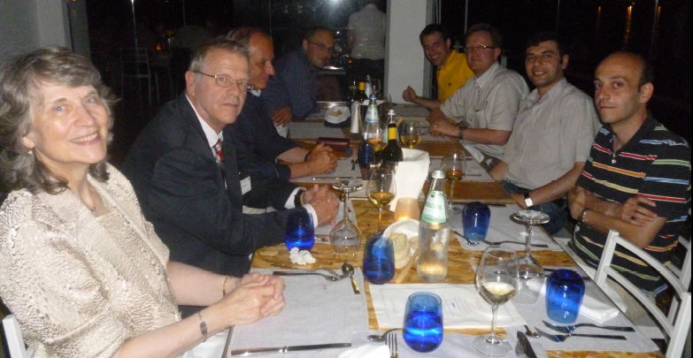

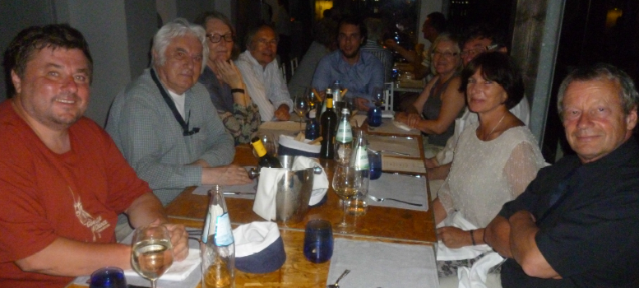


Slide 46




Thanks for making this such a nice community . . .

Slide 47
Extra

Slide 48
Mapping out the proton
What does the proton look like in terms of the quarks and gluons inside it?
Position
Momentum
Spin
Flavor
Color
Theoretical and experimental concepts to describe and access position only born in mid-1990s. Pioneering measurements over past decade.
Vast majority of past four decades focused on
1-dimensional momentum structure! Since 1990s starting to consider transverse components . . .
Polarized protons first studied in 1980s. How angular momentum of quarks and gluons add up still not well understood!
Early measurements of flavor distributions in valence region. Flavor structure at lower momentum fractions still yielding surprises!
Accounted for by theorists from beginning of QCD, but more detailed, potentially observable effects of color have come to forefront in last couple years . . .

Slide 49



EIC
A facility to bring this new era of quantitative QCD to maturity!
How can QCD matter be described in terms of the quark and gluon d.o.f. in the field theory?
How does a colored quark or gluon become a colorless object?
Study in detail
  “Simple” QCD bound states: Nucleons
  Collections of QCD bound states: Nuclei
  Hadronization

Slide 50

Midrapidity charge-separated hadrons in 62.4 GeV p+p: Reining in scale uncertainties with NLL resummation

Slide 51


Forward charged π and K production at 62.4 GeV

Slide 52

Scale uncertainty remains large for single-particle cross sections even for
√s =500 GeV and p_{T} up to 30 GeV
“Good” agreement with NLO, but still only within ~20-50%
Measured π-/π+ ratio at 200 GeV within ~15% of NLO calculation, but less “good” because of greatly reduced scale uncertainties
  Evidently other uncertainties relevant
What are the most appropriate uncertainties to use in each case?
Notes:
I’ve heard statements that the pT/2 to 2pT range of scale choices is unrealistically large for single-particle cross section calculations, but the measured ratio compared to the calculation indicates that there are significant uncertainties other than the scale uncertainty.

Slide 53

NNPDF dbar/ubar

Slide 54

Fermilab E1039

Slide 55

Eta vs. kaon A_{N}?
arXiv:1406.3541
Kaons higher, including K-, although not apples-to-apples.
PRL 101, 042001 (2008)
PHENIX Eta vs. kaons—kaons higher . . .?

Slide 56
Hadronization: A lot to learn, from a variety of collision systems
What are the ways in which partons can turn into hadrons?
Spin-momentum correlations in hadronization?
  Correlations now measured definitively in e+e-! (BELLE, BABAR)
Gluons vs. quarks?
  Gluon vs. quark jets a hot topic in the LHC p+p program right now
  Go back to clean e+e- with new jet analysis techniques in hand?
In “vacuum” vs. cold nuclear matter vs. hot + dense QCD matter?
  Use path lengths through nuclei to benchmark hadronization times → e+A
Hadronization via “fragmentation” (what does that really mean?), “freeze-out,” “recombination,” . . .?
  Soft hadron production from thermalized quark-gluon plasma—different mechanism than hadronization from hard-scattered q or g?
Light atomic nuclei and antinuclei also produced in heavy ion collisions at RHIC!
  How are such “compound” QCD systems formed from partons? Cosmological implications??
…
In my opinion, hadronization has been a largely neglected area over the past decades of QCD—lots of progress to look forward to in upcoming years, with e+A, p+p, and A+A all playing a role along with e⁺e⁻!
Notes:
Baryon anomaly

Slide 57

Comparing central d+Au with peripheral Au+Au
Direct ratio of spectra is flat above 2.5 GeV and species independent
  Baryon enhancement is quantitatively the same
  Ratio significantly less than unity—suggests energy loss for all species in peripheral Au+Au
PRC88, 024906 (2013)
No scaling applied

Slide 58


Enhancement of strange meson production in central Au+Au
K/π ratio higher in more central Au+Au than p+p, increases with centrality
K/π ratio in d+Au same as p+p for all centralities

Slide 59


Strange meson production in Au+Au
In Au+Au, kaon and pion most separated in central events
Phi seems to stay between kaon and proton
In d+Au, charged pions and kaons consistent with each other, and phi exhibits minimal modification
Suggests additional strange meson production mechanism in central Au+Au compared to d+Au or p+p

Slide 60





Insight from New Measurements
New information on proton structure
  G_{E}(Q²) ≠ G_{M}(Q²) → different charge, magnetization distributions
  Connection to GPDs: spin-space-momentum correlations
Model-dependent extraction of charge, magnetization distribution of proton:
J. Kelly, Phys. Rev. C 66, 065203 (2002)
A.Belitsky, X.Ji, F.Yuan, PRD69:074014 (2004)
G.Miller, PRC 68:022201 (2003)
x=0.1
x=0.4
x=0.7
1 fm
Slide courtesy J. Arrington
Notes:
Rich substructure when you combine momentum and spatial, spin and spatial distributions.

Slide 61

Eta mesons in 200 GeV p+p
Cross section data used in FF fit
NLO calculation for η/π⁰ ratio ~15% too low (no uncertainties shown)
In this particular case, PHENIX eta data and (earlier but consistent) π⁰ data were used in the respective FF fits, but in π⁰ fit, PHENIX data normalization scaled within uncertainty in one direction, and in eta fit, scaled in other direction
Fitting ratio directly would automatically take into account the 100% correlated normalization uncertainties
PRD83, 032001 (2011)

Slide 62


ALICE η/π⁰ ratio, p+p at 7 TeV
Same p_{T} range as PHENIX data
Calculated ratio again below data
Scale uncertainty on NLO calculation shown
PLB717, 152 (2012)

Slide 63




Density dependence of EMC effect?
J.Seely, et al., PRL103, 202301 (2009)
N. Fomin, et al., PRL108 (2012) 092052
Credit: P. Mueller
Notes:
K. Arai, et al, shows need for small components beyond 2xalpha+neutron, esp. for higher spin states.

Slide 64


Connection between short-range correlations and EMC effect: Importance of two-body effects??
5-10% suppression in all nucleons?
25-50% change in 20% of nucleons (high-momentum)?
J. Seely, et al., PRL103, 202301 (2009)
N. Fomin, et al., PRL 108, 092052 (2012)
JA, A. Daniel, D. Day, N. Fomin, D. Gaskell, P. Solvignon, PRC 86 (2012) 065204
O. Hen, et al., PRC 85, 047301 (2012)
L. Weinstein, et al., PRL 106, 052301 (2011)

Slide 65


p+p cross sections: Charged pions, 200 GeV
10% normalization uncertainty not shown
Charge-separated pion cross sections 5 < p_{T} < 14 GeV
Consistent with NLO pQCD calculations using DSS FFs, within (large) scale uncertainty
Data themselves have 10% normalization uncertainty
Use as input in future fits—how best to incorporate?

Slide 66


Slide 67

Mechanisms of hadronization other than “fragmentation”:
Baryon enhancement in d+Au and Au+Au
Precision d+Au data for identified charged hadrons in bins of centrality
New hadron production mechanism enabled by presence of additional partons/ nucleons
  Parton recombination?
Strong centrality dependence despite small range of N_{part} and N_{coll} values in d+Au
Well-known centrality-dependent baryon enhancement in Au+Au
PRC88, 024906 (2013)

