Slide 1
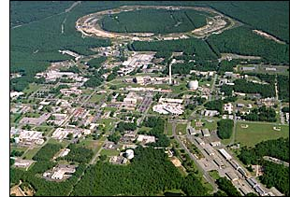
Investigating Proton Structure at the
Relativistic Heavy Ion Collider
Christine Aidala
University of Michigan
Southern Methodist University
December 1, 2014
Notes:
I feel that the overarching question that those of us working on the proton structure program at RHIC would like to contribute to answering is . . .

Slide 2
How do we understand the visible matter in our universe in terms of the fundamental quarks and gluons of quantum chromodynamics?
Notes:
An essential tool of the trade if this is a question you’re interested in tackling is . . .

Slide 3
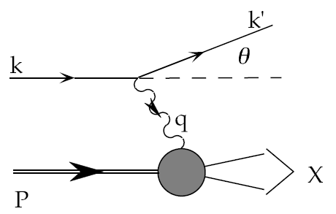
Deep-Inelastic Scattering:
A Tool of the Trade
Probe nucleon with an electron or muon beam
Interacts electromagnetically with (charged) quarks and antiquarks
“Clean” process theoretically—quantum electrodynamics well understood and easy to calculate
Technique that originally discovered the parton structure of the nucleon in the 1960s

Slide 4
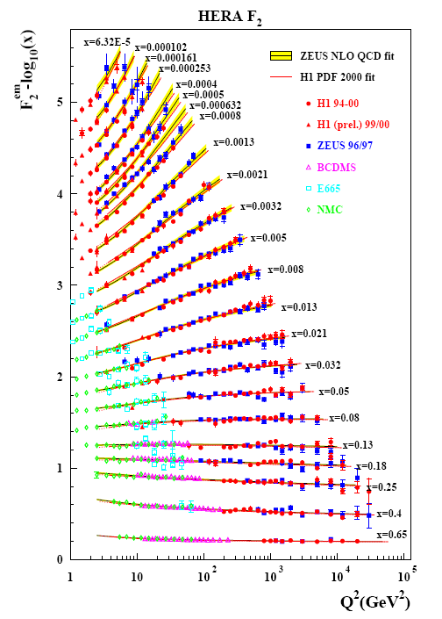
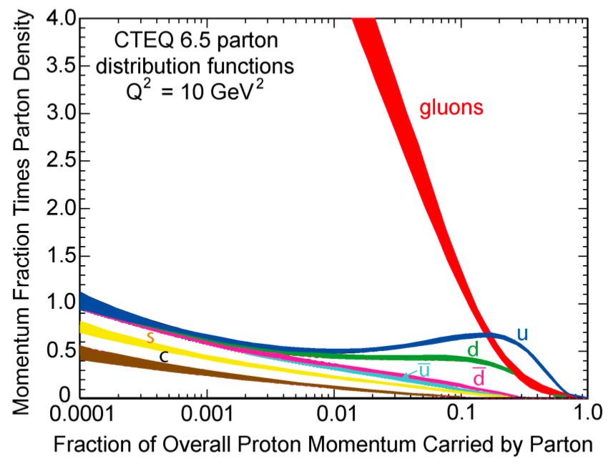
Decades of DIS data: What have we learned?
Wealth of data largely from HERA e+p collider
Rich structure at low x
Half proton’s linear momentum carried by gluons!
Notes:
There are a number of useful ways to look at and describe nucleon structure. For example in addition to the structure functions such as F2 shown here, which, if you will, lets you “see” the asymptotic freedom of QCD, you can also describe the proton in terms of parton distribution functions, . . . In any case, we’ve learned quite a lot from decades of DIS data on the linear momentum structure of the proton, but even in the age of HERA, . . .

Slide 5
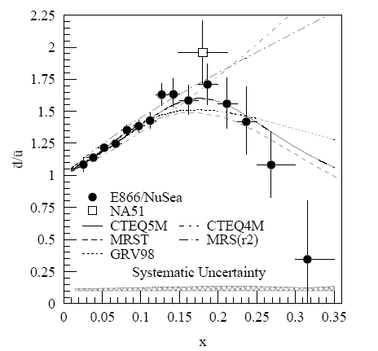
And a (relatively) recent surprise from p+p, p+d collisions
Fermilab Experiment 866 used proton-hydrogen and proton-deuterium collisions to probe nucleon structure via the Drell-Yan process
Would expect anti-down/anti-up ratio of 1 if sea quarks are only generated dynamically by gluon splitting into quark-antiquark pairs
Measured flavor asymmetry in the quark sea, with striking x behavior—still not well understood
Hadronic collisions play a complementary role to electron-nucleon scattering and have let us continue to find surprises in the rich linear momentum structure of the proton, even after > 40 years!
PRD64, 052002 (2001)

Slide 6
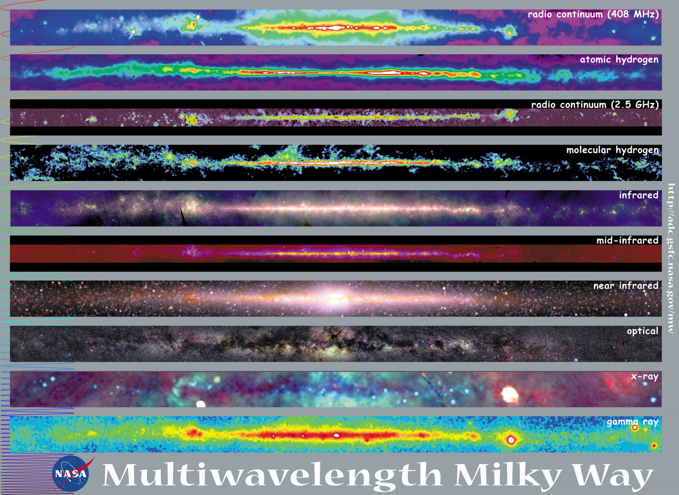
Observations with different probes allow us to learn different things!

Slide 7
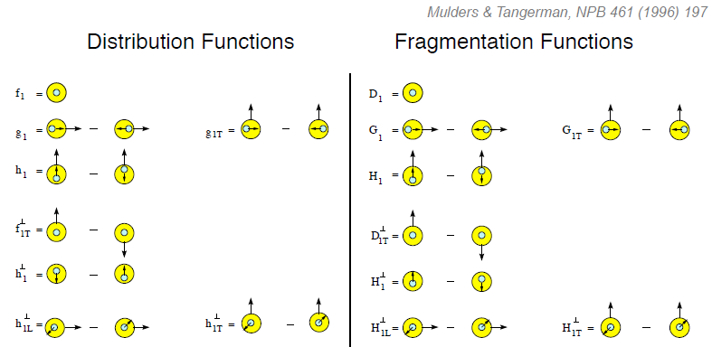
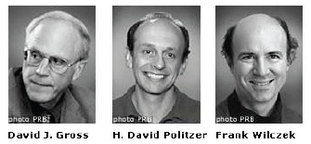
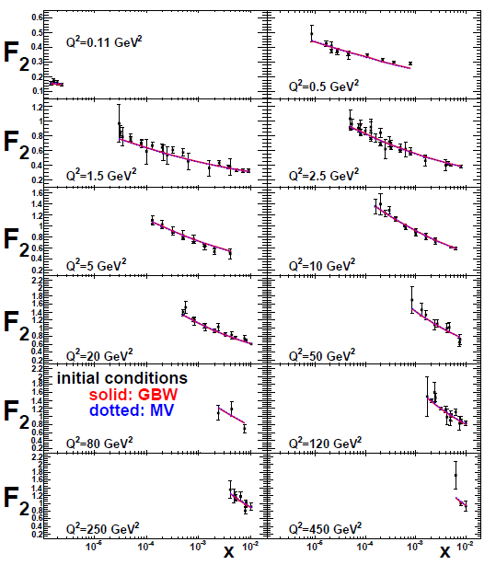
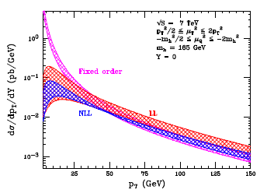
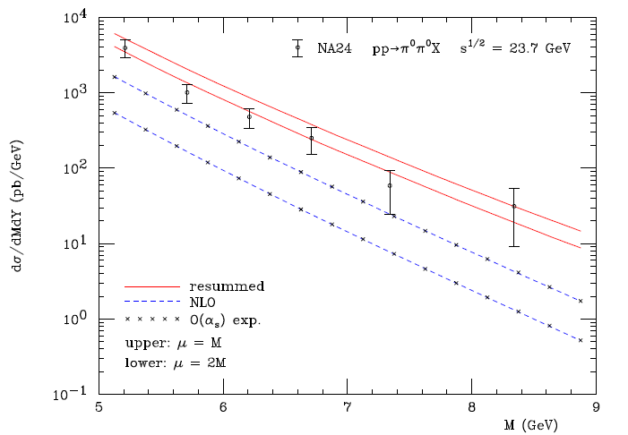
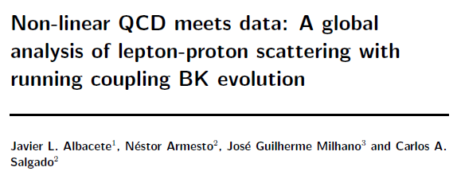
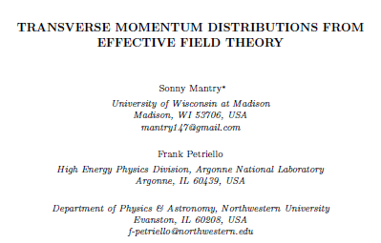
The nascent era of quantitative QCD!
Transverse-Momentum-Dependent
QCD: Discovery and development
  1973 → ~2004
Since 1990s starting to consider detailed internal QCD dynamics, going beyond traditional parton model ways of looking at hadrons—and perform phenomenological calculations using these new ideas/tools!
  Various resummation techniques
  Non-collinearity of partons with parent hadron
  Various effective field theories, e.g. Soft-Collinear Eff. Th.
  Non-linear evolution at small momentum fractions
Higgs vs. p_{T}
Collinear
Worm gear
Mulders & Tangerman, NPB 461, 197 (1996)
arXiv:1108.3609
Transversity
Almeida, Sterman, Vogelsang
PRD80, 074016 (2009)
PRD80, 034031 (2009)
Sivers
pp→π⁰π⁰X
Boer-Mulders
Worm gear
Pretzelosity
M (GeV)

Slide 8
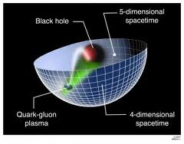
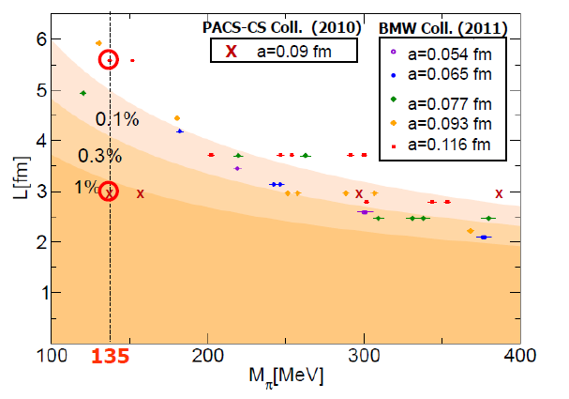
Additional recent theoretical progress in QCD
Progress in non-perturbative methods:
  Lattice QCD starting to perform calculations at physical pion mass!
  AdS/CFT “gauge-string duality” an exciting recent development as first fundamentally new handle to try to tackle QCD in decades!
PACS-CS: PRD81, 074503 (2010)
BMW: PLB701, 265 (2011)
“Modern-day ‘testing’ of (perturbative) QCD is as much about pushing the boundaries of its applicability as about the verification that QCD is the correct theory of hadronic physics.”
– G. Salam, hep-ph/0207147 (DIS2002 proceedings)
T. Hatsuda,
PANIC 2011
Notes:
Hadron spectrum, quark masses, pseudoscalar meson decay constants

Slide 9
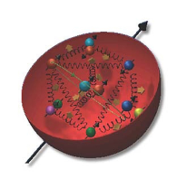
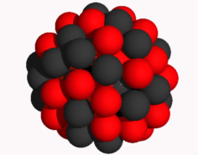
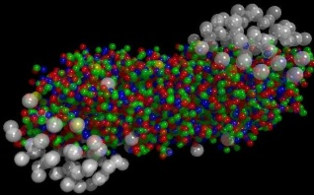
The Relativistic Heavy Ion Collider at Brookhaven National Laboratory
A great place to be to study QCD!
A collider-based program, but not designed to be at the energy (or intensity) frontier. More closely analogous to many areas of condensed matter research—create a system and study its properties
What systems are we studying?
  “Simple” QCD bound states—the proton is the simplest stable bound state in QCD (and conveniently, nature has already created it for us!)
  Collections of QCD bound states (nuclei, also available out of the box!)
  QCD deconfined! (quark-gluon plasma, some assembly required!)
Understand more complex QCD systems within
the context of simpler ones
RHIC was designed from the start as a single facility capable of nucleus-nucleus, proton-nucleus, and proton-proton collisions

Slide 10
Mapping out the proton
What does the proton look like in terms of the quarks and gluons inside it?
Position
Momentum
Spin
Flavor
Color
Theoretical and experimental concepts to describe and access position only born in mid-1990s. Pioneering measurements over past decade.
Vast majority of past four decades focused on
1-dimensional momentum structure! Since 1990s starting to consider other directions . . .
Polarized protons first studied in 1980s. How angular momentum of quarks and gluons add up still not well understood!
Good measurements of flavor distributions in valence region. Flavor structure at lower momentum fractions still yielding surprises!
Accounted for by theorists from beginning of QCD, but more detailed, potentially observable effects of color have come to forefront in last couple years . . .

Slide 11
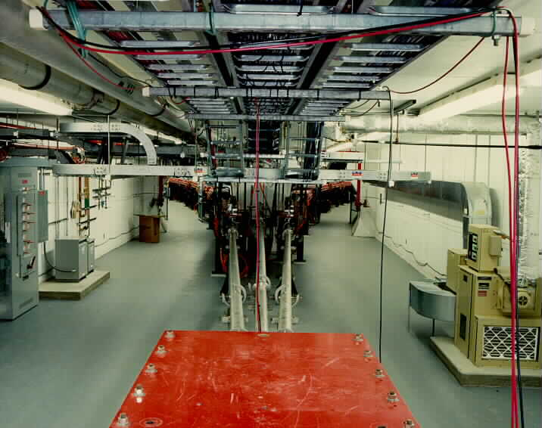
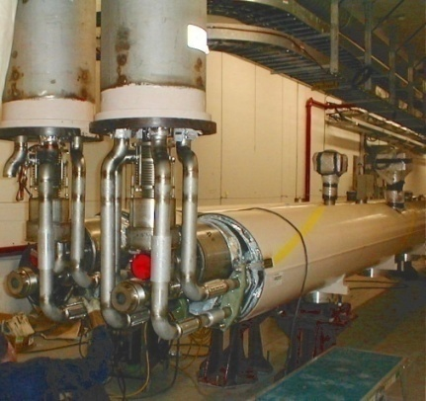
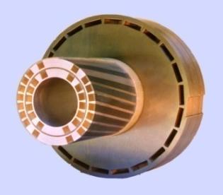
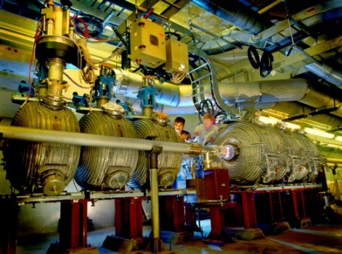
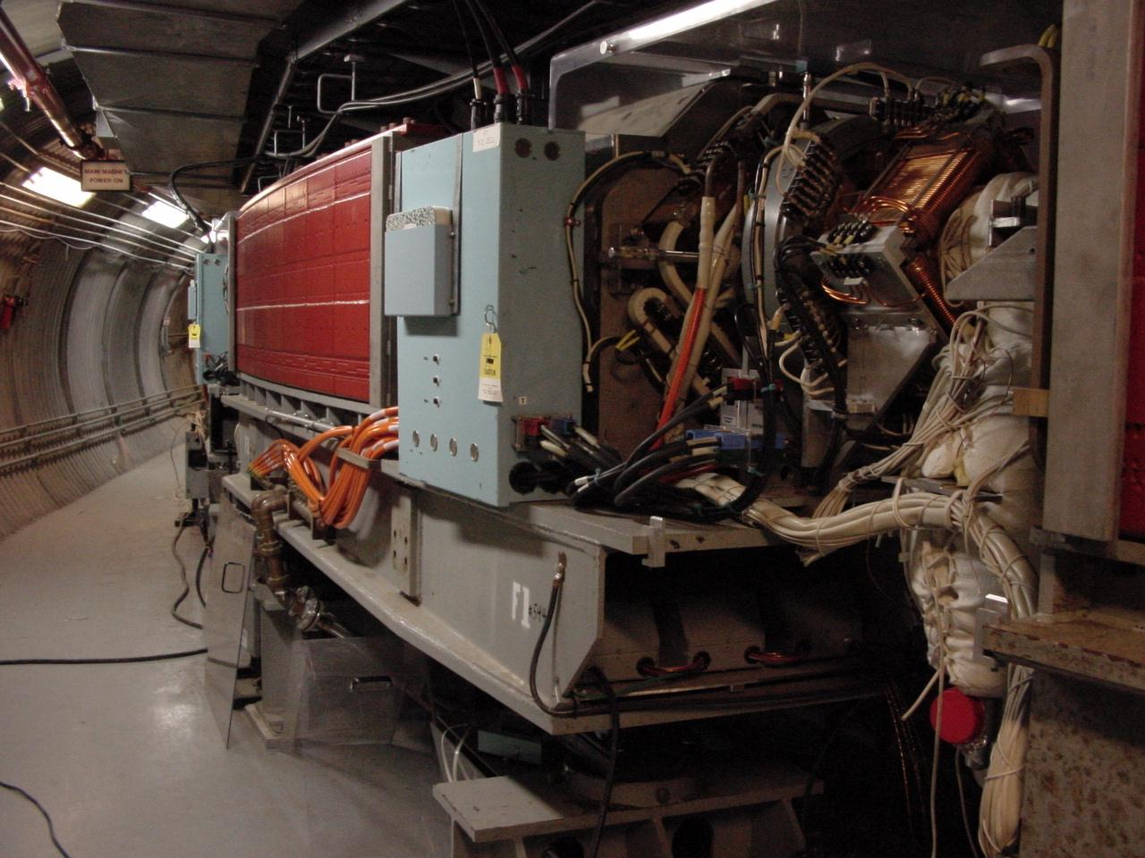
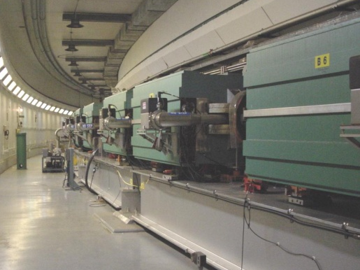
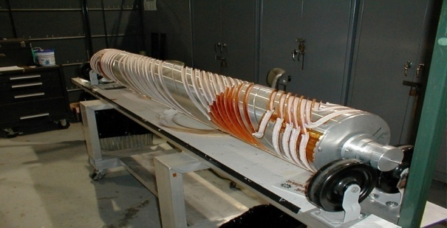
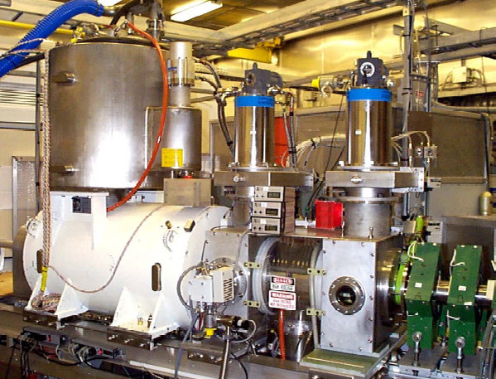
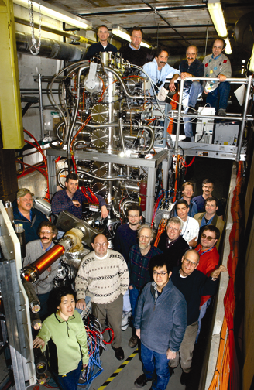
RHIC as a polarized p+p collider
Absolute Polarimeter (H jet)
RHIC pC Polarimeters
Siberian Snakes
PHOBOS
BRAHMS & PP2PP
Siberian Snakes
PHENIX
Spin Flipper
STAR
Spin Rotators
Various equipment to maintain and measure beam polarization through acceleration and storage
Partial Snake
Helical Partial
Snake
Polarized Source
Strong Snake
LINAC
AGS
200 MeV Polarimeter
BOOSTER
Rf Dipole
AGS Internal Polarimeter
AGS pC Polarimeter
Notes:
RHIC, as a high-energy polarized proton collider, really represents an outstanding achievement in accelerator physics. . . . [equipment].

Slide 12
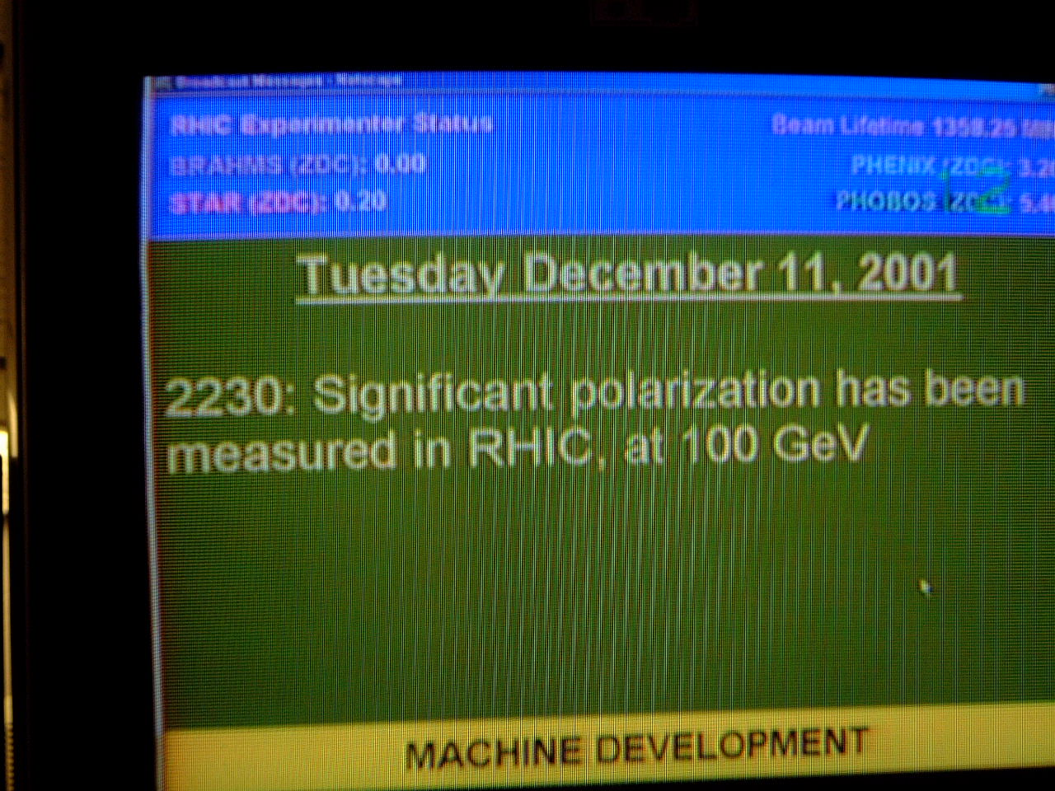
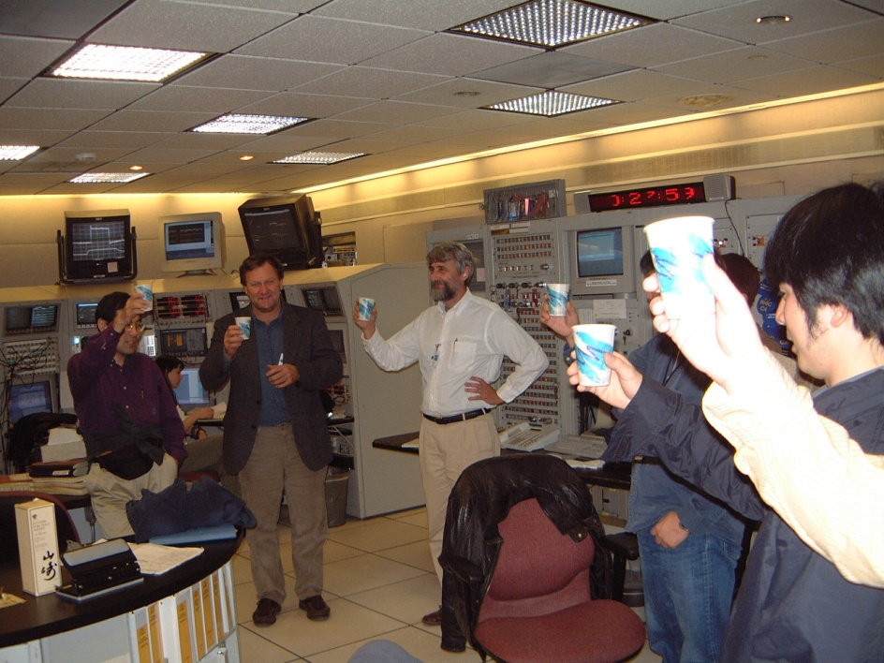

December 2001: News to celebrate

Slide 13
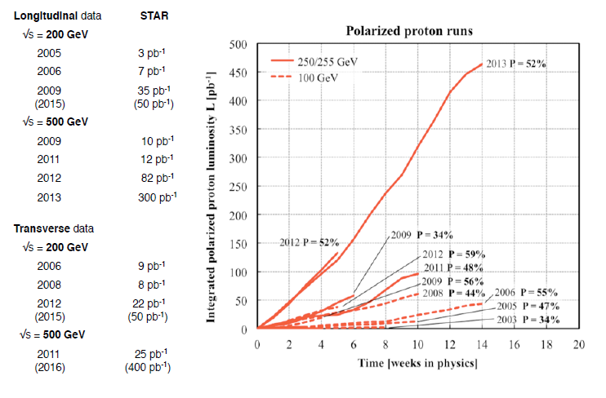
RHIC performance for polarized protons

Slide 14
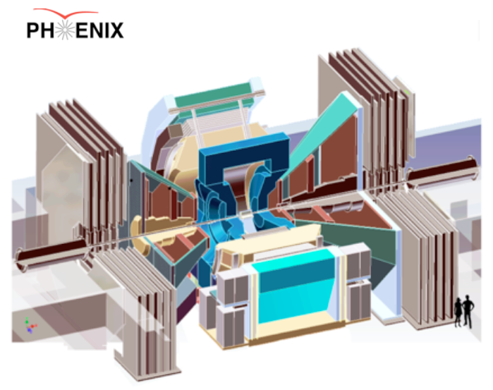
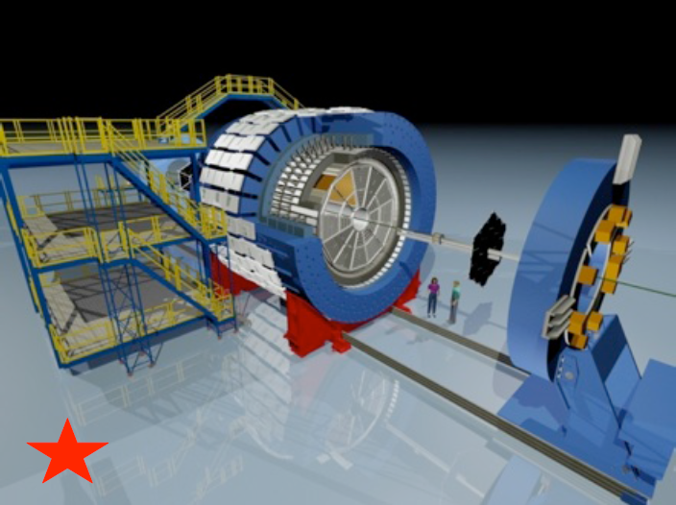
RHIC’s current main experiments
PHENIX:
High resolution; high rate capabilities for rare probes
Central arms |η|<0.35, Δφ∼2π with key strength measuring EM probes
Muon arms 1.2<|η|<2.4
Forward EM calorimetry
STAR:
Key strengths jets + correlations
Full acceptance including PID for |η|< 1, Δφ∼2π
Forward EM calorimetry

Slide 15
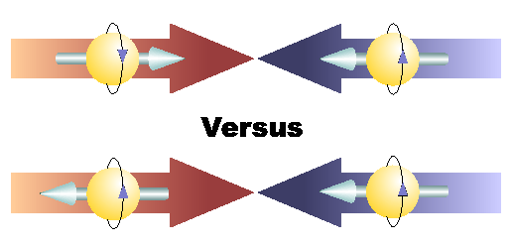
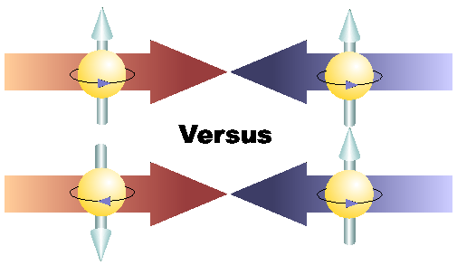
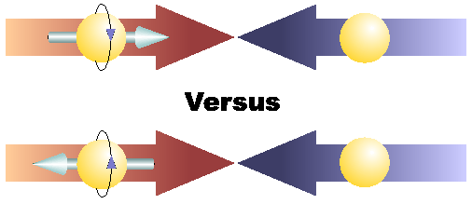
Proton spin structure at RHIC
Transverse spin and
spin-momentum
correlations
Transverse-momentum-
dependent distributions
, Jets
Back-to-Back Correlations
Single-Spin Asymmetries
Advantages of a polarized proton-proton collider:
Hadronic collisions → Leading-order access to gluons
High energies → Applicability of perturbative QCD
High energies → Production of new probes: W bosons

Slide 16
Reliance on input from simpler systems
Disadvantage of hadronic collisions: much “messier” than deep-inelastic scattering! → Rely on input from simpler systems
  Just as the heavy ion program at RHIC relies on information from simpler collision systems
The more we know from simpler systems such as deep-inelastic scattering and e+e- annihilation, the more we can in turn learn from hadronic collisions

Slide 17
Predictive power of pQCD
q(x₁)
Hard Scattering Process
X
g(x₂)
High-energy processes have predictable rates given:
Partonic hard scattering rates (calculable in pQCD)
    Parton distribution functions (need experimental input)
    Fragmentation functions (need experimental input)
Universal non-perturbative factors

Slide 18

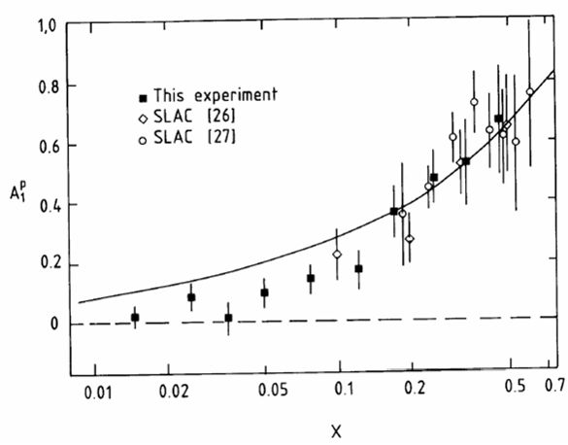
Proton “spin crisis”
SLAC: 0.10 < x <0.7
CERN: 0.01 < x <0.5
Quark-Parton Model
expectation
A₁(x)
0.1 < x_{SLAC} < 0.7
E130, Phys.Rev.Lett.51:1135 (1983)
472 citations
These haven’t been easy to measure!
EMC (CERN), Phys.Lett.B206:364 (1988)
1759 citations!
0.01 < x_{CERN} < 0.5
“Proton Spin Crisis”
x-Bjorken
Notes:
SLAC – up by 16 in 1 year, EMC – 84 in 1 year

Slide 19
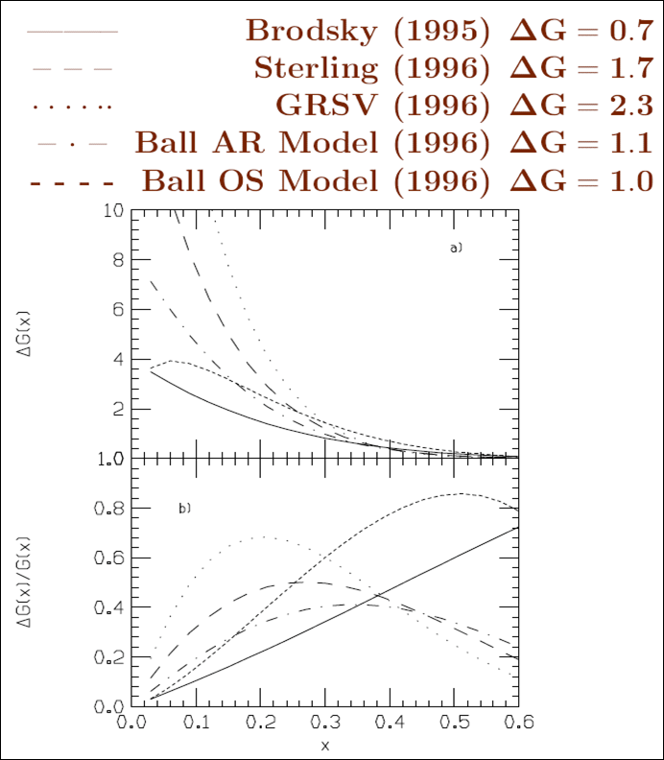
Quest for ΔG, the gluon spin contribution to the spin of the proton
With experimental evidence indicating that only about 30% of the proton’s spin is due to the spin of the quarks, in the mid-1990s predictions for the integrated gluon spin contribution to proton spin ranged from 0.7 – 2.3!
  Many models hypothesized large gluon spin contributions to screen the quark spin, but these would then require large orbital angular momentum in the opposite direction.

Slide 20
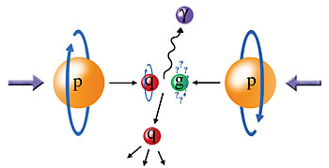
Probing the helicity structure of the nucleon with p+p collisions
Study difference in particle production rates for same-helicity vs. opposite-helicity proton collisions
DIS
?
pQCD
e+e-
Leading-order access to gluons → ΔG
Notes:
Let me now show you some highlights from the helicity program at RHIC.

Slide 21
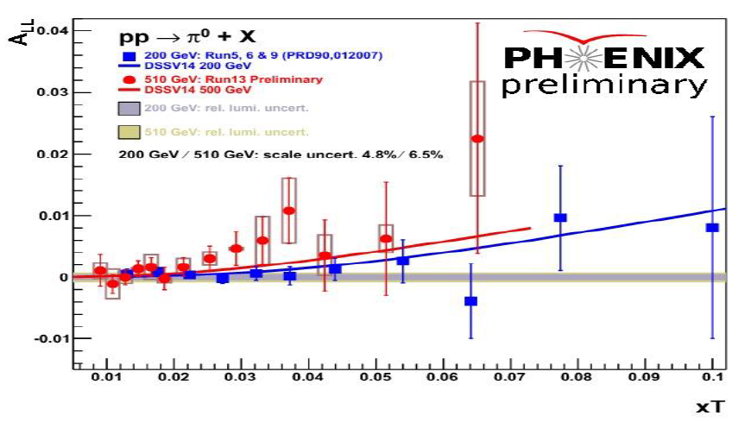
RHIC measurements sensitive to gluon polarization
Neutral pion
double-helicity asymmetries
π⁰ 200 GeV - PRD90, 012007 (2014)
π⁰ 510 GeV - Preliminary

Slide 22
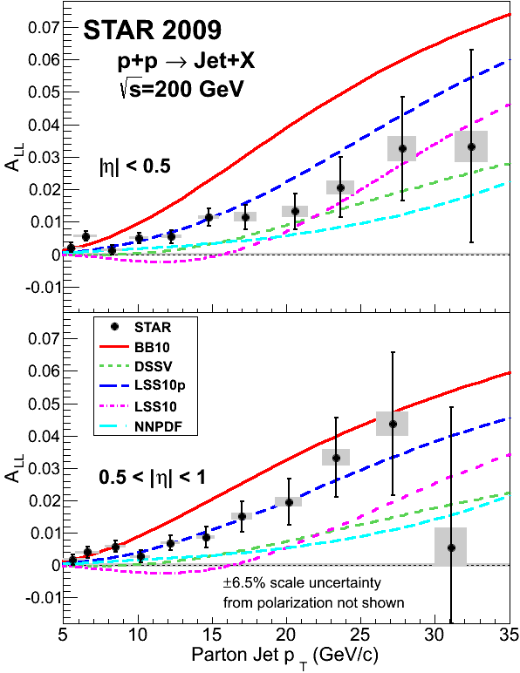
RHIC measurements sensitive to gluon polarization
arXiv:1405.5134
Clear nonzero asymmetry seen in STAR jet measurements from 2009 data!
PHENIX π⁰ data consistent

Slide 23
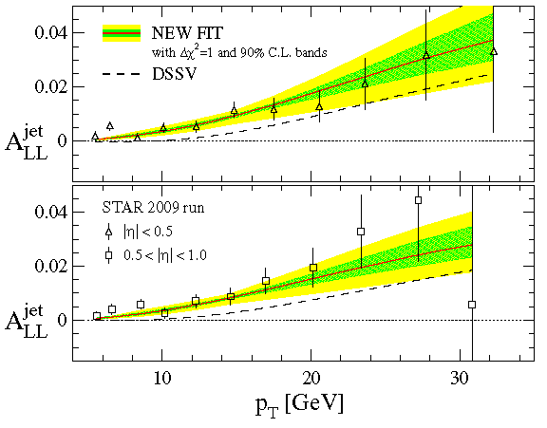
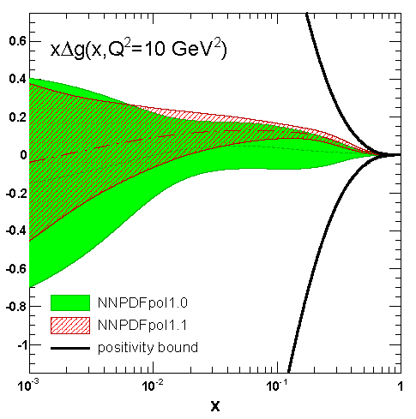
Two new helicity pdf fits
DSSV, PRL 113, 012001 (2014)
NNPDF, NPB 887.276 (2014)
DSSV and NNPDF have released new polarized pdf fits including RHIC data
2009 STAR jet A_{LL} results in particular provide significantly tighter constraints on gluon polarization than previous measurements
Both find evidence for positive gluon polarization in the region x > 0.05, but looks like orbital angular momentum will still be needed to account for total spin

Slide 24
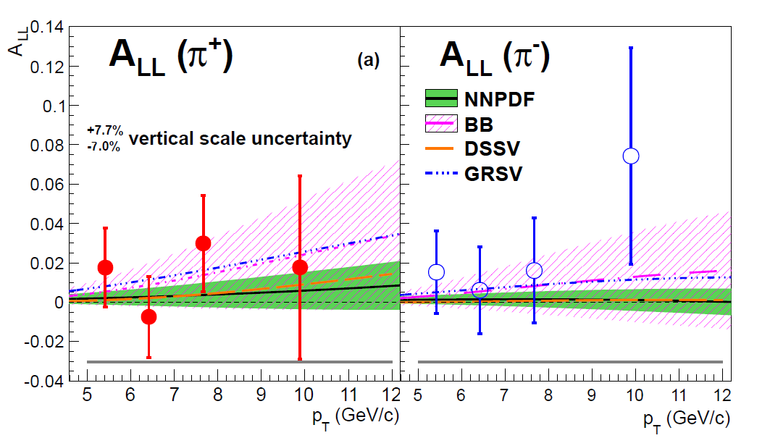
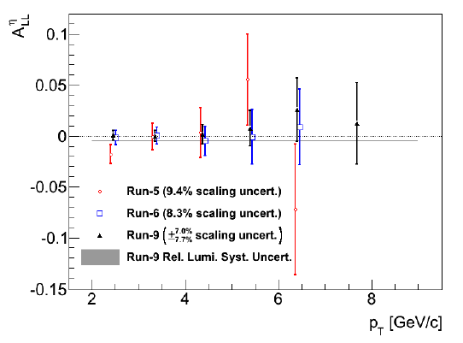
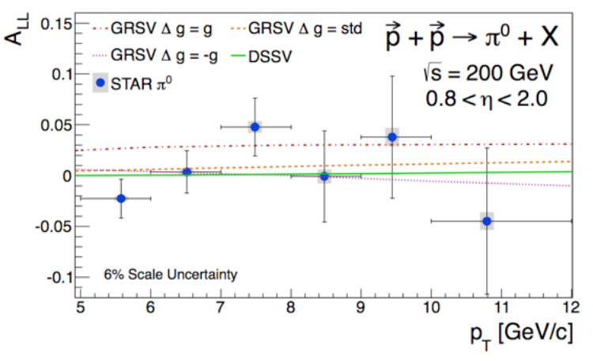
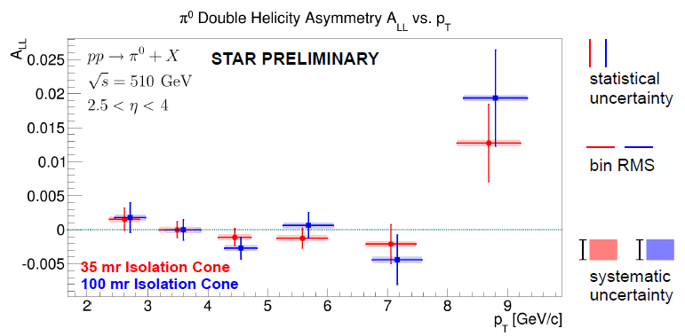
Other recently measured probes sensitive to gluon helicity
Midrapidity η
200 GeV
PRD90, 012007 (2014)
arXiv:1409.1907
Can provide complementary information.
Extending measurements to more forward rapidity and different √s will expand x range probed.
Forward π⁰
Very forward π⁰
510 GeV
PRD89, 012001 (2014)

Slide 25
Proton spin structure at RHIC
Transverse spin and
spin-momentum
correlations
Transverse-momentum-
dependent distributions
Not expected to resolve spin crisis, but of particular interest given surprising isospin-asymmetric structure of the unpolarized sea discovered by E866 at Fermilab.
, Jets
Back-to-Back Correlations
Single-Spin Asymmetries

Slide 26
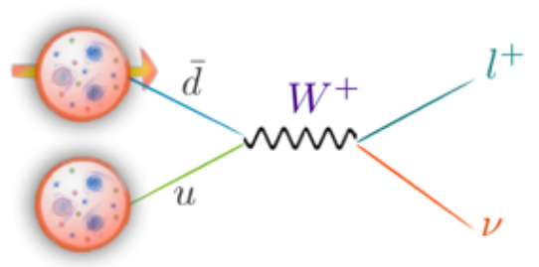
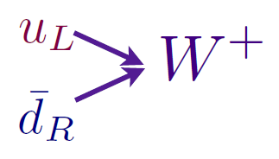
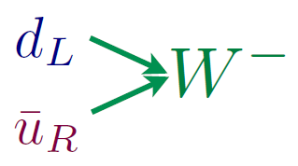
Flavor-separated sea quark helicities through W production
Flavor separation of the polarized sea quarks with no reliance on fragmentation functions, and at much higher scale than previous fixed-target experiments.
Complementary to semi-inclusive DIS measurements.
Parity violation of weak
interaction +
control over proton spin
orientation gives access to
flavor-spin structure of proton

Slide 27
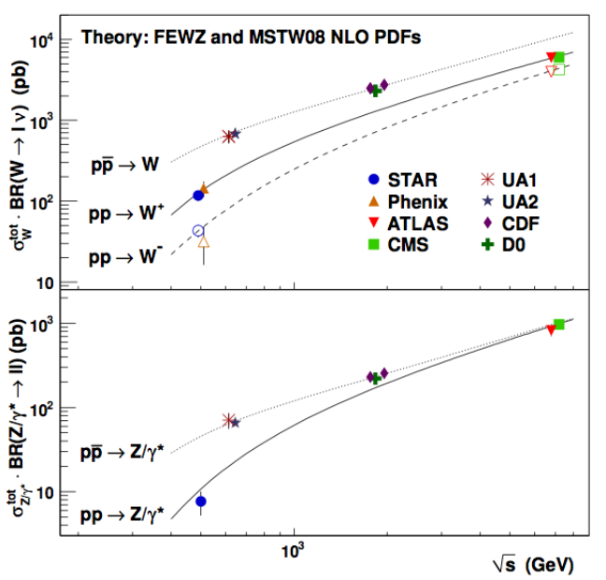
World W cross section measurements
RHIC
data

Slide 28


Large parity-violating single-helicity asymmetries
Improve constraints on light antiquark helicity distributions
New preliminary PHENIX muon results extend rapidity range

Slide 29

Flavor-separated sea quark helicities through W production
NNPDF, NPB 887.276 (2014)
(DSSV08: Before RHIC W data)
Latest NNPDF fit to helicity distributions, including RHIC W data: Indication of SU(3) breaking in the polarized quark sea (as in the unpolarized sea), but still relatively large uncertainties on helicity distributions of anti-up and anti-down quarks

Slide 30
Proton spin structure at RHIC
Transverse spin and
spin-momentum
correlations
Transverse-momentum-
dependent distributions
, Jets
Back-to-Back Correlations
Single-Spin Asymmetries

Slide 31

1976: Discovery in p+p collisions!
Huge transverse single-spin asymmetries
Argonne √s=4.9 GeV
Charged pions produced preferentially on one or the other side with respect to the transversely polarized beam direction
left
Due to quark transversity, i.e. correlation of transverse quark spin with transverse proton spin? Other effects? We’ll need to wait more than a decade for the birth of a new subfield in order to explore the possibilities . . .
right
W.H. Dragoset et al., PRL36, 929 (1976)

Slide 32
Transverse-momentum-dependent distributions and single-spin asymmetries
1989: The “Sivers mechanism” is proposed in an attempt to understand the observed asymmetries.
D.W. Sivers, PRD41, 83 (1990)
The Sivers distribution: the first transverse-momentum-dependent distribution (TMD)
Departs from the traditional collinear factorization assumption in pQCD and proposes a correlation between the intrinsic transverse motion of the quarks and gluons and the proton’s spin
New frontier! Parton dynamics inside hadrons, and in the hadronization process
Spin and momenta can be of partons or hadrons

Slide 33
Quark distribution functions
Similarly, can have k_{T}-dependent fragmentation functions (FFs). One example: the chiral-odd Collins FF, which provides one way of accessing transversity distribution (also chiral-odd).
No (explicit) k_{T} dependence
Transversity
k_{T} - dependent, T-even
k_{T} - dependent, T-odd
Sivers
Relevant measurements in simpler systems (DIS, e+e-) only starting to be made over the last ~9 years, providing evidence that many of these correlations are non-zero in nature! Rapidly advancing field both experimentally and theoretically.
Boer-Mulders

Slide 34





Sivers
e+p
μ+p
BELLE PRL96, 232002 (2006)
Collins x Collins
e⁺e⁻
Boer-Mulders x Collins
e+p
HERMES, PRD 87, 012010 (2013)
BaBar published ref. PRD90, 052003 (2014)
Collins x Collins
e⁺e⁻
e+p
μ+p
Transversity x Collins

Slide 35



Transverse single-spin asymmetries:
From low to high energies!
ANL
√s=4.9 GeV
BNL
√s=6.6 GeV
FNAL
√s=19.4 GeV
RHIC
√s=62.4 GeV
π⁰
PRD90, 012006
(2014)
left
right

Slide 36

Effects persist up to transverse momenta of 7(!) GeV/c at √s=500 GeV
Can try to interpret these non-perturbative effects within the framework of perturbative QCD.
Haven’t yet disentangled all the possible contributing effects to the (messy) process of p+p to pions
π⁰

Slide 37


Modified universality of T-odd transverse-momentum-dependent distributions:
Color in action!
Deep-inelastic lepton-nucleon scattering:
Attractive final-state interactions
Quark-antiquark annihilation to leptons:
Repulsive initial-state interactions
Still waiting for a polarized quark-antiquark annihilation measurement to compare to existing lepton-nucleon scattering measurements . . .
As a result, get opposite sign for the Sivers transverse-momentum-dependent pdf when measure in semi-inclusive DIS versus Drell-Yan: process-dependent pdf! (Collins 2002)

Slide 38






What things “look” like depends on how you “look”!
Slide courtesy of K. Aidala
Magnetic Force Microscopy
Computer Hard Drive
magnetic tip
Topography
Probe interacts with system being studied!
Lift height
Magnetism

Slide 39


Modified universality requires full QCD:
Gauge-invariant quantum field theory
Collins, 1993
From M. Anselmino, Transversity 2014

Slide 40
Physical consequences of a gauge-invariant quantum theory:
Aharonov-Bohm (1959)
Wikipedia:
“The Aharonov–Bohm effect is important conceptually because it bears on three issues apparent in the recasting of (Maxwell's) classical electromagnetic theory as a gauge theory, which before the advent of quantum mechanics could be argued to be a mathematical reformulation with no physical consequences. The Aharonov–Bohm thought experiments and their experimental realization imply that the issues were not just philosophical.
The three issues are:
whether potentials are "physical" or just a convenient tool for calculating force fields;
whether action principles are fundamental;
the principle of locality.”

Slide 41
Physical consequences of a gauge-invariant quantum theory:
Aharonov-Bohm (1959)
Physics Today, September 2009 :
The Aharonov–Bohm effects: Variations on a subtle theme,
by Herman Batelaan and Akira Tonomura.
“Aharonov stresses that the arguments that led to the prediction of the various electromagnetic AB effects apply equally well to any other gauge-invariant quantum theory. In the standard model of particle physics, the strong and weak nuclear interactions are also described by gauge-invariant theories. So one may expect that particle-physics experimenters will be looking for new AB effects in new domains.”

Slide 42
Physical consequences of a gauge-invariant quantum theory:
Aharonov-Bohm effect in QCD!!
See e.g. Pijlman,
hep-ph/0604226
or Sivers,
arXiv:1109.2521
Deep-inelastic lepton-nucleon scattering:
Attractive final-state interactions
Quark-antiquark annihilation to leptons:
Repulsive initial-state interactions
Simplicity of these two processes:
Abelian vs. non-Abelian nature of the gauge group doesn’t play a major qualitative role.
BUT: In QCD expect additional, new effects due to specific non-Abelian nature of the gauge group
As a result, get opposite sign for the Sivers transverse-momentum-dependent pdf when measure in semi-inclusive DIS versus Drell-Yan: process-dependent pdf! (Collins 2002)

Slide 43

QCD Aharonov-Bohm effect:
Color entanglement
  2010: Rogers and Mulders predict color entanglement in processes involving p+p production of hadrons if quark transverse momentum taken into account
  Quarks become correlated across the two protons
  Consequence of QCD specifically as a non-Abelian gauge theory!
PRD 81:094006 (2010)
Color flow can’t be described as flow in the two gluons separately. Requires simultaneous presence of both.

Slide 44



Testing the Aharonov-Bohm effect in QCD as a non-Abelian gauge theory
Landry, Brock, Nadolsky, Yuan, 2002
PRD82, 072001 (2010)
Drell-Yan lepton pair production
p+A → μ⁺+μ⁻+X
for different invariant masses:
No color entanglement expected
Hadron pair production
Get predictions from fits to data where no entanglement expected
Out-of-plane momentum component
Make predictions for processes where entanglement is expected; look for deviation

Slide 45
Summary and outlook
We still have a ways to go from the quarks and gluons of QCD to full descriptions of the protons and nuclei of the world around us!
After an initial “discovery and deveopment” period lasting ~30 years, we’re now taking early steps into an exciting new era of quantitative QCD!
Work related to the intrinsic transverse momentum of quarks within the proton has opened up a whole new research area focused on spin-momentum correlations and parton dynamics in QCD, and brought to light fundamental predictions of process-dependent pdfs and color entanglement across QCD bound states
There’s a large and diverse community of people—at RHIC and complementary facilities—driven to continue coaxing the secrets out of one of the most fundamental building blocks of the world around us.

Slide 46
Additional Material

Slide 47
The proton as a QCD “laboratory”
M. Grosse Perdekamp
Proton—simplest stable bound state in QCD!
?...
observation & models
fundamental theory
precision measurements
& more powerful theoretical tools
application?

Slide 48


Parton distribution functions inside a nucleon:
The language we’ve developed (so far!)
What momentum fraction would the scattering particle carry
if the proton were made of …
3 bound valence quarks
A point particle
x_{Bjorken}
1
1/3
1
3 bound valence quarks + some
low-momentum sea quarks
x_{Bjorken}
Sea
3 valence quarks
Valence
Small x
1/3
1
x_{Bjorken}
1/3
x_{Bjorken}
1
Halzen and Martin, “Quarks and Leptons”, p. 201

Slide 49
Consequences of QCD as a non-Abelian gauge theory:
New predictions emerging
2013: Ted Rogers predicts novel spin asymmetries due to color entanglement (PRD88, 014002)
No phenomenology yet, but 38 years after the discovery of huge transverse single-spin asymmetries (as well as spontaneous hyperon polarization in hadronic collisions), I’m hopeful that we may finally be on the right track!

Slide 50


Improvements in knowledge of gluon and sea quark spin contributions from RHIC data

Slide 51

World data on polarized proton structure function

Slide 52


NNPDF, NPB 887.276 (2014)

Slide 53


Dijet Cross Section and
Double Helicity Asymmetry
Dijets as a function of invariant mass
More complete kinematic reconstruction of hard scattering—pin down x values probed
STAR

Slide 54
Fragmentation Functions (FF’s):
Improving Our Input for Inclusive Hadronic Probes
FF’s not directly calculable from theory—need to be measured and fitted experimentally
The better we know the FF’s, the tighter constraints we can put on the polarized parton distribution functions!
Traditionally from e+e- data—clean system!
Framework now developed to extract FF’s using all available data from deep-inelastic scattering and hadronic collisions as well as e+e-
  de Florian, Sassot, Stratmann: PRD75:114010 (2007) and arXiv:0707.1506

Slide 55



Extending x Coverage
PRD79, 012003 (2009)
Measure in different kinematic regions
  e.g. forward vs. central
Change center-of-mass energy
  Most data so far at 200 GeV
  Brief run in 2006 at 62.4 GeV
  First 500 GeV data-taking to start next month!
62.4 GeV
Extend to lower x at √s = 500 GeV
Extend to higher x at √s = 62.4 GeV
200 GeV
present
x-range
√s = 200 GeV
Notes:
Get rid of!

Slide 56
Sampling the Integral of ΔG: π⁰ p_{T} vs. x_{gluon}
Inclusive asymmetry measurements in p+p collisions sample from wide bins in x—sensitive to (truncated) integral of ΔG, not to functional form vs. x
Based on simulation using NLO pQCD as input
PRL 103, 012003 (2009)

Slide 57


Slide 58
Longitudinal (Helicity) vs. Transverse Spin Structure
Transverse spin structure of the proton cannot be deduced from longitudinal (helicity) structure
  Spatial rotations and Lorentz boosts don’t commute!
  Only the same in the non-relativistic limit
Transverse structure linked to intrinsic parton transverse momentum (k_{T}) and orbital angular momentum!

Slide 59
The Collins Effect Must be Present
In e⁺e⁻ Annihilation into Quarks!
electron
Collins effect in e+e-
Quark fragmentation
will lead to effects
in di-hadron correlation
measurements!
q₁
q₂
quark-1
spin
quark-2
spin
positron

Slide 60



π
π
π, K, p
at 200 and 62.4 GeV
Pattern of pion species asymmetries in the forward direction
→ valence quark effect.
But this conclusion confounded by kaon and antiproton asymmetries!
200 GeV
62.4 GeV
Note different scales
K
K
K- asymmetries
underpredicted
200 GeV
62.4 GeV
p
p
Large antiproton asymmetry?? Unfortunately no 62.4 GeV measurement
200 GeV
62.4 GeV

Slide 61

Another Surprise: Transverse Single-Spin Asymmetry in Eta Meson Production
Further evidence against a valence quark effect!
Lots of territory still to explore to understand spin-momentum correlations in QCD!
Larger than the neutral pion!
STAR
PRD 86:051101 (2012)

Slide 62

New eta A_{N} from PHENIX
PRD90, 072008 (2014)
Large η A_{N} observed by STAR and PHENIX (and E704), similar in magnitude to π⁰
Expect to measure forward direct photons from 2015 data for p+p, p+A with transverse proton polarization—minimal sensitivity to final-state effects
  PHENIX MPC-EX forward preshower upgrade

Slide 63



Transverse single-spin asymmetry in dihadron production from STAR
Nonzero result observed in 200 GeV
Collinear process—should be cleanly sensitive to transversity times dihadron interference FF
Recent results from 500 GeV—also nonzero, and larger for larger pair p_{T} and larger pseudorapidity
Kinematic coverage overlaps HERMES, COMPASS
Bacchetta, Courtoy, Radici,
JHEP 1303, 119 (2013)

Slide 64



Testing the Aharonov-Bohm effect in QCD as a non-Abelian gauge theory
Don’t know what to expect from color-entangled quarks → Look for contradiction with predictions for the case of no color entanglement
But first need to parameterize (unpolarized) transverse-momentum-dependent parton distribution functions from world data—never looked at before!
Z boson production,
Tevatron CDF
dσ/dp_{T}
C.A. Aidala,
T.C. Rogers, in progress
dσ/dp_{T}
p+p → μ⁺+μ⁻+X
√s = 0.039 TeV
√s = 1.96 TeV
p_{T} (GeV/c)
p_{T} (GeV/c)

Slide 65
Spin-momentum correlations and the proton as a QCD “laboratory”
“Transversity” pdf:
Correlates proton transverse spin and quark transverse spin
“Sivers” pdf:
Correlates proton transverse spin and quark transverse momentum
“Boer-Mulders” pdf:
Correlates quark transverse spin and quark transverse momentum
S_{p}-S_{q} coupling
S_{p}-L_{q} coupling
S_{q}-L_{q} coupling

