Slide 1
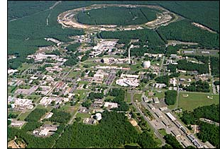
The PHENIX Decadal Plan:
Crafting the Future of the
Relativistic Heavy Ion Collider
Christine A. Aidala
Los Alamos National Lab
LANL P-25 Seminar
September 19, 2011

Slide 2
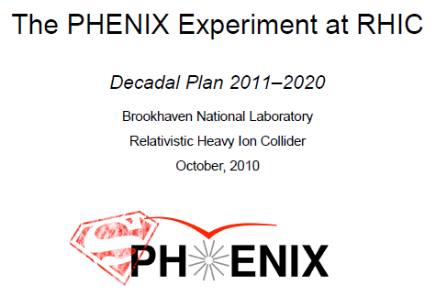
RHIC: Whence and whither?
RHIC turned on in 2000 as a groundbreaking facility: the world’s first heavy ion collider as well as the world’s first polarized proton collider
  Has tremendously advanced both fields over past decade!
Detector + accelerator upgrades over time have enhanced physics program well beyond baseline, with current program through ~2016 . . .
  PHENIX Forward Silicon Vertex detector (FVTX) to be installed and start data-taking over next few months!
In 2010 PHENIX and STAR Collaborations at RHIC charged by BNL management to (independently) formulate “Decadal Plans” laying out physics goals through and beyond currently foreseen program
  Initial documents handed in last fall (PHENIX’s 287 pages!)
  BUT – An ongoing planning process for the future of the facility!

Slide 3
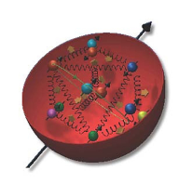
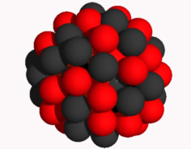
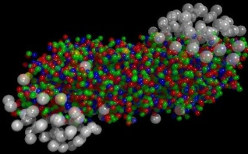
Why did we build RHIC in the first place?
To study QCD!
An accelerator-based program, but not designed to be at the energy (or intensity) frontier. More closely analogous to many areas of condensed matter research—create a system and study its properties!
What systems are we studying?
  “Simple” QCD bound states—the proton is the simplest stable bound state in QCD (and conveniently, nature has already created it for us!)
  Collections of QCD bound states (nuclei, also available out of the box!)
  QCD deconfined! (quark-gluon plasma, some assembly required!)

Slide 4
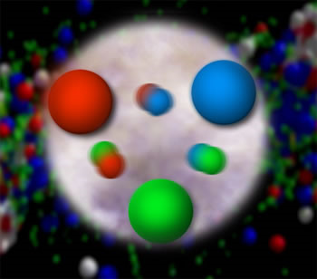
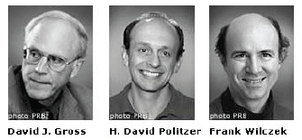
QCD: How far have we come?
Quantum chromodynamics an elegant and by now well-established field theory
  But d.o.f. are quarks and gluons, never observed in the lab! → QCD challenging!!
Three-decade period after initial birth of QCD dedicated to “discovery and development”
→ Symbolic closure: Nobel prize 2004 for asymptotic freedom
Now very early stages of second phase:
quantitative QCD!
Notes:
[While some a generation or so ahead of me have enjoyed very exciting careers [centered on][based around] the discovery and development of QCD, …]

Slide 5
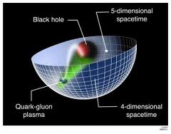
Advancing into the era of quantitative QCD: Theory already forging ahead!
In perturbative QCD, since 1990s starting to consider detailed internal QCD dynamics that parts with traditional parton model ways of looking at hadrons—and perform phenomenological calculations using these new ideas/tools!
  Non-collinearity of partons with parent hadron
  Non-linear evolution at small momentum fractions
  Various resummation techniques
  Various effective field theories
Non-perturbative methods:
  Lattice QCD just starting to perform calculations at physical point!
  AdS/CFT “gauge-string duality” an exciting recent development as first fundamentally new handle to try to tackle QCD in decades!

Slide 6
To continue advancing, critical to perform experimental work where quarks and gluons are relevant d.o.f. in the processes studied!

Slide 7
RHIC: A great place to (continue to) confront the challenges of QCD!
Understand more complex QCD systems within
the context of simpler ones
RHIC was designed from the start as a single facility capable of A+A, p+A, and p+p collisions
at the same center-of-mass energy
Major investment in RHIC beyond ~2017 closely linked to qualitatively expanding the capabilities of the facility → Add an electron ring . . .

Slide 8
What could RHIC look like in the future?
Its unprecedented flexibility could be extended even further!
e+p, p+p, e+A, p(d)+A, a+a, a+A, A+A
Electroweak and colored probes available in both the initial and final states!
Control over parton kinematics—e+A, e+p, fully reconstructed jets/more hermetic detectors
Variety of options for collision geometry (a+A, …)
  Will run Cu+Au in 2012!
Controlled experiments in hadronization
Quantitative understanding will develop from having a variety of measurements to compare . . .
Notes:
Starting to drop simplifying assumptions and approximations,
[deeper levels of understanding],. . .
Compare, contrast, provide different handles

Slide 9
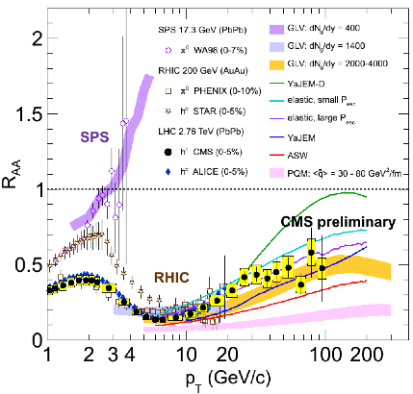
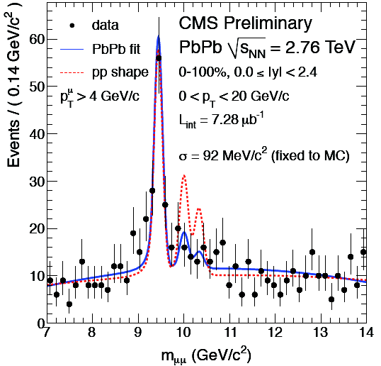
Heavy ions at the LHC: Helping us push forward into a more quantitative era for A+A!
Quark-gluon plasma created at LHC energies still appears to be strongly coupled!
Lots of work ahead to perform detailed comparisons to RHIC results at a variety of energies
  What generates the similarities?
  What generates the differences?
  …

Slide 10
Unanswered and emerging questions in
heavy ion physics
Are quarks strongly coupled to the QGP at all distance scales?
What are the detailed mechanisms for parton-QGP interactions and responses?
Are there quasiparticles at any scale?
Is there a relevant screening length in the QGP?
How is rapid equilibration achieved?
Electromagnetic energy loss in matter over
9 orders of magnitude in particle momentum

Slide 11
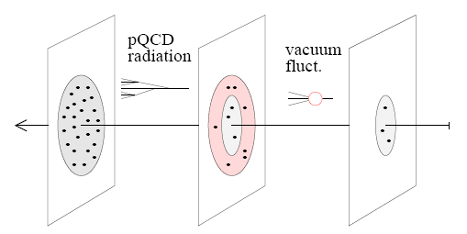
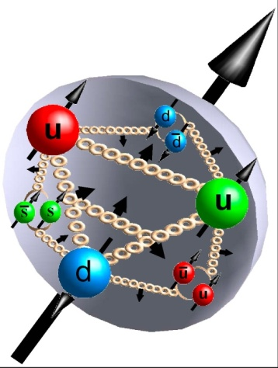
Unanswered and emerging questions in nucleon structure and the formation of hadrons
[Weiss 09]
What is the 3D spatial structure of the nucleon?
What is the nature of the spin of the nucleon (Spin puzzle continues!)
  How does orbital angular momentum contribute?
What spin-momentum correlations exist within hadrons and in the process of hadronization?
What is the role of color interactions in different processes?
radiative gluons/sea
non-pert. sea quarks/gluons
valence quarks/gluons

Slide 12
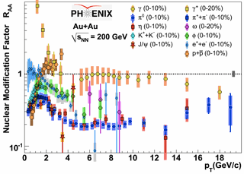
e+A vs. A+A:
Calibration using different probes
Already a technique extensively utilized in heavy ion physics!
  Probes that don’t interact strongly: direct photons, internal conversions of thermal photons, Z bosons
  Light mesons (light quarks—strongly interacting, various potential means of in-medium energy loss)
  Heavy flavor (strongly interacting but less affected by radiative energy loss) – silicon upgrades at RHIC will address over next few years!
e+A probes the initial state without the complications of strong interactions . . .

Slide 13
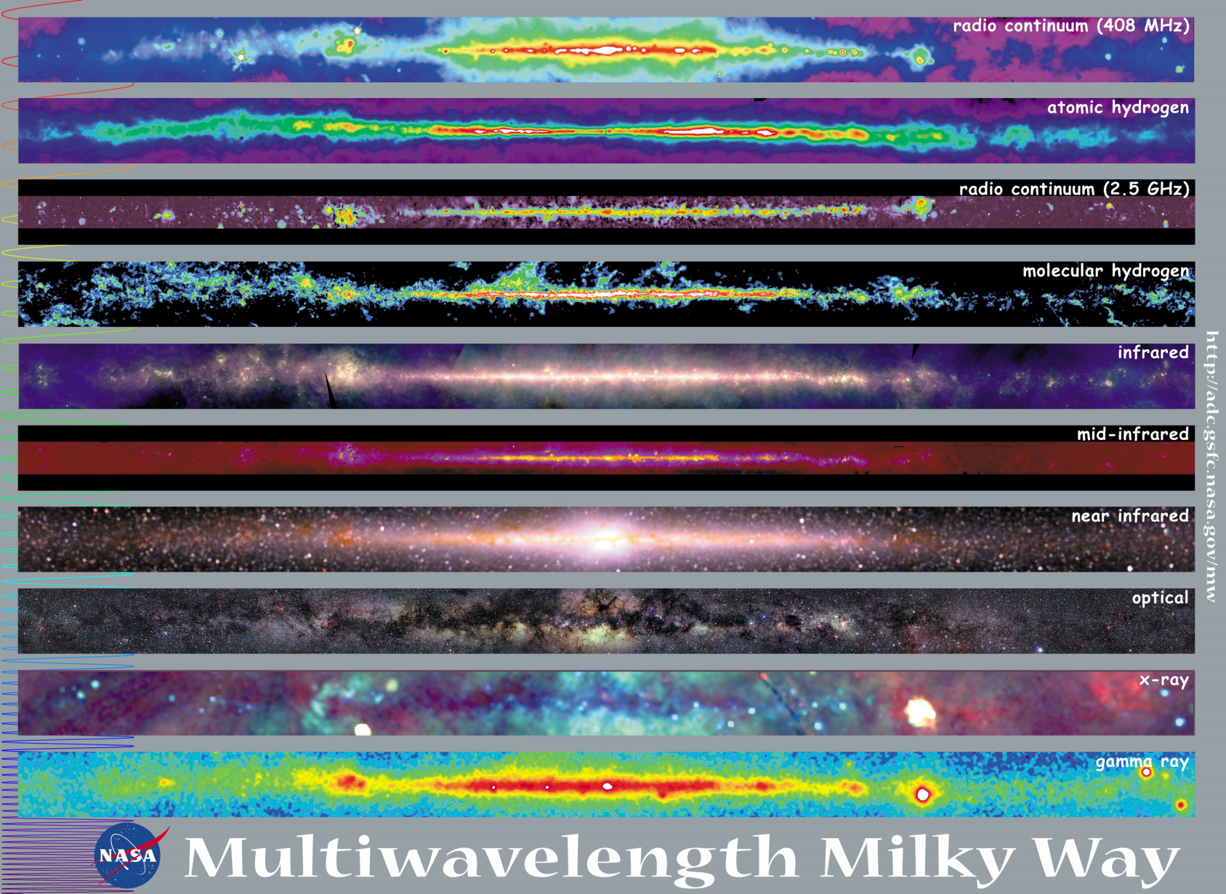
Observations with different probes allow us to learn different things!

Slide 14
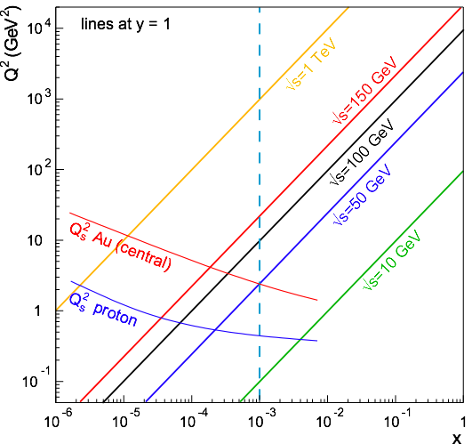
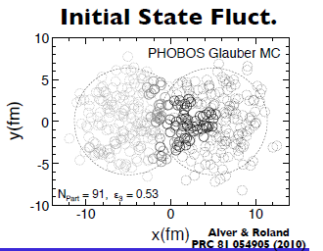
How can the RHIC A+A program be strengthened by adding electron beam capabilities?
Pin down the initial state:
Gluon saturation/Color Glass Condensate—can piece together a clear picture from e+A, p(d)+A, and A+A!
What’s the role of the initial state in the rapid thermalization observed at RHIC?
Can we quantify the role of initial-state fluctuations in the observed final-state correlations??
….

Slide 15
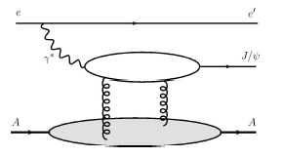
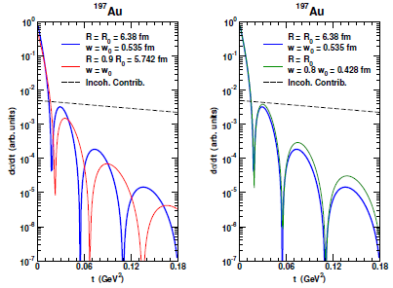

Impact-parameter-dependent nuclear gluon density via coherent vector meson production in e+A
Assume Woods-Saxon gluon density
Coherent diffraction pattern extremely sensitive to details of gluon density!

Slide 16
Continued p+p collisions at RHIC just for HI comparison once we have e+p?
If major new investment in RHIC as a facility is tied to adding an electron ring, aren’t e+p collisions better for studying nucleon structure anyway??
While electrons offer several advantages (interactions easy to calculate, reconstruct kinematics exactly), you can’t learn everything about the proton by probing it with an electron!!
  (Recall the ‘C’ in ‘QCD’ . . .)

Slide 17
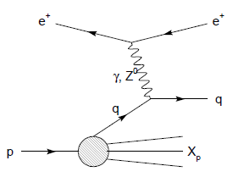
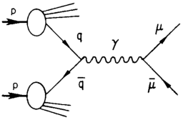
Modified universality of T-odd transverse-momentum-dependent distributions:
Color in action!
DIS: attractive final-state int.
Drell-Yan: repulsive initial-state int.
Some DIS measurements already exist. A polarized Drell-Yan measurement at RHIC will be a crucial test of our understanding of QCD!
As a result:

Slide 18
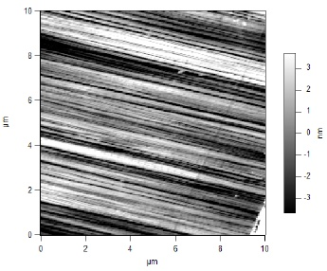
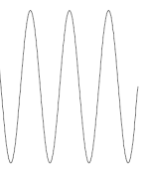
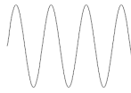
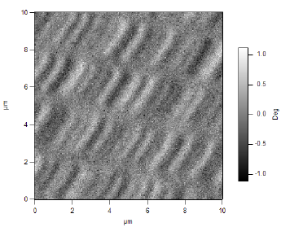
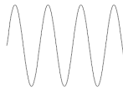
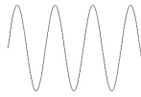
What things “look” like depends on how you “look”!
Slide courtesy of K. Aidala
Magnetic Force Microscopy
Computer Hard Drive
magnetic tip
Topography
Probe interacts with system being studied!
Lift height
Magnetism

Slide 19
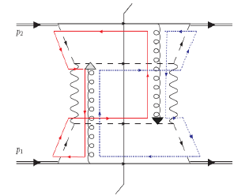
Factorization, color, and hadronic collisions
  Last year, theoretical work by T.C. Rogers, P.J. Mulders (PRD 81:094006, 2010) claimed pQCD factorization broken in processes involving hadro-production of hadrons if parton k_{T} taken into account (transverse-momentum-dependent (TMD) pdfs and/or FFs)
  “Color entanglement”
Non-collinear pQCD an exciting sub-field—lots of recent experimental activity, and theoretical questions probing deep issues of both universality and factorization in (perturbative) QCD!
Color flow can’t be described as flow in the two gluons separately. Requires simultaneous presence of both!

Slide 20
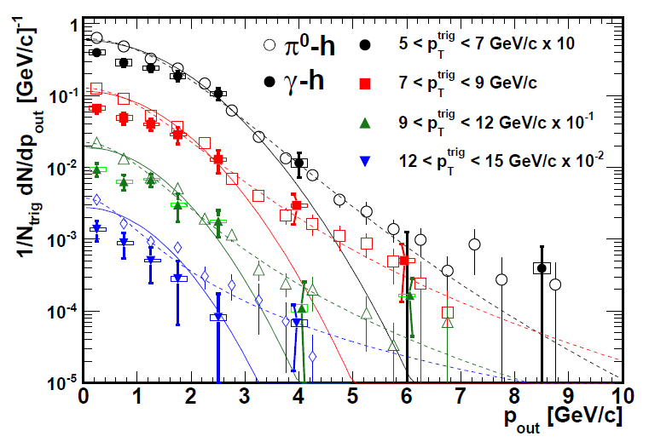
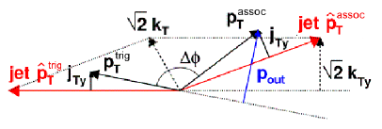

Testing factorization breaking with p+p comparison measurements for heavy ion physics:
Unanticipated synergy between programs!
PHENIX, PRD82, 072001 (2010)
Implications for observables describable using Collins-Soper-Sterman (“Q_{T}”) resummation formalism
Try to test using photon-hadron and dihadron correlation measurements in unpolarized p+p collisions at RHIC
Lots of expertise on such measurements within PHENIX, driven by heavy ion program!
(Curves shown here just empirical parameterizations from PHENIX paper)

Slide 21
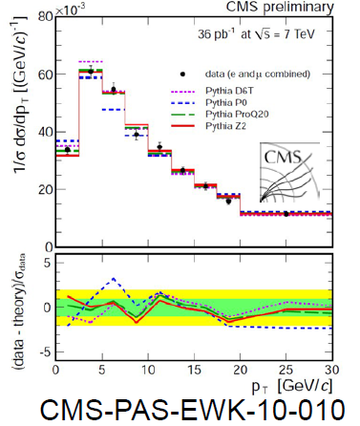
Testing TMD-factorization breaking with (unpolarized) p+p collisions at RHIC
Calculate p_{out} distributions assuming factorization works
  Will show different shape than data?
  Difference b/w factorized calculations and data will vary for 3-hadron vs. 4-hadron processes?
Take CSS soft factors (unpolarized non-collinear pdfs) from parameterizations of Drell-Yan and Z measurements
  New Z p_{T} spectra coming out of LHC and Tevatron will greatly improve parametrizations!
  Q² evolution worked out earlier this year: Aybat and Rogers, PRD83, 114042 (2011)

Slide 22
The more you know, the more you can learn . . .

Slide 23

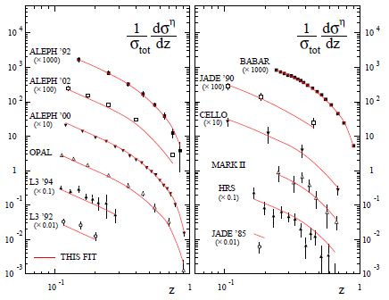
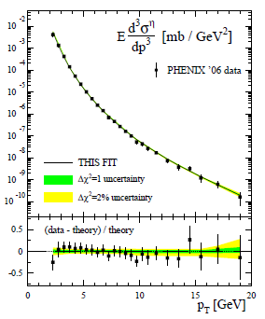
pQCD calculations for η mesons recently enabled by first-ever fragmentation function parametrization
Simultaneous fit to world e+e- and p+p data
  e+e- annihilation to hadrons simplest colliding system to study FFs
  Technique to include semi-inclusive deep-inelastic scattering and p+p data in addition to e+e only developed in 2007!
  Included PHENIX p+p cross section in eta FF parametrization
CAA, F. Ellinghaus, R. Sassot, J.P. Seele, M. Stratmann,
PRD83, 034002 (2011)

Slide 24
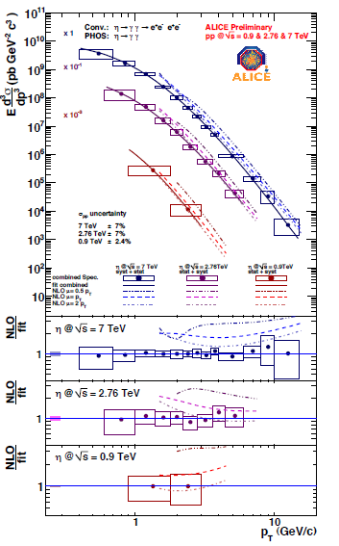
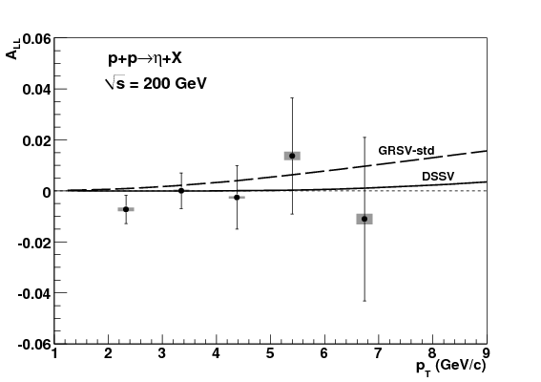
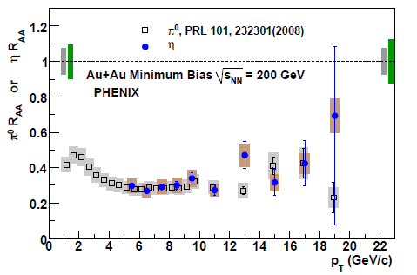
Some “applications” of eta FF
PHENIX, PRD83, 032001 (2011)
PRC82, 011902 (2010)
Eta double-helicity asymmetry, to learn more about gluon polarization
Eta cross section at LHC, to evaluate existing pQCD tools and pdfs against particle production at much higher √s
Can use to try to understand particle suppression in heavy ion collisions as well!
Cyclical process of refinement—the more non-perturbative functions are constrained, the more we can learn from additional measurements
ALICE, arXiv:1106.5932

Slide 25
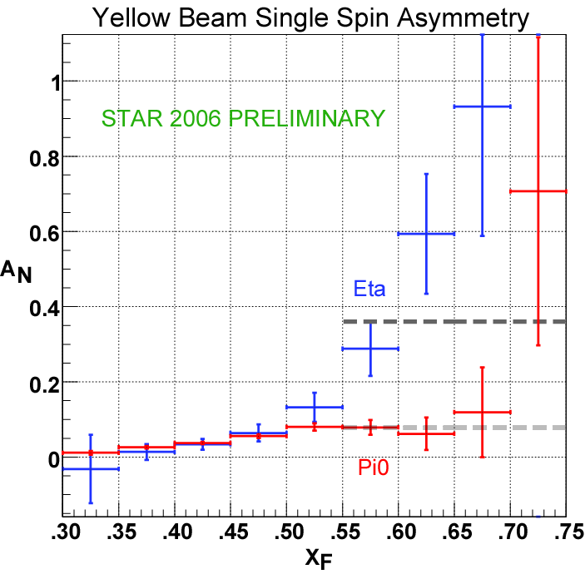
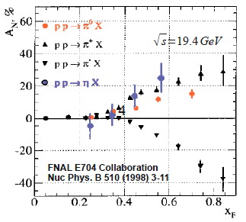
Another eta measurement of interest:Transverse single-spin asymmetry in eta production
Sensitive to spin-momentum correlations in the proton and/or in hadronization
Larger than the neutral pion!
STAR
Note earlier FNAL E704 data consistent . . .

Slide 26
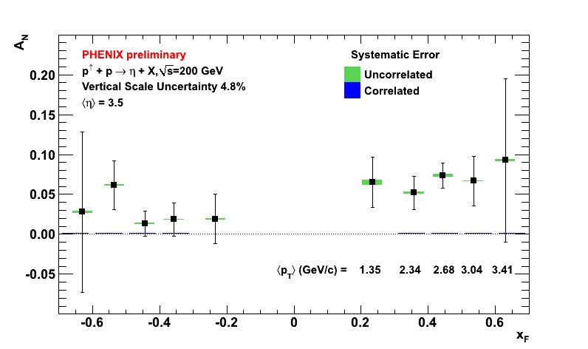
Recent PHENIX etas show no sharp increase for x_{F} > 0.5!
Released at PANIC, MIT, July 2011

Slide 27
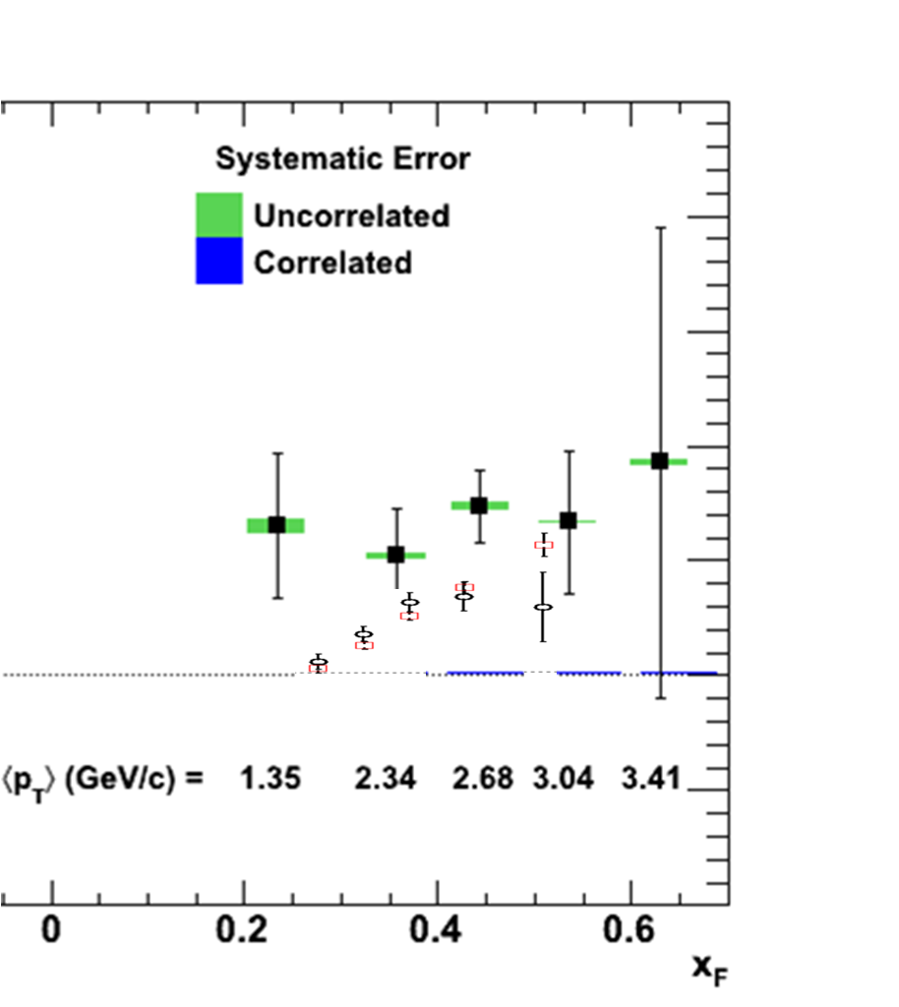
PHENIX eta vs. neutral pion
Not official PHENIX plot—not apples-to-apples comparison
Still suggests larger asymmetry for etas than for (merged-cluster) neutral pions!
Will need to wait for final results from both collaborations to understand eta vs. neutral pion . . .
Theory??

Slide 28
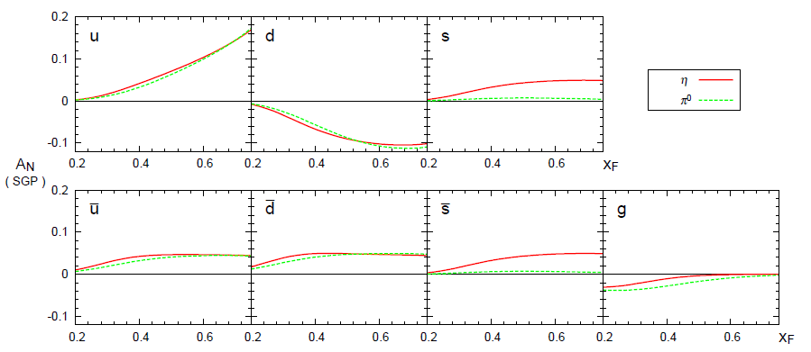
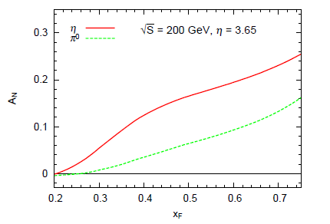
First eta transverse single-spin asymmetry theory calculation
Using new eta FF parametrization, first theory calculation now published (STAR kinematics)
Obtain larger asymmetry for eta than for pi0 over entire x_{F} range, not nearly as large as STAR result
Due to strangeness contribution!
Kanazawa + Koike, PRD83, 114024 (2011)

Slide 29
Hadronization: A lot to learn, from a variety of collision systems
What are the ways in which partons can turn into hadrons?
Spin-momentum correlations in hadronization?
  Correlations now measured definitively in e+e-! (BELLE)
Gluons vs. quarks?
  Gluon vs. quark jets a hot topic in the LHC p+p program right now
  Go back to clean e+e- with new jet analysis techniques in hand?
In “vacuum” vs. cold nuclear matter vs. hot + dense QCD matter?
  Use path lengths through nuclei to benchmark hadronization times
Hadronization via “fragmentation” (what does that really mean?), “freeze-out,” “recombination” (quasiparticles in medium?), . . .?
  Soft hadron production from thermalized quark-gluon plasma—different mechanism than hadronization from hard-scattered q or g?
Light atomic nuclei and antinuclei also produced in heavy ion collisions at RHIC!
  How are such “compound” QCD systems formed from partons??
…
QCD subfields studied at RHIC (and elsewhere) are at different points in terms of our present level of understanding, but everything moving in the same direction to (finally!) become more quantitative.
As the various subfields mature, the power they have to strengthen and inform one another is ever increasing!

Slide 30
How can we evolve the detectors and facility in order to do the physics we’d like to at RHIC in the future?

Slide 31
Some thoughts on future detectors
Multipurpose, flexible—ready to address new questions as they arise!
Uniform, compact
Two multipurpose detectors? One optimized for hadronic/nuclear collisions with secondary capabilities in e+A, e+p; other vice versa? Possible to optimize for both??
Staged implementations, but integrate end goals into earlier-stage designs
Renewed collaborations!
  Major new program should attract new collaborators!

Slide 32
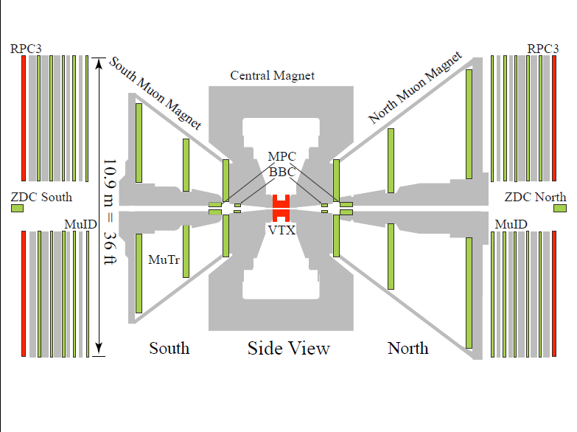
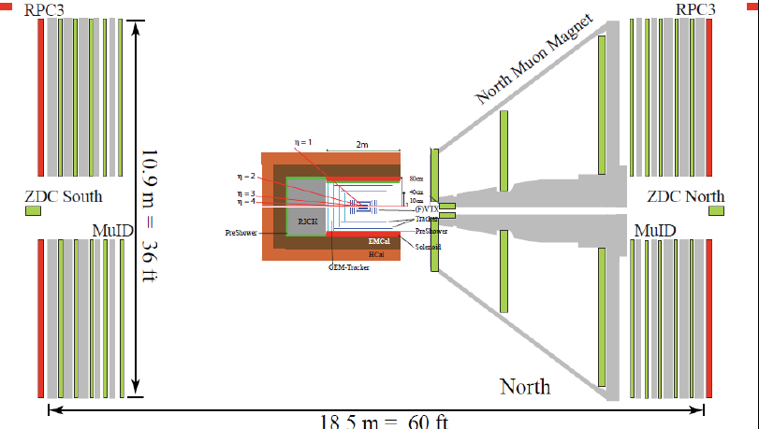
Thinking big . . . Or, well, small
Conceptual design for detector to be installed between ~2017 and ~2021
Current PHENIX detector

Slide 33
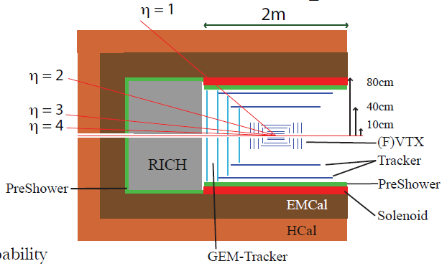
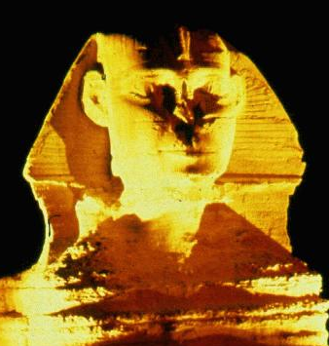
sPHENIX detector concept
PHENIX discussing major overhaul of detector beyond ~2016
STAR currently discussing much more modest upgrades
SPHNX??

Slide 34
Staging concepts: Midrapidity barrel
Midrapidity barrel focused largely on jet measurements in heavy ion physics, with bulk of program to be completed before an electron beam available ~2022
  But need to keep in mind ultimate e+p/e+A environment in everything designed now
    E.g. magnet, leaving space to eventually add particle ID, . . .
  Probably replace inner tracking with lower-mass tracking once electron beam available

Slide 35
Staging concepts:
Forward spectrometer
Forward spectrometer focused mainly on p+p and p+A physics
Should be able to design magnetic field + spectrometer with strong capabilities both in p+p/p+A as well as e+p/e+A (hadron-going direction)
Would implement after midrapidity barrel upgrade
  Likely very minor forward upgrades and/or more improvised solutions to access some of the physics in the meantime (e.g. restack old calorimeters)
When electron beam available in early 2020s replace other muon arm with (simpler) spectrometer for electron-going direction

Slide 36
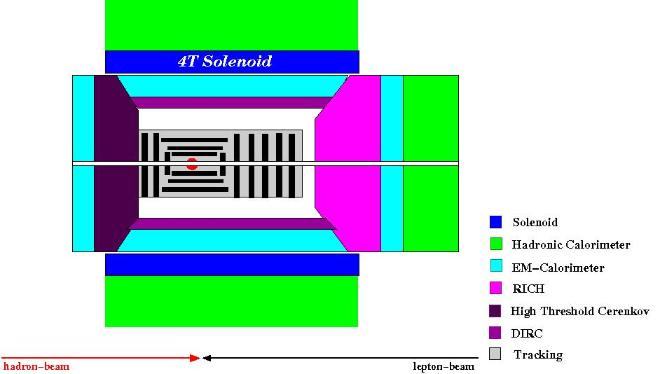
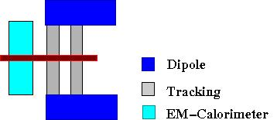
e+p/e+A-optimized concept from
Electron-Ion Collider Collaboration
Forward / Backward
Spectrometers:
Hadron-going-direction spectrometer similar to forward spectrometer optimized for p+p/p+A
high acceptance -5 < η < 5 central detector
good PID and vertex resolution
tracking and calorimeter coverage the same → good momentum resolution
low material density → minimal multiple scattering and bremsstrahlung
forward electron and proton dipole spectrometers

Slide 37
Long-term accelerator prospects
Could go up to energies as high as √s = 650 GeV for p+p, (260 GeV for Au+Au) with new DX magnets
  W cross section ~2x higher than at 500 GeV, . . .
Traditional or coherent electron cooling for proton beams to increase luminosity
Polarized He³ beams?
  R&D for polarized He³ source ongoing
  Workshop on polarized He³ at BNL at end of this month!
    Physics as well as technical discussions

Slide 38
Moving forward
Initial detector R&D workshops December 14-16, 2010 at BNL
Modest detector R&D funding was made available this year through PHENIX
First DOE call for Electron-Ion Collider detector R&D proposals was also this year
  Several overlapping efforts with PHENIX R&D projects
  Joint proposals from institutions currently within and outside of PHENIX and RHIC
sPHENIX physics goals and detector concepts positively reviewed by RHIC Program Advisory Committee in June
sPHENIX simulation studies initiated last year and ongoing
  5-day “workfest” just held at BNL last week!
. . .
Should be lots of opportunities over next several years for national labs such as LANL to get involved in detector development

Slide 39
So, is this really a decadal plan we’ve been talking about??
Not exactly. We’re talking about how we could, by 2020, be in position to embark upon a new longer-term program at RHIC, with both electron-hadron and hadron-hadron collisions available to us, and with major new detection capabilities designed to allow us to pursue a comprehensive QCD program!

Slide 40
Summary and outlook
The next stage of all of QCD physics is to move toward much more quantitative measurements and calculations—RHIC an excellent facility to drive this!
  Comfortable energy regime for the quarks and gluons of QCD to be the relevant d.o.f.
  Unprecedented control of numerous variables over a wide range—energy, geometry, probe, parton kinematics, polarization, . . .
Strategy: Develop and propose an integrated, comprehensive physics program for the future of the facility taking full advantage of both electroweak and hadronic/nuclear collisions!
The challenge of QCD continues!
RHIC could become an even more powerful tool to fulfill advancement to a quantitative era in QCD by the 2020s!

Slide 41
Extra

Slide 42
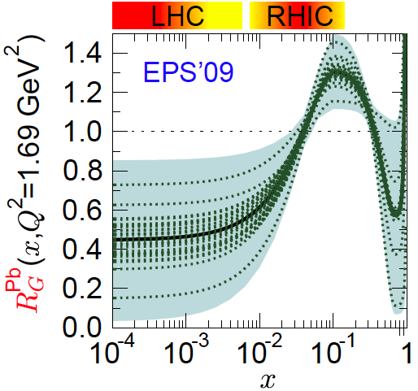
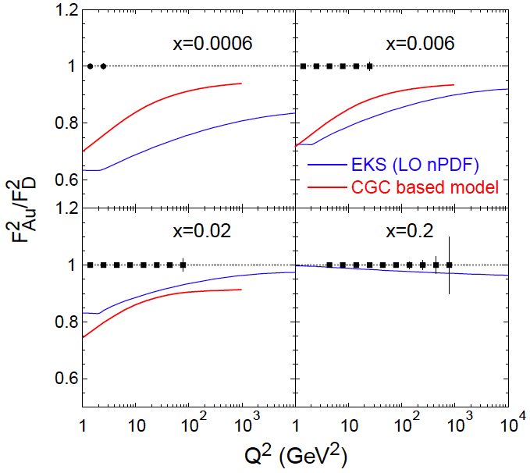
e+A collisions: F₂ for nuclei
shadowing
LHC η=0
RHIC η=3
Assumptions:
10GeV x 100GeV/n
  √s=63GeV
Ldt = 4/A fb⁻¹
  equiv to 3.8 10³³ cm⁻²s⁻¹
  T=2weeks; DC:50%
Detector: 100% efficient
  Q² up to kin. limit sx
Statistical errors only
  Note: L~1/A
“sweet” spot
R=1
antishadowing

Slide 43
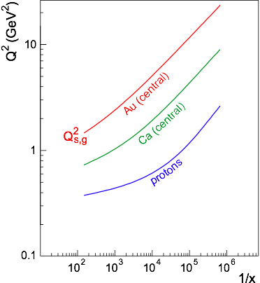
Reaching the saturation regime
Saturation:
Au: Strong hints from RHIC at x ~ 10⁻³
p: Weak hints at HERA up to x=6.32⋅10⁻⁵, Q² = 1-5 GeV²
Nuclear Enhancement:
Hera
Coverage:
  Need lever arm in Q² at fixed x to constrain models
  Need Q > Qs to study onset of saturation
ep: even 1 TeV is on the low side
eA: √s = 50 GeV is marginal,
around √s = 100 GeV desirable
→ 20 GeV x 100 GeV
Kowalski, Lappi and Venugopalan, PRL 100, 022303 (2008));
Armesto et al., PRL 94:022002;
Kowalski, Teaney, PRD 68:114005)

Slide 44
Collinear factorization in pQCD:
Long history, relatively well tested
Origins ~30 years ago
Wealth of data on linear momentum structure of the nucleon that can be described in terms of twist-2, collinear pdf’s
  Less experimental data for the polarized case, but (most) theoretical concepts for the polarized twist-2, collinear distributions shared the same origin as in the unpolarized case
Realm in which the ΔG and W helicity programs at RHIC exist
Everything described as a function of linear momentum fraction
If want to access QCD dynamics, need to go beyond the twist-2, collinearly factorized picture.
Dynamics ↔ (transverse) SSA’s ~ S•(p₁×p₂)

Slide 45

Twist-two pdf’s and FF’s, including TMD’s
Transversity
Measured non-zero
Sivers
Polarizing FF
Boer-Mulders
Pretzelosity
Collins
N.B. Also experimental evidence for non-zero collinear “interference” or “di-hadron” FF.
Only single-hadron FF’s shown here.

Slide 46


Progress in pQCD techniques: Threshold resummation to extend pQCD to lower energies
pBe→hhX
pp→π⁰π⁰X
M (GeV)
cos θ*
Almeida, Sterman, Vogelsang PRD80, 074016 (2009) .
Cross section for dihadron production vs. invariant mass and cos θ* at sqrt(s)~20-40 GeV using threshold resummation (rigorous method for implementing p_{T} and rapidity cuts on hadrons to match experiment). Much improved agreement compared to NLO!

Slide 47


Progress in pQCD techniques: Phenomenological applications of a non-linear gluon saturation regime at low x
Phys. Rev. D80, 034031 (2009)

Slide 48

Eta p_{T} shape consistent with neutral pions
η

Slide 49

Drell-Yan transverse SSA predictions
x_{F}
x_{F}
y
y

Slide 50

Flavor separation of TMDs using He³
Zhongbo
Kang
With polarized He³ as well as proton beams at RHIC, new handles on flavor separation of various transverse spin observables possible
  What will the status of the (non-)valence quark puzzle be by then??

Slide 51

Full flavor separation of light quark helicity distributions with p+p and p+He³

Slide 52

A (relatively) recent surprise from p+p, p+d collisions
Fermilab Experiment 866 used proton-hydrogen and proton-deuterium collisions to probe nucleon structure via the Drell-Yan process
Anti-up/anti-down asymmetry in the quark sea, with an unexpected x behavior!
Hadronic collisions let us continue to find surprises in the rich linear momentum structure of the proton, even after > 40 years of DIS!
PRD64, 052002 (2001)

Slide 53
Questions
Observables
Needs
Quarks strongly coupled
Interaction mechanisms
Jets, Dijets,
γ-Jet (FF, radiation)
Charm/Beauty Jets
Quasiparticles in medium
Identify physics questions
→Define observables
→Determine detector needs
…Still lots of work ahead of us!
J/ψ at multiple energies
Screening Length
Upsilons (all states)
Thermal Behavior
Thermalization time
Direct γ* flow
Large Acceptance
High Rate
Electron ID
Photon ID
Excellent Jet Capabilities (HCAL)

Slide 54
Physics expected by ~2016
Not easy to predict the future, but we
expect that the following will be in hand:
Heavy Ions:
1. Full characterization of bulk medium dynamics (e.g. η/s, ζ, T, ε)
2. Completion of Low Energy scan for critical point
3. Experimental measure of charm/beauty dynamics p_{T} ~ 6 GeV
4. Parton energy loss (jets) start on program
Proton Spin Structure:
1. W→lepton measurements to constrain Δu, Δubar, Δd, Δdbar
2. Completion of gluon Δg via π⁰, η, h^{+/-} A_{LL} @ 200 and 500 GeV
3. A_{N} measurements for hadrons

Slide 55

Quark vs. gluon jets at RHIC and LHC

Slide 56

Hadronic calorimetry tightens relation between measured and true jet energy
GEANT4 simulation

