Slide 1
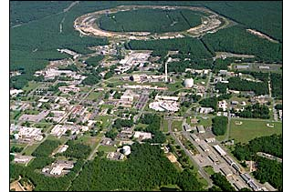
Investigating the Spin Structure of the Proton at RHIC
Christine Aidala
Los Alamos National Lab
Jefferson Lab
May 15, 2009
Notes:
I feel that the overarching question that those of us working on the proton structure program at RHIC would like to contribute to answering is . . .

Slide 2
How do we understand the visible matter in our universe in terms of the fundamental quarks and gluons of QCD?
Notes:
An essential tool of the trade if this is a question you’re interested in tackling is . . .

Slide 3
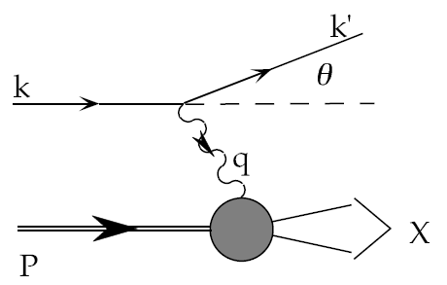
Deep-Inelastic Scattering:
A Tool of the Trade
Probe nucleon with an electron or muon beam
Interacts electromagnetically with (charged) quarks and antiquarks
“Clean” process theoretically—quantum electrodynamics well understood and easy to calculate
Technique that originally discovered the parton structure of the nucleon in the 1960’s!

Slide 4
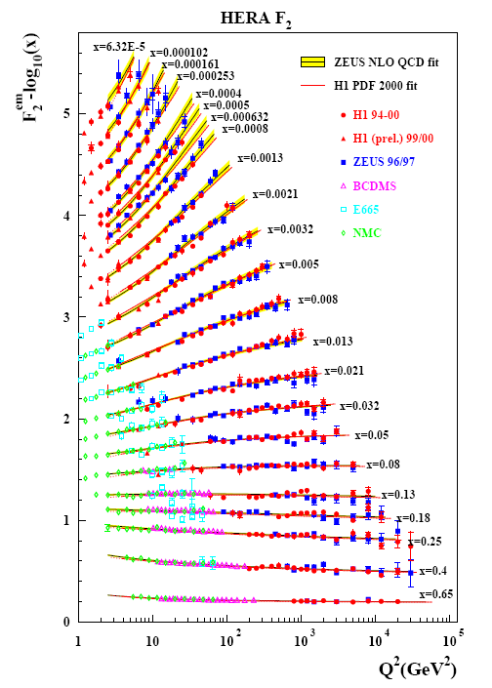
Decades of DIS Data: What Have We Learned?
Wealth of data largely thanks to proton-electron collider, HERA, in Hamburg, which shut down in 2007
Rich structure at low x
Half proton’s linear momentum carried by gluons!
PRD67, 012007 (2003)
Notes:
There are a number of useful ways to look at and describe nucleon structure. For example in addition to the structure functions such as F2 shown here, which, if you will, lets you “see” the asymptotic freedom of QCD, you can also describe the proton in terms of parton distribution functions, . . . In any case, we’ve learned quite a lot from decades of DIS data on the linear momentum structure of the proton, but even in the age of HERA, . . .

Slide 5
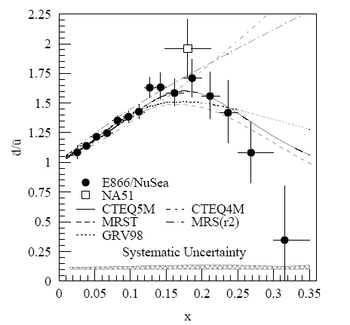
And a (Relatively) Recent Surprise From p+p, p+d Collisions
Fermilab Experiment 866 used proton-hydrogen and proton-deuterium collisions to probe nucleon structure via the Drell-Yan process
Anti-up/anti-down asymmetry in the quark sea, with an unexpected x behavior!
Hadronic collisions play a complementary role to DIS and have let us continue to find surprises in the rich linear momentum structure of the proton, even after 40 years!
PRD64, 052002 (2001)

Slide 6
What about the angular momentum structure of the proton?

Slide 7

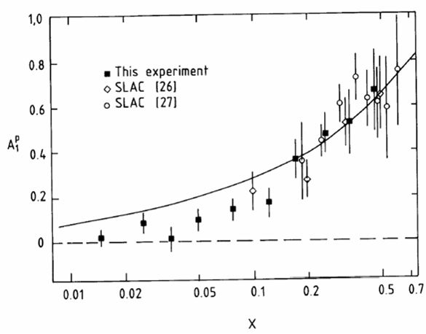
Proton “Spin Crisis”
SLAC: 0.10 < x <0.7
CERN: 0.01 < x <0.5
Quark-Parton Model
expectation!
A₁(x)
0.1 < x_{SLAC} < 0.7
E130, Phys.Rev.Lett.51:1135 (1983)
424 citations
These haven’t been easy to measure!
EMC (CERN), Phys.Lett.B206:364 (1988)
1447 citations!
0.01 < x_{CERN} < 0.5
“Proton Spin Crisis”
x-Bjorken

Slide 8
Decades of Polarized DIS
HERMES
Quark Spin – Gluon Spin – Transverse Spin – GPDs – L_{z}
SLAC E80-E155
CERN EMC,SMC COMPASS
DESY HERMES
JLAB Halls A, B, C
No polarized electron-proton collider to date, but we did end up with a polarized proton-proton collider . . .
→2000
ongoing
→2007
ongoing
PRL92, 012005 (2004)
Notes:
These have all been fixed-target experiments. By the 1990’s, the technology existed to accelerate polarized proton beams to high energies. In fact I got into this business in the 1990’s working on studies in support of polarizing the proton beam at HERA. Polarized HERA was never realized, but while discussions for polarized HERA were going on in the ‘90’s, plans were already being implemented to polarize the proton beams they would have at RHIC.

Slide 9
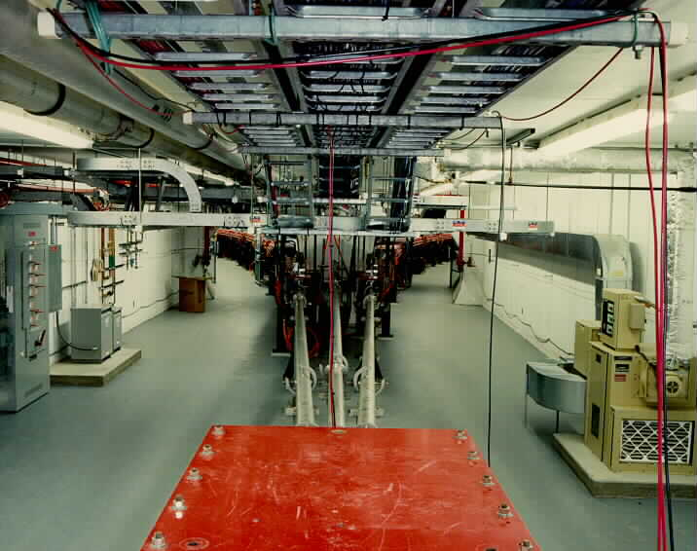
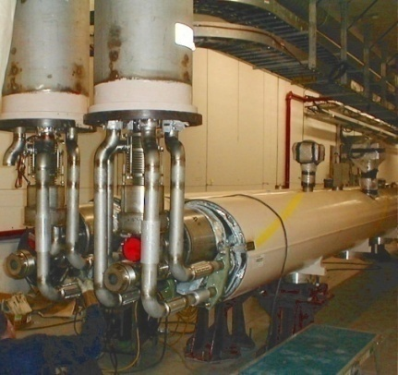
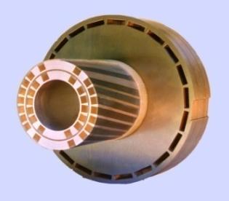
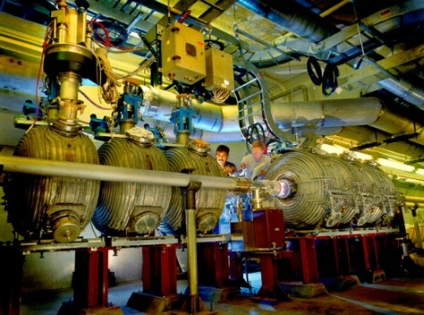
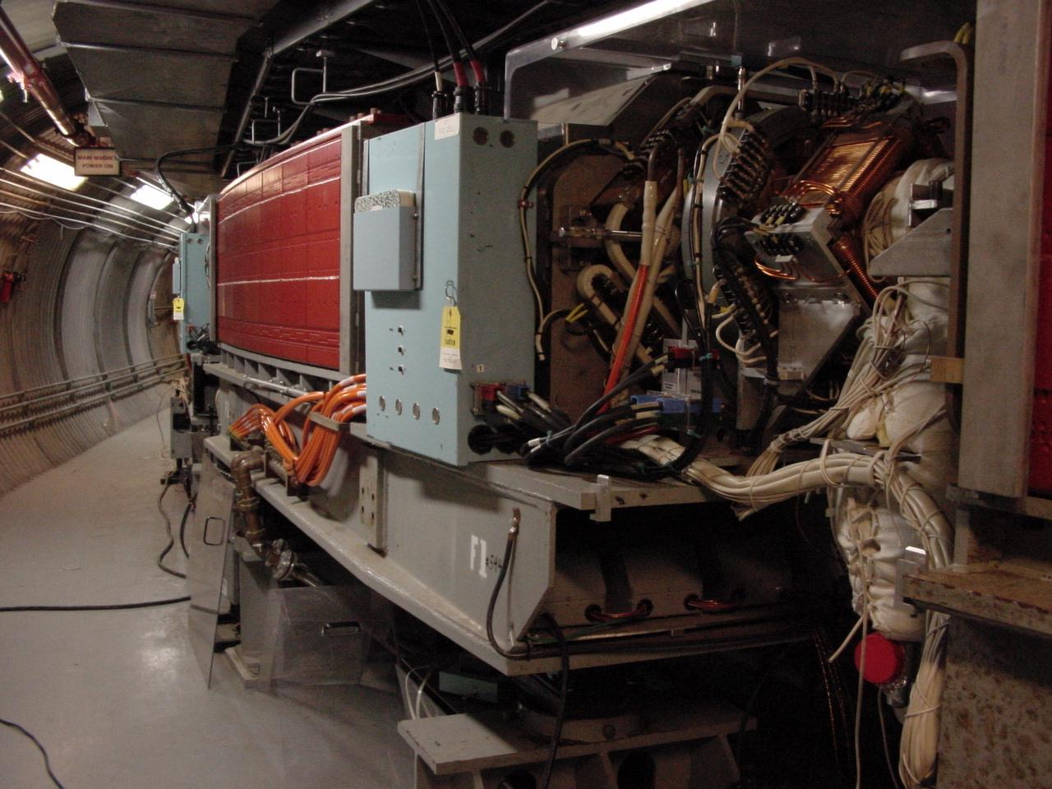
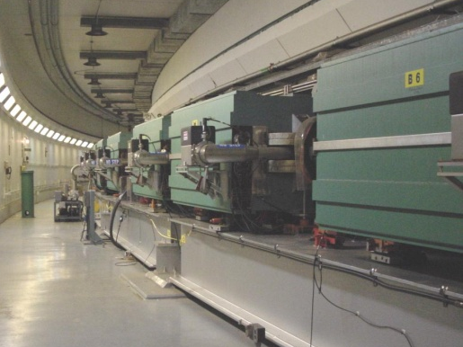
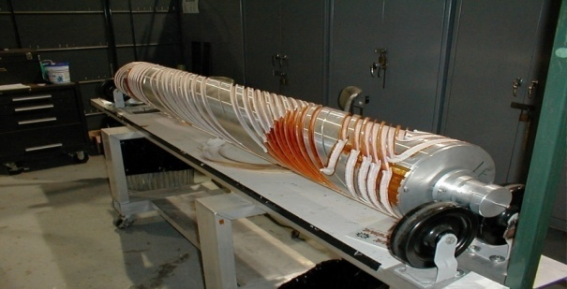
RHIC as a Polarized p+p Collider
Absolute Polarimeter (H jet)
RHIC pC Polarimeters
Siberian Snakes
PHOBOS
BRAHMS & PP2PP
Siberian Snakes
PHENIX
Spin Flipper
STAR
Spin Rotators
Various equipment to maintain and measure beam polarization through acceleration and storage
Partial Snake
Helical Partial
Snake
Polarized Source
Strong Snake
LINAC
AGS
200 MeV Polarimeter
BOOSTER
Rf Dipole
AGS Internal Polarimeter
AGS pC Polarimeter
Notes:
RHIC, as a high-energy polarized proton collider, really represents an outstanding achievement in accelerator physics. . . . [equipment].

Slide 10
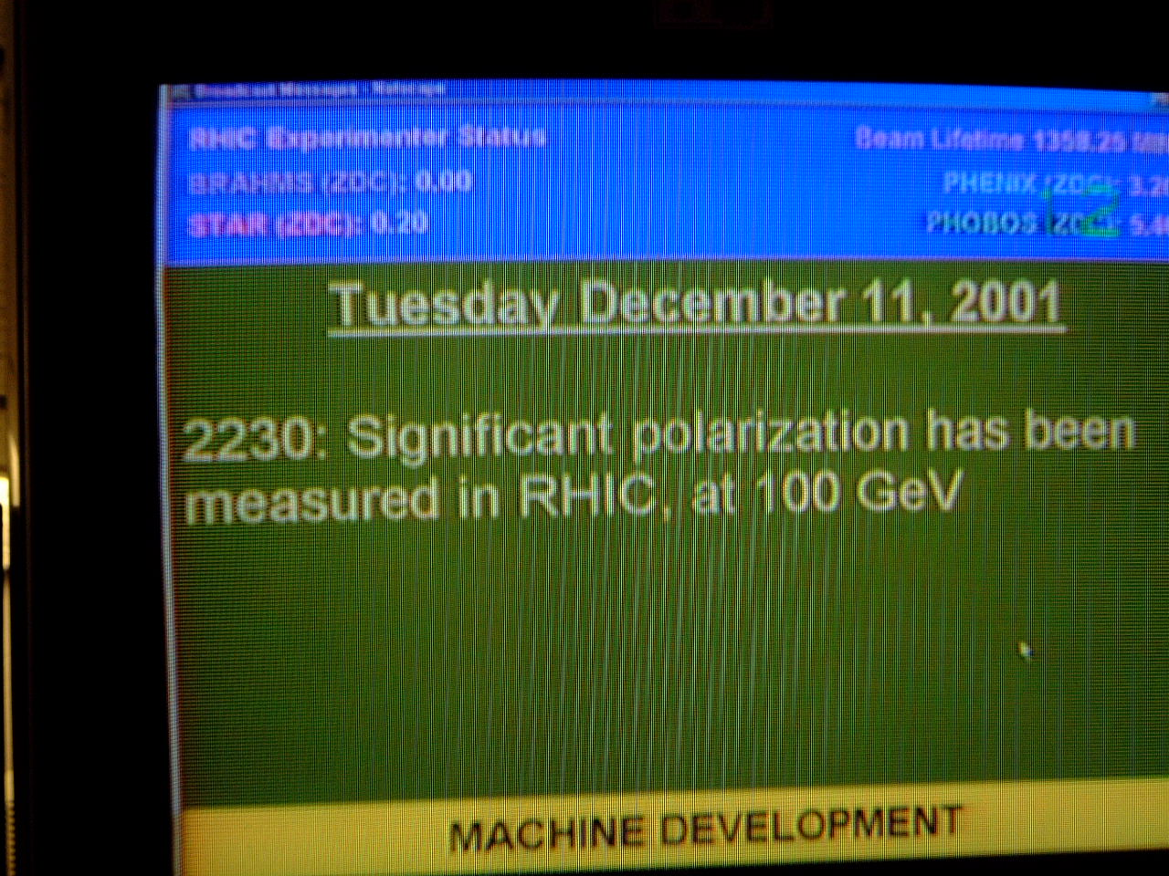
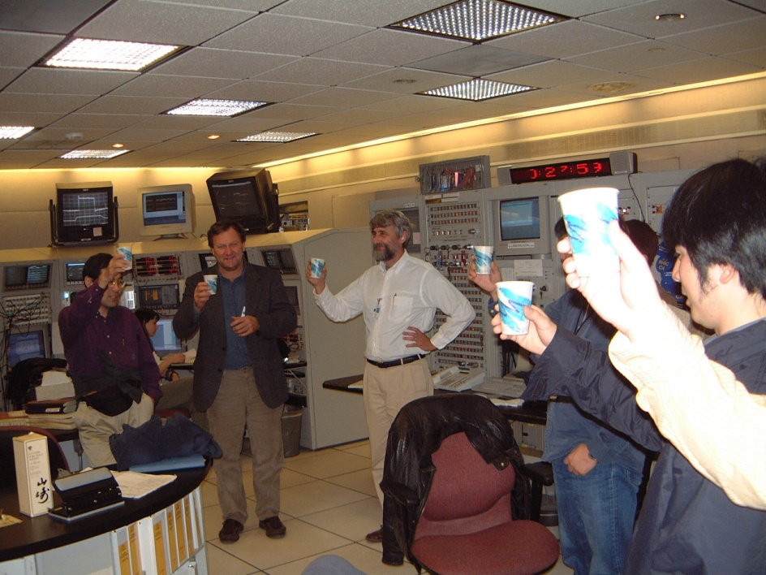
December 2001: News to Celebrate

Slide 11
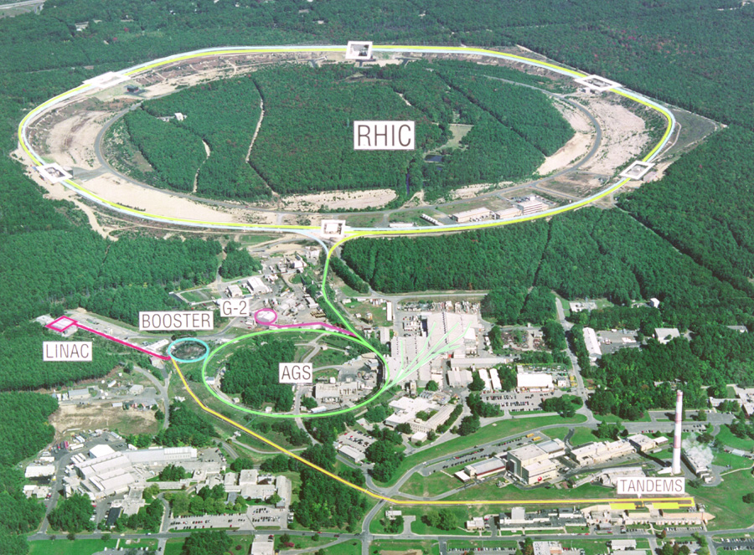

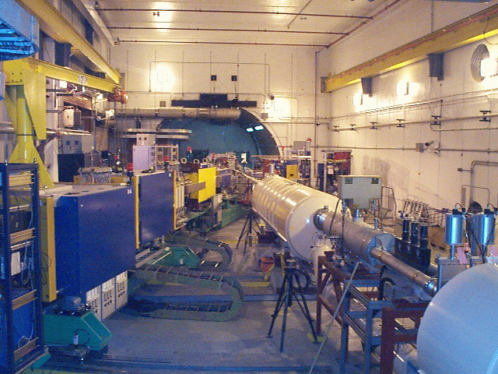
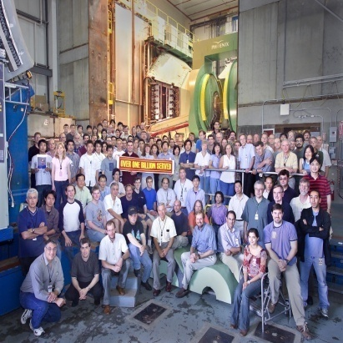
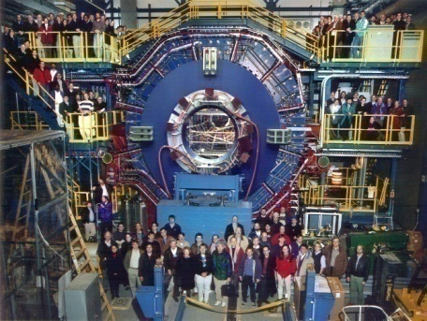


RHIC Spin Physics Experiments
Three experiments: STAR, PHENIX, BRAHMS
Future running only with STAR and PHENIX
Transverse spin only
(No rotators)
Longitudinal or transverse spin
Longitudinal or transverse spin
Accelerator performance:
Avg. pol ~60% at 200 GeV (design 70%).
Achieved 3.5x10³¹ cm⁻² s⁻¹ lumi (design ~5x this).

Slide 12
Proton Spin Structure at RHIC
Transversity
Transverse-momentum-
dependent distributions
, Jets
Prompt Photons
Single-Spin Asymmetries
Back-to-Back Correlations
Advantages of a polarized proton-proton collider:
Hadronic collisions → Leading-order access to gluons
High energies → Applicability of perturbative QCD
High energies → Production of new probes: W bosons

Slide 13
Reliance on Input from Simpler Systems
Disadvantage of hadronic collisions: much “messier” than DIS! → Rely on input from simpler systems
The more we know from simpler systems such as DIS and e+e- annihilation, the more we can in turn learn from hadronic collisions!

Slide 14
Factorization and Universality in Perturbative QCD
q(x₁)
Hard Scattering Process
X
g(x₂)
“Hard” probes have predictable rates given:
    Parton distribution functions (need experimental input)
    Partonic hard scattering rates (calculable in pQCD)
    Fragmentation functions (need experimental input)
Universality
(Process
independence)

Slide 15
Proton Spin Structure at RHIC
Transversity
Transverse-momentum-
dependent distributions
, Jets
Prompt Photons
Single-Spin Asymmetries
Back-to-Back Correlations

Slide 16
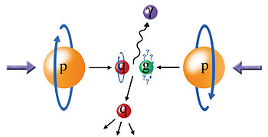
Probing the Helicity Structure of the Nucleon with p+p Collisions
Study difference in particle production rates for same-helicity vs. opposite-helicity proton collisions
DIS
?
pQCD
e+e-
Leading-order access to gluons → ΔG
Notes:
Let me now show you some highlights from the helicity program at RHIC.

Slide 17
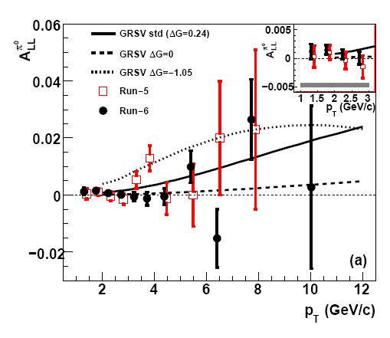
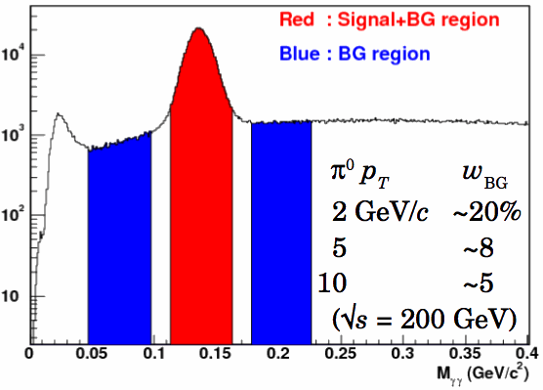

Inclusive Neutral Pion Asymmetry at √s=200 GeV
arXiv:0810.0694, submitted to PRL
PHENIX: Limited acceptance and fast EMCal trigger → Neutral pions have been primary probe
- Subject to fragmentation function uncertainties, but easy to reconstruct
Helicity asymmetry measurement
Notes:
“Quality of data fits versus gluon spin in measured region”
How do we know that we can trust pqcd in extracting gluon spin?
“pQCD works well at RHIC energies”

Slide 18
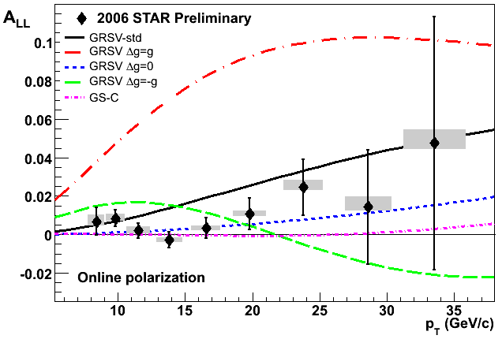
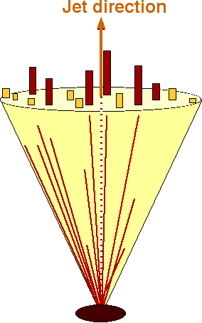
Inclusive Jet Asymmetry at √s=200 GeV
A_{LL} systematics | (x 10 ⁻³)
Reconstruction + Trigger Bias | [-1,+3] (p_{T} dep)
Non-longitudinal Polarization | ~ 0.03 (p_{T} dep)
Relative Luminosity | 0.94
Backgrounds | 1st bin ~ 0.5 Else ~ 0.1
STAR: Large acceptance
→ Jets have been primary probe
Not subject to uncertainties on fragmentation functions, but need to handle complexities of jet reconstruction
π⁺
e⁺
π⁰
π⁻
Κ⁰
p_{T} systematic | ±6.7%
Helicity asymmetry measurement
GRSV curves and data with cone radius R= 0.7 and -0.7 < η < 0.9
STAR
18
Notes:
18

Slide 19
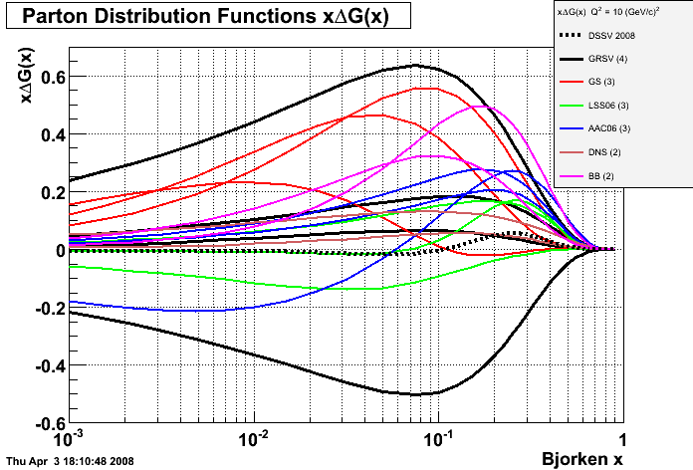
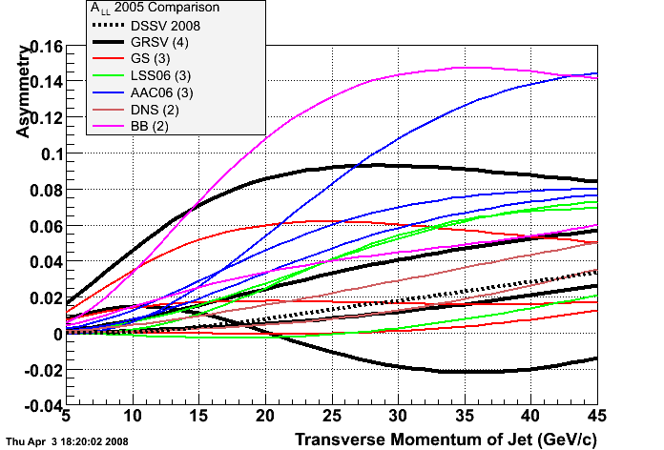
Sensitivity to GRSV parametrization is not unique! The STAR data constrain several predictions.
Q² = 10 GeV²
Bjorken x
There are many predictions for Δg(x) vs x which can be translated into predictions for A_{LL} vs. jet, pion, etc. p_{T} and compared with RHIC data.
Notes:
19

Slide 20
Sampling the Integral of ΔG: π⁰ p_{T} vs. x_{gluon}
Inclusive asymmetry measurements in p+p collisions sample from wide bins in x—sensitive to (truncated) integral of ΔG, not to functional form vs. x
Based on simulation using NLO pQCD as input
arXiv:0810.0694, submitted to PRL

Slide 21
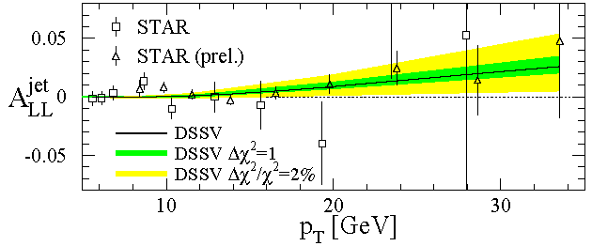
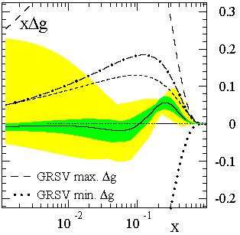
Present Status of Δg(x): Global pdf Analyses
de Florian et al., PRL101, 072001 (2008)
Still a long road ahead! Need to perform measurements with higher precision and covering a greater range in gluon momentum fraction.
The first global next-to-leading-order (NLO) analysis to include inclusive DIS, semi-inclusive DIS, and RHIC p+p data on an equal footing
Truncated moment of Δg(x) at moderate x found to be small
Best fit finds node in gluon distribution near x ~ 0.1
  Not prohibited, but not so intuitive . . .
x range covered by current RHIC measurements at 200 GeV
Notes:
If you consider the thousands of points going into standard global fits of unpolarized pdf’s, we’ve still got a long way to go!

Slide 22
The Future of ΔG Measurements at RHIC
Extend x coverage
  Run at different center-of-mass energies
    Already results for neutral pions at 62.4 GeV, now first data at 500 GeV
  Extend measurements to forward particle production
    Forward calorimetry recently enhanced in both PHENIX and STAR
Go beyond inclusive measurements—i.e. measure the final state more completely—to better reconstruct the kinematics and thus the x values probed.
  Jet-jet and direct photon – jet measurements – But need higher statistics!
Additional inclusive measurements of particles sensitive to different combinations of quark and gluon scattering . . .

Slide 23
The Pion Isospin Triplet, A_{LL} and ΔG
At transverse momenta > ~5 GeV/c, midrapidity pions dominantly produced via qg scattering
Tendency of π⁺ to fragment from an up quark and π⁻ from a down quark and fact that Δu and Δd have opposite signs make A_{LL} of π⁺ and π⁻ differ measurably
Order of asymmetries of pion species can provide information on the sign of ΔG, which remains unknown!
Fraction pions produced

Slide 24
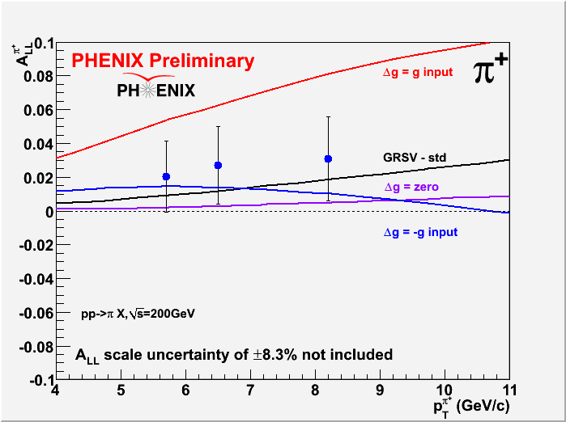
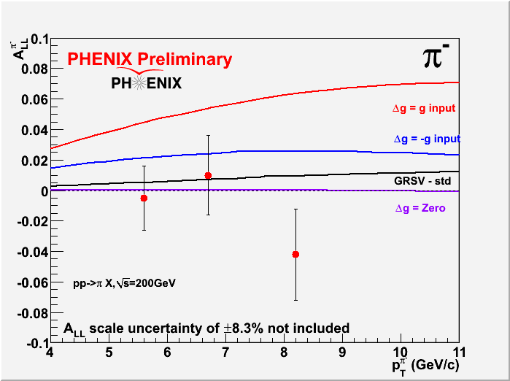
Charged pion A_{LL} at 200 GeV
So far statistics-limited, but expected to become more significant measurement using data from ongoing 200 GeV run!

Slide 25
Proton Spin Structure at RHIC
Transversity
Transverse-momentum-
dependent distributions
, Jets
Prompt Photons
Single-Spin Asymmetries
Back-to-Back Correlations

Slide 26
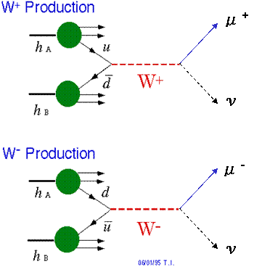
Flavor-Separated Sea Quark Polarizations Through W Production
Flavor separation of the polarized sea quarks with no reliance on FF’s!
Complementary to semi-inclusive DIS measurements.
Parity violation of the weak
interaction in combination with
control over the proton spin
orientation gives access to the
flavor spin structure in the proton!

Slide 27
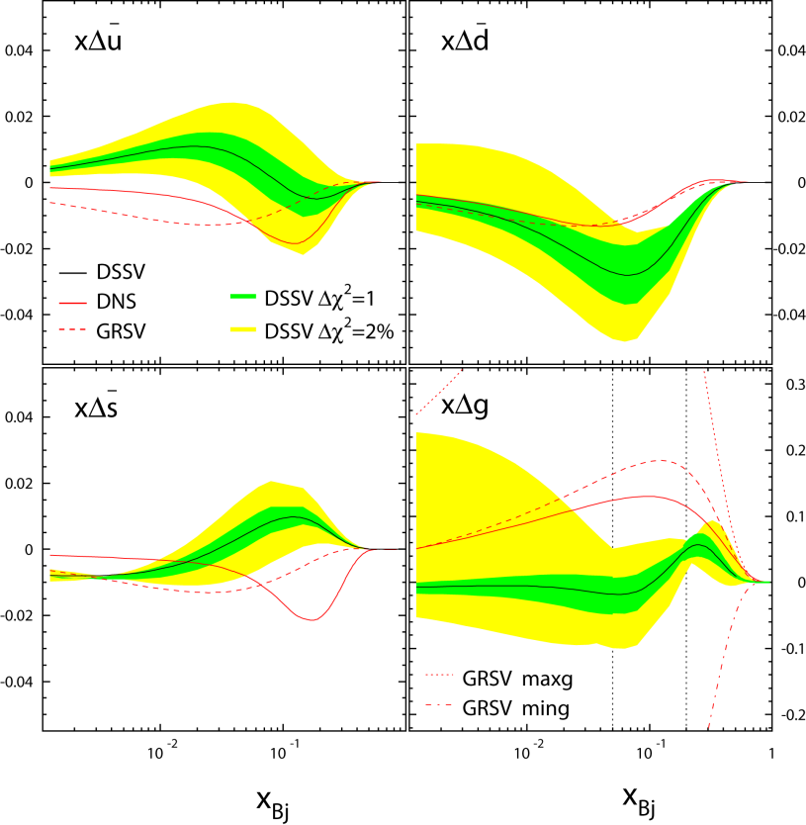
Flavor-Separated Sea Quark Polarizations Through W Production
Latest global fit to helicity distributions: Still relatively large uncertainties on helicity distributions of anti-up and anti-down quarks!
DSSV, PRL101, 072001 (2008)

Slide 28
First 500 GeV Data Recorded!
First 500 GeV run took place in February and March this year!
Largely a commissioning run for the accelerator, the polarimeters, and the detectors
  Polarization ~35% so far—many additional depolarizing resonances compared to 200 GeV
  Both STAR and PHENIX will finish installing detector/trigger upgrades to be able to make full use of the next 500 GeV run
  But W → e already possible with current data!

Slide 29
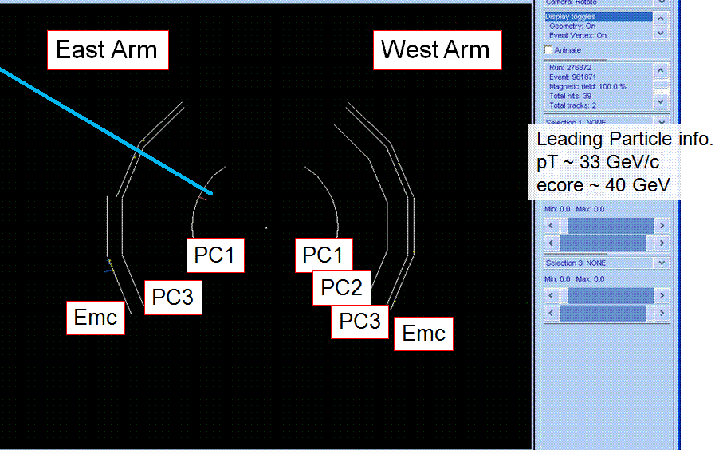
The Hunt for W’s at RHIC has Begun!
At PHENIX, special streams of data were produced very quickly and are already being analyzed to sort out issues related to the higher energy and luminosity.
Stay tuned!
Event display of a candidate W event

Slide 30
Proton Spin Structure at RHIC
Transversity
Transverse-momentum-
dependent distributions
, Jets
Prompt Photons
Single-Spin Asymmetries
Back-to-Back Correlations

Slide 31
Longitudinal (Helicity) vs. Transverse Spin Structure
Transverse spin structure of the proton cannot be deduced from longitudinal (helicity) structure
  Spatial rotations and Lorentz boosts don’t commute!
  Only the same in the non-relativistic limit
Transverse structure linked to intrinsic parton transverse momentum (k_{T}) and orbital angular momentum!

Slide 32
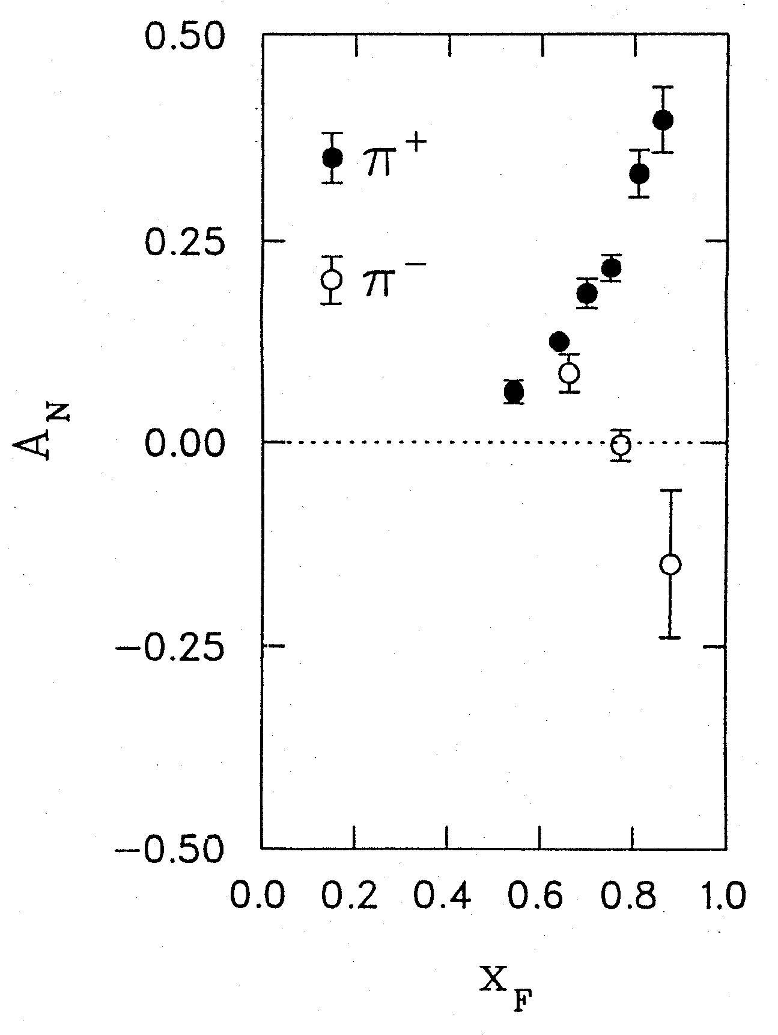
1976: Discovery in p+p Collisions!
Large Transverse Single-Spin Asymmetries
Argonne √s=4.9 GeV
Charged pions produced preferentially on one or the other side with respect to the transversely polarized beam direction!
left
Due to transversity? Other effects? We’ll need to wait more than a decade for the birth of a new subfield in order to explore the possibilities . . .
right
W.H. Dragoset et al., PRL36, 929 (1976)

Slide 33
Transverse-Momentum-Dependent Distributions and Single-Spin Asymmetries
1989: The “Sivers mechanism” is proposed in an attempt to understand the observed asymmetries.
D.W. Sivers, PRD41, 83 (1990)
The Sivers distribution: the first transverse-momentum-dependent distribution (TMD)!
Departs from the traditional collinear factorization assumption in pQCD and proposes a correlation between the intrinsic transverse motion of the quarks and gluons and the proton’s spin

Slide 34
Quark Distribution Functions
Similarly, can have k_{T}-dependent fragmentation functions (FF’s). One example: the chiral-odd Collins FF, which provides one way of accessing transversity distribution (also chiral-odd).
No k_{T} dependence
Transversity
k_{T} - dependent, T-even
k_{T} - dependent, T-odd
Sivers
Relevant measurements in simpler systems (DIS, e+e-) only starting to be made over the last ~5 years! Rapidly advancing field both experimentally and theoretically!
Boer-Mulders

Slide 35
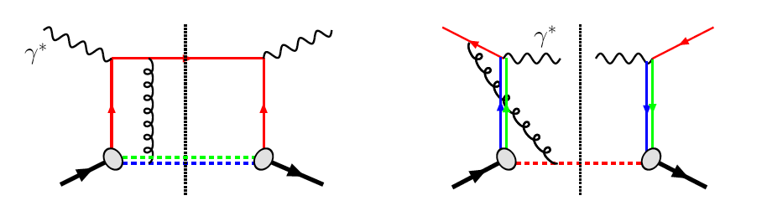
TMD’s and Universality:
Modified Universality of Sivers Asymmetries
DIS: attractive FSI
Drell-Yan: repulsive ISI
Measurements in semi-inclusive DIS already exist. A p+p measurement will be a crucial test of our understanding of QCD!
But Drell-Yan in p+p requires high luminosity—should be possible to test sooner via photon-jet asymmetry measurements
(proposed by Bacchetta et al., PRL99, 212002 (2007)).
As a result:

Slide 36
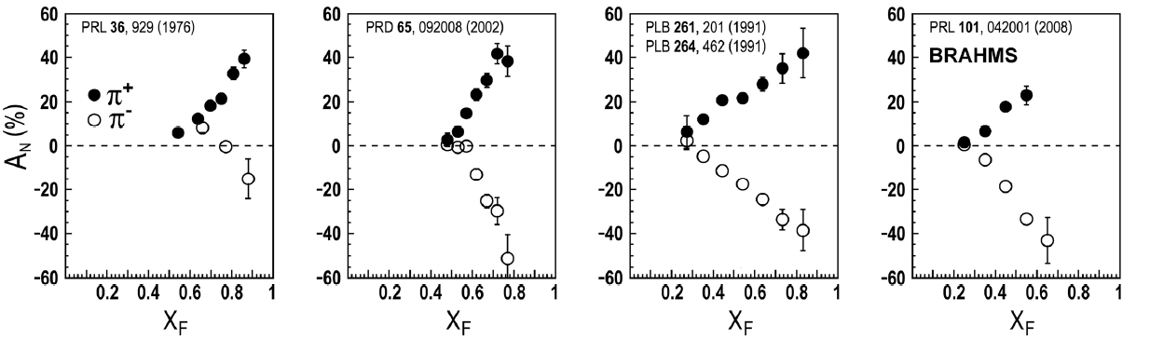
Transverse Single-Spin Asymmetries:
From Low to High Energies!
ANL
√s=4.9 GeV
BNL
√s=6.6 GeV
FNAL
√s=19.4 GeV
RHIC
√s=62.4 GeV
RHIC
√s=200 GeV!
π⁰
left
STAR
right

Slide 37
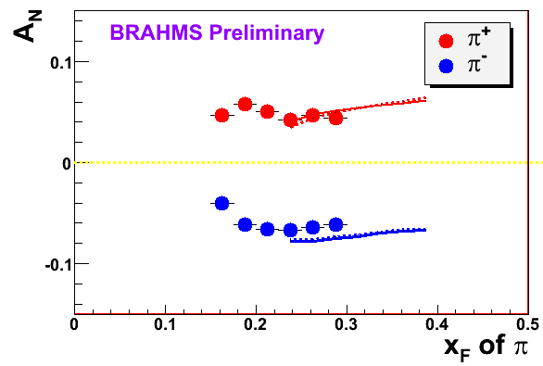
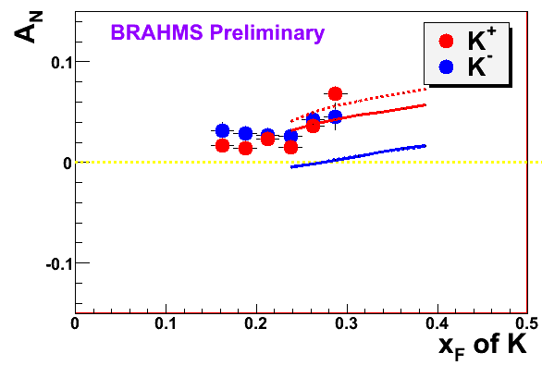
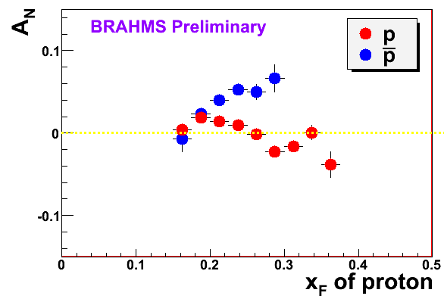
π
π
π, K, p
at 200 and 62.4 GeV
Pattern of pion species asymmetries in the forward direction
→ valence quark effect.
But this conclusion confounded by kaon and antiproton asymmetries!
200 GeV
62.4 GeV
Note different scales
K
K
K- asymmetries
underpredicted
200 GeV
62.4 GeV
p
p
Large antiproton asymmetry?? Unfortunately no 62.4 GeV measurement
200 GeV
62.4 GeV

Slide 38
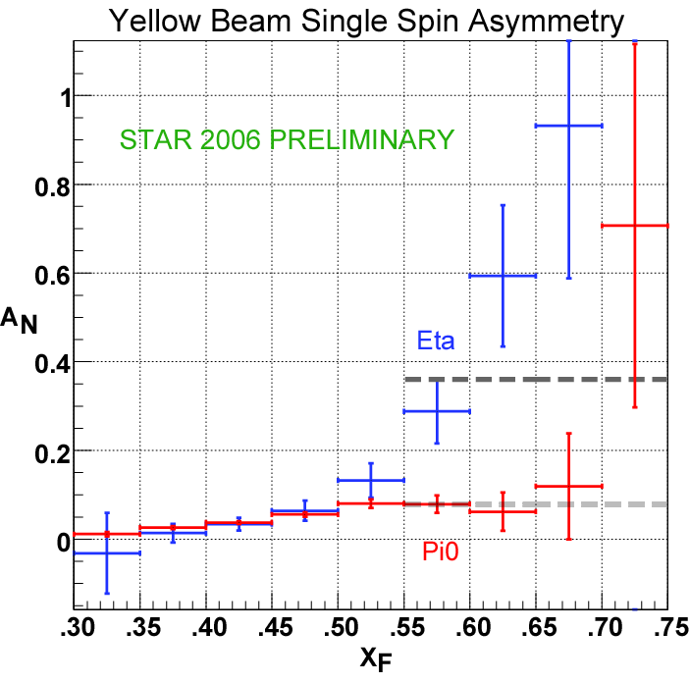
Another Surprise: Transverse Single-Spin Asymmetry in Eta Meson Production
Further evidence against a valence quark effect!
Larger than the neutral pion!
STAR

Slide 39
Nucleon Structure:
Transversity vs. Sivers vs. Boer-Mulders
Transversity : correlation between transverse proton spin and quark spin
Sivers : correlation between transverse proton spin and quark transverse momentum
Boer-Mulders: correlation between transverse quark spin and quark transverse momentum
Long-term goal: Description of the nucleon in terms of the quark and gluon wavefunctions!
S_{p}– S_{q} – coupling?
S_{p}-- L_{q}– coupling???
S_{q}-- L_{q}– coupling???

Slide 40
QED vs. QCD
observation & models
precision measurements
& fundamental theory

Slide 41

Glancing Into the Future:
The Electron-Ion Collider
Design and build a new facility with the capability of colliding a beam of electrons with a wide variety of nuclei as well as polarized protons and light ions: the Electron-Ion Collider

Slide 42
The EIC: Communities Coming Together
At RHIC, heavy ions and nucleon spin structure already meet, but in some sense by “chance”
  Genuinely different physics
  Communities come from different backgrounds
  Bound by an accelerator that has capabilities relevant to both
Proposed EIC a facility where heavy ion and nucleon structure communities truly come together, peering into various forms of hadronic matter to continue to uncover the secrets and subtleties of QCD . . .

Slide 43
Conclusions and Prospects
After 40 of studying the internal structure of the nucleon and nuclei, we remain far from the ultimate goal of being able to describe nuclear matter in terms of its quark and gluon degrees of freedom!
Further data from RHIC will better constrain the gluon spin contribution to the spin of the proton and continue to push forward knowledge of the transverse spin structure of the nucleon and the role of transverse-momentum-dependent distributions.
The EIC promises to usher in a new era of precision measurements that will probe the behavior of quarks and gluons in nucleons as well as nuclei, bringing us to a new phase in understanding the rich complexities of QCD in matter.
There’s a large and diverse community of people—at RHIC and complementary facilities—driven to continue coaxing the secrets out of one of the most fundamental building blocks of the world around us.

Slide 44
Additional Material

Slide 45
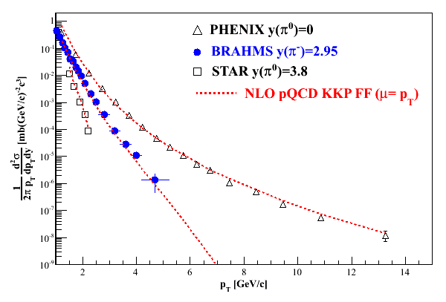
Polarization-averaged cross sections at √s=200 GeV
Good description at 200 GeV over all rapidities down to p_{T} of 1-2 GeV/c.

Slide 46
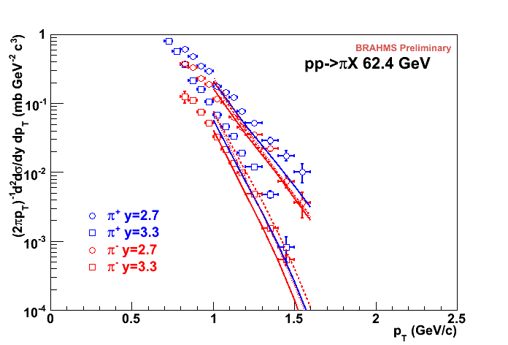
√s=62.4 GeV
Forward pions
Comparison of NLO pQCD calculations with BRAHMS π data at high rapidity. The calculations are for a scale factor of μ=p_{T}, KKP (solid) and DSS (dashed) with CTEQ5 and CTEQ6.5.
Surprisingly good description of data, in apparent disagreement with earlier analysis of ISR π⁰ data at 53 GeV.
Still not so bad!

Slide 47
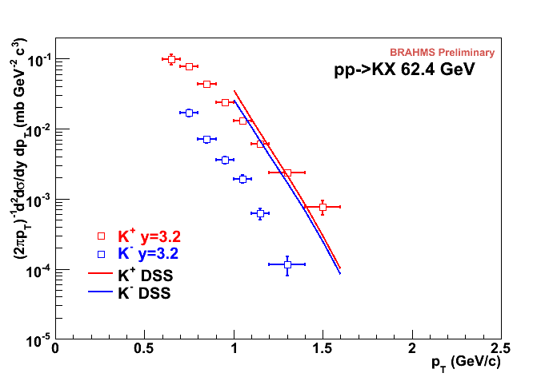
√s=62.4 GeV
Forward kaons
K⁻ data suppressed ~order of magnitude (valence quark effect).
NLO pQCD using recent DSS FF’s gives ~same yield for both charges(??).
Related to FF’s? PDF’s??
K⁺: Not bad!
K⁻: Hmm…
Notes:
Authero of DSS knows about this.

Slide 48
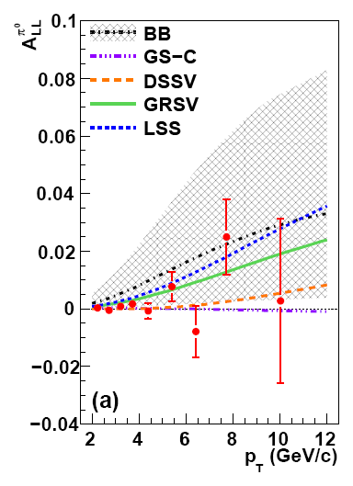
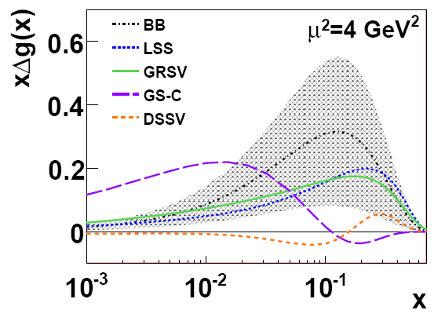
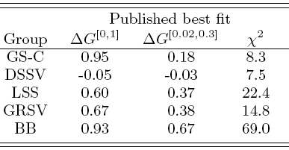
π⁰ A_{LL}: Agreement with Different Parametrizations of Δg(x)
Small ΔG in our measured x region 0.02 to 0.3 gives small A_{LL} (DSSV and GS-C). Large ΔG gives comparatively larger A_{LL} .
Note small A_{LL} does not necessarily mean small ΔG in the full x range!
arXiv:0810.0694, submitted to PRL
Notes:
48

Slide 49
π⁰ A_{LL}: Agreement with different parametrizations
For each parametrization, vary ΔG^{[0,1]} at the input scale while fixing Δq(x) and the shape of Δg(x), i.e. no refit to DIS data.
For range of shapes studied, current data relatively insensitive to shape in x region covered.
Need to extend x range!
arXiv:0810.0694, submitted to PRL

Slide 50
Fragmentation Functions (FF’s):
Improving Our Input for Inclusive Hadronic Probes
FF’s not directly calculable from theory—need to be measured and fitted experimentally
The better we know the FF’s, the tighter constraints we can put on the polarized parton distribution functions!
Traditionally from e+e- data—clean system!
Framework now developed to extract FF’s using all available data from deep-inelastic scattering and hadronic collisions as well as e+e-
  de Florian, Sassot, Stratmann: PRD75:114010 (2007) and arXiv:0707.1506

Slide 51
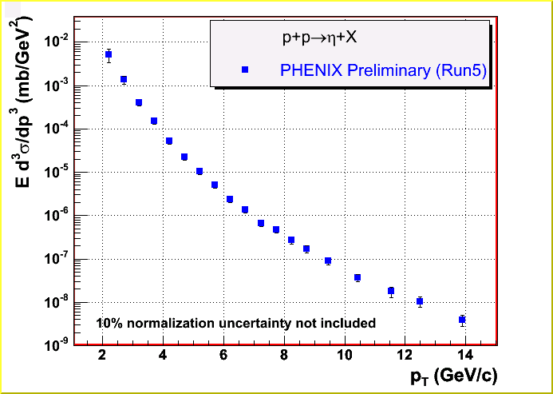



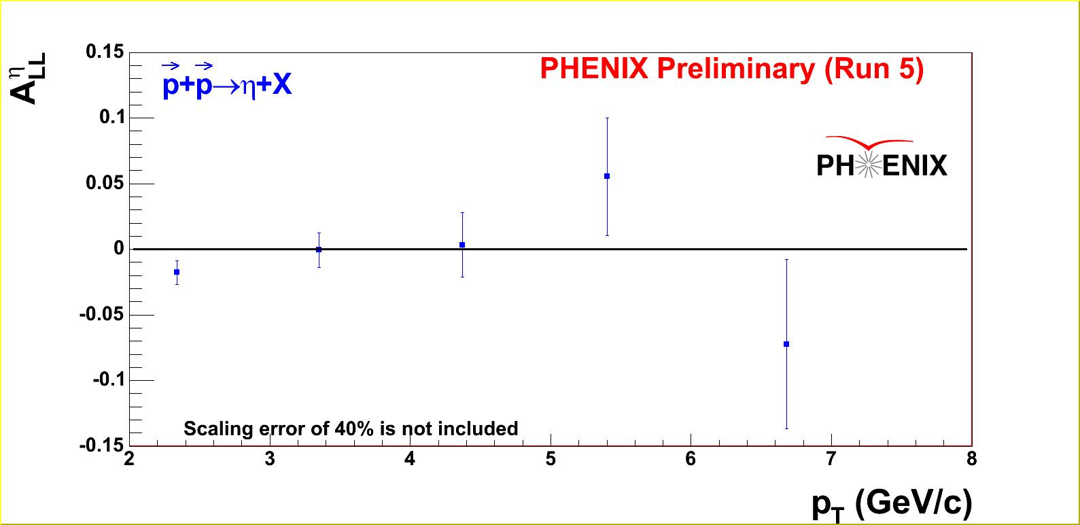

An Example:
Cross Section and A_{LL} of η Meson
η
η fragmentation function has not been available in the literature! No theoretical comparisons possible . . .
Δg²
ΔgΔq
Δq²
η

Slide 52
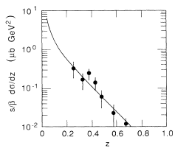
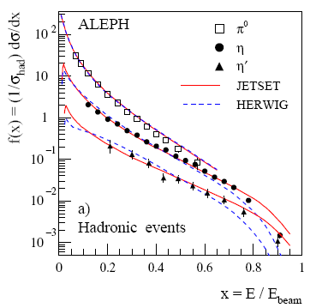
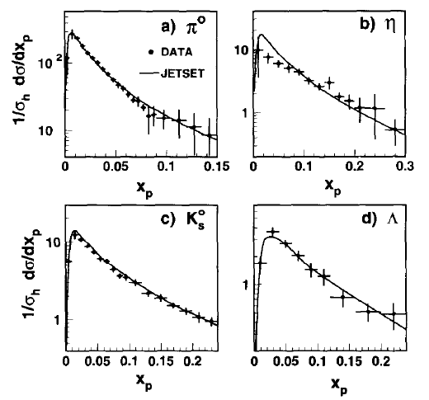
Parameterizing the η FF Using e+e- and PHENIX p+p Data
MARK II
Once FF is available, asymmetry data provides additional constraint on ΔG!
HRS
L3
OPAL
CA, J. Seele,
M. Stratmann,

Slide 53



η A_{LL} at 200 GeV
~1/2 as abundant as π⁰
40% photon branching ratio
Different wavefunction from π⁰
Stronger gluon/strange
Calculations using preliminary fragmentation function parametrizations

Slide 54


Extending x Coverage
PRD79, 012003 (2009)
Measure in different kinematic regions
  e.g. forward vs. central
Change center-of-mass energy
  Most data so far at 200 GeV
  Brief run in 2006 at 62.4 GeV
  First 500 GeV data-taking to start next month!
62.4 GeV
Extend to lower x at √s = 500 GeV
Extend to higher x at √s = 62.4 GeV
200 GeV
present
x-range
√s = 200 GeV
Notes:
Get rid of!

Slide 55
Neutral Pion A_{LL} at 62.4 GeV
Converting to x_{T}, can see significance of 62.4 GeV measurement (0.08 pb⁻¹) compared to published data from 2005 at 200 GeV (3.4 pb⁻¹).
PRD79, 012003 (2009)

Slide 56


A_{LL} of Non-identified Charged Hadrons at 62.4 GeV
Cross section measurement in progress!
14% polarization uncertainty not included

Slide 57

Reduce Integration Bins: Correlation Measurements
Di-Jet and Photon-Jet Asymmetries allows reconstruction of partonic x1 and x2 at leading order.

Slide 58

pQCD Scale Dependence at RHIC vs. Spin-Dependent DIS
Scale dependence
benchmark:
Tevatron ~ 1.2
RHIC ~ 1.3
COMPASS ~ 2.5 – 3
HERMES ~ 4 – 5
Scale dependence
at RHIC is significantly
reduced compared to
fixed-target polarized
DIS.
HERMES
(hadron pairs)
Change in pQCD calculation of
cross section if factorization scale
change by factor 2
COMPASS
(hadron pairs)
RHIC
(direct photon)
E708
(direct photon)
CDF
(direct photon)

Slide 59



Sensitivity projections vs. p_{T}
1 < η < 2
300 pb⁻¹
Realistic BG subtraction
Recent PDFs ~representing current allowed Δu/Δd range
Δd and Δu isolated
STAR
59
Notes:
59

Slide 60
Understanding Transverse Spin Measurements in Hadronic Collisions
Theoretical interpretation of longitudinally polarized measurements at RHIC relies on the existence of results from simpler systems, e.g.
  Fragmentation functions from e+e- experiments
  Δu, Δd from deep-inelastic scattering experiments
Relevant quantities for transverse spin calculations starting to be measured and parameterized now…

Slide 61
Prokudin et al. at Ferrara

Slide 62
Prokudin et al. at Ferrara

Slide 63


Transverse SSA’s Persist up to RHIC Energies!
√s = 62.4 GeV
PRL101, 042001 (2008)
π⁰

Slide 64
Transverse SSA’s Persist up to RHIC Energies!
√s = 62.4 GeV
PRL101, 042001 (2008)
π⁰

Slide 65

Sensitivity to fragmentation functions
KKP
DSS
KKP
DSS

Slide 66

Transverse SSA’s at √s = 200 GeV at RHIC
π⁰
BRAHMS Preliminary
PRL101, 222001 (2008)
STAR

Slide 67
π
π
π, K, p
at 200 and 62.4 GeV
200 GeV
62.4 GeV
Rapid advances in transverse spin structure and
transverse-momentum-dependent distributions over the past seven years!
Unexpected experimental measurements drive theoretical progress!
Many more interesting transverse spin results expected from RHIC
in upcoming years.
Note different scales
K
K
K- asymmetries
underpredicted
200 GeV
62.4 GeV
p
p
Large antiproton asymmetry?? Unfortunately no 62.4 GeV measurement
But where can we go beyond RHIC to learn more?
200 GeV
62.4 GeV

Slide 68

Run-8 data does show expected decrease at low pT
Black points: Phys. Rev. Lett. 101, 222001 (2008)

Slide 69
Sensitivity to fragmentation functions
KKP
DSS
KKP
DSS

Slide 70
Transverse SSA’s at √s = 200 GeV at RHIC
π⁰
BRAHMS Preliminary
PRL101, 222001 (2008)
STAR

Slide 71
Neutral Pion Transverse SSA:
Decrease at Low pT Now Observed
Black points: Phys. Rev. Lett. 101, 222001 (2008)

Slide 72
Forward π⁰ A_{N} at 200 GeV: p_{T} dependence
arXiv:0801.2990
Accepted by PRL
STAR

Slide 73


A_{N} of Mid-rapidity Neutral Pions
PRL 95,
202001 (2005)
A_{N} for both neutral pions and charged hadrons at mid-rapidity consistent with zero within a few percent.
|η| < 0.35

Slide 74

Interference Fragmentation Function to Probe Transversity
Added statistics from 2008 running. No significant asymmetries seen at mid-rapidity.

Slide 75






Attempting to Probe k_{T} from
Orbital Motion
k_{T} larger
k_{T} smaller
Spin-correlated transverse momentum (orbital angular momentum) may contribute to jet k_{T}. (Meng Ta-chung et al., Phys. Rev. D40, 1989)
Possible helicity dependence
Would depend on (unmeasured) impact parameter, but may observe net effect after averaging over impact parameter
Same
helicity
Opposite
helicity

Slide 76

SSA of heavy flavor vs. x_{F}
Qualitative conclusion: Data constrain the gluon Sivers function
to be significantly smaller than the maximal allowed.
Translation between D meson and muon kinematics and
estimate of charm vs. bottom components underway such
that more quantitative comparison can be made in the future.
Data: Prompt muons
Calculations: D mesons

Slide 77

What about charmonium?
J/ψ complicated by unknown production mechanism!
Recent calculations for charmonium from F.Yuan, arXiv:0801.4357 [hep-ph]
x_{F}

Slide 78


New “rough” calculation for J/Ψ A_{N} at RHIC
Assumed gluon Sivers function ~ 0.5 x(1-x) times unpolarized gluon distribution
Assumed 30% J/Ψ from χ_{c} decays
No direct contributions!
  Color-singlet is small in the cross section
  Color-octet, FSI/ISI cancel out, SSA vanishes in the limit of p_{T}<<M_{Q}
  Origin of potential non-zero asymmetry is through χ_{c}!
But beware: Production mechanism remains poorly understood!
0.03
A_{N}
0.02
F. Yuan
0.01
-0.1 0 0.1 0.2 0.3 0.4
x_{F}

Slide 79

Forward neutrons at √s=200 GeV at PHENIX
Large negative SSA observed for x_{F}>0, enhanced by requiring concidence with forward charged particles (“MinBias” trigger).
No x_{F} dependence seen.
Mean p_{T}
(Estimated by simulation assuming ISR p_{T} dist.)
0.4<|x_{F}|<0.6 0.088 GeV/c
0.6<|x_{F}|<0.8 0.118 GeV/c
0.8<|x_{F}|<1.0 0.144 GeV/c
preliminary | A_{N}
Without MinBias | -6.6 ±0.6 %
With MinBias | -8.3 ±0.4 %
charged
particles
neutron
neutron

Slide 80
Forward neutrons at other energies
Significant forward neutron asymmetries observed down to 62.4 and up to 410 GeV!
√s=62.4 GeV
√s=410 GeV

Slide 81






Single-Spin Asymmetries for Local Polarimetry:
Confirmation of Longitudinal Polarization
A_{N}
Spin Rotators OFF
Vertical polarization
Blue
φ
Yellow
Spin Rotators ON
Current Reversed!
Radial polarization
Blue
Yellow
Spin Rotators ON
Correct Current
Longitudinal polarization!
Blue
Yellow

Slide 82

First Observation of the Collins Effect
in Polarized Deep Inelastic Electron-Proton Scattering
HERMES
Collins Asymmetries in semi-
inclusive deep inelastic scattering
e+p → e + π + X
~ Transversity (x) x Collins(z)
A_{UT} sin(φ+φ_{s})

Slide 83
The Collins Effect Must be Present
In e⁺e⁻ Annihilation into Quarks!
electron
q₁
q₂
quark-1
spin
quark-2
spin
Collins effect in e+e-
Quark fragmentation
will lead to effects
in di-hadron correlation
measurements!
positron

Slide 84


Observation of the Collins Effect in e⁺e⁻
Annihilation with Belle
Belle (UIUC/RBRC) group
Collins Asymmetries in e⁺e⁻
annihilation into hadrons
e⁺+e⁻ → π⁺ + π⁻ + X
~ Collins(z₁) x Collins (z₂)
PRELIMINARY
ϕ₂−π
Θ
e⁻
ϕ₁
e⁺
A₁₂ cos(φ₁+φ₂)

Slide 85




Sivers Asymmetries at HERMES
and COMPASS
implies non-zero L_{q}
π^{+/−}
Κ^{+/−}

Slide 86

Fundamental Theoretical Work: Sivers Effect
and Questions of Universality and Factorization
Annual number of publications on transverse spin
in SPIRES vs time. The total number of pulications
is about ~750, about 15% are experimental.

Slide 87




Towards a 3D spin-flavor landscape
W^{u}(x,k,r)
x = 0.01
m
x = 0.40
x = 0.70
m
d³r
d²k_{T}
p
x
p
TMD
GPD
B
TMD^{u}(x,k_{T})
f₁,g₁,f_{1T} ,g_{1T}
h₁, h_{1T} ,h_{1L} ,h₁
Link to Orbital Momentum
GPD^{u}(x,ξ,t)
H^{u}, E^{u}, H^{u}, E^{u}
Link to Orbital Momentum
~
~
Wigner function: Probability to find a u(x) quark with a certain polarization at position r and with momentum k
Fourier transform in momentum transfer
d²k_{T}
ξ = 0, t = 0
dx
f₁(x)
g₁, h₁
u(x)
Δu, δu
F₁^{u}(t)
F₂^{u},G_{A}^{u},G_{P}^{u}
Parton
Distributions
Form Factors
gives transverse position of quark (parton) with longitud. mom. fraction x

Slide 88

The STAR Detector at RHIC
STAR

Slide 89

PHENIX Detector
Philosophy:
  High rate capability to measure rare probes,
  but limited acceptance.
2 central
spectrometers
Track charged particles and detect electromagnetic processes
azimuth
2 forward
spectrometers
- Identify and track muons

Slide 90


BRAHMS detector
Philosophy:
  Small acceptance spectrometer arms
  designed with good charged particle ID.

Slide 91
Helicity Flip Amplitudes
Elastic proton-quark scattering
(related to inelastic scattering through optical theorem)
Helicity flip distribution also called the “transversity” distribution.
Corresponds to the difference in probability of scattering off of a transversely polarized quark within a transversely polarized proton with the quark spin parallel vs. antiparallel to the proton’s.
Chiral-odd! But chirality conserved in QCD processes . . . Can transversity exist and produce observable effects?
Three independent pdf’s corresponding to following helicity states:
Take linear combinations to form:
Helicity average
Helicity difference
Helicity flip

