Slide 1
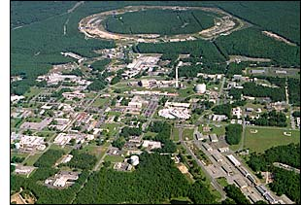
Investigating the Spin Structure of the Proton at RHIC:
Recent Results
Christine Aidala
Los Alamos National Lab
INFN Ferrara
June 17, 2010
Notes:
I feel that the overarching question that those of us working on the proton structure program at RHIC would like to contribute to answering is . . .

Slide 2
Proton Structure at RHIC
Gluon helicity distribution and ΔG
Flavor–separated sea quark helicity distributions
“Transverse spin” phenomena
Transversity
Transverse-momentum-
dependent distributions
, Jets
Prompt Photons
Single-Spin Asymmetries
Back-to-Back Correlations
Advantages of a polarized proton-proton collider:
Hadronic collisions → Leading-order access to gluons
High energies → Applicability of perturbative QCD
High energies → Production of new probes: W bosons

Slide 3
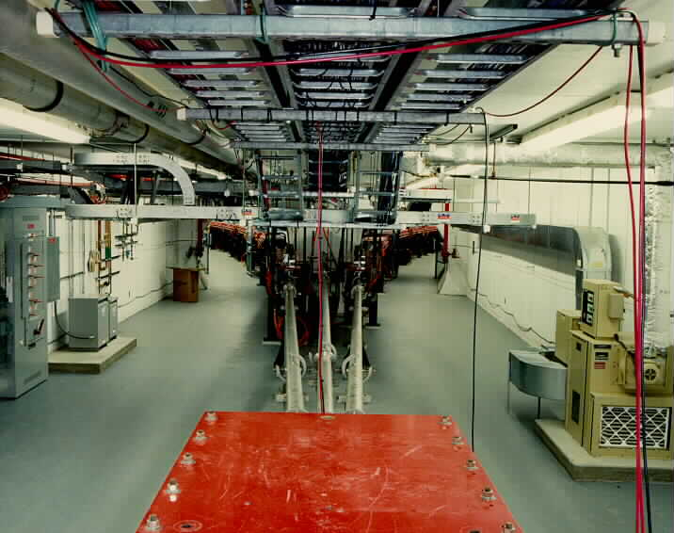
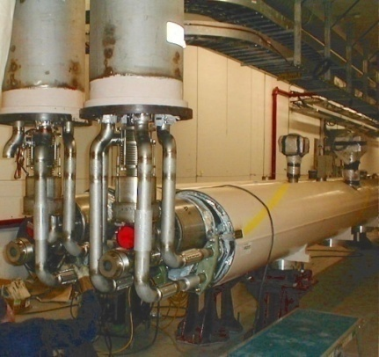
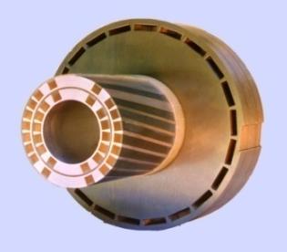
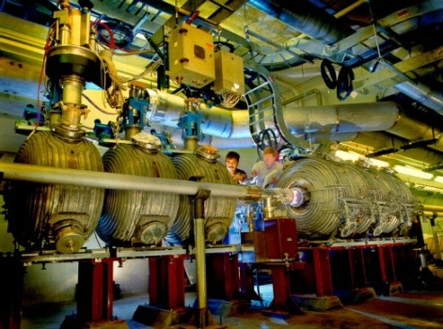
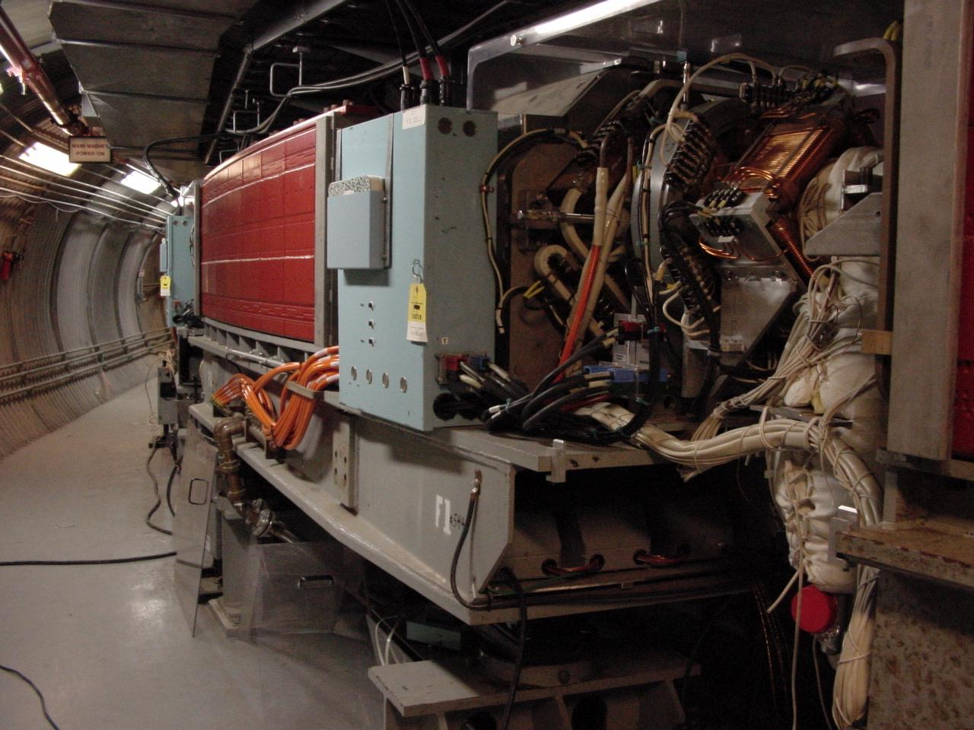
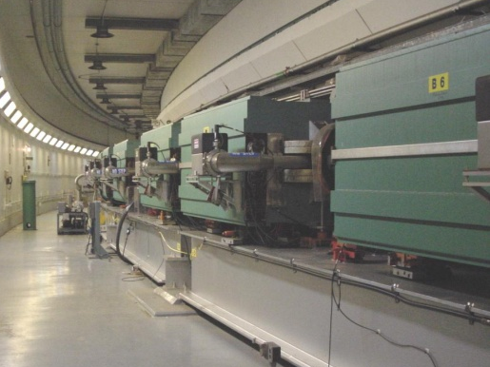
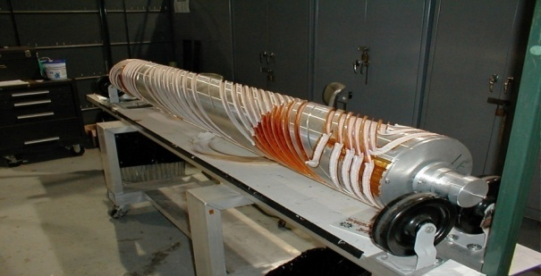
RHIC as a Polarized p+p Collider
Absolute Polarimeter (H jet)
RHIC pC Polarimeters
Siberian Snakes
PHOBOS
BRAHMS & PP2PP
Siberian Snakes
PHENIX
Spin Flipper
STAR
Spin Rotators
Various equipment to maintain and measure beam polarization through acceleration and storage
Partial Snake
Helical Partial
Snake
Polarized Source
Strong Snake
LINAC
AGS
200 MeV Polarimeter
BOOSTER
Rf Dipole
AGS Internal Polarimeter
AGS pC Polarimeter
Notes:
RHIC, as a high-energy polarized proton collider, really represents an outstanding achievement in accelerator physics. . . . [equipment].

Slide 4
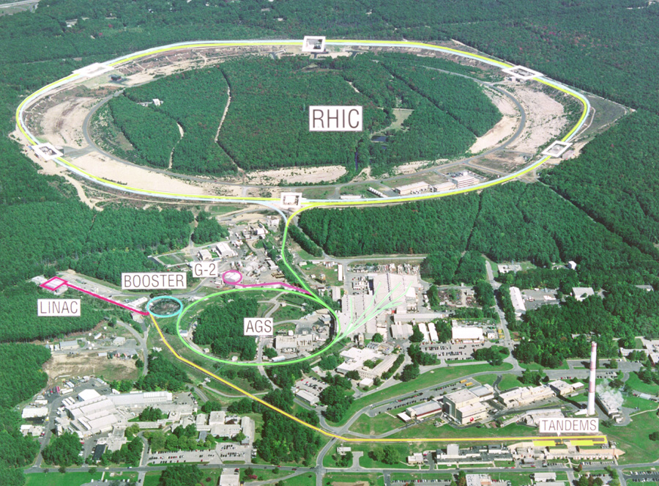

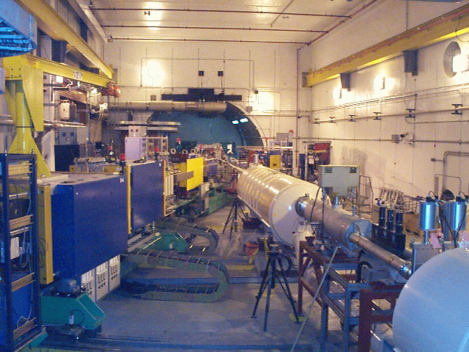
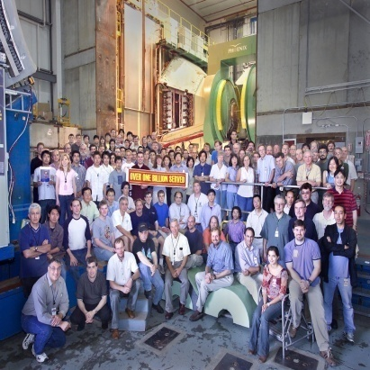
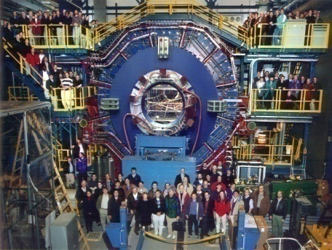


RHIC Spin Physics Experiments
Three experiments: STAR, PHENIX, BRAHMS
After 2006 only STAR and PHENIX running
Transverse spin only
(No rotators)
Longitudinal or transverse spin
Longitudinal or transverse spin
Accelerator performance:
Avg. pol ~55% at 200 GeV (design 70%).
Achieved 5.0x10³¹ cm⁻² s⁻¹ lumi (design ~4x this).

Slide 5
RHIC Integrated Luminosity and Polarization History
(PHENIX lumi values)
Run | Energy | Polarization | Longitudinal |  | Transverse
 | [GeV] | [%] | L [pb⁻¹] | LP⁴ [pb⁻¹] | L [pb⁻¹] | LP² [pb⁻¹]
2002 | 200 | 15 | - | - | 0.15 | 3.4 x 10⁻³
2003 | 200 | 27 | 0.35 | 1.9 x 10⁻³ | - | -
2004 | 200 | 40 | 0.12 | 9 x 10⁻³ | - | -
2005 | 200 | 49 (47) | 3.4 | 2 x 10⁻¹ | 0.16 | 3.5 x 10⁻²
2006 | 200 | 57 (51) | 7.5 | 7.9 x 10⁻¹ | 2.7 | 7.0 x 10⁻¹
2006 | 62 | 48 | 0.08 | 4.2 x 10⁻³ | 0.02 | 4.6 x 10⁻³
2008 | 200 | 46 | - | - | 5.2 | 1.1 x 10⁰
2009 | 500 | 39 | 14 | 2.1x 10⁻¹ | - | -
2009 | 200 | 55 | 16 | 1.5 x 10⁰ | - | -
First 500 GeV commissioning run in 2009

Slide 6
Studying Nucleon Structure in p+p: Reliance on Input from Simpler Systems
Disadvantage of hadronic collisions: much “messier” than DIS! → Rely on input from simpler systems
The more we know from simpler systems such as DIS and e+e- annihilation, the more we can in turn learn from hadronic collisions!

Slide 7
Factorization and Universality in Perturbative QCD
q(x₁)
Hard Scattering Process
More on factorization and universality later . . .
X
g(x₂)
“Hard” probes have predictable rates given:
    Parton distribution functions (need experimental input)
    Partonic hard scattering rates (calculable in pQCD)
    Fragmentation functions (need experimental input)
Universality
(Process
independence)

Slide 8
Proton Spin Structure at RHIC
Gluon helicity distribution and ΔG
Flavor–separated sea quark helicity distributions
“Transverse spin” phenomena
Transversity
Transverse-momentum-
dependent distributions
, Jets
Prompt Photons
Single-Spin Asymmetries
Back-to-Back Correlations

Slide 9
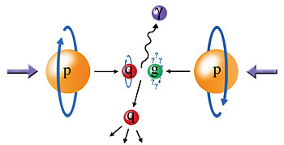
Probing the Helicity Structure of the Nucleon with p+p Collisions
Study difference in particle production rates for same-helicity vs. opposite-helicity proton collisions
DIS
?
pQCD
e+e-
Leading-order access to gluons → ΔG
Notes:
Let me now show you some highlights from the helicity program at RHIC.

Slide 10
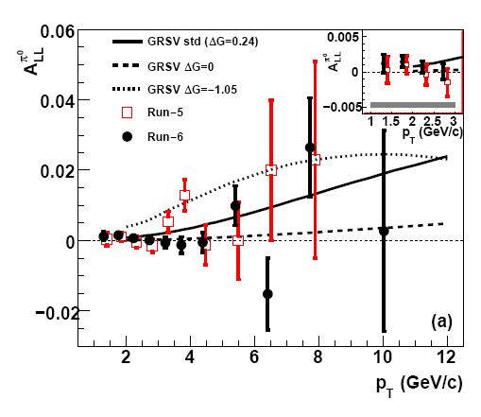
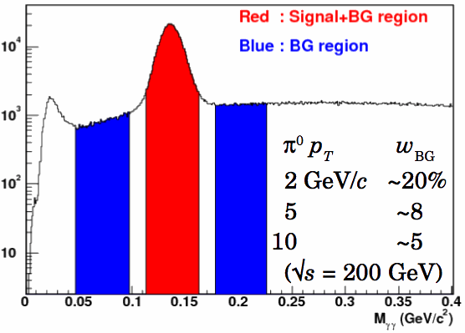

Inclusive Neutral Pion Asymmetry at √s=200 GeV
PRL 103, 012003 (2009)
PHENIX: Limited acceptance and fast EMCal trigger → Neutral pions have been primary probe
- Subject to fragmentation function uncertainties, but easy to reconstruct
Helicity asymmetry measurement
Notes:
“Quality of data fits versus gluon spin in measured region”
How do we know that we can trust pqcd in extracting gluon spin?
“pQCD works well at RHIC energies”

Slide 11
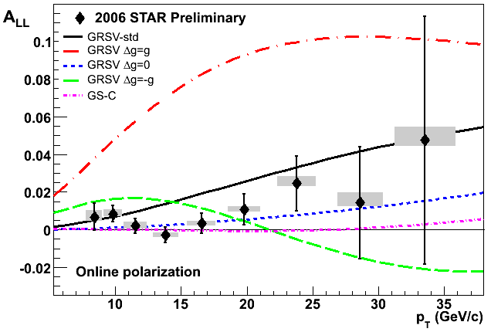
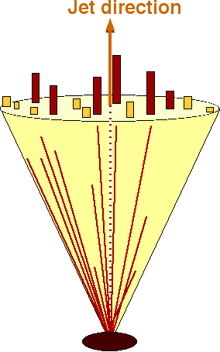
Inclusive Jet Asymmetry at √s=200 GeV
A_{LL} systematics | (x 10 ⁻³)
Reconstruction + Trigger Bias | [-1,+3] (p_{T} dep)
Non-longitudinal Polarization | ~ 0.03 (p_{T} dep)
Relative Luminosity | 0.94
Backgrounds | 1st bin ~ 0.5 Else ~ 0.1
STAR: Large acceptance
→ Jets have been primary probe
Not subject to uncertainties on fragmentation functions, but need to handle complexities of jet reconstruction
π⁺
e⁺
π⁰
π⁻
Κ⁰
p_{T} systematic | ±6.7%
Helicity asymmetry measurement
GRSV curves and data with cone radius R= 0.7 and -0.7 < η < 0.9
STAR
11
Notes:
11

Slide 12
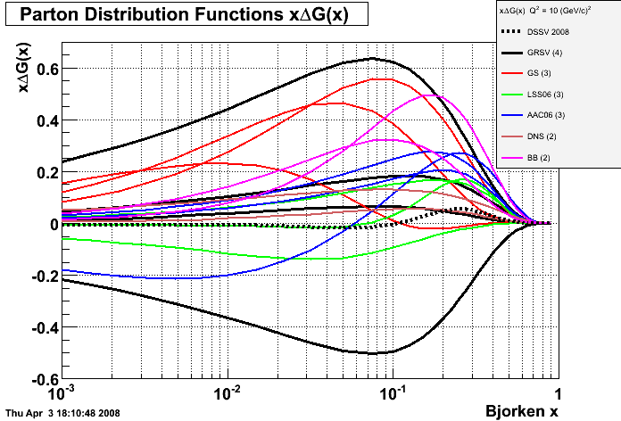
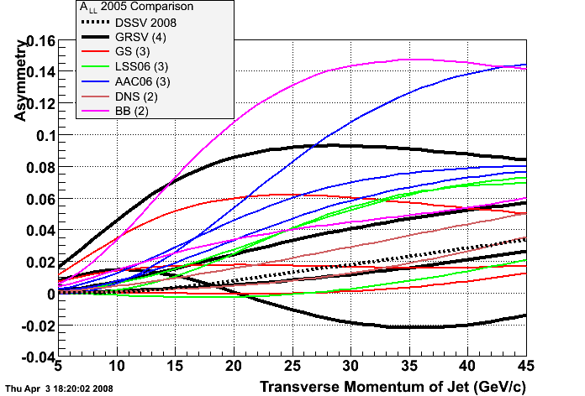
Q² = 10 GeV²
Bjorken x
Any parameterization or assumption for Δg(x) vs x can be translated into predictions for A_{LL} vs. jet, pion, etc. p_{T} and compared with RHIC data.
Notes:
12

Slide 13
Sampling the Integral of ΔG: π⁰ p_{T} vs. x_{gluon}
Inclusive asymmetry measurements in p+p collisions sample from wide bins in x—sensitive to (truncated) integral of ΔG, not to functional form vs. x
Based on simulation using NLO pQCD as input
PRL 103, 012003 (2009)

Slide 14
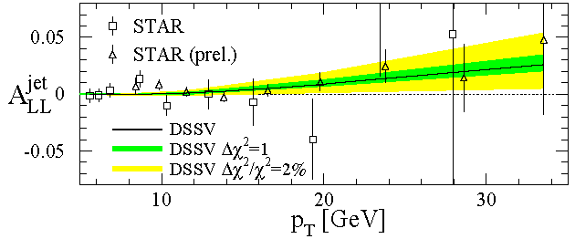
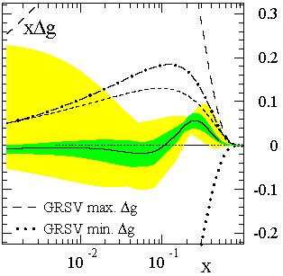
Present Status of Δg(x): Global pdf Analyses
de Florian et al., PRL101, 072001 (2008)
RHIC results have improved constraints, but evidently trying to measure something small! Still a long road ahead . . . Need more data and measurements covering a greater range in gluon momentum fraction.
DSSV: The first global next-to-leading-order (NLO) analysis to include inclusive DIS, semi-inclusive DIS, and RHIC p+p data on an equal footing
Truncated moment of Δg(x) at moderate x found to be small
Best fit finds node in gluon distribution near x ~ 0.1
  Not prohibited, but not so intuitive . . .
x range covered by current RHIC measurements at 200 GeV
Notes:
If you consider the thousands of points going into standard global fits of unpolarized pdf’s, we’ve still got a long way to go!

Slide 15
The Pion Isospin Triplet, A_{LL} and ΔG
At transverse momenta > ~5 GeV/c, midrapidity pions dominantly produced via qg scattering
Tendency of π⁺ to fragment from an up quark and π⁻ from a down quark and fact that Δu and Δd have opposite signs make A_{LL} of π⁺ and π⁻ differ
Order of asymmetries of pion species can provide information on the sign of ΔG, which remains uncertain . . .
Fraction pions produced
PHENIX preliminary results from 2009 data released last week

Slide 16
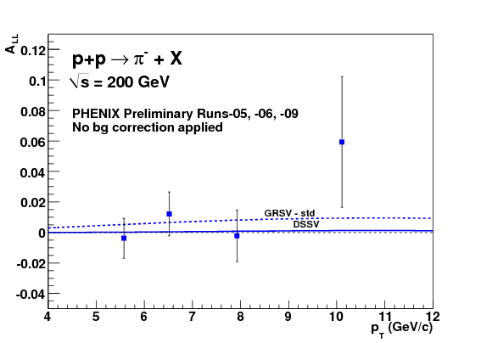
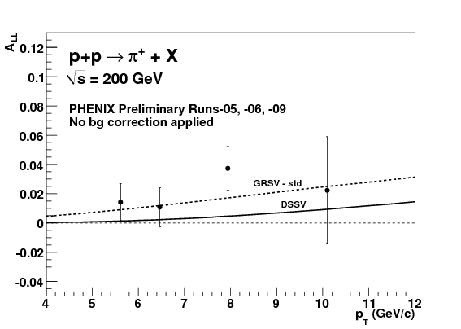
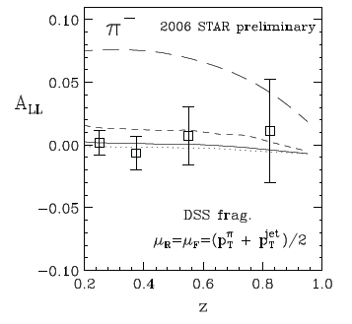
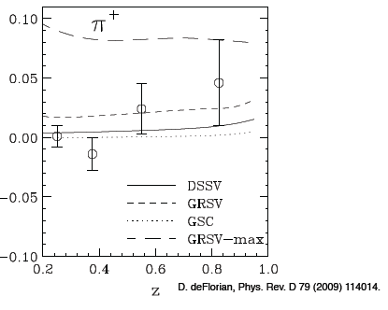
Still limited statistics. Small ΔG → small differences between pion asymmetries!
STAR
STAR

Slide 17
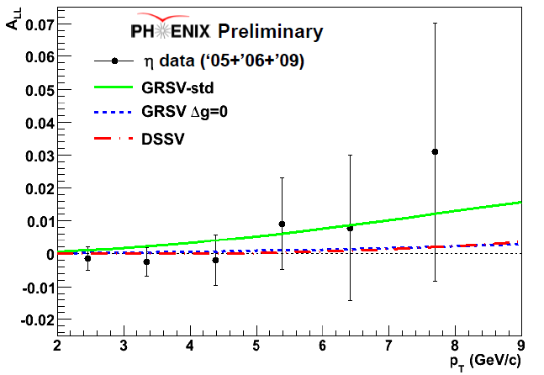
η asymmetry results from PHENIX
Preliminary results from 2009 data released last week
η at 200 GeV
  Analysis and sensitivities similar to π⁰
  Independent confirmation
  of ΔG, additional statistics
NLO pQCD calculations enabled by recent parameterization of eta FFs from world data (CAA, J. Seele, M. Stratmann, R. Sassot).
PHENIX 2005+2006 results and FF paper to be submitted simultaneously to PRD within a few weeks.

Slide 18
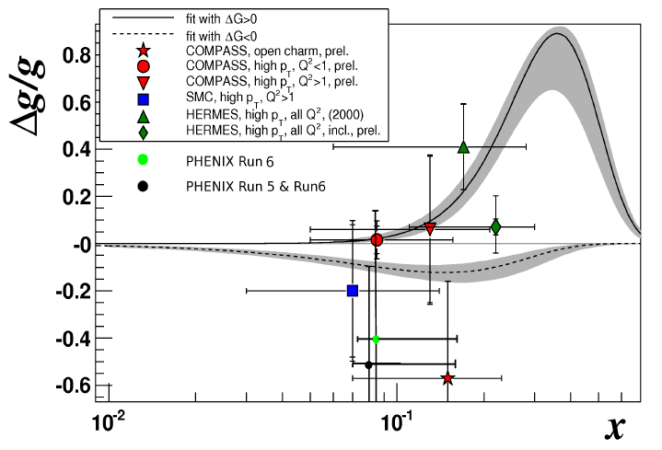
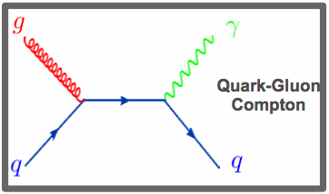
ΔG/G – LO extraction from direct photon A_{LL}
R. Bennett
Statistical uncertainty from 2005 and 2006 data similar to COMPASS open charm result
New 200 GeV data (16 pb⁻¹, compared to < 10 in current result) from 2009 being analyzed.
Not a PHENIX result. Uses PHENIX preliminary data.

Slide 19
The Future of ΔG Measurements at RHIC
Extend x coverage
  Run at different center-of-mass energies
    Already results for neutral pions at 62.4 GeV, now first data at 500 GeV
  Extend measurements to forward particle production
    Forward calorimetry recently enhanced in both PHENIX and STAR
Go beyond inclusive measurements—i.e. measure the final state more completely—to better reconstruct the kinematics and thus the x values probed.
  Jet-jet and direct photon – jet measurements – But need higher statistics! STAR expects first results from 2009 data.

Slide 20
Proton Spin Structure at RHIC
Gluon helicity distribution and ΔG
Flavor–separated sea quark helicity distributions
“Transverse spin” phenomena
Transversity
Transverse-momentum-
dependent distributions
, Jets
Prompt Photons
Single-Spin Asymmetries
Back-to-Back Correlations

Slide 21
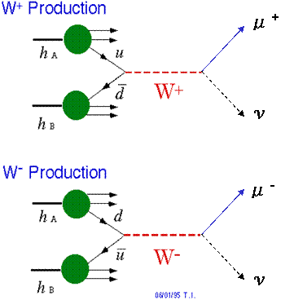
Flavor-Separated Sea Quark Polarizations Through W Production
Flavor separation of the polarized sea quarks with no reliance on FF’s, and at much higher scale than previous fixed-target experiments.
Complementary to semi-inclusive DIS measurements.
Parity violation of the weak
interaction in combination with
control over the proton spin
orientation gives access to the
flavor spin structure in the proton!
Measure final-state lepton (e or μ)

Slide 22
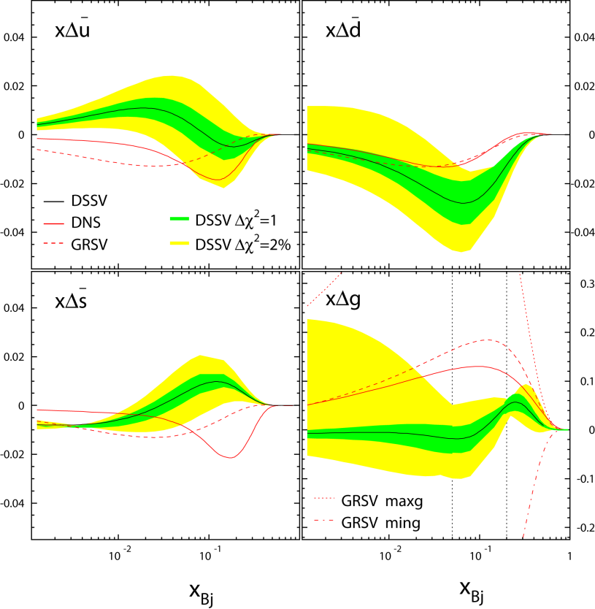
Flavor-Separated Sea Quark Polarizations Through W Production
Latest global fit to helicity distributions: Indication of SU(3) breaking in the polarized quark sea (as in the unpolarized sea), but still relatively large uncertainties on helicity distributions of anti-up and anti-down quarks!
DSSV, PRL101, 072001 (2008)

Slide 23
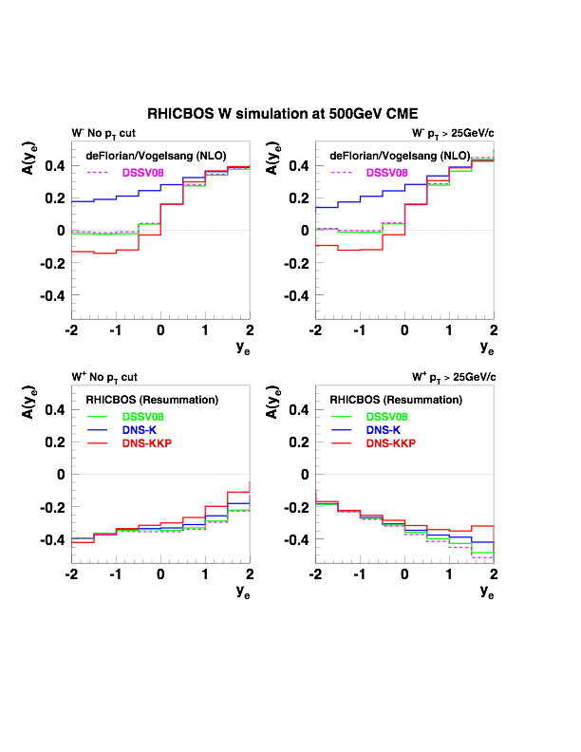
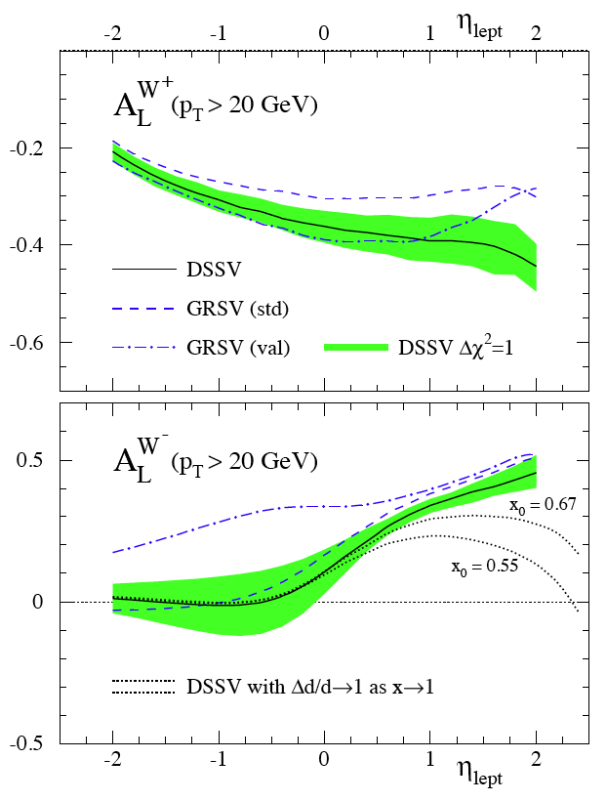

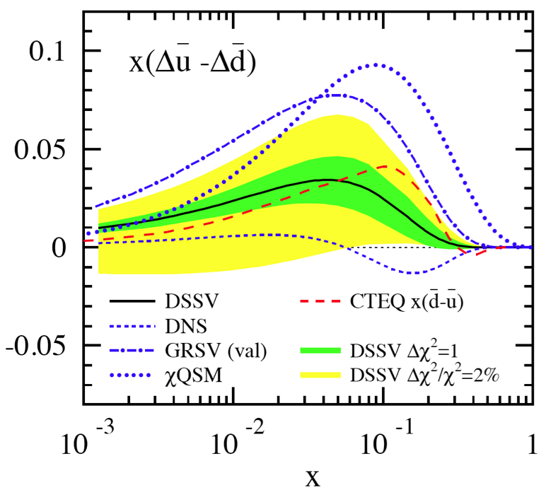





Flavor Sensitivies at Different Rapidity
Calculations:
1) RHICBOS: P.M. Nadolsky and C.-P. Yuan, Nucl. Phys. B666 (2003) 31.
2) deFlorian / Vogelsang: D. deFlorian, private communications.

Slide 24
First 500 GeV Data in 2009
First 500 GeV run took place in February and March 2009
Largely a commissioning run for the accelerator, the polarimeters, and the detectors
  Average polarization ~39% —many additional depolarizing resonances compared to 200 GeV
  Both STAR and PHENIX will finish installing detector/trigger upgrades to be able to make full use of the next 500 GeV run
  But W → e at midrapidity already possible with current data!

Slide 25
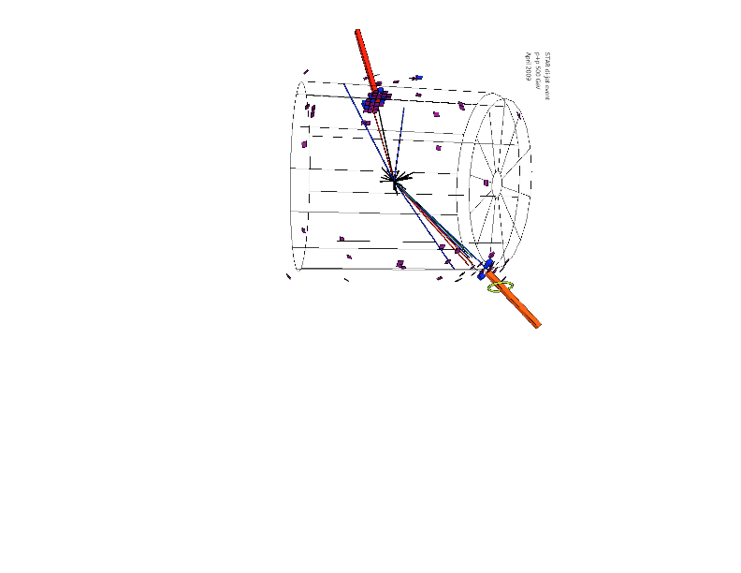
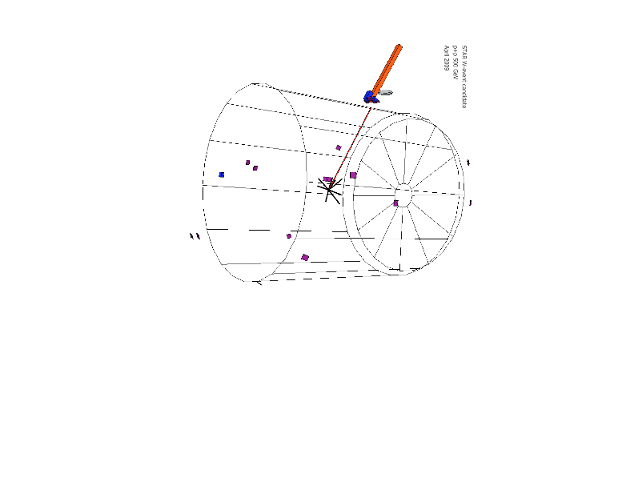
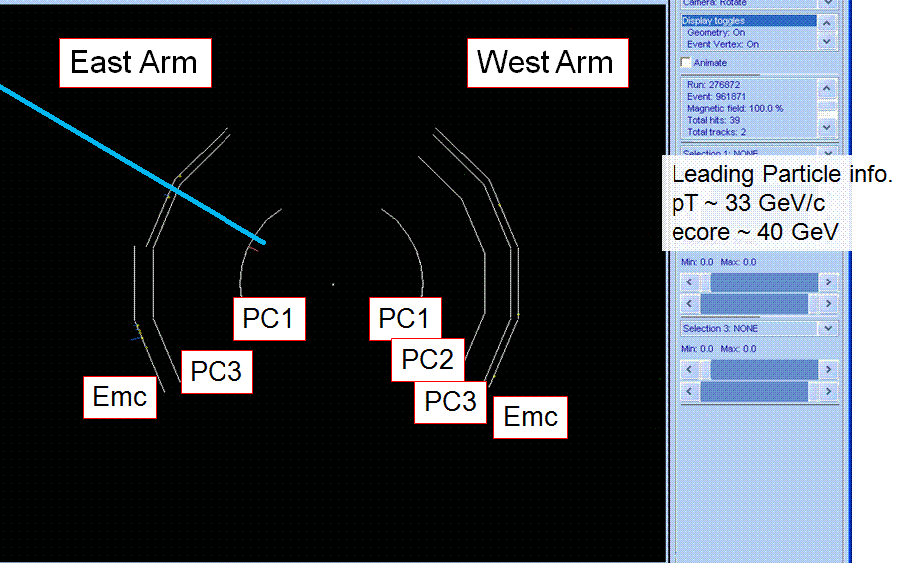
The Hunt for W’s at RHIC has Begun!
STAR W candidate
STAR dijet event
PHENIX W candidate

Slide 26
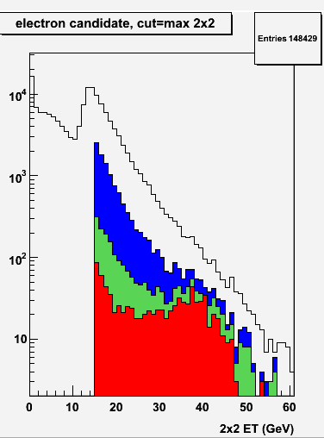

STAR W Physics Analysis
Evolution of ET distribution vs. cut ID
Starting raw distribution
TPC track - EMCal cluster match
No near-cone ET (isolation)
No away-cone ET
(missing energy on opposite side)
Clear Jacobian peak seen, characteristic of W production and in contrast to QCD background!

Slide 27
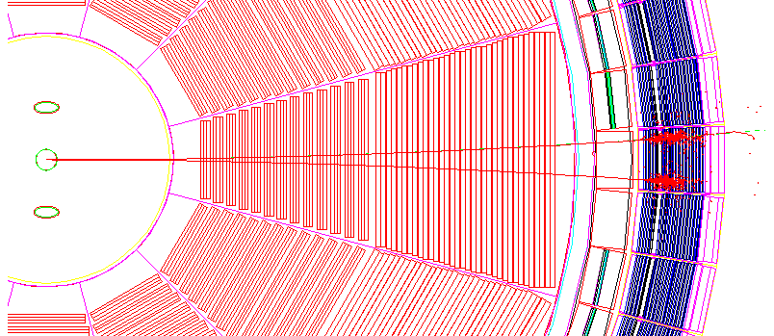
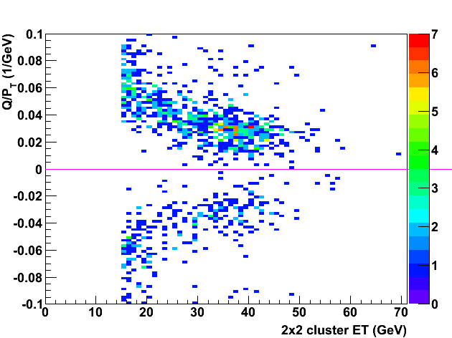
Charge Separation at 40 GeV (STAR)
Recall: Collider experiment!
TPC
vertex
positron p_{T} = 5 GeV
electron p_{T} = 5 GeV
200 cm of tracking
BEMC
+/- distance D: ~1/P_{T}
p_{T} = 5 GeV : D ~15 cm
p_{T} = 40 GeV : D ~2 cm
Successful separation of
different charge states!
Q: Charge-sign
of
reconstructed
track
Q / pT (1/GeV)
positrons
Assign:
Q/p_{T} > 0 positrons
Q/p_{T} < 0 to be electrons
electrons
EMC Cluster E_{T} (GeV)

Slide 28
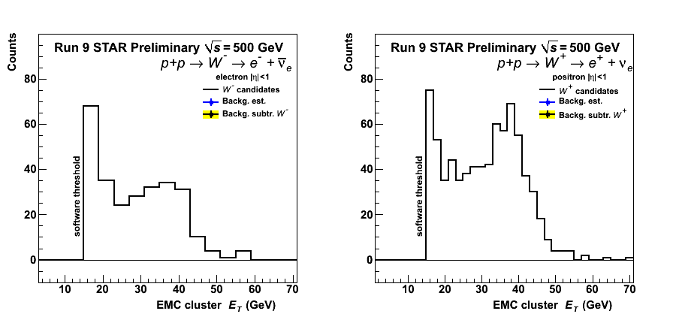
Charge-Separated E_{T} Distributions
Jacobian peaks visible for both charges
Charge-separated W⁺/W⁻ candidate distributions of the EMC cluster transverse energy ET (GeV) after all cuts (no bg subtraction)

Slide 29
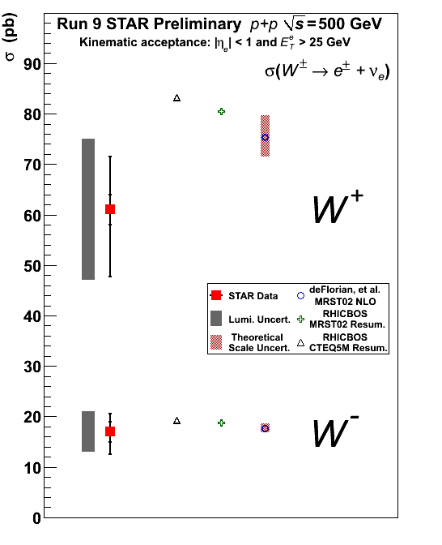
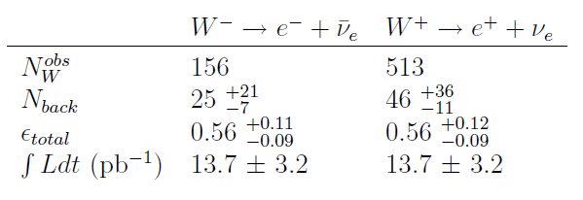

Preliminary W Cross Section Results
Total W⁺/W⁻ cross-section results
STAR Preliminary Run 9
(p+p √s=500 GeV)
Reasonable agreement between measured and theoretical cross-sections within uncertainties!
STAR

Slide 30
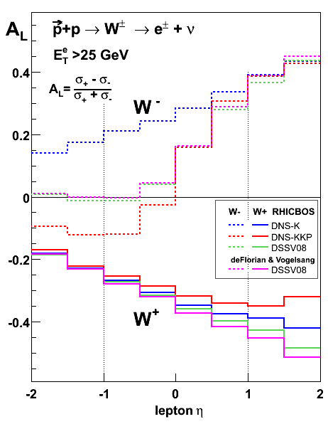
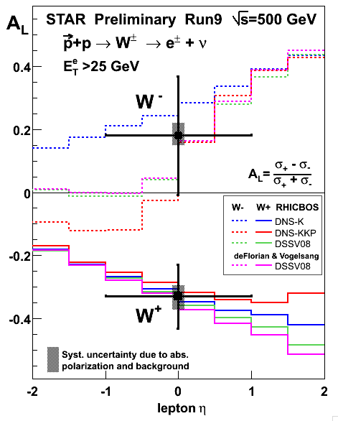
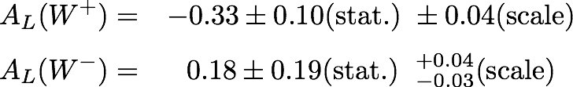
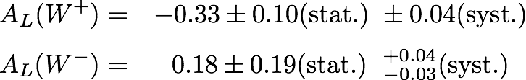
Preliminary A_{L} Results from 2009
500 GeV Commissioning Run
STAR Preliminary Run 9
(p+p √s=500 GeV)
AL(W⁺) negative with a significance of 3.3σ
  First non-zero helicity asymmetry at RHIC!
AL(W⁻) central value positive
STAR

Slide 31
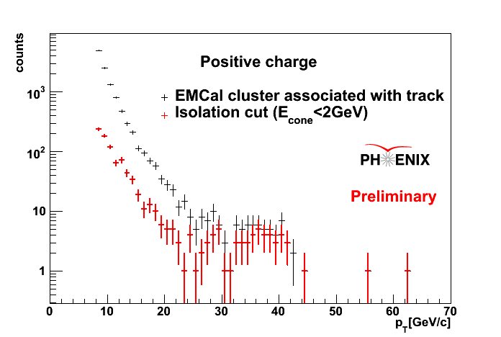
PHENIX W Analysis: Raw Asymmetries (e⁺)
 | Background | Signal
p_{T} Range (GeV/c) | 12-20 | 30-50
Raw Asymmetry | 0.035±0.047 | -0.29±0.11
Notes:
BG is expected to be 0
Signal non zero
31

Slide 32
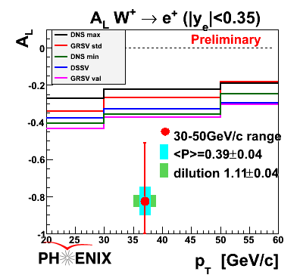
PHENIX W Analysis:
Preliminary A_{L} Results
Using average polarization 0.39±0.04:
Asymmetry corrected for dilution by Z and QCD backgrounds
A_{L}^{W+} = -0.83 ± 0.31
Measured asymmetries by STAR and PHENIX in agreement with theory using polarized pdf’s (DSSV) constrained by polarized DIS data
⇒ Universality of helicity distribution functions

Slide 33
Proton Spin Structure at RHIC
Gluon helicity distribution and ΔG
Flavor–separated sea quark helicity distributions
“Transverse spin” phenomena
Transversity
Transverse-momentum-
dependent distributions
, Jets
Prompt Photons
Single-Spin Asymmetries
Back-to-Back Correlations

Slide 34
Longitudinal (Helicity) vs. Transverse Spin Structure
Transverse spin structure of the proton cannot be deduced from longitudinal (helicity) structure
  Spatial rotations and Lorentz boosts don’t commute!
  Only the same in the non-relativistic limit
Transverse structure linked to intrinsic parton transverse momentum (k_{T}) and orbital angular momentum!
  Parton dynamics

Slide 35
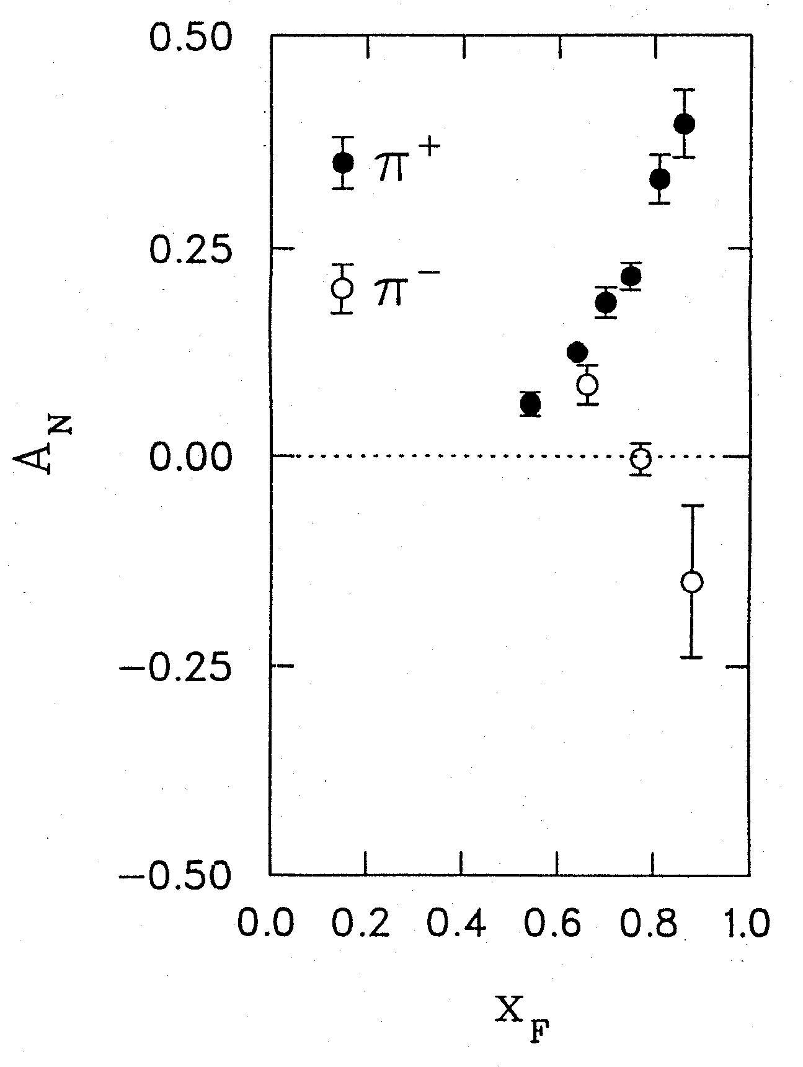
1976: Discovery in p+p Collisions!
Large Transverse Single-Spin Asymmetries
Argonne √s=4.9 GeV
Charged pions produced preferentially on one or the other side with respect to the transversely polarized beam direction!
left
Due to transversity? Other effects? We’ll need to wait more than a decade for the birth of a new subfield in order to explore the possibilities . . .
right
W.H. Dragoset et al., PRL36, 929 (1976)

Slide 36
Transverse-Momentum-Dependent Distributions and Single-Spin Asymmetries
1989: The “Sivers mechanism” is proposed in an attempt to understand the observed asymmetries.
D.W. Sivers, PRD41, 83 (1990)
The Sivers distribution: the first transverse-momentum-dependent distribution (TMD)!
Departs from the traditional collinear factorization assumption in pQCD and proposes a correlation between the intrinsic transverse motion of the quarks and gluons and the proton’s spin

Slide 37
Quark Distribution Functions
Similarly, can have k_{T}-dependent fragmentation functions (FF’s). One example: the chiral-odd Collins FF, which provides one way of accessing transversity distribution (also chiral-odd).
No k_{T} dependence
Transversity
k_{T} - dependent, T-even
k_{T} - dependent, T-odd
Sivers
Relevant measurements in simpler systems (DIS, e+e-) only starting to be made over the last ~6 years! Rapidly advancing field both experimentally and theoretically!
Boer-Mulders

Slide 38
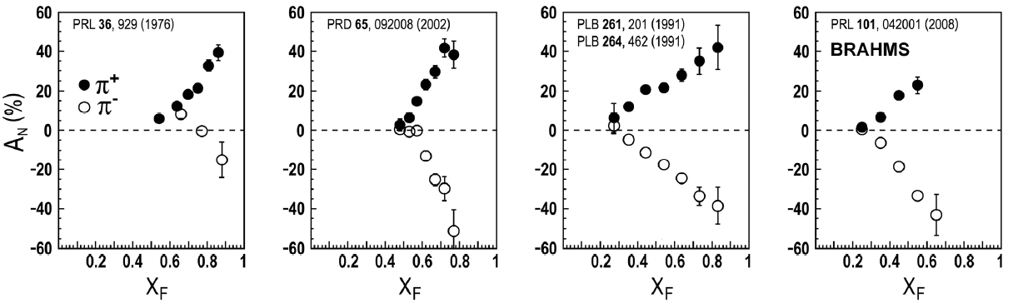
Transverse Single-Spin Asymmetries:
From Low to High Energies!
ANL
√s=4.9 GeV
BNL
√s=6.6 GeV
FNAL
√s=19.4 GeV
RHIC
√s=62.4 GeV
RHIC
√s=200 GeV!
π⁰
left
STAR
right

Slide 39



π
π
π, K, p
at 200 and 62.4 GeV
Pattern of pion species asymmetries in the forward direction
→ valence quark effect.
But this conclusion confounded by kaon and antiproton asymmetries!
200 GeV
62.4 GeV
Note different scales
K
K
K- asymmetries
underpredicted
200 GeV
62.4 GeV
p
p
Large antiproton asymmetry?? Unfortunately no 62.4 GeV measurement
200 GeV
62.4 GeV

Slide 40


Another Surprise: Transverse Single-Spin Asymmetry in Eta Meson Production
There were hints already from E704!
Further evidence against a valence quark effect!
PHENIX analysis in progress . . .
Larger than the neutral pion!
STAR

Slide 41

Neutral Pion Transverse SSA:
Expected Decrease at Low p_{T} Now Observed
Black points:
Phys. Rev. Lett. 101, 222001 (2008)
Flat
p_{T} dependence
2.5-3.5 GeV/c? Or falling above ~3 GeV/c??
STAR

Slide 42


Improved Forward Coverage in PHENIX: A_{N} of Forward Clusters in MPC at √s=200 GeV
2008 data, released earlier this year.
Fraction of clusters
Decay photon
π⁰
Direct photon
p_{T} (GeV/c)

Slide 43


PHENIX:A_{N} of Forward Clusters in MPC for Different Pseudorapidities
GeV/c
GeV/c
Decay photon
π⁰
Direct photon
Fraction of clusters
Eta>3.3
x_{F}

Slide 44


PHENIX:A_{N} of Forward Clusters in MPC vs. p_{T}
Turnover for
p_{T} >~3 GeV/c?
Decay photon
π⁰
Direct photon
Fraction of clusters
p_{T}

Slide 45


Compare: Recent HERMES Results for SSA in Inclusive Hadron Production
Non-zero, but smaller magnitudes than low-energy p+p results
Sharp turnover for p_{T}>~0.8 GeV/c

Slide 46

PHENIX Results for Midrapidity π⁰ A_{N}
2002 Published Result 2008 Preliminary Result
A_{N}
p_{T}
Released earlier
this year.
20x smaller error bars than 200 result!
→Large improvement in both polarization and luminosity
Notes:
Color code

Slide 47

PHENIX Results for Midrapidity π⁰ and η A_{N}
A_{N}
p_{T}
A_{N} consistent with zero (at level 10⁻³!) at midrapidity. Most precise RHIC asymmetry results to date.

Slide 48


BELLE Interference FF Measurement
Preliminary
Preliminary
Preliminary
With measurement from e+e- available, can learn from p+p (probe transversity x IFF)!
Preliminary
Preliminary
Preliminary
Measurement probes ( H₁< )²
Non-zero and large
Preliminary
Preliminary
8x8 m₁ m₂ binning

Slide 49

PHENIX IFF Results at Midrapidity vs. Pair Mass
Added statistics from 2008 running
As in DIS measurements, no significant effect observed around rho mass.

Slide 50

PHENIX IFF Results at Midrapidity vs. p_{T}
Added statistics from 2008 running
No significant asymmetries seen at mid-rapidity (yet!).

Slide 51

TMD’s and Universality:
Modified Universality of Sivers Asymmetries
DIS: attractive FSI
Drell-Yan: repulsive ISI
Measurements in semi-inclusive DIS already exist. A Drell-Yan measurement will be a crucial test of our understanding of QCD!
Multiple dedicated polarized Drell-Yan experiments now being proposed.
As a result:

Slide 52
TMDs, Factorization, and Universality in Other Hadronic Reactions
Recent work by T.C. Rogers, P.J. Mulders (PRD81:094006, 2010/hep-ph 1001.2977) on “color entanglement”—no “standard” factorization for TMDs possible when > 2 hadrons involved in hard process!
For single-weighted functions still possible . . .
Solution for non-weighted functions may be to include all hadrons in a single soft part
We’ve known in principle all along that factorization is an approximation! Finally ready to start to move beyond the simplest approximation of hadrons that don’t “communicate” in multi-hadron interactions!

Slide 53
QED vs. QCD
observation & models
precision measurements
& fundamental theory

Slide 54

Glancing Into the Future:
The Electron-Ion Collider
Design and build a new facility with the capability of colliding a beam of electrons with a wide variety of nuclei as well as polarized protons and light ions: the Electron-Ion Collider

Slide 55
The EIC: Communities Coming Together
At RHIC, heavy ions and nucleon spin structure already meet, but in some sense by “chance”
  Genuinely different physics
  Communities come from different backgrounds
  Bound by an accelerator that has capabilities relevant to both
Proposed EIC a facility where heavy ion and nucleon structure communities truly come together, peering into various forms of hadronic matter to continue to uncover the secrets and subtleties of QCD . . .

Slide 56
Conclusions and Prospects
After > 40 years of studying the internal structure of the nucleon and nuclei, we remain far from the ultimate goal of being able to describe nuclear matter in terms of its quark and gluon degrees of freedom!
Further data from RHIC will better constrain the helicity distributions within the proton and continue to push forward knowledge of the quantum mechanical spin-momentum correlations of partons in nucleons.
The EIC promises to usher in a new era of precision measurements that will probe the behavior of quarks and gluons in nucleons as well as nuclei, bringing us to a new phase in understanding the rich complexities of QCD in matter.
There’s a large and diverse community of people—at RHIC and complementary facilities—driven to continue exploring QCD and coaxing the secrets out of one of the most fundamental building blocks of the world around us.

Slide 57
Additional Material

Slide 58

Polarization-averaged cross sections at √s=200 GeV
Good description at 200 GeV over all rapidities down to p_{T} of 1-2 GeV/c.

Slide 59

√s=62.4 GeV
Forward pions
Comparison of NLO pQCD calculations with BRAHMS π data at high rapidity. The calculations are for a scale factor of μ=p_{T}, KKP (solid) and DSS (dashed) with CTEQ5 and CTEQ6.5.
Surprisingly good description of data, in apparent disagreement with earlier analysis of ISR π⁰ data at 53 GeV.
Still not so bad!

Slide 60

√s=62.4 GeV
Forward kaons
K⁻ data suppressed ~order of magnitude (valence quark effect).
NLO pQCD using recent DSS FF’s gives ~same yield for both charges(??).
Related to FF’s? PDF’s??
K⁺: Not bad!
K⁻: Hmm…
Notes:
Authero of DSS knows about this.

Slide 61



π⁰ A_{LL}: Agreement with Different Parametrizations of Δg(x)
Small ΔG in our measured x region 0.02 to 0.3 gives small A_{LL} (DSSV and GS-C). Large ΔG gives comparatively larger A_{LL} .
Note small A_{LL} does not necessarily mean small ΔG in the full x range!
arXiv:0810.0694, submitted to PRL
Notes:
61

Slide 62
π⁰ A_{LL}: Agreement with different parametrizations
For each parametrization, vary ΔG^{[0,1]} at the input scale while fixing Δq(x) and the shape of Δg(x), i.e. no refit to DIS data.
For range of shapes studied, current data relatively insensitive to shape in x region covered.
Need to extend x range!
arXiv:0810.0694, submitted to PRL

Slide 63


Extending x Coverage
PRD79, 012003 (2009)
Measure in different kinematic regions
  e.g. forward vs. central
Change center-of-mass energy
  Most data so far at 200 GeV
  Brief run in 2006 at 62.4 GeV
  First 500 GeV data-taking to start next month!
62.4 GeV
Extend to lower x at √s = 500 GeV
Extend to higher x at √s = 62.4 GeV
200 GeV
present
x-range
√s = 200 GeV
Notes:
Get rid of!

Slide 64
Neutral Pion A_{LL} at 62.4 GeV
Converting to x_{T}, can see significance of 62.4 GeV measurement (0.08 pb⁻¹) compared to published data from 2005 at 200 GeV (3.4 pb⁻¹).
PRD79, 012003 (2009)

Slide 65

Ordering of A_{LL} for pion species?
Not yet clear.
Small ΔG → small predicted differences between asymmetries!

Slide 66

Reduce Integration Bins: Correlation Measurements
Di-Jet and Photon-Jet Asymmetries allows reconstruction of partonic x1 and x2 at leading order.

Slide 67


STAR W Analysis: BG Subtraction
S/B~6
S/B~11
Background distribution and background-subtracted signal distribution
B/(S+B) (ET > 25GeV) W⁻: 16%
B/(S+B) (ET > 25GeV) W⁺: 8%

Slide 68


STAR W Analysis: Data/MC Comparison
Comparison of data and PYTHIA+GEANT simulations for W signal events at 500GeV
Systematic uncertainties were estimated by varying cuts and normalization regions for QCD background and by varying BEMC energy scale uncertainty (±7.5%)

Slide 69

STAR W Cross Section: Uncertainties
Total W⁺/W⁻ cross-section uncertainties
W reconstruction systematic uncertainties
  Track reconstruction: 15 – 20%
  Vertex reconstruction: 3%
  BEMC Energy scale: < 1%
Normalization / Luminosity systematic uncertainty
  Vernier scan absolute cross section: 23%
Background systematic uncertainty
  Vary data driven QCD background shape and normalization region (E_{T} < 17 – 21 GeV)
Bernd Surrow

Slide 70
STAR W A_{L} Uncertainties
Parity-violating single-spin asymmetry W⁺/W⁻ AL uncertainties
W⁺ |  |  | W ⁻
high | low |  | high | low
0.09 | 0.09 |  | 0.09 | 0.09 |  | Absolute polarization magnitude of both beams (P1+P2) (9.2%)
0.07 | 0.02 |  | 0.13 | 0.03 |  | QCD unpolarized background
0.07 | 0.07 |  | 0.14 | 0.14 |  | QCD pol. bckg. ~0: use 1/2 stat error of this test
0.01 | 0.00 |  | 0.01 | 0.00 |  | Decay of pol. within fill
0.13 | 0.11 |  | 0.21 | 0.17 |  | Total syst. in fraction of measured AL
The following effects were found to be negligible:
Dilution of AL due to swap of W⁺/W⁻ charges : Tracks with false curvature were removed
ALL P1P2 term cancels out
Transverse spin term negligible
Nuclear Physics Seminar - BNL
Upton, NY, March 16, 2010
Bernd Surrow

Slide 71



W Projections (STAR)
Assumptions:
Efficiency:
  Mid-rapidity: 0.65
  Forward rapidity: 0.60
  Assume availability of 9MHz RF
Background:
  Mid-rapidity: Run 9
  Forward rapidity: QCD MC simulations
Full charge-sign discrimination at high-pT

Slide 72



W Projections vs. p_{T}
1 < η < 2
300 pb⁻¹
Realistic BG subtraction
Recent PDFs ~representing current allowed Δu/Δd range
Δd and Δu isolated
STAR
72
Notes:
72

Slide 73


PHENIX W Analysis: Electron p_{T} Spectra
Data- and MC-driven BG estimation:
EMCal cluster distribution after subtracting cosmic background
× (Conversion + Accidental)
× Tracking Acceptance
(NLO Hadrons thru Geant + FONLL c/b)
× Normalization from fit to 10-20 GeV
+
+
-
The same scale factor for PYTHIA was used for W/Z shape.
W⁻→e⁻ signal has fewer counts than W⁺→e⁺ signal as expected
Notes:
Background form all EMCal clusters.
Signal shape looks reasonable.
73

Slide 74

PHENIX W Analysis: Isolation Cut
Signature of a W event is that it is isolated
Sum up energy in a cone around electron and in cone on opposite hemisphere
ΣE < 2GeV
+
-
90+% of signal is kept (red histograms)
Factor ~5 reduction in jet dominated region
2/20/2010
74
Notes:
Isolation cut (figure)
Positive, negative
Most of them are preserved.
Positive first
74

Slide 75


A_{LL} of Non-identified Charged Hadrons at 62.4 GeV
Cross section measurement in progress!
14% polarization uncertainty not included

Slide 76




Towards a 3D spin-flavor landscape
W^{u}(x,k,r)
x = 0.01
m
x = 0.40
x = 0.70
m
d³r
d²k_{T}
p
x
p
TMD
GPD
B
TMD^{u}(x,k_{T})
f₁,g₁,f_{1T} ,g_{1T}
h₁, h_{1T} ,h_{1L} ,h₁
Link to Orbital Momentum
GPD^{u}(x,ξ,t)
H^{u}, E^{u}, H^{u}, E^{u}
Link to Orbital Momentum
~
~
Wigner function: Probability to find a u(x) quark with a certain polarization at position r and with momentum k
Fourier transform in momentum transfer
d²k_{T}
ξ = 0, t = 0
dx
f₁(x)
g₁, h₁
u(x)
Δu, δu
F₁^{u}(t)
F₂^{u},G_{A}^{u},G_{P}^{u}
Parton
Distributions
Form Factors
gives transverse position of quark (parton) with longitud. mom. fraction x

Slide 77
Understanding Transverse Spin Measurements in Hadronic Collisions
Theoretical interpretation of longitudinally polarized measurements at RHIC relies on the existence of results from simpler systems, e.g.
  Fragmentation functions from e+e- experiments
  Δu, Δd from deep-inelastic scattering experiments
Relevant quantities for transverse spin calculations starting to be measured and parameterized now…

Slide 78
Prokudin et al. at Ferrara

Slide 79
Prokudin et al. at Ferrara

Slide 80

Improved Forward Coverage in PHENIX:Muon Piston Calorimeter
Photon merging effects prevent two-photon π⁰ analysis for E>20 GeV (p_{T}>2 GeV/c)
62 GeV
20 GeV → 0.65 x_{F}:Two-photon π⁰ analysis
200 GeV
20 GeV → 0.20 x_{F} : “Single clusters”.
Yields dominated by π⁰’s but also get
contributions from:
Electromagnetic
  Direct photons
  Decay photons (η, etc)
  Estimated using Pythia (TuneA)
Hadronic: (π^{+/-}, K^{+/-}, etc.)
  Estimated with Pythia+GEANT.
  Initial estimate is <10% contamination in lowest
  energy bin with decreasing fraction as
  deposited energy increases
  Qualitatively consistent with expected detector
  behavior
Decay photon impact positions for low and high energy π⁰’s

Slide 81

Midrapidity Neutral Pion SSA: Limit on Gluon Sivers Function
Data points: π⁰ A_{N} at x_{F}=0
Leading order model-dependent
constraints on gluon Sivers function
Similar storyline to A_{LL}
  Initial data rules out maximally polarized distributions
  Later data puts precise determination on distribution
Phys. Rev. D 74, 094011
Cyan: Gluon Sivers Function at positivity bound, no sea quark Sivers
Thick Red: Gluon Sivers parameterized to be 1 sigma from PHENIX π⁰ A_{N}
Blue: Asymmetry from Sea quark Sivers at positivity bound
Green: Asymmetry from Gluon Sivers for case of sea quark at positivity bound
Notes:
Limit on gluon sivers
Impact of 2002 result: Limit on gluon sivers function
Remove storyline?

Slide 82




Constraints on Sivers Function:
Heavy Flavor
Theoretical predictions:
D meson A_{N}
Production dominated by gluon-gluon fusion at RHIC energy
Gluon transversity zero
→Asymmetry cannot originate from Transversity x Collins
Sensitive to gluon Sivers effect
Gluon Sivers=Max
Quark Sivers=0
Gluon Sivers=0
Quark Sivers=Max
High twist (PRD 78 114013)
T_{G}^{(d)}, T_{G}^{(f)} twist 3 gluon correlators
Solid: T_{G}^{(d)}, T_{G}^{(f)} same sign
Dashed: T_{G}^{(d)}=T_{G}^{(f)}=0
Dotted: T_{G}^{(d)}, T_{G}^{(f)} opposite sign

Slide 83



Constraints on Sivers Function: Heavy Flavor
PHENIX: no reconstruction of D meson
Dominated by charm production in current kinematic range
Measurements at mid and forward rapidity
Constraints on both twist-3 and Sivers functions

Slide 84

SSA of heavy flavor vs. x_{F}
Qualitative conclusion: Data constrain the gluon Sivers function
to be significantly smaller than the maximal allowed.
Translation between D meson and muon kinematics and
estimate of charm vs. bottom components underway such
that more quantitative comparison can be made in the future.
Data: Prompt muons
Calculations: D mesons

Slide 85






Attempting to Probe k_{T} from
Orbital Motion
k_{T} larger
k_{T} smaller
Spin-correlated transverse momentum (orbital angular momentum) may contribute to jet k_{T}. (Meng Ta-chung et al., Phys. Rev. D40, 1989)
Possible helicity dependence
Would depend on (unmeasured) impact parameter, but may observe net effect after averaging over impact parameter
Same
helicity
Opposite
helicity

Slide 86

Forward neutrons at √s=200 GeV at PHENIX
Large negative SSA observed for x_{F}>0, enhanced by requiring concidence with forward charged particles (“MinBias” trigger).
No x_{F} dependence seen.
Mean p_{T}
(Estimated by simulation assuming ISR p_{T} dist.)
0.4<|x_{F}|<0.6 0.088 GeV/c
0.6<|x_{F}|<0.8 0.118 GeV/c
0.8<|x_{F}|<1.0 0.144 GeV/c
preliminary | A_{N}
Without MinBias | -6.6 ±0.6 %
With MinBias | -8.3 ±0.4 %
charged
particles
neutron
neutron

Slide 87
Forward neutrons at other energies
Significant forward neutron asymmetries observed down to 62.4 and up to 410 GeV!
√s=62.4 GeV
√s=410 GeV

Slide 88

The STAR Detector at RHIC
STAR

Slide 89


PHENIX Detector
Philosophy:
  High rate capability to measure rare probes,
  but limited acceptance.
2 central
spectrometers
Track charged particles and detect electromagnetic processes
azimuth
2 forward
spectrometers
- Identify and track muons

Slide 90


BRAHMS detector
Philosophy:
  Small acceptance spectrometer arms
  designed with good charged particle ID.

Slide 91

And a (Relatively) Recent Surprise From p+p, p+d Collisions
Fermilab Experiment 866 used proton-hydrogen and proton-deuterium collisions to probe nucleon structure via the Drell-Yan process
Anti-up/anti-down asymmetry in the quark sea, with an unexpected x behavior!
Hadronic collisions play a complementary role to DIS and have let us continue to find surprises in the rich linear momentum structure of the proton, even after 40 years!
PRD64, 052002 (2001)

