Slide 1
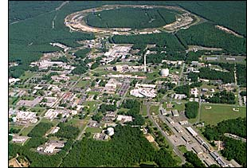
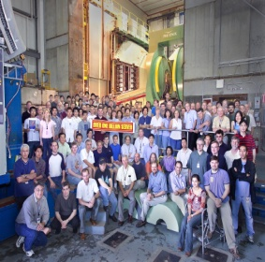


Cross Section and Double-Helicity Asymmetry in Charged Hadron Production at √s=62.4 GeV at
Christine A. Aidala
Los Alamos National Lab
SPIN 2010, Juelich, Germany
September 28, 2010

Slide 2
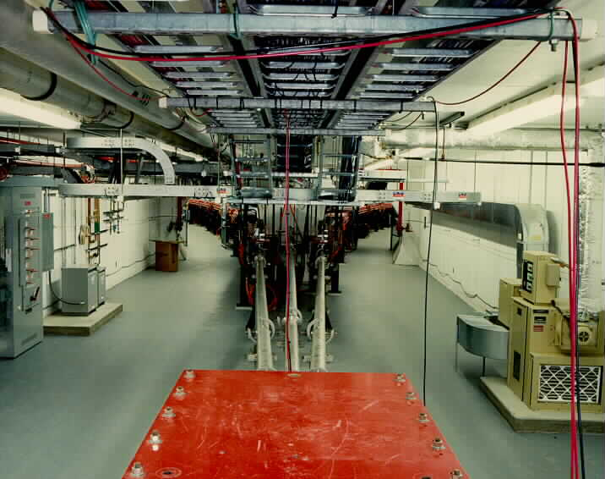
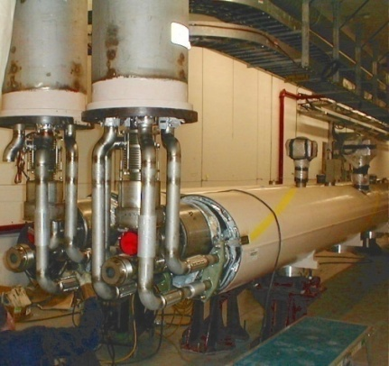
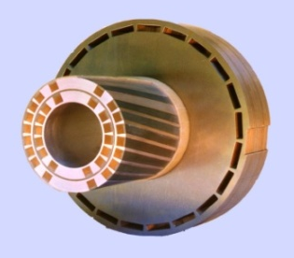
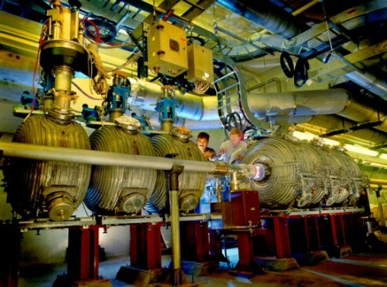
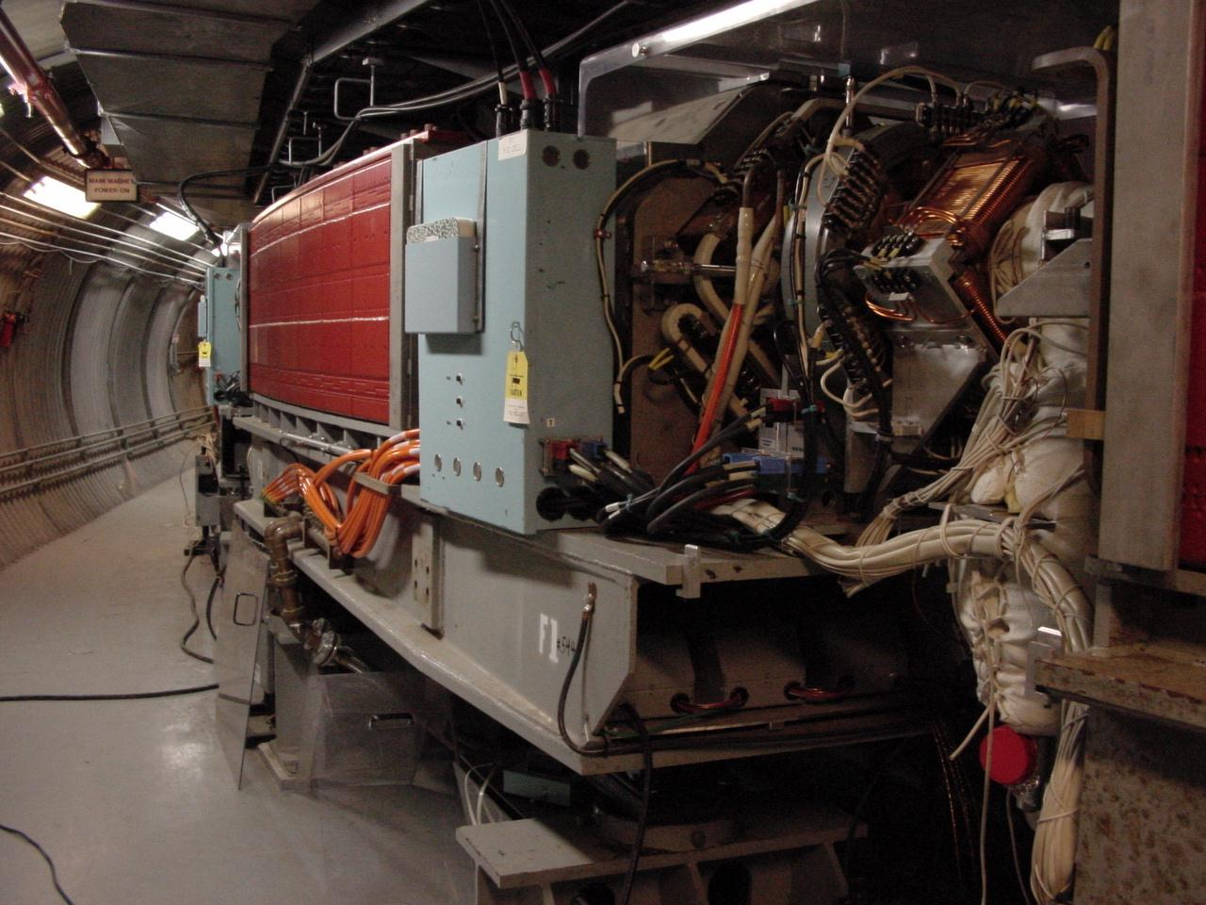
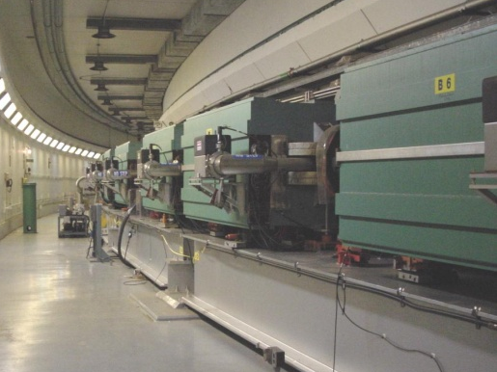
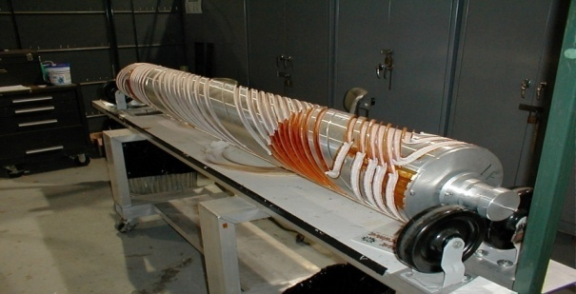
RHIC as a Polarized p+p Collider
Absolute Polarimeter (H jet)
RHIC pC Polarimeters
Siberian Snakes
Overarching goal of RHIC spin program is to study nucleon structure in terms of (polarized) parton distribution functions (pdfs)
High energies: √s = 50-500 GeV
Perturbative QCD framework
PHOBOS
BRAHMS & PP2PP
Siberian Snakes
PHENIX
Spin Flipper
STAR
Spin Rotators
Various equipment to maintain and measure beam polarization through acceleration and storage
Partial Snake
Helical Partial
Snake
Polarized Source
Strong Snake
LINAC
AGS
200 MeV Polarimeter
BOOSTER
Rf Dipole
AGS Internal Polarimeter
AGS pC Polarimeter
Notes:
RHIC, as a high-energy polarized proton collider, really represents an outstanding achievement in accelerator physics. . . . [equipment]. I’m going to be showing a number of results from RHIC throughout my talk, but I’d like to put them in a broader context of the contributions that hadronic interactions have made to this field over the years.

Slide 3
Predictive Power of pdf’s:
Factorization and Universality in Perturbative QCD
q(x₁)
Hard Scattering Process
X
g(x₂)
“Hard” probes have predictable rates given:
    Parton distribution functions (need experimental input)
    Partonic hard scattering rates (calculable in pQCD)
    Fragmentation functions (need experimental input)
Universality
(Process
independence)

Slide 4
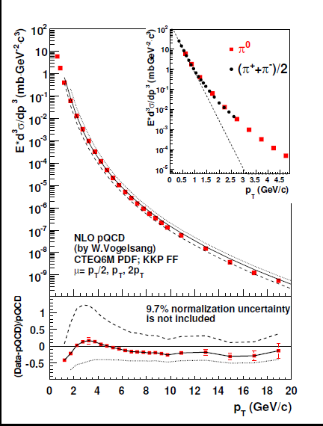
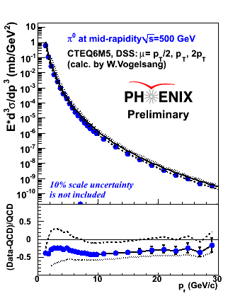
Midrapidity pion production at 200 and 500 GeV compared to NLO pQCD
200 GeV
500 GeV
Reasonable description of polarization-averaged cross sections at these energies using pdfs and FFs constrained by previous world data.
Note that cross sections for inclusive hadron production at RHIC are now being included in global analyses to constrain fragmentation functions!
Better knowledge of fragmentation functions in turn allows for tighter constraints on polarized pdfs.

Slide 5
Lower energies: √s=62.4 GeV
Midrapidity π⁰’s
PRD79, 021002 (2009)
Comparisons to NLO and NLL pQCD calculations using μ=p_{T} shown.
Unlike at 200 GeV, scale choice of μ=p_{T} underpredicts the data.
→ Threshold logarithm effects still relevant at this intermediate energy?
11% normalization
uncertainty not included
But—overall, pretty good agreement!

Slide 6
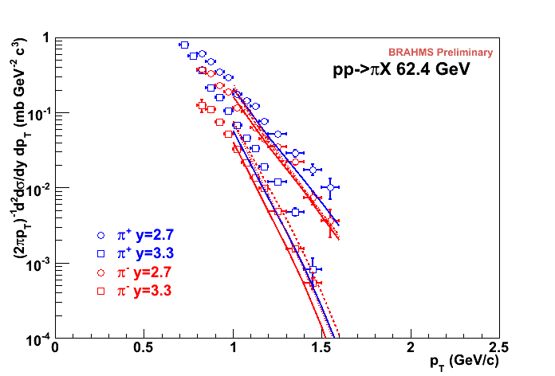

√s=62.4 GeV
Forward pions
Comparison of NLO pQCD calculations with BRAHMS π data at high rapidity. The calculations are for a scale factor of μ=p_{T}, KKP (solid) and DSS (dashed) with CTEQ5 and CTEQ6.5.
Surprisingly good description of data, in apparent disagreement with earlier analysis of ISR π⁰ data at 53 GeV.
No comparison to NLL yet.
Still not so bad!

Slide 7
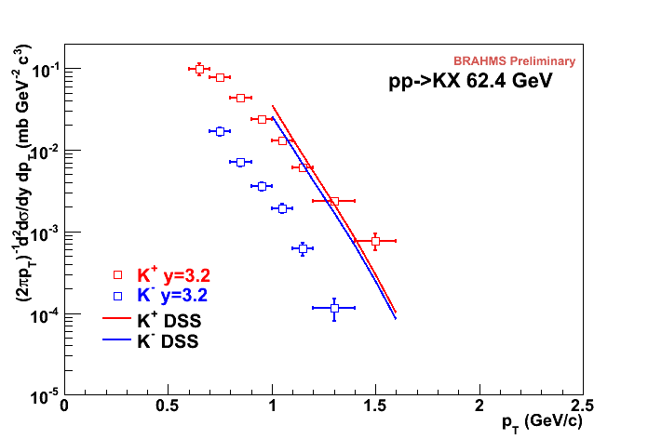
√s=62.4 GeV
Forward kaons
K⁻ data suppressed ~order of magnitude (valence quark effect).
NLO pQCD using recent DSS fragmentation functions (FFs) gives ~same yield for both charges(??).
Related to FFs? pdfs??
No comparison to NLL yet.
Still work to be done in describing hadronic collisions with pQCD at lower energies, particularly at forward rapidities.
K⁺: Not bad!
K⁻: Hmm…
Notes:
Authero of DSS knows about this.

Slide 8
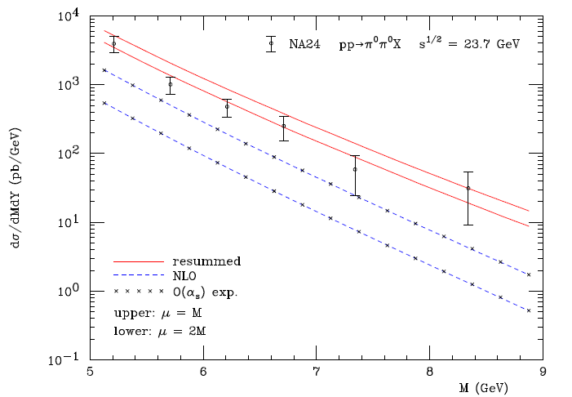
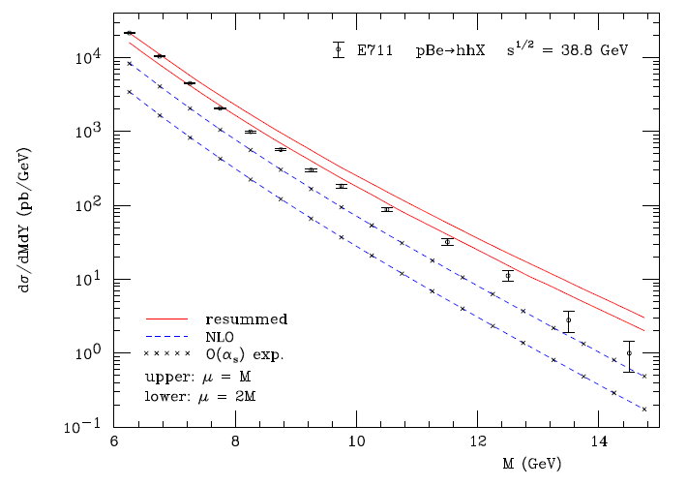
Progress in pQCD calculational techniques
23.7 GeV!
38.8 GeV!
pQCD an ever-more-powerful tool.
Interpretation of p+p results—over a wider range of energies—getting easier!
“Modern-day ‘testing’ of (perturbative) QCD is as much about pushing the boundaries of its applicability as about the verification that QCD is the correct theory of hadronic physics.”
– G. Salam, hep-ph/0207147 (DIS2002 proceedings)
One recent example:
Almeida, Sterman, Vogelsang, PRD80, 074016 (2009)
Cross section for di-hadron production vs. invariant mass using threshold resummation (rigorous method for implementing p_{T} and rapidity cuts on hadrons to match experiment)
8
Notes:
8

Slide 9
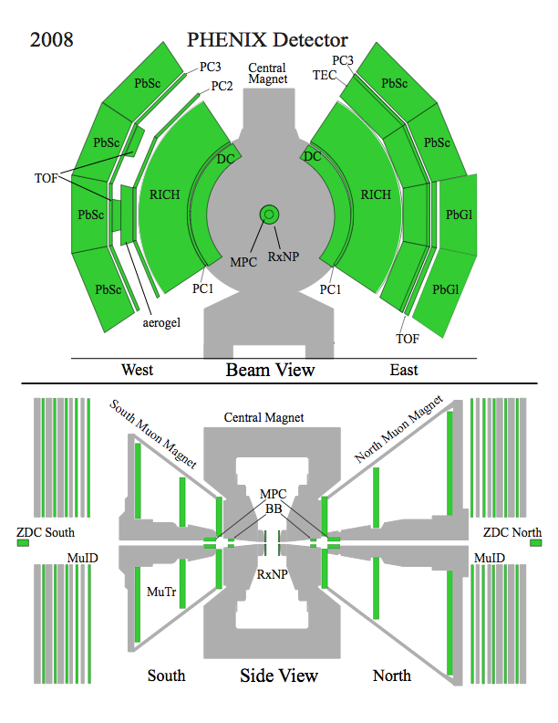
PHENIX detector
Philosophy:
  High rate capability to measure rare probes,
  fine granularity calorimetry, limited acceptance.
2 central spectrometers
  Track charged particles and detect electromagnetic processes
2 forward muon spectrometers
  Identify and track muons
2 forward EM calorimeters (as of 2007)
  Measure forward pions, etas
Luminosity counters
  Beam-Beam Counter (BBC)
  Zero-Degree Calorimeter (ZDC)

Slide 10


Measuring midrapidity charged hadrons at PHENIX
Two-week p+p run at sqrt(s)=62.4 GeV in 2006
Analyzed 11.1 nb⁻¹ (214M events)
Reconstruct tracks using Drift Chamber and Pad Chambers
RICH veto to eliminate electrons
Coincidence in two Beam-Beam Counters required for minimum-bias event
  Luminosity counters

Slide 11
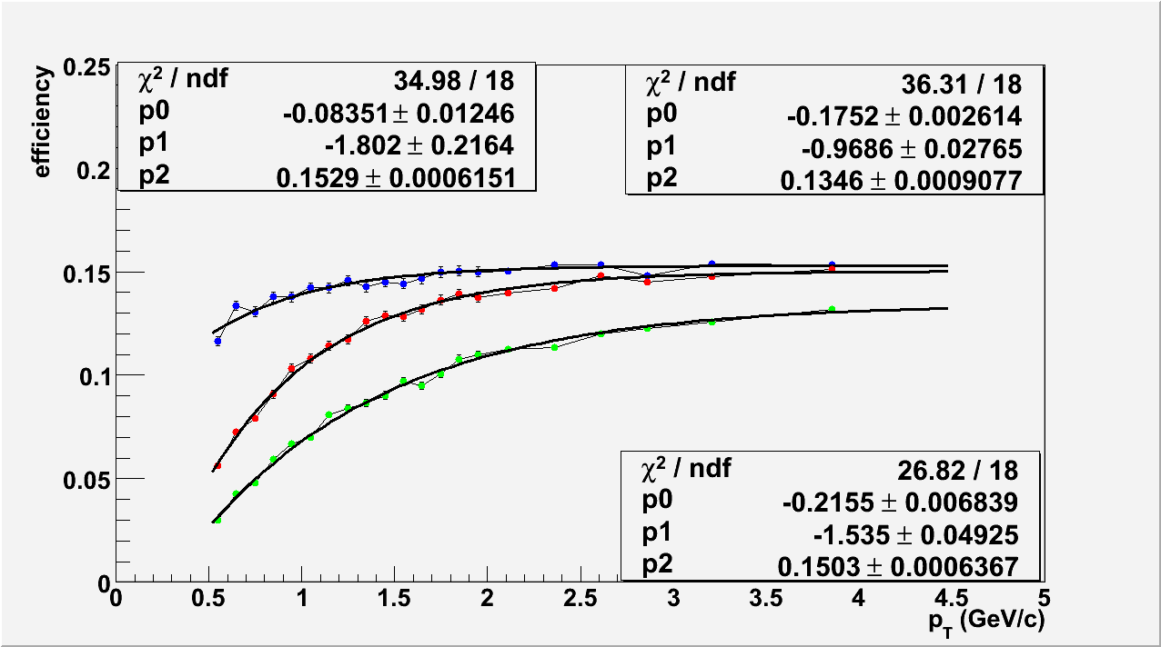
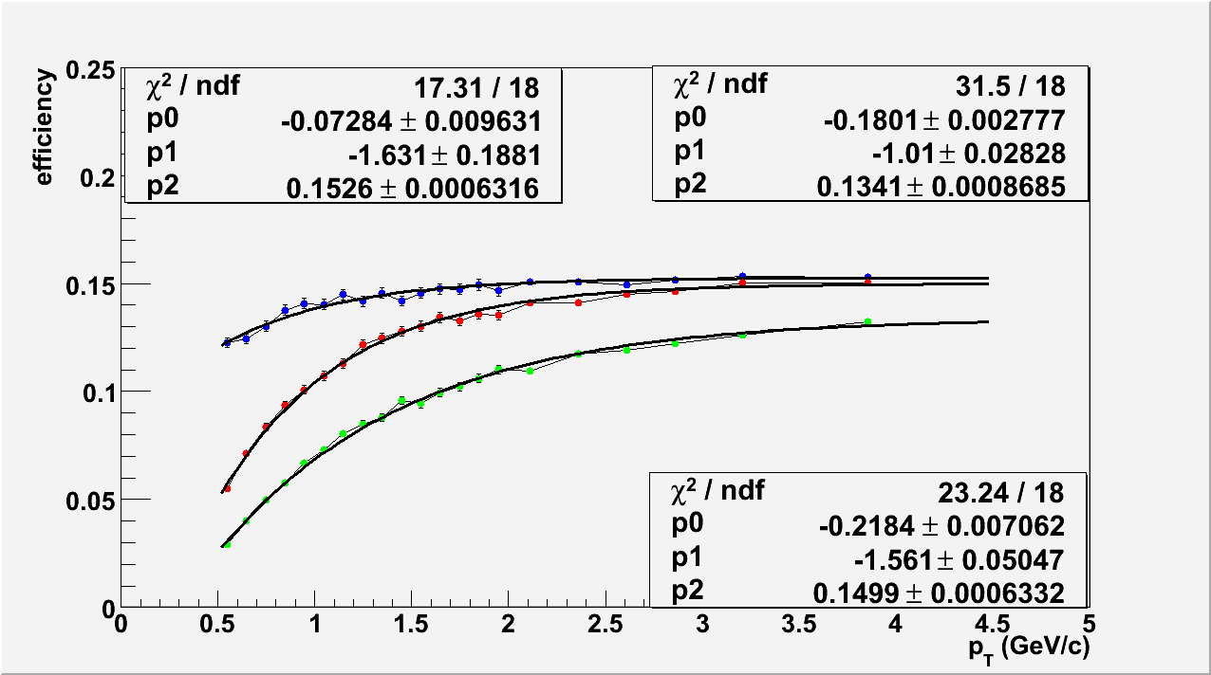
Particle-species dependent efficiency corrections
π+
π-
p
p
K+
K-
F(x) = [0]*exp([1] *x) + [2]
Use Monte Carlo to generate single-particle events over 2π in azimuth and one unit of rapidity
Run through full GEANT detector simulation, matching dead channel maps and fiducial cuts to experiment

Slide 12
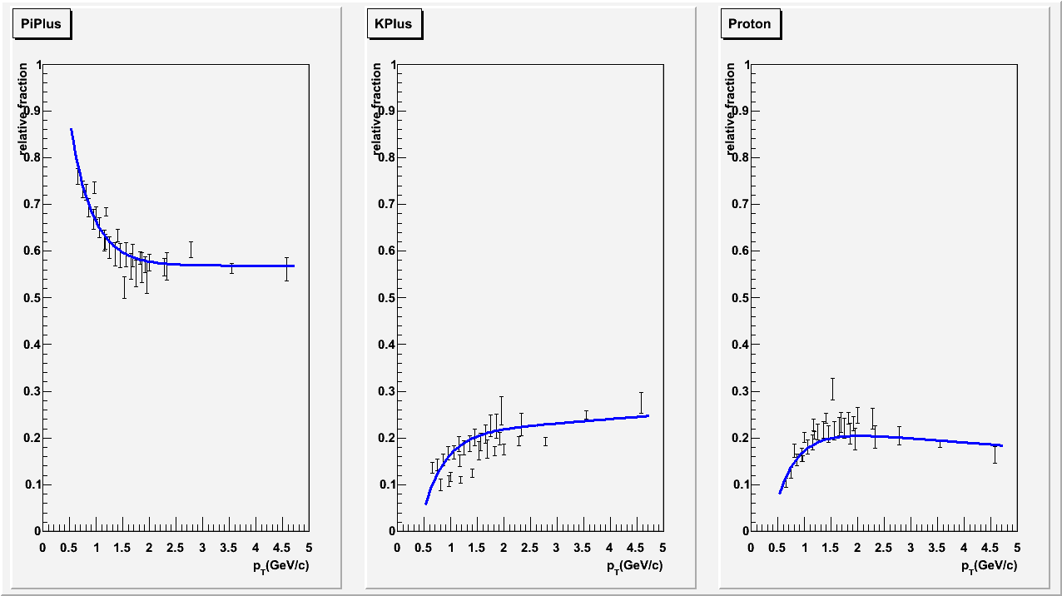
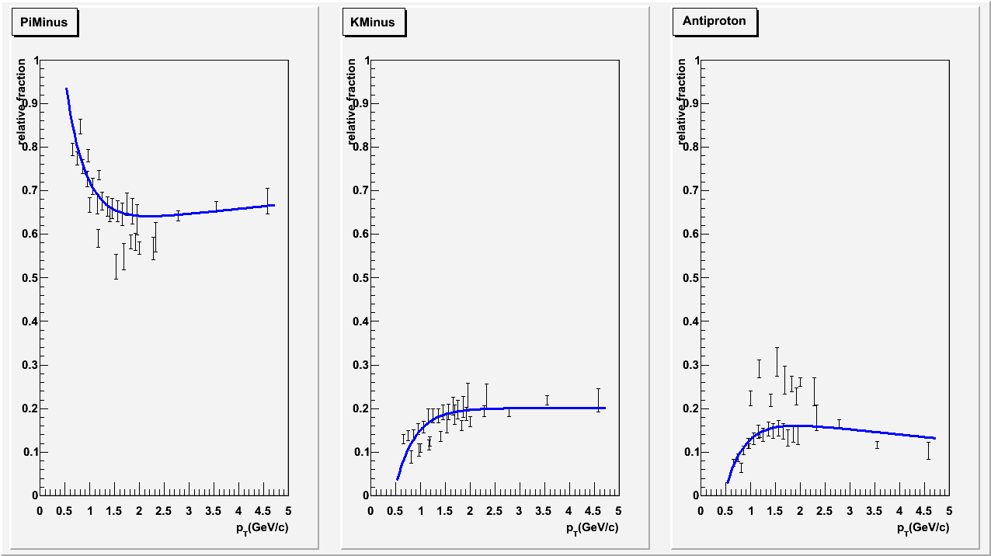
Particle species fractions
Fraction
1.0
0.9
0.8
0.7
0.6
0.5
0.4
0.3
0.2
0.1
For non-identified charged hadron analysis, need particle species fractions to weight efficiencies
Obtain from fits to identified data fractions at same energy from PHENIX and ISR
Estimate systematic uncertainty using fractions from one data set only
π+
K+
p
p_{T} (GeV/c)
p_{T} (GeV/c)
p_{T} (GeV/c)
0 1 2 3 4 5
0 1 2 3 4 5
0 1 2 3 4 5
1.0
0.9
0.8
0.7
0.6
0.5
0.4
0.3
0.2
0.1
π-
K-
p
p_{T} (GeV/c)
p_{T} (GeV/c)
p_{T} (GeV/c)
0 1 2 3 4 5
0 1 2 3 4 5
0 1 2 3 4 5
F(x) = [0]exp([1] *x) + [2] + [3]*x
(Fits constrained to sum to1 across all p_{T})

Slide 13
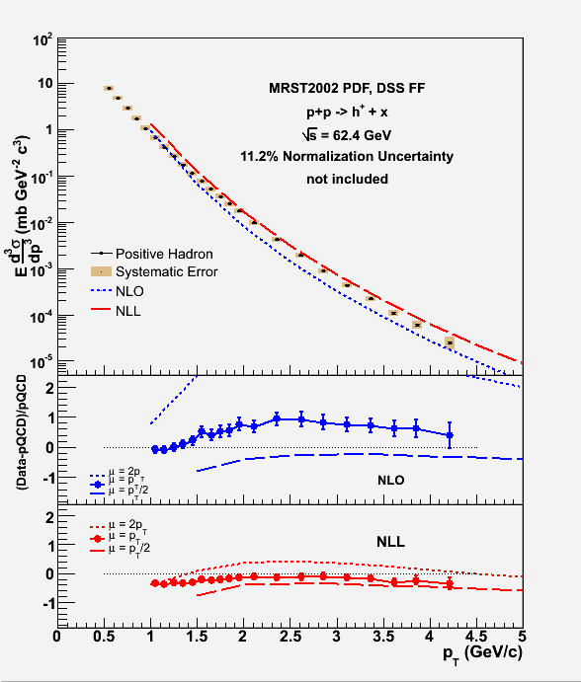
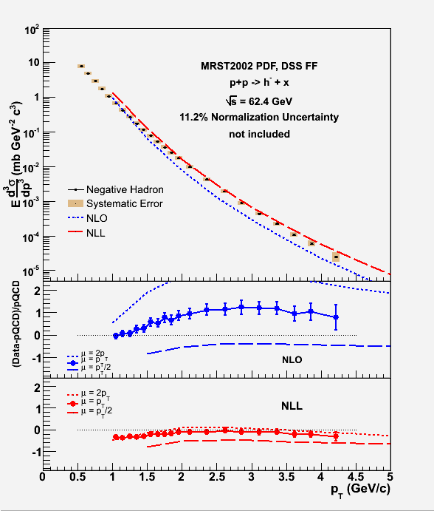
Midrapidity charged hadron production at 62.4 GeV: Results
PHENIX preliminary
PHENIX preliminary
As in the case of 62.4 GeV midrapidity π⁰ measurement, choice of scale μ=p_{T} at NLO underestimates the data.
NLL calculation has much smaller scale dependence and describes data reasonably well.
h+
h-
NLO
NLO
NLL
NLL

Slide 14
Systematic uncertainties on cross sections
1 − 5% from PID fraction
0.6 − 5% from background fraction
0.5 − 1.5% from correction factor for smearing
2.2% from MC/data scale factor
11 − 24% from ‘acceptance + efficiency’ correction values
11.2% overall normalization uncertainty

Slide 15
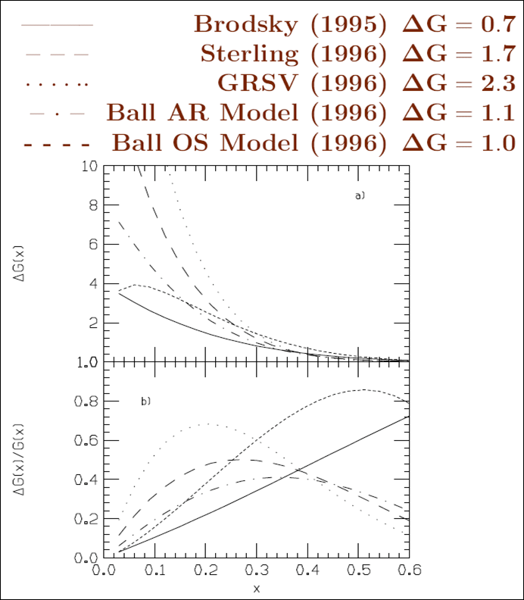
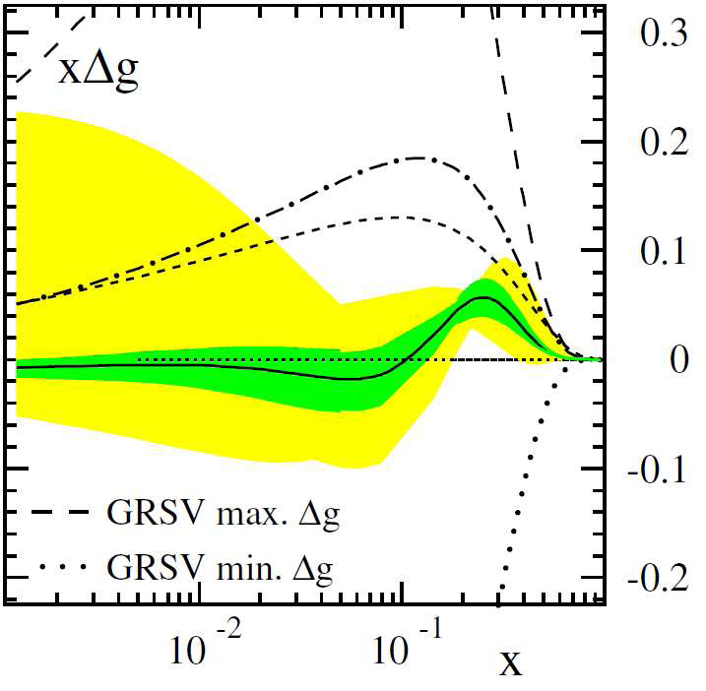
The quest for ΔG, the gluon spin contribution to the spin of the proton
With experimental evidence already indicating that only about 30% of the proton’s spin is due to the spin of the quarks, in the mid-1990s, predictions for ΔG at x=0.1 ranged from 2 to 10(!)
Global NLO pQCD fit by DSSV in 2008 including RHIC data at 200 and 62.4 GeV results in best fit with ΔG<0.5 at x=0.1
Data in the intervening years have significantly improved constraints, but it looks like we’re trying to hunt down something pretty small!
de Florian et al., PRL101, 072001 (2008)

Slide 16
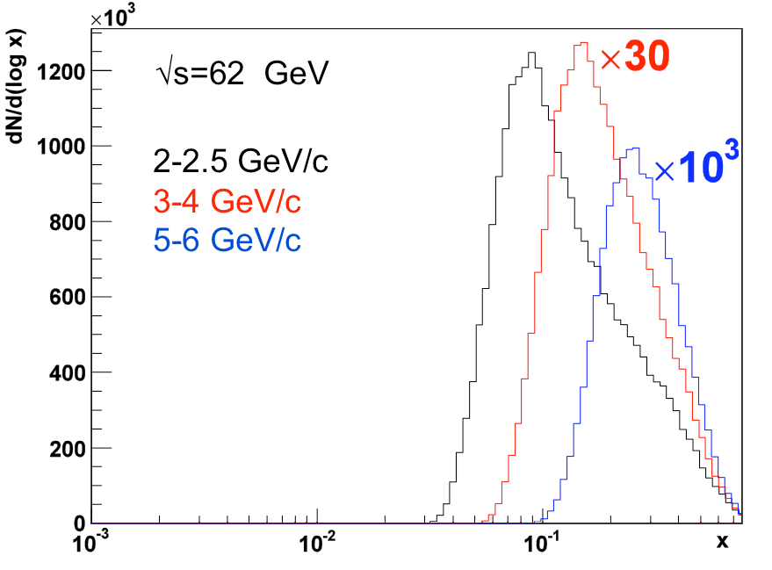
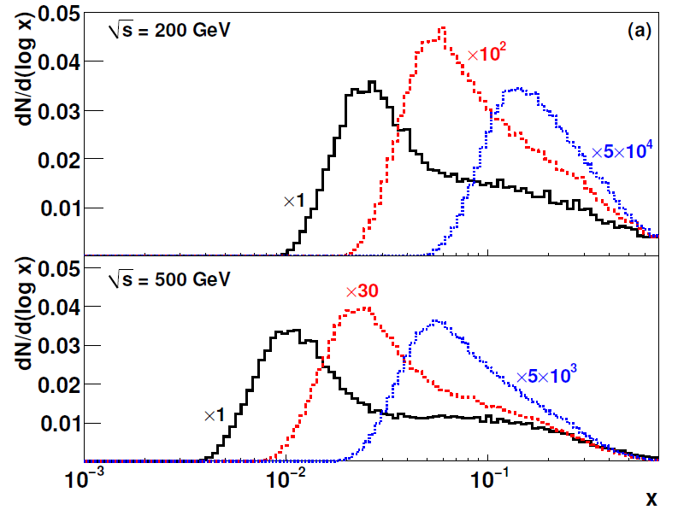
(Gradually) Mapping out Δg(x)
In p+p collisions, parton momentum fraction x correlated with p_{T} of produced particle in a hard-scattering event
RHIC a very flexible machine—sqrt(s) for p+p collisions 50-500 GeV
Running at different energies samples from different x ranges
2-2.5 GeV/c
4-5 GeV/c
9-12 GeV/c

Slide 17
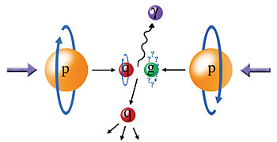
Probing the Helicity Structure of the Nucleon with p+p Collisions
Study difference in particle production rates for same-helicity vs. opposite-helicity proton collisions
(mainly) DIS
?
pQCD
(mainly) e+e-
Leading-order access to gluons → ΔG
Notes:
Let me now show you some highlights from the helicity program at RHIC.

Slide 18

Neutral Pion A_{LL} at 62.4 GeV
Converting to x_{T}, can see significance of 62.4 GeV measurement (0.08 pb⁻¹) compared to published data from 2005 at 200 GeV (3.4 pb⁻¹).
PRD79, 012003 (2009)

Slide 19
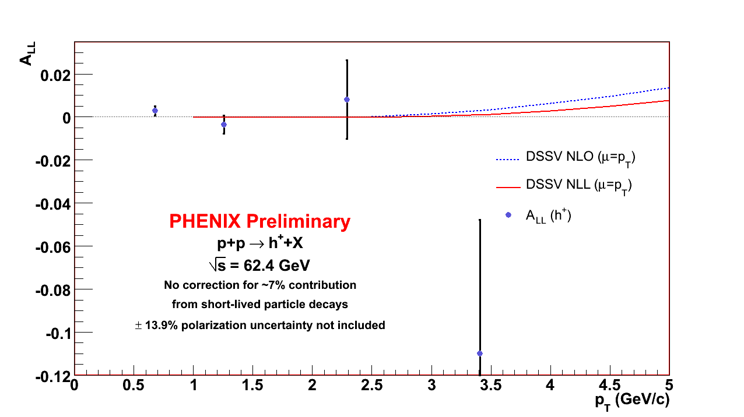
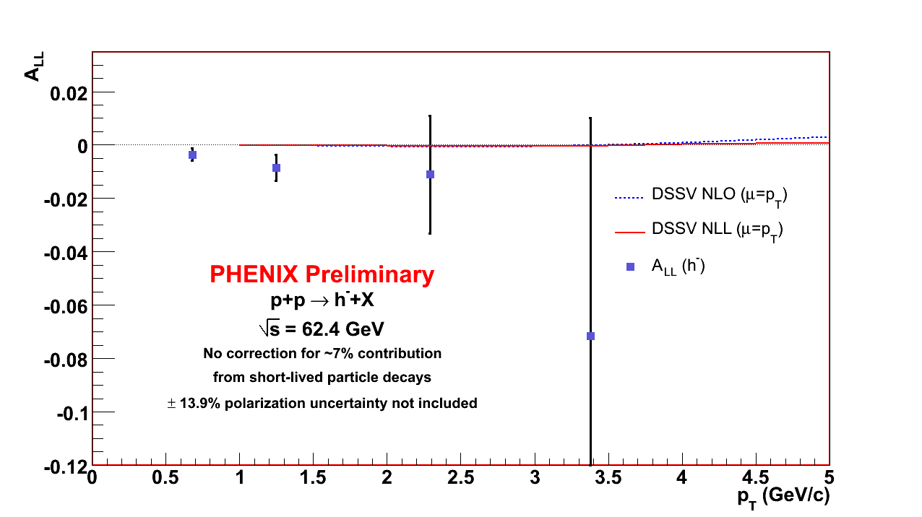
Double-helicity asymmetry: Results
A_{LL} h+
A_{LL} h-
With such small asymmetry predictions now, need more data to improve constraints further!
Average polarization: 0.48
13.9% scale uncertainty on product of beam polarizations.
Uncertainty on A_{LL} due to relative luminosity uncertainty: 1.4x10⁻³
Theoretical curves for NLO and NLL obtained by summing
species-dependent predictions weighted by detection efficiencies.

Slide 20
Summary
Cross section and double-helicity asymmetry for midrapidity charged hadrons at sqrt(s)=62.4 GeV have been measured by PHENIX
Comparison of cross section data to pQCD calculations can provide information on applicability of different calculational techniques
  NLL resummation relevant for midrapidity at 62.4 GeV?
Measurement of double-helicity asymmetries at RHIC for processes calculable in pQCD over a range of energies and for a variety of observables can help constrain Δg(x)

Slide 21
Backup

Slide 22
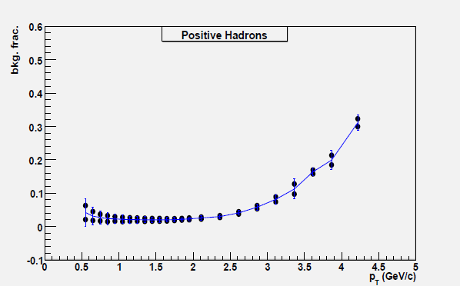
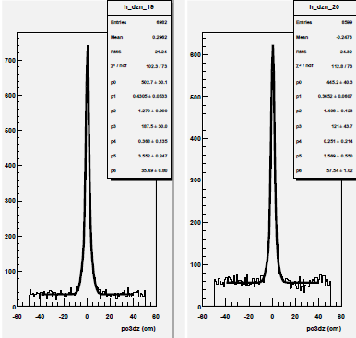
Background estimation
Total bg levels ~4-30%
~Flat tails in z distribution around projected hit—due to bg
Matching in z to PC3 for two high-p_{T} bins
Most significant background from decays in flight
PHENIX did not have a vertex detector in 2006
Tracks assumed to originate at the event vertex
Project track stubs measured in Drift Chamber and PC1 to outer detectors and
look for matching hit in phi, z
Drift Chamber outside of magnetic field
Decays that happen right in front of the Drift Chamber bend very little
and get (mis)reconstructed with high p_{T} --use matching distributions to estimate

Slide 23
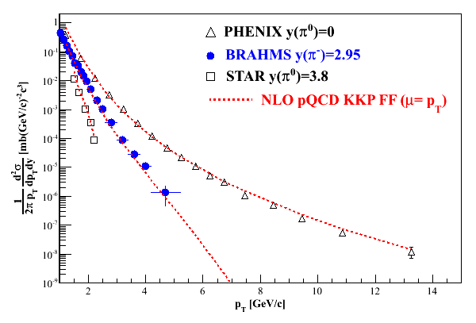
Polarization-averaged cross sections at √s=200 GeV
Good description at 200 GeV over all rapidities down to p_{T} of 1-2 GeV/c.

Slide 24
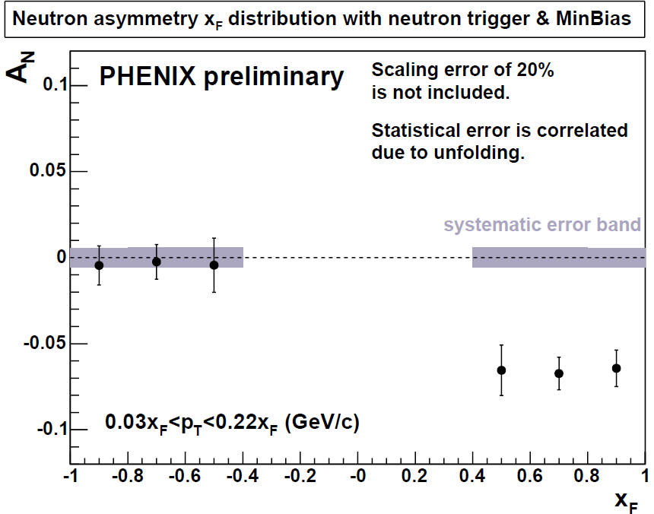
Forward neutrons at √s=200 GeV at PHENIX
Large negative SSA observed for x_{F}>0, enhanced by requiring concidence with forward charged particles (“MinBias” trigger).
No x_{F} dependence seen.
Mean p_{T}
(Estimated by simulation assuming ISR p_{T} dist.)
0.4<|x_{F}|<0.6 0.088 GeV/c
0.6<|x_{F}|<0.8 0.118 GeV/c
0.8<|x_{F}|<1.0 0.144 GeV/c
preliminary | A_{N}
Without MinBias | -6.6 ±0.6 %
With MinBias | -8.3 ±0.4 %
charged
particles
neutron
neutron

Slide 25
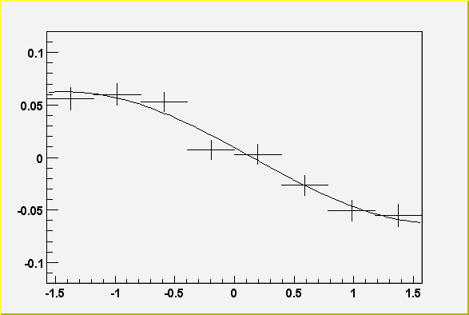
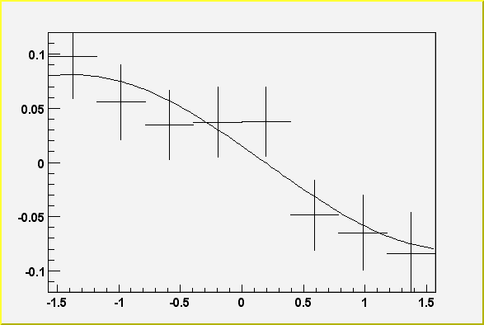
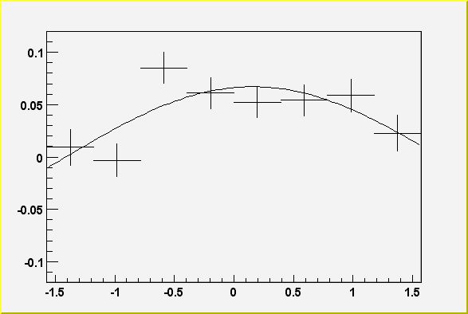
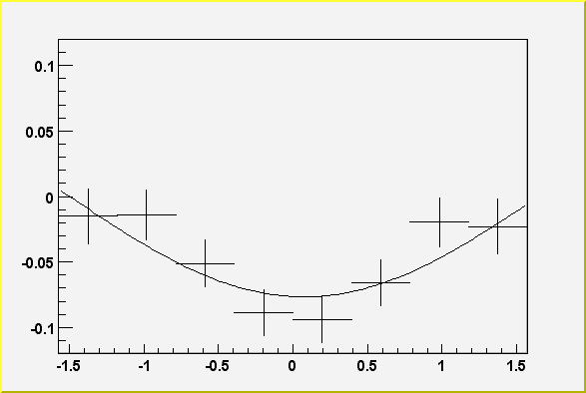
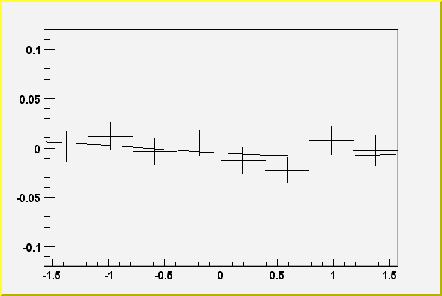
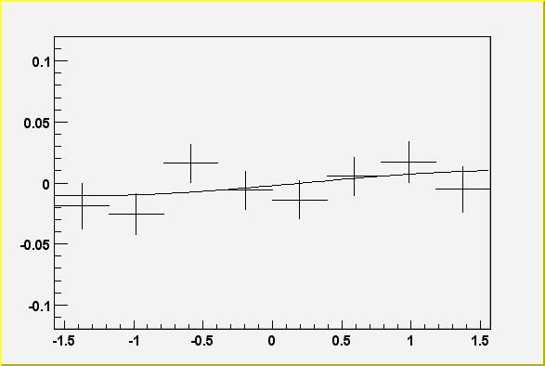
Neutron SSA for local polarimetry
A_{N}
Spin Rotators OFF
Vertical polarization
Blue
φ
Yellow
Allows measurement of any remaining component in an undesired direction
Spin Rotators ON
Radial polarization
Blue
Yellow
Spin Rotators ON
Longitudinal polarization
Blue
Yellow
25
25
Notes:
25

Slide 26
Forward neutrons at other energies
Significant forward neutron asymmetries observed down to 62.4 and up to 410 GeV!
√s=62.4 GeV
√s=410 GeV

Slide 27
Polarized Collider Development
Parameter | Unit | 2002 | 2003 | 2004 | 2005 | 2006
No. of bunches | -- | 55 | 55 | 56 | 106 | 111
bunch intensity | 10¹¹ | 0.7 | 0.7 | 0.7 | 0.9 | 1.4
store energy | GeV | 100 | 100 | 100 | 100 | 100
β* | m | 3 | 1 | 1 | 1 | 1
peak luminosity | 10³⁰cm⁻²s⁻¹ | 2 | 6 | 6 | 10 | 35
average luminosity | 10³⁰cm⁻²s⁻¹ | 1 | 4 | 4 | 6 | 20
Collision points | -- | 4 | 4 | 4 | 3 | 2
average polarization, store | % | 15 | 35 | 46 | 47 | 60-65

Slide 28
Machine performance:
Transverse spin running at PHENIX
Year | √s [GeV] | Recorded L | Pol [%] | FOM (P²L)
2001 (Run-2) | 200 | .15 pb⁻¹ | 15 | 3.4 nb⁻¹
2005 (Run-5) | 200 | .16 pb⁻¹ | 47 | 38 nb⁻¹
2006 (Run-6) | 200 | 2.7 pb⁻¹ | 51 | 700 nb⁻¹
2006 (Run-6) | 62.4 | .02 pb⁻¹ | 48 | 4.6 nb⁻¹
2008 (Run-8) | 200 | 5.2 pb⁻¹ | 46 | 1100 nb⁻¹

