Slide 1
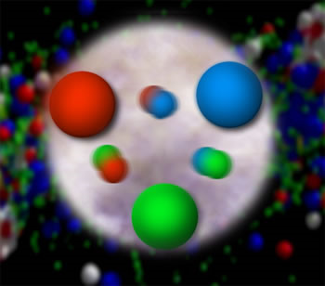
Peering Into the Proton
Christine A. Aidala
University of Michigan
Saturday Morning Physics
March 23, 2013

Slide 2
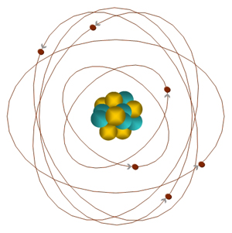
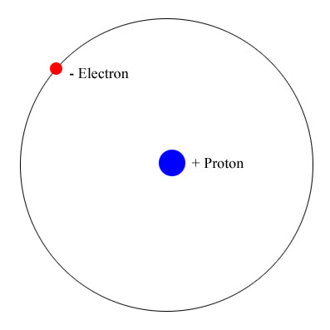
What’s inside an atom?
Carbon
6 protons
6 neutrons
6 electrons
Hydrogen
1 proton
1 electron

Slide 3
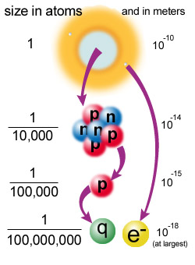
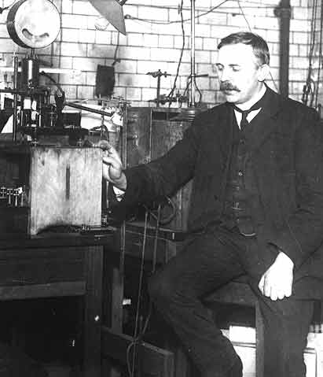
Probing inside atoms: mostly empty space!
1911: Ernest Rutherford scatters alpha particles from radioactive decay off of a thin gold foil
Most went right through!
But—about 1/8000 bounced back!
So atoms have a small, positively charged core → the nucleus
Notes:
Positive core repelled positive alphas. Millimeter grain of sand to 100 m football field (The Physics Dept. has been advocating to have the field converted to metric, but it hasn’t caught on yet!) Rutherford named the hydrogen nucleus the proton.

Slide 4
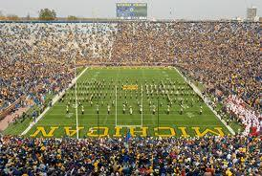


The electrons orbit really far away!

Slide 5
Probing inside protons . . .
Late 1960s: scatter electrons off of protons
Many bounced back sharply! . . .
But weren’t bouncing off of the whole proton → subcomponents!
  Protons not solid lumps of positive charge
  Constituents that make up the proton now called “quarks”
Quark
Notes:
More than half a century later, using an electron accelerator at Stanford University.

Slide 6
Scattering experiments to learn about hidden structure

Slide 7
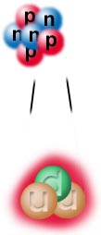

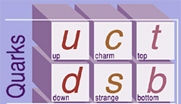
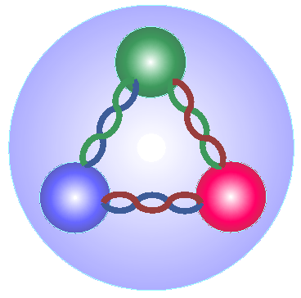
Quarks and gluons
Simplest model of the proton is three quarks: 2 up “flavored” quarks and 1 down “flavored” quark.
But these quarks are not completely free in the proton!
  Bound by force-carrier particles called “gluons”
  “Sea quarks” also present: short-lived quark-antiquark pairs from quantum mechanical fluctuations
Notes:
Not mostly empty space

Slide 8
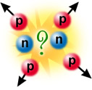
The strong force
How does nucleus stay together?? Electromagnetic force should cause protons to repel one another
Protons and neutrons interact via the strong force, carried by gluons
  Much stronger than the electromagnetic force (~100×) and waaayyy stronger than gravity (~10³⁸×!!) (thus the name!)
  But—very very short range! (~10⁻¹⁵ meters)

Slide 9
“Color” charge and
Quantum Chromodynamics
Strong force acts on particles with color charge
  Quarks, plus gluons themselves! (Contrast with photons, which are electrically neutral)
“Color” because three different “charges” combine to make a neutral particle:
Quantum Chromodynamics (QCD)—theory describing the strong force
Note that quarks also carry fractional electric charge!!
Proton = up + up + down quarks
+1 = (+2/3) + (+2/3) + (-1/3)
Neutron = down + down + up
0 = (-1/3) + (-1/3) + (+2/3)
red + blue + green =
white

Slide 10
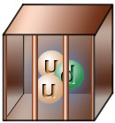
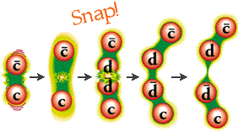
Quark confinement
Never see quarks or gluons directly!
  Confined to composite, color-neutral particles
  Groups of three quarks rgb called baryons, or quark-antiquark pairs (red-antired, . . .,) called mesons
If you try to pull two quarks apart, energy between them increases until you produce a new quark-antiquark pair (good old E=mc²)
“D⁻ meson”
“D⁺ meson”
Notes:
Segue into probes of different length scales

Slide 11
Electron-proton scattering
Courtesy T.C. Rogers
Proton
Pow!
Electron
X
Just by measuring the scattered electron’s energy and angle, you know:
Total energy exchanged in the scattering
How much of the proton’s momentum was carried by the quark you hit
h
Produced particles

Slide 12
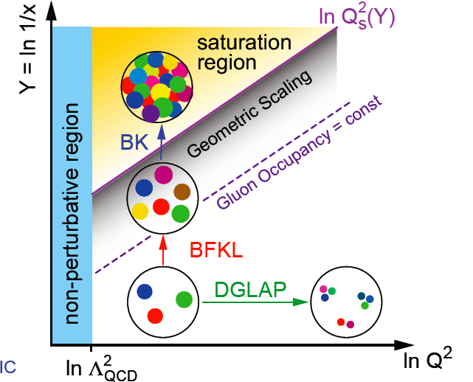
So what does it look like inside the proton? It depends . . .
Struck quark carries less
of proton’s momentum
α_{s}~1 α_{s} << 1
More energy transferred

Slide 13
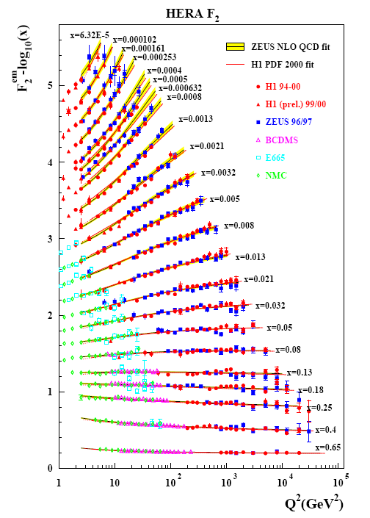
Experimental data on proton structure
Complex structure where quarks and gluons each carry only a small fraction of the proton’s momentum
99% of the proton’s mass comes from quark + gluon interactions!
Struck quark carries less
of proton’s momentum
More energy transferred

Slide 14


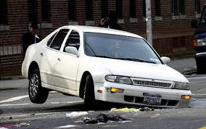


Probes sensitive to different length scales
What size potholes will bother you if you’re driving a . . .
Notes:
[Transition slide before this?]

Slide 15
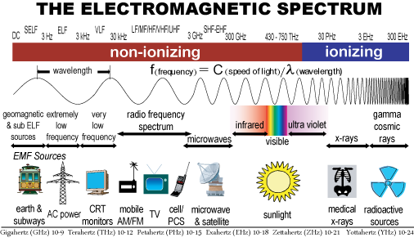
Higher energies to see smaller things
Energy

Slide 16
High-energy particle accelerators
Molecular and atomic structure of matter: study using
  ultraviolet light (wavelengths 10-400 nanometers)
  x-rays (wavelengths 0.01-10 nanometers)
Nuclei and protons: 10,000× to 100,000× smaller than atoms → Need high-energy particle accelerators to see inside them!
Notes:
Synchrotron light source facilities – 5 national facilities in the U.S.

Slide 17
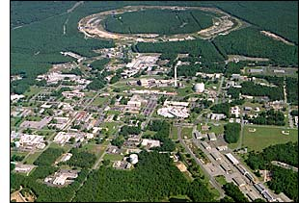
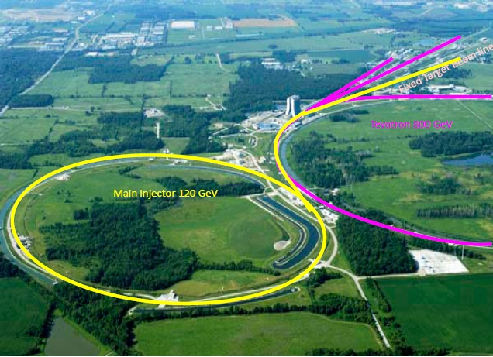
My experiments
The PHENIX experiment at the Relativistic Heavy Ion Collider at Brookhaven National Lab (BNL) on Long Island, NY
The SeaQuest experiment at Fermi National Accelerator Laboratory outside Chicago

Slide 18
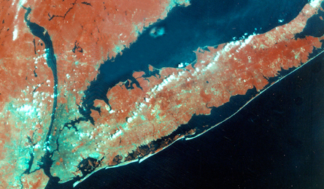

Relativistic Heavy Ion Collider at
Brookhaven National Laboratory
Long Island,
New York
Notes:
RHIC is (was) visible from space and is located on Eastern Long Island

Slide 19
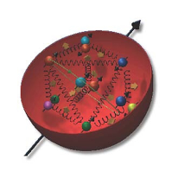
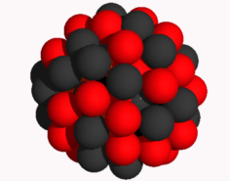
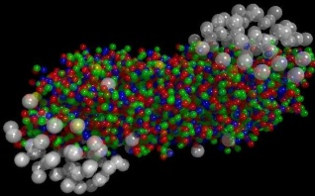
The Relativistic Heavy Ion Collider at Brookhaven National Laboratory
A great place to study protons and the strong force!
What systems are we studying?
  Protons
  Nuclei
  Nuclear matter so hot and dense that the quarks and gluons are briefly deconfined—“quark-gluon plasma”
Two colliding beams of ions, ranging from hydrogen (protons) through uranium nuclei
  All electrons stripped off the atoms, so bare nuclei
Notes:
Can do one nucleus in one beam, another in the other

Slide 20
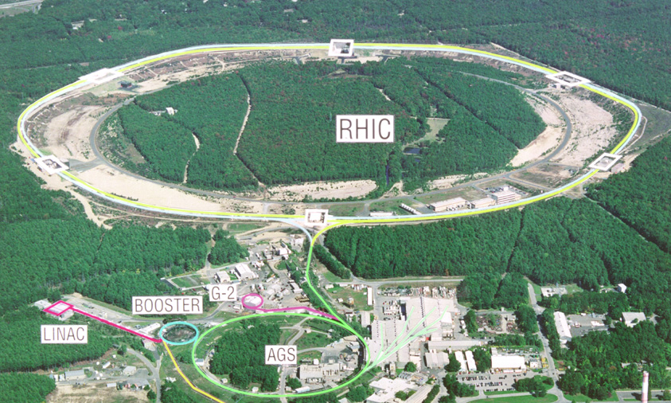
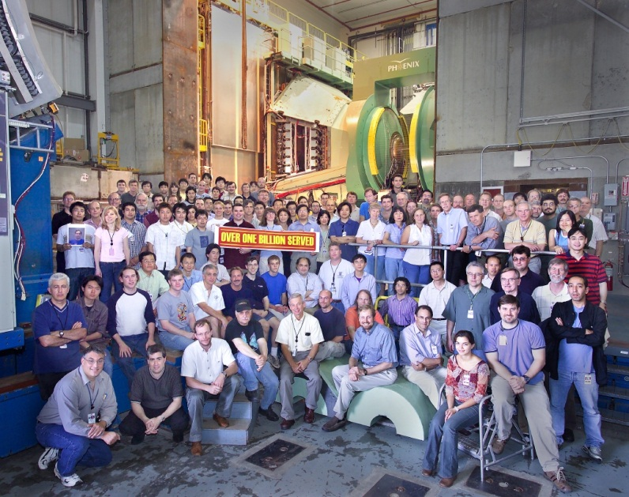
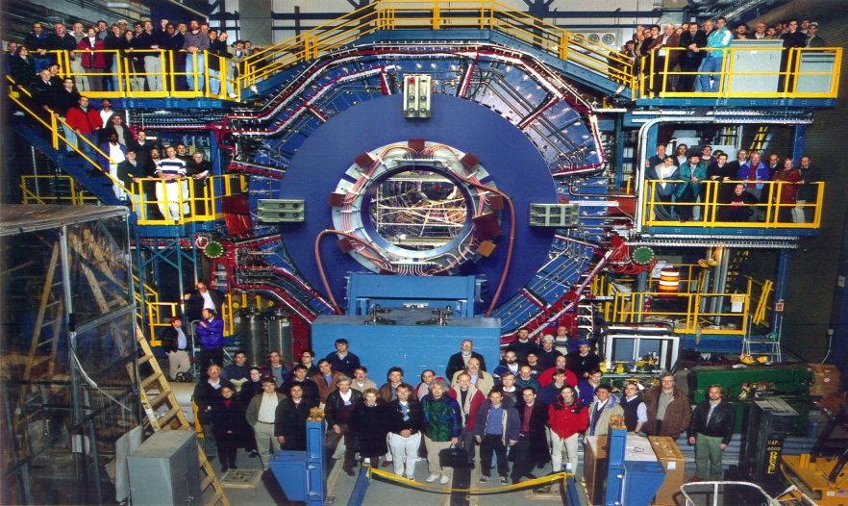


RHIC’s experiments
Running since 2000

Slide 21
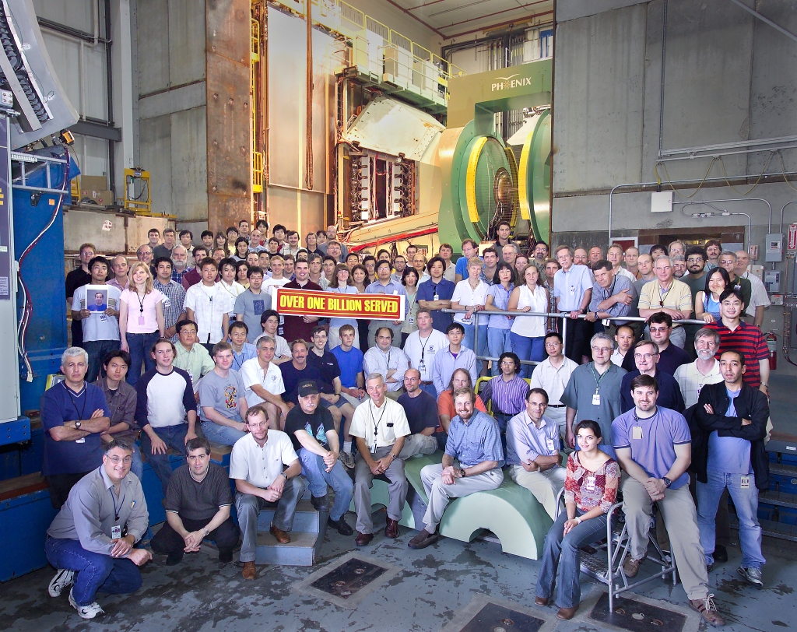

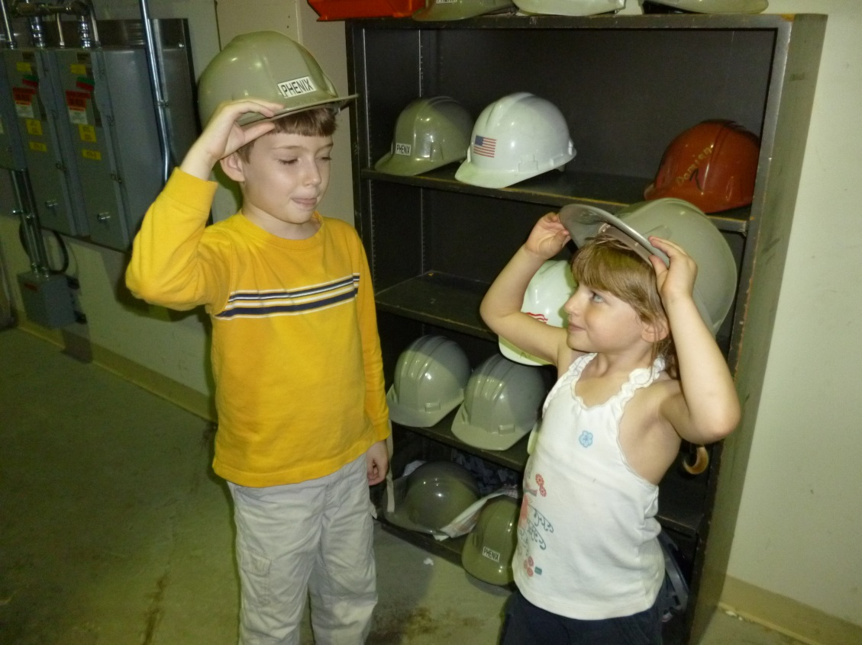

The PHENIX experiment
14 Countries, 73 Institutions
~550 Participants
Notes:
Love the international aspect. Lots of students. I first worked on RHIC, actually on our rival experiment, for a summer as an undergrad, and four years later came back to the facility as a Ph.D. student. Training the next generation of scientists is a big part of the mission of large facilities such as colliders, and you can never start them too young . . .

Slide 22
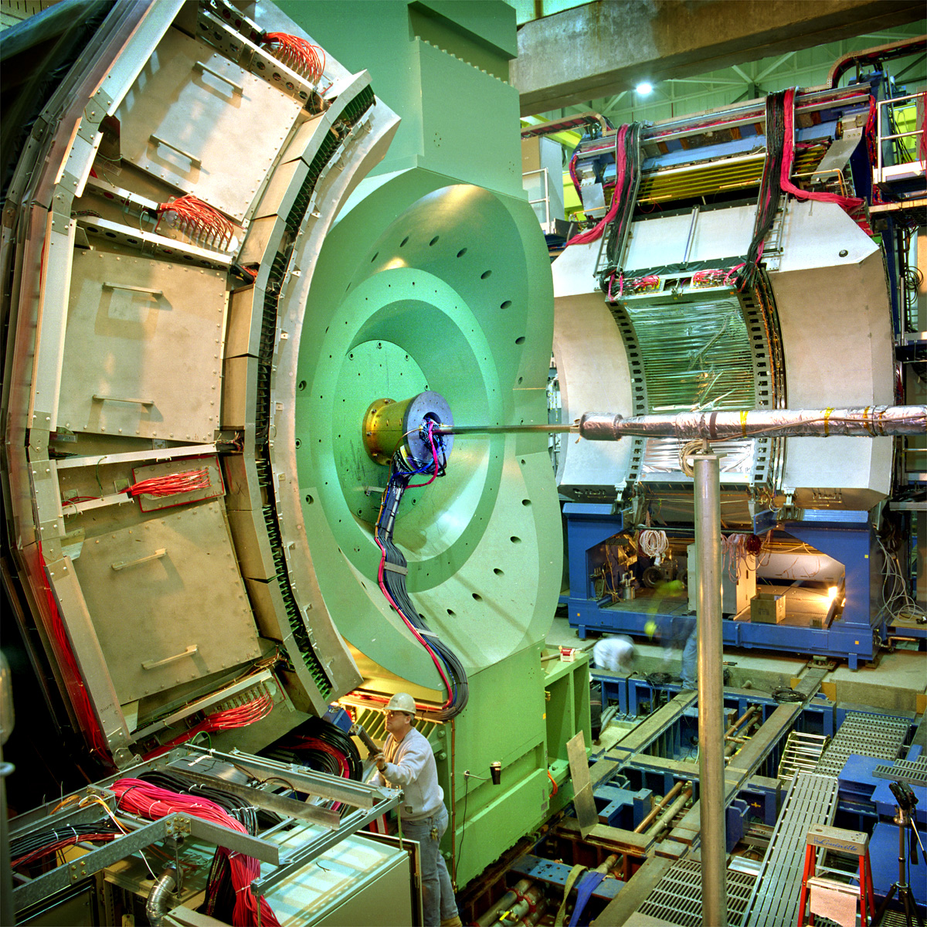
PHENIX detector
4 stories tall
40 feet long
~3000 tons
Different detector subsystems for measuring different kinds of produced particles or different information about them
Electric charge
Momentum
Energy
Particle type

Slide 23
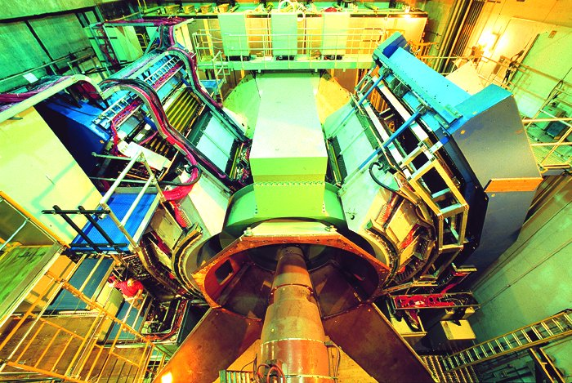
PHENIX detector
Notes:
[PHENIX assembly movie?] Symmetric around collision point

Slide 24
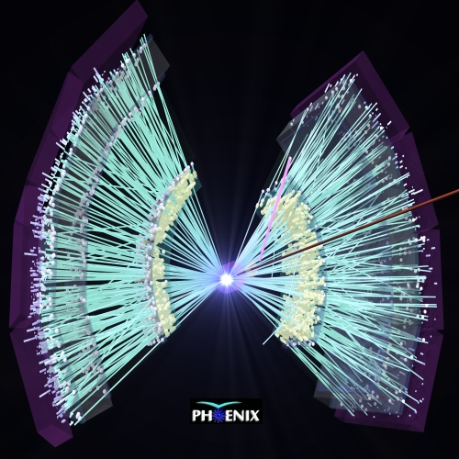
Gold+Gold collision in PHENIX central arms
Thousands of tracks!
Proton+proton collisions only produce ~5-10 tracks at the energies I study

Slide 25
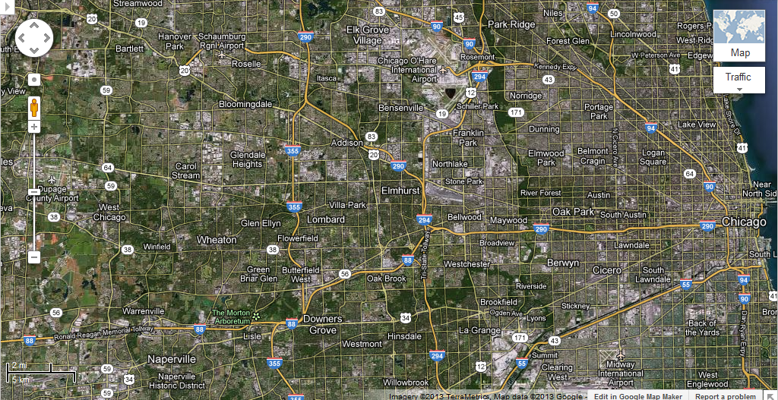
Fermi National Accelerator Laboratory

Slide 26
SeaQuest experiment at the Fermilab Main Injector
Main Injector accelerates protons
Hit stationary targets of
  liquid hydrogen
  liquid deuterium (hydrogen with a neutron in the nucleus)
  solid carbon, iron, and tungsten
Brief run last spring, will take physics data summer 2013 – summer 2015
3 Countries, 17 Institutions
~65 Participants
Notes:
20 degrees above absolute zero

Slide 27

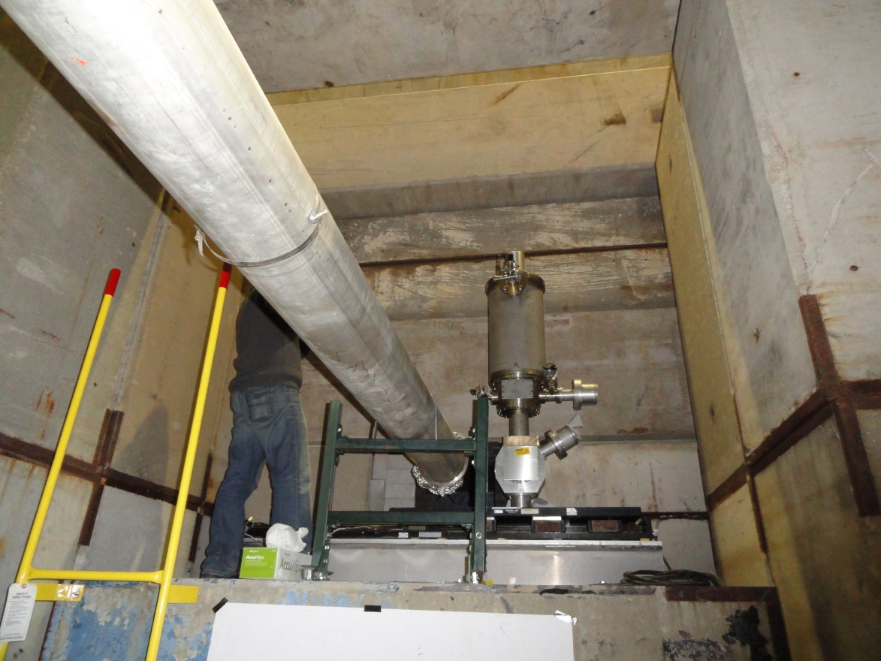
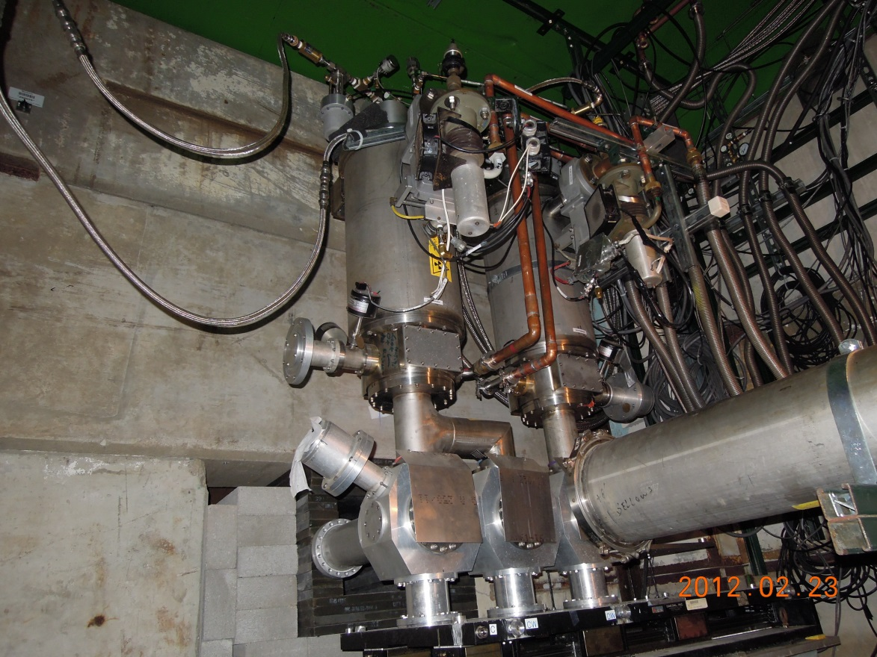
SeaQuest beam pipe and targets

Slide 28
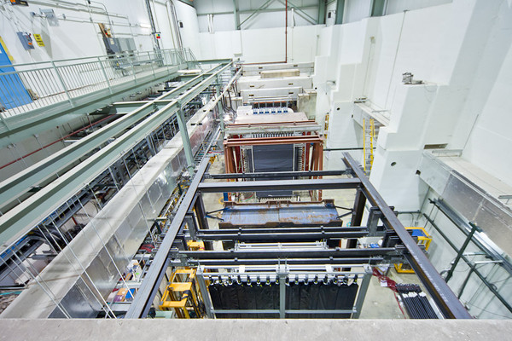
SeaQuest detector
Notes:
Proton beam hitting stationary target—now not symmetric. Everything sprays forward

Slide 29
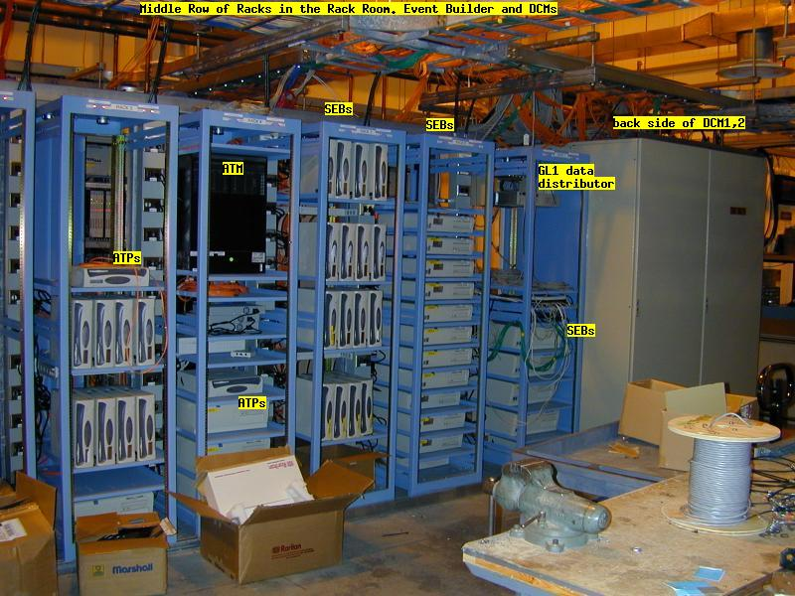
Where does the data go?

Slide 30
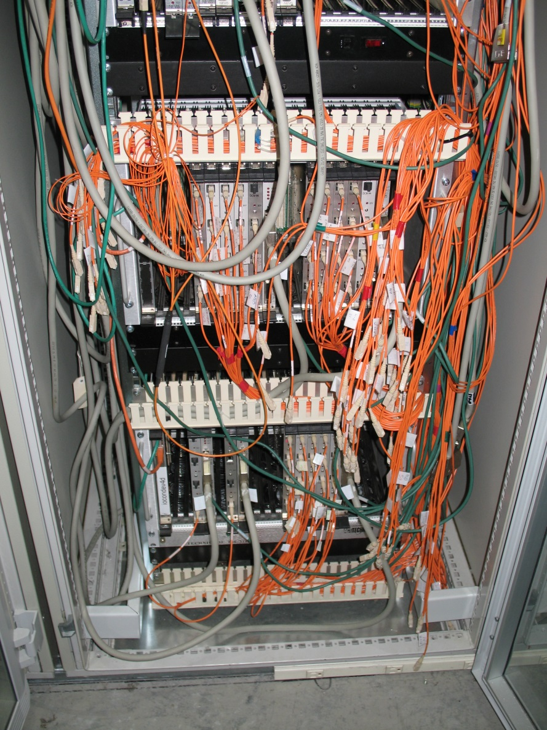
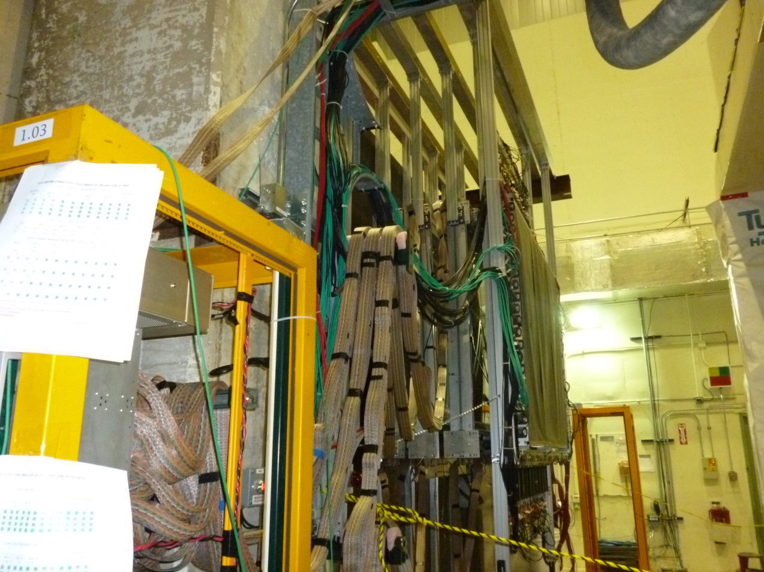


Cables, cables everywhere!

Slide 31
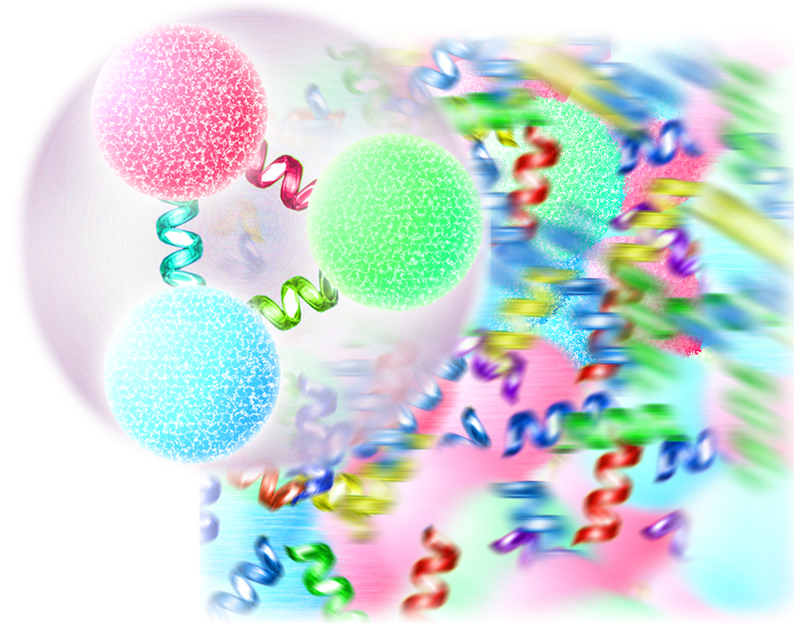

How do we really know what’s going on if we can’t see it directly??
Notes:
Wall demo

Slide 32
Summary
Even though protons are a fundamental building block of everyday matter, we still have lots to learn about the complex behavior of the quarks and gluons inside them!
High-energy particle accelerators allow us to probe the structure of very tiny objects
A community of a couple thousand people around the world is working to unravel the mysteries of the proton and the strong force that holds it together . . .

