Slide 1
A feasibility study for measurements using electroweak probes at the proposed Electron-Ion Collider: Investigating nucleon structure and the fundamental electroweak couplings to light quarks
Christine Aidala, Ming Liu, ?

Slide 2
Outline (LDRD ER Format)
Research Goals
Background & Significance
R&D Approach
  Preliminary Studies
  Methods, Technical Challenges, & Alternatives
  Expected Results
  Schedule & Milestones
Mission Relevance & Program Development Plan
Budget Justification Request
Qualifications of Research Team

Slide 3
Research Goals
Determine expected uncertainties for measurements of the unpolarized and polarized electroweak structure functions of the nucleon F3 and g5, as a function of the beam energies and luminosities at the proposed EIC
Determine expected uncertainties on the unpolarized and polarized strangeness distributions in the nucleon that could be extracted from such measurements
Determine expected uncertainties on the fundamental coupling of the Z boson to the up and down quarks that could be extracted from such measurements
Provide feedback critical to design of the accelerator:
  How much gain from (unpolarized) positrons?
  How much gain from pushing to higher energies than current default expectations for the EIC? Proposals for higher energies are on the table (up to 30 on 325 GeV at eRHIC), but the physics case has not yet been made.

Slide 4
Background & Significance
EIC will be first machine capable of colliding beams of polarized electrons against polarized protons and polarized light ions, as well as unpolarized heavy ions.
  Unique capability to measure the polarized electroweak structure function of the nucleon, g5! No previous measurements exist, and no other facilities are planned or proposed that could perform this measurement!
EIC will have at least 100x the instantaneous electron-proton luminosity than the HERA collider, which ran polarized electrons and positrons on unpolarized protons
  Expect great improvement in measurement of the unpolarized electroweak structure function of the nucleon, F3

Slide 5
Background & Significance (cont.)
Flavor structure of the nucleon sea a current hot topic (see next slides)
  E906 investigating unpolarized u-bar, d-bar
  RHIC W program investigating polarized u-bar, d-bar
(Still need to understand what JLab data will contribute on unpolarized and polarized strangeness in the meantime, but expect it to depend on fragmentation functions, while extraction of strangeness distributions from inclusive structure function measurements would not--complementarity)

Slide 6
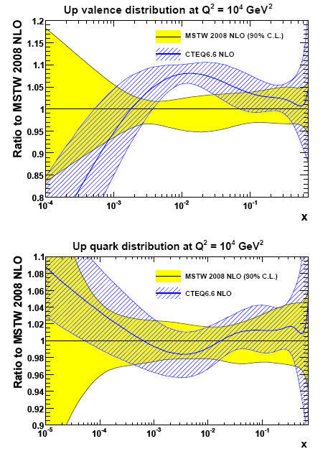
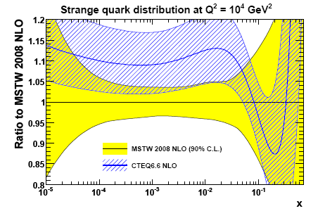
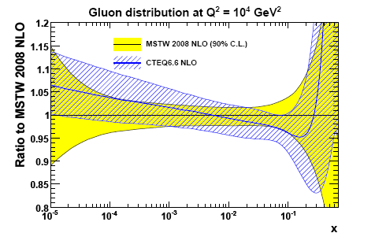
MSTW vs CTEQ: similar sets of PDFs?
arXiv:0901.0002
PRD78 (2008) 013004
let’s compare the two most recent fits within their quoted uncertainties:
Flavor structure of unpolarized proton
find:
error bands largely overlap
surprising tension for up and down valence quarks
some offset for strange density
likely due to data selection
likely due to different ansatz for s(x,μ₀)

Slide 7
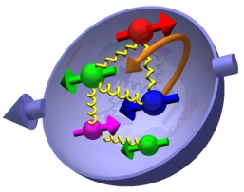
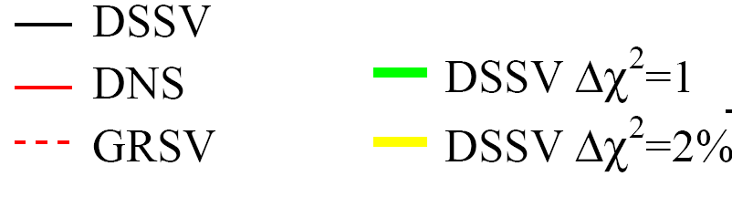
emerging picture: sea polarizations
indications for an SU(2) breaking of light u,d sea
breaking of similar size than in unpol. case
mainly determined by SIDIS data
“bands”: error estimate from Lagr. mult.
similar patterns in many models:
large-N_{C}, chiral quark soliton, meson cloud
Thomas, Signal, Cao; Diakonov, Polyakov, Weiss; …
a strange strangeness polarization
Δs(x) always thought to be negative, but …
mainly determined from SIDIS kaon data
consistent with LO-type analyses by
HERMES and COMPASS
needs further studies – exp. & theory !
x

Slide 8
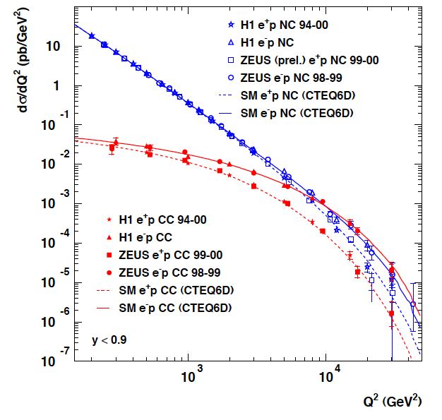
Neutral and Charged Current Cross Sections from HERA
NC
CC
Max Q² (=s) for 20 x 250 GeV
Max Q² (=s) for 11 x 60 GeV
M_{W}²
M_{Z}²
EW unification at high Q²

Slide 9
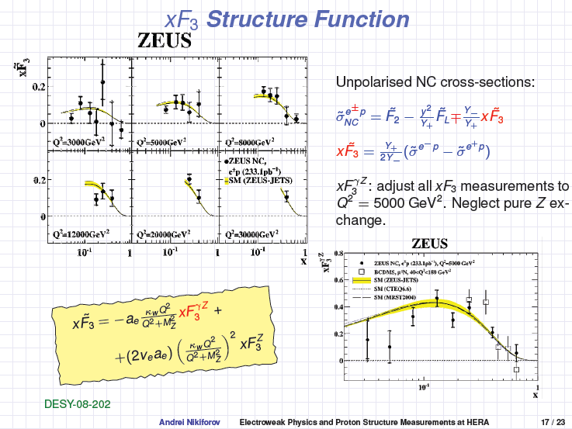
F3 from HERA—large uncertainties

Slide 10
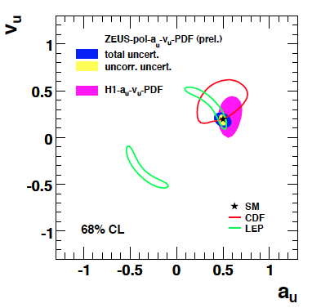
Extraction of EW coupling parameters to up quark
EIC constraint would be best measurement in DIS, and better than any current experimental constraints.
LHC p+p data may reduce constraint compared to CDF in the meantime.

Slide 11
R&D Approach:
Preliminary study for g₅ at EIC
2 fb^-1, compare to 5 fb^-1 expected per year → feasible. 1st measurement ever! Only possible at the EIC.

Slide 12
R&D Approach:
Methods
Use existing MC generator and detector simulations currently being developed by others to perform simulation studies for observables as a function of beam energies, luminosities . . .
No significant technical challenges expected

Slide 13
R&D Approach:
Schedule & Milestones
Goal to provide input for the 2012/13 Long Range Plan
  Regarding issues potentially affecting accelerator design
  To possibly attract support from individuals from other communities, e.g. electroweak and/or those interested in precision calculations for the LHC (electroweak coupling to up, down)

Slide 14
Budget Justification Request
1.0 FTE postdoc and M&S for PD’s computer and travel
Partial support of staff member (Ming)?
Modest additional M&S for Ming’s or my EIC-related travel?

Slide 15
Qualifications of Research Team
Involved in experimental nuclear/HEP for many years, nucleon structure at PHENIX, polarized HERA (CA), E906 (Ming), already involved in EIC planning . . .

