Slide 1
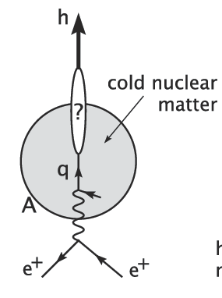
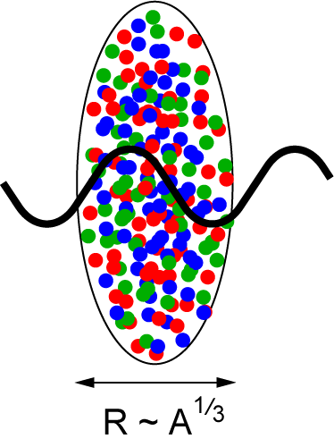
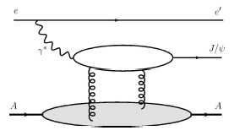
Future Directions:
Studying Nuclear Matter at the Electron-Ion Collider
Christine A. Aidala
LANL Heavy Ion Physics
Internal Review
January 10, 2012

Slide 2
Why an Electron-Ion Collider?
The Electron-Ion Collider (EIC)
A proposed new facility capable of colliding a beam of (polarized) electrons with a variety of hadronic beams:
  Polarized protons
  Polarized light ions (e.g. He³)
  (Unpolarized) light and heavy ions
Collider rather than fixed-target facility—reach higher energies
  Can use perturbative QCD methods
  Can study new effects such as gluon saturation
Electromagnetic rather than hadronic probes
  Simpler to interpret
  But will also want to cross-check and test newfound understanding against data from (more complex) hadronic collisions!
Compare to HERA e+p collider (shut down 2007)
  Only unpolarized proton beams at HERA, no nuclear beams
  EIC lower energies than HERA, but expected EIC luminosities 100-1000x greater

Slide 3
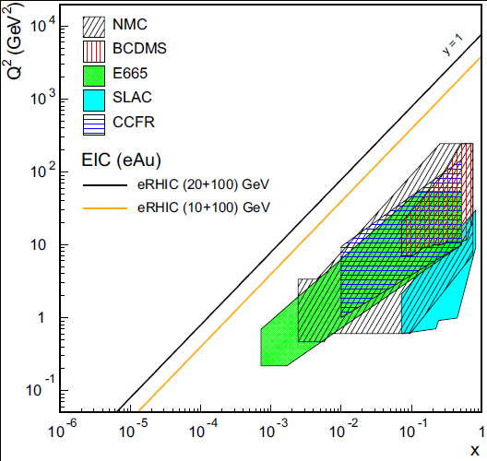
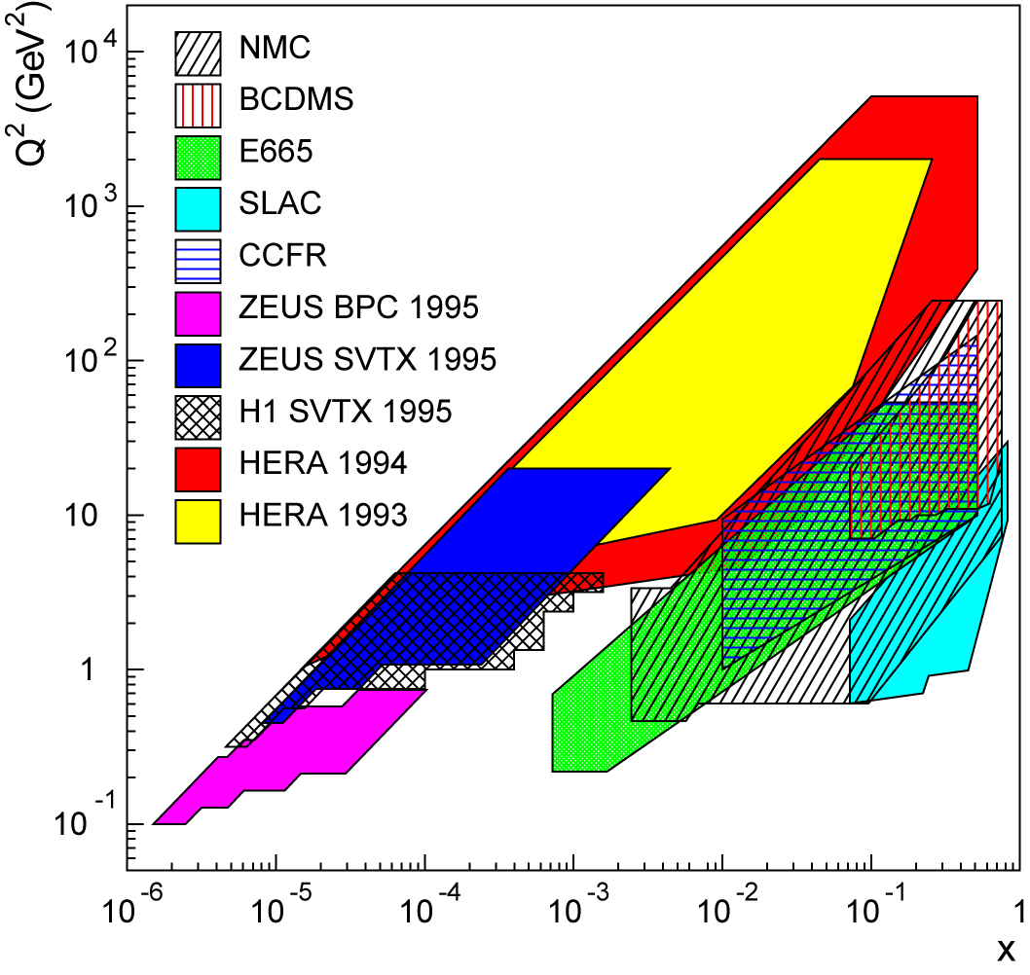
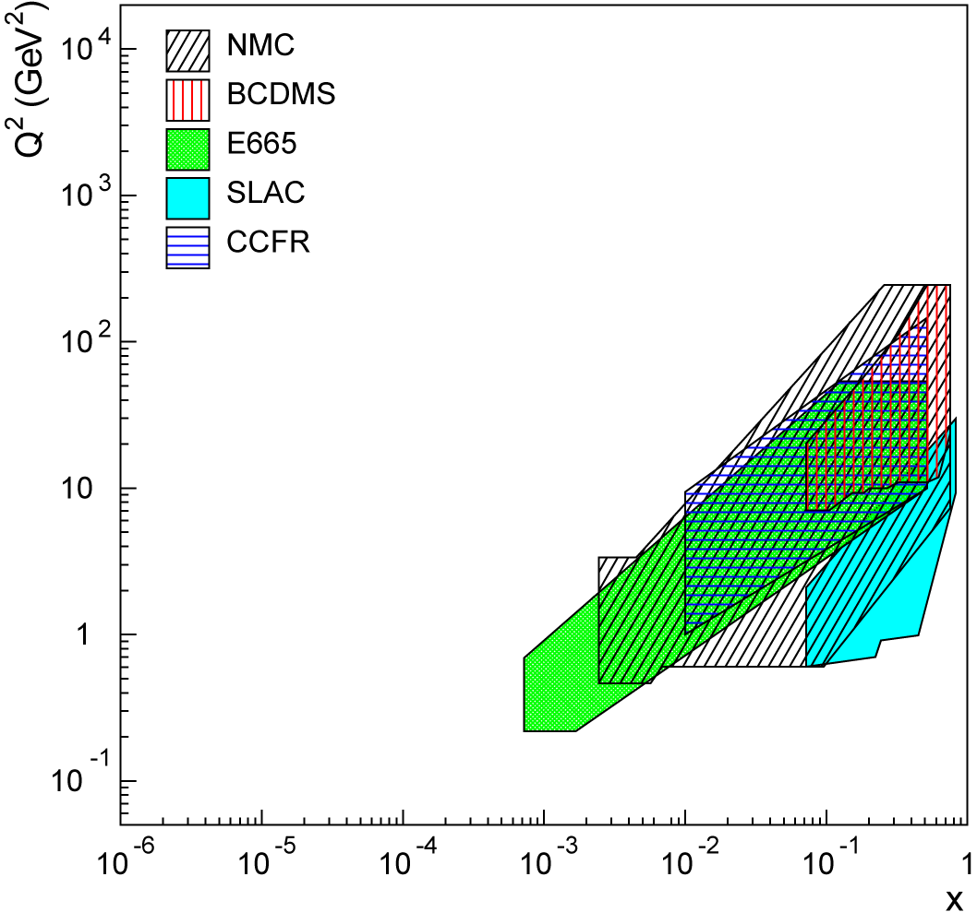
Kinematic coverage and a new
Electron-Ion Collider
Existing data over wide kinematic range for (unpolarized) lepton-proton collisions.
Lots of unexplored territory for lepton-nucleus collisions!
x-Q² coverage for deep-inelastic scattering
EIC (20x100) GeV
EIC (10x100) GeV

Slide 4
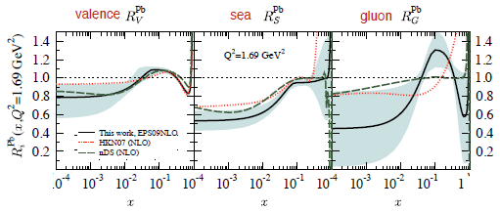
Nuclear modification of pdfs
JHEP 0904, 065 (2009)
Lower limit of EIC range
Gluon suppression at low x due to saturation effects? Currently huge uncertainties on gluon distributions in nuclei!
As heavy ion physics is becoming more and more quantitative, understanding details of initial-state nuclear effects increasingly important!

Slide 5
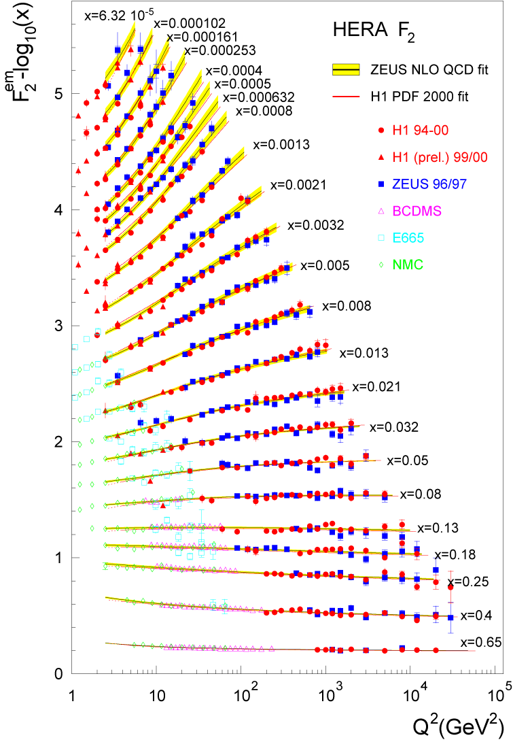
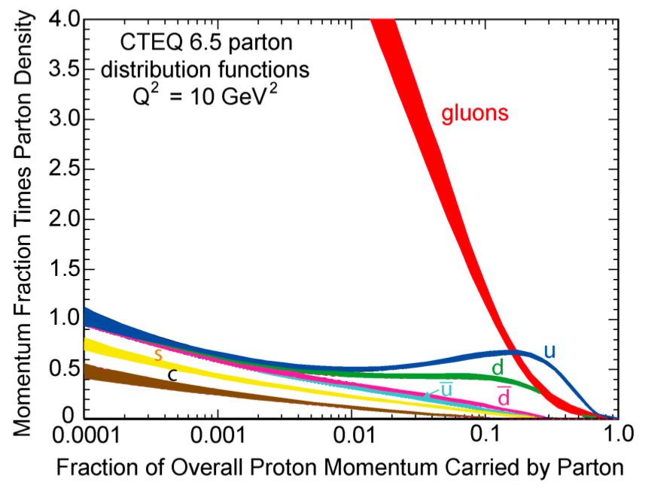
Accessing gluons with an electroweak probe
Access the gluons in DIS via scaling violations:
dF₂/dlnQ² and linear DGLAP evolution in Q² → G(x,Q²)
OR
Via F_{L} structure function
Requires measurements at several values of √s
OR
Via dihadron production
Gluons dominate
low-x wave function
Gluons in fact dominate
(not-so-)low-x wave
function for the proton!
!

Slide 6
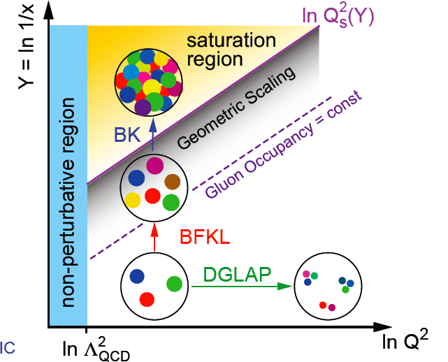
Non-linear QCD and gluon saturation
small x
x = P_{parton}/P_{nucleon}
At small x, linear (DGLAP or BFKL) evolution gives strongly rising g(x) → Violation of Froissart unitarity bound
Non-linear (BK/JIMWLK) evolution includes recombination effects → gluon saturation
Bremsstrahlung
~ α_{s}ln(1/x)
Recombination
~ α_{s}ρ
Easier to reach saturation regime in nuclei than nucleons due to A^{1/3} enhancement of saturation scale → e+A collisions clean environment to study non-linear QCD!
α_{s}~1 α_{s} << 1

Slide 7
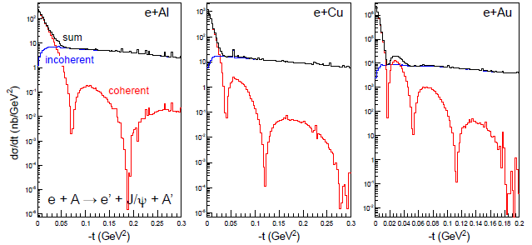
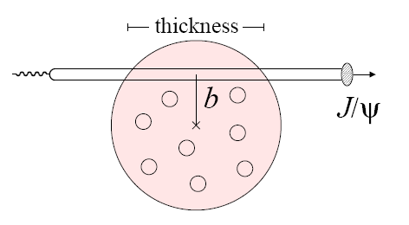
Impact-parameter-dependent nuclear gluon density via exclusive J/Ψ production in e+A
Coherent diffraction pattern extremely sensitive to details of gluon density in nuclei!
- Experimentally suppress incoherent background by vetoing products of nuclear breakup (e.g. Zero-Degree Calorimeters)

Slide 8
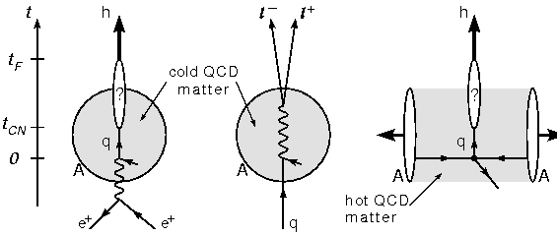
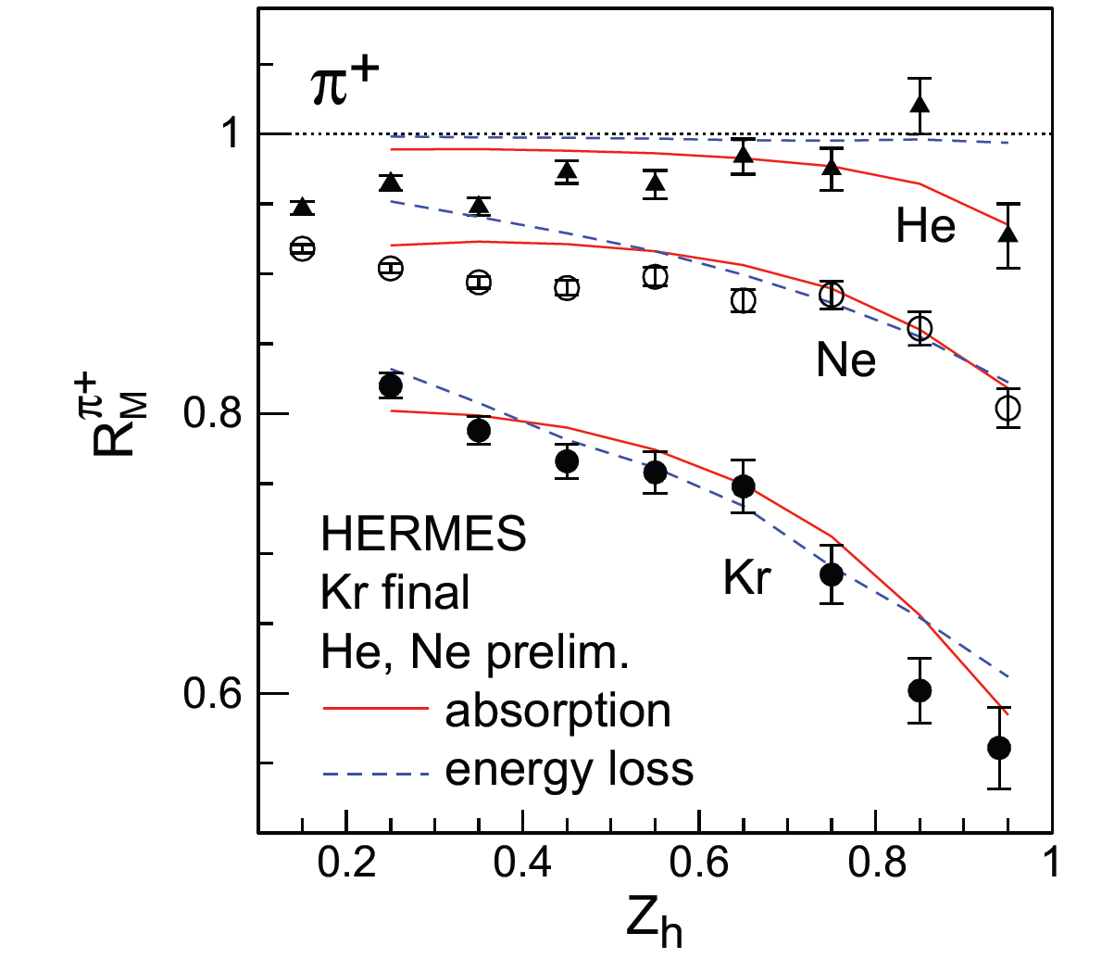
Parton propagation in matter and hadronization
Interaction of fast color charges with matter?
Conversion of color charge to hadrons?
Existing data → hadron production modified on nuclei compared to the nucleon!
EIC will provide tremendous statistics and much greater kinematic coverage!
-Study quark interaction with CNM
Study time scales for color neutralization and hadron formation
e+A complementary to jets in A+A: cold vs. hot matter

Slide 9
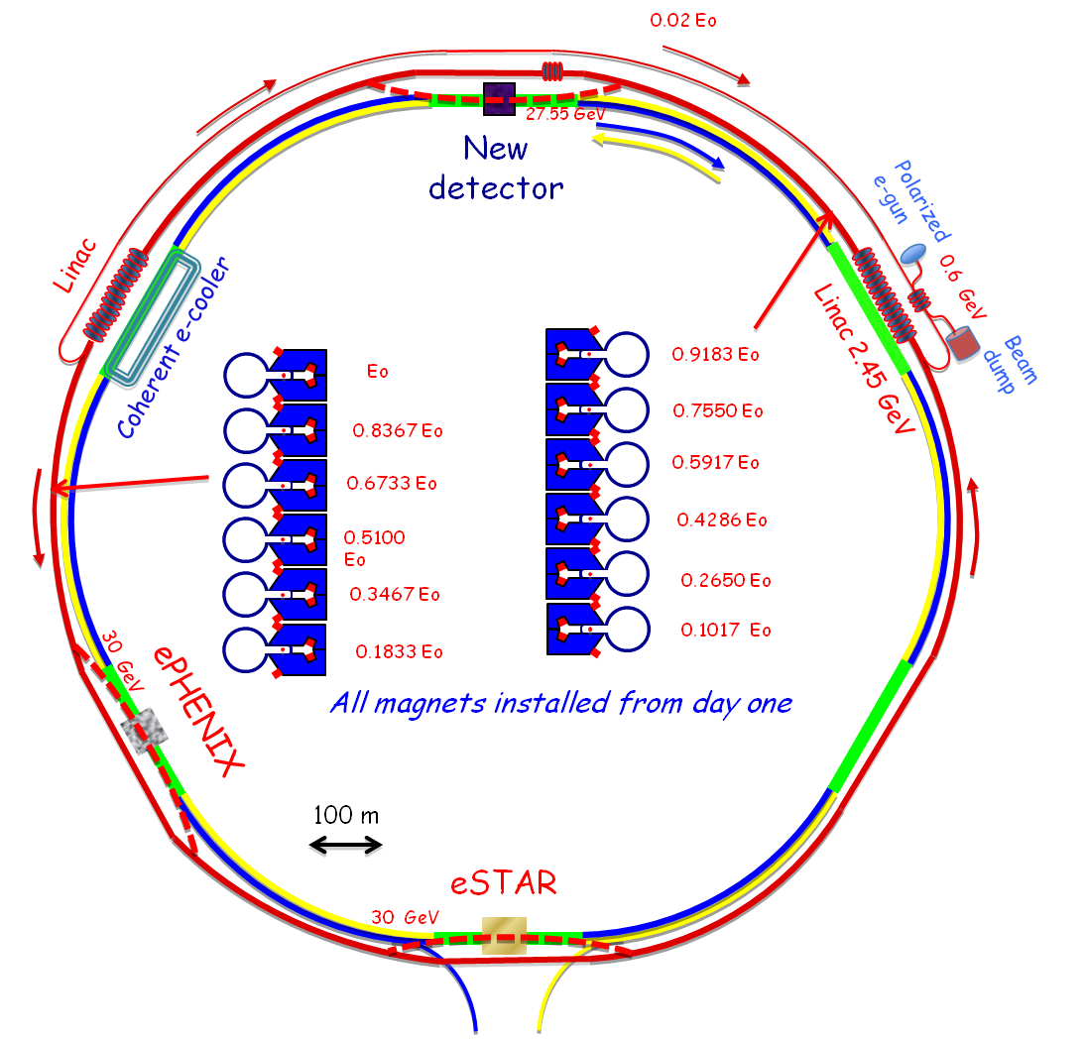
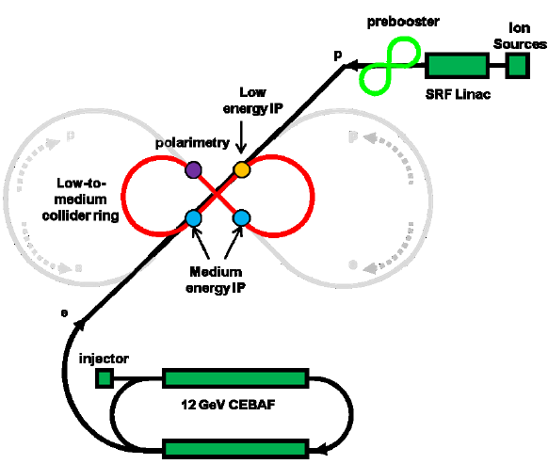
EIC accelerator concepts
eRHIC at BNL:
Add electron ring to RHIC
As part of the longer-term planning process underway within PHENIX, considering strategies for A+A/p+A/p+p upgrades program to lead into e+A/e+p program → ePHENIX
ELIC at JLab:
Add proton/ion beam to CEBAF

Slide 10
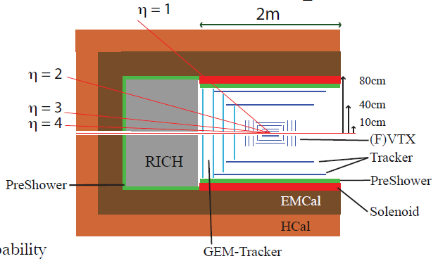
From sPHENIX to ePHENIX
Designing sPHENIX detector such that it could evolve into a suitable detector for e+A/e+p
  sPHENIX forward spectrometer should work for hadron-going-direction at ePHENIX
  Replace tracking to be lower mass
  Add electron-going-direction spectrometer
  Add PID at midrapidity
Notes:
Decadal Plan p. 195

Slide 11
ePHENIX/EIC: A natural continuation of LANL’s RHIC program
Overarching physics focus of the EIC: Deepen understanding of QCD through study of nucleon structure and cold nuclear matter
  Excellent match with current group interests!
  Few RHIC institutions have groups in both physics programs—an unusual strength to be exploited
  LANL currently one of the leading institutions in cold nuclear matter physics within the heavy ion community!
Facility will unite the nucleon structure and heavy ion physics communities currently brought together at RHIC not by common physics but by a collider with capabilities relevant to both
  LANL well positioned to play a leadership role within the EIC if it chooses
  Leitch, McGaughey established leaders in CNM
  Aidala, Jiang, Liu extensive experience in nucleon structure
Time to get involved intellectually is now, as the case for the 2013 LRP is being developed

Slide 12
LANL’s institutional value to the EIC
Timely buy-in from LANL as an institution also highly valuable in helping to realize the EIC
  Clear indication of interest at an institutional level a signal to others in the field as well as to funding agencies that the project is garnering support and momentum
  LANL has significant institutional resources to develop and build major hardware components for a new facility, including LDRD for detector R&D
  While data-taking at an EIC will be after 2020, relevant nearer-term opportunities exist
    DOE site-generic EIC detector R&D money available as of FY11
    Plan to keep sPHENIX forward detectors into ePHENIX era → integrated design process now

Slide 13
Extensive involvement
Broad involvement by LANL PHENIX team in supporting the ongoing long-term planning process within PHENIX
Participation in December 2011 sPHENIX Workfest in Boulder, CO (Durham, Huang, Jiang, Liu)
Member of ePHENIX Task Force (Aidala)
Participation in 2010 INT program in Seattle to develop EIC science case (Aidala, Jiang, Liu)
Direct involvement in producing PHENIX Decadal Plan document in 2010 (Aidala, Leitch, van Hecke)
Participation in January 2010 EIC collaboration meeting at Stony Brook (Aidala, Jiang, Leitch, Liu)

Slide 14
Summary
The EIC promises to usher in a new era of precision measurements that will probe the behavior of quarks and gluons in nucleons as well as nuclei, bringing us to a new phase in understanding the rich complexities of QCD in matter
The P-25 PHENIX team is well positioned to play a leadership role in both the e+A and e+p programs at the EIC
LANL’s involvement as an institution would be highly valuable in helping to realize the EIC
Staged plan offers variety of physics as well as detector opportunities on a range of timescales

Slide 15
Extra

Slide 16
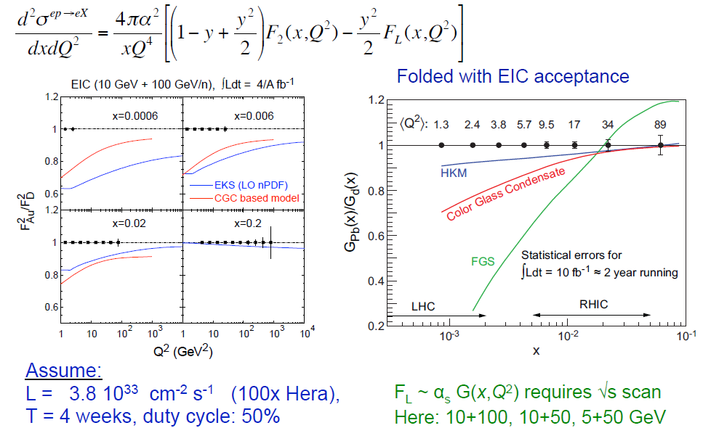
Accessing gluons in nuclei at the EIC
Via scaling violations of F₂
“Directly” via F_{L} ~ αsG (x,Q²)

Slide 17
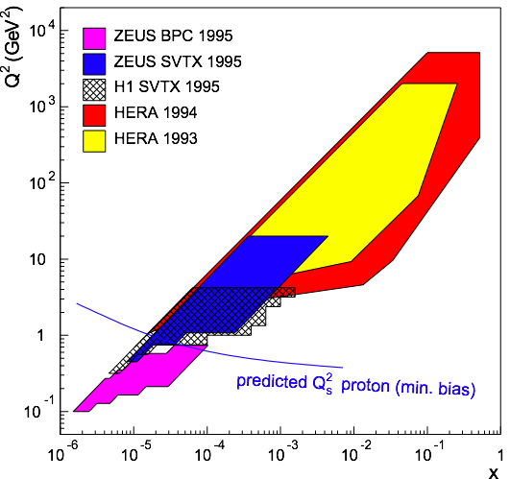
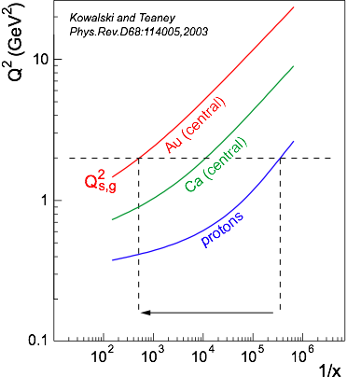
High-density gluon matter: Saturation
At small x linear evolution gives
strongly rising g(x)
BK/JIMWLK non-linear evolution includes
recombination effects → saturation
  Dynamically generated scale
  Saturation Scale: Q²_{s}(x)
    Increases with energy or decreasing x
  Observables scale with Q²/Q²_{s}(x) instead of x and Q² separately
α_{s}~1 α_{s} << 1
EIC (e+A):
  Instead of extending x, Q reach
  → increase Q_{s}
  Nuclear enhancement of saturation scale:
HERA (e+p):
Despite high energy range:
  F2, Gp(x, Q²) only outside the saturation regime
  Regime where non-linear QCD (saturation phenomena) (Q < Qs) not reached, but close
  Only way in e+p is to increase √s
Notes:
x < 0.01== coherence kicks in

Slide 18
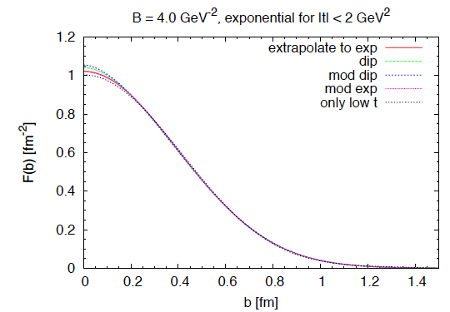
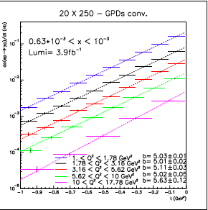
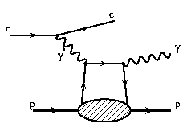
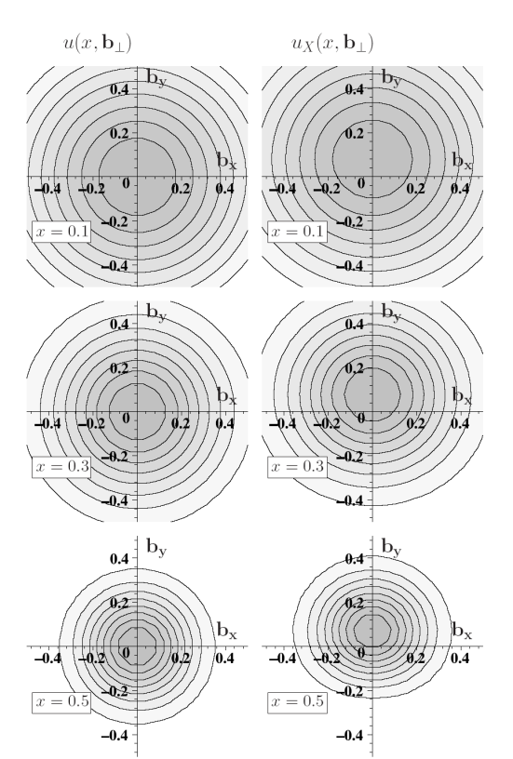
Spatial imaging of the nucleon
Deeply Virtual
Compton Scattering
Perform spatial imaging via exclusive processes
Detect all final-state particles
Nucleon doesn’t break up
Measure cross sections vs. four-momentum transferred to struck nucleon: Mandelstam t
dσ(ep→γp)/dt (nb)
Goal: Cover wide range in t.
Fourier transform → impact-
parameter-space profiles
Obtain b profile from slope vs. t.
t (GeV²)

Slide 19
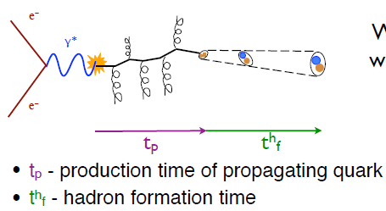
Comprehensive hadronization studies possible at the EIC
Wide range of Q²: QCD evolution of fragmentation functions and medium effects
Hadronization of charm, bottom
→ Clean probes with definite QCD predictions
High luminosity
→ Multi-dimensional binning and correlations
High energy: study jets and their substructure in e+p vs. e+A
Wide range of scattered parton energy → move hadronization inside/outside nucleus, distinguish energy loss and attenuation

Slide 20
Parton propagation and fragmentation in nuclear DIS
Nuclear DIS:
    Clean measurement in ‘cold’ nuclear matter
    Suppression of high-pT hadrons analogous to but weaker than at RHIC
Fundamental question:
When do partons get color neutralized?
Parton energy loss vs. (pre)hadron absorption
Energy transfer in lab rest frame:
HERMES: 2 < ν < 25 GeV
EIC: 10-1600 GeV!
Zh = Eh/ν

Slide 21
Physics-driven detector requirements
e+p physics
  the detector needs to cover inclusive (ep -> e’X) → semi-inclusive (ep -> e’hadron(s)X) → exclusive reactions (ep -> e’pπ)
    large acceptance absolutely crucial
    particle identification (π,K,p,n) over wide momentum range
    excellent vertex resolution (charm)
    particle detection for very low scattering angle
  small systematic uncertainty for e/p polarization measurements
  very small systematic uncertainty for luminosity measurement
e+A physics
  requirements very similar to e+p
    most challenging get information on recoiling heavy ion
    from exclusive and diffractive reactions.
As part of a new facility, one or more new detectors will need to be designed and built. Design work and R&D starting now. Lots of near- and long-term opportunities for national lab involvement!

Slide 22

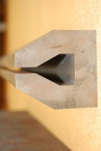
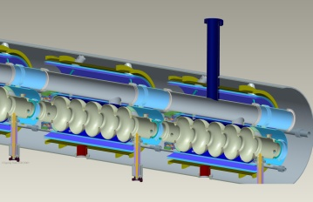

eRHIC at BNL
0.02 Eo
Polarized
e-gun
0.6 GeV
Beam
dump
27.55 GeV
New
detector
Linac
Coherent e-cooler
0.9183 Eo
Linac 2.45 GeV
Eo
0.8367 Eo
0.7550 Eo
0.6733 Eo
0.5917 Eo
0.5100 Eo
0.4286 Eo
0.3467 Eo
0.2650 Eo
0.1017 Eo
0.1833 Eo
30 GeV
All magnets installed from day one
ePHENIX
E_{e} ~5-20 GeV (30 GeV w/ reduced lumi)
E_{p} 50-250 GeV
E_{A} up to 100 GeV/n
Initial E_{e} ~ 5 GeV.
Install additional RF cavities over time to reach E_{e} = 30 GeV.
100 m
eSTAR
30 GeV
Notes:
We returned to developing cost effective and ECO-friendly eRHIC option with ERL located in the existing RHIC tunnel. We plan to install all magnets for 6 passes and 30 GeV from the start and then build up SRF linac from 1 GeV to 5 GeV per pass.
In this case electrons will pass through the detector halls in the way to the top energy, will collide in up to 3 IRs. Then they will be decelerated to the injection energy and damped.

Slide 23
Medium-Energy EIC at JLab (MEIC)
E_{e} = 3-11 GeV
E_{p} ~100 GeV
E_{A} ~50 GeV/n
Upgradable to high-energy machine:
E_{e} ~20 GeV
E_{p} ~ 250 GeV

Slide 24
Detector concepts
Large detector acceptance:
|η| < ~5
Low radiation length critical
→ low electron energies
Precise vertex reconstruction
→ separate b and c
DIRC/RICH → π, K, p hadron ID
Forward detectors to tag proton in exclusive reactions
Detector will need to measure
Inclusive processes
  Detect scattered electron with high precision
Semi-inclusive processes
  Detect at least one final-state hadron in addition to scattered electron
Exclusive processes
  Detect all final-state particles in the reaction

Slide 25
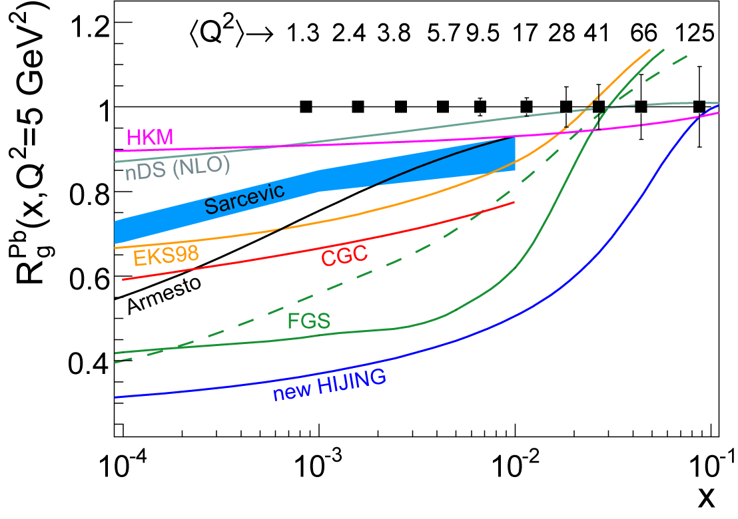
Connection to RHIC & LHC Physics
Matter at RHIC
  Thermalizes fast (τ₀ ~ 0.6 fm/c)
  We don’t know why and how
  Initial conditions? ⇒ G(x, Q²)
Role of saturation?
  RHIC → forward region
  LHC → midrapidity
    bulk (low-p_{T} matter) & semi-hard jets
Jet Quenching:
  Need Reference: E-loss in cold matter
  No HERMES data for
    charm energy loss
    in LHC energy range
LHC
RHIC
EIC provides essential new input:
Precise handle on x, Q²
Means to study exclusive effects

Slide 26
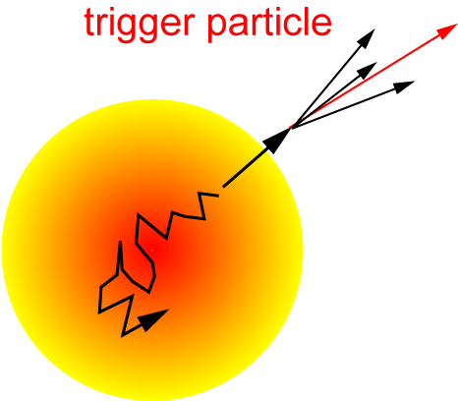
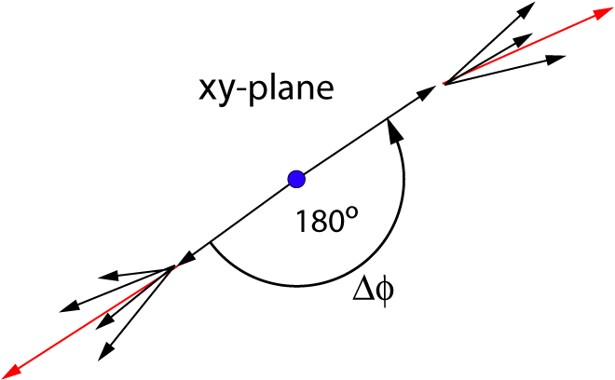
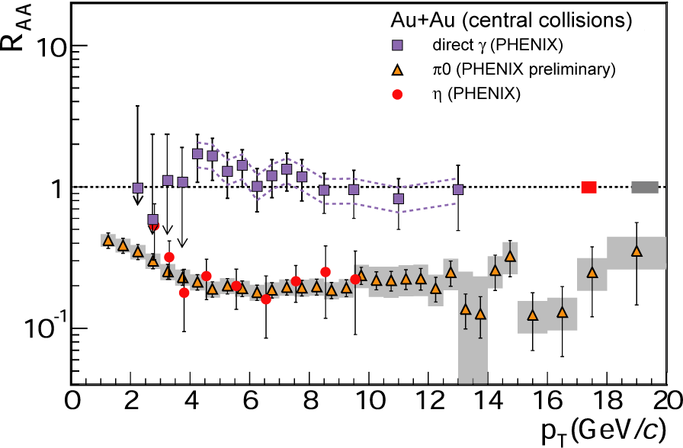
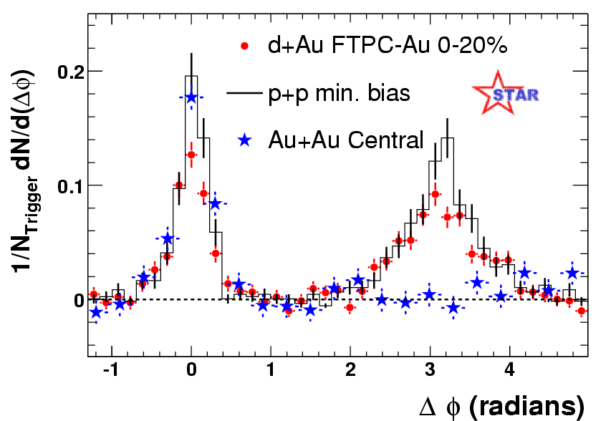
Interaction of fast probes with gluonic medium
Observation of jet quenching in nucleus-nucleus collisions at RHIC
RHIC Au+Au @ 200 GeV/n

Slide 27
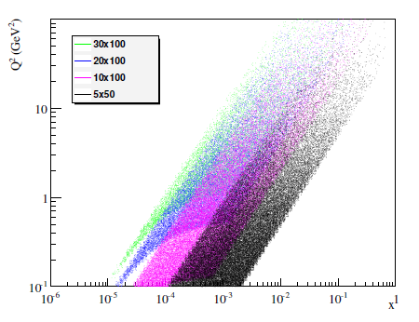
From sPHENIX to ePHENIX
Measure electron within
-4 < η < +1
5 GeV e beam
Q²>1 GeV²
Would need to plan accordingly—low-mass tracking, energy and angular resolutions, . . .
Notes:
Decadal Plan p. 195

