Slide 1
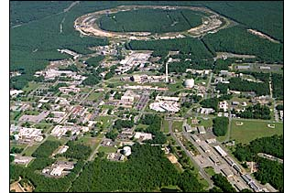

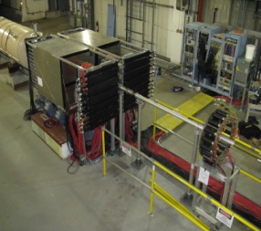
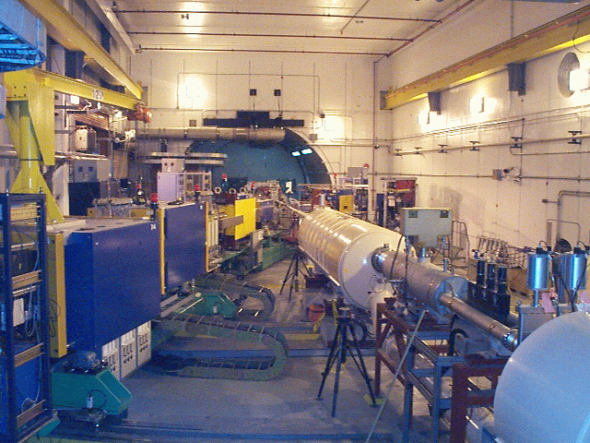
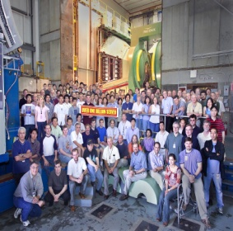
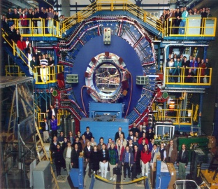


Single-Spin Asymmetries and Transverse-Momentum-Dependent Distributions at RHIC
A_{N}DY
Christine Aidala
Los Alamos National Lab
Quarks, Hadrons, and the LHC, IIT Bombay
August 30, 2011

Slide 2
Pushing the boundaries of pQCD
“Modern-day ‘testing’ of (perturbative) QCD is as much about pushing the boundaries of its applicability as about the verification that QCD is the correct theory of hadronic physics.”
– G. Salam, hep-ph/0207147 (DIS2002 proceedings)
Since 1990s starting to consider detailed internal QCD dynamics that parts with traditional parton model ways of looking at hadrons—and perform phenomenological calculations using these new ideas/tools!
  Non-linear evolution at small momentum fractions
  Various resummation techniques
  Non-collinearity of partons with parent hadron

Slide 3
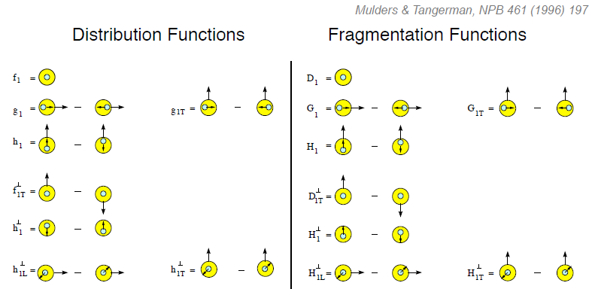
Dropping the simplifying assumption of collinearity: Transverse-momentum-dependent distributions
Collinear
Worm gear
Collinear
Now evidence for variety of spin-momentum correlations in proton, and in process of hadronization!
Transversity
Measured non-zero!
Sivers
Polarizing FF
Boer-Mulders
Pretzelosity
Collins
Worm gear

Slide 4
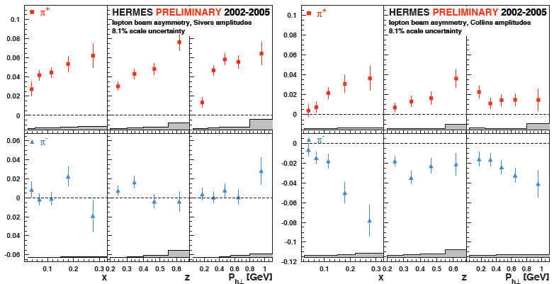
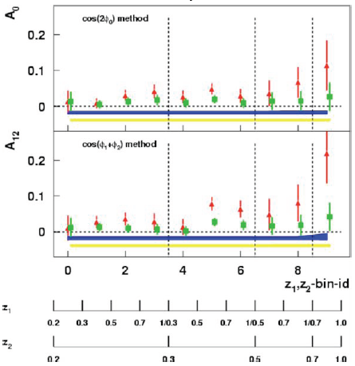
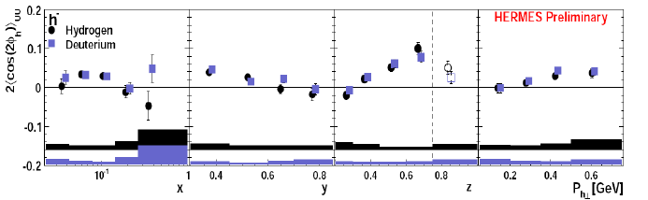
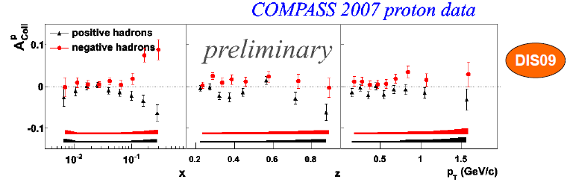
Sivers
Collins
BELLE Collins: PRL96, 232002 (2006)
Boer-Mulders
SPIN2008
A flurry of experimental results from semi-inclusive DIS and e+e- over last ~9 years
Collins

Slide 5
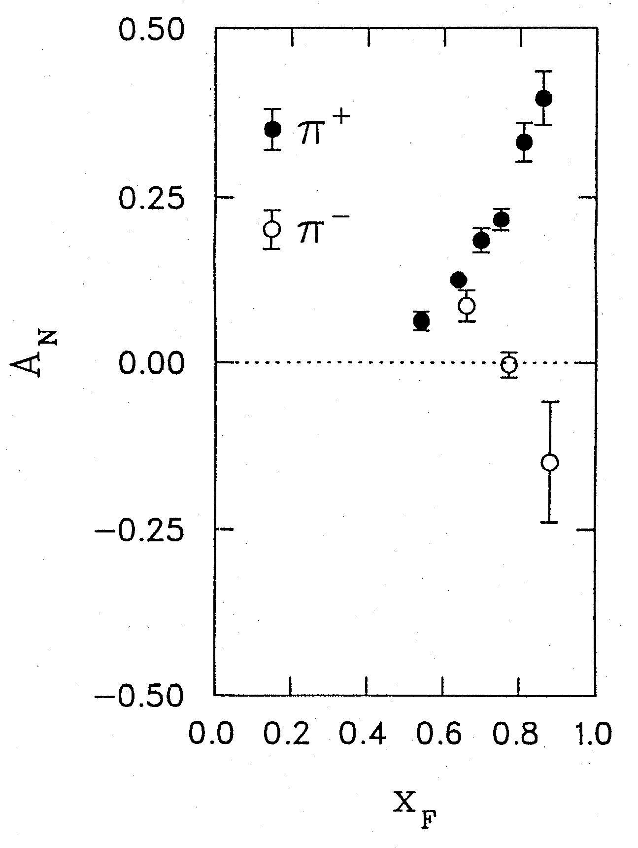
Transversely polarized hadronic collisions:
A historical discovery ground
Argonne ZGS, p_{beam} = 12 GeV/c
left
right
Striking asymmetries!! After more than a decade, will inspire the birth of a new subfield . . .
W.H. Dragoset et al., PRL36, 929 (1976)

Slide 6
Transverse-momentum-dependent distributions and single-spin asymmetries
1989: “Sivers mechanism” proposed
Take into account the transverse momentum (k_{T}) of quarks within the proton, and postulate a correlation between quark k_{T} and proton spin!
Single-spin asymmetries ~ S•(p₁×p₂)
Probe spin-momentum correlations!
D.W. Sivers, PRD41, 83 (1990)

Slide 7
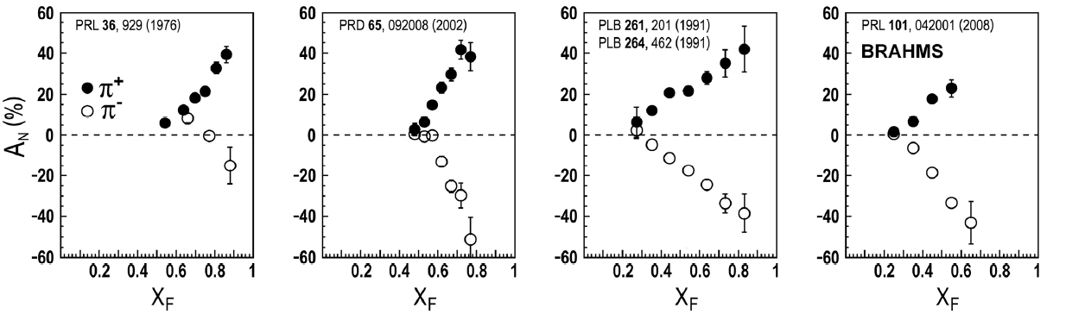
Transverse single-spin asymmetries:
From low to high energies!
ANL
√s=4.9 GeV
BNL
√s=6.6 GeV
FNAL
√s=19.4 GeV
RHIC
√s=62.4 GeV
RHIC
√s=200 GeV
π⁰
STAR
left
These soft effects—due to QCD dynamics within the nucleon—remain relevant up to scales where we can attempt to describe them using pQCD!
right
7
Notes:
7

Slide 8
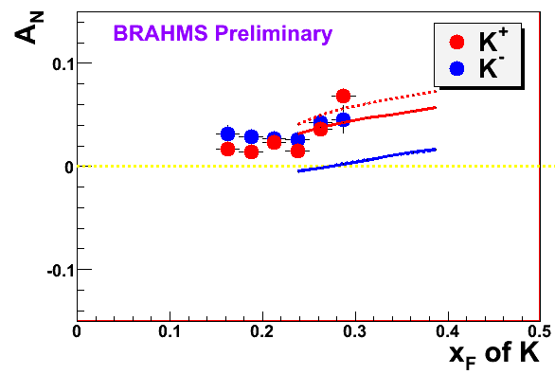
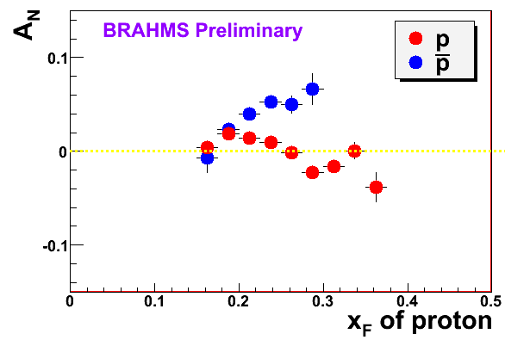
High-x_{F} asymmetries, but not valence quarks??
Pattern of pion species asymmetries in the forward direction
→ valence quark effect.
But this conclusion confounded by kaon and antiproton asymmetries from RHIC!
Note different scales
PRL 101, 042001 (2008)
K
K
K⁻ asymmetries
underpredicted
200 GeV
62.4 GeV
p
Large antiproton asymmetry?!
(No calculations attempted yet . . .)
p
200 GeV
62.4 GeV

Slide 9
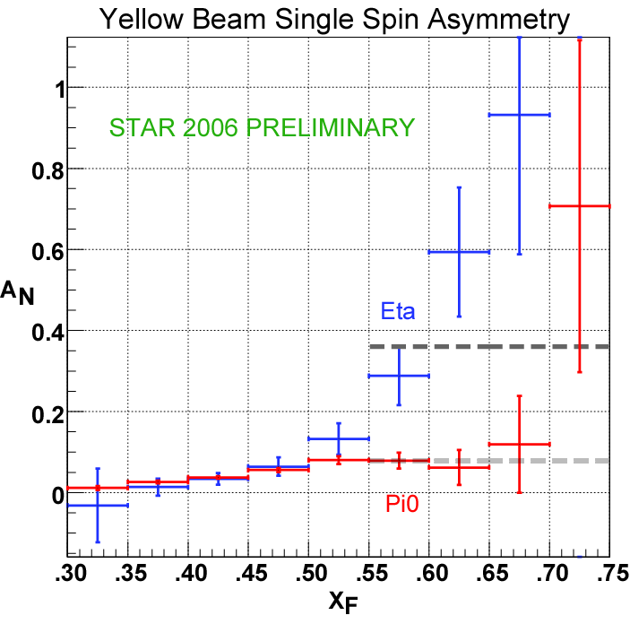
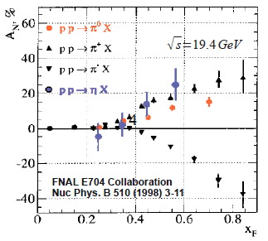
Another surprise: Transverse single-spin asymmetry in eta meson production
Further evidence against a valence quark effect??
Larger than the neutral pion!
STAR
Note earlier FNAL E704 data consistent . . .

Slide 10
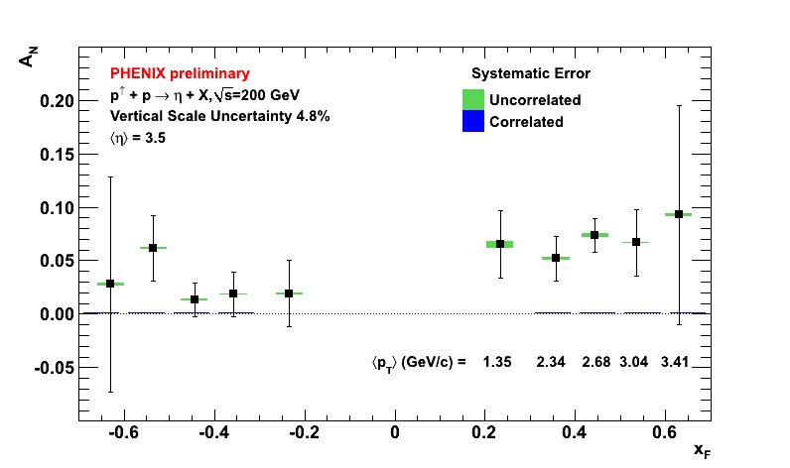

Recent PHENIX etas show no sharp increase for x_{F} > 0.5!
Released at PANIC, MIT, July 2011

Slide 11
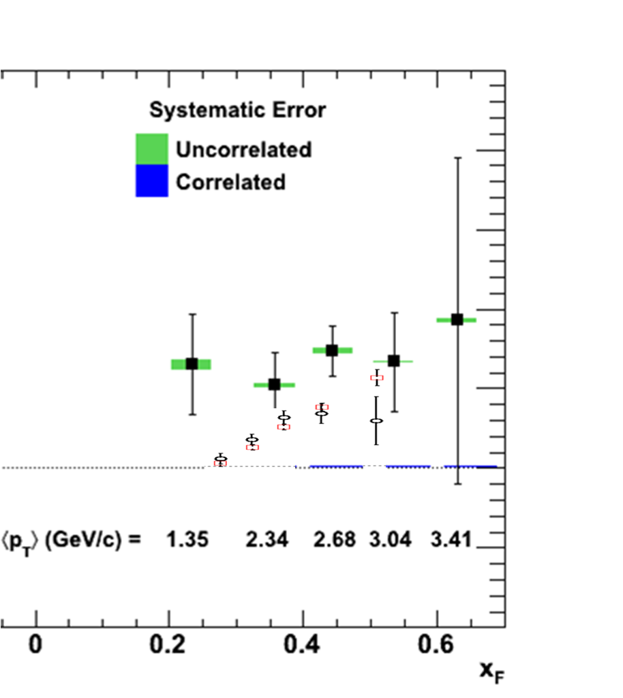
PHENIX eta vs. neutral pion
Still suggests larger asymmetry for etas than for (merged-cluster) neutral pions!
Will need to wait for final results from both collaborations . . .

Slide 12
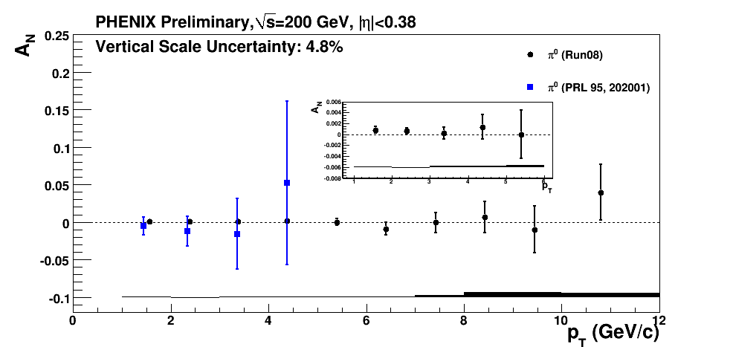
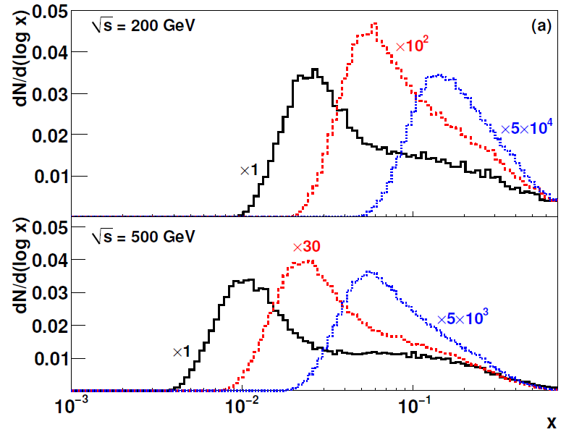
Neutral pions at midrapidity (x_{F} = 0)
More data (and further theoretical work) needed to clarify if the large transverse single-spin asymmetries in forward hadron production are a valence quark/high x effect!
Midrapidity neutral pion production asymmetry consistent with zero, even out to large p_{T} (x ~ 0.2)
2-2.5 GeV/c
4-5 GeV/c
9-12 GeV/c
Notes:
Color code

Slide 13
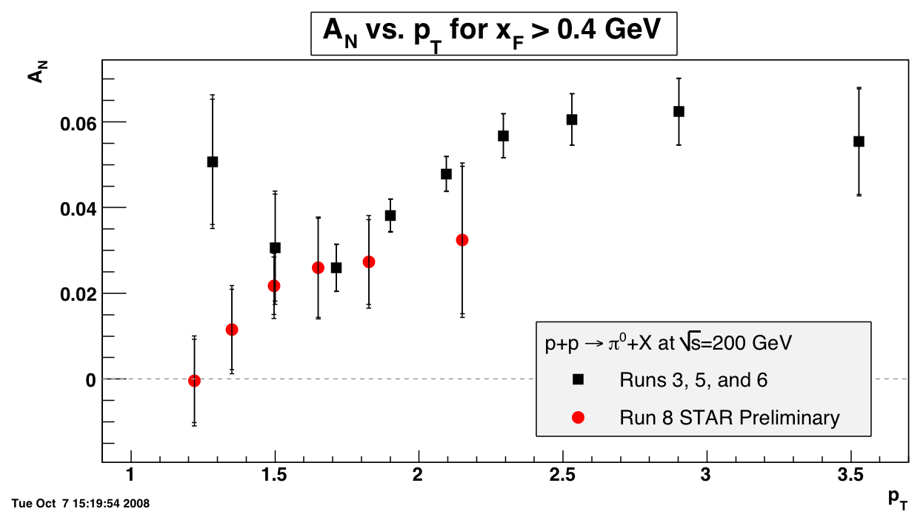
What about p_{T} dependence of forward asymmetries?
Kinematically constrained to be 0 at p_{T} = 0.
Predicted for many years to fall off at larger p_{T} as 1/p_{T}, but no clear indication of this in data . . .
Black points: Phys. Rev. Lett. 101, 222001 (2008)
STAR

Slide 14
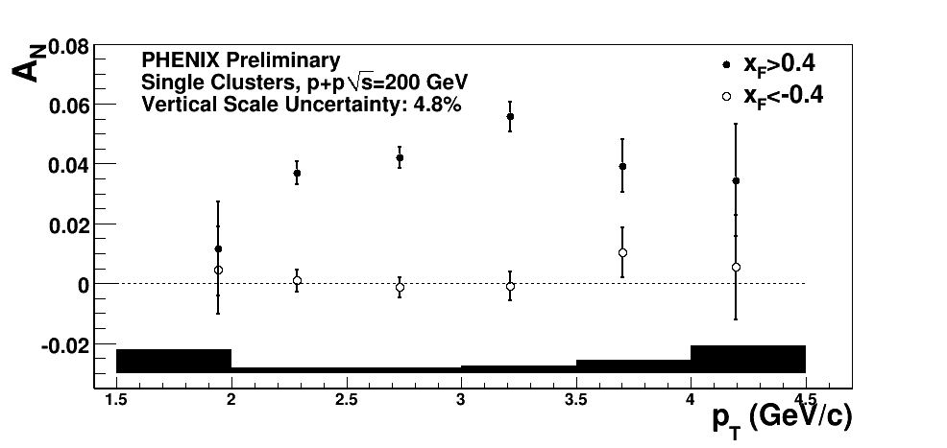
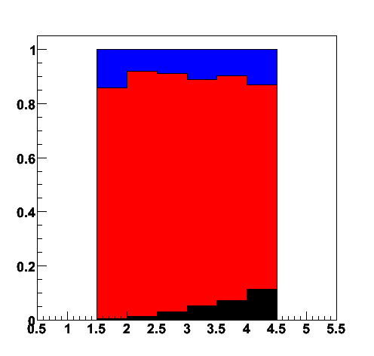
p_{T} dependence of PHENIX data similar
Starts to drop after p_{T} ~ 3 GeV/c??
Decay photon
π⁰
Direct photon
Fraction of clusters
p_{T}

Slide 15
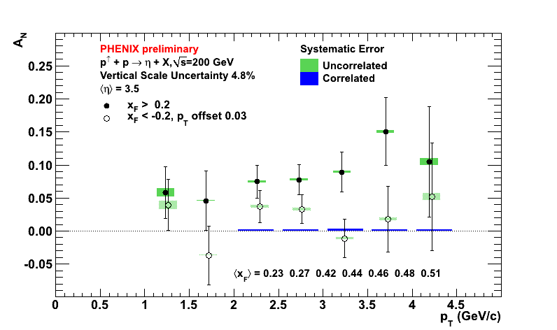
Eta p_{T} shape consistent with neutral pions
η

Slide 16
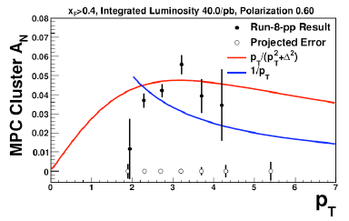
Trying to understand p_{T} dependence
More recent phenomenology by Zhongbo Kang: 1/p_{T} → p_{T}/(p_{T}²+Δ²) (add a constant term)
Additional data in 2012 expected to clarify high-p_{T} behavior of observed asymmetries!

Slide 17
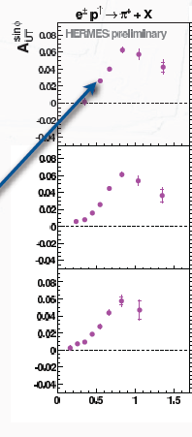
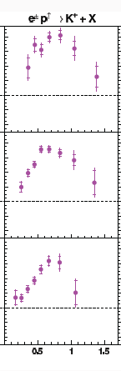

p_{T} dependence of HERMES inclusive(!) hadron data
Clear rise from low p_{T} and turn-over at ~0.8 GeV/c, for both pions and kaons
π⁺
Κ⁺
0.2 < x_{F} < 1
0.2 < x_{F} < 1
0.08 < x_{F} < 0.2
0.08 < x_{F} < 0.2
What can we learn by comparing DIS vs. p+p measurements?
-0.1 < x_{F} < 0.08
-0.1 < x_{F} < 0.08
p_{T} (GeV/c)

Slide 18
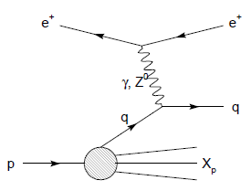
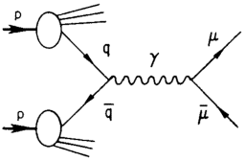
Modified universality of T-odd transverse-momentum-dependent distributions:
Color in action!
Semi-inclusive DIS: attractive final-state
interaction
Drell-Yan:
repulsive initial-state
interaction
Some semi-inclusive DIS measurements already exist. Polarized Drell-Yan measurements will be a crucial test of our understanding of quantum chromodynamics!
As a result:

Slide 19
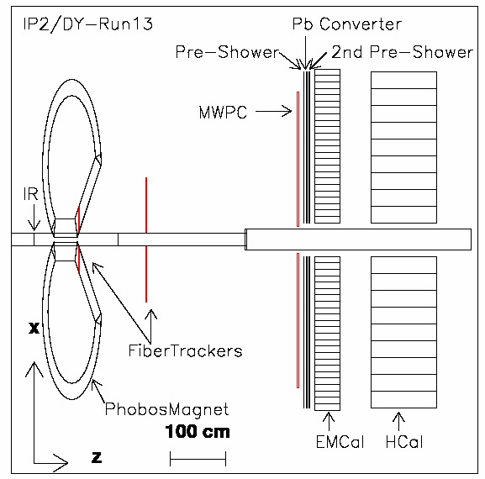

New (small) experiment at RHIC: A_{N}DY
Drell-Yan feasibility test at former BRAHMS IP
Take transversely polarized data at √ s = 500 GeV during STAR + PHENIX longitudinal W program
Reuse existing detectors
η > 3, M > 4 GeV/c², 0.1<x_{F}<0.3
Measure jet, π⁰, Drell-Yan σ and transverse single-spin asym.
Expect single D-Y asym. point with uncertainty ~0.015 (predicted asym ~0.05-0.10)
In collaboration w/institutions not previously involved in RHIC: JLab, William & Mary
Left/right symmetric HCal
Trigger/DAQ electronics
Left/right symmetric
ECal
Blue-facing BBC
Left/right symmetric preshower
2011 Configuration
Beryllium vacuum pipe

Slide 20
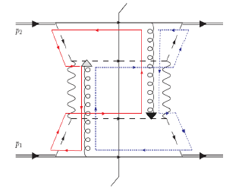
Factorization, color, and hadronic collisions
  Last year, theoretical work by T.C. Rogers, P.J. Mulders (PRD 81:094006, 2010) claimed pQCD factorization broken in processes involving hadro-production of hadrons if parton k_{T} taken into account (TMD pdfs and/or FFs)
  “Color entanglement”
Color flow can’t be described as flow in the two gluons separately. Requires simultaneous presence of both!

Slide 21
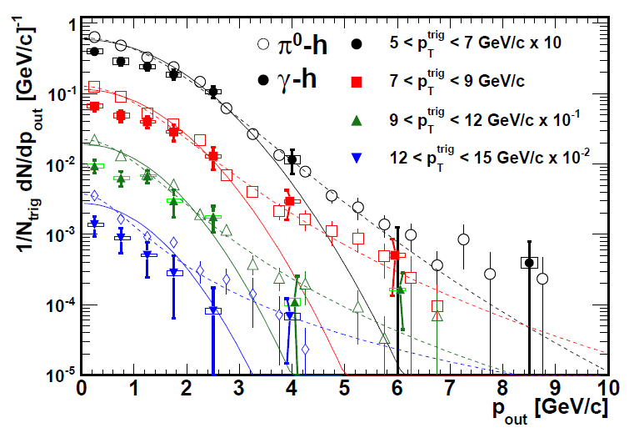
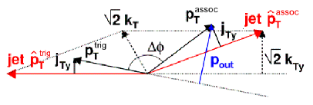
Testing TMD-factorization breaking with (unpolarized) p+p collisions at RHIC
PHENIX, PRD82, 072001 (2010)
Implications for observables describable using Collins-Soper-Sterman (“Q_{T}”) resummation formalism
Try to test using photon-hadron and dihadron correlation measurements in unpolarized p+p collisions at RHIC
Lots of expertise on such measurements within PHENIX, driven by heavy ion program!
(Curves shown here just empirical parameterizations from PHENIX paper)

Slide 22
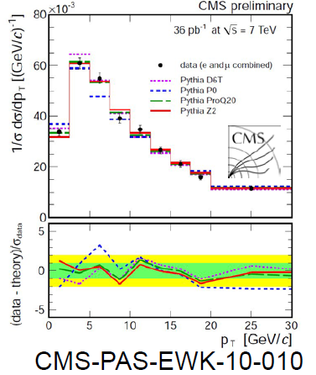
Testing TMD-factorization breaking with (unpolarized) p+p collisions at RHIC
Calculate p_{out} distributions assuming factorization works
  Will show different shape than data?
  Difference b/w factorized calculations and data will vary for 3-hadron vs. 4-hadron processes?
Take CSS soft factor (unpolarized TMDs) from parameterizations of Drell-Yan and Z measurements
  New Z p_{T} spectra coming out of LHC and Tevatron will greatly improve parametrizations!
  Evolution worked out earlier this year: Aybat and Rogers, PRD83, 114042 (2011)

Slide 23
Conclusions
Now starting to explore QCD dynamics!
Transverse-momentum-dependent distributions probe spin-momentum correlations in QCD, both in nucleon and process of hadronization
Flurry of activity since 2002, with experimental data from semi-inclusive DIS, e+e-, and p+p
Field has brought to the forefront fundamental issues of universality, factorization and color interactions
  Fruitful interplay among different collision systems!
Remaining puzzles and open questions—look forward to more data from RHIC and other facilities in upcoming years!

Slide 24
Additional Material

Slide 25
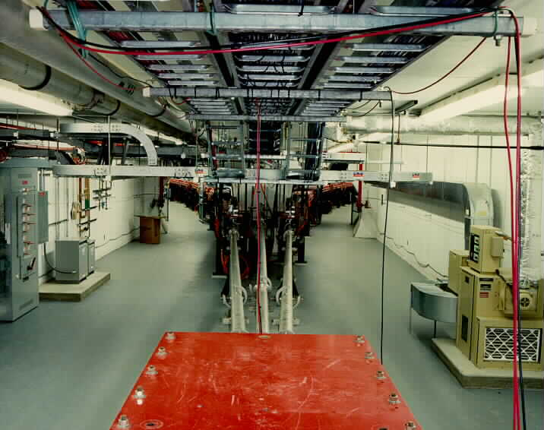
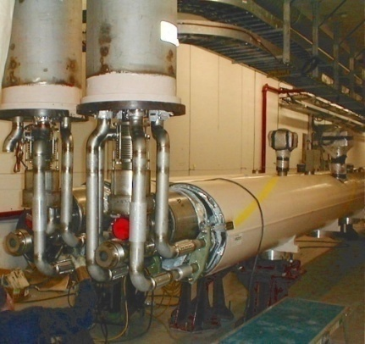
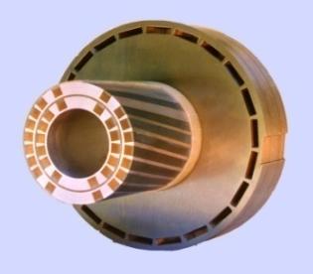
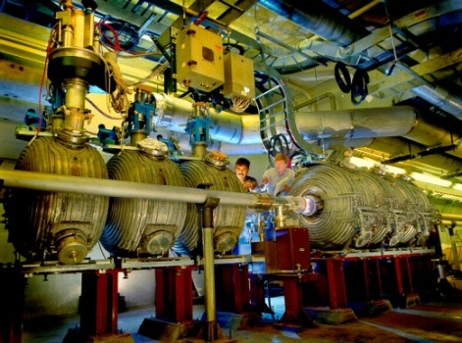
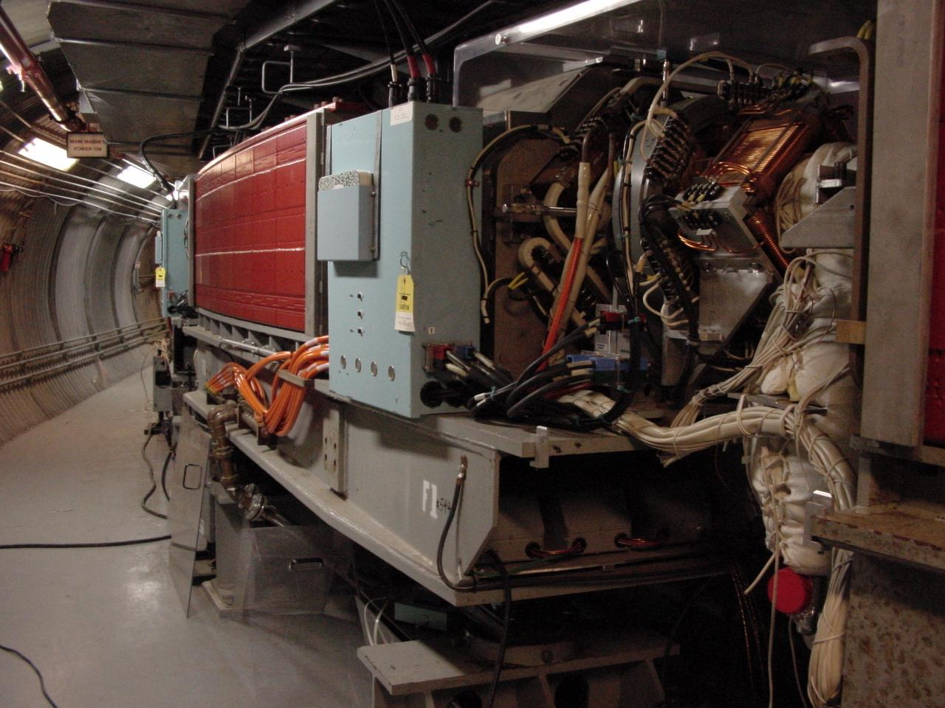
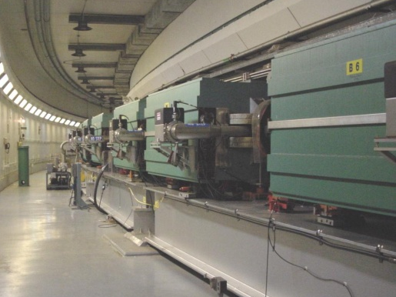
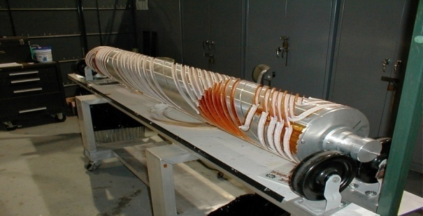
RHIC as a Polarized p+p Collider
Absolute Polarimeter (H jet)
RHIC pC Polarimeters
Siberian Snakes
PHOBOS
BRAHMS & PP2PP
Siberian Snakes
PHENIX
Spin Flipper
STAR
Spin Rotators
Various equipment to maintain and measure beam polarization through acceleration and storage
Partial Snake
Helical Partial
Snake
Polarized Source
Strong Snake
LINAC
AGS
200 MeV Polarimeter
BOOSTER
Rf Dipole
AGS Internal Polarimeter
AGS pC Polarimeter
Notes:
RHIC, as a high-energy polarized proton collider, really represents an outstanding achievement in accelerator physics. . . . [equipment].

Slide 26
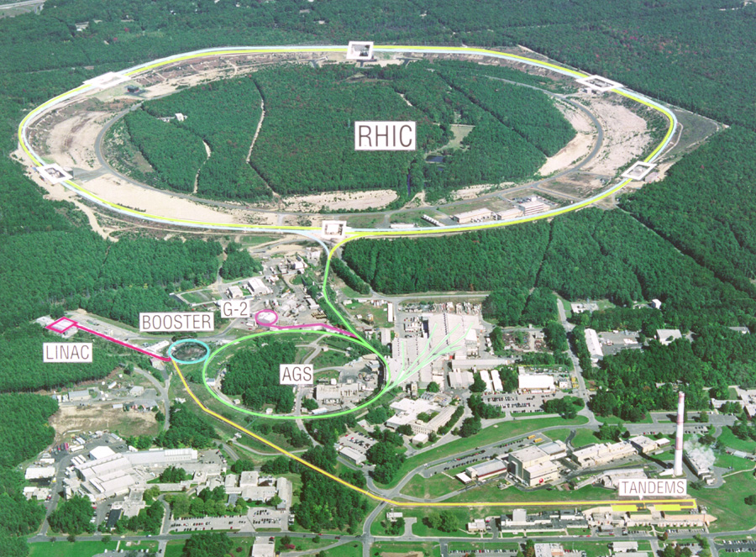
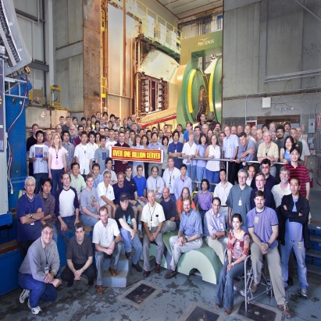


Spin physics at RHIC
Polarized protons at RHIC 2002-present
Mainly √s = 200 GeV, also 62.4 GeV in 2006, started 500 GeV program in 2009
Two large multipurpose detectors: STAR and PHENIX
  Longitudinal or transverse polarization
One small spectrometer until 2006: BRAHMS
  Transverse polarization only
Transverse spin only
(No rotators)
Longitudinal or transverse spin
Longitudinal or transverse spin

Slide 27
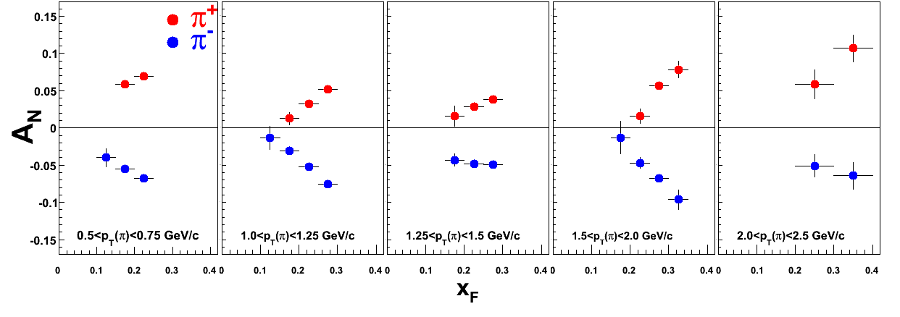
Forward π⁺⁻ A_{N} at √s = 200 GeV: x_{F}-p_{T} dependence
BRAHMS Preliminary

Slide 28
Forward π⁰ A_{N} at 200 GeV: x_{F}-p_{T} dependence
Phys. Rev. Lett. 101, 222001 (2008)
STAR

Slide 29
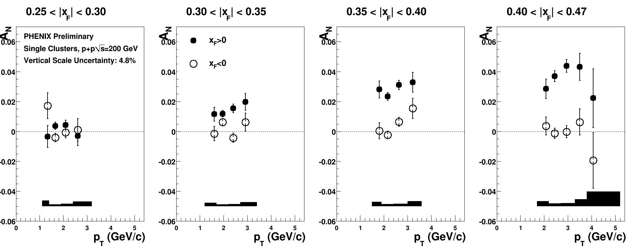
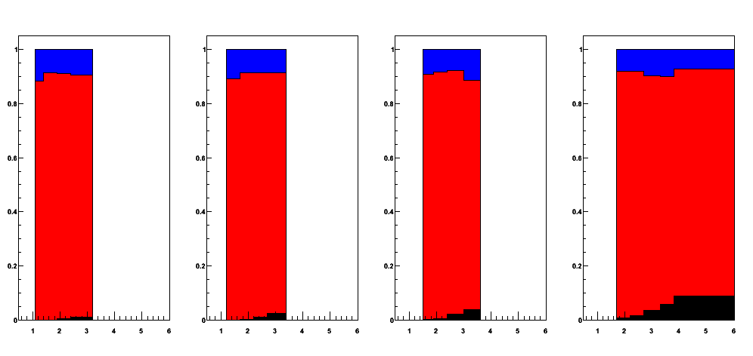
Cluster A_{N} at 200 GeV: x_{F}-p_{T} dependence
Decay photon
π⁰
Direct photon
Fraction of clusters
p_{T} (GeV/c)

Slide 30
Forward π⁺⁻ A_{N} at √s = 62.4 GeV: x_{F}-p_{T} dependence
arXiv:0801.1078
At low-p_{T} A_{N}(π) increases with p_{T}.
(Theoretically constrained to be 0 at p_{T}=0)

Slide 31
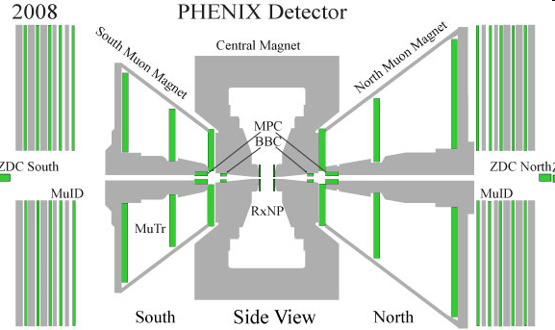
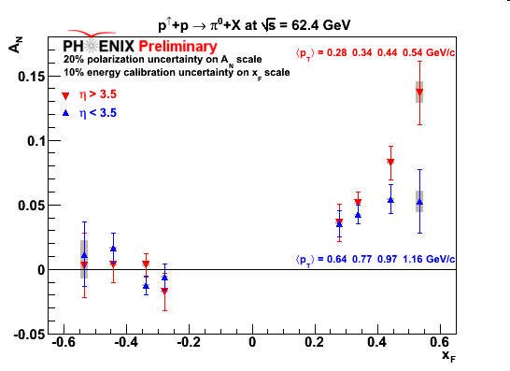
Forward π⁰ A_{N} at 62.4 GeV:
Rapidity dependence
η > 3.5
η < 3.5
PLB 603,173 (2004)

Slide 32
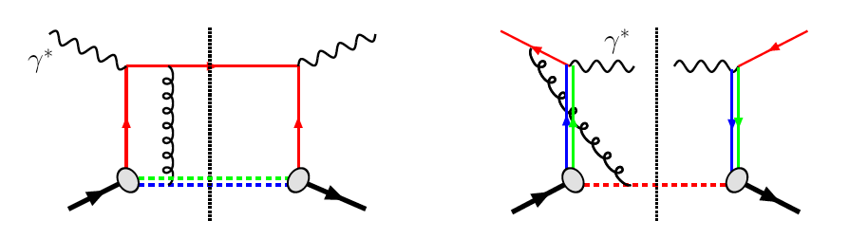
TMDs and Universality:
Modified Universality of T-Odd TMDs
DIS: attractive FSI
Drell-Yan: repulsive ISI
As a result:

Slide 33
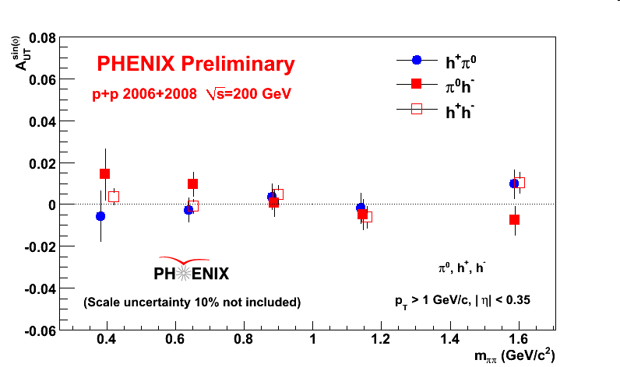
Interference fragmentation function to probe transversity
Need more statistics!

Slide 34
Prokudin et al. at Ferrara

Slide 35

Forward neutrons at √s=200 GeV at PHENIX
Large negative SSA observed for x_{F}>0, enhanced by requiring concidence with forward charged particles (“MinBias” trigger).
No x_{F} dependence seen.
Mean p_{T}
(Estimated by simulation assuming ISR p_{T} dist.)
0.4<|x_{F}|<0.6 0.088 GeV/c
0.6<|x_{F}|<0.8 0.118 GeV/c
0.8<|x_{F}|<1.0 0.144 GeV/c
preliminary | A_{N}
Without MinBias | -6.6 ±0.6 %
With MinBias | -8.3 ±0.4 %
charged
particles
neutron
neutron

Slide 36






Neutron SSA for local polarimetry
A_{N}
Spin Rotators OFF
Vertical polarization
Blue
φ
Yellow
Spin Rotators ON
Radial polarization
Blue
Yellow
Spin Rotators ON
Longitudinal polarization
Blue
Yellow
36
36
Notes:
36

Slide 37

Bunch-by-bunch polarization information
From ~10 minutes of 500 GeV commissioning data in March 2009!
South-going beam
(at PHENIX IR)
North-going beam
(at PHENIX IR)
crossing #
crossing #
With transverse polarization, use scalers to count raw left-right SSA in forward neutron production for each bunch crossing.
Measurement of bunch-by-bunch variation in polarization.
(Sign flip for bunches polarized vertically up vs. down.)
37
37
Notes:
37

Slide 38
Forward neutrons at other energies
Significant forward neutron asymmetries observed down to 62.4 and up to 410 GeV!
√s=62.4 GeV
√s=410 GeV

Slide 39

p_{T} scaling of forward neutron SSA?
Large SSA remains unexplained—Challenge to theorists!
Inclusive neutrons
62.4, 200, 500 GeV
Neutrons with charged particle trigger
200, 500 GeV

Slide 40

Polarization-averaged cross sections at √s=200 GeV
Good description at 200 GeV over all rapidities down to p_{T} of 1-2 GeV/c.

Slide 41
Lower energies: √s=62.4 GeV
Midrapidity pions
PRD79, 021002 (2009)
Comparisons to NLO and NLL pQCD calculations using μ=p_{T} shown.
Unlike at 200 GeV, scale choice of μ=p_{T} underpredicts the data.
→ Threshold logarithm effects still relevant at this intermediate energy?
11% normalization
uncertainty not included
But—overall, pretty good agreement!

Slide 42

√s=62.4 GeV
Forward pions
Comparison of NLO pQCD calculations with BRAHMS π data at high rapidity. The calculations are for a scale factor of μ=p_{T}, KKP (solid) and DSS (dashed) with CTEQ5 and CTEQ6.5.
Surprisingly good description of data, in apparent disagreement with earlier analysis of ISR π⁰ data at 53 GeV.
No comparison to NLL yet.
Still not so bad!

Slide 43

√s=62.4 GeV
Forward kaons
K⁻ data suppressed ~order of magnitude (valence quark effect).
NLO pQCD using recent DSS FF’s gives ~same yield for both charges(??).
Related to FF’s? PDF’s??
No comparison to NLL yet.
Still work to be done in describing hadronic collisions with pQCD at lower energies, particularly at forward rapidities.
K⁺: Not bad!
K⁻: Hmm…
Notes:
Authero of DSS knows about this.

Slide 44
Planning for the longer-term future
Last fall PHENIX and STAR handed in (independent) “Decadal Plans” to BNL management
Joint discussions among BNL management and the two collaborations ongoing
Long-term future at RHIC (past ~2018) clearly affected by what happens with the proposed Electron-Ion Collider!

Slide 45

Improved forward detection capabilities
PHENIX discussing major overhaul of detector beyond ~2016
STAR discussing much more modest upgrades
Details aside, anticipate good forward jet reconstruction would be possible at RHIC, and strong forward Drell-Yan capabilities as well
sPHENIX (SPHINX?) detector as currently envisioned

Slide 46
Long-term accelerator prospects
Could go up to energies as high as sqrt(s)=650 GeV with new DX magnets
  W cross sections ~double w.r.t. 500 GeV: quark and antiquark flavor separation for various transverse-momentum-dependent distributions, alternate probe to D-Y for Sivers sign change, . . .
Polarized He³ beams foreseen for EIC—could run He³ in hadron-hadron mode at RHIC as well
  He³ workshop at BNL in late September

Slide 47

He³ for flavor separation of transverse spin observables
Zhongbo
Kang
With polarized He³ as well as proton beams at RHIC, new handles on flavor separation of various transverse spin observables possible
  What will the status of the (non-)valence quark puzzle be by then??

