Slide 1
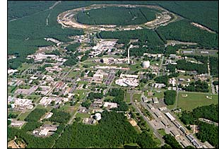
Investigating Proton Structure at the
Relativistic Heavy Ion Collider
Christine Aidala
University of Michigan
HiX Workshop, Frascati
November 19, 2014

Slide 2
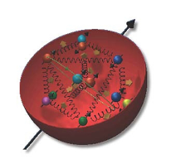
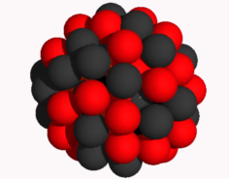
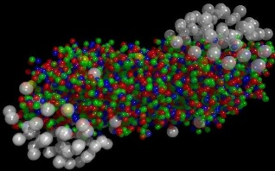
The Relativistic Heavy Ion Collider at Brookhaven National Laboratory
A collider-based program, but not designed to be at the energy (or intensity) frontier. More closely analogous to many areas of condensed matter research—create a system and study its properties
What systems are we studying?
  “Simple” QCD bound states—the proton is the simplest stable bound state in QCD (and conveniently, nature has already created it for us!)
  Collections of QCD bound states (nuclei, also available out of the box!)
  QCD deconfined! (quark-gluon plasma, some assembly required!)
Understand more complex QCD systems within
the context of simpler ones
RHIC designed from the start as a single facility capable of nucleus-nucleus, proton-nucleus, and proton-proton collisions

Slide 3
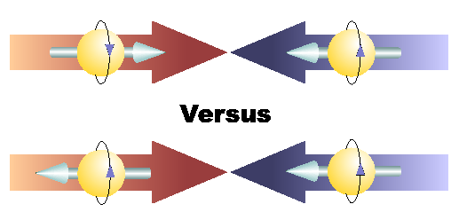
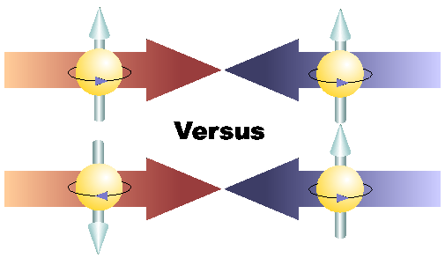
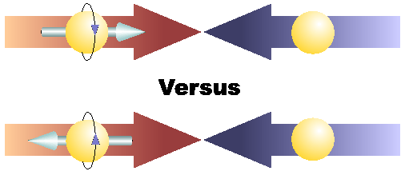
Proton spin structure at RHIC
Transverse spin and
spin-momentum
correlations
Transverse-momentum-
dependent distributions
, Jets
Back-to-Back Correlations
Single-Spin Asymmetries
Advantages of a polarized proton-proton collider:
Hadronic collisions → Leading-order access to gluons
High energies → Applicability of perturbative QCD
High energies → Production of new probes: W bosons

Slide 4
Reliance on input from simpler systems
Disadvantage of hadronic collisions: much “messier” than deep-inelastic scattering → Rely on input from simpler systems
  Just as the heavy ion program at RHIC relies on information from simpler collision systems
The more we know from simpler systems such as DIS and e+e- annihilation, the more we can in turn learn from hadronic collisions!

Slide 5
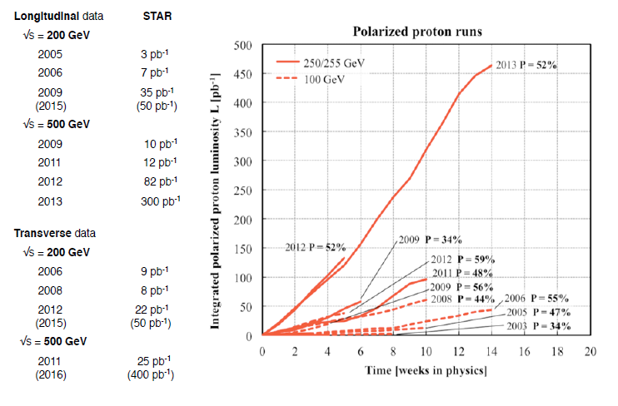
RHIC performance for polarized protons

Slide 6
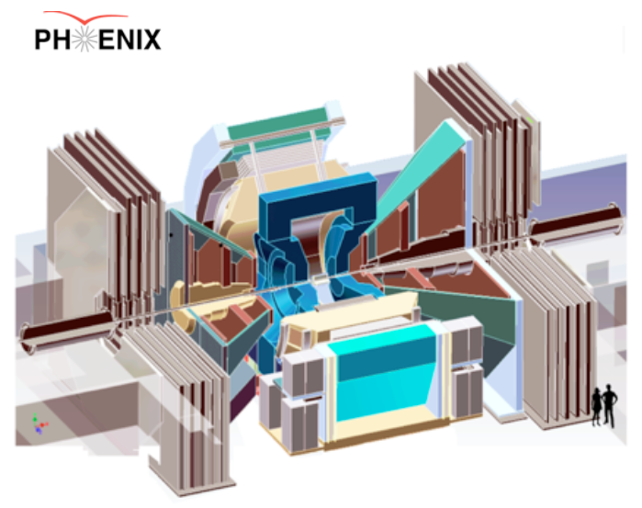
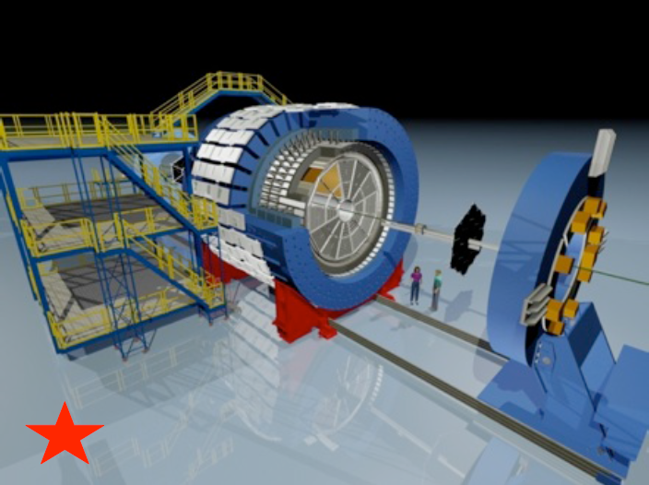
RHIC’s current main experiments
PHENIX:
High resolution; high rate capabilities for rare probes
Central arms |η|<0.35, Δφ∼2π with key strength measuring EM probes
Muon arms 1.2<|η|<2.4
Forward EM calorimetry
STAR:
Key strengths jets + correlations
Full acceptance including PID for |η|< 1, Δφ∼2π
Forward EM calorimetry

Slide 7
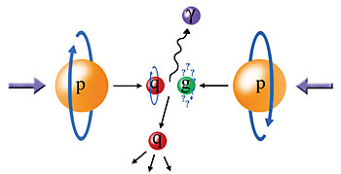
Probing the helicity structure of the nucleon with p+p collisions
Study difference in particle production rates for same-helicity vs. opposite-helicity proton collisions
DIS
?
pQCD
e+e-
Leading-order access to gluons → ΔG
Notes:
Let me now show you some highlights from the helicity program at RHIC.

Slide 8
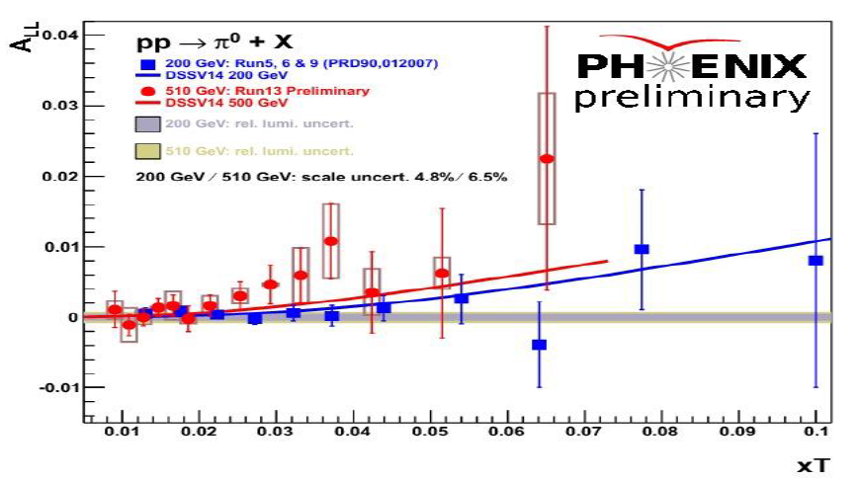
Neutral pion and jet double-helicity asymmetries
π⁰ 200 GeV - PRD90, 012007 (2014)
π⁰ 510 GeV - Preliminary

Slide 9
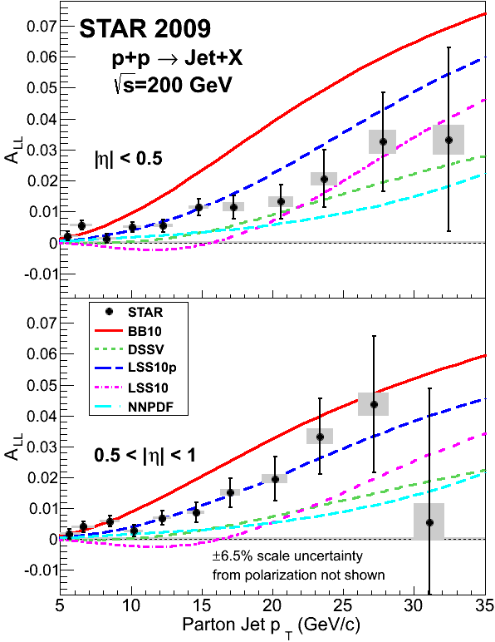
Neutral pion and jet double-helicity asymmetries
arXiv:1405.5134
Clear nonzero asymmetry seen in STAR jet measurements from 2009 data!
PHENIX π⁰ data consistent

Slide 10
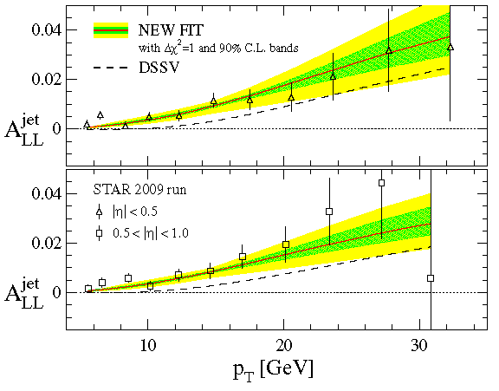
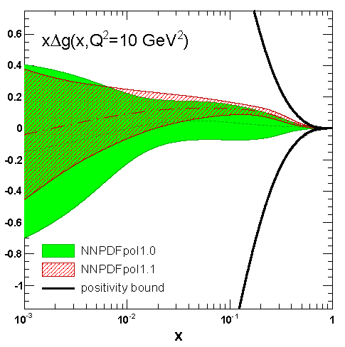
Two new helicity pdf fits
DSSV, PRL 113, 012001 (2014)
NNPDF, NPB 887.276 (2014)
DSSV and NNPDF have released new polarized pdf fits including RHIC data
2009 STAR jet A_{LL} results in particular provide significantly tighter constraints on gluon polarization than previous measurements
Both find evidence for positive gluon polarization in the region x > 0.05 – See talks by M. Stratmann and E. Nocera

Slide 11
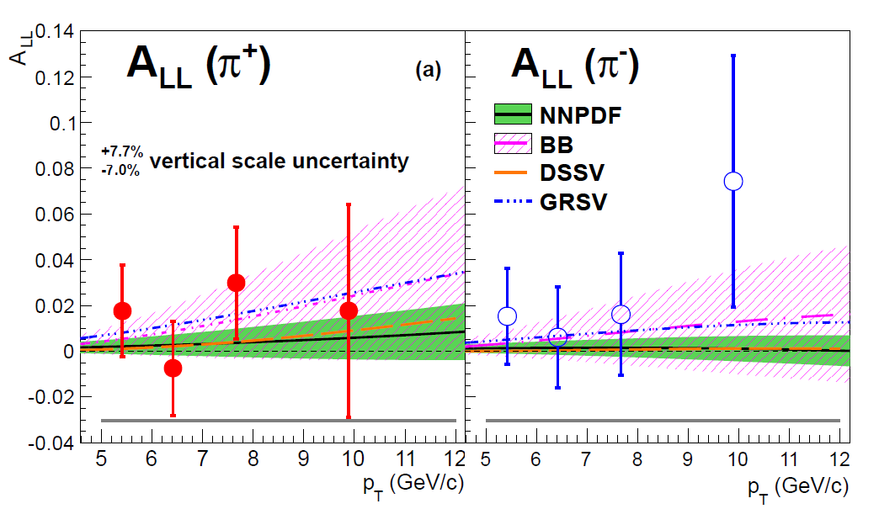
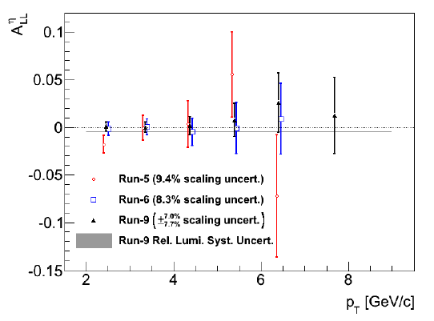
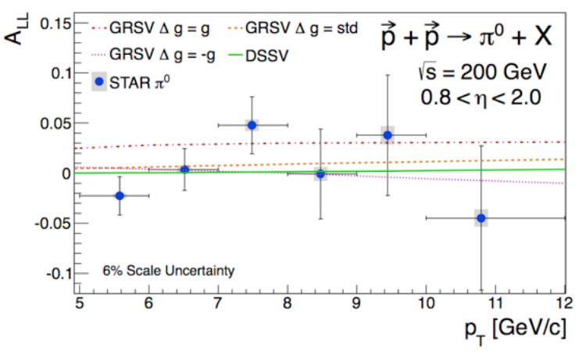
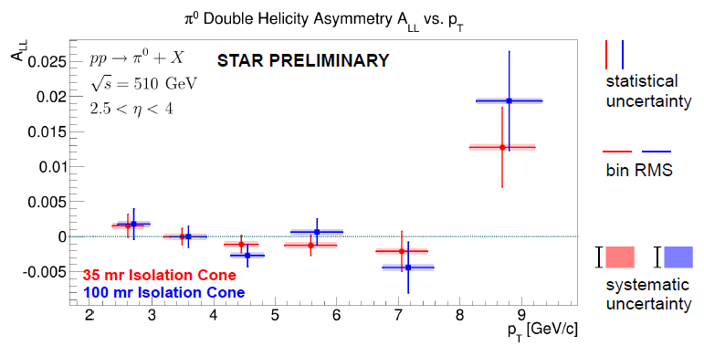
Other recently measured probes sensitive to gluon helicity
Midrapidity η
200 GeV
PRD90, 012007 (2014)
arXiv:1409.1907
Can provide complementary information.
Extending measurements to more forward rapidity and different √s will expand x range probed.
Forward π⁰
Very forward π⁰
510 GeV
PRD89, 012001 (2014)

Slide 12
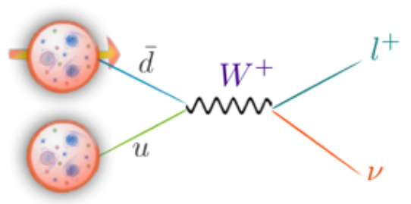
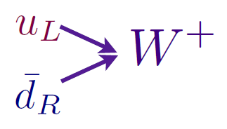
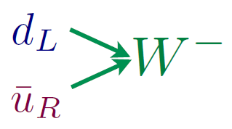
Flavor-separated sea quark helicities through W production
Flavor separation of the polarized sea quarks with no reliance on fragmentation functions, and at much higher scale than previous fixed-target experiments.
Complementary to semi-inclusive DIS measurements.
Parity violation of weak
interaction +
control over proton spin
orientation gives access to
flavor-spin structure of proton

Slide 13
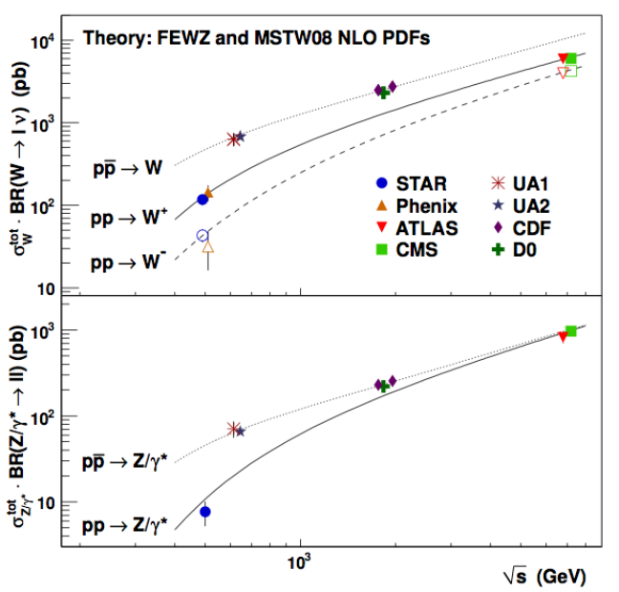
World W cross section measurements
RHIC
data

Slide 14
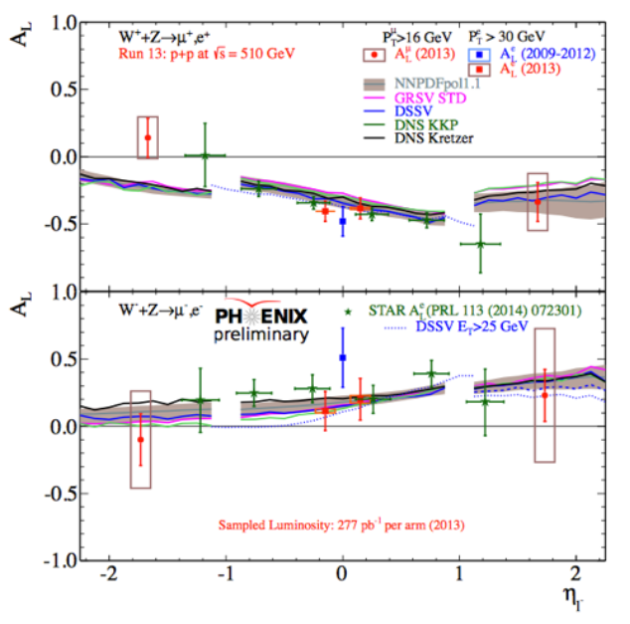
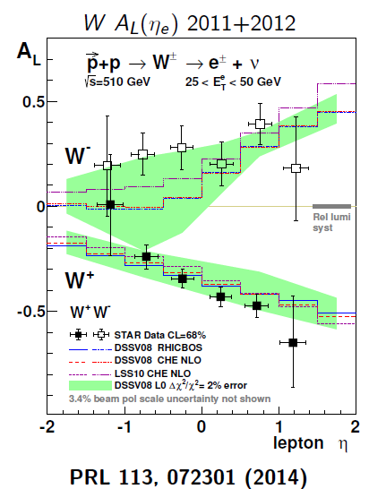
Large parity-violating single-helicity asymmetries
Improve constraints on light antiquark helicity distributions
  See talks by M. Stratmann, E. Nocera
New preliminary PHENIX muon results extend rapidity range

Slide 15

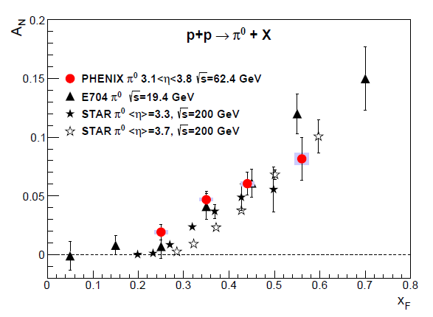
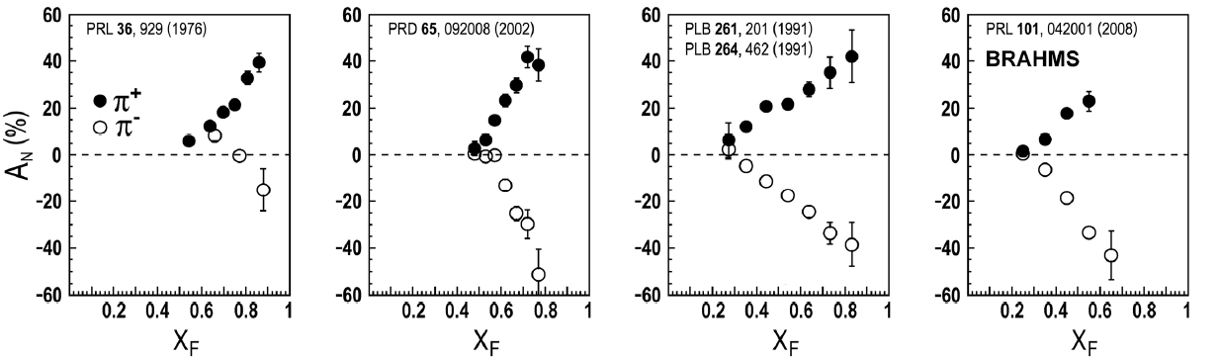
Transverse single-spin asymmetries:
From low to high energies!
ANL
√s=4.9 GeV
BNL
√s=6.6 GeV
FNAL
√s=19.4 GeV
RHIC
√s=62.4 GeV
π⁰
PRD90, 012006
(2014)
left
right

Slide 16
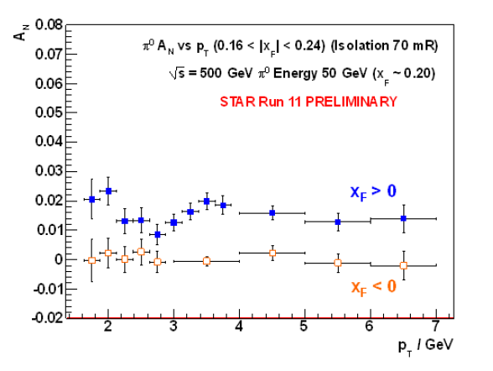
Effects persist up to transverse momenta of 7(!) GeV/c at √s=500 GeV
Can try to interpret these non-perturbative effects within the framework of perturbative QCD.
Haven’t yet disentangled all the possible contributing effects to the (messy) process of p+p to pions
π⁰

Slide 17
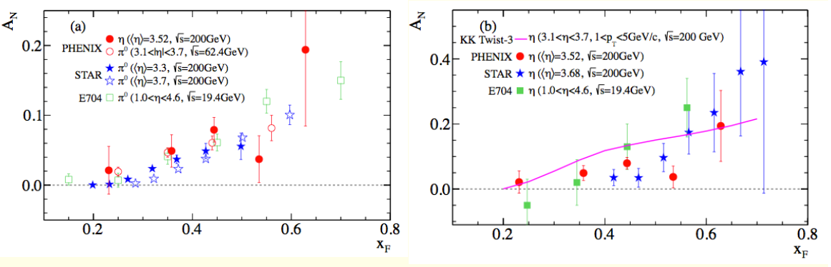
New eta A_{N} from PHENIX
PRD90, 072008 (2014)
Large η A_{N} observed by STAR and PHENIX (and E704), similar in magnitude to π⁰
Expect to measure forward direct photons from 2015 data for p+p, p+A with transverse proton polarization—minimal sensitivity to final-state effects
  PHENIX MPC-EX forward preshower upgrade

Slide 18
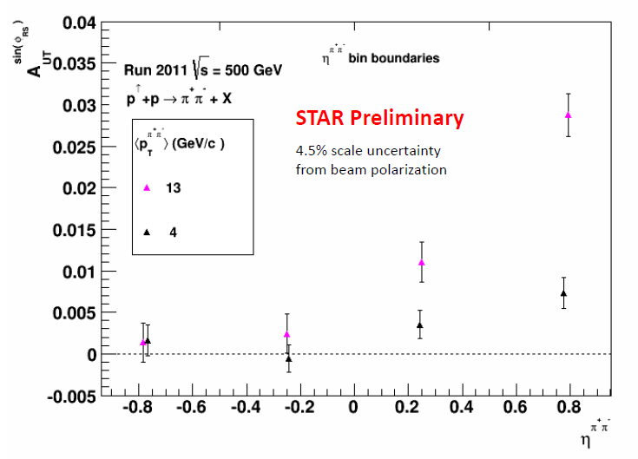
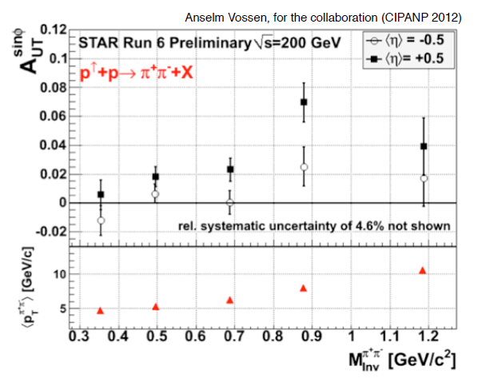
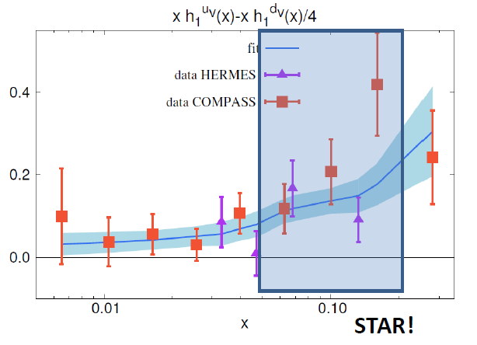
Transverse single-spin asymmetry in dihadron production from STAR
Nonzero result observed in 200 GeV
Collinear process—should be cleanly sensitive to transversity times dihadron interference FF
Recent results from 500 GeV—also nonzero, and larger for larger pair p_{T} and larger pseudorapidity
Kinematic coverage overlaps HERMES, COMPASS
Bacchetta, Courtoy, Radici,
JHEP 1303, 119 (2013)

Slide 19
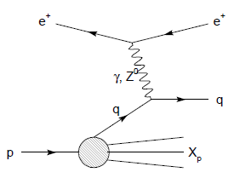
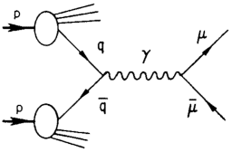
Modified universality of T-odd transverse-momentum-dependent distributions:
Color in action!
Deep-inelastic lepton-nucleon scattering:
Attractive final-state interactions
Quark-antiquark annihilation to leptons:
Repulsive initial-state interactions
Still waiting for a polarized quark-antiquark annihilation measurement to compare to existing lepton-nucleon scattering measurements . . .
As a result, get opposite sign for the Sivers transverse-momentum-dependent pdf when measure in semi-inclusive DIS versus Drell-Yan: process-dependent pdf! (Collins 2002)

Slide 20
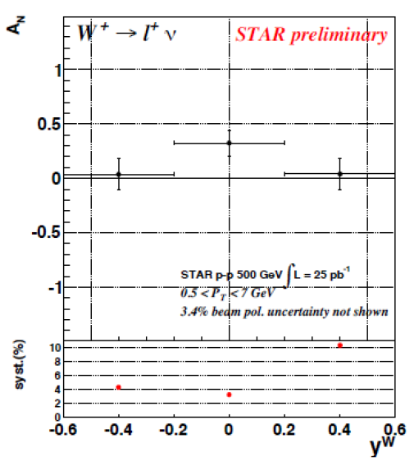
Probing modified universality via W production at RHIC
Possible long 510 GeV run in 2016
  Could measure W A_{N} with uncertainty ~0.06 at STAR

Slide 21

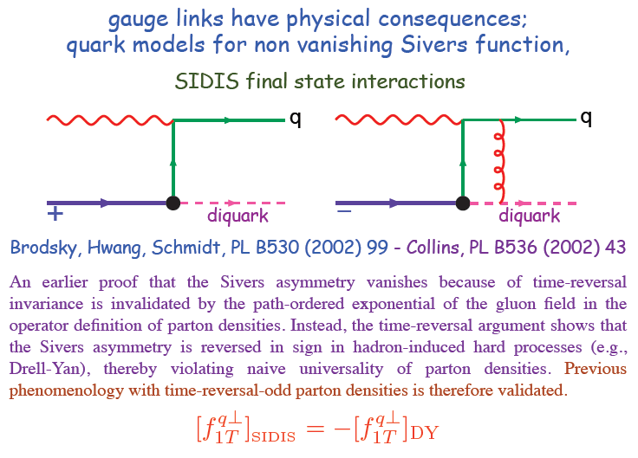
Modified universality requires full QCD:
Gauge-invariant quantum field theory
Collins, 1993
From M. Anselmino, Transversity 2014

Slide 22
Physical consequences of a gauge-invariant quantum theory:
Aharonov-Bohm (1959)
Wikipedia:
“The Aharonov–Bohm effect is important conceptually because it bears on three issues apparent in the recasting of (Maxwell's) classical electromagnetic theory as a gauge theory, which before the advent of quantum mechanics could be argued to be a mathematical reformulation with no physical consequences. The Aharonov–Bohm thought experiments and their experimental realization imply that the issues were not just philosophical.
The three issues are:
whether potentials are "physical" or just a convenient tool for calculating force fields;
whether action principles are fundamental;
the principle of locality.”

Slide 23
Physical consequences of a gauge-invariant quantum theory:
Aharonov-Bohm (1959)
Physics Today, September 2009 :
The Aharonov–Bohm effects: Variations on a subtle theme,
by Herman Batelaan and Akira Tonomura.
“Aharonov stresses that the arguments that led to the prediction of the various electromagnetic AB effects apply equally well to any other gauge-invariant quantum theory. In the standard model of particle physics, the strong and weak nuclear interactions are also described by gauge-invariant theories. So one may expect that particle-physics experimenters will be looking for new AB effects in new domains.”

Slide 24
Physical consequences of a gauge-invariant quantum theory:
Aharonov-Bohm effect in QCD!!
Deep-inelastic lepton-nucleon scattering:
Attractive final-state interactions
Quark-antiquark annihilation to leptons:
Repulsive initial-state interactions
Simplicity of these two processes:
Abelian vs. non-Abelian nature of the gauge group doesn’t play a major qualitative role.
BUT: In QCD expect additional, new effects due to specific non-Abelian nature of the gauge group
See e.g. Pijlman,
hep-ph/0604226
or Sivers,
arXiv:1109.2521
As a result:

Slide 25
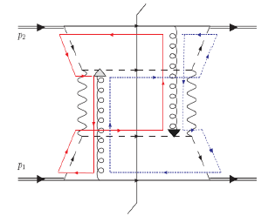
QCD Aharonov-Bohm effect:
Color entanglement
  2010: Rogers and Mulders predict color entanglement in processes involving p+p production of hadrons if quark transverse momentum taken into account
  Quarks become correlated across the two protons
  Consequence of QCD specifically as a non-Abelian gauge theory!
PRD 81:094006 (2010)
Color flow can’t be described as flow in the two gluons separately. Requires simultaneous presence of both.

Slide 26
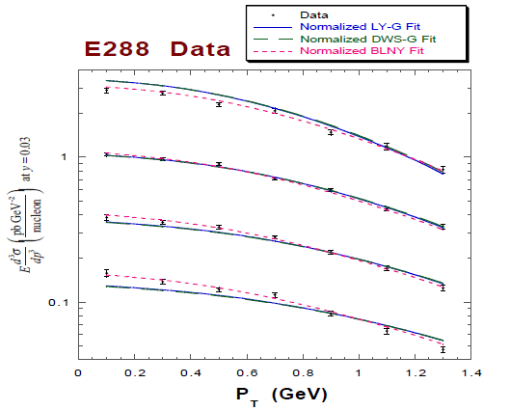
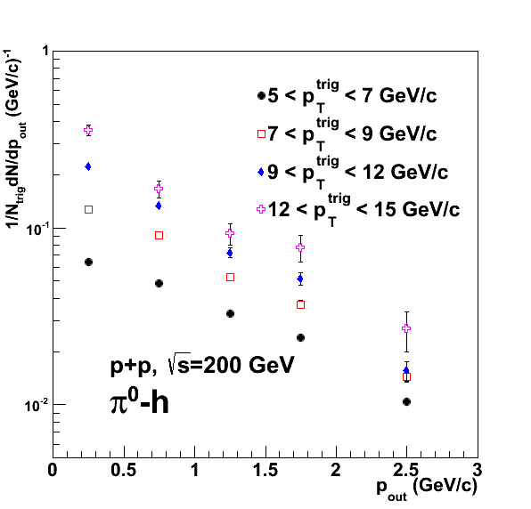

Testing the Aharonov-Bohm effect in QCD as a non-Abelian gauge theory
Landry et al., 2002
PRD82, 072001 (2010)
Drell-Yan lepton pair production
p+A → μ⁺+μ⁻+X
for different invariant masses:
No color entanglement expected
Hadron pair production
Get predictions from fits to data where no entanglement expected
Out-of-plane momentum component
Make predictions for processes where entanglement is expected; look for deviation

Slide 27
Summary and outlook
Data from RHIC are helping to constrain the gluon and flavor-separated sea quark helicity distributions
Lots of interesting effects continue to be observed in transverse single-spin asymmetries in p+p
  Spin-momentum and spin-spin correlations
Additional results forthcoming from 2012 and 2013 data sets
Stay tuned for polarized p+p and p+A running in 2015!
Hadronic interactions play a complementary role to DIS in the study of nucleon structure, and allow further exploration of color effects

Slide 28
Additional Material

Slide 29
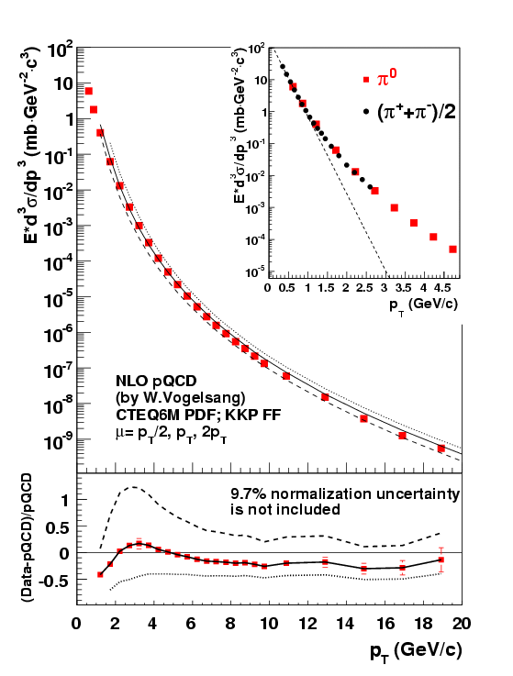

Neutral pion cross sections
PRD79, 012003 (2009)
62.4 GeV
200 GeV
Notes:
Get rid of!

Slide 30
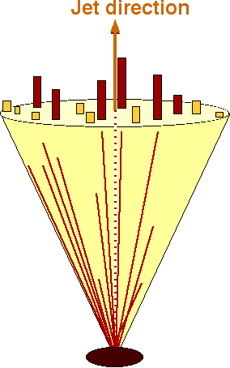
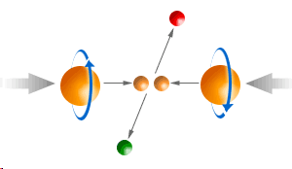
Jet reconstruction at STAR
Detector
For 2006 200 GeV data:
  Mid-point cone algorithm
  Adapted from Tevatron II – hep-ex/0005012
    Seed energy = 0.5 GeV
    Cone radius R = 0.7 in η-φ space
    Split/merge fraction f = 0.5
Geant
Particle
For 2009 200 GeV data
  Anti-k_{T} algorithm
  Cacciari, Salam, and Soyez, JHEP 0804, 063
    Cone radius R = 0.6
Pythia
For 2012 510 GeV data
  Anti-k_{T} algorithm
    Cone radius R = 0.5
Parton
Use Pythia + Geant to quantify detector response

Slide 31
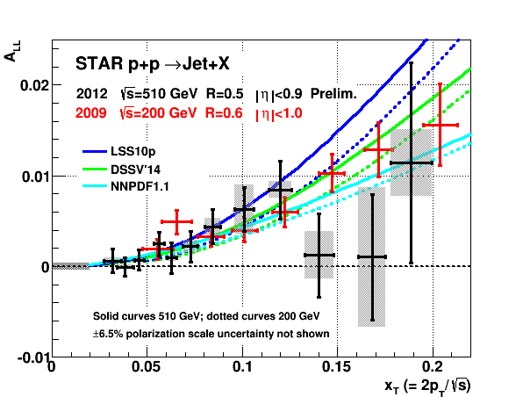
Jet double-helicity asymmetry at 510 GeV
Also clearly nonzero

Slide 32
Sampling the integral of ΔG: π⁰ p_{T} vs. x_{gluon}
Inclusive asymmetry measurements in p+p collisions sample from wide bins in x—sensitive to (truncated) integral of ΔG, not to functional form vs. x
√s = 200 GeV
Based on simulation using NLO pQCD as input
PRL 103, 012003 (2009)

Slide 33
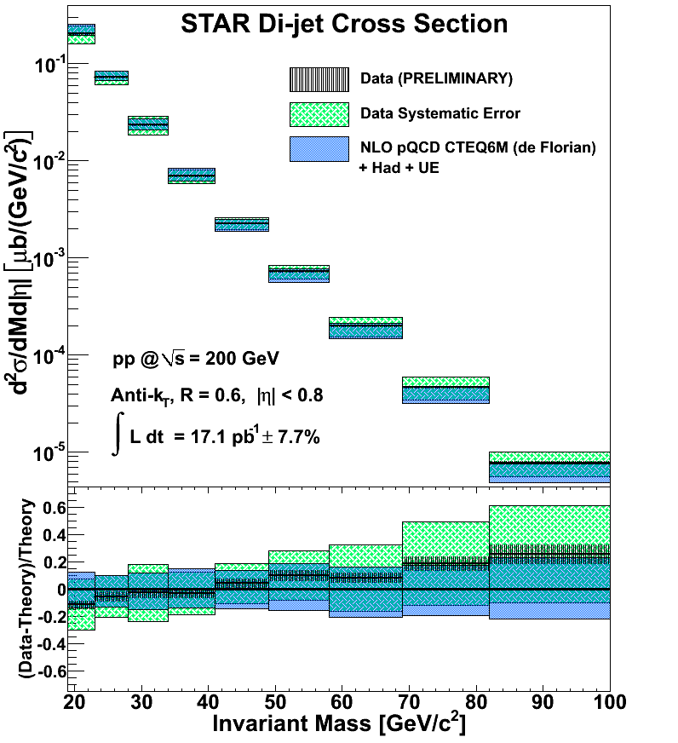
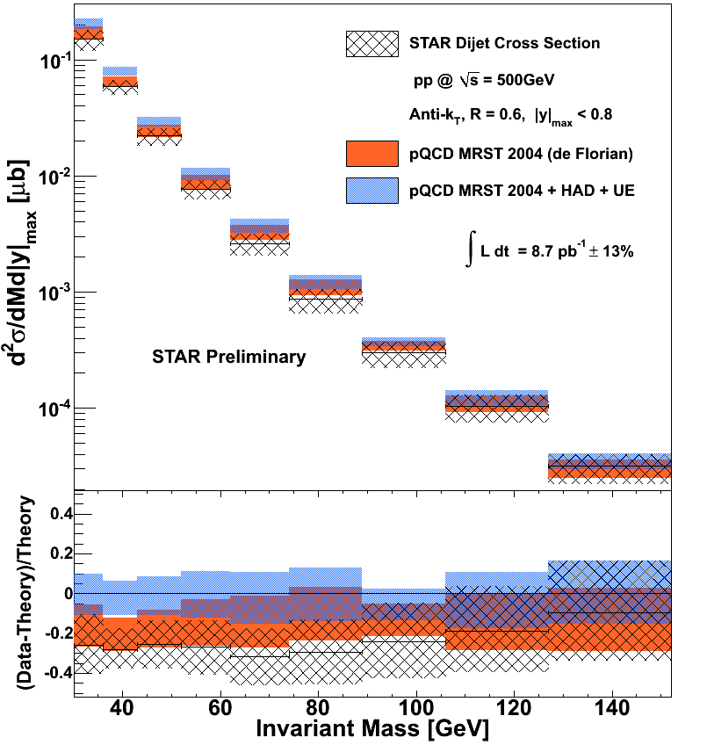
Dijet cross section at 200 GeV and 500 GeV
200 GeV
500 GeV
Di-jet cross section well described by NLO pQCD with corrections for hadronization and underlying event
STAR

Slide 34
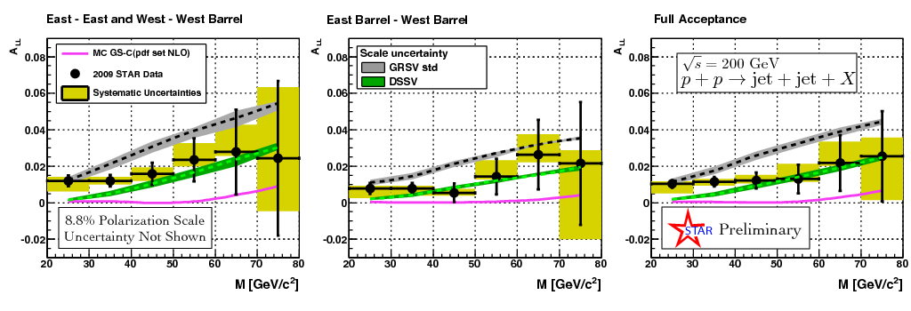
Dijet double helicity asymmetry
Clear nonzero asymmetry observed
Can better reconstruct hard scattering kinematics to pin down x values probed
STAR

Slide 35
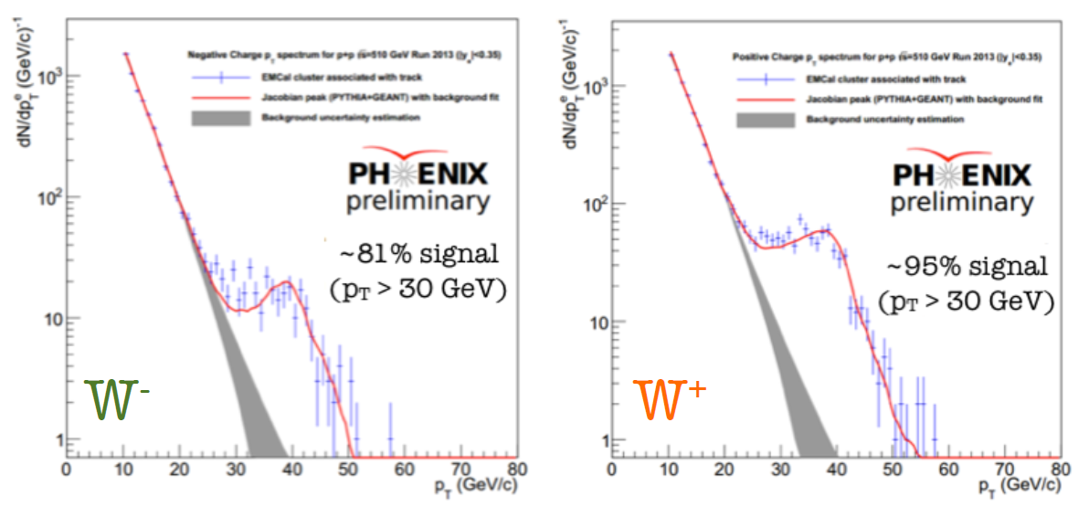
PHENIX Run-13 preliminary W peaks (midrapidity)

Slide 36
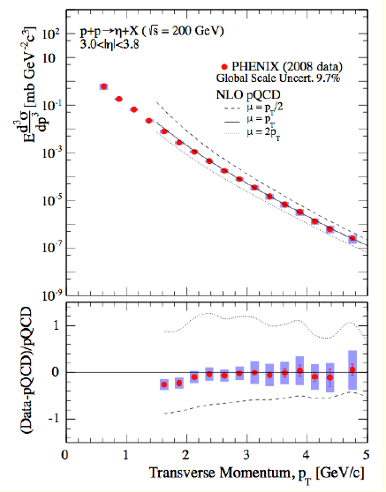
Forward eta cross section at
200 GeV
PRD90, 072008 (2014)

Slide 37
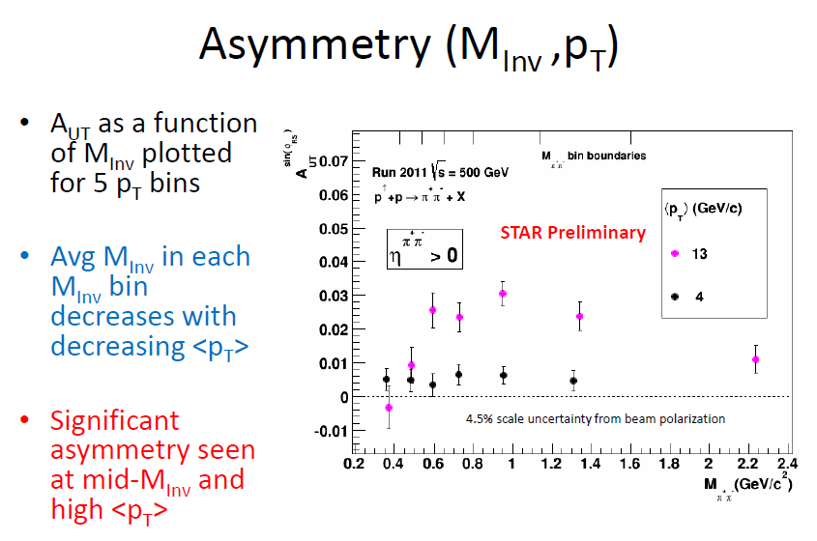
Transverse single-spin asymmetry in dihadron production

Slide 38
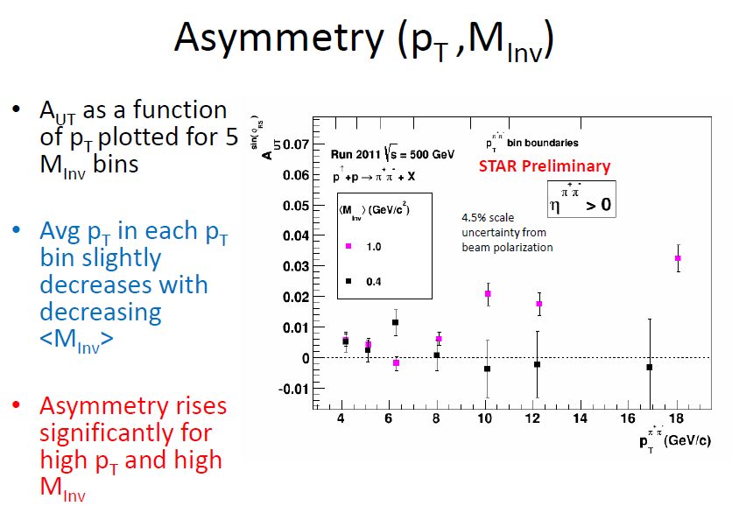
Transverse single-spin asymmetry in dihadron production

Slide 39

Azimuthal distribution of pions within jets
Collins-like measurement
Nonzero effect observed

Slide 40

Azimuthal distribution of pions within jets

Slide 41


η and π⁰ A_{N} at midrapidity
Sensitive to gg, qg scattering
Consistent with zero

Slide 42

Enhanced A_{N} for isolated forward neutral pions

Slide 43

Open heavy flavor A_{N} to probe twist-3 trigluon correlations
Expect measurement with ~0.01 accuracy from 2015 data, with displaced vertex heavy flavor tagging

Slide 44



π
π
π, K, p
at 200 and 62.4 GeV
Pattern of pion species asymmetries in the forward direction
→ valence quark effect.
But this conclusion confounded by kaon and antiproton asymmetries!
200 GeV
62.4 GeV
Note different scales
K
K
K- asymmetries
underpredicted
200 GeV
62.4 GeV
p
p
Large antiproton asymmetry?? Unfortunately no 62.4 GeV measurement
200 GeV
62.4 GeV

Slide 45

Another surprise: Transverse single-spin asymmetry in eta meson production
Further evidence against a valence quark effect!
Lots of territory still to explore to understand spin-momentum correlations in QCD!
Larger than the neutral pion!
STAR
PRD 86:051101 (2012)

Slide 46









RHIC as a polarized p+p collider
Absolute Polarimeter (H jet)
RHIC pC Polarimeters
Siberian Snakes
PHOBOS
BRAHMS & PP2PP
Siberian Snakes
PHENIX
Spin Flipper
STAR
Spin Rotators
Various equipment to maintain and measure beam polarization through acceleration and storage
Partial Snake
Helical Partial
Snake
Polarized Source
Strong Snake
LINAC
AGS
200 MeV Polarimeter
BOOSTER
Rf Dipole
AGS Internal Polarimeter
AGS pC Polarimeter
Notes:
RHIC, as a high-energy polarized proton collider, really represents an outstanding achievement in accelerator physics. . . . [equipment].

