Slide 1
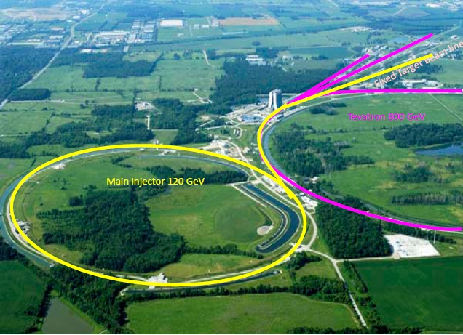
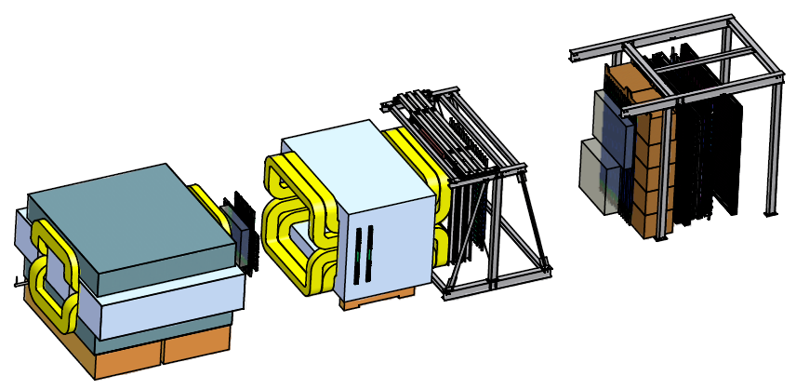
Accelerator Studies for Polarized Protons at the Fermilab Main Injector
Christine A. Aidala
University of Michigan
DNP Meeting
Waikoloa, HI
October 7, 2014

Slide 2
History
In 1991-95 Fermilab Director John Peoples commissioned studies to examine what would be needed to polarize the (planned) Main Injector (as well as the already existing Tevatron)
  Spin@Fermi collaboration, led by A. Krisch
August 2011 - Update of 1995 report submitted by Spin@Fermi collaboration to Fermilab
  arXiv:1110.3042
Spring 2012 - Formal experiment proposal submitted to Fermilab
Spring 2012 - Impact study and cost estimate by Fermilab
  June 2012 – Final report by H. White, W. Pellico, M. Leonova, I. Kourbanis, M. Kaducak
2012-13 long shutdown – No longer space for 2 snakes after accelerator modifications

Slide 3
History, cont.
2012-13 - Development of novel single-snake design
  arXiv:1309.1063
May 2013 – Workshop at Fermilab
Fall 2013 - Stage-1 approval by Fermilab directorate based on single-snake design
Current status: Have conceptual design that works at least for a perfect machine—perfect magnet alignment, perfect orbits, no momentum spread, etc.
Now: Starting to perform detailed spin-tracking simulations with more realistic parameters

Slide 4
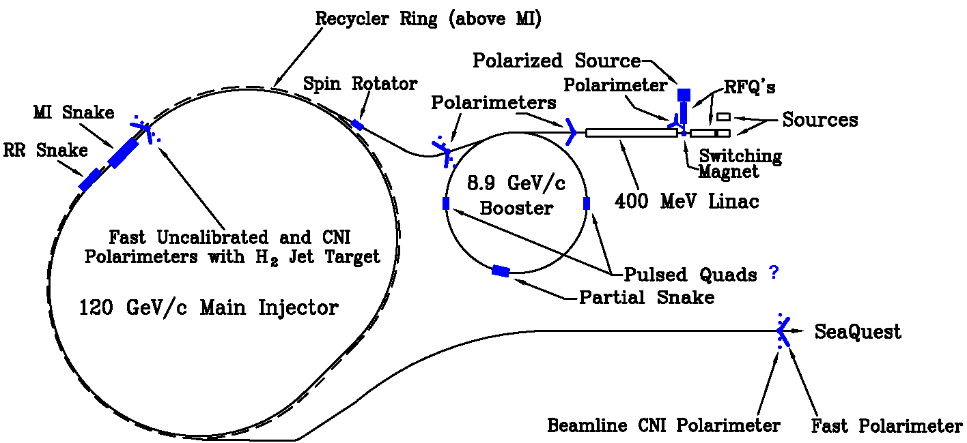
Proposed modifications for polarized beam

Slide 5
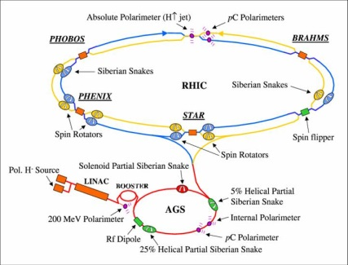
Differences compared to RHIC
Most significant difference: Ramp time of Main Injector < 0.7 s, at RHIC 1-2 min
  Warm magnets at MI vs. superconducting at RHIC
  Pass through all depolarizing resonances much more quickly
Beam remains in MI 5 s, in RHIC ~8 hours
  Extracted beam vs. storage ring
  Much less time for cumulative depolarization

Slide 6
Differences compared to RHIC (cont.)
Additionally, MI runs ~48 weeks/year. Plan is for polarized protons 6 s/minute or 1 min/10 min (unpolarized source for neutrino experiments for 90% of time). Would be able to work on polarization development continuously.
Disadvantage compared to RHIC—no institutional history of accelerating polarized proton beams
  Fermilab E704 had polarized beams through hyperon decays

Slide 7
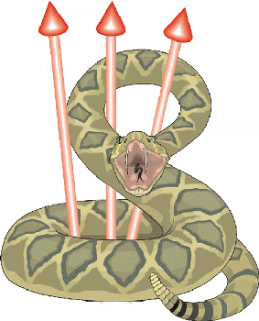
Novel single-snake design for MI as medium-energy proton synchrotron
  arXiv:1309.1063, F. Antoulinakis et al.
  Concept proposed decades ago by Kondratenko (published in SPIN proceedings), but has never been implemented
  Tests at RHIC in 2000 with one installed snake unsuccessful, but that snake was designed as one of a pair
    Also much slower ramp due to RHIC’s superconducting magnets → slower passage through depolarizing resonances

Slide 8

Single snake with single, 4-twist helical dipole
Compared to RHIC with 2 snakes, each 4 single-twist helical dipoles - Reduced space requirement
More flexible placement around machine
  Doesn’t need to be 180 degrees from a second snake
  Potentially useful for non-circular accelerator geometries—JPARC?? (triangular configuration)
Smaller excursions—allow wider dynamic range from injection to top energy
Reduction in cost—1 helical dipole instead of 8, correspondingly reduced cryogenic needs

Slide 9
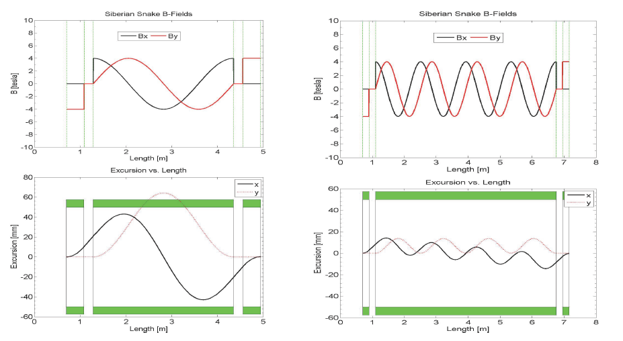
Excursions at 8.9 GeV injection:
1-twist vs. 4-twist
B-field components: 1 twist
B-field components: 4 twists
Excursions go beyond beam pipe aperture!
Excursions greatly reduced

Slide 10
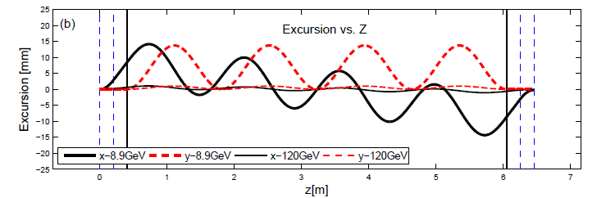
Excursions at 8.9 vs. 120 GeV
Excursions decrease with increasing energy
  Most stringent constraints at 8.9 GeV injection
Dipoles at ends of helix for optical transparency

Slide 11

Standalone snake design
Most work of past few years has focused on snake design studies for Main Injector
Numerical simulations as well as independent matrix calculations
  Particle transport and spin tracking over the length of the snake
Standalone simulations—not integrated into Main Injector lattice

Slide 12
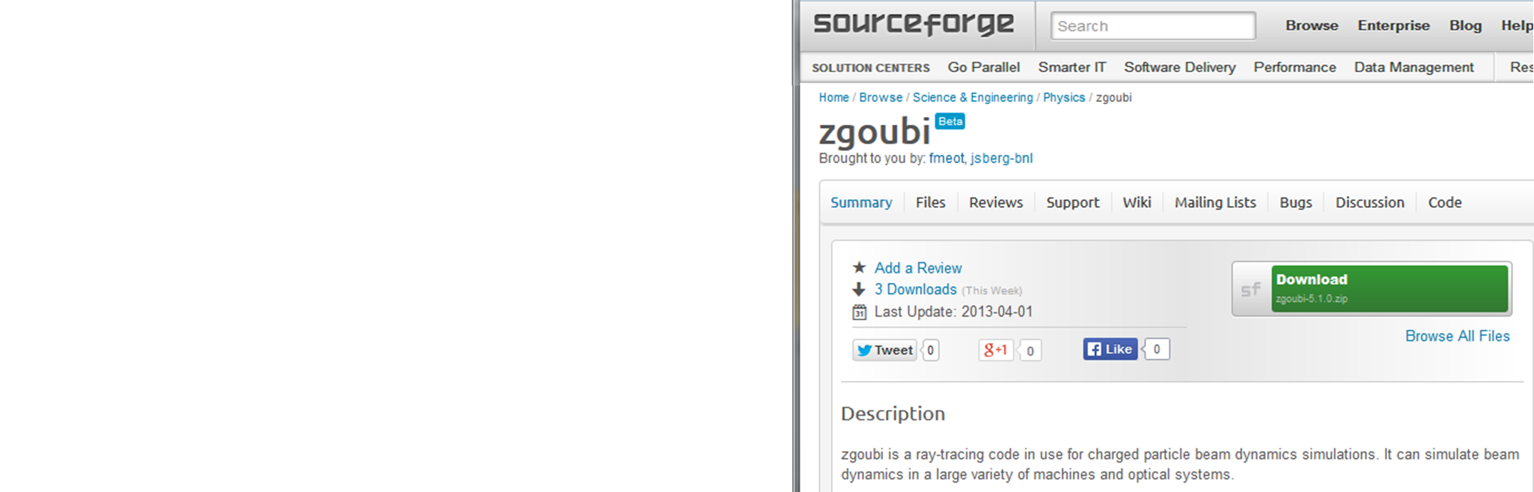
Over the last year: First steps toward comprehensive simulations
Acquired current lattice files for Booster and Main Injector from Fermilab Accelerator Division
Converted format from older version CERN Methodical Accelerator Design (MAD-8) to MAD-X to be able to work with Zgoubi spin-tracking package
  Zgoubi written and maintained by F. Meot, BNL
  Tracks position and spin direction through each optical element
  Particle transport (beta functions) verified against original MAD-8 code
Zgoubi set up and running at Michigan
  M. Schubnell, C. Aldred – U. of Michigan
  M. Syphers – Michigan State U.
  Communication with M. Bai and F. Meot at BNL

Slide 13
Moving toward comprehensive simulations
Calculated intrinsic depolarizing resonance strengths in Zgoubi using current lattice files
  Consistent with original studies from 1990s
Implemented a “point-like” snake at the correct position in the MI lattice (MI-30)
  Simply flips spin by fixed amount at that point in the lattice
  Point-like snakes used in RHIC simulations—sufficient at RHIC energies
  AGS snake simulations implemented as full field maps
  With 8.9 GeV injection energy into MI (c.f. 24 GeV into RHIC), will likely be important to simulate snake in more detail

Slide 14
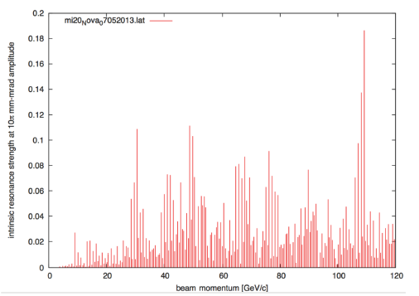
Intrinsic depolarizing resonances in Main Injector
Strongest intrinsic depolarizing resonance < 0.2
Calculated using Zgoubi and current lattice files
10π mm-mrad emittance

Slide 15
Moving toward comprehensive simulations (cont.)
Figured out how to implement various parameters in Zgoubi
  Ramp rates of accelerator components, emittance, momentum spread of particles, orbit distortions
Now have in place knobs to play with—need to move to systematic studies using realistic parameters!

Slide 16
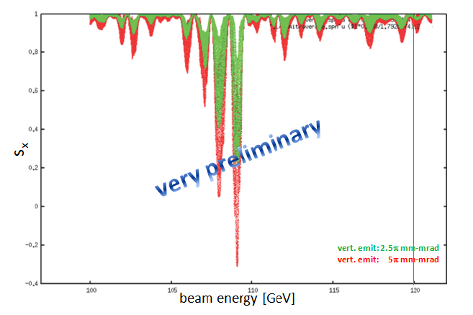
Playing with knobs:
Effect of emittance on final polarization as function of energy
Point-like snake in correct location, actual ramp rate for acceleration.
Only small difference seen at final energy of 120 GeV
Vert. emit: 2.5π mm-mrad
Vert. emit: 5π mm-mrad
100
120

Slide 17
Work to be done—Next steps
Seeking funding for accelerator physics postdoc
  Joint U. Michigan – Michigan State U. proposal, W. Lorenzon, CAA, M. Syphers
Seek to demonstrate feasibility of single-snake solution to maintain polarization in medium-energy proton synchrotrons
Full multiparticle spin tracking with realistic parameters for all stages of acceleration
  Booster (400 MeV-8.9 GeV), Recycler Ring (8.9 GeV), Main Injector (8.9-120 GeV)
  So far mainly single particle
Depolarizing resonances due to snake itself an issue with single snake? Need to investigate

Slide 18
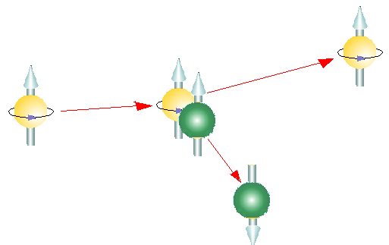
Other items to study:
Polarimetry with a single snake
With single snake rather than snake pair, stable spin direction precessing in horizontal plane
  Not as straightforward to use transverse single-spin asymmetry due to Coulomb-nuclear interference (CNI) in elastic scattering as at RHIC
Need to study possibility of placing polarimetry in Main Injector at location with large/maximal radial component
At experiment, primary goal is transverse polarization, so polarimetry not a problem there
(polarized)
proton beam
scattered
proton
polarized
proton target
or Carbon target
recoil proton
or Carbon

Slide 19
Summary
Have concept that works for a perfect machine
More detailed studies just beginning
Once comprehensive studies are complete, will be able to do real cost-benefit analysis
  Primary beam of protons on fixed target yields luminosities 10³-10⁴ times those available from RHIC as a collider—if we could polarize the Main Injector beam, would open up new opportunities for high-statistics polarized Drell-Yan, complementary to the wide variety of observables accessible with higher energies and collider geometry at RHIC
Potential of new technique for medium-energy proton synchrotrons in general
Having the experience of RHIC behind us can only make things easier

Slide 20
Extra material

Slide 21
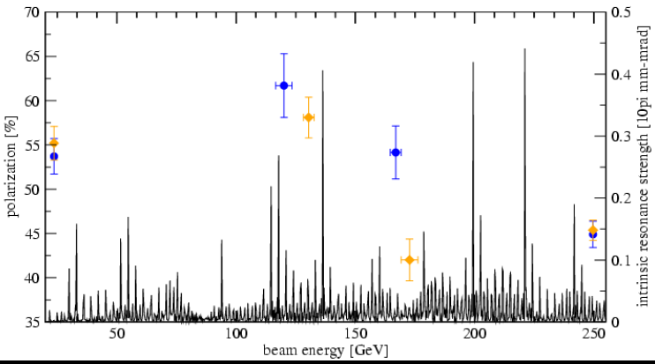
RHIC intrinsic depolarizing resonances

Slide 22
Modifications to accelerator chain:
Source to LINAC
Source—Dubna interested
  Switching magnet—to go between polarized and unpolarized sources—would use unpolarized source (higher intensity) for neutrino program
  35 keV transport line from polarized source to RFQ
RFQ - new
750 keV transport line from new RFQ to LINAC—no modifications necessary
LINAC – acceleration from 750 keV up to 400 MeV
  No depolarization in LINACs—no modifications necessary
400 MeV transport line—no modifications necessary

Slide 23
Modifications to accelerator chain:
Booster to Recycler Ring
Booster – acceleration from 400 MeV to 8.9 GeV
  4% partial snake – solenoid – to overcome 15 weak imperfection resonances
  One weak intrinsic resonance—3-μs pulsed quads for tune jumping
8.9 GeV transport line to Recycler Ring – need to study if spin rotator needed—vertical and horizontal bends
Recycler Ring – warm partial snake?
8.9 GeV transport line to Main Injector—no modifications necessary

Slide 24
Modifications to accelerator chain: Main Injector to Experimental Hall
Main Injector – single, 4-twist superconducting helical dipole snake
Transport line to NM4 experimental hall
  Has vertical as well as horizontal bends—likely need spin rotator

Slide 25
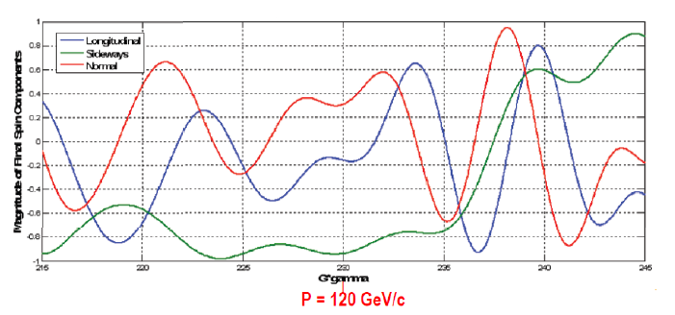
(Crazy?) idea: Control spin direction for experiment via energy tuning??
Corresponds to energy range of ~112-128 GeV
Otherwise use spin rotator

Slide 26
RFQ
Radio Frequency Quadrupole
A linear accelerator which focuses, bunches, and accelerates a continuous beam of charged particles with high efficiency, while preserving the emittance
First demonstrated in 1980
Transforms output from high-current, small-emittance source into a high-intensity beam that can be accelerated up to high energies

Slide 27
Other polarimetry
35 keV—Lamb-shift polarimeter
400 MeV polarimeter—proton-carbon CNI

Slide 28
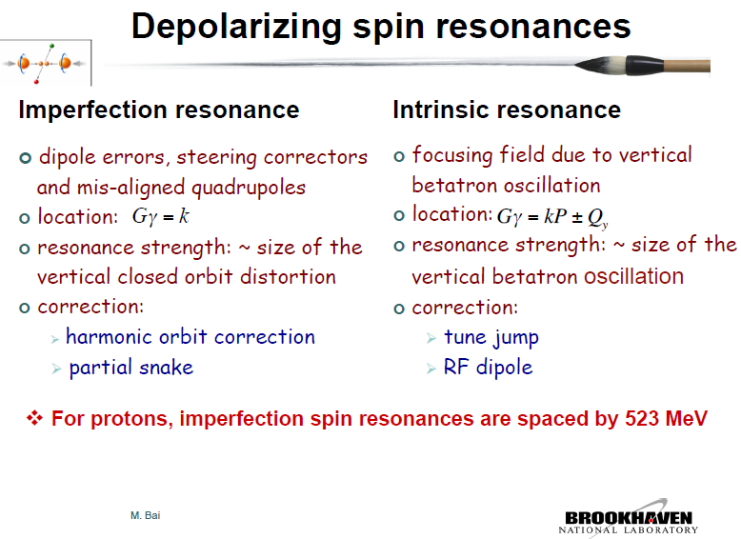

From M. Bei
Thomas-BMT equation:

Slide 29
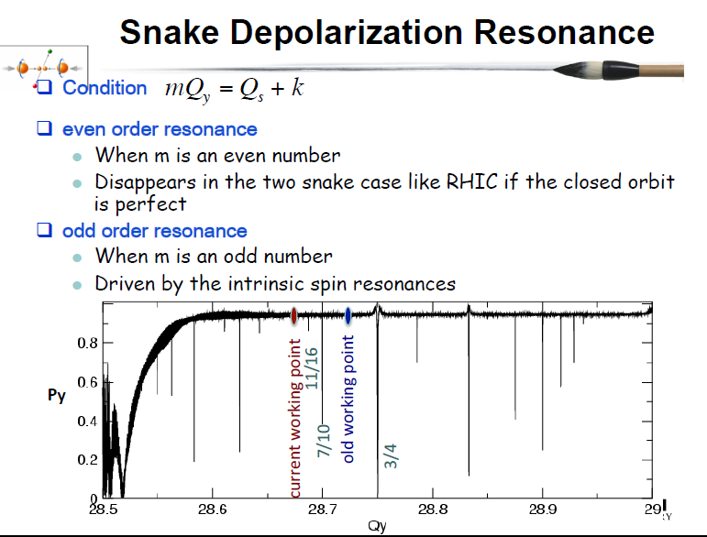
From M. Bei

Slide 30
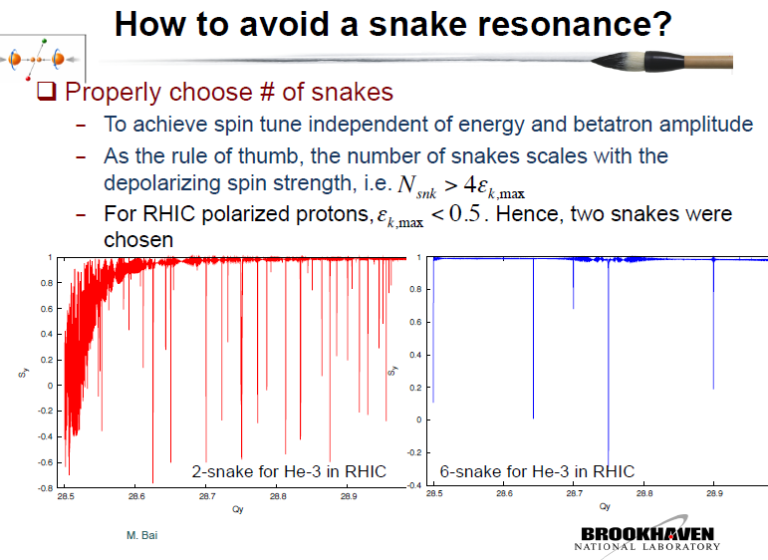
From M. Bei

Slide 31
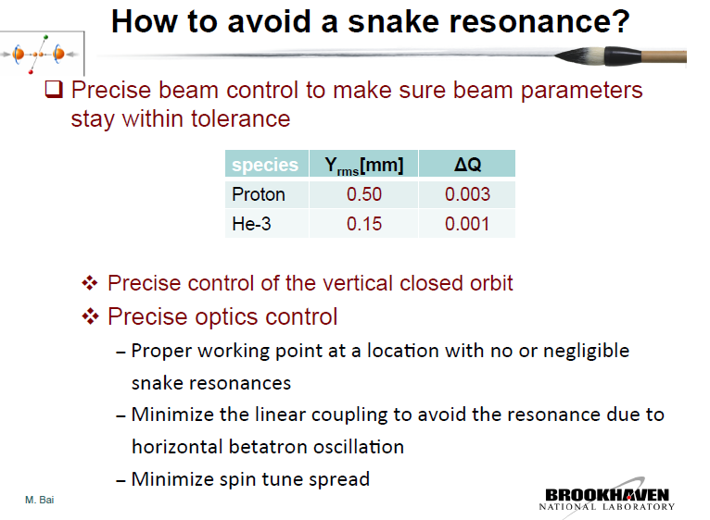
From M. Bei

