Slide 1
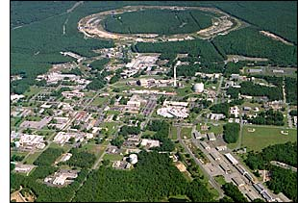
Entering the Electronic Age at RHIC:
RHIC
e
Christine A. Aidala
University of Michigan
APS Division of Nuclear Physics Fall Meeting
October 24, 2012

Slide 2
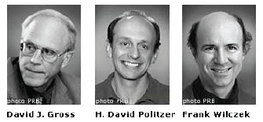
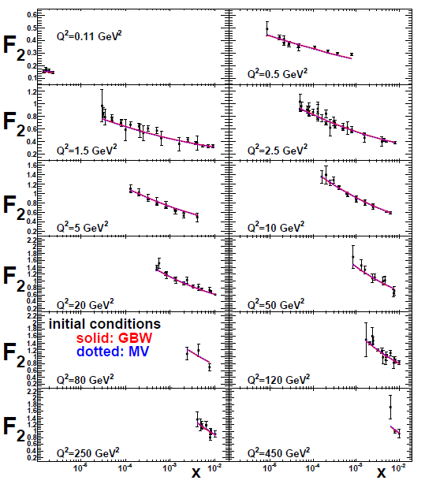
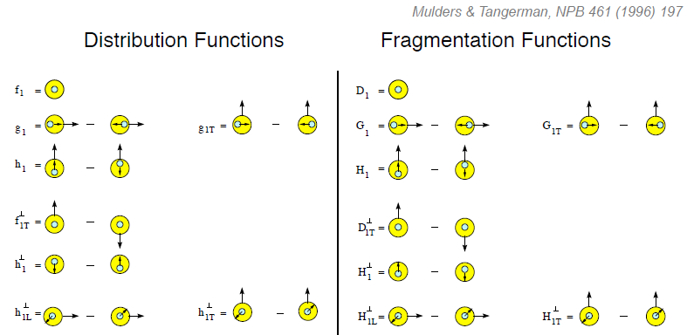
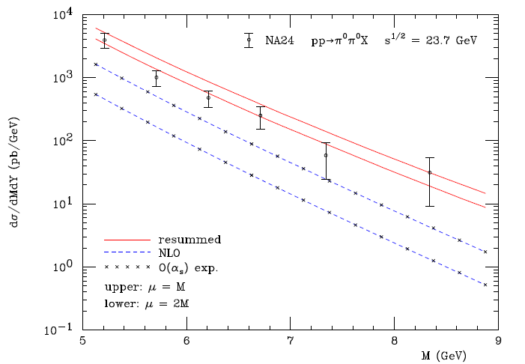
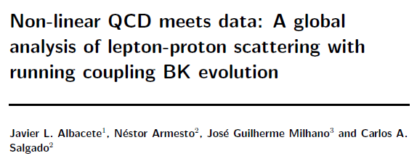
Entering a new era:
Quantitative QCD!
Transverse-Momentum-Dependent
QCD: Discovery and development
  1973 → ~2004
Since 1990s starting to consider detailed internal QCD dynamics that parts with traditional parton model ways of looking at hadrons—and perform phenomenological calculations using these new ideas/tools!
  Various resummation techniques
  Non-collinearity of partons with parent hadron
  Non-linear evolution at small momentum fractions
Mulders & Tangerman, NPB 461, 197 (1996)
Collinear
Worm gear
Almeida, Sterman, Vogelsang
PRD80, 074016 (2009)
PRD80, 034031 (2009)
Transversity
pp→π⁰π⁰X
Sivers
M (GeV)
Boer-Mulders
Pretzelosity
Worm gear

Slide 3
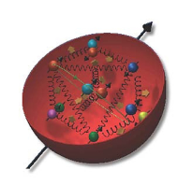
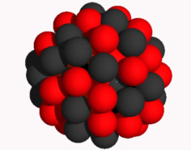
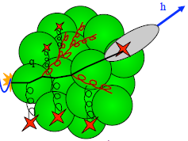
eRHIC
A facility to bring this new era of quantitative QCD to maturity!
Study in detail
  “Simple” QCD bound states: Nucleons
  Collections of QCD bound states: Nuclei
  Hadronization
Collider energies: Focus on
sea quarks and gluons

Slide 4
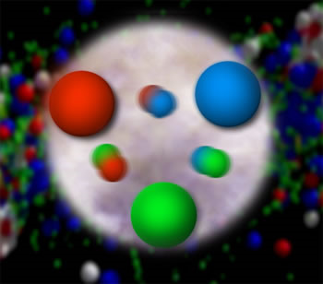
Lots of fundamental questions remain to be answered in QCD!
At short distances the proton appears as a system of many quarks, antiquarks and gluons. How does this relate to the simple picture where the proton is made up of three quarks?
What is the dynamical origin of sea quarks and gluons inside the proton?
How is hadron structure influenced by chiral symmetry and its breaking?
How does the proton spin originate at the microscopic level?

Slide 5
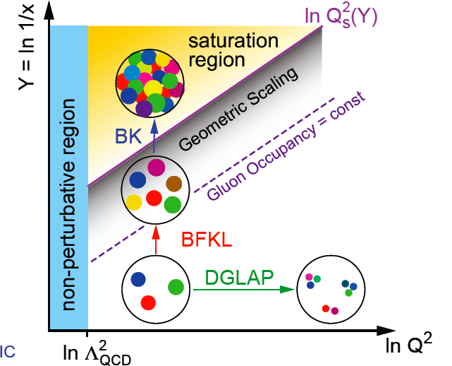
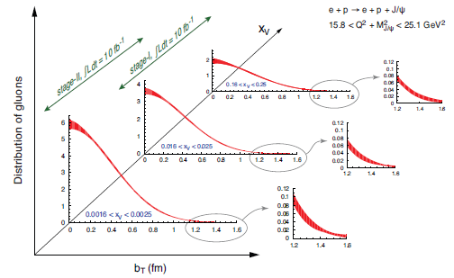
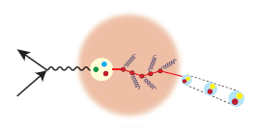
Fundamental questions . . .
How are the sea quarks and gluons distributed in space and momentum inside the nucleon?
How does the nuclear environment affect the distribution of quarks and gluons and their interactions in nuclei?
Where does the saturation of gluon densities set in?
How does confinement manifest itself in the structure of hadrons?
How does a colored quark or gluon become a colorless object?
α_{s}~1 α_{s} << 1

Slide 6
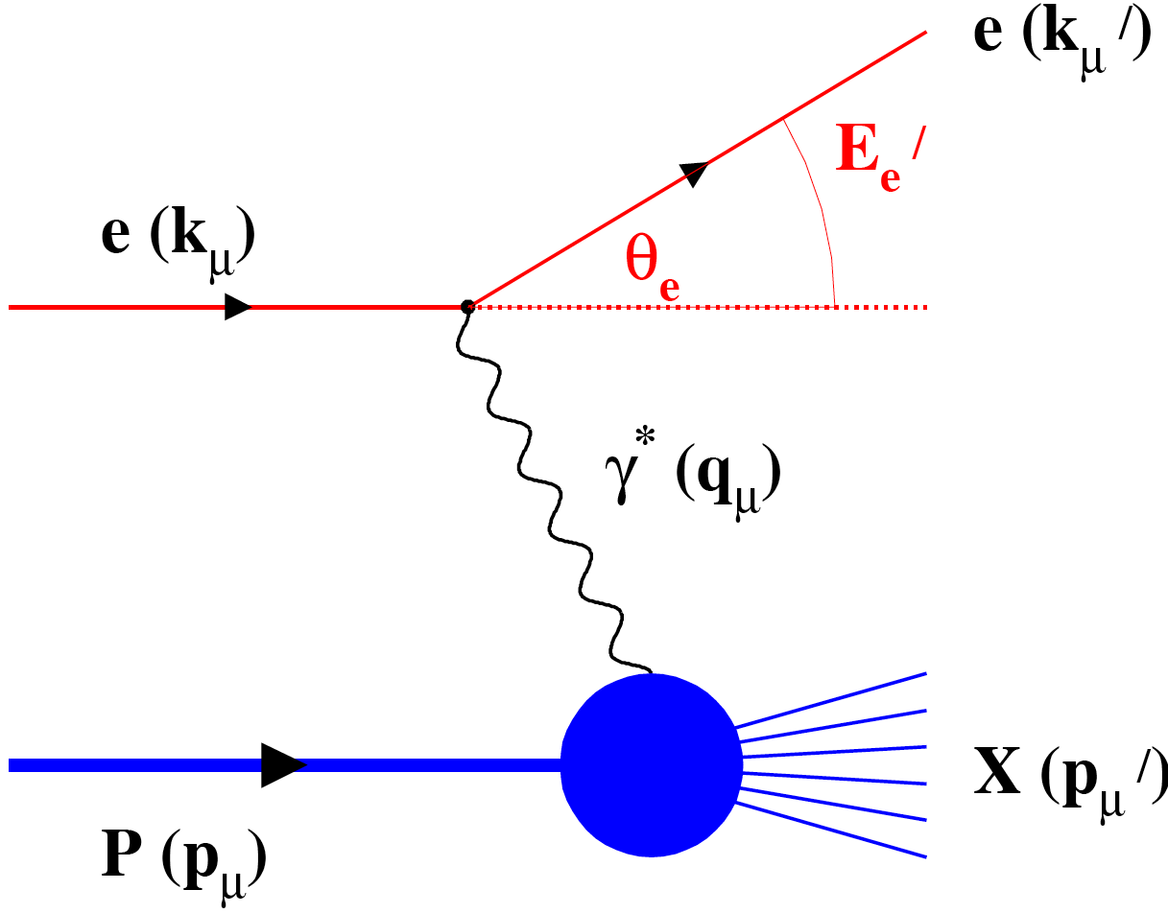
Why eRHIC?
Electroweak probe
  “Clean” processes to interpret (QED)
  Measurement of scattered electron → full kinematic information on partonic scattering
Collider mode → Higher energies
  Quarks and gluons relevant d.o.f.
  Perturbative QCD applicable
  Heavier probes accessible (e.g. charm, bottom, W boson exchange)
A very flexible facility: wide range of beam species and energies

Slide 7
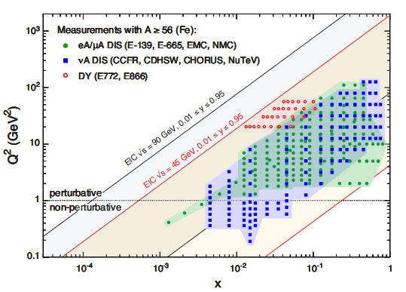
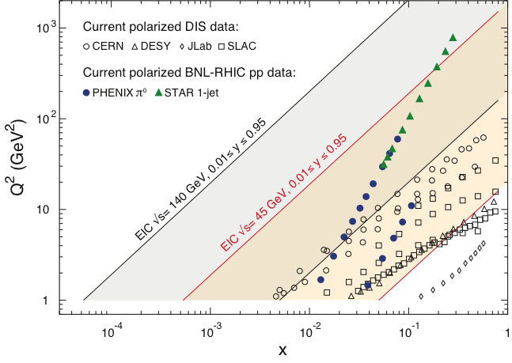
Accelerator capabilities
Polarized beams of p, He³
  Previously only fixed-target polarized DIS experiments!
Beams of light → heavy ions
  Previously only fixed-target e+A experiments!
Luminosity 1000x that of HERA e+p collider
Notes:
Add sqrt(s) ranges?

Slide 8
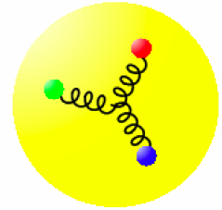
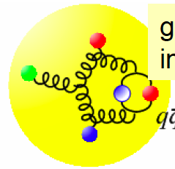
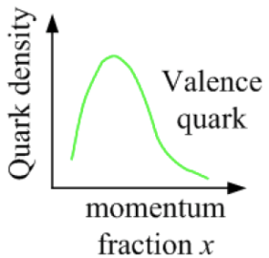
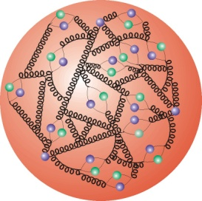
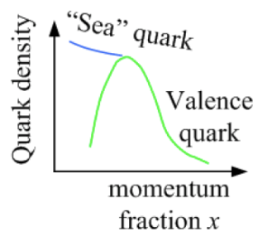
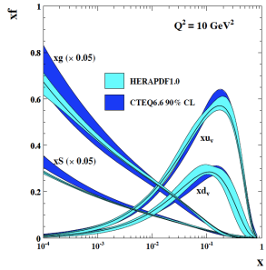
Accessing quarks and gluons through DIS
Kinematics:
Measure of resolution power
Measure of inelasticity
Measure of momentum fraction of struck quark
Gluon splits
into quarks
Quark splits
into gluon
splits
into quarks …
10⁻¹⁶m
10⁻¹⁹m
higher √s
increases resolution

Slide 9
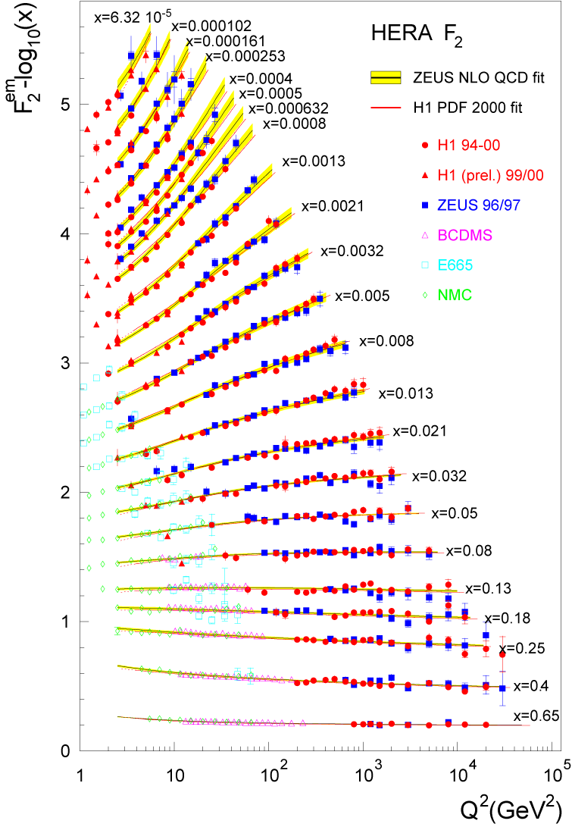
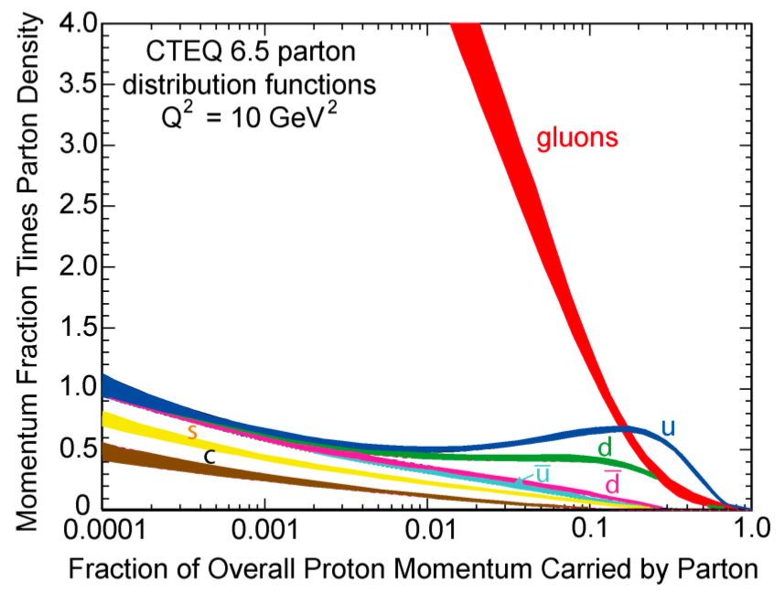
Accessing gluons with an electroweak probe
Access the gluons in DIS via scaling violations:
dF₂/dlnQ² and linear DGLAP evolution in Q² → G(x,Q²)
OR
Via F_{L} structure function
OR
Via dihadron production
→See L. Zheng’s talk 10/27
OR
Via diffractive scattering
→See M. Lamont’s talk 10/25
Gluons dominate
low-x wave function
Gluons in fact dominate
(not-so-)low-x wave
function!
!

Slide 10
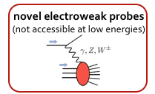
Proton helicity structure
Current data vs. eRHIC phase space
RHIC p+p data:
constrain Δg(x)
for ~ 0.05 < x < 0.2
20x250 GeV
eRHIC Stage 2
5x100 GeV
eRHIC Stage 1
Q² 2 decades
New opportunities for DIS with polarized beams
X ⬅ 2 decades
4.6x10⁻³
(COMPASS)

Slide 11
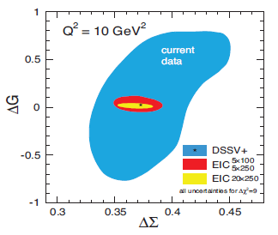
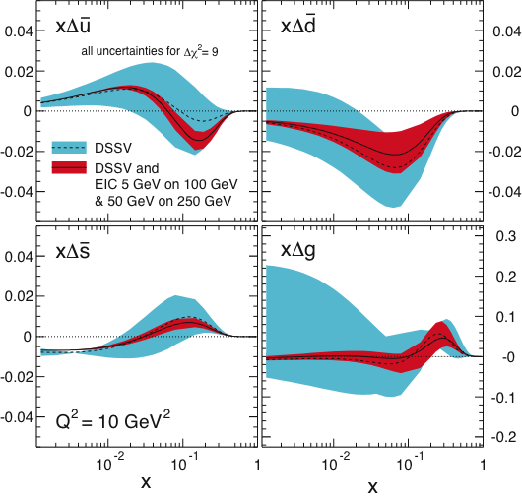
Pinning down sea quark + gluon helicity distribution functional forms
Semi-inclusive DIS data (measure produced hadron in addition to scattered electron) provide flavor separation of sea quarks
Plots include only eRHIC stage-1 data
(5 GeV electron beam)

Slide 12
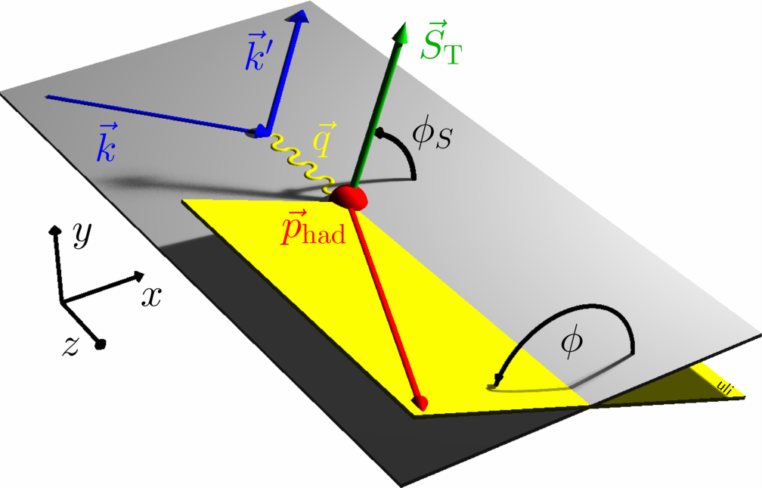
Spin-momentum correlations in QCD:
Transverse-momentum-dependent (TMD) distribution and fragmentation functions
Clean access to partonic kinematics in (semi-inclusive) DIS
  Semi-inclusive DIS: Measure produced hadron in addition to scattered electron
  More info than inclusive DIS
Can isolate the various TMD pdfs and FFs via measured angular dependences

Slide 13
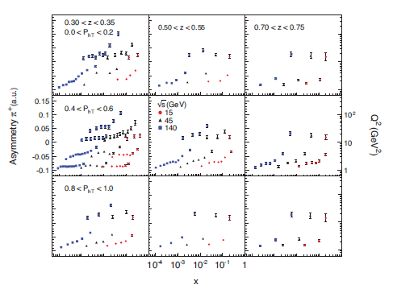
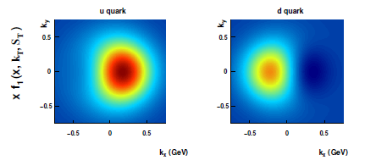
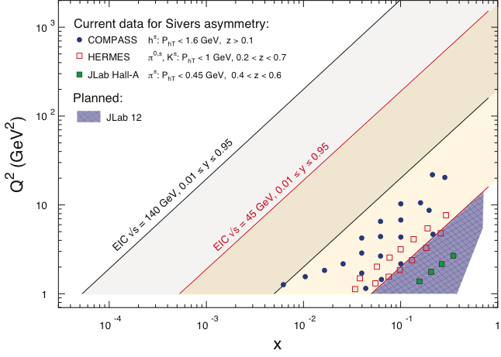
Example: Sivers function
Correlation between quarks’ transverse momentum and proton’s transverse spin
See talk by
T. Burton, 10/27
Quark densities in transverse momentum plane for a proton polarized in the +y direction. Up and down quarks orbiting in opposite directions??
High luminosity → measure transverse single-spin asymmetry vs. x differentially in Q², p_{T} and z.

Slide 14
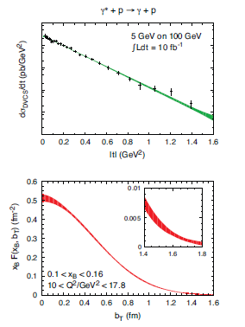
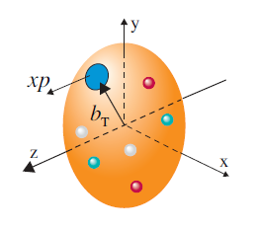
Spatial imaging of the nucleon
See talk by T. Burton, 10/27
Perform spatial imaging via exclusive processes
Detect all final-state particles
Nucleon doesn’t break up
Measure cross sections vs. four-momentum transferred to struck nucleon: Mandelstam t
Goal: Cover wide range in t.
Fourier transform → impact-
parameter-space profiles
Obtain b profile from slope vs. t.

Slide 15
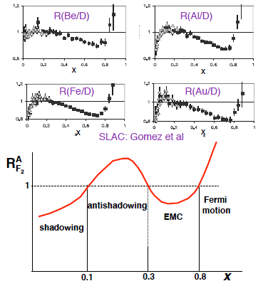

Nuclei: Simple superpositions of nucleons?
No!! Rich and intriguing differences compared to free nucleons, which vary with the linear momentum fraction probed (and likely transverse momentum, impact parameter, . . .).
Understanding the nucleon in terms of the quark and gluon d.o.f. of QCD does NOT allow us to understand nuclei in terms of the colored constituents inside them!

Slide 16
Lots of ground to cover in e+A!
What is the role of strong gluon fields, parton saturation effects, and collective gluon excitations in nuclei?
Can we experimentally find evidence of nonlinear QCD dynamics in high-energy scattering off nuclei?
What are the momentum and spatial distributions of gluons and sea quarks in nuclei?
Are there strong quark and gluon density fluctuations inside a large nucleus?
How does the nucleus respond to the propagation of a color charge through it?

Slide 17
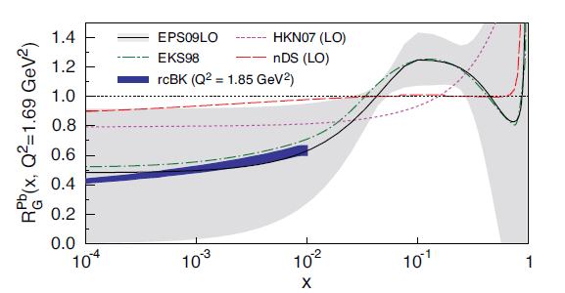
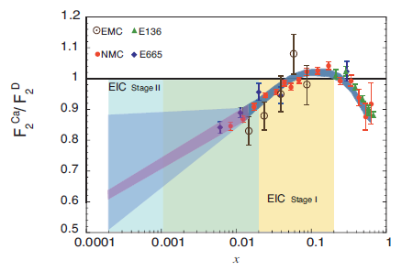

Nuclear modification of partonic structure
Large extrapolation uncertainty on global fit to existing fixed-target data
Greatly reduced with EIC data!
What’s the behavior of low-x gluons in nuclei??

Slide 18
Gluon saturation
At small x linear evolution gives
strongly rising g(x)
  violation of Froissart
  unitary bound
BK/JIMWLK non-linear evolution includes
recombination effects → saturation
  Dynamically generated scale
  Saturation Scale: Q²_{s}(x)
    Increases with energy or decreasing x
  Scale with Q²/Q²_{s}(x) instead of x and Q² separately
small x
x = P_{parton}/P_{nucleon}
Bremsstrahlung
~ α_{s}ln(1/x)
Recombination
~ α_{s}ρ
α_{s}~1 α_{s} << 1

Slide 19
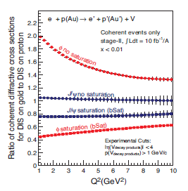
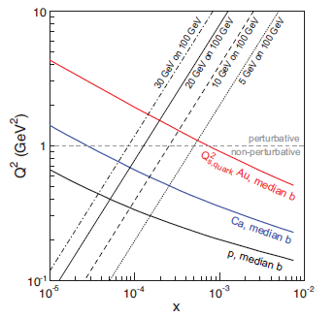

Gluon saturation
Nuclear enhancement of saturation scale: can reach this non-linear QCD regime at higher x (lower energies) than in e+p
Multiple handles to study saturation regime, e.g.
  Dihadron correlations – See L. Zheng’s talk, 10/27
  Diffractive scattering
    Inclusive diffractive structure function for nuclei
    Exclusive diffractive production of vector mesons

Slide 20
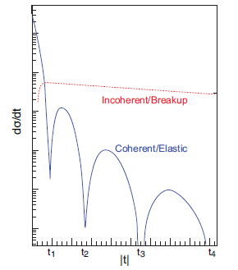
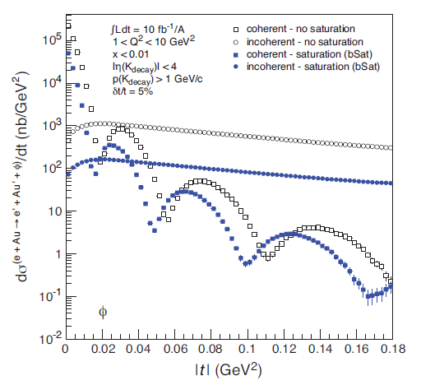
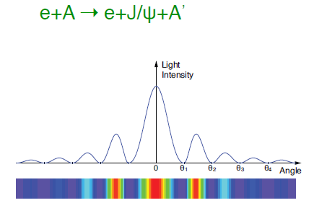
Impact-parameter-dependent nuclear gluon density via exclusive vector meson production
Just like in optics—the positions of the diffractive minima are related to the size of the obstacle
Low t: Coherent diffraction dominates – gluon density
High t: Incoherent diffraction dominates – gluon correlations
These exclusive measurements sensitive to saturation effects!

Slide 21
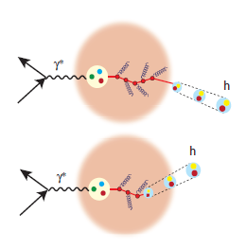
Hadronization at eRHIC
Use nuclei as femtometer-scale detectors of the hadronization process!
Wide range of scattered parton energy; small to large nuclei
  Move hadronization inside/outside nucleus
  Distinguish energy loss and attenuation
Comprehensive studies of hadronization as well as of propagation of color charges through nuclei possible at eRHIC!

Slide 22
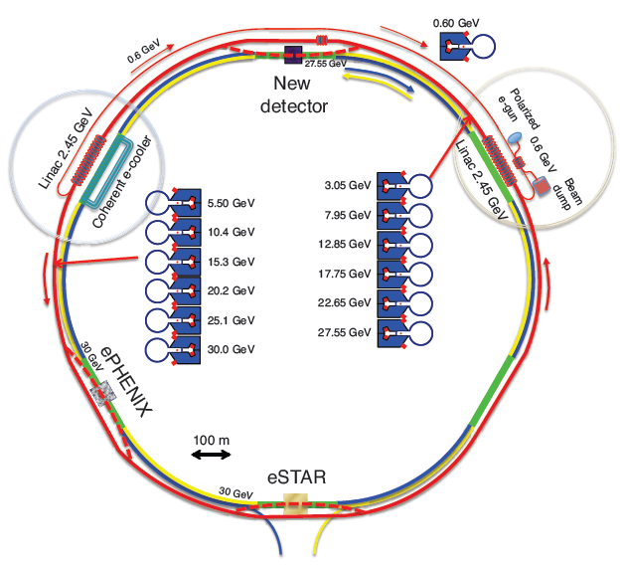
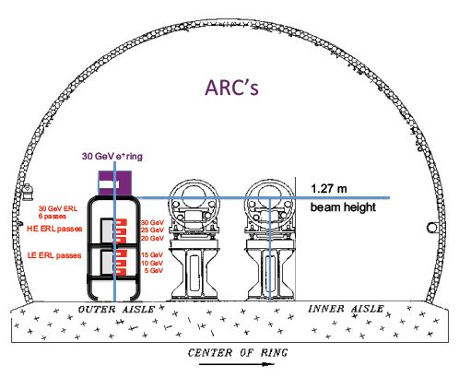
eRHIC accelerator
E_{e} ~5-20 GeV (30 GeV w/ reduced lumi)
E_{p} 50-250 GeV
E_{A} up to 100 GeV/n
Initial E_{e} ~ 5 GeV.
Install additional RF cavities over time to reach
E_{e} = 30 GeV.
All magnets installed from day one

Slide 23
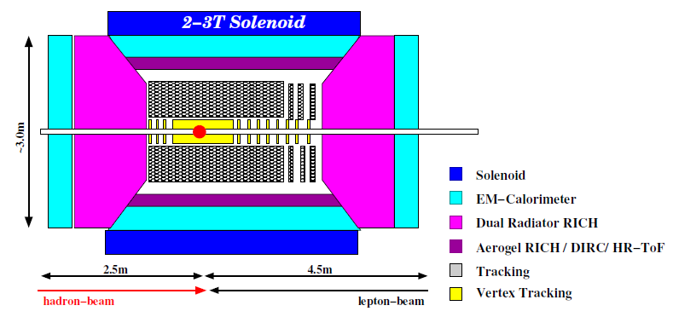
Detector concepts
Large detector acceptance:
|η| < ~5
Low radiation length critical
→ low electron energies
Precise vertex reconstruction
→ separate b and c
DIRC/RICH → π, K, p hadron ID
Forward detectors to tag proton in exclusive reactions
Detector will need to measure
Inclusive processes
  Detect scattered electron with high precision
Semi-inclusive processes
  Detect at least one final-state hadron in addition to scattered electron
Exclusive processes
  Detect all final-state particles in the reaction
Latest call for Electron-Ion Collider detector R&D proposals: https://wiki.bnl.gov/conferences/index.php/EIC_R%25D

Slide 24

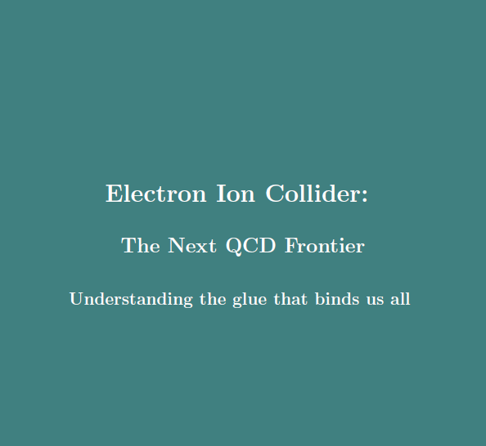
Summary
We’ve recently moved beyond the discovery and development phase of QCD into a new era of quantitative QCD!
eRHIC, capable of colliding polarized electrons with a variety of unpolarized nuclear species as well as polarized protons and polarized light nuclei over center-of-mass energies from ~30 to ~175 GeV, could provide experimental data to bring this new era to maturity over the upcoming decades!
Electron-Ion Collider White Paper recently released! http://www.bnl.gov/rhic/eicrev/ch/ch-files/c1-c6.pdf

Slide 25
Additional Material

Slide 26
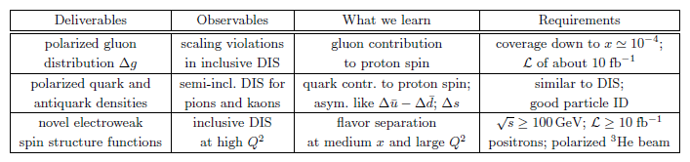
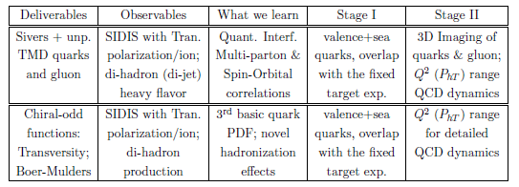
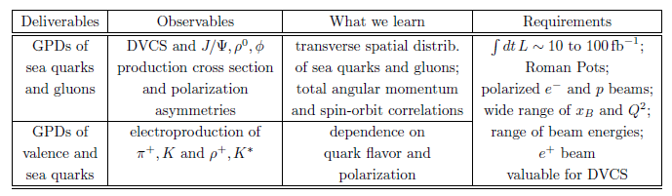
Key measurements of the nucleon
Spin and flavor
3-D structure: transverse momentum dependence
3-D structure: spatial imaging

Slide 27
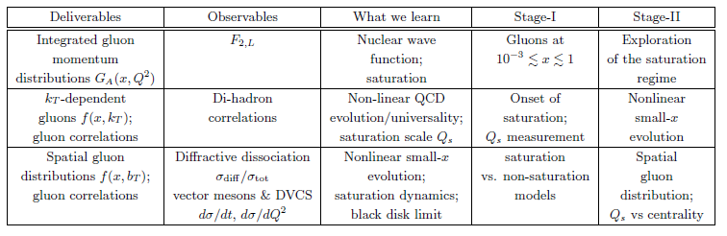

Key measurements of nuclei
High gluon densities
Non-saturation regime

Slide 28

eRHIC e+p luminosities

Slide 29






3D quantum phase-space tomography of the nucleon
Wigner Distribution
W(x,r,k_{t})
TMDs
GPDs
3D picture in momentum space:
  transverse-momentum-dependent distributions
3D picture in coordinate space:
  generalized parton distributions
u-quark
Polarized p
d-quark
Polarized p

Slide 30

Probing gluon Sivers function via
D mesons

Slide 31


Spatial imaging: Gluon vs quark distributions in impact parameter space
Do singlet quarks and gluons have the same transverse distribution?
Hints from HERA:
Area (q+q) > Area g
-
Singlet quark size e.g. from deeply virtual Compton scattering
Gluon size e.g. from J/Ψ electroproduction
Deeply Virtual
Compton Scattering

Slide 32

DVCS kinematic coverage

Slide 33


Q_{s} : A scale that binds them all
Nuclear shadowing
Geometrical scaling
proton × 5
nuclei
Freund et al., hep-ph/0210139
Is the wave function of hadrons and nuclei universal at low x?

Slide 34


Slide 35

Exclusive processes: Collider energies

Slide 36

Dihadron correlations in e+A scattering: Sensitive to saturation

Slide 37


Hadronization and energy loss
nDIS:
  Clean measurement in ‘cold’ nuclear matter
  Suppression of high-p_{T} hadrons analogous but weaker than at RHIC
Fundamental question:
When do coloured partons get neutralized?
Parton energy loss vs.
(pre)hadron absorption
Energy transfer in lab rest frame
EIC: 10-1600 GeV² HERMES: 2-25 GeV²
EIC can measure heavy flavor energy loss

Slide 38


Hadronization and energy loss
Difference in z dependence of pion and D FFs
Striking difference in multiplicity ratio (e+Pb/e+p) for D vs. pion production—slopes sensitive to transport coefficients

Slide 39

Charged-current cross section
Q² > 1 GeV²
no y cut
y > 0.1
20×250
HERA

Slide 40

Measuring sin² θ_{W} at the EIC
√s = 140 GeV
200 fb⁻¹

