Slide 1
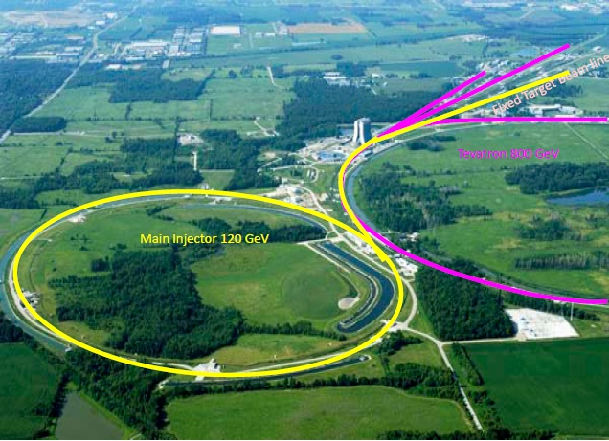
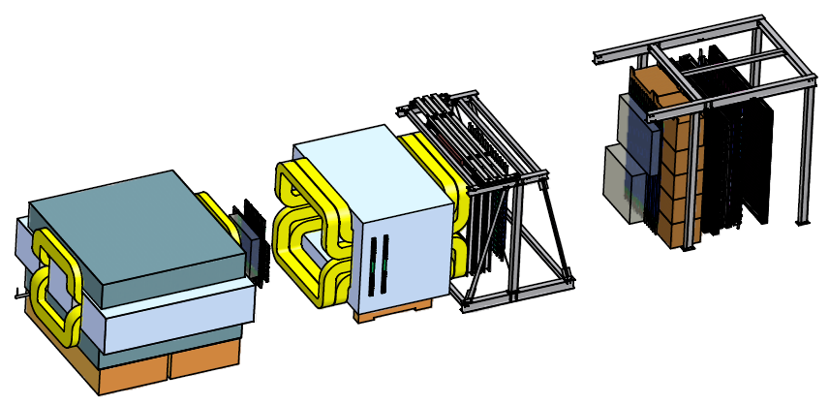
Putting a New Spin on an Existing Machine:
Prospects for Polarizing the Fermilab Main Injector
Christine A. Aidala
University of Michigan
(On behalf of the Fermilab P-1027 Collaboration)
DNP Meeting
Newport Beach, CA
October 26, 2012

Slide 2
Why polarize the Main Injector?
Opportunity to continue the several-decade-long, powerful Drell-Yan program at Fermilab with control over an additional d.o.f: spin!
  Drell-Yan a “clean” process in hadronic interactions (electromagnetic final state)—excellent probe for testing QCD predictions
In particular: Opportunity to test predicted color interactions in QCD via spin-momentum correlation measurements!

Slide 3
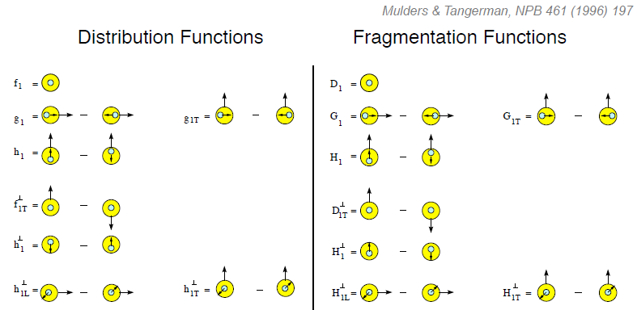
QCD spin-momentum correlations: Transverse-momentum-dependent parton distributions
Transverse-Momentum-Dependent
Mulders & Tangerman, NPB 461, 197 (1996)
Collinear
Worm gear
Evidence so far that several of these non-zero!
Transversity
Transverse-momentum-dependent pdfs provide theoretical framework to describe spin-momentum correlations in nucleon, but difficult to disentangle contributions to inclusive hadron asymmetries
→ Turn to simpler processes: semi-inclusive deep-inelastic scattering and Drell-Yan!
Sivers
Boer-Mulders
Pretzelosity
Worm gear

Slide 4
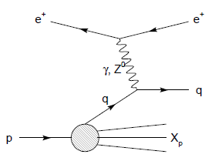
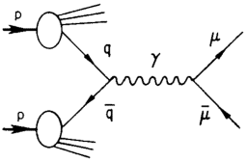
Modified universality of T-odd transverse-momentum-dependent distributions:
Color in action!
DIS: attractive final-state
interactions
Drell-Yan: repulsive initial-state interactions
Crucial test of our understanding of QCD!
(NSAC Milestone HP13)
As a result:

Slide 5
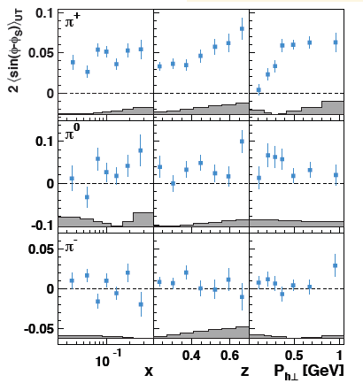
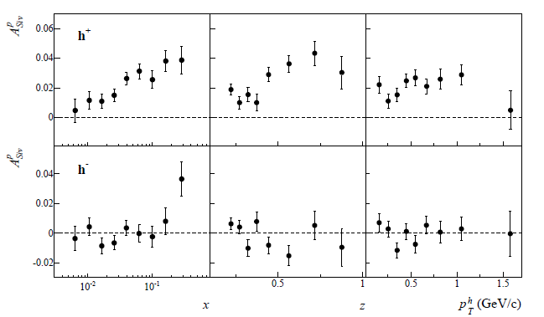
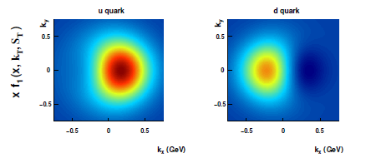
Sivers measurements in SIDIS
HERMES: PRL 103, 152002 (2009)
COMPASS: arXiv:1205.5122
Comparable Drell-Yan measurements needed!
Fit to SIDIS data: quark densities in transverse momentum plane for a proton polarized in the +y direction. Up and down quarks orbiting in opposite directions??
Future measurements at JLab 12 GeV planned

Slide 6
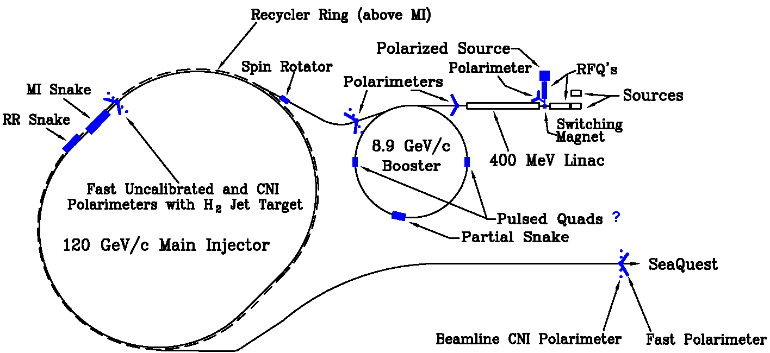
Polarized Drell-Yan at Fermilab Main Injector
Polarize beam in Main Injector – Proposal submitted to Fermilab management September 2011
Use SeaQuest dimuon spectrometer and target
  Approved for 2-3 years of running: 3.4 x 10¹⁸ protons on target
  By 2015: fully understood, optimized for Drell-Yan, and ready to take pol. beam
arXiv:1110.3042

Slide 7
Facts and figures
120 GeV polarized proton beam on liquid hydrogen and deuterium targets
x_{beam} 0.3-0.9, x_{target} 0.1-0.45
L ~ 2.0 x 10³⁵ cm⁻² s⁻¹
  10% available beam time—minimal impact on neutrino program
  Existing targets could handle 1.0 x 10³⁶ cm⁻² s⁻¹
70% polarization
Run for ~2 years, starting after SeaQuest completed (2015)
Could install all equipment in the two (already) scheduled 8-week shutdowns in 2014 and 2015
Future polarized target could open up additional opportunities!
  Studying antiquarks 0.1<x<0.45 in a polarized nucleon
  Investigating double-spin asymmetries
  See talk by Kwangbok Lee

Slide 8
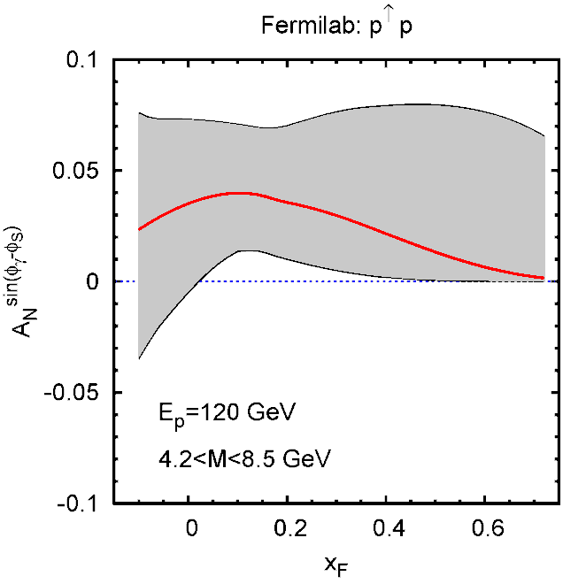
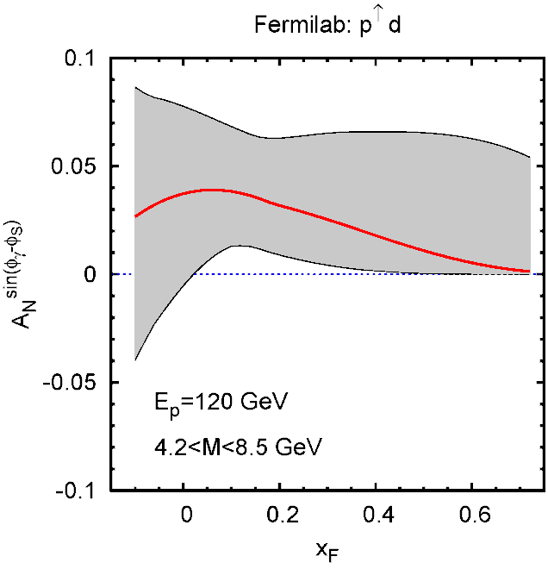
Sivers asymmetry predictions
Predictions from Anselmino et al. based on fit to SIDIS data
  Gray error bands correspond to Δχ²=20
Asymmetries expected to be several %
  Similar for H and D (measuring Sivers function in polarized proton beam, not in target)
FNAL
120 GeV
polarized beam
√s ~ 15 GeV
(Unpolarized)
Hydrogen target
FNAL
120 GeV
polarized beam
√s ~ 15 GeV
(Unpolarized)
Deuterium target
Anselmino et al. priv. comm. 2010

Slide 9
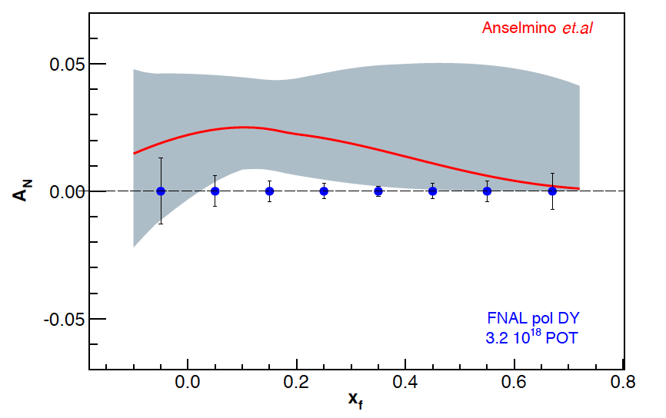
Experimental sensitivity to Sivers asymmetry
Luminosity: L_{av} = 2 x 10³⁵ (10% of available beam time: I_{av} = 15 nA)
3.2 x 10¹⁸ total protons (= 2 yrs at 50% efficiency) with P_{b} = 70%
Δχ²=20 error band
Note:
~650k DY events
330k DY events
Measure not only sign, but also size and maybe shape of Sivers function!
FNAL pol D-Y stat errors
3.2 x 10¹⁸ POT
~1,288k D-Y events
Notes:
Note that SSA A_N^sin(phi-phi_s) is scaled by 2/pi

Slide 10
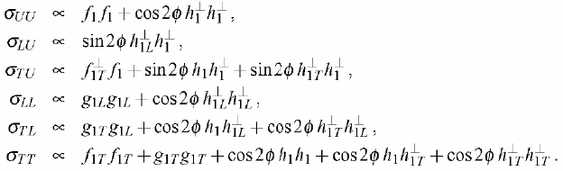
Additional physics opportunities with transverse polarization
Arnold, Metz, Schlegel, PRD79, 034005 (2009)
Azimuthal dependence of Drell-Yan cross section in terms of transverse-momentum-dependent distributions
Opportunities with longitudinal polarization – See talk by Kwangbok Lee

Slide 11
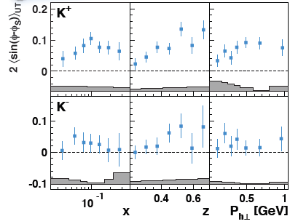
Additional physics opportunities with transverse polarization
Polarized beam → Valence quarks
Polarized target → Sea quarks
  Sivers function for sea quarks ~unknown, but hints that it’s non-zero
Single spin: Transversity x Boer-Mulders function
  Will learn more about Boer-Mulders for sea quarks already from SeaQuest
Polarized beam and target
  Transversity (valence) x Transversity (sea)
    Sea quark transversity might be small
HERMES: PRL 103, 152002 (2009)

Slide 12
Status
Presented to Fermilab PAC June 2012, with follow-up October 2012
Cost estimate performed in close coordination with Fermilab management earlier this year
  ~$10.5M, including 50% contingency
Currently in discussion with funding agencies

Slide 13
P-1027 Collaboration (October 2012)
Abilene Christian University
Donald Isenhower, Tyler Hague,
Rusty Towell, Shon Watson
Academia Sinica
Wen-Chen Chang, Yen-Chu Chen,
Shiu Shiuan-Hal, Da-Shung Su
Argonne National Laboratory
John Arrington, Don Geesaman
Kawtar Hafidi, Roy Holt, Harold
Jackson, Paul E. Reimer*, Josh Rubin
University of Colorado
Ed Kinney
Fermilab
Chuck Brown, David Christian
University of Illinois
Bryan Dannowitz, Markus Diefenthaler,
Bryan Kerns, Naomi C.R
Makins, R. Evan McClellan
KEK
Shinya Sawada
Los Alamos National Laboratory
Ming Liu, Xiang Jiang, Pat McGaughey, J. Huang
University of Maryland
Betsy Beise, Kaz Nakahara
University of Michigan
Christine Aidala,
Wolfgang Lorenzon*, Richard Raymond, Qu Zhongming
National Kaohsiung Normal University
Rurngsheng Guo, Su-Yin Wang
RIKEN
Yuji Goto
Rutgers University
Lamiaa El Fassi, Ron Gilman, Ron Ransome, A. Tadepalli
Tokyo Institute of Technology
Shou Miyasaka, Ken-ichi Nakano,
Florian Saftl, Toshi-Aki Shibata
Yamagata University
Yoshiyuki Miyachi
University of Basque Country†
Gunar Schnell
*Co-Spokespersons
†new group (Aug’12)
Working in close collaboration on accelerator issues with Spin@Fermi group, led by Alan Krisch
Collaboration includes most of the SeaQuest groups and one new group (total 16 groups as of October 2012)
13

Slide 14
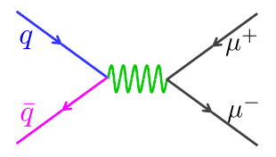
Summary
Polarizing Main Injector at Fermilab a unique opportunity to perform high-statistics polarized Drell-Yan measurements for 0.35<x<0.85 as early as ~2015
Use existing SeaQuest spectrometer and targets
Would enable mapping out Sivers function at high x, providing crucial data to compare sign, magnitude, and perhaps shape to semi-inclusive DIS measurements, testing predicted color interactions in QCD
Addition of a polarized target would allow access to sea quarks and double-spin measurements → See talk by K. Lee
Parton dynamics within hadrons: a rich area of QCD that we’re only just starting to explore!
New collaborators welcome!

Slide 15
Extra material

Slide 16
Planned polarized Drell-Yan experiments
experiment | particles | energy | x_{b} or x_{t} | Luminosity | timeline
COMPASS (CERN) | π± + p↑ | 160 GeV √s = 17.4 GeV | x_{t} = 0.2 – 0.3 | 2 x 10³³ cm⁻² s⁻¹ | 2014
PAX (GSI) | p↑ + p_{bar} | collider √s = 14 GeV | x_{b} = 0.1 – 0.9 | 2 x 10³⁰ cm⁻² s⁻¹ | >2017
PANDA (GSI) | p_{bar} + p↑ | 15 GeV √s = 5.5 GeV | x_{t} = 0.2 – 0.4 | 2 x 10³² cm⁻² s⁻¹ | >2016
NICA (JINR) | p↑ + p | collider √s = 20 GeV | x_{b} = 0.1 – 0.8 | 1 x 10³⁰ cm⁻² s⁻¹ | >2014
PHENIX (RHIC) | p↑ + p | collider √s = 500 GeV | x_{b} = 0.05 – 0.1 | 2 x 10³² cm⁻² s⁻¹ | >2018
RHIC internal target phase-1 | p↑ + p | 250 GeV √s = 22 GeV | x_{b} = 0.25 – 0.4 | 2 x 10³³ cm⁻² s⁻¹ | >2018
RHIC internal target phase-2 | p↑ + p | 250 GeV √s = 22 GeV | x_{b} = 0.25 – 0.4 | 6 x 10³⁴ cm⁻² s⁻¹ | >2018
SeaQuest (unpol.) (FNAL) | p + p | 120 GeV √s = 15 GeV | x_{b} = 0.35 – 0.85 x_{t} = 0.1 – 0.45 | 3.4 x 10³⁵ cm⁻² s⁻¹ | 2012
pol. SeaQuest§ (FNAL) | p↑ + p | 120 GeV √s = 15 GeV | x_{b} = 0.35 – 0.85 | 1 x 10³⁶ cm⁻² s⁻¹ | >2015
§ L= 1 x 10³⁶ cm⁻² s⁻¹ (LH₂ tgt limited) / L= 2 x 10³⁵ cm⁻² s⁻¹ (10% of MI beam limited)

Slide 17
Polarized Drell-Yan at Fermilab Main Injector
Polarized Beam in Main Injector
  use SeaQuest spectrometer
  use SeaQuest target
    liquid H₂ target can take I_{av} = ~5 x 10¹¹ p/s (=80 nA)
  1 mA at polarized source can deliver about I_{av} = ~1 x 10¹² p/s (=150 nA)
  for 100% of available beam time (A. Krisch: Spin@Fermi report in (Aug 2011): arXiv:1110.3042 [physics.acc-ph])
    26 μs linac pulses, 15 Hz rep rate, 12 turn injection into booster, 6 booster pulses into Recycler Ring, followed by 6 more pulses using slip stacking in MI
    1 MI pulse = 1.9 x 10¹² p
    using three 2-s cycles (1.33-s ramp time, 0.67-s slow extraction) /min (=10% of beam time):
    → 2.8 x 10¹² p/s (=450 nA) instantaneous beam current , and I_{av} = ~0.95 x 10¹¹ p/s (=15 nA)
  Scenarios:
    L = 2.0 x 10³⁵ /cm²/s (10% of available beam time: I_{av} = 15 nA)
    L = 1 x 10³⁶ /cm²/s (50% of available beam time: I_{av} = 75 nA)
  x-range:
    x_{b} = 0.35 – 0.85 (valence quarks) x_{t} = 0.1 – 0.35 (sea quarks)
Systematic uncertainty in beam polarization measurement ΔP_{b}/P_{b} <5%

Slide 18
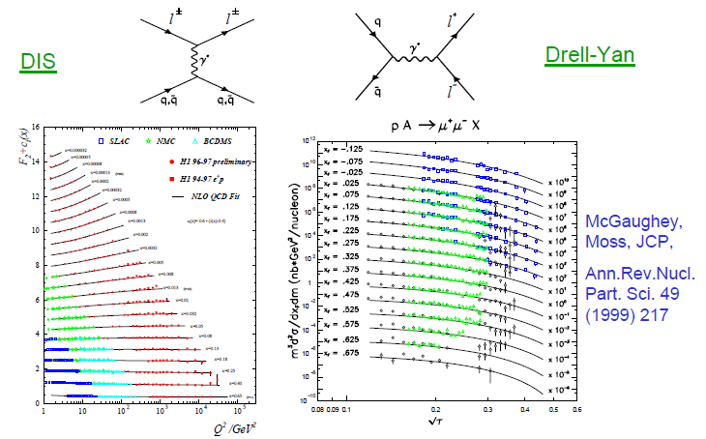
Complementarity of Drell-Yan and DIS
Both Drell-Yan and deep-inelastic scattering are tools to probe the quark and antiquark structure of hadrons!

Slide 19
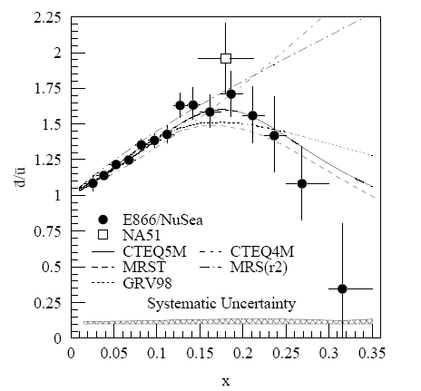
A (relatively) recent surprise from p+p, p+d collisions
Fermilab Experiment 866 used proton-hydrogen and proton-deuterium collisions to probe nucleon structure via the Drell-Yan process
Anti-up/anti-down difference in the quark sea, with an unexpected x behavior!
Indicates “primordial” sea quarks, in addition to those dynamically generated by gluon splitting!
Hadronic collisions play a complementary role to e+p DIS and have let us continue to find surprises in the rich linear momentum structure of the proton, even after > 40 years!
PRD64, 052002 (2001)

Slide 20
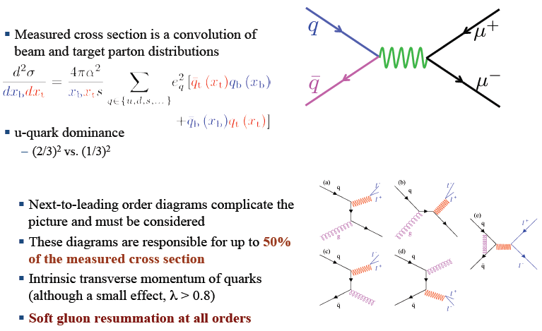
Dilepton pair production

Slide 21
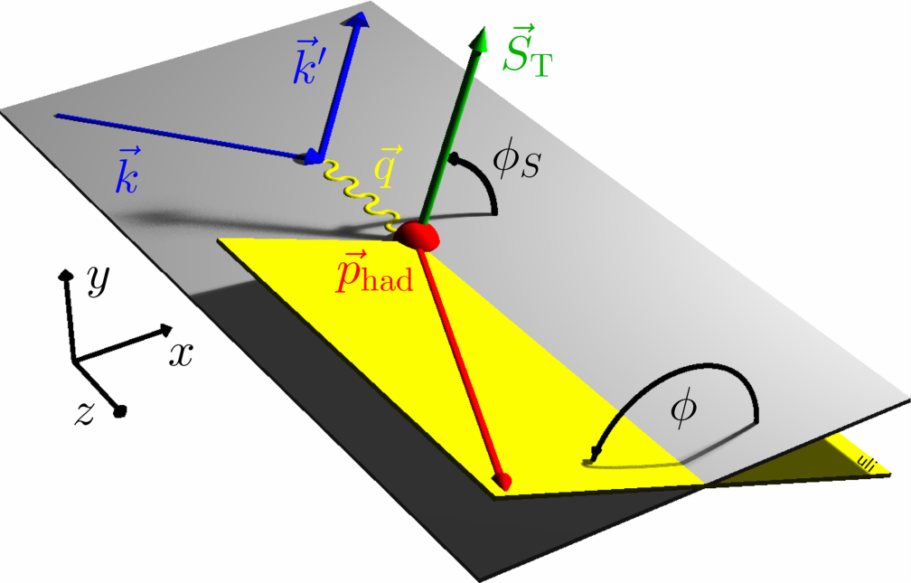
Probing spin-momentum correlations in the nucleon: Measuring transverse-momentum-dependent distributions
Sivers
angle of hadron relative to initial quark spin
Angular dependences in semi-inclusive DIS
isolation of the various TMD distribution and fragmentation functions

Slide 22
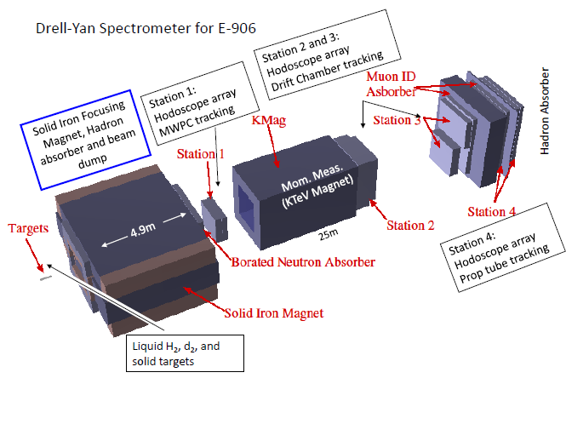
Fermilab E906/SeaQuest:
A dedicated fixed-target Drell-Yan experiment
Physics programs:
  Nucleon structure
  Cold nuclear matter
120 GeV/c proton beam from Fermilab Main Injector
Liquid hydrogen and deuterium, nuclear (C, Ca, W) targets
Commissioning to start in December, data-taking through ~2015

Slide 23
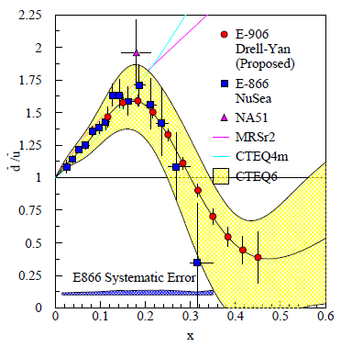
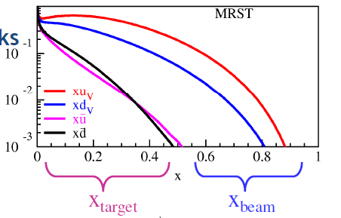
E906/SeaQuest: Probing high-x antiquarks
Follow-up experiment to FNAL E866 - main goal to extend measurements to higher x
  E866 found a strong flavor asymmetry in the proton’s sea quarks, with a striking x dependence
  Sea quarks generated perturbatively via gluon splitting should be flavor symmetric!
  “Intrinsic” antiquarks?
120 GeV proton beam from FNAL Main Injector (E866: 800 GeV)
  Reach higher x values
  Also improved statistics: D-Y cross section ~1/s
E906
E866
Talk by Chiranjib Dutta, JC7 (Friday)

Slide 24
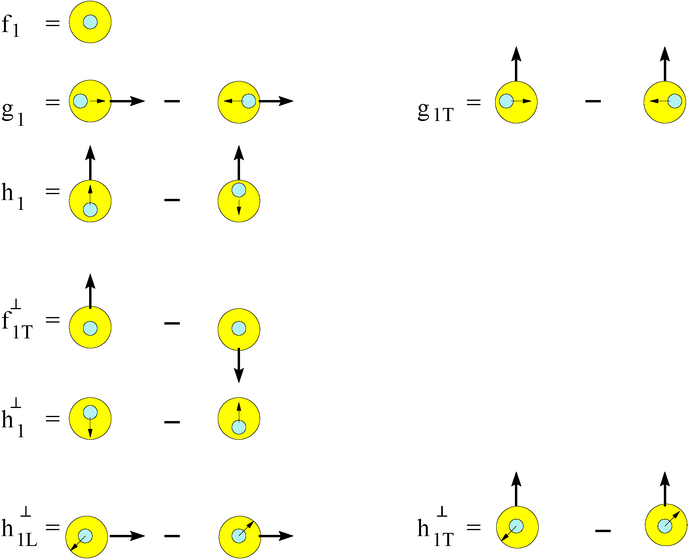
Transverse Momentum Distributions (Introduction)
survive k_{T} integration
Sivers Function
k_{T} - dependent, T-even
k_{T} - dependent,
Naïve T-odd
Boer-Mulders Function
Notes:
Besides the maybe familiar 2 or 3 parton distribution functions there are five additional structure functions, probably less well known, but equally fundamental.

