Slide 1
STAR Upgrade Overview Flemming Videbæk, BNL
Unanswered/open questions at RHIC:
STAR plans and strategies on how to address them in the context of upgrades in the next decade
Extending Physics reach with new lepton probe: eSTAR at eRHIC
Material from JHLee talk at Riken, October 2011
Thanks to Carl Gagliari, Jamie Dunlop, Ernst Sichtermann, Zhangbu Xu

Slide 2
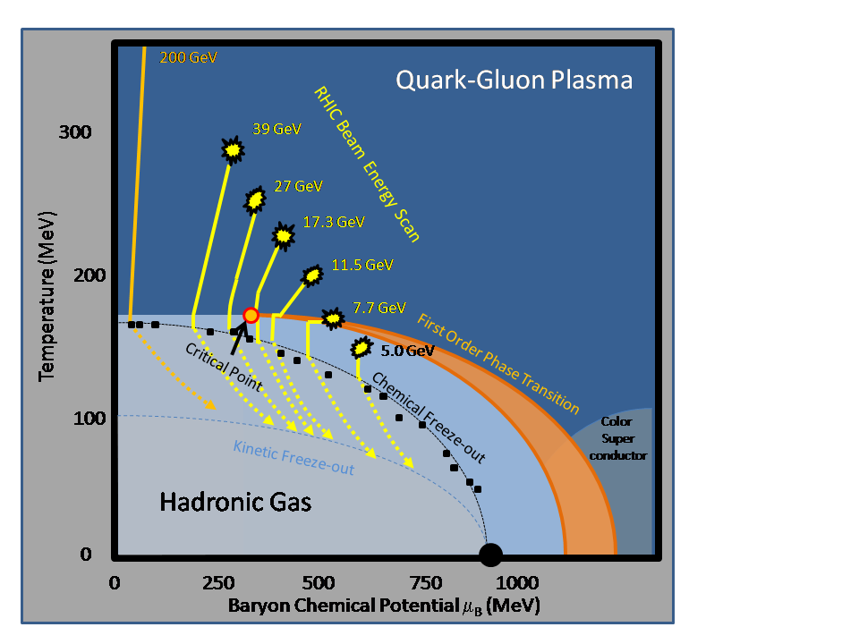
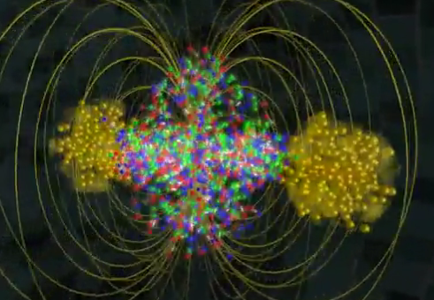
Key unanswered questions I What is the nature of QCD matter at the extremes
What are the properties of the strongly-coupled system produced at RHIC, and how does it thermalize?
Where is the QCD critical point and the associated first-order phase transition line?
Are the interactions of energetic partons with QCD matter characterized by weak or strong coupling? What is the detailed mechanism for partonic energy loss?
Can we strengthen current evidence for novel symmetries in QCD matter and open new avenues?
What other exotic particles are produced at RHIC?
Notes:
From the decadal plan

Slide 3
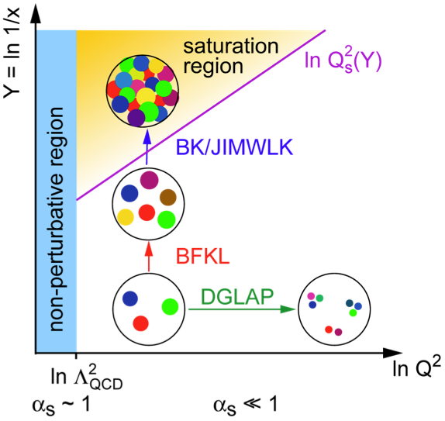
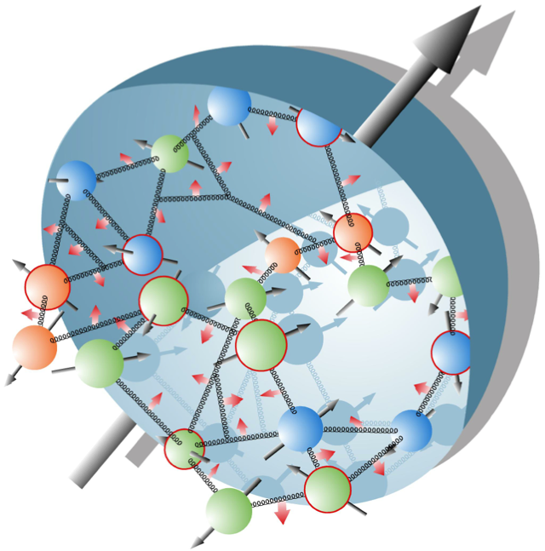
Key unanswered questions II
What is the partonic structure of nucleons and nuclei?
What is the partonic spin structure of the proton?
What are the dynamical origins of spin-dependent interactions in hadronic collisions?
What is the nature of the initial state in nuclear collisions? Nuclear structure at high-energy (small-x)?

Slide 4
STAR strategies to answer these questions I
Hot QCD matter: high luminosity RHIC II (fb⁻¹ equivalent)
Heavy Flavor Tracker: precision charm and beauty
Muon Telescope Detector: e+μ and μ+μ at mid-rapidity
Trigger and DAQ upgrades to make full use of luminosity
Full use of the flexibility of RHIC (U+U,...)
Phase structure of QCD matter: energy scan
Analysis of Phase 1 Completed in Runs 10,11 followed by targeted fine-scale energy scan depending on result

Slide 5
STAR strategies to answer these questions II
Nucleon spin structure and diffraction
Forward GEM Tracker: flavor-separated anti-quark polarizations
Forward Hadron Calorimeter: strange quark polarization
Roman Pots (phase II): proton spectator tagging in polarized p+³He, central exclusive diffraction p+p➛p+MX+p
Nucleon spin and cold QCD matter: high precision p+p and p+A, followed by e+p and e+A
Major upgrade of capabilities in forward/backward (electron) direction
Utilizing mid-rapidity detectors for the initial e+p and e+A program , and adding forward capabilities

Slide 6
Near term
Forward Gem Tracker
Detector ~60% complete. Assembled, and will be installed into STAR with new supporting Carbon Fiber shells next week for Run-12
Heavy Flavor Tracker
Two layers pixel active pixel sensors layers, and two outer Si-layers. Topological HQ identification.
Received CD-2/3 approval this month and will move into construction phase [~2-2.5 years].
Early Completion for run-14.
Muon Telescope Detector
RPC technology; ~45% acceptance in (-0.7,0.7). Incremental upgrade 2012-1014.

Slide 7
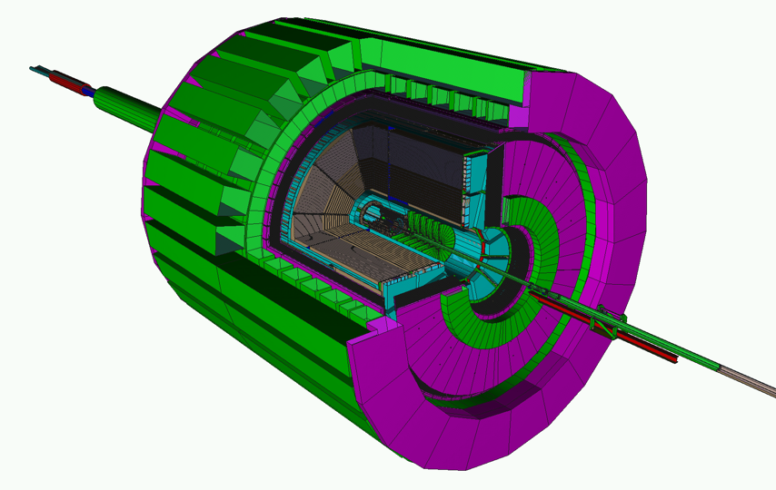
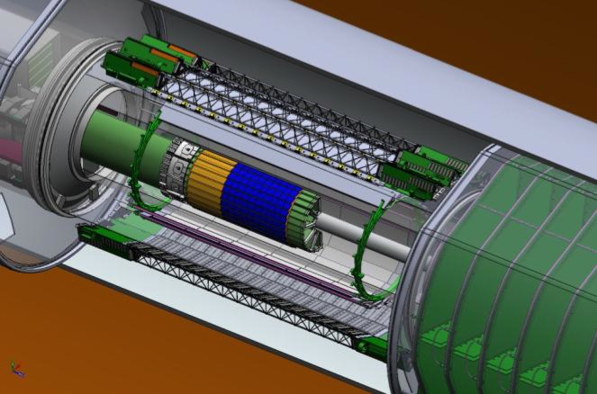
Evolution of STAR
Tracking: TPC
Particle ID: TOF
Electromagnetic Calorimetry:
BEMC+EEMC+FMS
(-1 ≤ η ≤ 4)
Additional
upgrades:
Muon Telescope Detector (2013)
FHC, RP,...
Trigger and DAQ
Forward Upgrades
Heavy Flavor Tracker (2013)
Forward Gem Tracker
(2011)
Full azimuthal particle identification
over a broad range in pseudorapidity

Slide 8
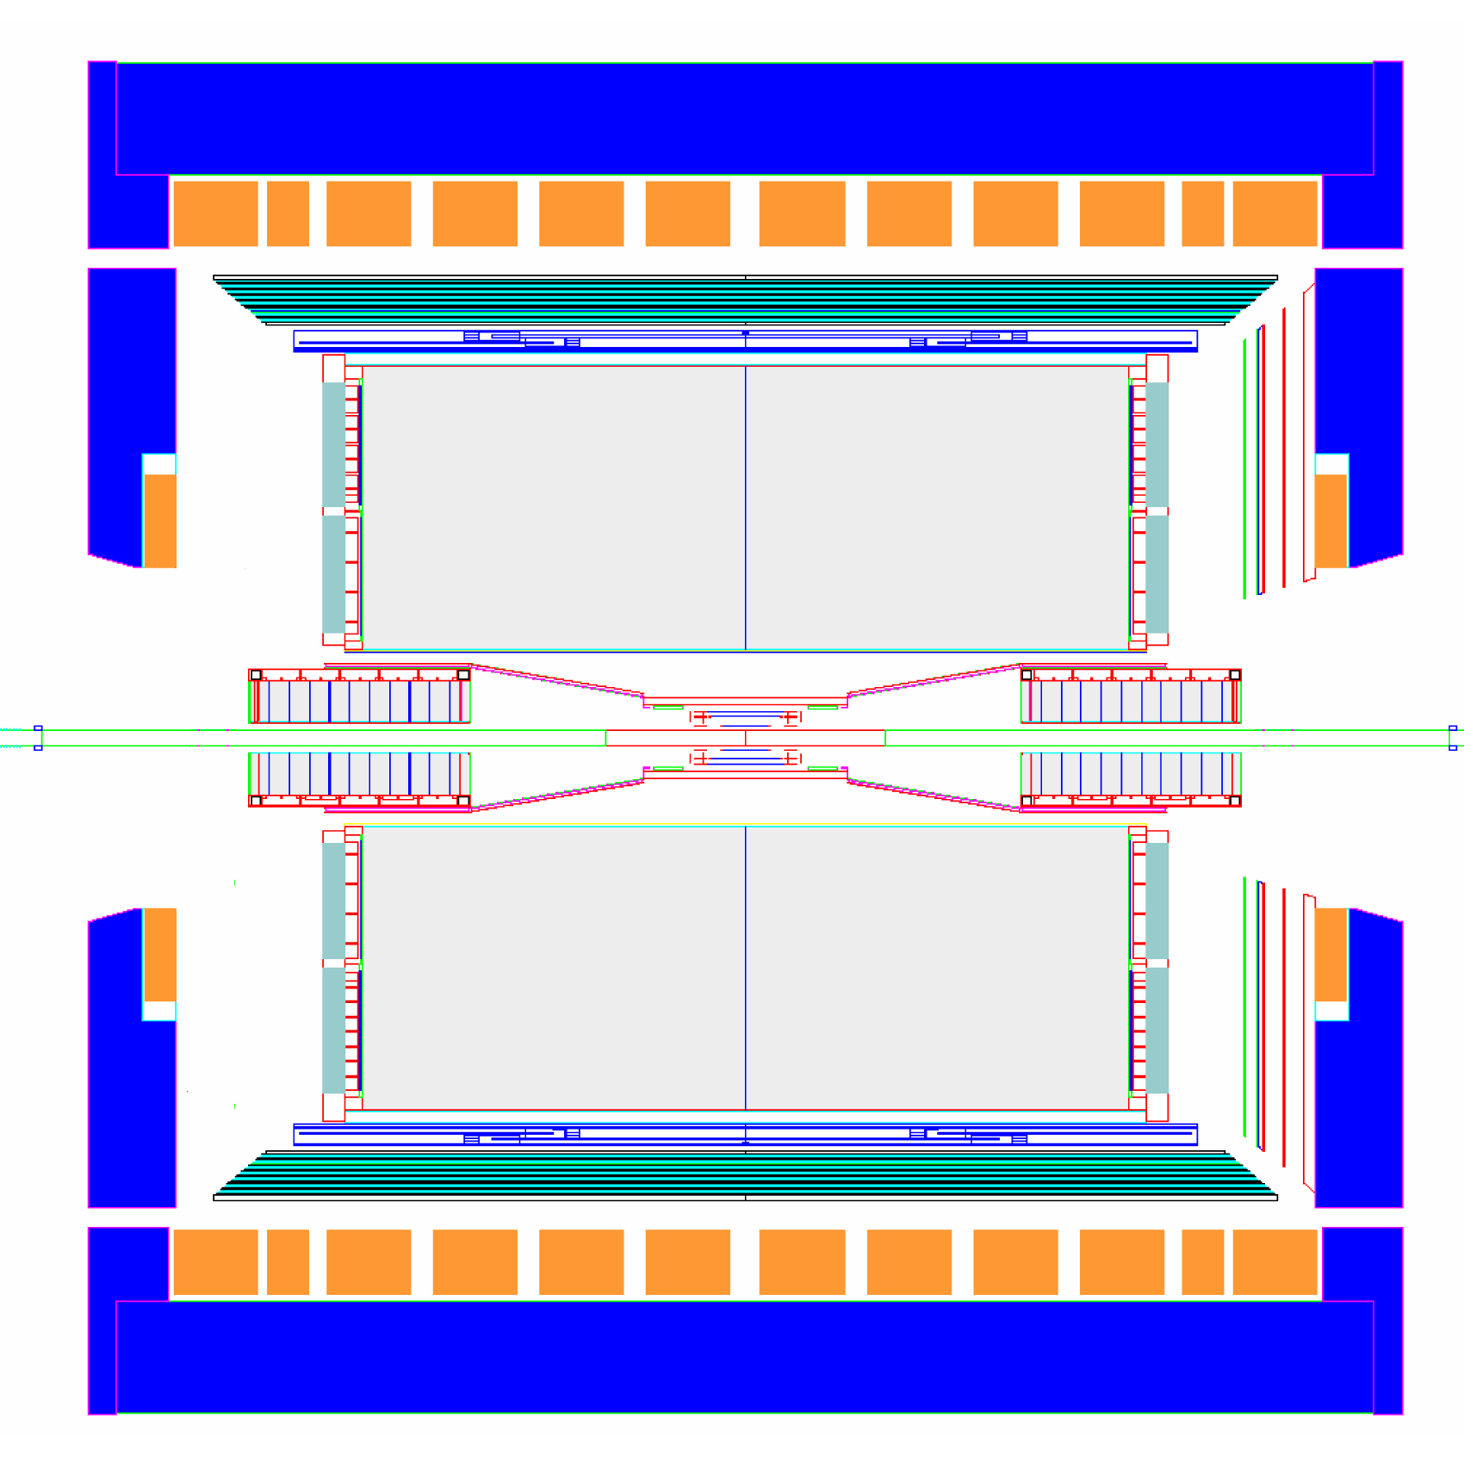
Longer Term STAR moving forward:
proton
nucleus
~ 2016+
~ 6 additional GEM disks
Tracking: 2.5 < η < 4
FMS
FHC
W powder HCal
Preshower
1/2” Pb radiator
Shower “max”
RICH
Baryon/meson separation
Forward instrumentation optimized for p+A and transverse spin physics
Charged-particle tracking
e/h and γ/π⁰ discrimination
Baryon/meson separation
The upgrade can be utilized for forward (hadronic side) in e+p, e+A

Slide 9
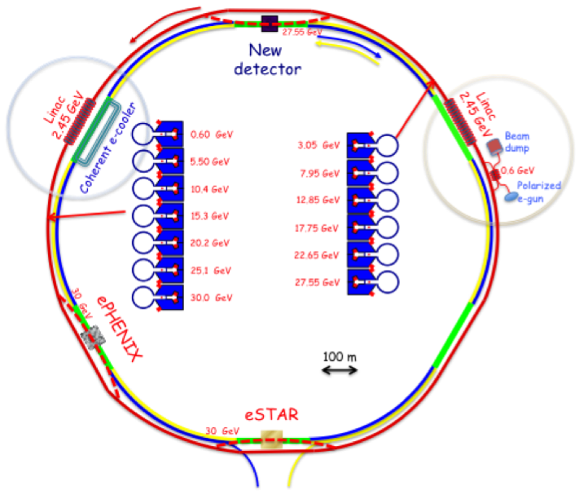
STAR to eSTAR
Optimizing STAR for e+A and e+p collisions for eRHIC phase I (5 GeV energy energy)

Slide 10
STAR detector upgrade consideration for eRHIC phase I
General consideration:
low multiplicity: <Nch> ~ 4-6 for √s = 40-65 GeV (from ep Hera measurements) <Nch(ep)> ~ <Nch(eA)>
Interaction rate: 300 - 600 kHz at 10³⁴ cm⁻² s⁻¹
Inclusive measurements
Backward (-2.5 < η < -1) electron acceptance essential to span DIS regime
Semi-inclusive physics
Need to investigate how well PID coverage is matched to SIDIS kinematics
Both backward and forward hadron coverage valuable for SIDIS
Exclusive physics program
Need forward (~beam rapidity) proton and expanded photon detection (DVCS)
Roman Pots (also for spectator proton tagging in e+³He)
EM calorimetry for -4 < η < -1
Rapidity gap acceptance for diffractive events

Slide 11
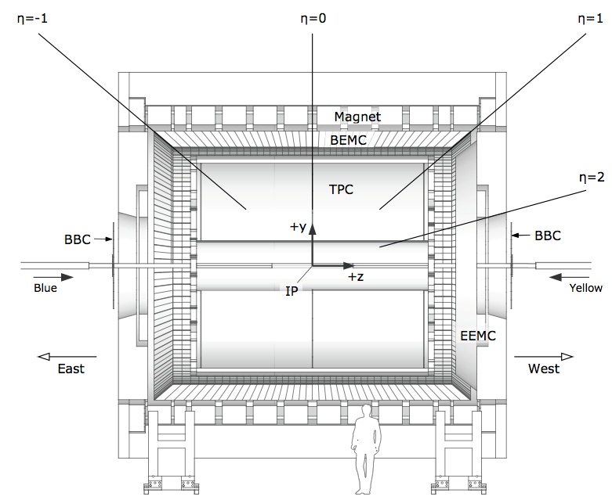
Targeting eSTAR: Backward (electron direction) Upgrade
Main upgrade: Additional electron ID and reconstruction in -2.5<η<-1
ToF: π , K identification,
t0, electron
ECal: 5 GeV, 10 GeV, ...
electron beams
GCT: a compact
tracker with enhanced
electron capability;
seeks to combine high-threshold
(gas) Cherenkov with TPC(-like)
tracking (EIC generic detector R&D)
Conceptual Design and Simulations started active working group
eSTAR Task Force formed
ToF/ECal
TPC i.s.
GCT
TPC i.s.
ECal

Slide 12
Summary
STAR upgrade to continue addressing the key open questions in hot/cold nuclear matter at extreme conditions and spin structures of nucleon
mid-decade - precision, extending to heavy flavor: FGT+ HFT + MTD all underway
A+A, A+B, p+p
later in the decade - exploring forward regime
polarized p+A, p+p, p+³He
end of decade - beginning of STAR with eRHIC: eSTAR
For STAR to maintain capability to deliver compelling physics in the coming decade and beyond, upgrades and strong user involvement is needed.

Slide 13
Backup Slides

Slide 14
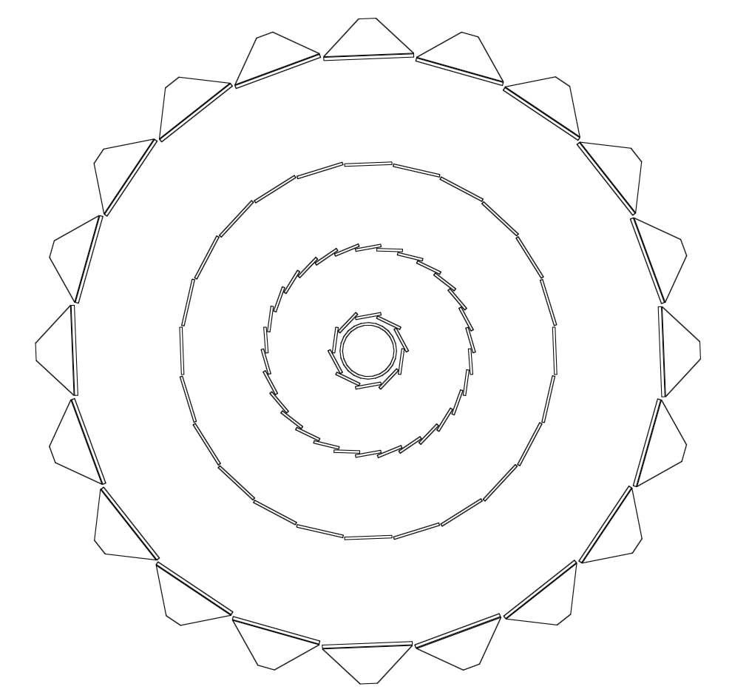
Heavy Flavor Tracker (HFT)
30
Intermediate Si Tracker
Si Strip Detector
Beampipe
Pixel Detector
The HFT puts 4 layers of Silicon around the vertex
Provides ~20 μm space point resolution on tracks
Uniquely thin pixels (< 0.6% X₀/layer, targeting 0.32% X₀)
Topological reconstruction of open charm at low p_{T}
DAQ1000-level rate capabilities
Will be ready for the 2014 run
20
10
-10
-20
-30

Slide 15
STAR Upgrades and physics: sQGP, QCD phases
year | near term (11-13) | mid-decade (14-16) | long term (17-19)
Colliding system | p+p, A+A | p+p, A+A | p+p, p+A, A+A
Upgrade | FGT,FHC,DAQ10K,Trigger | HFT, MTD,Trigger | Forward Detectors,Trigger
Properties of sQGP | Υ, J/Ψ➛ee, mee,v2 | Υ, J/Ψ➛μμ, Charm v2, RCP, corr, Λc/D, μ-atoms | p+A comparison
Mechanism of energy loss | Jets,γ-jets, NPE | Charm, Bottom | Jets in CNM
QCD critical point | Fluctuations, Correlations, Ratios | Focused study of critical point region
Novel symmetries | Azimuthal correlations | e-μ,μ-μ
Exotic particles | Heavy antimatter

Slide 16
STAR Upgrades and physics: Nucleon spin and Cold nuclear matter
year | near term (11-13) | mid-decade (14-16) | long term (17-19)
Colliding system | p+p | p+p, p+³He | p+p, p+A
Upgrade | FGT,FHC,DAQ10K,Trigger | HFT,MTD,Trigger, RP phase II | Forward Detectors,Trigger
Nucleon spin structure | W AL jet and di-jet ALL, intra-jet correlation, Λ DLL/DTT | W AL with polarized ³He | AN in p+p, p+A
QCD beyond collinear factorization | Forward AN | Forward AN with ³He (Flavor separation) | Drell-Yan, Forward-Forward corr.
Exotic particles |  | exotic mesons | exotic mesons
Properties of initial states |  |  | Charm corr. Drell-Yan J/Ψ. F-Fcorr. ,Λ

Slide 17
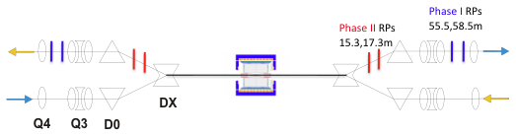
More Forward: Roman Pots (Phase II) Spectator proton tagging in p+³He Diffraction in p+p
Spectator tagging crucial for identifying target nucleon in p/e+³He: polarized neutron target
Deflected protons due to different rigidity can be detected in RPs
A common detector system (“forward proton spectrometer”) can be utilized for measuring diffractive protons and spectator protons in ³He
Detectors/technique can be utilized to measure p+p➛p+MX+p, and other large rapidity gap events

Slide 18
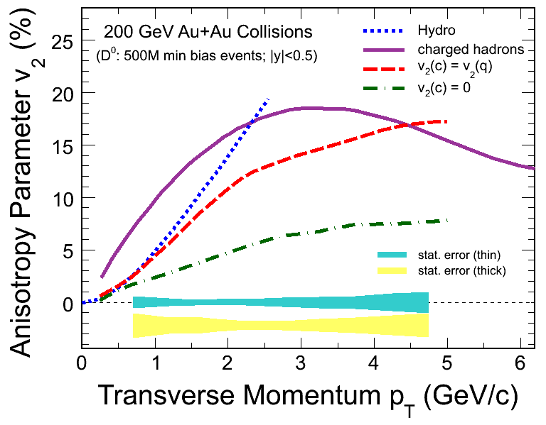
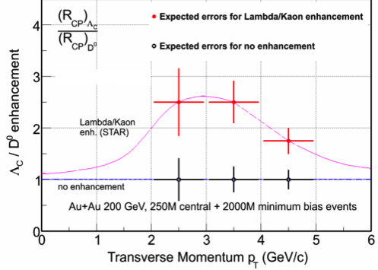
HFT Physics: Properties of sQGP with Open Charm
Does charm flow hydrodynamically?
Heavy Flavor Tracker: unique access to low-p_{T} fully reconstructed charm
Are charmed hadrons produced via coalescence?
Heavy Flavor Tracker: unique access to charm baryons
Would force a significant reinterpretation of non-photonic electron R_{AA}
Muon Telescope Detector: does J/Ψ flow?

Slide 19
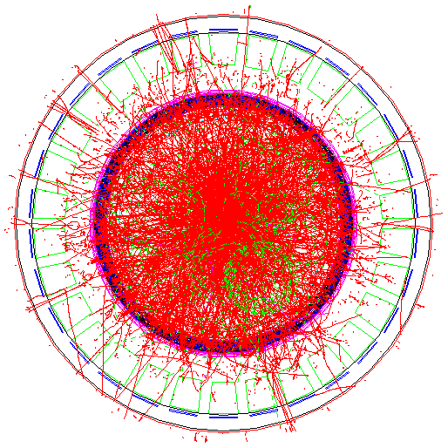
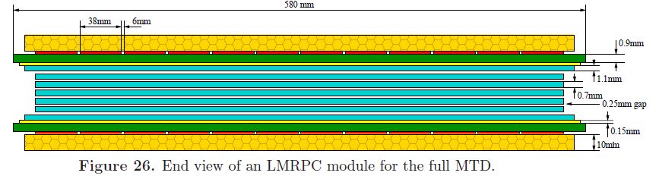
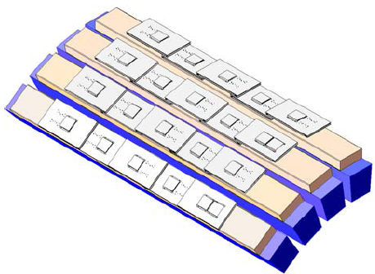
Muon Telescope Detector (MTD)
Muon Tagger: use the magnet steel as absorber, TPC for tracking
Acceptance: 45% for |η|<0.5
118 modules, 1416 readout strips, 2832 readout channels
Long-MRPC detector technology, HPTDC electronics (same as STAR-TOF)
Unique capability to identify muons at mid-rapidity at RHIC
Ready in 2014

Slide 20
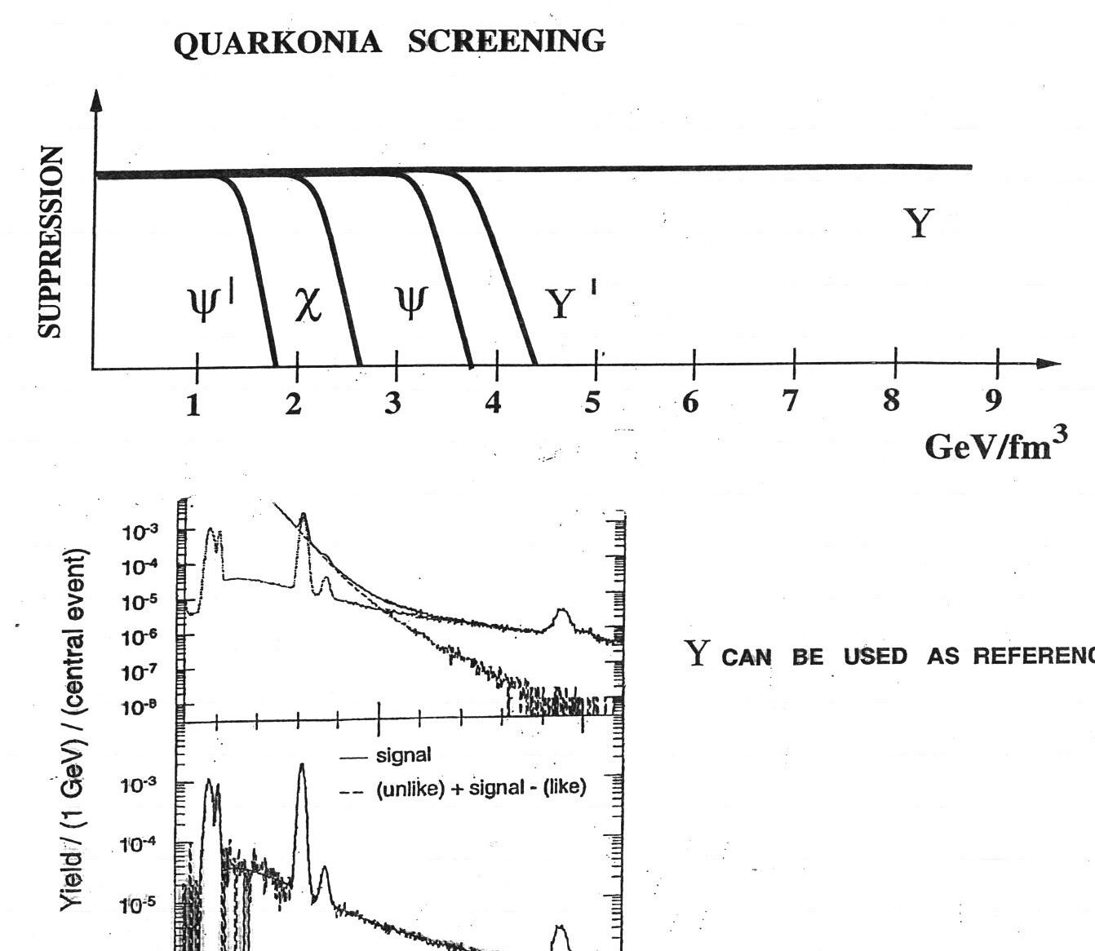
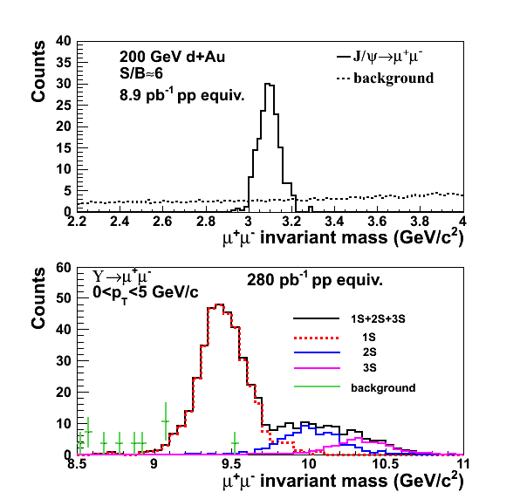
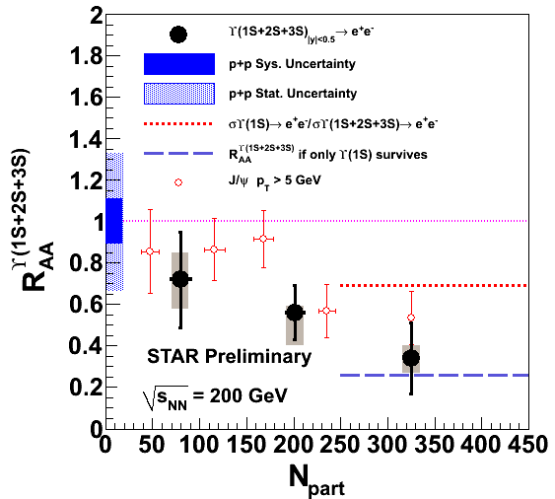
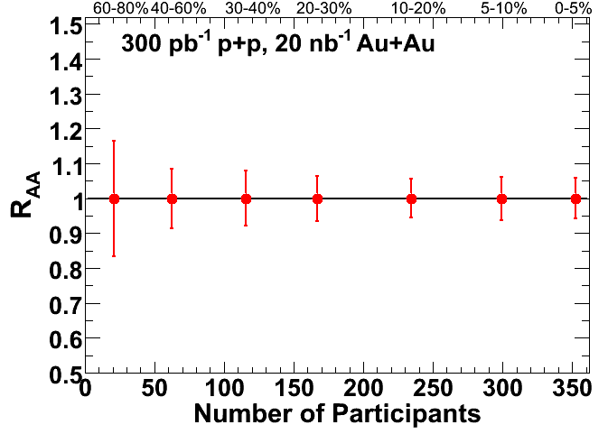
MTD physics: Properties of sQGP with Upsilon
What quarkonia states dissociate
at RHIC energy densities?
What is the energy density?
RHIC
Υ
Muon Telescope Detector: dissociation of Υ, separated by state
At RHIC: small contribution from coalescence, so interpretation clean
No contribution of Bremsstrahlung tails, unlike electron channel

Slide 21
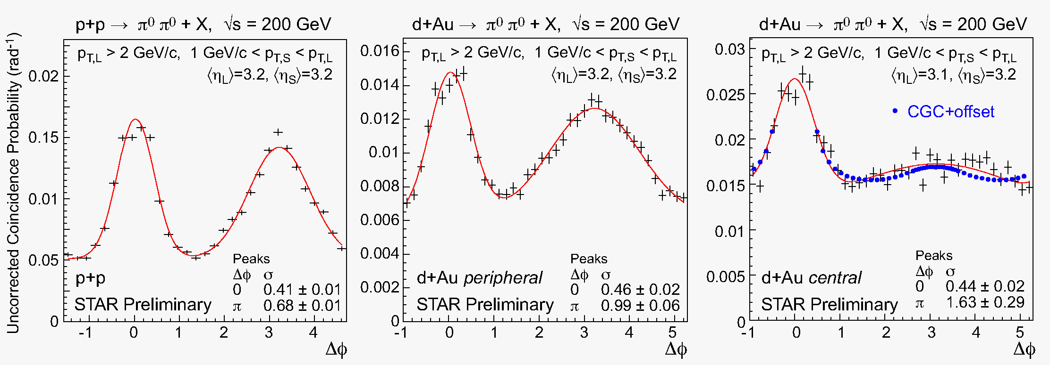
Cold QCD matter – the initial state at RHIC
STAR
preliminary
pp
peripheral dAu
central dAu
RHIC may provide unique access to the onset of saturation
Future questions for p+A
What is the gluon density in the (x,Q²) range relevant at RHIC?
What role does saturation of gluon densities play at RHIC?
What is Q_{s} at RHIC, and how does it scale with A and x?
What is the impact parameter dependence of the gluon density?
Dihadron measurement in e+A with clean kinematic control at eRHIC

Slide 22
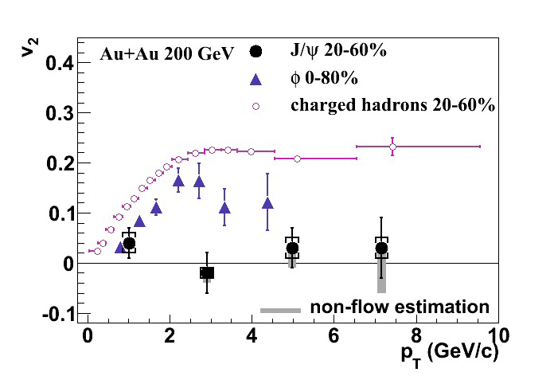
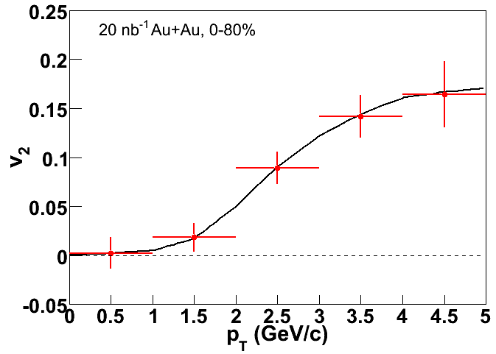
J/Ψ Flow: MTD projection
J/Ψ v₂ small
Either charm does not flow, or coalescence is not a dominant contributor to J/Ψ production,
Or charm flows strongly for p_{T} where coalescence small, and vice versa.
[X. Zhao and R. Rapp, Phys. Rev. C 82:064905 (2010)]
More subtle measurements needed
Dramatic improvement with RHIC II and MTD

Slide 23
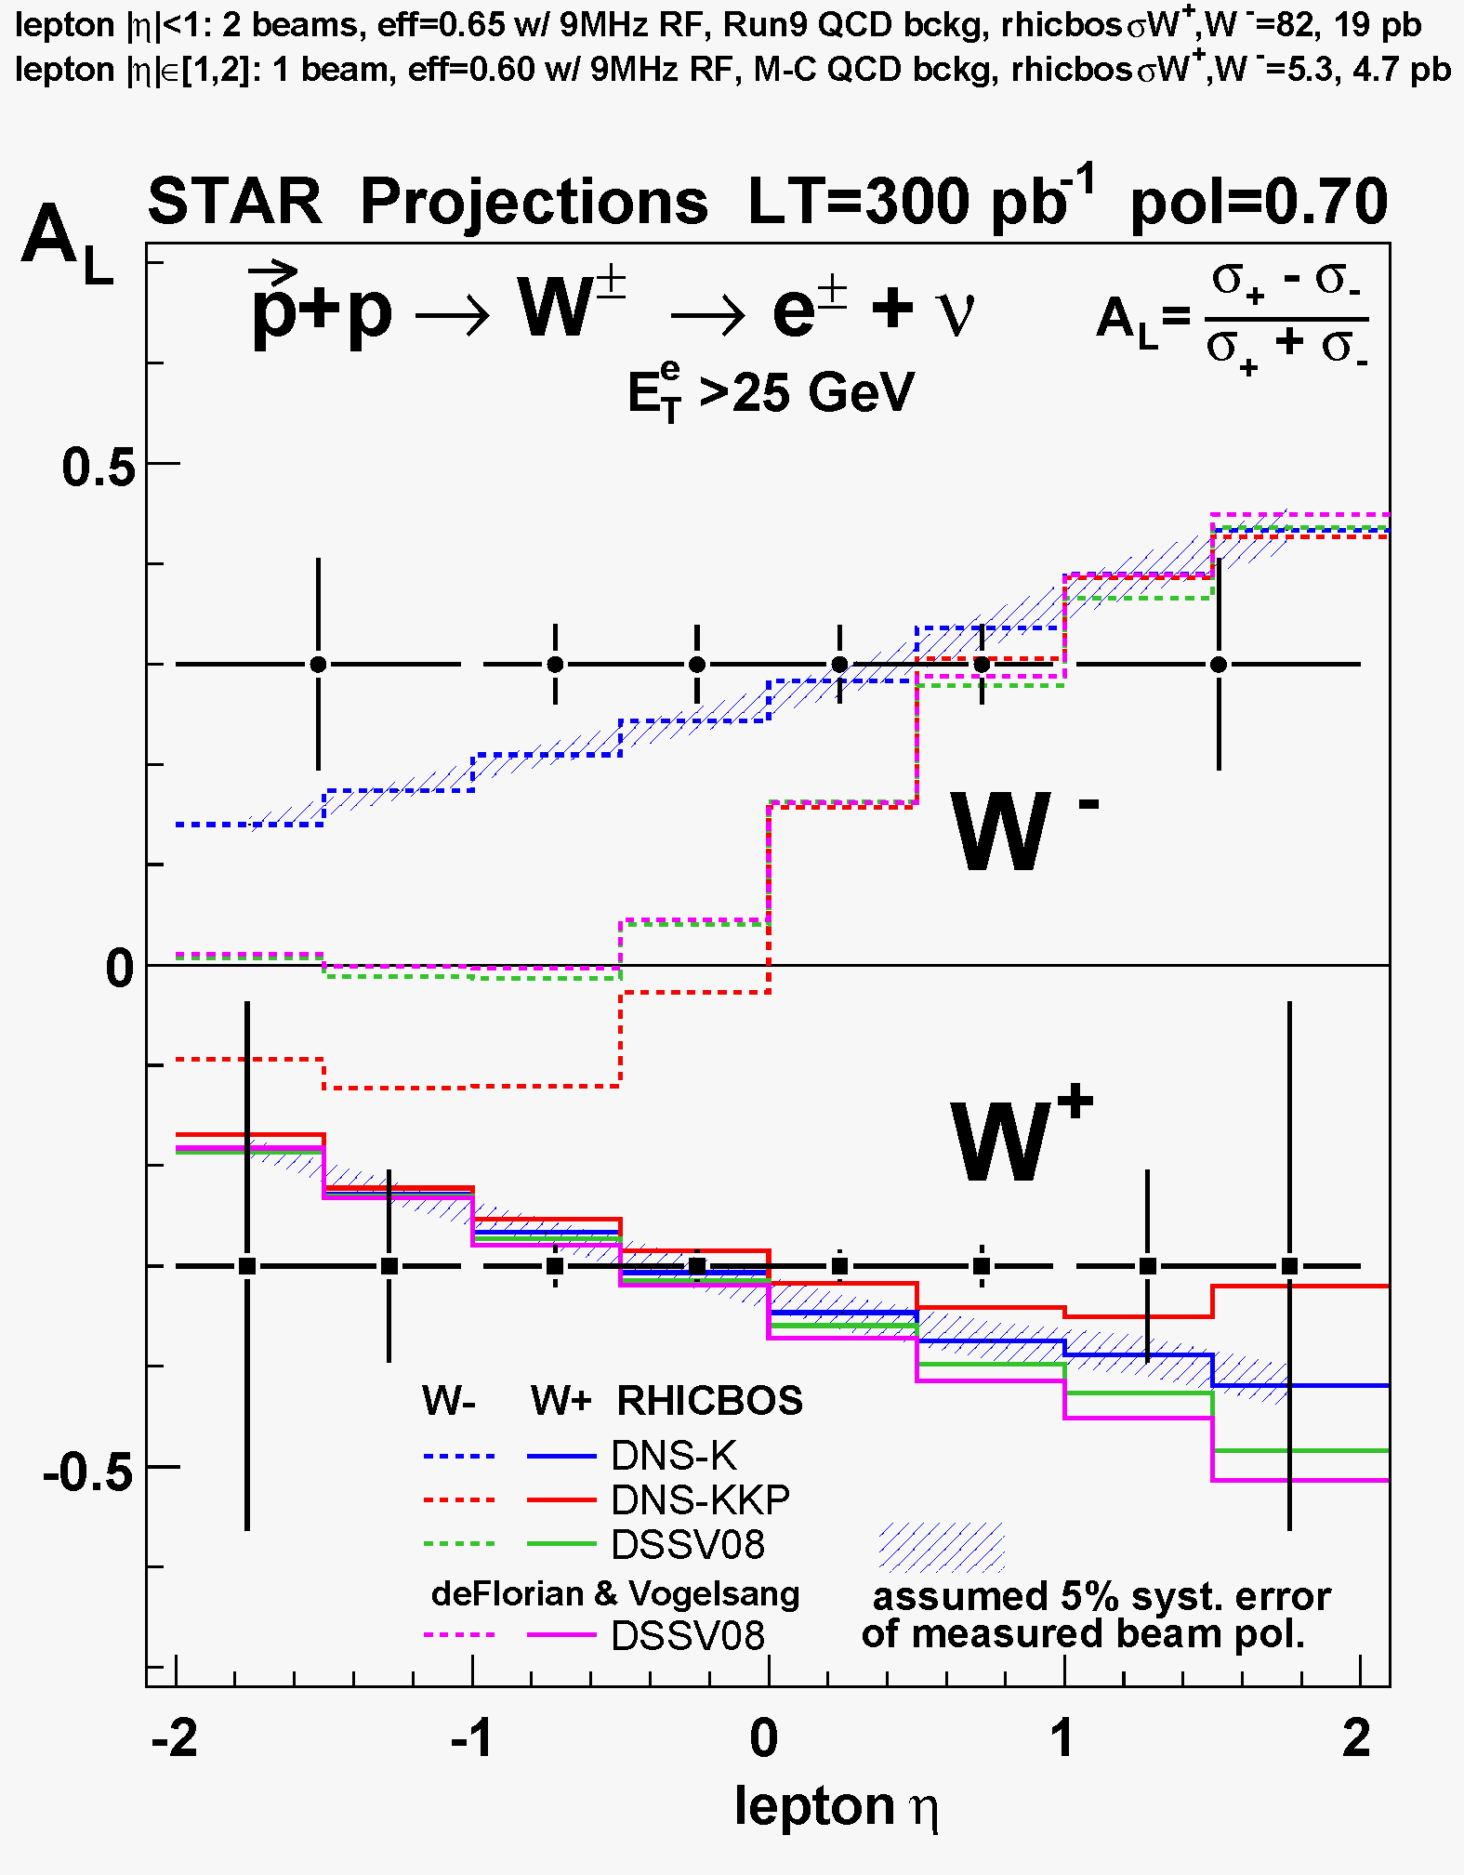
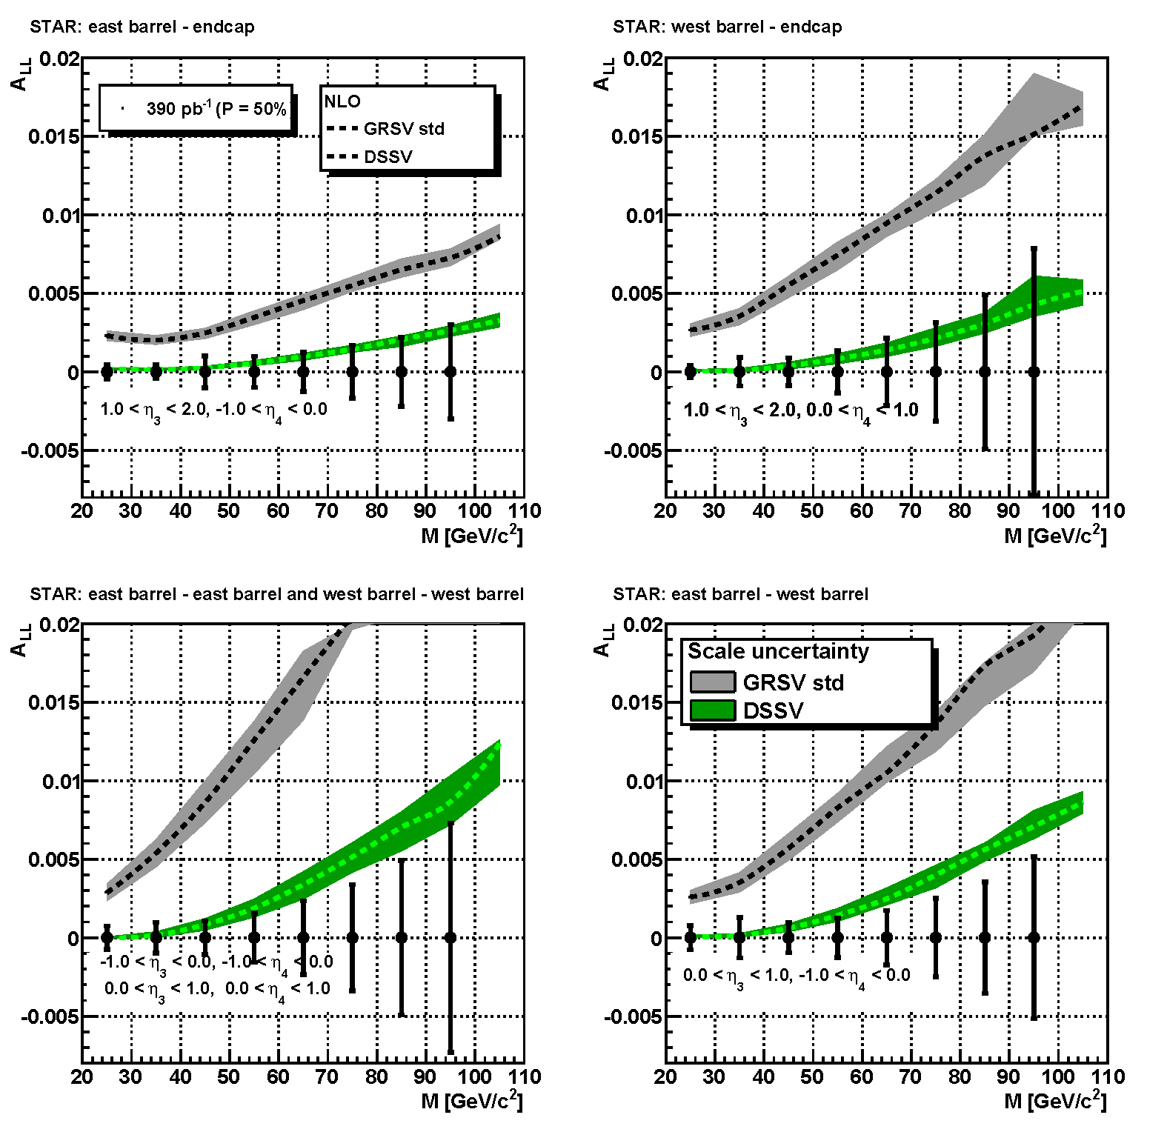
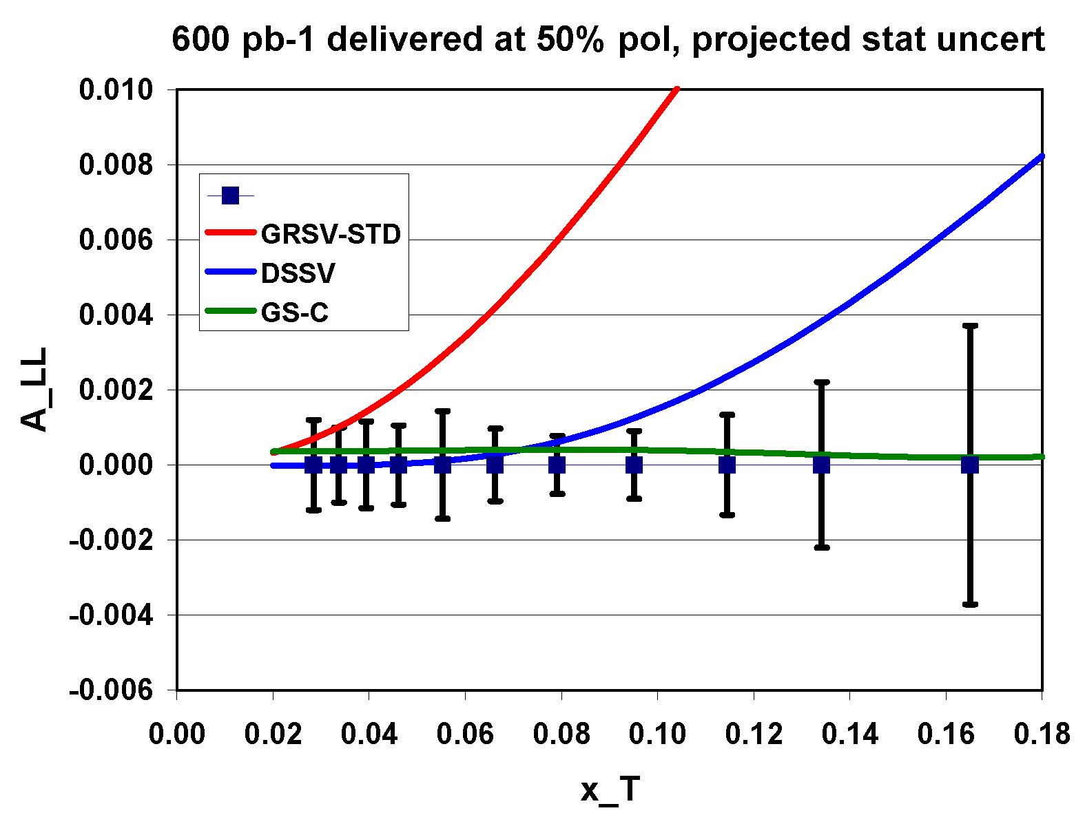
Anti-quark and gluon polarization with 500 GeV p+p
Assumes 600 pb⁻¹ delivered @ P = 50%
W measurement will significantly reduce uncertainties on anti-quark polarizations
FGT essential for the forward W’s
Inclusive jet and di-jet A_{LL} will extend our knowledge of gluon polarization to smaller-x

Slide 24
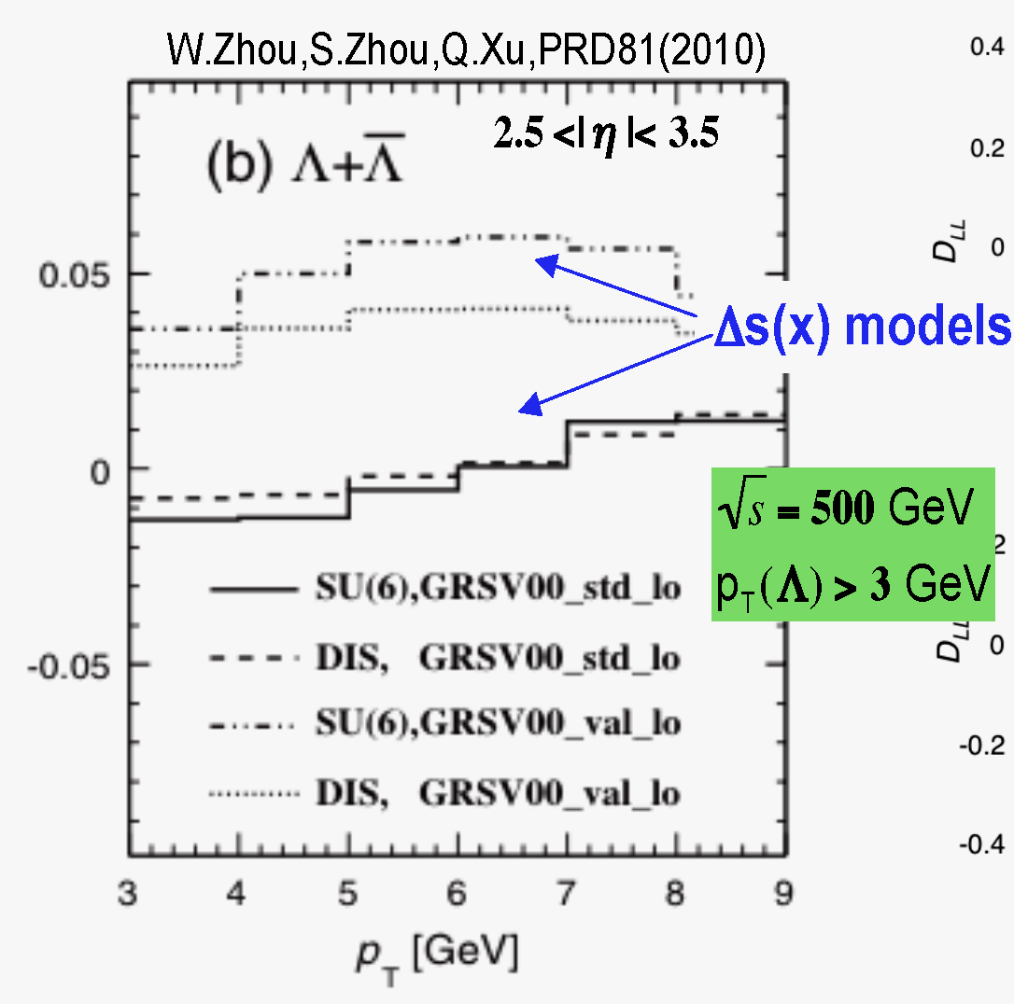
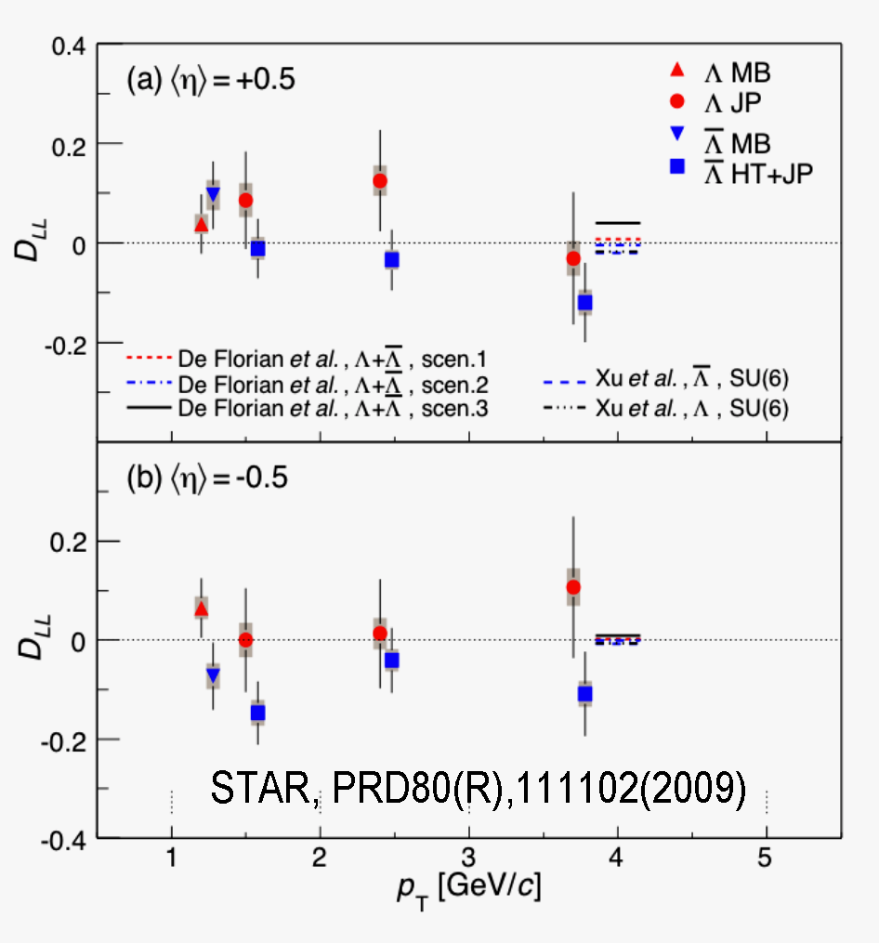
Accessing strange polarization with Λ
√s = 200 GeV, run-5 data, mid rapidity √s = 500 GeV, forward rapidity
STAR has performed initial Λ D_{LL} measurements at mid-rapidity
Provides access to strange quark polarization
Most interesting with quite high p_{T} Λ (trigger and statistics limited)
Similar measurements at forward rapidity are very promising
Requires the Forward Hadron Calorimeter

Slide 25
Some planned p+A measurements
Nuclear modifications of the gluon PDF
Access from charm production
Gluon saturation
Forward-forward correlations (extension of existing π⁰-π⁰)
h-h
π⁰-π⁰
γ-h
γ-π⁰
Drell-Yan
Able to reconstruct x₁, x₂, Q² event-by-event
Can be compared directly to nuclear DIS
True 2 →1 provides model-independent access to x₂ < 0.001
Λ polarization at high-xF (polarization sensitive to saturation scale)
polarized proton + A: Probing the saturation scale in the nucleus with asymmetries? (Z. Kang, F. Yuan PRD84 (2011))
Easier to measure
Easier to interpret

Slide 26
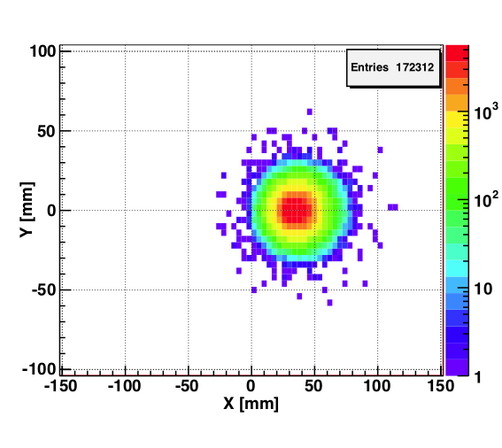
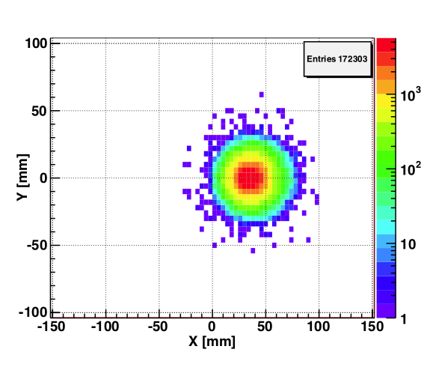
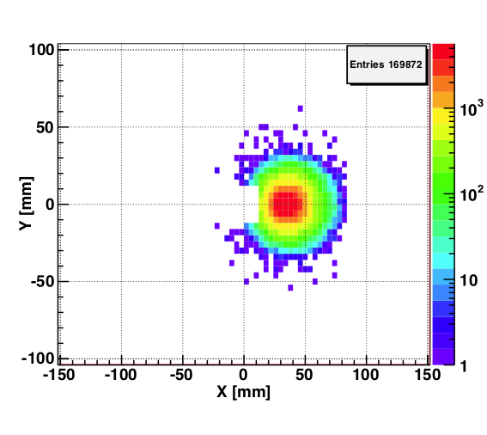
Spectator proton from ³He with the current RHIC optics
generated
Passed DX aperture
Accepted in RP
DPMJETIII + Hector simulation
The same RP configuration with the current RHIC optics (at z ~ 15m between DX and D0)
High acceptance (~ 98%) of spectator proton can be achived

Slide 27
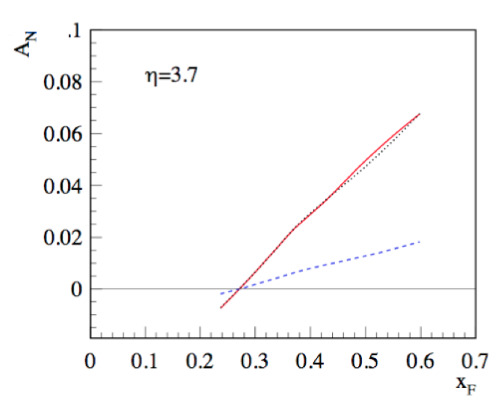
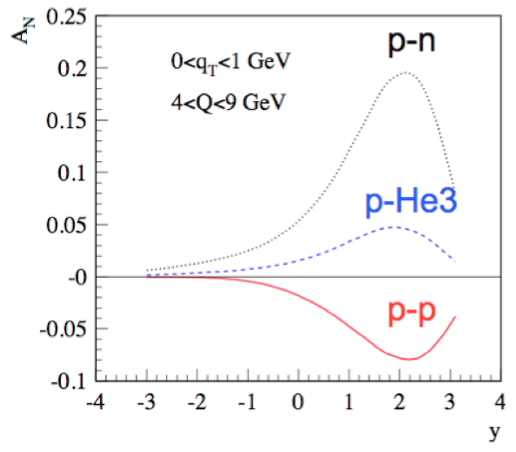
polarized n+p in ³He+p
√s=200GeV
Drell-Yan
π⁰
Z. Kang, Riken He3 Workshop (2011)
Spin-dependent distribution, Sivers function has opposite sign for u- and d-quark flavor
Polarized ³He could be used to confirm and verify this opposite sign

Slide 28
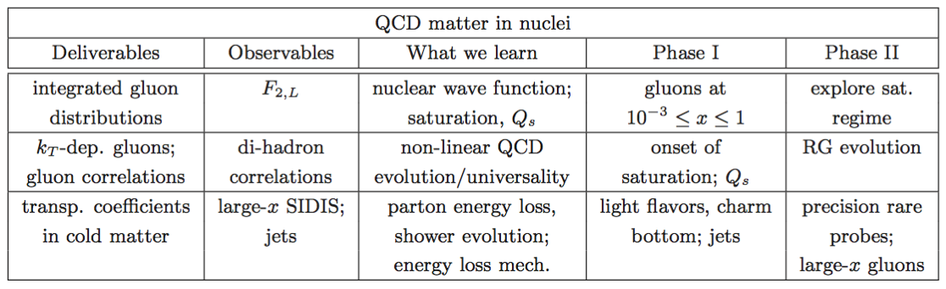

Golden Measurement in e+A
The EIC Science case: a report on the joint BNL/INT/JLab program (2011)

Slide 29
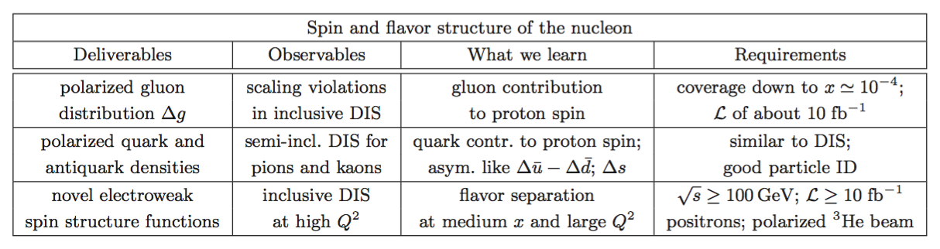

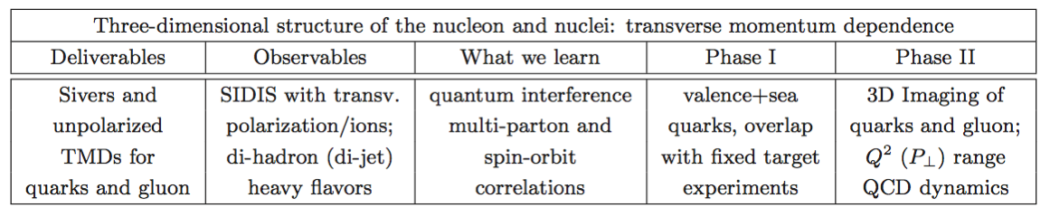

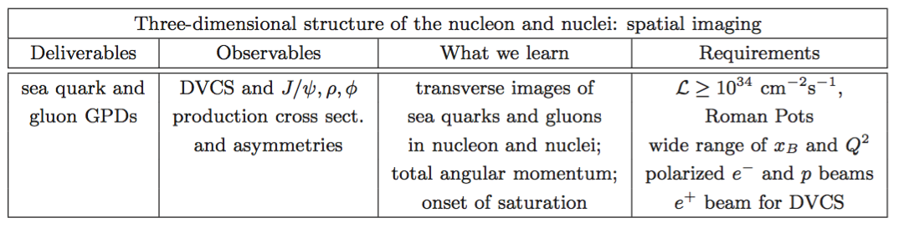
Golden Measurements in e+p

Slide 30
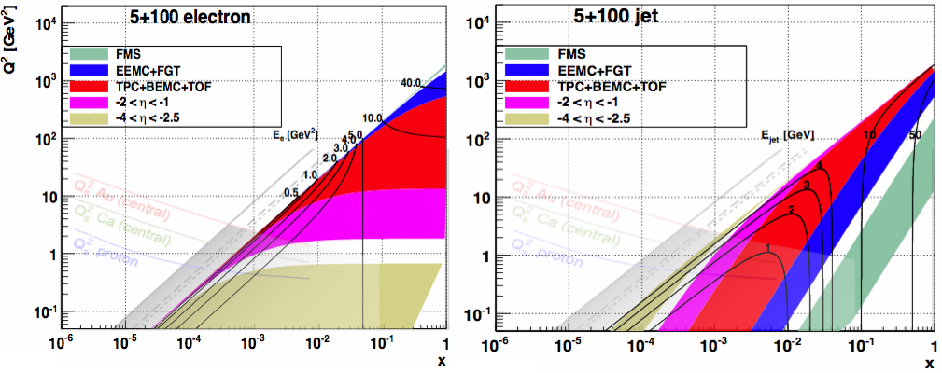
STAR at eRHIC - Phase 1
Current detector matches quite well to kinematics of eRHIC
Particle ID, sufficient p_{T} resolution, etc. at mid-rapidity (Q²>10 GeV²)
Space to extend: focus on 1<Q²<10 GeV² (-2 < η < -1)
Some important phase 1 measurements:
F_{L} in e+p and e+A
g₁ in polarized e+p
SIDIS in e+p and e+A over broad (x,Q²) range, including dihadron measurements.

Slide 31
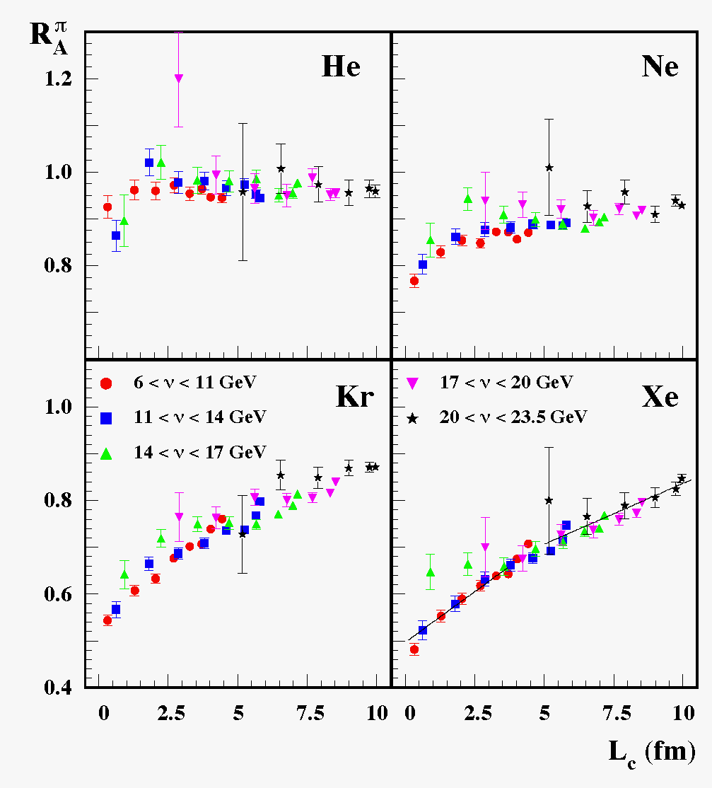
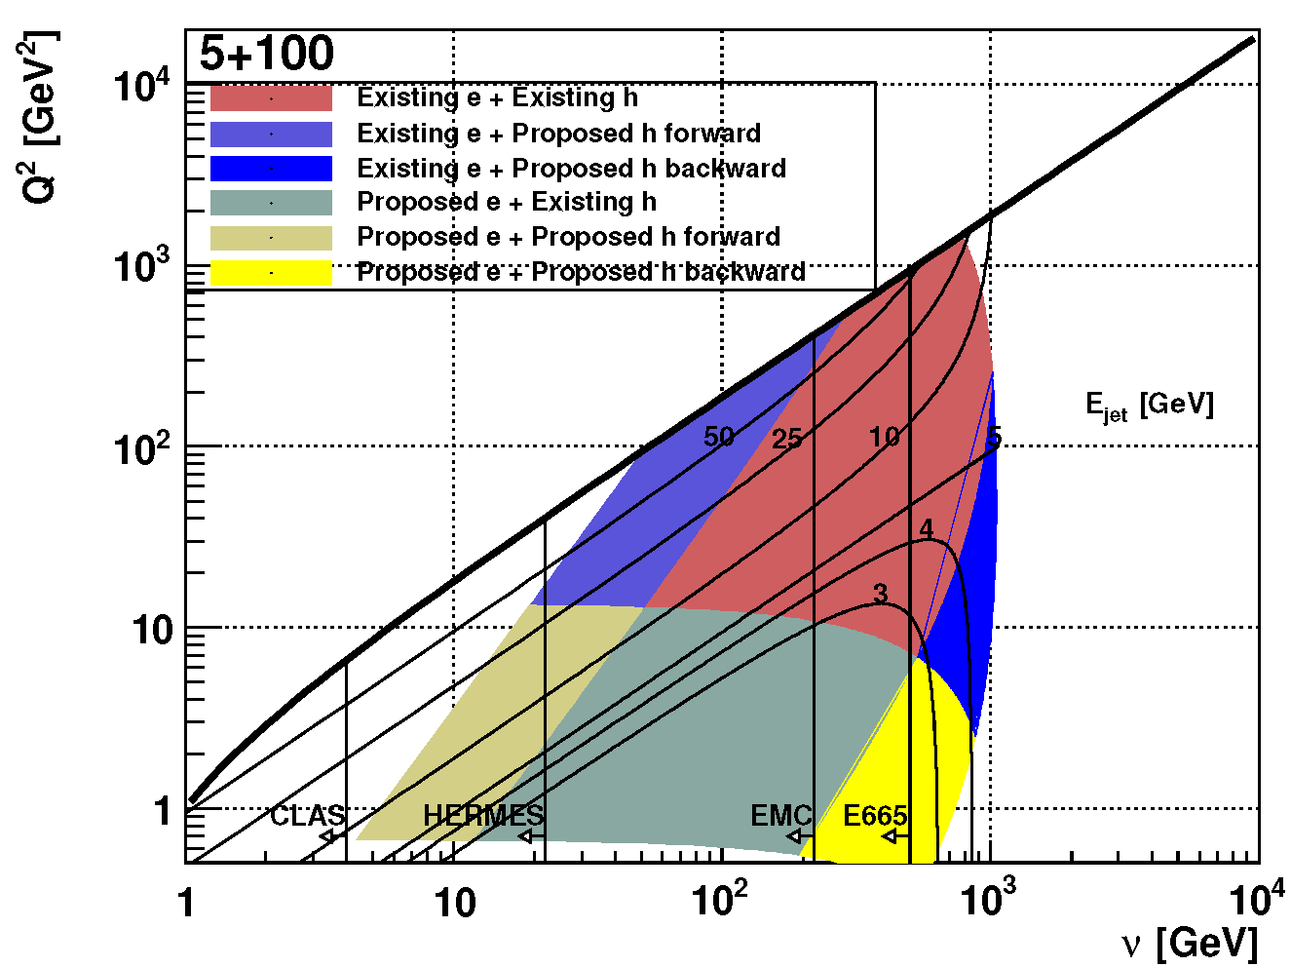
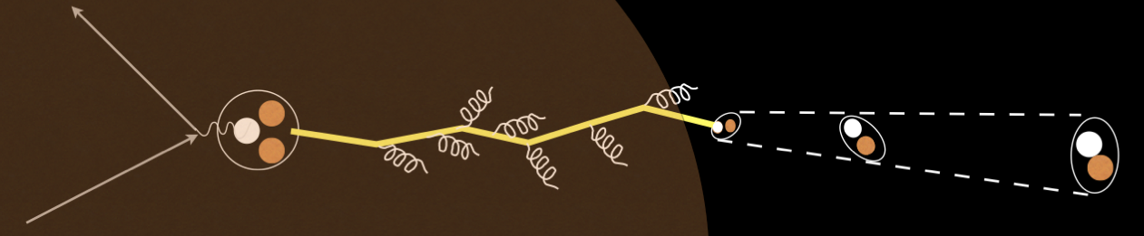
Parton energy loss in cold QCD matter
HERMES, NP B780, 1
L_{c} up to few 100 fm
Complementary tool to investigate partonic energy loss
HERMES: hadrons can form partially inside the medium
Mixture of hadronic absorption and partonic energy loss
eRHIC: light quark hadrons form well outside the medium
Heavy quarks: unexplored to date. Low β → short formation time

Slide 32
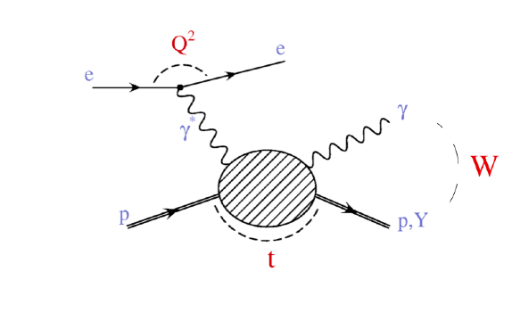
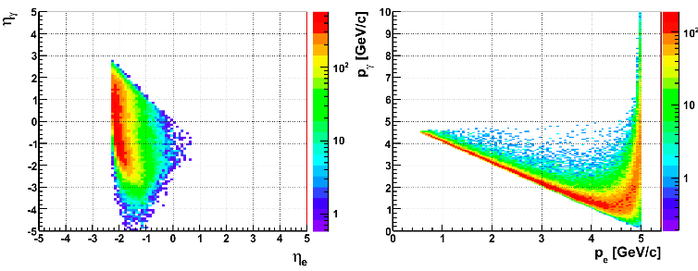
Beyond inclusive DIS: DVCS
Deeply Virtual Compton Scattering
Requires measurement of electron, proton, and photon exclusively
Proton requires Roman Pot, intimately tied to I.R. design
Aperture needs mostly driven by proton energy
Common device (Roman Pots) can be used for spectator tagging in ³He
Electron acceptance overlaps with inclusive DIS: -2<η<-1
Further possibilities under investigation: diffraction in J/ψ, …

