Slide 1
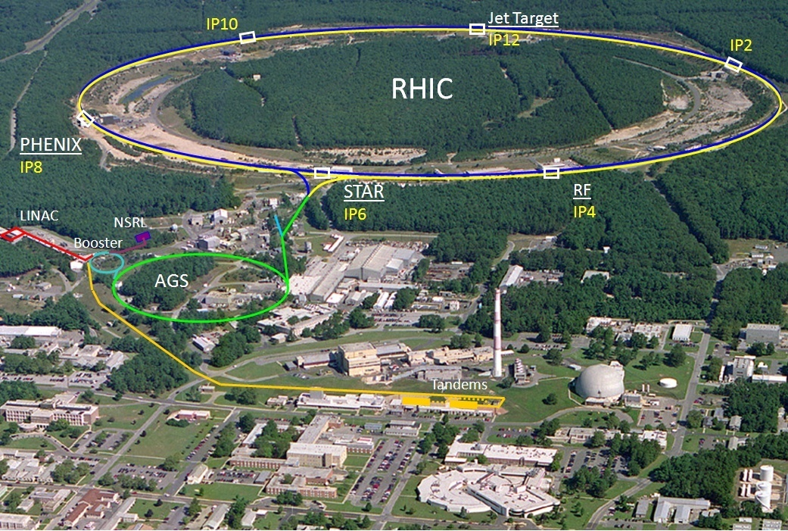
Relativistic Heavy Ion Collider 1 of 2 ion colliders (other is LHC), only polarized p-p collider
2 superconducting 3.8 km rings
2 large, 1 small experiments
100 GeV/nucleon Au
250 GeV polarized protons
Performance defined by
1. Luminosity L
2. Proton polarization P
3. Versatility (species, E)

Slide 2
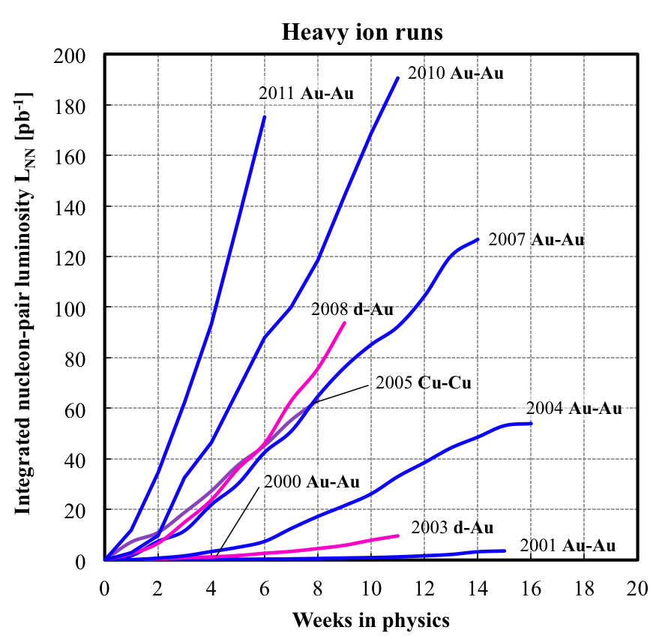
RHIC heavy ions – luminosity evolution to date
<L> = 15x design in 2011
About 2x increase in L_{int}/week each
Run-4 to Run-7
Run-7 to Run10
Run-10 to Run-11
Rate of progress will slow down – burn off 50% of beam in collisions already
L_{NN} = L N₁N₂ (= luminosity for beam of nucleons, not ions)

Slide 3
RHIC – effect of stochastic cooling in 2011
luminosity in 2 consecutive stores
Factor 2 gain in average luminosity from stochastic cooling so far – add horizontal cooling for Run-12
with long. and vert. stochastic cooling
w/o with cooling
w/o cooling
strong transverse cooling makes longitudinal cooling less efficient, i.e. these longitudinal profiles at the end of a store with be more pronounced with horizontal cooling next year
[hourglass factor 0.75 at beginning, 0.55 at end of store]
40ns
Notes:
Stores: 16024 (prematurely ended by YA2 drop) and 16025, PHENIX luminosity, luminosity gain 16025/16024 = 1.9 (with 4.1h length both)
Cooling period shown: fillno 16002 to 16006 (Fri 06/03/11 and Sat 06/04/11)

Slide 4
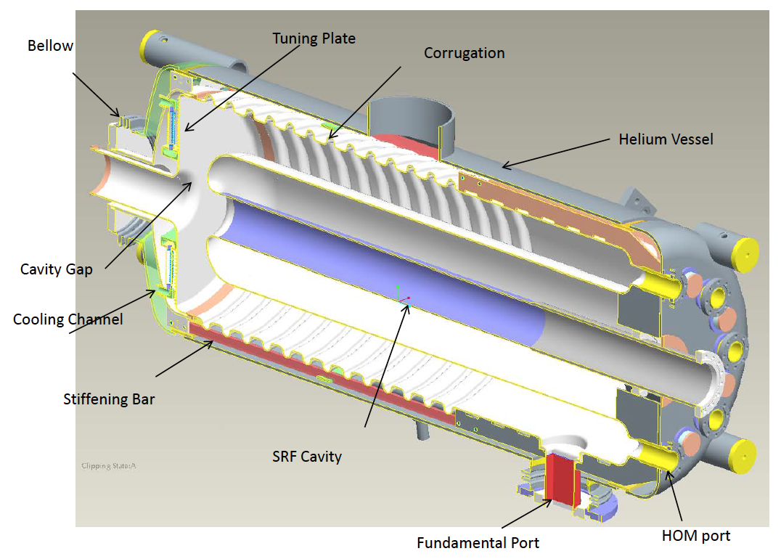
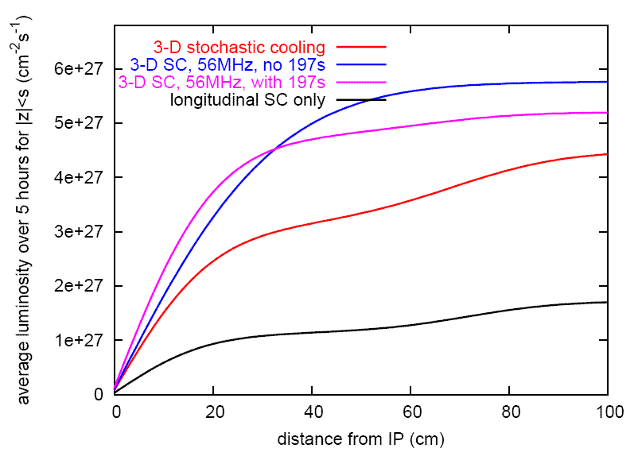
56 MHz SRF for heavy ions – under construction (I. Ben-Zvi et al.)
Longitudinal profile at end of store
even with cooling ions migrate into neighboring buckets
can be reduced with increased longitudinal focusing
Commissioning planned for 2014
40ns
40 ns
Average luminosity vs. vertex size
+ 56 MHz SRF
full 3D cooling
λ/4 Ni resonator
common to both beams
beam driven
56 MHz, 2 MV
demonstrated 2011 long. + ver. cooling
Calculations Calculation by M. Blaskiewicz
Notes:
Longitudinal profile: 11676 Blue

Slide 5
RHIC heavy ions – other luminosity limits
Operate close to a number of other limits:
Instabilities on ramp at transition (γ_{tr} = 26) driven by machine impedance and electron cloud
Beam loading during rf rebucketing limit removed last summer by separating common storage cavities
Intensity limit of beam dump (quench Q4) limit removed last summer by inserting sleeves in beam dump pipe
Bunch intensity limit from injector chain injected N_{b} = 1.5x10⁹ in Run-11
Chromatic aberrations with small β* about 50% of particle loss due to burn-off, other 50% largely due to off-momentum dynamic aperture tested β* squeeze in store after cooling to equilibrium
at limit in 2007
at limit in 2010
at limit in 2010
at limit in 2011
Above list changes from year to year as most limiting effects are mitigated.

Slide 6
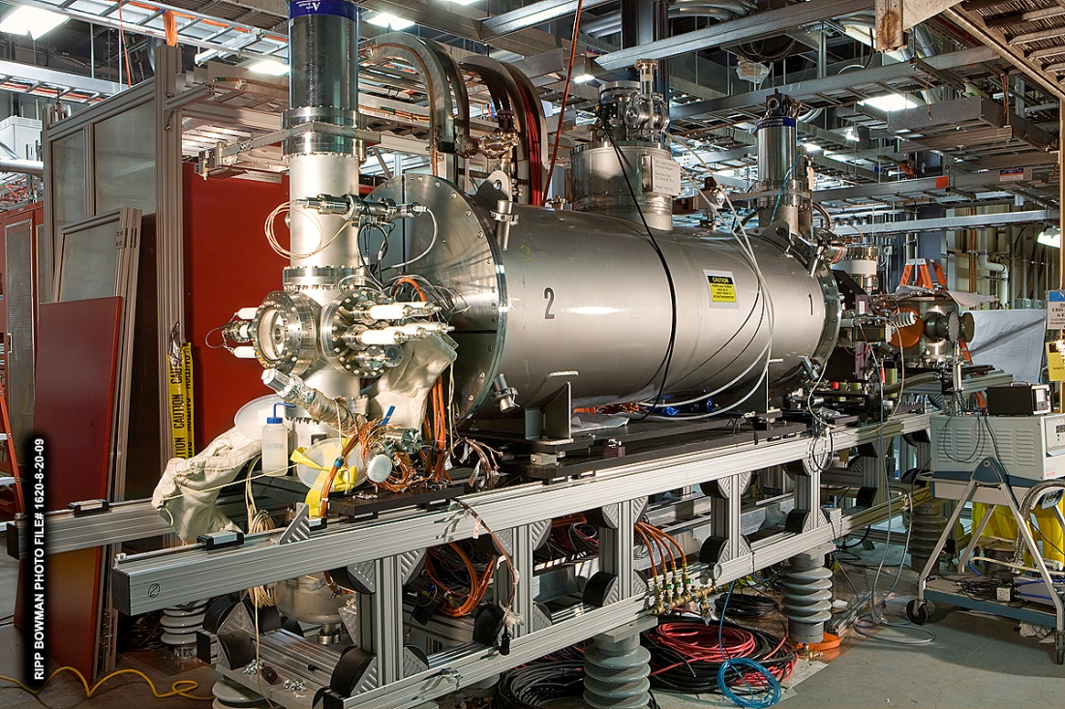
Electron Beam Ion Source (EBIS) (J. Alessi et al.)
10 A electron beam creates desired charge state(s) in trap within 5 T superconducting solenoid
Accelerated through RFQ and linac, injected into AGS Booster
All ion species incl. noble gas, uranium and polarized ³He
Operated for NSRL with
He⁺, He²⁺, Ne⁵⁺, Ne⁸⁺, Ar¹¹⁺, Ti¹⁸⁺, Fe²⁰⁺
Commissioning for RHIC Run-12 under way
Work on ~2x Au³²⁺ increase to design intensity (from transmission)
Received U cathode

Slide 7
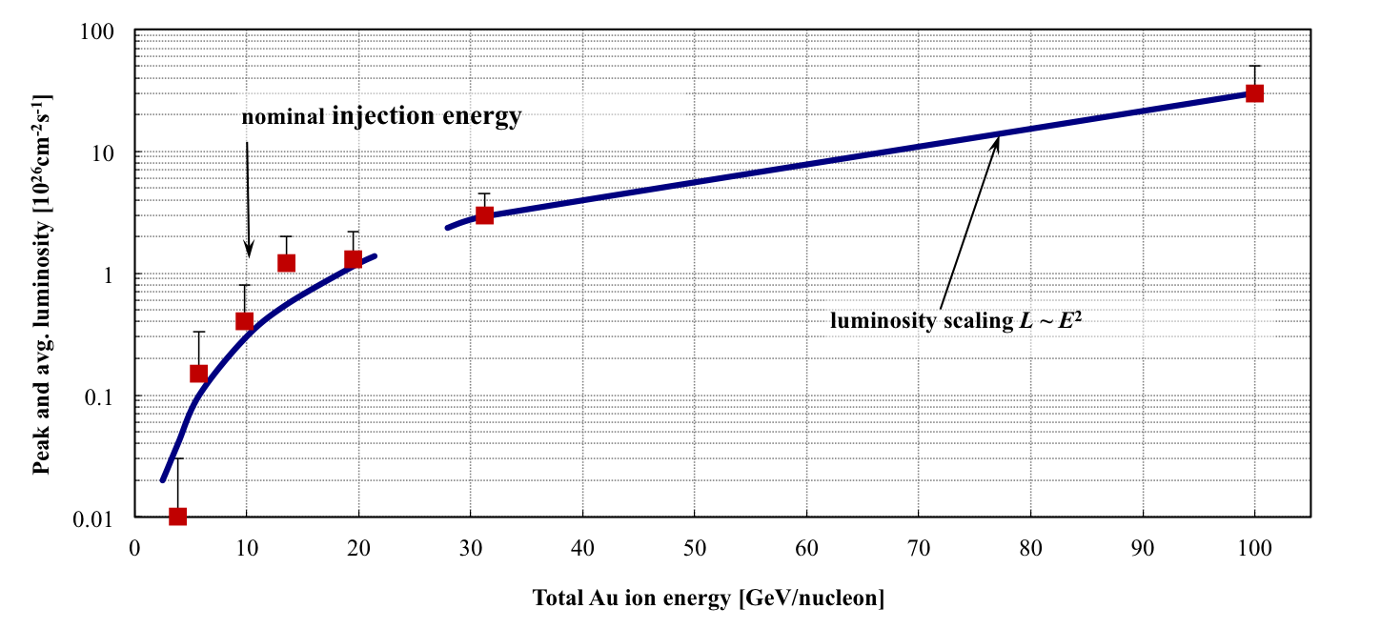
Au-Au energy scan to date
Peak and average luminosities fall faster than 1/γ² at lowest energies Need cooling at low energies to significantly increase luminosities

Slide 8
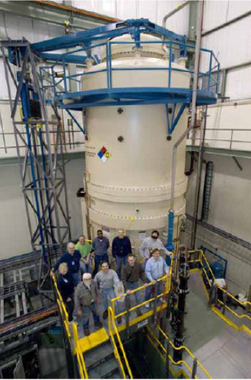
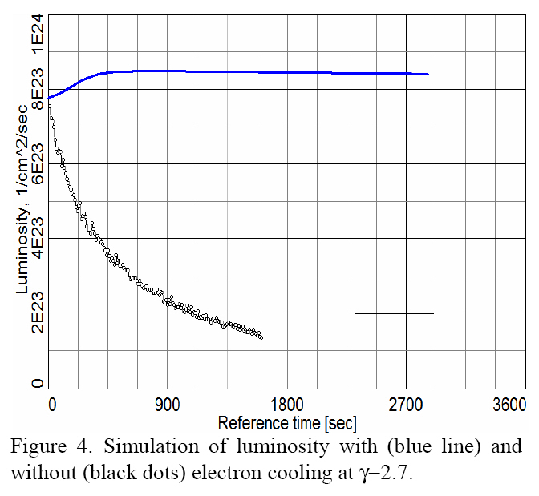
e-cooling for low energy collider operation (A. Fedotov et al.)
Fermilab Pelletron (cooled 8 GeV pbar for Tevatron use) usable – scheduled for decommissioning in 3/2012, so far have not requested transfer
Cooling into space charge limit ΔQ_{sc} ~ 0.05 (new collider regime)
with cooling
Expect up to factor 5 more integrated luminosity (depending on energy and ΔQ_{sc})
A. Fedotov et al. HB 2008
without cooling

Slide 9
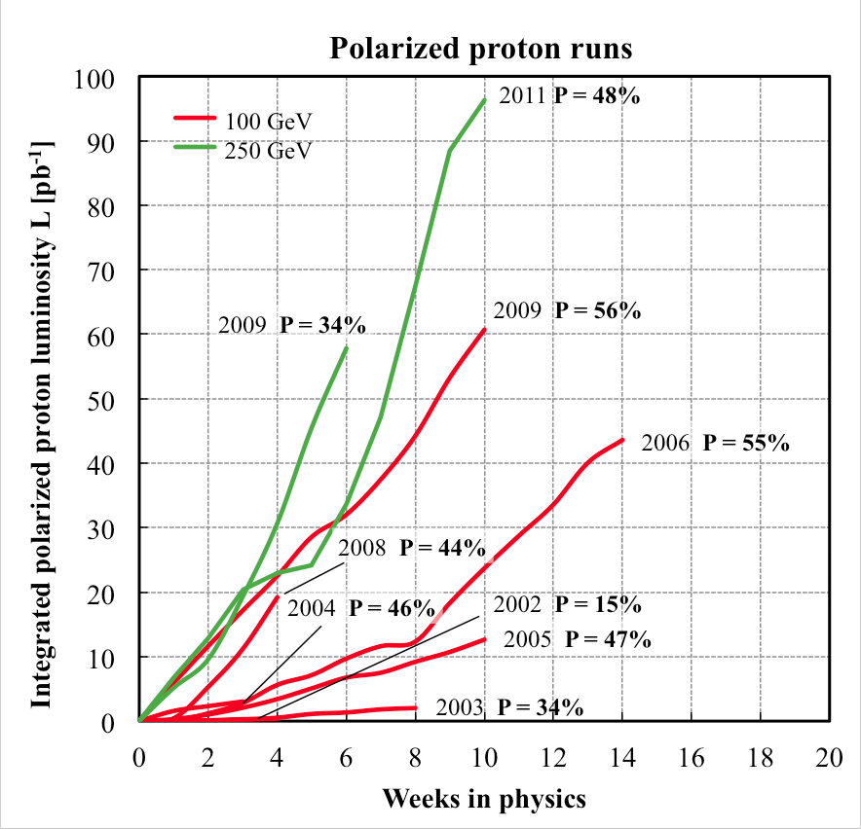
RHIC polarized protons – luminosity and polarization
At 250 GeV in 2011
L_{avg} = 90x10³⁰cm⁻²s⁻¹
P_{avg} = 48%
L_{avg} +60% rel. to 2009
P_{avg} +40% rel. to 2011
FOM = LP⁴ (longitudinally polarized beams)

Slide 10
A_{n}DY in 2011 (250 GeV pp)
Beam envelope function β* = 3.0 m at IP2
Reduced IP2 crossing angle from initially 2.0 mrad to zero
Added 3rd collision with following criteria:
N_{b} ≤ 1.5x10¹¹
Beam loss rate <15%/h in both beams
Not before first polarization measurement 3h into store
ξ/IP = 0.005
small impact
visible impact,
few percent loss to STAR/PHENIX
ξ/IP = 0.004
PHENIX
STAR
loss rates
AnDY
Notes:
Criteria in effect from 8 April 2011, 22:08

Slide 11
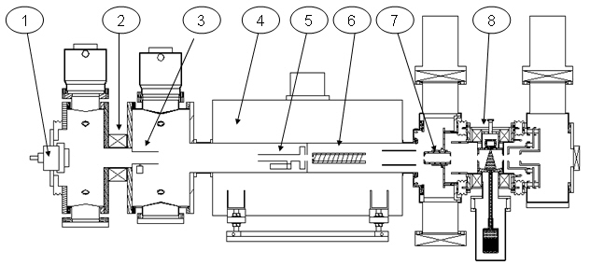
Optically Pumped Polarized H– source (OPPIS) – A. Zelenski
Upgraded OPPIS (2013)
Goals: 1. H⁻ beam current increase to 10mA (order of magnitude) 2. Polarization to 85-90% (~5% increase)
Upgrade components:
1. Atomic hydrogen injector (collaboration with BINP Novosibirsk)
2. Superconducting solenoid (3 T)
3. Beam diagnostics and polarimetry
Source Neutralizer Ionizer Rb-cell Sona Na-jet (H⁺) (H⁰) (H⁺) (H⁰) (H⁻)
sc solenoid
10x intensity increase was demonstrated in a pulsed operation by using a very high-brightness Fast Atomic Beam Source instead of the ECR source
Superconducting solenoid delayed – may have impact on commissioning schedule.

Slide 12
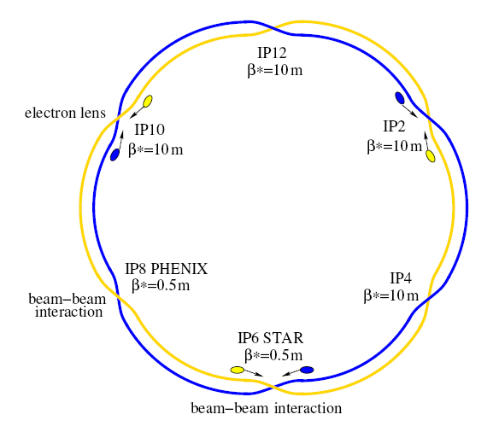
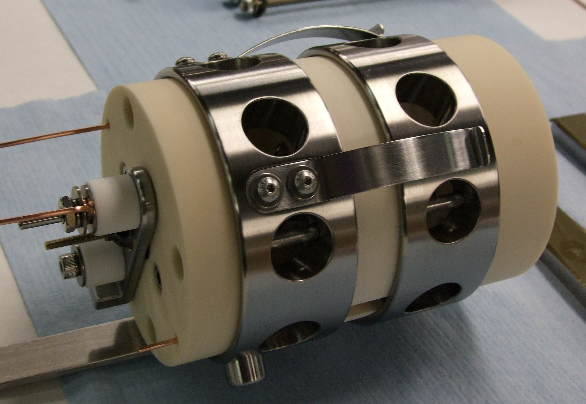
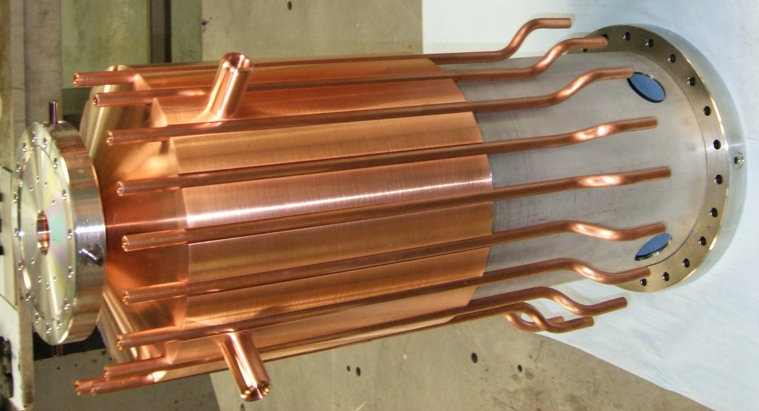
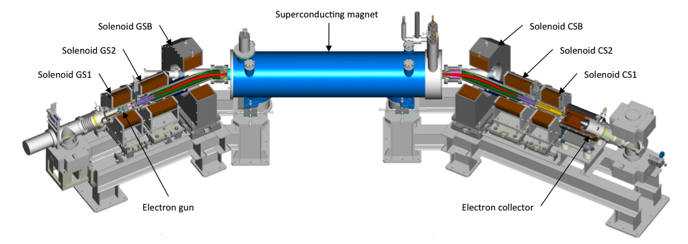
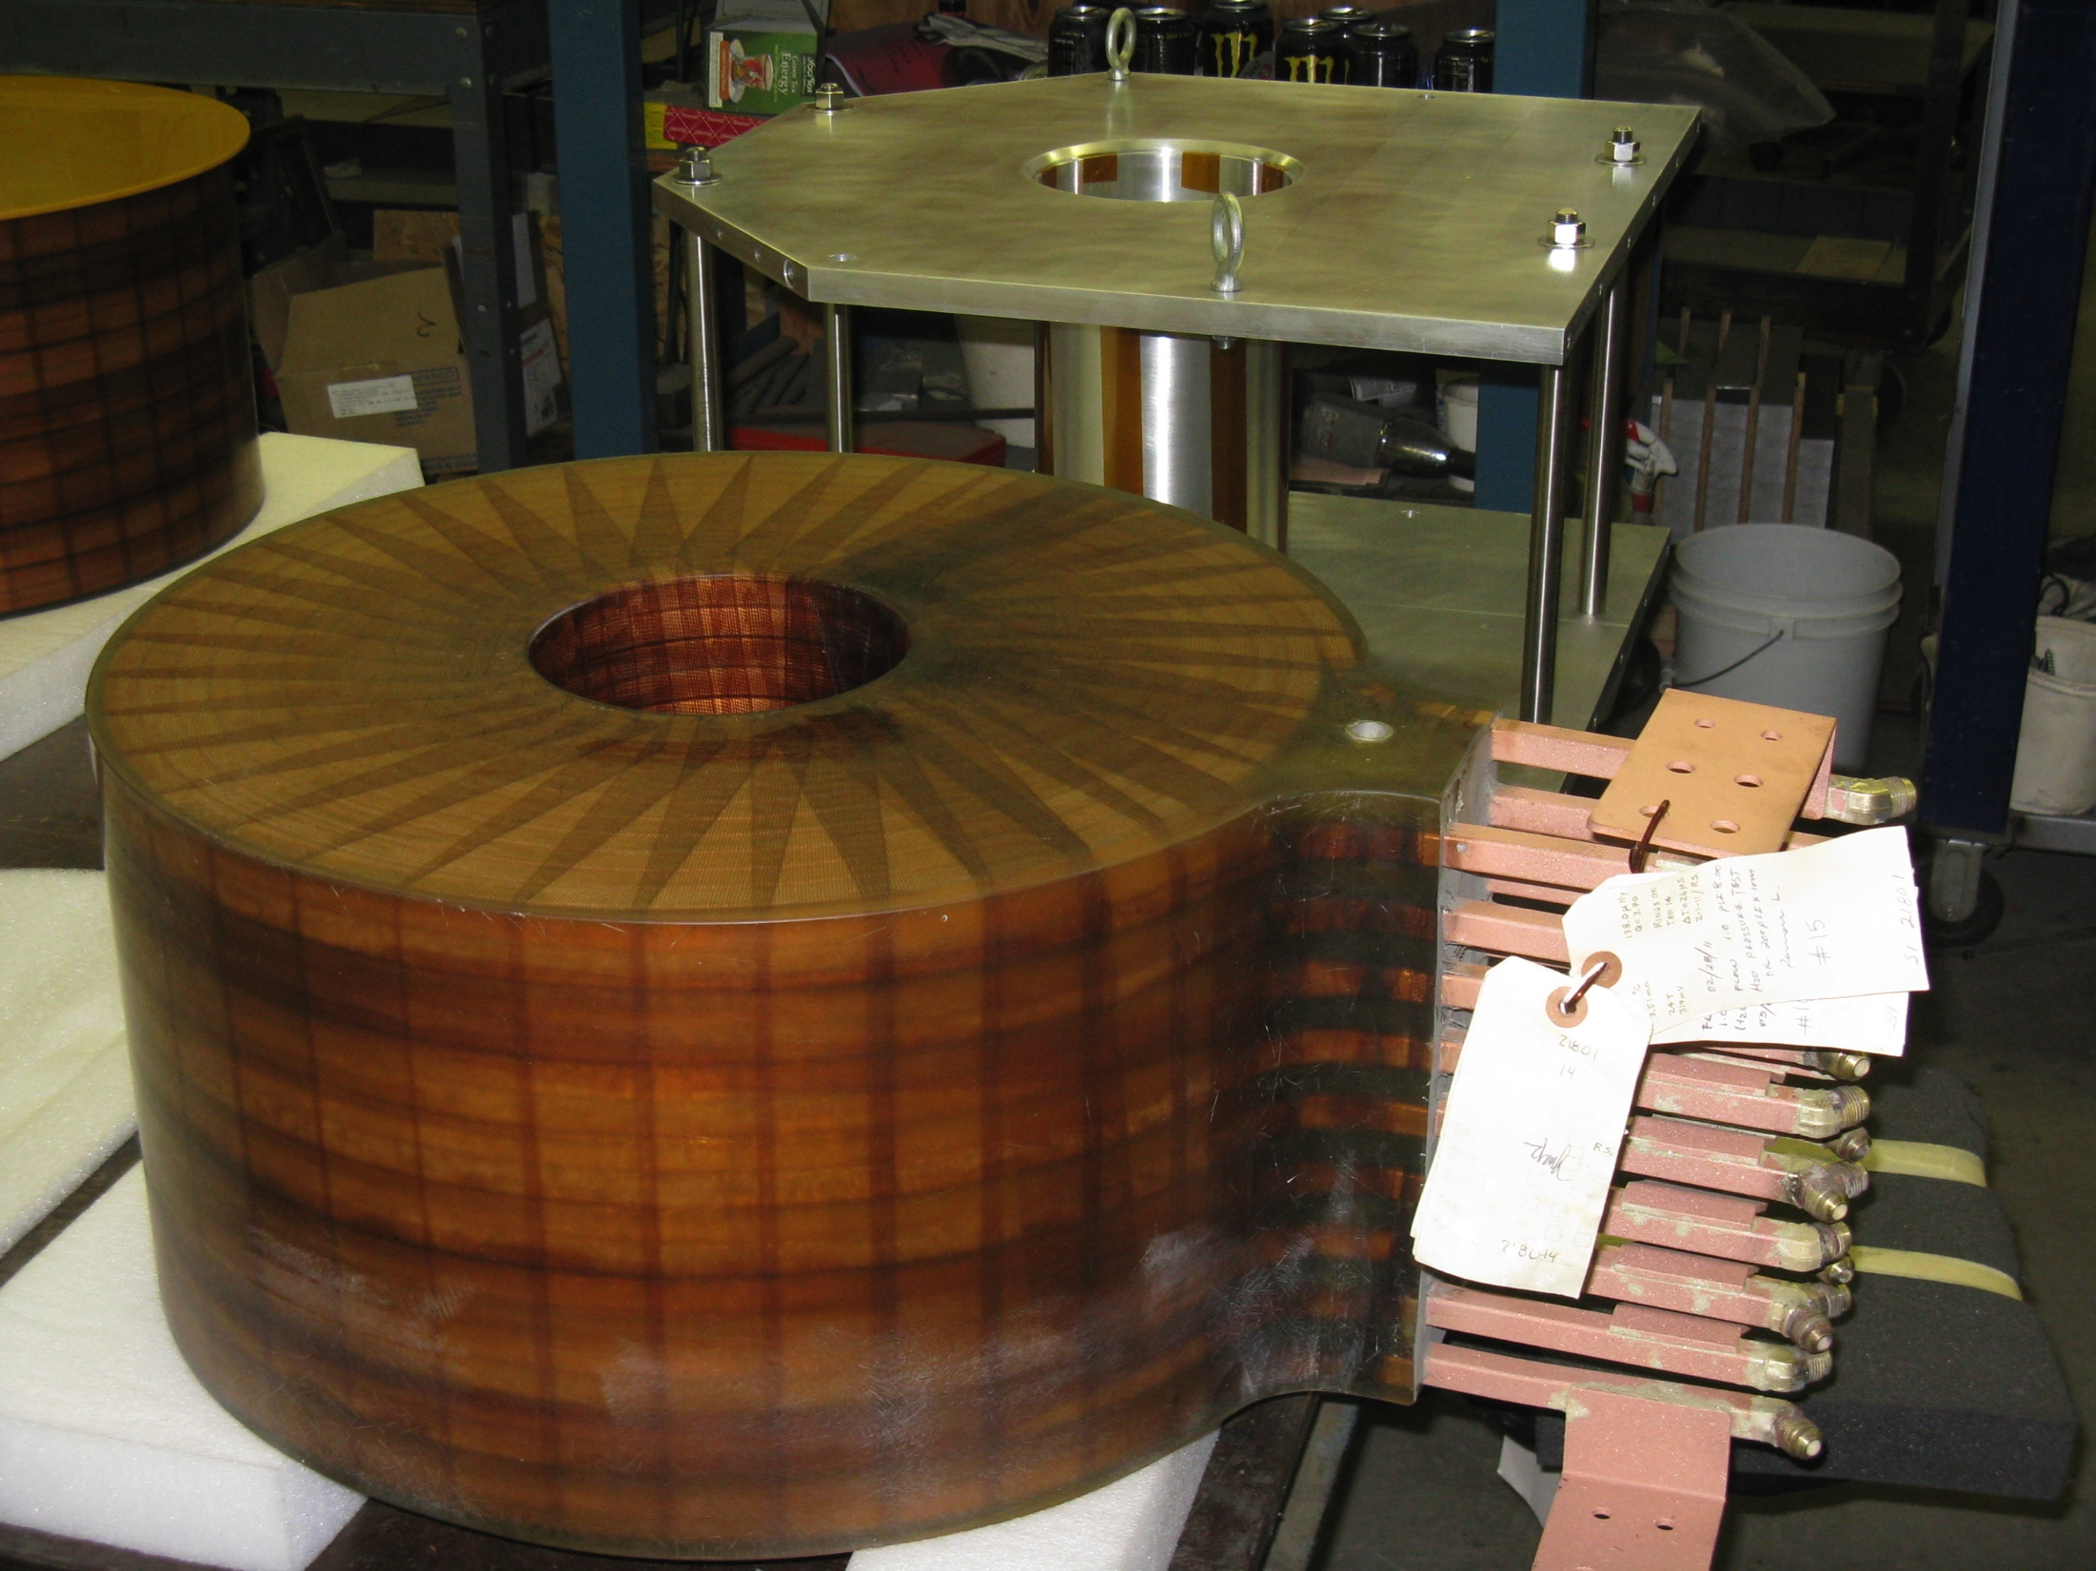
Electron lenses – partial head-on beam-beam compensation
Polarized proton luminosity limited by head-on beam-beam effect (ΔQ_{bb,max} ~ 0.02)
Basic idea: In addition to 2(3) beam-beam collisions with positively charged beam have another collision with a negatively charged beam with the same amplitude dependence.
-- Electron lenses are used in the Tevatron --
Exact compensation for:
short bunches
Δψ_{x,y} = kπ between p-p and p-e collision
no nonlinearities between p-p and p-e
same amplitude dependent kick from p-p, p-e
only approximate realization possible
Expect up to 2x more luminosity with OPPIS upgrade Commissioning planned for 2013
e-gun
e-collector
main solenoid manufacturing in SMD
GS1 manufacturing in industry

Slide 13
Polarized ³He – Workshop 28-30 September 2011
Developing plan for implementation
³Heh source being developed with MIT
³Heh in EBIS/Booster/AGS
³Heh in RHIC may require 6 snakes in 1 ring
Polarimetry
Implementation technically possible in ~3-4 years

Slide 14
High-luminosity polarized proton operation
Will probably not exceed L_{peak}~10³³cm⁻²s⁻¹ at √s = 500 GeV without cooling, or superbunches (say 6 bunches filling ½ circumference)
Coherent Electron Cooling PoP test in preparation (V. Litvinenko et al)
Collision scheme with crossing angle and cooling could boost luminosity by another factor ~5

Slide 15
RHIC luminosity and polarization goals
parameter |  | unit | achieved |  | goals
Au-Au operation |  |  | 2011 |  | ≥ 2014 3D stochastic cooling + 56 MHz SRF
energy | GeV/nucleon |  | 100 |  | 100
no colliding bunches | … |  | 111 |  | 111
bunch intensity | 10⁹ |  | 1.3 |  | ≥ 1.1
avg. luminosity | 10²⁶ cm⁻²s⁻¹ |  | 30 |  | 40
p↑-p↑ operation |  |  | 2009 / 2011 |  | ≥ 2012 |  | ≥ 2014 source + e-lenses
energy | GeV |  | 100 | 250 | 100 | 250 | 100 | 250
no colliding bunches | … |  | – 107 – |  | – 107 – |  | – 107 –
bunch intensity | 10¹¹ |  | 1.3 | 1.65 | 1.3 | 1.7 | 1.7 | 2.5
avg. luminosity | 10³⁰ cm⁻²s⁻¹ |  | 24 | 90 | 30 | 150 | 60 | 300
avg. polarization* | % |  | 56 | 48 | – 60 – |  | – 70 –
*Intensity and time-averaged polarization as measured by the H-jet. Luminosity-averaged polarizations, relevant in single-spin colliding beam experiments, are higher. For example, for intensity-averaged P = 48% and R_{x} = R_{y} = 0.2 (250 GeV, 2011), the luminosity-averaged polarization is P = 52%.

Slide 16
http://www.rhichome.bnl.gov/RHIC/Runs/

Slide 17
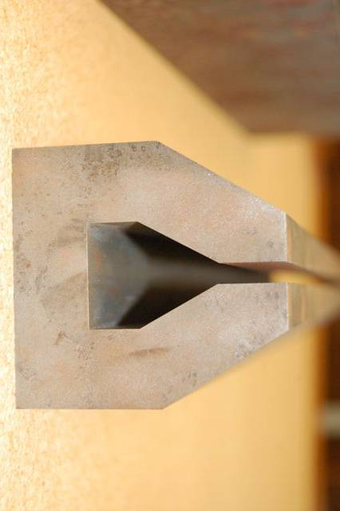
eRHIC Design
Vertically separated
recirculating passes.
# of passes will be chosen
to optimize eRHIC cost
eRHIC detector
injector
2 SRF linac
1 -> 5 GeV per pass
4 (6) passes
Coherent
e-cooler
20 GeV
e-beam
eRHIC-I & eRHIC: energy of electron beam is increased from 5 GeV to 30 GeV by building up the linacs
5 mm
15 GeV
e-beam
Design allows for:
multiple IP’s
reusing infra-structure + det. components for STAR, PHENIX?
easy up-grade
IR design to reach 10³⁴cm⁻²s⁻² luminosity
Common vacuum chamber
5 mm
10 GeV
e-beam
5 GeV
e-beam
5 mm
RHIC: 250 GeV p or 100 GeV/u Au with DX magnets removed
5 mm
ePHENIX
Gap 5 mm total
0.3 T for 30 GeV
eSTAR

