Slide 1

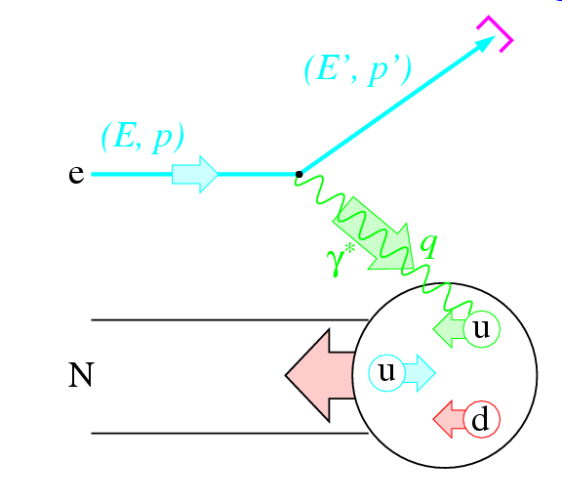
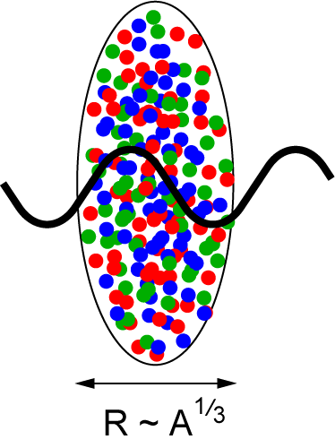
The Electron-Ion Collider:
Tackling QCD from the Inside
(of Nucleons and Nuclei) Out
Christine A. Aidala
Los Alamos National Lab
APS Division of Nuclear Physics Fall Meeting
October 27, 2011

Slide 2
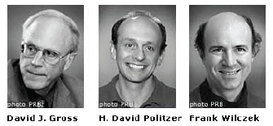
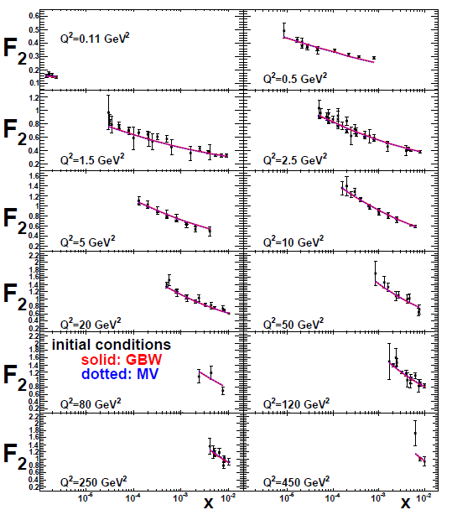
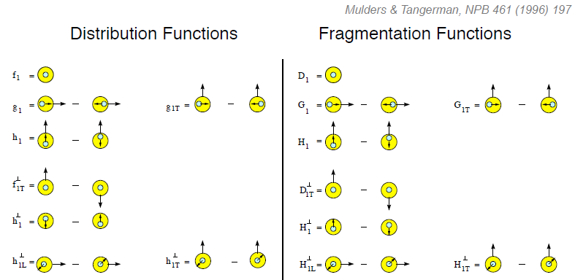
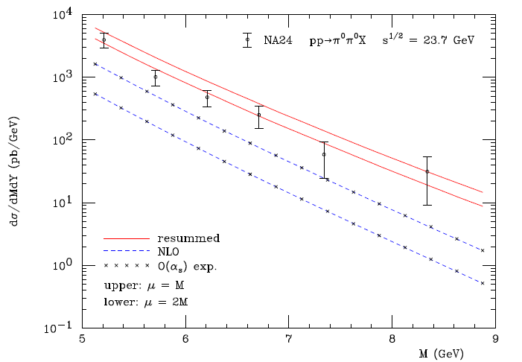
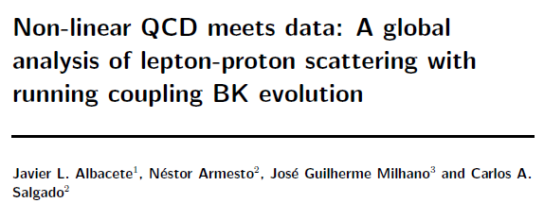
Entering a new era:
Quantitative QCD!
Transverse-Momentum-Dependent
QCD: Discovery and development
  1973 → ~2004
Since 1990s starting to consider detailed internal QCD dynamics that parts with traditional parton model ways of looking at hadrons—and perform phenomenological calculations using these new ideas/tools!
  Various resummation techniques
  Non-collinearity of partons with parent hadron
  Non-linear evolution at small momentum fractions
Mulders & Tangerman, NPB 461, 197 (1996)
Collinear
Worm gear
Almeida, Sterman, Vogelsang
PRD80, 074016 (2009)
PRD80, 034031 (2009)
Transversity
pp→π⁰π⁰X
Sivers
M (GeV)
Boer-Mulders
Pretzelosity
Worm gear

Slide 3
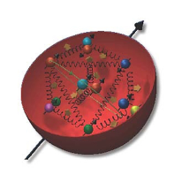
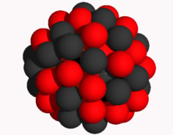
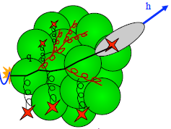
The Electron-Ion Collider
A facility to bring this new era of quantitative QCD to maturity!
How can QCD matter be described in terms of the quark and gluon d.o.f. in the field theory?
How does a colored quark or gluon become a colorless object?
Study in detail
  “Simple” QCD bound states: Nucleons
  Collections of QCD bound states: Nuclei
  Hadronization
Collider energies: Focus on
sea quarks and gluons

Slide 4
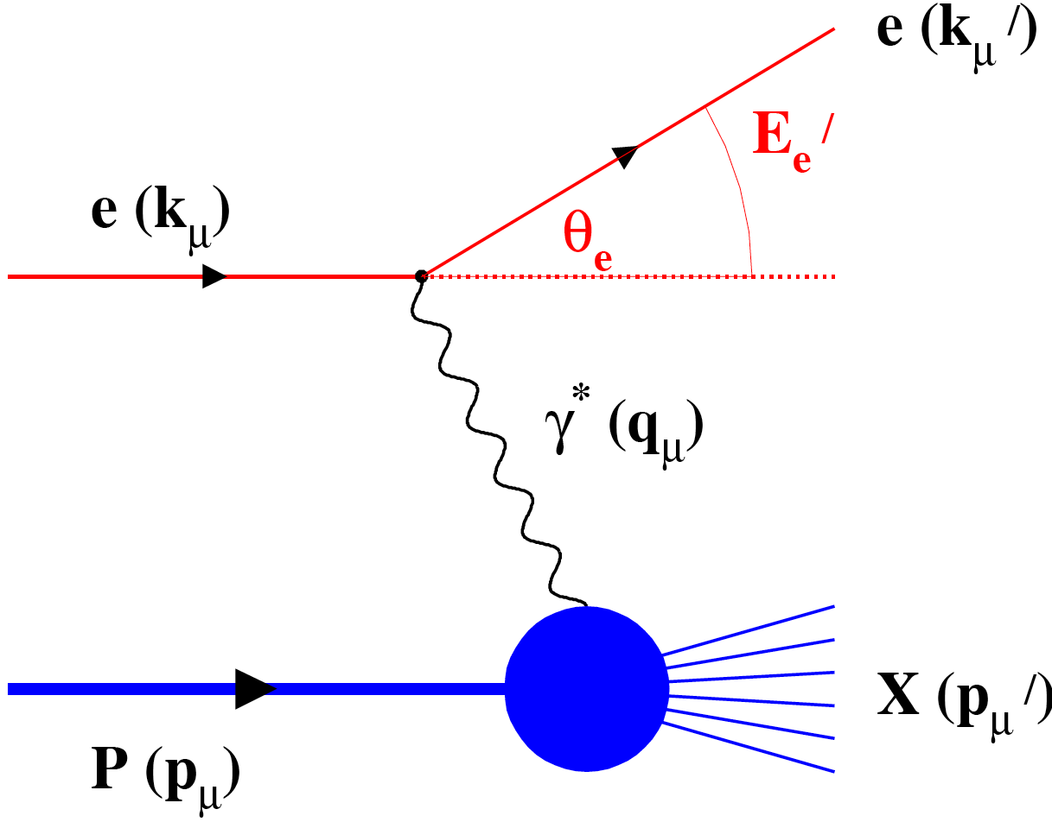
Why an Electron-Ion Collider?
Electroweak probe
  “Clean” processes to interpret (QED)
  Measurement of scattered electron → full kinematic information on partonic scattering
Collider mode → Higher energies
  Quarks and gluons relevant d.o.f.
  Perturbative QCD applicable
  Heavier probes accessible (e.g. charm, bottom, W boson exchange)
See A. Deshpande’s talk

Slide 5
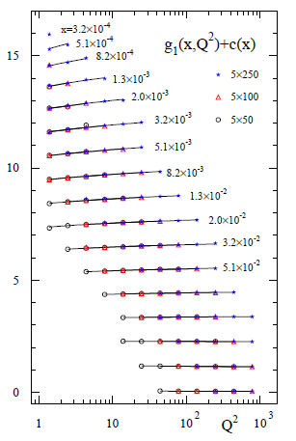
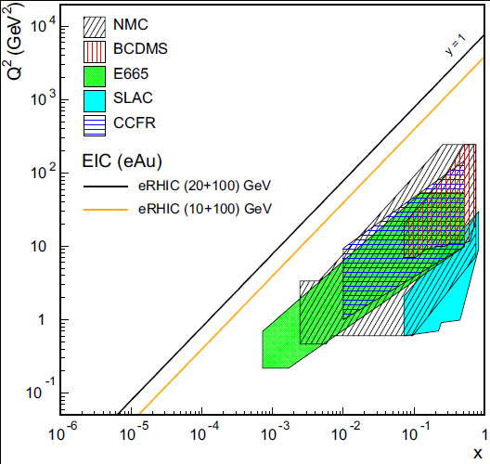
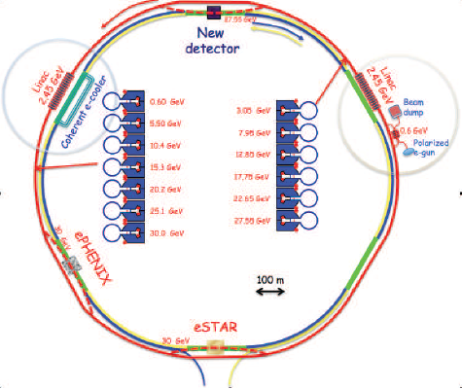
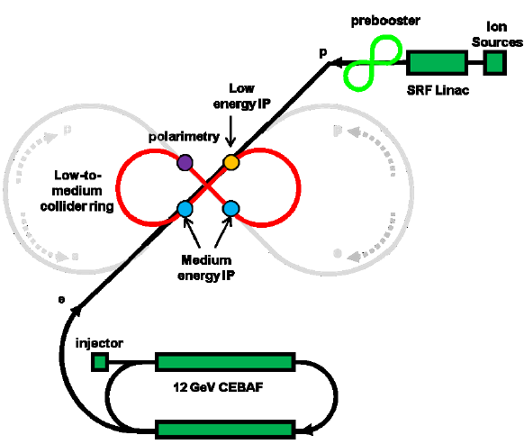
Accelerator concepts
Polarized beams of p, He³
  Previously only fixed-target polarized experiments!
Beams of light → heavy ions
  Previously only fixed-target e+A experiments!
Luminosity 100-1000x that of HERA e+p collider
Two concepts: Add electron facility to RHIC at BNL or ion facility to CEBAF at JLab
EIC
EIC (20x100) GeV
EIC (10x100) GeV
Notes:
Add sqrt(s) ranges?

Slide 6
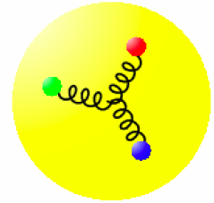
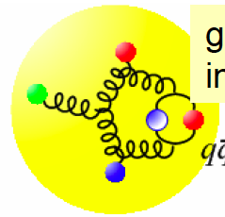
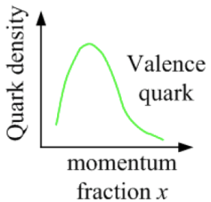
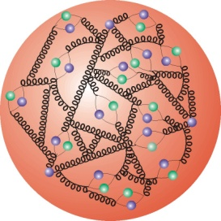
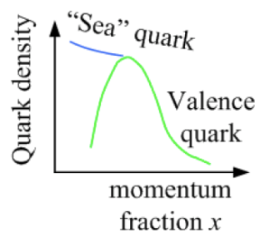
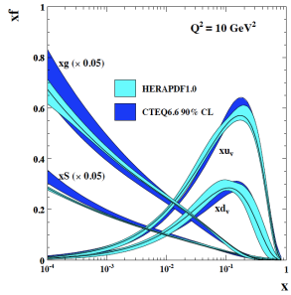
Accessing quarks and gluons through DIS
Kinematics:
Measure of resolution power
Measure of inelasticity
Measure of momentum fraction of struck quark
Gluon splits
into quarks
Quark splits
into gluon
splits
into quarks …
10⁻¹⁶m
10⁻¹⁹m
higher √s
increases resolution

Slide 7
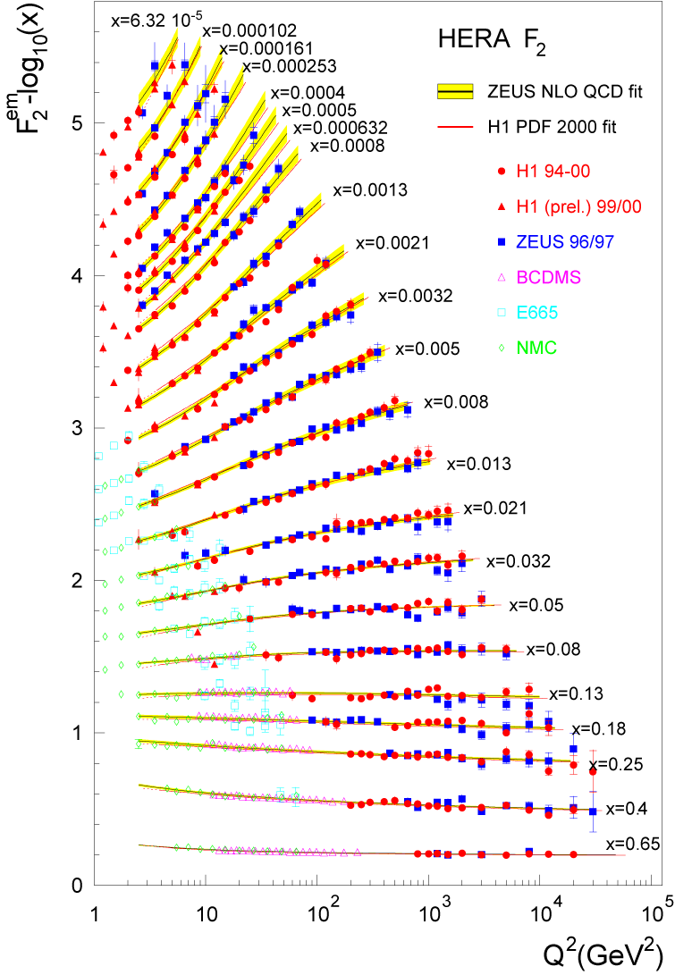
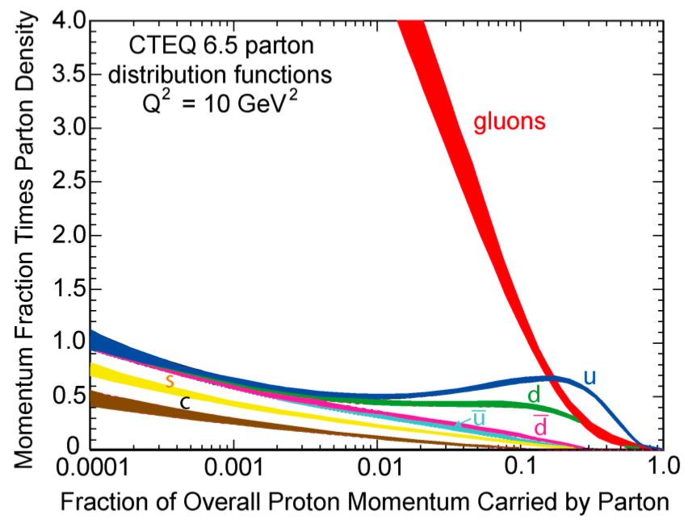
Accessing gluons with an electroweak probe
Access the gluons in DIS via scaling violations:
dF₂/dlnQ² and linear DGLAP evolution in Q² → G(x,Q²)
OR
Via F_{L} structure function
See R. Debbe’s talk
OR
Via dihadron production
→See L. Zheng’s talk
Gluons dominate
low-x wave function
Gluons in fact dominate
(not-so-)low-x wave
function!
!

Slide 8
Mapping out the proton
What does the proton look like in terms of the quarks and gluons inside it?
Position
Momentum
Spin
Flavor
Color
Theoretical and experimental concepts to describe and access position only born in mid-1990s. Pioneering measurements over past decade.
Vast majority of past four decades focused on
1-dimensional momentum structure! Since 1990s starting to consider other directions . . .
Polarized protons first studied in 1980s. How angular momentum of quarks and gluons add up still not well understood!
Early measurements of flavor distributions in valence region. Flavor structure at lower momentum fractions still yielding surprises!
Accounted for by theorists from beginning of QCD, but more detailed, potentially observable effects of color have come to forefront in last couple years . . .

Slide 9
Understanding proton spin: Pinning down Δg and revealing its functional form
1 month running
5x250 GeV²
(11x100 GeV²)
EIC projected uncertainty
Notes:
Mark all golden measurements or none

Slide 10
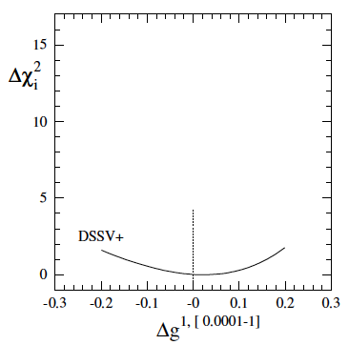
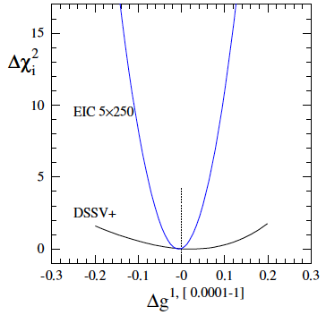
What can be achieved for Δg via scaling violations?
χ² profile significantly
narrower already
for one month of running
with 5 GeV x 250 GeV
or 11 GeV x 100 GeV
(11x100)
“DSSV+” includes also latest
COMPASS (SI)DIS data
(no impact on DSSV Δg)
DSSV: PRL 101, 072001 (2008); PRD 80, 034030 (2009)

Slide 11
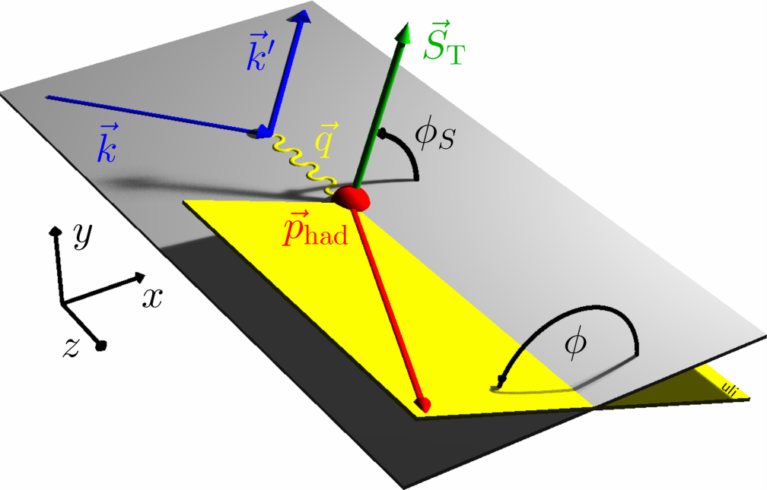
Probing spin-momentum correlations in the nucleon: Measuring transverse-momentum-dependent distribution and fragmentation functions
angle of hadron relative to final quark spin (Collins)
Collins
angle of hadron relative to initial quark spin (Sivers)
Angular dependences in semi-inclusive DIS
isolation of the various TMD distribution and fragmentation functions
(not just Sivers and Collins!)
Sivers

Slide 12
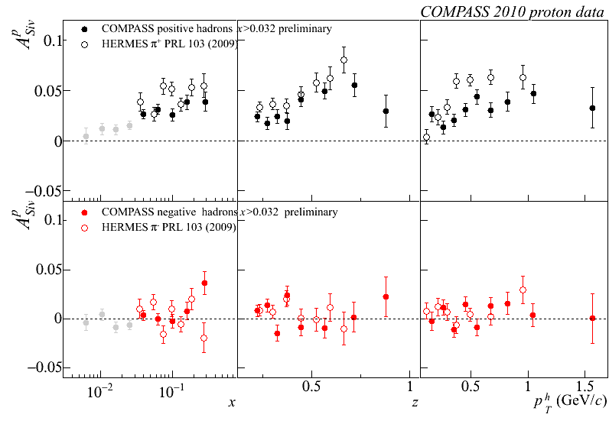
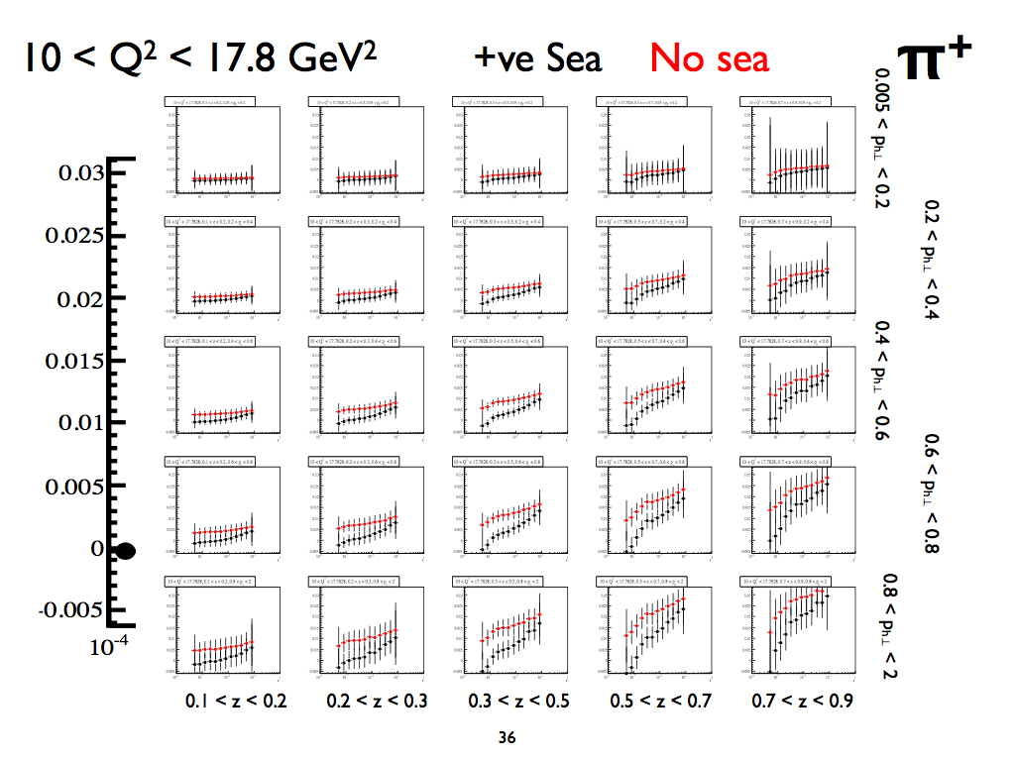
Example: Sivers function
HERMES and COMPASS:
EIC: 1 month @ 20 GeV x 250 GeV
Measure single transverse-spin asymmetry vs. x differentially in p_{T} and z.
Spin-momentum correlation of several percent observed for π⁺ production from a transversely polarized proton!

Slide 13
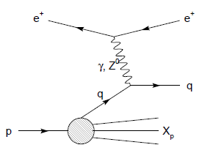
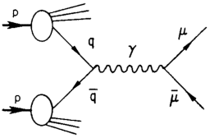
Modified universality of Sivers transverse-momentum-dependent distribution:
Color in action!
Semi-inclusive DIS: attractive final-state
interaction
Drell-Yan:
repulsive initial-state
interaction
Comparing detailed measurements in polarized semi-inclusive DIS and polarized Drell-Yan will be a crucial test of our understanding of quantum chromodynamics!
As a result:

Slide 14

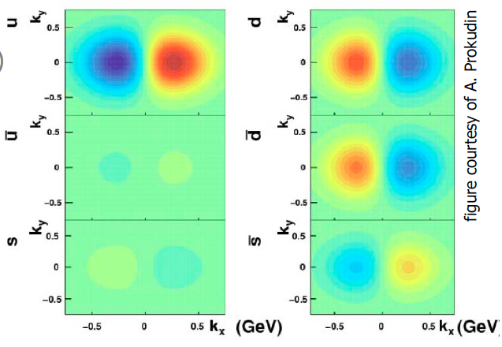
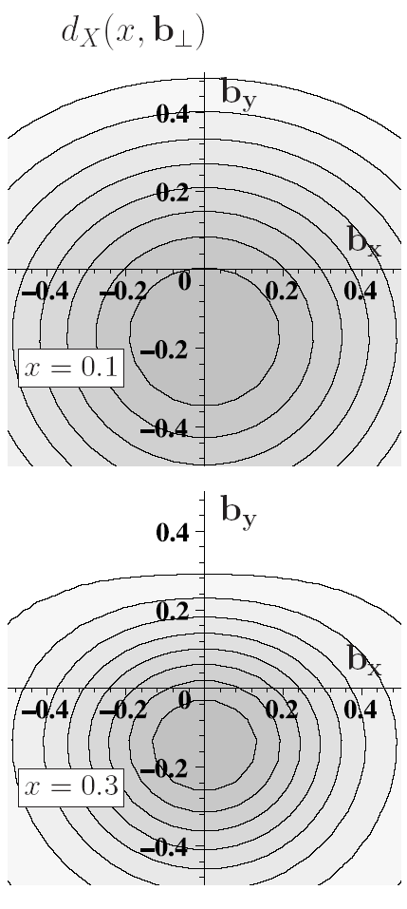
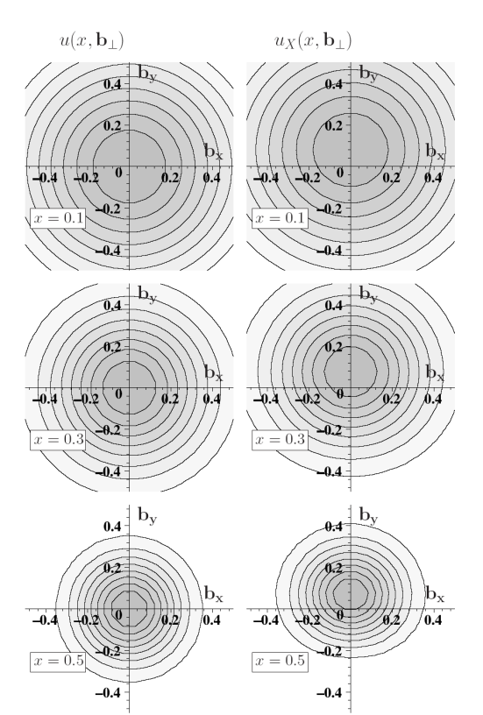
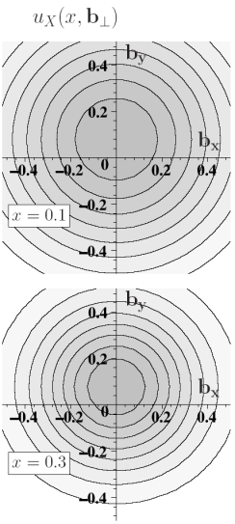
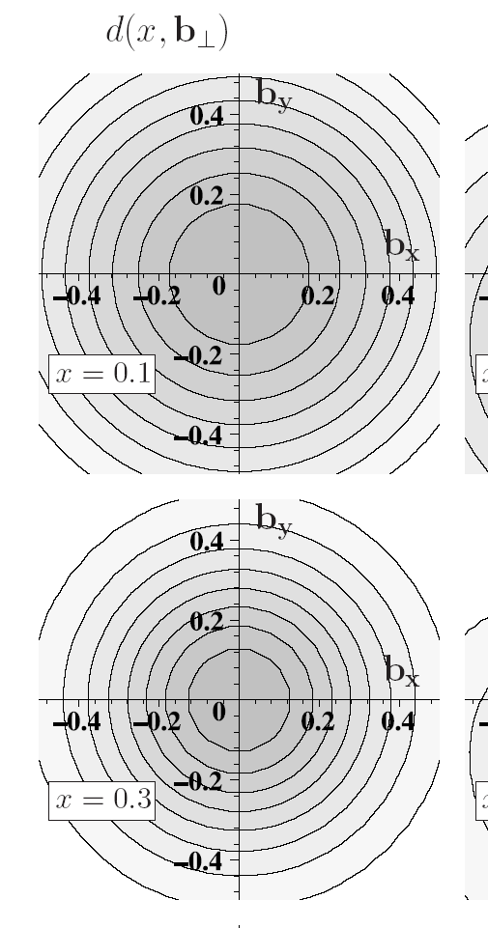
3D quantum phase-space tomography of the nucleon
Wigner Distribution
W(x,r,k_{t})
TMDs
GPDs
3D picture in momentum space:
  transverse-momentum-dependent distributions
3D picture in coordinate space:
  generalized parton distributions
u-quark
Polarized p
d-quark
Polarized p

Slide 15
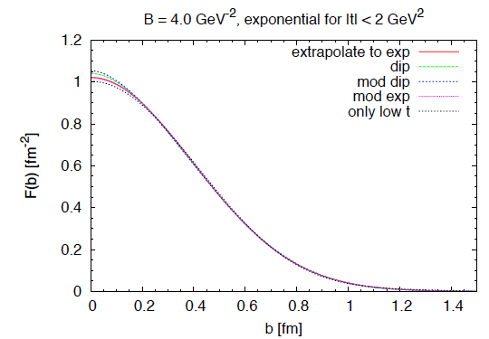
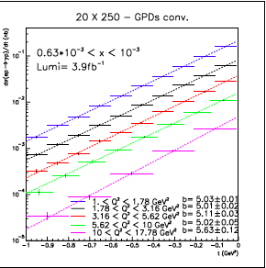
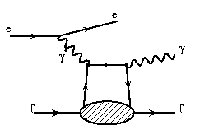
Spatial imaging of the nucleon
Deeply Virtual
Compton Scattering
Perform spatial imaging via exclusive processes
Detect all final-state particles
Nucleon doesn’t break up
Measure cross sections vs. four-momentum transferred to struck nucleon: Mandelstam t
dσ(ep→γp)/dt (nb)
Goal: Cover wide range in t.
Fourier transform → impact-
parameter-space profiles
Obtain b profile from slope vs. t.
t (GeV²)

Slide 16
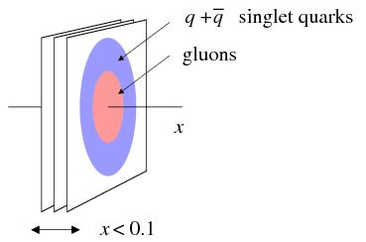
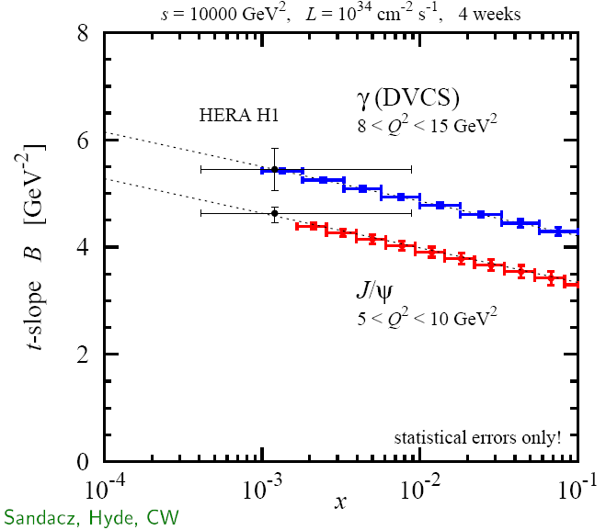
Gluon vs quark distributions in impact parameter space
Do singlet quarks and gluons have the same transverse distribution?
Hints from HERA:
Area (q+q) > Area g
-
Singlet quark size e.g. from deeply virtual Compton scattering
Gluon size e.g. from J/Ψ electroproduction
Can also perform spatial imaging via exclusive meson production → T. Horn’s talk
√s=100 GeV
~30 days, ε=1.0, L =10³⁴ s⁻¹cm⁻²

Slide 17
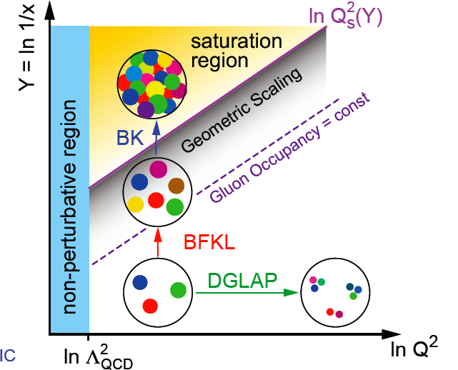
Gluon saturation
At small x linear evolution gives
strongly rising g(x)
  violation of Froissart
  unitary bound
BK/JIMWLK non-linear evolution includes
recombination effects → saturation
  Dynamically generated scale
  Saturation Scale: Q²_{s}(x)
    Increases with energy or decreasing x
  Scale with Q²/Q²_{s}(x) instead of x and Q² separately
small x
x = P_{parton}/P_{nucleon}
Bremsstrahlung
~ α_{s}ln(1/x)
Recombination
~ α_{s}ρ
See talks by R. Debbe + L. Zheng
Saturation must set in at forward rapidity/low x when gluons start to overlap + recombination becomes important
α_{s}~1 α_{s} << 1

Slide 18
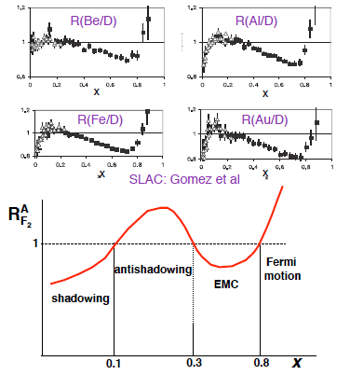

Nuclei: Simple superpositions of nucleons?
No!! Rich and intriguing differences compared to free nucleons, which vary with the linear momentum fraction probed (and likely transverse momentum, impact parameter, . . .).
Understanding the nucleon in terms of the quark and gluon d.o.f. of QCD does NOT allow us to understand nuclei in terms of the colored constituents inside them!

Slide 19
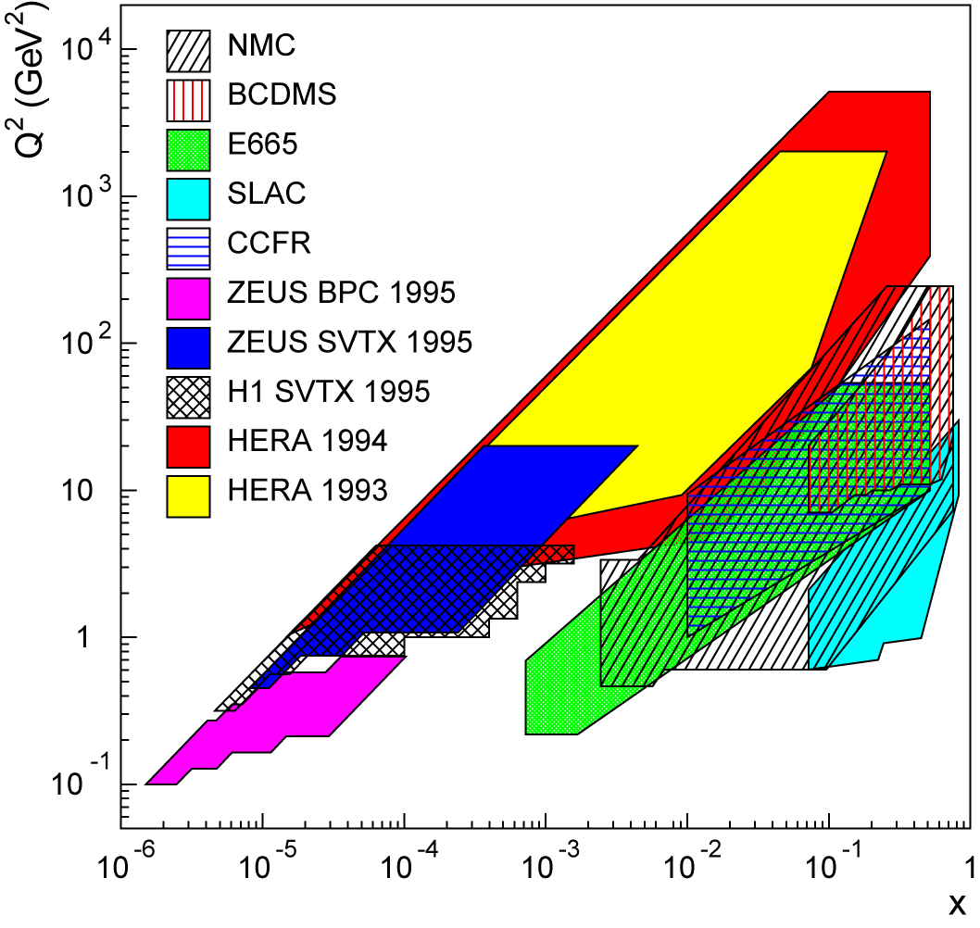
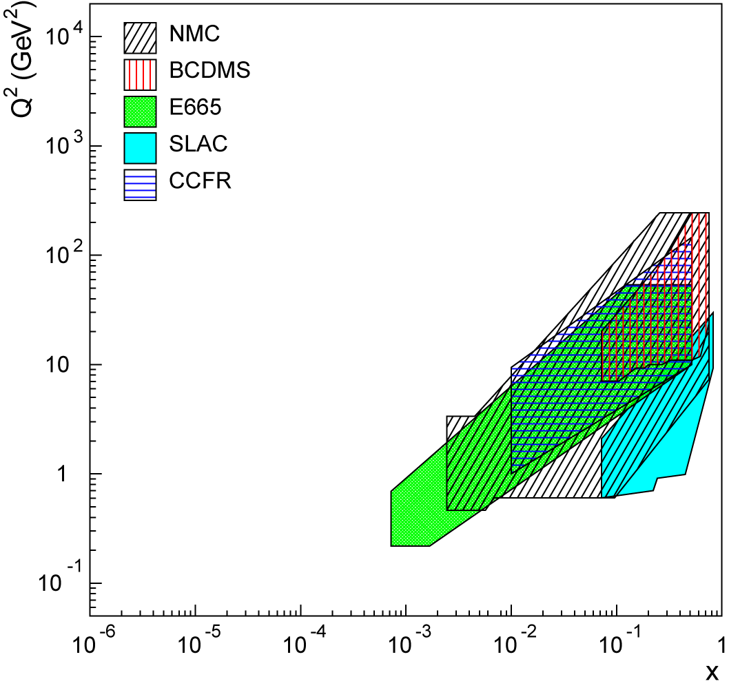
Lots of ground to cover in e+A!
Existing data over wide kinematic range for (unpolarized) lepton-proton collisions.
Not so for lepton-nucleus collisions!
EIC (20x100) GeV
EIC (10x100) GeV

Slide 20
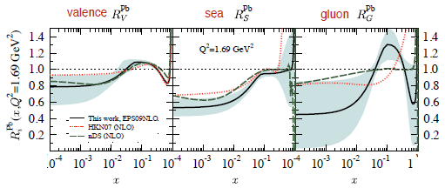
Nuclear modification of pdfs
JHEP 0904, 065 (2009)
Lower limit of EIC range
Huge uncertainties on gluon distributions in nuclei in particular!

Slide 21
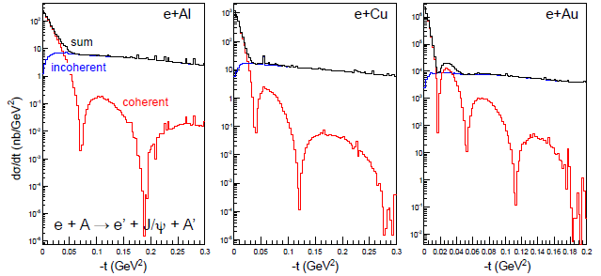
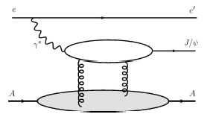
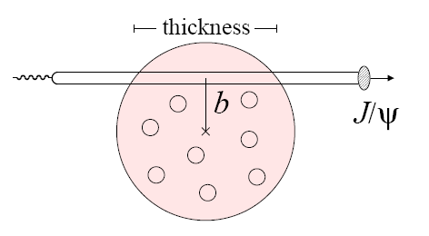

Impact-parameter-dependent nuclear gluon density via exclusive J/Ψ production in e+A
Assume Woods-Saxon gluon density
Coherent diffraction pattern extremely sensitive to details of gluon density in nuclei!

Slide 22
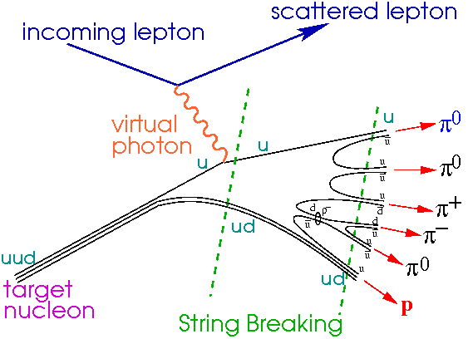
Hadronization
current
fragmentation
+η ∼ 4
EIC
Fragmentation from
QCD vacuum
target
fragmentation
-η ∼ −4

Slide 23
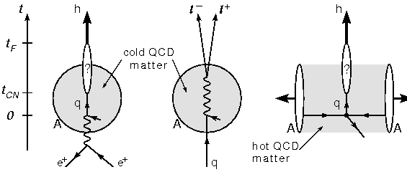


Hadronization: Parton propagation in matter
Interaction of fast color charges with matter?
Conversion of color charge to hadrons through fragmentation and breakup?
Existing data → hadron production modified on nuclei compared to the nucleon!
EIC will provide ample statistics and much greater kinematic coverage!
Study time scales for color neutralization and hadron formation
e+A complementary to jets in A+A: cold vs. hot matter

Slide 24

Comprehensive hadronization studies possible at the EIC
Wide range of Q²: QCD evolution of fragmentation functions and medium effects
Hadronization of charm, bottom
→ Clean probes with definite QCD predictions
High luminosity
→ Multi-dimensional binning and correlations
High energy: study jets and their substructure in e+p vs. e+A
Wide range of scattered parton energy → move hadronization inside/outside nucleus, distinguish energy loss and attenuation

Slide 25




eRHIC at BNL
0.02 Eo
See talk by N. Tsoupas
Polarized
e-gun
Beam
dump
27.55 GeV
0.6 GeV
New
detector
Linac
Coherent e-cooler
0.9183 Eo
Linac 2.45 GeV
Eo
0.8367 Eo
0.7550 Eo
0.6733 Eo
0.5917 Eo
0.5100 Eo
0.4286 Eo
0.3467 Eo
0.2650 Eo
0.1017 Eo
0.1833 Eo
30 GeV
All magnets installed from day one
ePHENIX
E_{e} ~5-20 GeV (30 GeV w/ reduced lumi)
E_{p} 50-250 GeV
E_{A} up to 100 GeV/n
Initial E_{e} ~ 5 GeV.
Install additional RF cavities over time to reach E_{e} = 30 GeV.
100 m
eSTAR
30 GeV
Notes:
We returned to developing cost effective and ECO-friendly eRHIC option with ERL located in the existing RHIC tunnel. We plan to install all magnets for 6 passes and 30 GeV from the start and then build up SRF linac from 1 GeV to 5 GeV per pass.
In this case electrons will pass through the detector halls in the way to the top energy, will collide in up to 3 IRs. Then they will be decelerated to the injection energy and damped.

Slide 26
Medium-Energy EIC at JLab (MEIC)
E_{e} = 3-11 GeV
E_{p} ~100 GeV
E_{A} ~50 GeV/n
Upgradable to high-energy machine:
E_{e} ~20 GeV
E_{p} ~ 250 GeV

Slide 27
Detector concepts
Large detector acceptance:
|η| < ~5
Low radiation length critical
→ low electron energies
Precise vertex reconstruction
→ separate b and c
DIRC/RICH → π, K, p hadron ID
Forward detectors to tag proton in exclusive reactions
Detector will need to measure
Inclusive processes
  Detect scattered electron with high precision
Semi-inclusive processes
  Detect at least one final-state hadron in addition to scattered electron
Exclusive processes
  Detect all final-state particles in the reaction

Slide 28
Further information and opportunities
Detailed report now available from 10-week INT workshop held last September – November
  arXiv:1108.1713 (>500 pages!)
  More concise white paper in preparation
Initial generic detector R&D for the EIC in FY2011, additional funding available for FY2012
  https://wiki.bnl.gov/conferences/index.php/EIC_R%25D
  See talk by J. Dunkelberger

Slide 29
Conclusions
We’ve recently moved beyond the discovery and development phase of QCD into a new era of quantitative QCD!
An Electron-Ion Collider capable of colliding polarized electrons with a variety of unpolarized nuclear species as well as polarized protons and polarized light nuclei over center-of-mass energies from ~30 to ~130 GeV could provide experimental data to bring this new era to maturity over the upcoming decades!

Slide 30
Additional Material

Slide 31

Tables of golden measurements

Slide 32

Tables of golden measurements

Slide 33
Full Acceptance Detector
7 meters
solenoid
detectors
ion dipole w/ detectors
ion FFQs
0 mrad
IP
ions
50 mrad
electron FFQs
electrons
2+3 m
2 m
2 m
Central detector
Detect particles with angles down to 0.5º before ion FFQs.
Need 1-2 Tm dipole.
Detect particles with angles below 0.5º beyond ion FFQs and in arcs.
Solenoid yoke + Muon Detector
TOF
RICH or DIRC/LTCC
EM Calorimeter
Tracking
RICH
4-5m
HTCC
Muon Detector
Hadron Calorimeter
EM Calorimeter
Very-forward detector
Large dipole bend @ 20 meter from IP
(to correct the 50 mr ion horizontal crossing angle) allows for very-small angle detection (<0.3º)
Solenoid yoke + Hadronic Calorimeter
2m
3m
2m
Notes:
33
33

Slide 34
Detector Requirements from Physics
Detector must be multi-purpose
  Need the same detector for inclusive (ep -> e’X), semi-inclusive (ep -> e’hadron(s)X), exclusive (ep -> e’πp) reactions and eA interactions
  Able to run for different energies (and ep/A kinematics) to
  reduce systematic errors
Needs to have large acceptance
  Cover both mid- and forward-rapidity
  particle detection to very low scattering angle; around 1º in e and p/A direction
particle identification is crucial
  e, π, K, p, n over wide momentum range and scattering angle
  excellent secondary vertex resolution (charm and bottom)
small systematic uncertainty for e,p-beam polarization and luminosity measurement

Slide 35

MEIC at JLab
Prebooster
0.2 GeV/c → 3-5 GeV/c
protons
Big booster
3-5 GeV/c → up to 20 GeV/c
protons
3 Figure-8 rings
stacked vertically

Slide 36
Luminosities (eRHIC)
 | e | p | ²He³ | ⁷⁹Au¹⁹⁷ | ⁹²U²³⁸
Energy, GeV | 20 | 250 | 166 | 100 | 100
CM energy, GeV |  | 140 | 115 | 90 | 90
Number of bunches/distance between bunches | 74 nsec | 166 | 166 | 166 | 166
Bunch intensity (nucleons) ,10¹¹ | 0.24 | 2 | 3 | 5 | 5
Bunch charge, nC | 3.8 | 32 | 31 | 19 | 19
Beam current, mA | 50 | 420 | 411 | 250 | 260
Normalized emittance of hadrons , 95% , mm mrad |  | 1.2 | 1.2 | 1.2 | 1.2
Normalized emittance of electrons, rms, mm mrad |  | 23 | 35 | 57 | 57
Polarization, % | 80 | 70 | 70 | none | none
rms bunch length, cm | 0.2 | 4.9 | 8 | 8 | 8
β*, cm | 5 | 5 | 5 | 5 | 5
Luminosity per nucleon, x 10³⁴ cm⁻²s⁻¹ |  | 1.46 | 1.39 | 0.86 | 0.92
Luminosity for 30 GeV e-beam operation will be at 20% level
Hourglass effect is included

Slide 37

eRHIC at BNL

Slide 38







RHIC as a Polarized p+p Collider
Absolute Polarimeter (H jet)
RHIC pC Polarimeters
Siberian Snakes
PHOBOS
BRAHMS & PP2PP
Siberian Snakes
PHENIX
Spin Flipper
STAR
Spin Rotators
Various equipment to maintain and measure beam polarization through acceleration and storage
Partial Snake
Helical Partial
Snake
Polarized Source
Strong Snake
LINAC
AGS
200 MeV Polarimeter
BOOSTER
Rf Dipole
AGS Internal Polarimeter
AGS pC Polarimeter
Notes:
RHIC, as a high-energy polarized proton collider, really represents an outstanding achievement in accelerator physics. . . . [equipment].

Slide 39

Limitations of Linear Evolution in QCD
Established models:
Linear DGLAP evolution in Q²
Linear BFKL evolution in x
Linear evolution in Q² has a built-in high-energy “catastrophe”
xG rapid rise for decreasing x and violation of (Froissart) unitary bound
⇒ must saturate
  What’s the underlying dynamics?
⇒ Need new approach

Slide 40

Non-Linear QCD - Saturation
Linear BFKL evolution in x
  Explosion of color field as x→0??
New: BK/JIMWLK
based models
  introduce non-linear effects
  ⇒ saturation
  characterized by a scale Q_{s}(x,A)
  arises naturally in the “Color Glass Condensate” (CGC) framework
proton
proton
N partons
N partons
new partons emitted as energy increases
could be emitted off any of the N partons
any 2 partons can recombine into one
Regimes of QCD Wave Function
Notes:
BFKL: Balitsky, Lipatov, Fadin, Kuraev
JIMWLK: Jilian-Marian, Ianescu, McLarren, Weigert, Lianidov, Kovner
BK: Balitsky, Kotchekov

Slide 41


Q_{s} : A Scale that Binds Them All
Nuclear shadowing
Geometrical scaling
proton × 5
nuclei
Freund et al., hep-ph/0210139
Is the wave function of hadrons and nuclei universal at low x?

Slide 42

Hadronization and Energy Loss
nDIS:
  Clean measurement in ‘cold’ nuclear matter
  Suppression of high-p_{T} hadrons analogous but weaker than at RHIC
Fundamental question:
When do coloured partons get neutralized?
Parton energy loss vs.
(pre)hadron absorption
Energy transfer in lab rest frame
EIC: 10-1600 GeV² HERMES: 2-25 GeV²
EIC can measure heavy flavor energy loss

Slide 43

Exclusive Processes: Collider Energies

Slide 44


Gluon imaging with J/Ψ (or φ)
Transverse spatial distributions from exclusive J/ψ, and φ at Q²>10 GeV²
  Transverse distribution directly from Δ_{T} dependence
  Reaction mechanism, QCD description studied at HERA [H1, ZEUS]
Physics interest
  Valence gluons, dynamical origin
  Chiral dynamics at b~1/M_{π}
  [Strikman, Weiss 03/09, Miller 07]
  Diffusion in QCD radiation
Existing data
  Transverse area x < 0.01 [HERA]
  Larger x poorly known [FNAL]
[Weiss INT10-3 report]

Slide 45


Slide 46

Charged-current cross section
Q² > 1 GeV²
no y cut
y > 0.1
20×250
HERA

Slide 47
Evidence for variety of spin-momentum correlations in proton, and in process of hadronization!
Collinear
Worm gear
Collinear
Transversity
Measured non-zero!
Sivers
Polarizing FF
Boer-Mulders
Pretzelosity
Collins
Worm gear

Slide 48




Sivers
Collins
BELLE Collins: PRL96, 232002 (2006)
Boer-Mulders
SPIN2008
A flurry of experimental results from semi-inclusive DIS and e+e- over last ~9 years
Collins

