Slide 1

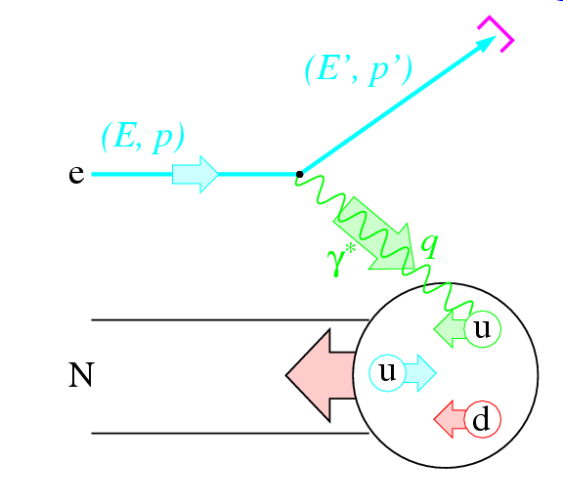
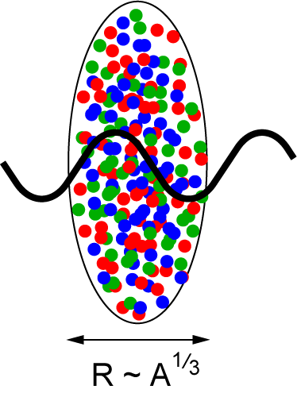
The Electron-Ion Collider:
Tackling QCD from the Inside
(of Nucleons and Nuclei) Out
Christine A. Aidala
Los Alamos National Lab
TNT Colloquium, Duke University
February 21, 2012

Slide 2
Theory of strong interactions:
Quantum Chromodynamics
  Salient features of QCD not evident from Lagrangian!
    Color confinement – the color-charged quarks and gluons of QCD are always confined in color-neutral bound states
    Asymptotic freedom – when probed at high energies/short distances, the quarks and gluons inside a hadron behave as nearly free particles
  Gluons: mediator of the strong interactions
    Determine essential features of strong interactions
    Dominate structure of QCD vacuum (fluctuations in gluon fields)
    Responsible for > 98% of the visible mass in universe(!)
An elegant and by now well established field theory, yet with degrees of freedom that we can never observe directly in the laboratory!

Slide 3
How do we understand the visible matter in our universe in terms of the fundamental quarks and gluons of QCD?

Slide 4
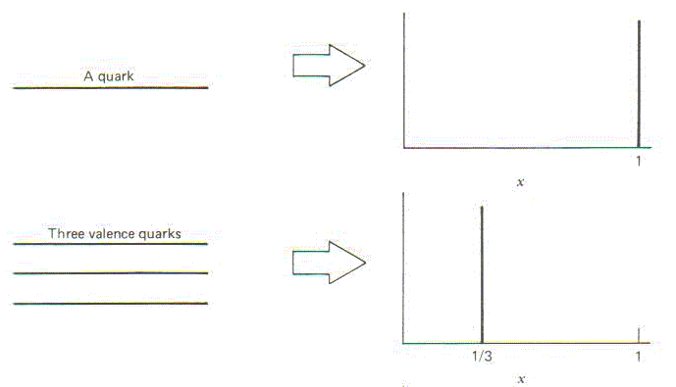
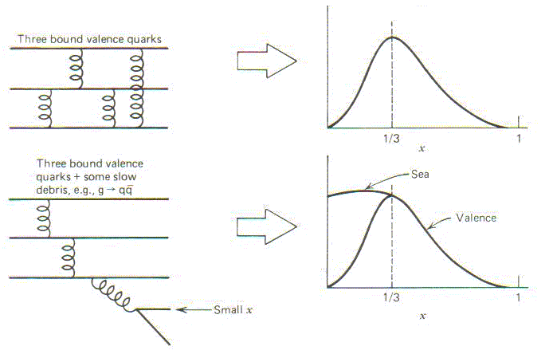
Parton distribution functions inside a nucleon:
The language we’ve developed (so far!)
What momentum fraction would the scattering particle carry
if the proton were made of …
3 bound valence quarks
A point particle
x_{Bjorken}
1
3 bound valence quarks + some
low-momentum sea quarks
1/3
1
x_{Bjorken}
Sea
3 valence quarks
Valence
Small x
1/3
1
x_{Bjorken}
1/3
x_{Bjorken}
1
Halzen and Martin, “Quarks and Leptons”, p. 201

Slide 5
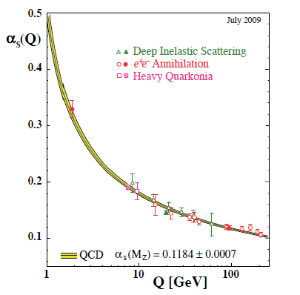
Perturbative QCD
Take advantage of running of the strong coupling constant with energy (asymptotic freedom)—weak coupling at high energies (short distances)
Perturbative expansion as in quantum electrodynamics (but many more diagrams due to gluon self-coupling!!)
Most importantly: pQCD provides a rigorous way of relating the fundamental field theory to a variety of physical observables!
Stronger coupling
Higher resolution
Higher resolution
Notes:
Scattering energy

Slide 6
Predictive power of pQCD
q(x₁)
Hard Scattering Process
X
g(x₂)
High-energy processes have predictable rates given
Partonic hard scattering rates (calculable in pQCD)
    Parton distribution functions (need experimental input)
    Fragmentation functions (need experimental input)
Universal non-perturbative factors

Slide 7
Factorization and universality in perturbative QCD
Need to systematically factorize short- and long-distance physics—observable physical QCD processes always involve at least one long-distance scale (confinement)!
Long-distance (i.e. non-perturbative) functions need to be universal in order to be portable across calculations for many processes
Measure observables sensitive to parton distribution functions (pdfs) and fragmentation functions (FFs) in various colliding systems over a wide kinematic range→constrain by performing
simultaneous fits to world data

Slide 8
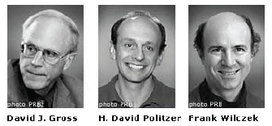
QCD: How far have we come?
QCD challenging!!
Three-decade period after initial birth of QCD dedicated to “discovery and development”
Symbolic closure: Nobel prize 2004 to Gross, Politzer, Wilczek for asymptotic freedom
Since 1990s starting to consider detailed internal QCD dynamics, going beyond traditional parton model ways of looking at hadrons—and perform phenomenological calculations using these new ideas/tools!
Now very early stages of second phase:
quantitative QCD!
Notes:
[While some a generation or so ahead of me have enjoyed very exciting careers [centered on][based around] the discovery and development of QCD, …]

Slide 9
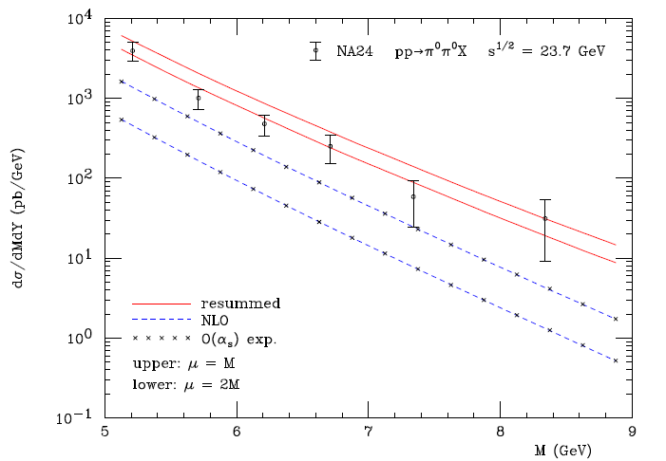
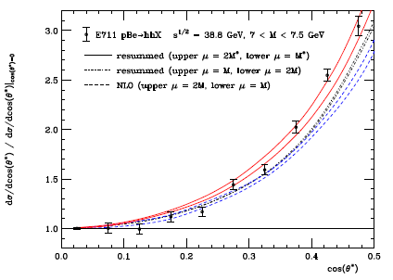
Example: Threshold resummation to extend pQCD to lower energies
pBe→hhX
pp→π⁰π⁰X
M (GeV)
cos θ*
Almeida, Sterman, Vogelsang PRD80, 074016 (2009)
Resummation techniques in pQCD allow inclusion of a subset
of higher-order terms in α_{s}.

Slide 10
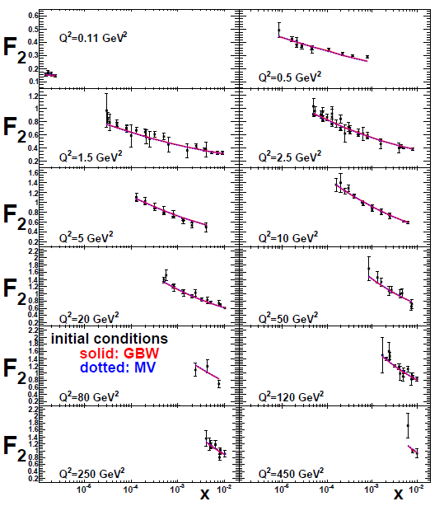
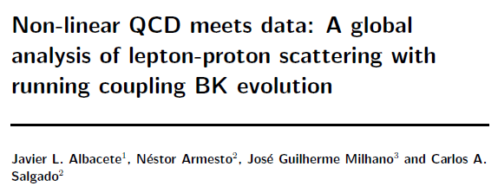
Example: Non-linear QCD evolution at low parton momentum fractions
Phys. Rev. D80, 034031 (2009)

Slide 11
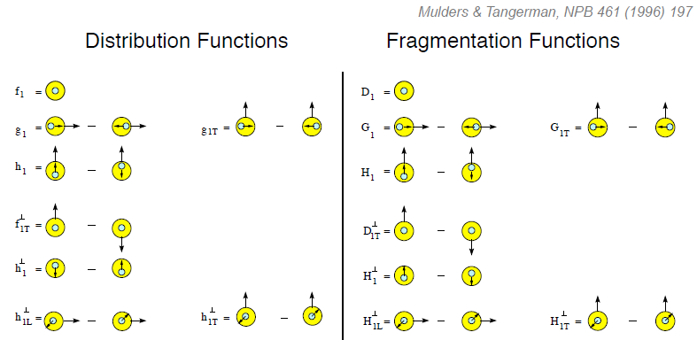
Example: Dropping the simplifying assumption of collinearity
Collinear
Worm gear
Collinear
Transversity
Sivers
Polarizing FF
Boer-Mulders
Pretzelosity
Collins
Worm gear
Spin-momentum correlations: S•(p₁×p₂)

Slide 12
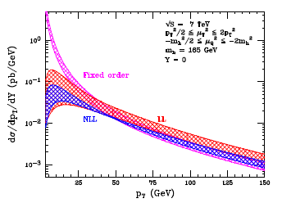
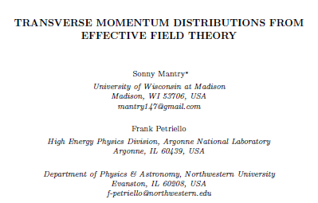
Example: Soft Collinear Effective Theory
Higgs vs. p_{T}
arXiv:1108.3609
Offers an alternative framework to handle effects of intrinsic transverse motion of partons!

Slide 13
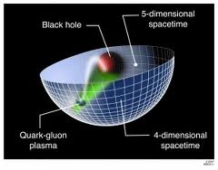
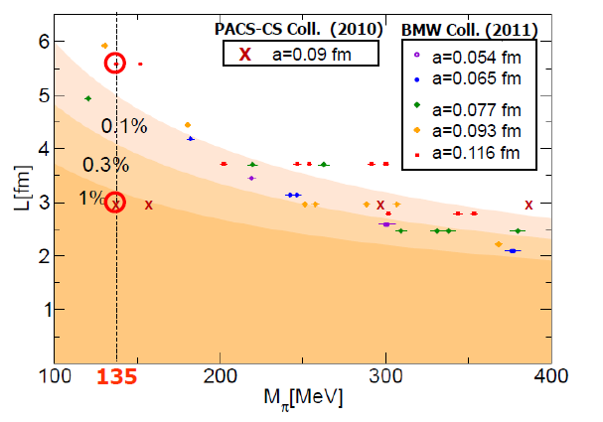
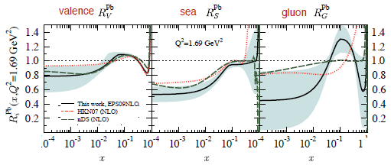
Additional recent theoretical progress in QCD
Renaissance in nuclear pdfs
  EPS2009 parameterization already 127 citations!
Progress in non-perturbative methods:
  Lattice QCD just starting to perform calculations at physical pion mass!
  AdS/CFT “gauge-string duality” an exciting recent development as first fundamentally new handle to try to tackle QCD in decades!
PACS-CS: PRD81, 074503 (2010)
BMW: PLB701, 265 (2011)
“Modern-day ‘testing’ of (perturbative) QCD is as much about pushing the boundaries of its applicability as about the verification that QCD is the correct theory of hadronic physics.”
– G. Salam, hep-ph/0207147 (DIS2002 proceedings)
T. Hatsuda,
PANIC 2011
JHEP 0904, 065 (2009)
Notes:
Hadron spectrum, quark masses, pseudoscalar meson decay constants

Slide 14
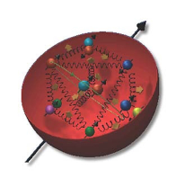
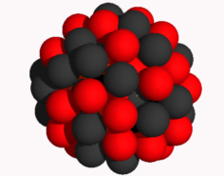
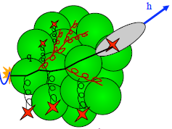
The Electron-Ion Collider
A facility to bring this new era of quantitative QCD to maturity!
How can QCD matter be described in terms of the quark and gluon d.o.f. in the field theory?
How does a colored quark or gluon become a colorless object?
Study in detail
  “Simple” QCD bound states: Nucleons
  Collections of QCD bound states: Nuclei
  Hadronization
Collider energies: Focus on
sea quarks and gluons

Slide 15
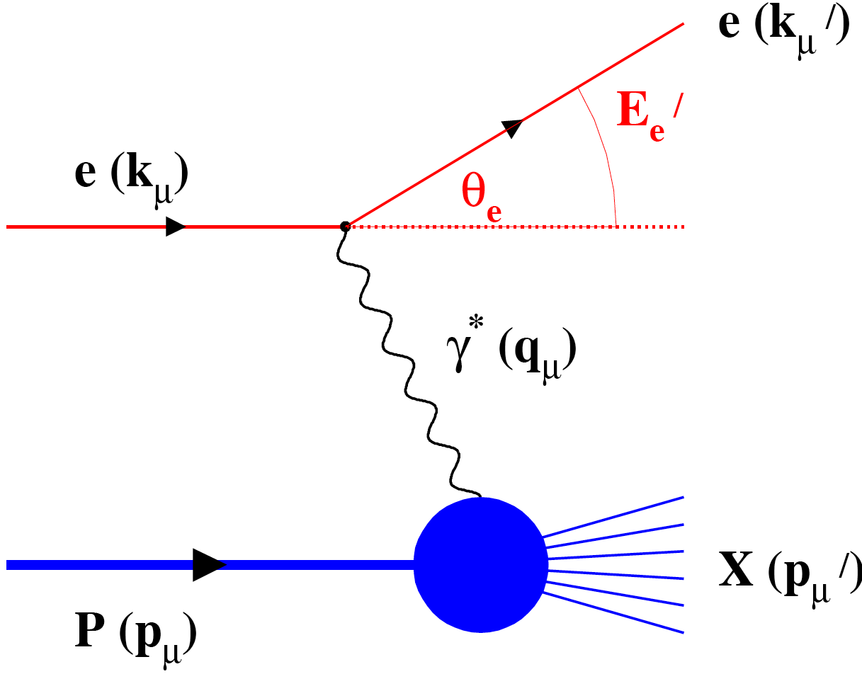
Why an Electron-Ion Collider?
Deep-inelastic lepton-hadron scattering (DIS): Electroweak probe
  “Clean” processes to interpret (quantum electrodynamics!)
  Measurement of scattered electron → full kinematic information on partonic scattering
Collider mode → Higher energies
  Quarks and gluons relevant d.o.f.
  Perturbative QCD applicable
  Heavier probes accessible (e.g. charm, bottom, W boson exchange)

Slide 16
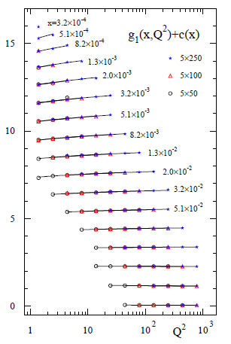
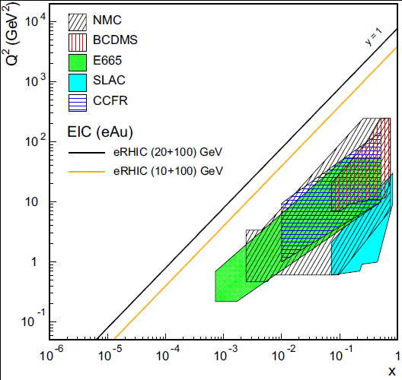
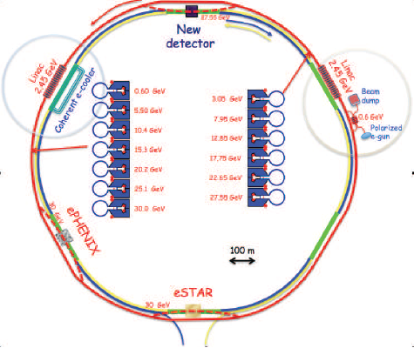
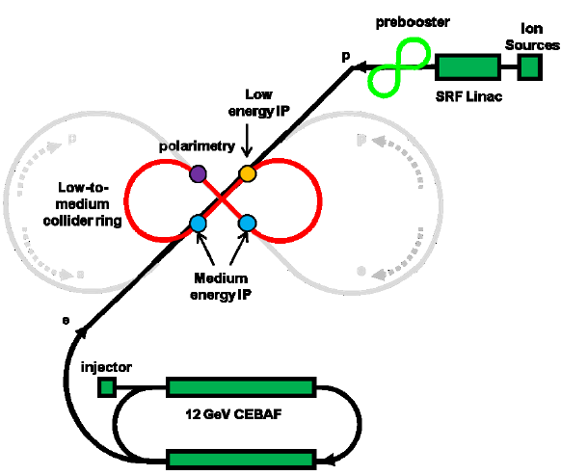
Accelerator concepts
Polarized beams of protons, ³He
  Previously only fixed-target polarized experiments!
Beams of light → heavy ions
  Previously only fixed-target e+A experiments!
Luminosity 100-1000x that of HERA e+p collider
Two concepts: Add electron facility to RHIC at BNL or ion facility to CEBAF at JLab
EIC
EIC (20x100) GeV
EIC (10x100) GeV
Notes:
Add sqrt(s) ranges?

Slide 17
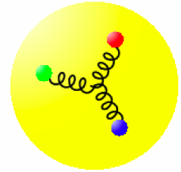
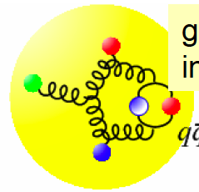
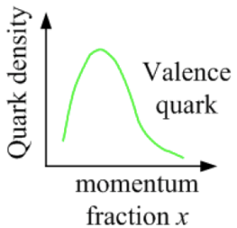
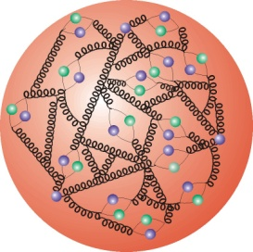
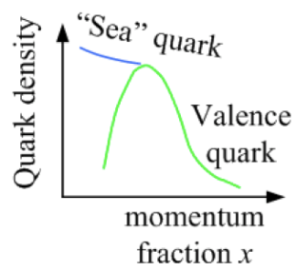
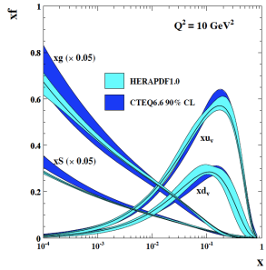
Accessing quarks and gluons through DIS
Kinematics:
Measure of resolution power
Measure of inelasticity
Measure of momentum fraction of struck quark
Gluon splits
into quarks
Quark splits
into gluon
splits
into quarks
10⁻¹⁶m
10⁻¹⁹m
higher √s
increases resolution

Slide 18
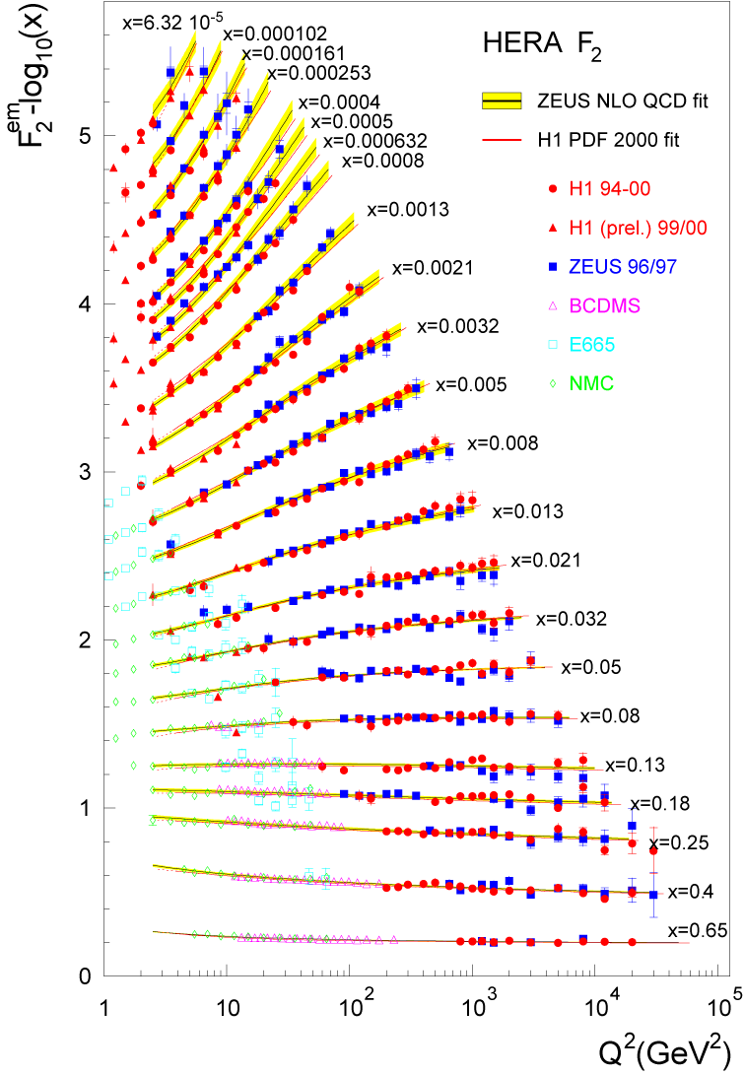
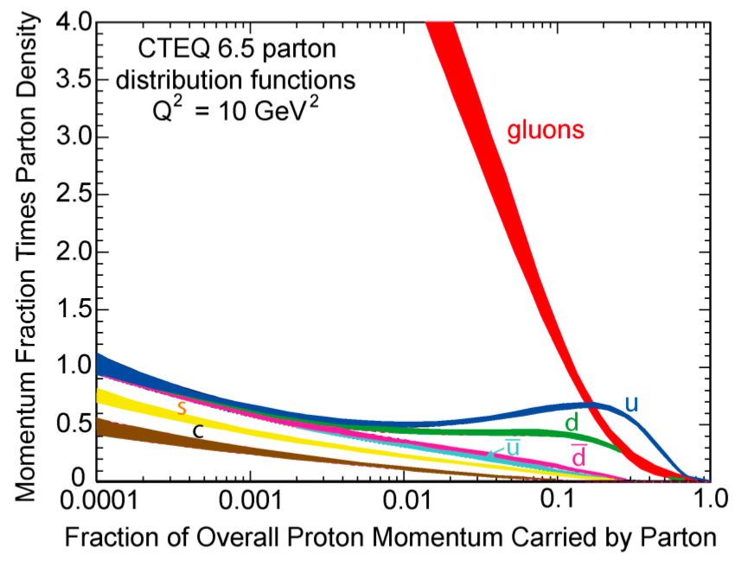
Accessing gluons with an electroweak probe?
Access the gluons in DIS via scaling violations in F₂ structure function:
dF₂/dlnQ² and linear DGLAP evolution in Q² → G(x,Q²)
OR
Via F_{L} structure function
OR
Via dihadron or charm production
Gluons dominate
low-x wave function
Gluons in fact dominate
(not-so-)low-x wave
function!
!

Slide 19
Mapping out the proton
What does the proton look like in terms of the quarks and gluons inside it?
Position
Momentum
Spin
Flavor
Color
Theoretical and experimental concepts to describe and access position only born in mid-1990s. Pioneering measurements over past decade.
Vast majority of past four decades focused on
1-dimensional momentum structure! Since 1990s starting to consider other directions . . .
Polarized protons first studied in 1980s. How angular momentum of quarks and gluons add up still not well understood!
Good measurements of flavor distributions in valence region. Flavor structure at lower momentum fractions still yielding surprises!
Accounted for by theorists from beginning of QCD, but more detailed, potentially observable effects of color have come to forefront in last couple years . . .

Slide 20
Experimental evidence for variety of spin-momentum correlations in proton, and in process of hadronization
Collinear
Worm gear
Collinear
Transversity
Measured non-zero!
Sivers
Polarizing FF
Boer-Mulders
Pretzelosity
Collins
Worm gear
S•(p₁×p₂)

Slide 21
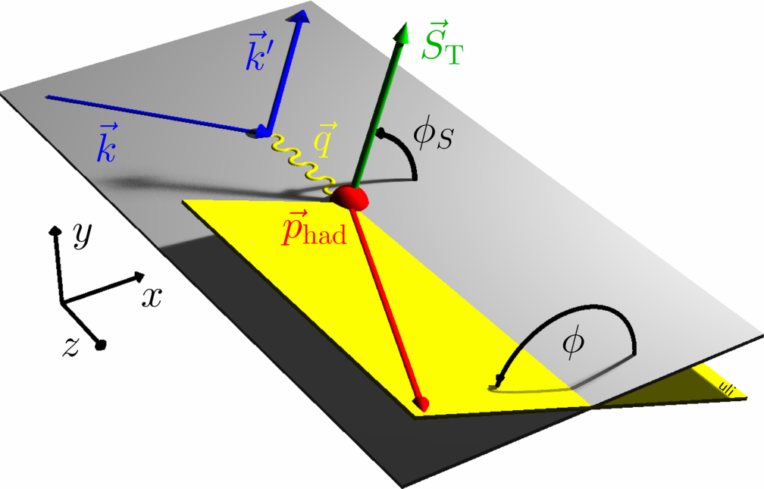
Probing spin-momentum correlations in the nucleon via angular distributions
angle of hadron relative to final quark spin (“Collins FF”)
Collins FF
angle of hadron relative to initial quark spin (“Sivers pdf”)
Angular dependences in semi-inclusive DIS
isolation of the various transverse-momentum-dependent distribution and fragmentation functions
(not just Sivers and Collins!)
Sivers pdf

Slide 22
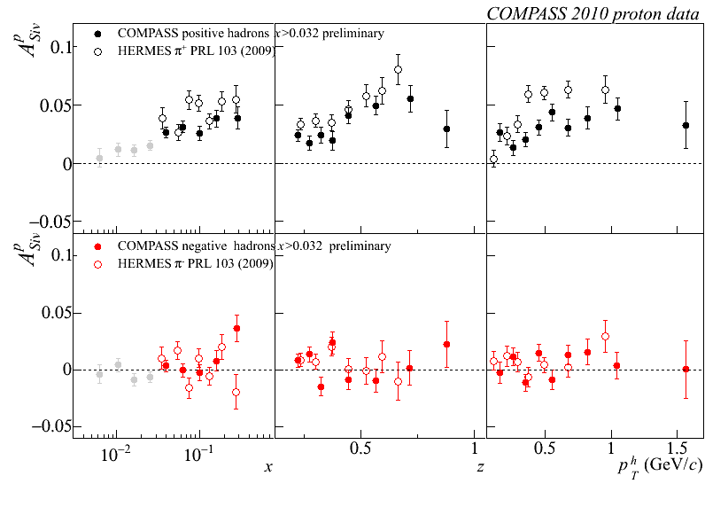
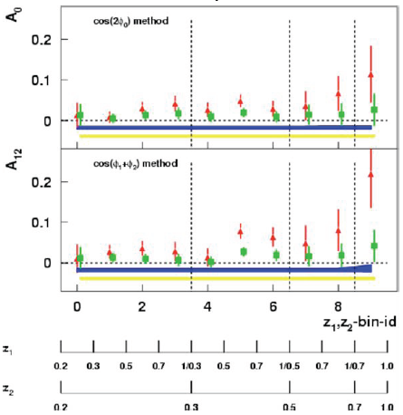
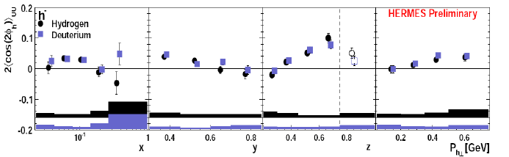
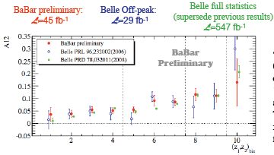
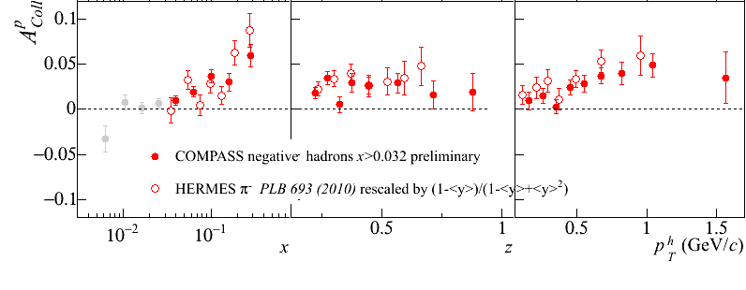
Sivers
A flurry of new experimental results from deep-inelastic e+p scattering and e⁺e⁻ annihilation over last ~8 years!
e+p
μ+p
BELLE PRL96, 232002 (2006)
Collins
e⁺e⁻
Boer-Mulders
SPIN2008
e+p
BaBar: Released August 2011
Collins
e⁺e⁻
e+p
μ+p
Transversity x Collins

Slide 23
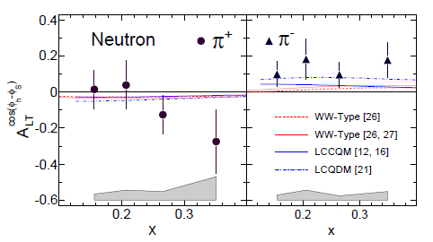
First evidence for non-zero “worm gear” g_{1T} spin-momentum correlation!
Evidence for longitudinally polarized quarks in a transversely polarized neutron!
Requires orbital angular momentum of quarks.
JLab Hall A
Worm gear g_{1T}
e+³He
J. Huang, H. Gao et al., PRL 108, 052001 (2012)

Slide 24
The proton: The hydrogen atom of QCD
“Transversity” pdf:
Correlates proton transverse spin and quark transverse spin
“Sivers” pdf:
Correlates proton transverse spin and quark transverse momentum
“Boer-Mulders” pdf:
Correlates quark transverse spin and quark transverse momentum
S_{p}-S_{q} coupling
S_{p}-L_{q} coupling
S_{q}-L_{q} coupling

Slide 25
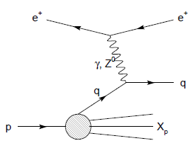
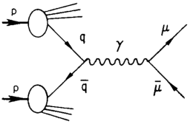
Modified universality of Sivers transverse-momentum-dependent distribution:
Color in action!
Semi-inclusive DIS: attractive final-state
interaction
Drell-Yan:
repulsive initial-state
interaction
Comparing detailed measurements in polarized semi-inclusive DIS and polarized Drell-Yan will be a crucial test of our understanding of quantum chromodynamics!
As a result:

Slide 26

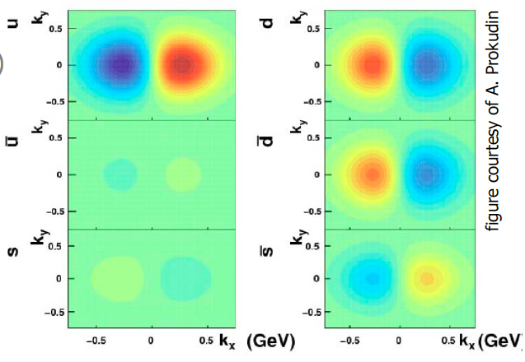
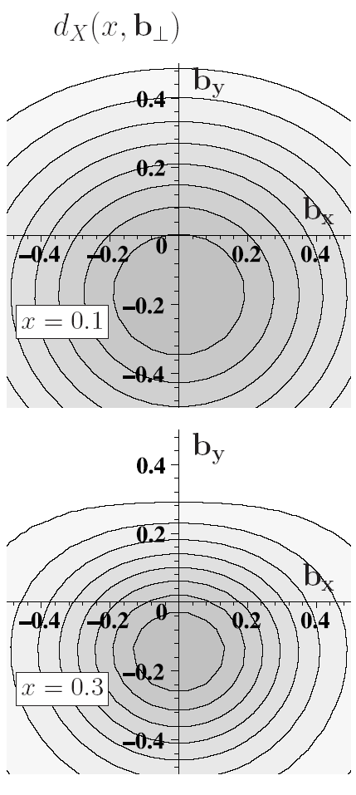
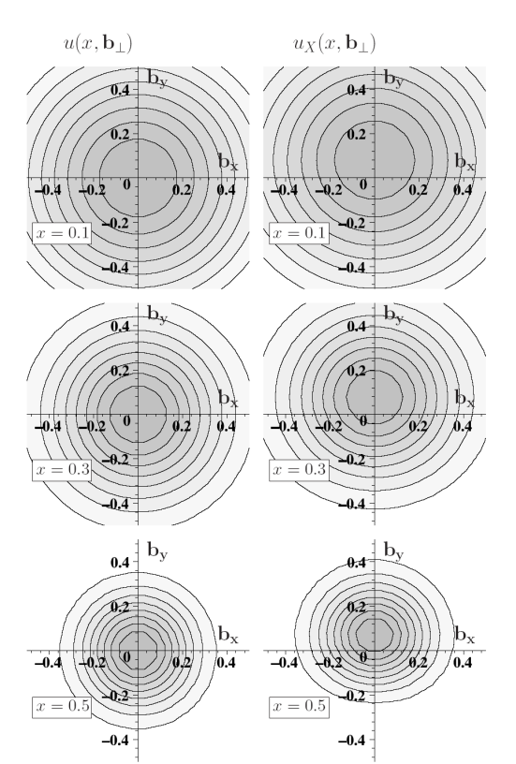
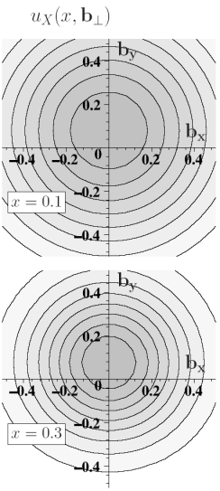
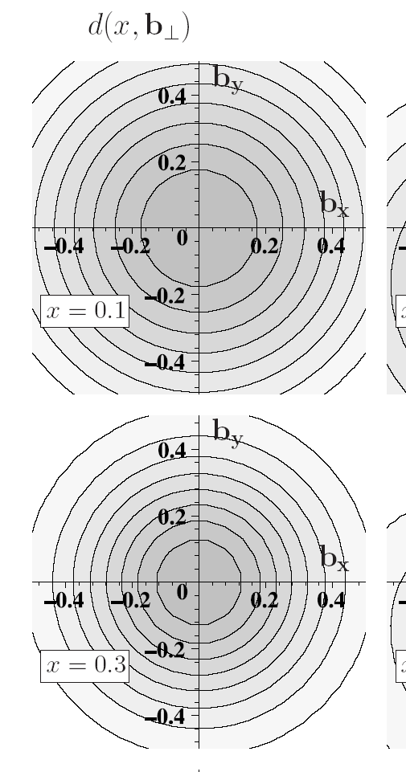
3D quantum phase-space tomography of the nucleon
Wigner Distribution
W(x,r,k_{t})
TMDs
GPDs
3D picture in momentum space:
  transverse-momentum-dependent distributions
3D picture in coordinate space:
  generalized parton distributions
u-quark
Polarized p
d-quark
Polarized p

Slide 27
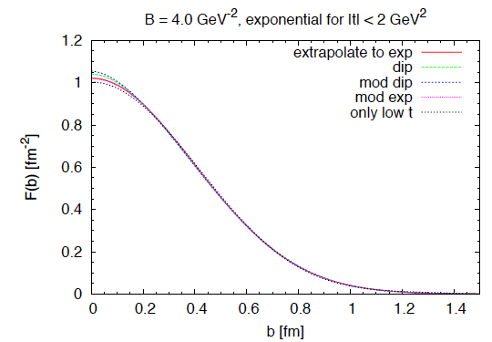
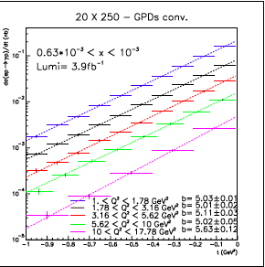
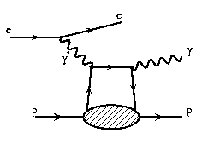
Spatial imaging of the nucleon
Deeply Virtual
Compton Scattering
Perform spatial imaging via exclusive processes
Detect all final-state particles
Nucleon doesn’t break up
Measure cross sections vs. four-momentum transferred to struck nucleon: Mandelstam t
dσ(ep→γp)/dt (nb)
Goal: Cover wide range in t.
Fourier transform → impact-
parameter-space profiles
Obtain b profile from slope vs. t.
t (GeV²)

Slide 28
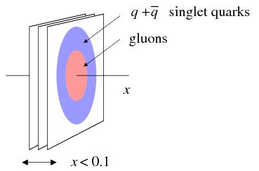

Gluon vs quark distributions in impact parameter space
Do singlet quarks and gluons have the same transverse distribution?
Hints from HERA:
Area (q+q) > Area g
-
Singlet quark size e.g. from deeply virtual Compton scattering
Gluon size e.g. from J/Ψ electroproduction
Can also perform spatial imaging via exclusive meson production
√s=100 GeV
~30 days, ε=1.0, L =10³⁴ s⁻¹cm⁻²

Slide 29

Non-linear QCD and gluon saturation
small x
At small x, linear (DGLAP or BFKL) evolution gives strongly rising g(x) → Violation of Froissart unitarity bound
Non-linear (BK/JIMWLK) evolution includes recombination effects → gluon saturation
x = P_{parton}/P_{nucleon}
Bremsstrahlung
~ α_{s}ln(1/x)
Recombination
~ α_{s}ρ
Easier to reach saturation regime in nuclei than nucleons due to A^{1/3} enhancement of saturation scale → e+A collisions clean environment to study non-linear QCD!
α_{s}~1 α_{s} << 1

Slide 30


Nuclei: Simple superpositions of nucleons?
No!! Rich and intriguing differences compared to free nucleons, which vary with the linear momentum fraction probed (and likely transverse momentum, impact parameter, . . .).
Understanding the nucleon in terms of the quark and gluon d.o.f. of QCD does NOT allow us to understand nuclei in terms of the colored constituents inside them!

Slide 31


Lots of ground to cover in e+A!
Existing data over wide kinematic range for (unpolarized) lepton-proton collisions.
Not so for lepton-nucleus collisions!
EIC (20x100) GeV
EIC (10x100) GeV

Slide 32
Nuclear modification of pdfs
JHEP 0904, 065 (2009)
Lower limit of EIC range
Study in detail at the EIC!
Huge uncertainties on gluon distributions in nuclei in particular!

Slide 33




Impact-parameter-dependent nuclear gluon density via exclusive J/Ψ production in e+A
Assume Woods-Saxon gluon density
Coherent diffraction pattern extremely sensitive to details of gluon density in nuclei!

Slide 34
Hadronization: A lot to learn, from a variety of collision systems
What are the ways in which partons can turn into hadrons?
Spin-momentum correlations in hadronization?
  Yes! Correlations now measured definitively in e+e-! (BELLE, BABAR)
Gluons vs. quarks?
  Gluon vs. quark jets a hot topic in the LHC p+p program right now
  Go back to clean e+e- with new jet analysis techniques in hand?
In “vacuum” vs. cold nuclear matter vs. hot + dense QCD matter?
  Use path lengths through nuclei to benchmark hadronization times → e+A
Hadronization via “fragmentation” (what does that really mean?), “freeze-out,” “recombination,” . . .?
  Soft hadron production from thermalized quark-gluon plasma—different mechanism than hadronization from hard-scattered q or g?
Light atomic nuclei and antinuclei also produced in heavy ion collisions at RHIC!
  How are such “compound” QCD systems formed from partons? Cosmological implications??
…
In my opinion, hadronization has been a largely neglected area over the past decades of QCD—lots of progress to look forward to in upcoming years, with e+A, e+p, p+p, and A+A all playing a role along with the traditional e⁺e⁻!
Notes:
Baryon anomaly

Slide 35

Hadronization at the EIC: From current to target fragmentation regions
current
fragmentation
+η ∼ 4
EIC
Fragmentation from
QCD vacuum
target
fragmentation
-η ∼ −4

Slide 36


Parton propagation in matter and hadronization
Interaction of fast color charges with matter?
Conversion of color charge to hadrons?
Existing data → hadron production modified on nuclei compared to the nucleon!
EIC will provide tremendous statistics and much greater kinematic coverage!
-Study quark interaction with cold nuclear matter
Study time scales for color neutralization and hadron formation
e+A complementary to jets in A+A: cold vs. hot matter

Slide 37
Parton propagation and energy loss in colored matter?
Electromagnetic energy loss in matter well studied over 9 orders of magnitude in energy. Energy loss of color charges only starting to be explored!

Slide 38

Comprehensive hadronization studies possible at the EIC
Wide range of Q²: QCD evolution of fragmentation functions and medium effects
Hadronization of charm, bottom
→ Clean probes with definite QCD predictions
High luminosity
→ Multi-dimensional binning and correlations
High energy: study jets and their substructure in e+p vs. e+A
Wide range of scattered parton energy → move hadronization inside/outside nucleus, distinguish energy loss and attenuation

Slide 39




eRHIC at BNL
0.02 Eo
Polarized
e-gun
0.6 GeV
Beam
dump
27.55 GeV
New
detector
Linac
Coherent e-cooler
0.9183 Eo
Linac 2.45 GeV
Eo
0.8367 Eo
0.7550 Eo
0.6733 Eo
0.5917 Eo
0.5100 Eo
0.4286 Eo
0.3467 Eo
0.2650 Eo
0.1017 Eo
0.1833 Eo
30 GeV
All magnets installed from day one
ePHENIX
E_{e} ~5-20 GeV (30 GeV w/ reduced lumi)
E_{p} 50-250 GeV
E_{A} up to 100 GeV/n
Initial E_{e} ~ 5 GeV.
Install additional RF cavities over time to reach E_{e} = 30 GeV.
100 m
eSTAR
30 GeV
Notes:
We returned to developing cost effective and ECO-friendly eRHIC option with ERL located in the existing RHIC tunnel. We plan to install all magnets for 6 passes and 30 GeV from the start and then build up SRF linac from 1 GeV to 5 GeV per pass.
In this case electrons will pass through the detector halls in the way to the top energy, will collide in up to 3 IRs. Then they will be decelerated to the injection energy and damped.

Slide 40
Medium-Energy EIC at JLab (MEIC)
E_{e} = 3-11 GeV
E_{p} ~100 GeV
E_{A} ~50 GeV/n
Upgradable to high-energy machine:
E_{e} ~20 GeV
E_{p} ~ 250 GeV

Slide 41
Detector concepts
Large detector acceptance:
|η| < ~5
Low radiation length critical
→ low electron energies
Precise vertex reconstruction
→ separate b and c
DIRC/RICH → π, K, p hadron ID
Additional forward dipole and detectors
Detector will need to measure
Inclusive processes
  Detect scattered electron with high precision
Semi-inclusive processes
  Detect at least one final-state hadron in addition to scattered electron
Exclusive processes
  Detect all final-state particles in the reaction
Central detector
Solenoid yoke + Muon Detector
TOF
RICH or DIRC/LTCC
EM Calorimeter
Tracking
RICH
4-5m
HTCC
Muon Detector
Hadron Calorimeter
EM Calorimeter
Solenoid yoke + Hadronic Calorimeter
2m
3m
2m

Slide 42
Further information and opportunities
Detailed report available from 10-week INT workshop held September – November 2010 to develop the science case for the EIC
  arXiv:1108.1713 (>500 pages!)
  More concise white paper in preparation
Initial generic detector R&D for the EIC in FY2011, additional funding available for FY2012
  https://wiki.bnl.gov/conferences/index.php/EIC_R%25D

Slide 43
Conclusions
We’ve recently moved beyond the discovery and development phase of QCD into a new era of quantitative QCD!
An Electron-Ion Collider capable of colliding polarized electrons with a variety of unpolarized nuclear species as well as polarized protons and polarized light nuclei over center-of-mass energies from ~30 to ~130 GeV could provide experimental data to bring this new era to maturity over the upcoming decades!

Slide 44
Additional Material

Slide 45

Tables of golden measurements

Slide 46

Tables of golden measurements

Slide 47

MEIC at JLab
Prebooster
0.2 GeV/c → 3-5 GeV/c
protons
Big booster
3-5 GeV/c → up to 20 GeV/c
protons
3 Figure-8 rings
stacked vertically

Slide 48
Luminosities (eRHIC)
 | e | p | ²He³ | ⁷⁹Au¹⁹⁷ | ⁹²U²³⁸
Energy, GeV | 20 | 250 | 166 | 100 | 100
CM energy, GeV |  | 140 | 115 | 90 | 90
Number of bunches/distance between bunches | 74 nsec | 166 | 166 | 166 | 166
Bunch intensity (nucleons) ,10¹¹ | 0.24 | 2 | 3 | 5 | 5
Bunch charge, nC | 3.8 | 32 | 31 | 19 | 19
Beam current, mA | 50 | 420 | 411 | 250 | 260
Normalized emittance of hadrons , 95% , mm mrad |  | 1.2 | 1.2 | 1.2 | 1.2
Normalized emittance of electrons, rms, mm mrad |  | 23 | 35 | 57 | 57
Polarization, % | 80 | 70 | 70 | none | none
rms bunch length, cm | 0.2 | 4.9 | 8 | 8 | 8
β*, cm | 5 | 5 | 5 | 5 | 5
Luminosity per nucleon, x 10³⁴ cm⁻²s⁻¹ |  | 1.46 | 1.39 | 0.86 | 0.92
Luminosity for 30 GeV e-beam operation will be at 20% level
Hourglass effect is included

Slide 49

eRHIC at BNL

Slide 50







RHIC as a Polarized p+p Collider
Absolute Polarimeter (H jet)
RHIC pC Polarimeters
Siberian Snakes
PHOBOS
BRAHMS & PP2PP
Siberian Snakes
PHENIX
Spin Flipper
STAR
Spin Rotators
Various equipment to maintain and measure beam polarization through acceleration and storage
Partial Snake
Helical Partial
Snake
Polarized Source
Strong Snake
LINAC
AGS
200 MeV Polarimeter
BOOSTER
Rf Dipole
AGS Internal Polarimeter
AGS pC Polarimeter
Notes:
RHIC, as a high-energy polarized proton collider, really represents an outstanding achievement in accelerator physics. . . . [equipment].

Slide 51

Limitations of Linear Evolution in QCD
Established models:
Linear DGLAP evolution in Q²
Linear BFKL evolution in x
Linear evolution in Q² has a built-in high-energy “catastrophe”
xG rapid rise for decreasing x and violation of (Froissart) unitary bound
⇒ must saturate
  What’s the underlying dynamics?
⇒ Need new approach

Slide 52

Non-Linear QCD - Saturation
Linear BFKL evolution in x
  Explosion of color field as x→0??
New: BK/JIMWLK
based models
  introduce non-linear effects
  ⇒ saturation
  characterized by a scale Q_{s}(x,A)
  arises naturally in the “Color Glass Condensate” (CGC) framework
proton
proton
N partons
N partons
new partons emitted as energy increases
could be emitted off any of the N partons
any 2 partons can recombine into one
Regimes of QCD Wave Function
Notes:
BFKL: Balitsky, Lipatov, Fadin, Kuraev
JIMWLK: Jilian-Marian, Ianescu, McLarren, Weigert, Lianidov, Kovner
BK: Balitsky, Kotchekov

Slide 53


Q_{s} : A scale that binds them all
Nuclear shadowing
Geometrical scaling
proton × 5
nuclei
Freund et al., hep-ph/0210139
Is the wave function of hadrons and nuclei universal at low x?

Slide 54
Hadronization and Energy Loss
nDIS:
  Clean measurement in ‘cold’ nuclear matter
  Suppression of high-p_{T} hadrons analogous but weaker than at RHIC
Fundamental question:
When do coloured partons get neutralized?
Parton energy loss vs.
(pre)hadron absorption
Energy transfer in lab rest frame
EIC: 10-1600 GeV² HERMES: 2-25 GeV²
EIC can measure heavy flavor energy loss

Slide 55

Exclusive processes: Collider energies

Slide 56


Gluon imaging with J/Ψ (or φ)
Transverse spatial distributions from exclusive J/ψ, and φ at Q²>10 GeV²
  Transverse distribution directly from Δ_{T} dependence
  Reaction mechanism, QCD description studied at HERA [H1, ZEUS]
Physics interest
  Valence gluons, dynamical origin
  Chiral dynamics at b~1/M_{π}
  [Strikman, Weiss 03/09, Miller 07]
  Diffusion in QCD radiation
Existing data
  Transverse area x < 0.01 [HERA]
  Larger x poorly known [FNAL]
[Weiss INT10-3 report]

Slide 57


Slide 58

Charged-current cross section
Q² > 1 GeV²
no y cut
y > 0.1
20×250
HERA

Slide 59
Understanding proton spin: Pinning down gluon polarization
Helicity sum rule for proton:
1 month running
11x100 GeV²
or 5x250 GeV²
EIC projected uncertainty
Notes:
Mark all golden measurements or none

Slide 60


What can be achieved for Δg via scaling violations?
χ² profile significantly
narrower already
for one month of running
with 5 GeV x 250 GeV
or 11 GeV x 100 GeV
(11x100)
“DSSV+” includes also latest
COMPASS (SI)DIS data
(no impact on DSSV Δg)
DSSV: PRL 101, 072001 (2008); PRD 80, 034030 (2009)

Slide 61

Example: Sivers function
HERMES and COMPASS:
EIC: 1 month @ 20 GeV x 250 GeV
Measure single transverse-spin asymmetry vs. x differentially in p_{T} and z.
Spin-momentum correlation of several percent observed for π⁺ production from a transversely polarized proton!

Slide 62

A (relatively) recent surprise from p+p, p+d collisions
Fermilab Experiment 866 used proton-hydrogen and proton-deuterium collisions to probe nucleon structure via the Drell-Yan process
Anti-up/anti-down difference in the quark sea, with an unexpected x behavior!
Indicates “primordial” sea quarks, in addition to those dynamically generated by gluon splitting!
Hadronic collisions play a complementary role to e+p DIS and have let us continue to find surprises in the rich linear momentum structure of the proton, even after > 40 years!
PRD64, 052002 (2001)

Slide 63
Detector concepts: BNL design

Slide 64
Full Acceptance Detector at JLab
7 meters
solenoid
detectors
ion dipole w/ detectors
ion FFQs
0 mrad
IP
ions
50 mrad
electron FFQs
electrons
2+3 m
2 m
2 m
Central detector
Detect particles with angles down to 0.5º before ion FFQs.
Need 1-2 Tm dipole.
Detect particles with angles below 0.5º beyond ion FFQs and in arcs.
Solenoid yoke + Muon Detector
TOF
RICH or DIRC/LTCC
EM Calorimeter
Tracking
RICH
4-5m
HTCC
Muon Detector
Hadron Calorimeter
EM Calorimeter
Very-forward detector
Large dipole bend @ 20 meter from IP
(to correct the 50 mr ion horizontal crossing angle) allows for very-small angle detection (<0.3º)
Solenoid yoke + Hadronic Calorimeter
2m
3m
2m
Notes:
64
64

