Slide 1
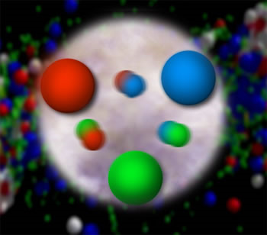
From Quarks and Gluons to the World Around Us:
Advancing Quantum Chromodynamics by Probing Nucleon Structure
Christine A. Aidala
University of Michigan
Notre Dame
January 29, 2014

Slide 2
Theory of strong interactions:
Quantum Chromodynamics
  Salient features of QCD not evident from Lagrangian!
    Color confinement
    Asymptotic freedom
  Gluons: mediator of the strong interactions
    Determine essential features of strong interactions
    Dominate structure of QCD vacuum (fluctuations in gluon fields)
    Responsible for > 98% of the visible mass in universe(!)
An elegant and by now well established field theory, yet with degrees of freedom that we can never observe directly in the laboratory!

Slide 3
How do we understand the visible matter in our universe in terms of the fundamental quarks and gluons of QCD?

Slide 4
The proton as a QCD “laboratory”
Proton—simplest stable bound state in QCD!
?...
observation & models
fundamental theory
precision measurements
& more powerful theoretical tools
application?

Slide 5
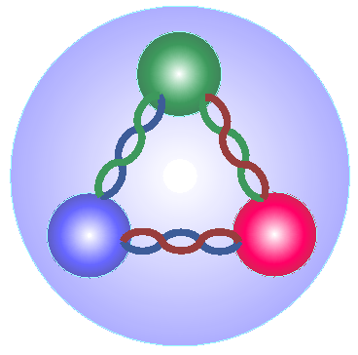
Nucleon structure: The early years
1933: Estermann and Stern measure the proton’s anomalous magnetic moment → indicates proton not a pointlike particle!
1960s: Quark structure of the nucleon
  SLAC inelastic electron-nucleon scattering experiments by Friedman, Kendall, Taylor → Nobel Prize
  Theoretical development by Gell-Mann → Nobel Prize
1970s: Formulation of QCD . . .

Slide 6
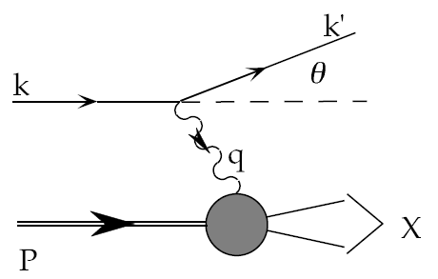
Deep-inelastic lepton-nucleon scattering:
A tool of the trade
Probe nucleon with an electron or muon beam
Interacts electromagnetically with (charged) quarks and antiquarks
“Clean” process theoretically—quantum electrodynamics well understood and easy to calculate!

Slide 7
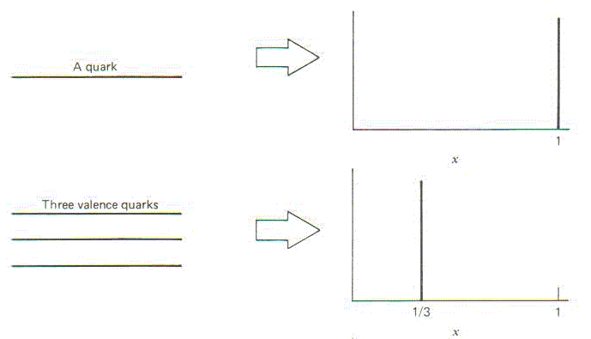
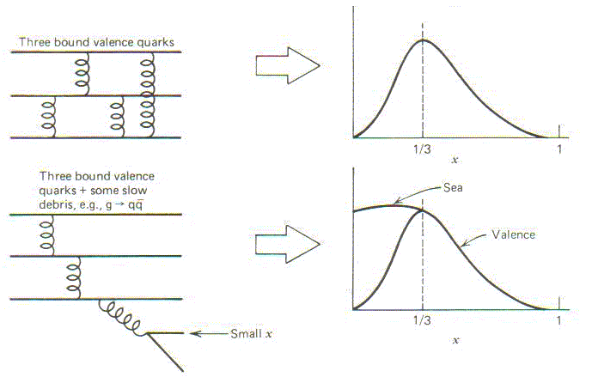
Parton distribution functions inside a nucleon:
The language we’ve developed (so far!)
What momentum fraction would the scattering particle carry
if the proton were made of …
3 bound valence quarks
A point particle
x_{Bjorken}
1
1/3
1
3 bound valence quarks + some
low-momentum sea quarks
x_{Bjorken}
Sea
3 valence quarks
Valence
Small x
1/3
1
x_{Bjorken}
1/3
x_{Bjorken}
1
Halzen and Martin, “Quarks and Leptons”, p. 201

Slide 8
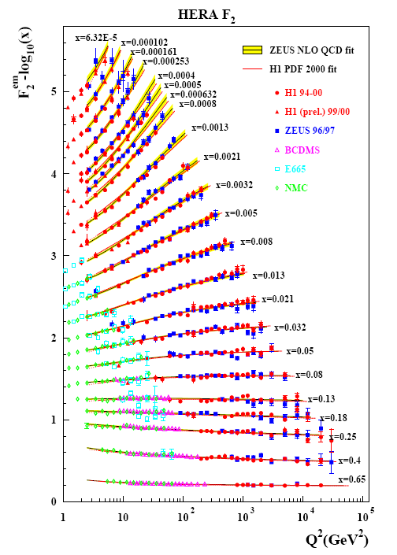
Decades of deep-inelastic lepton-nucleon scattering data: What have we learned?
Wealth of data largely thanks to proton-electron collider, HERA, in Hamburg, which run 1992-2007
Rich structure at low x
Half proton’s linear momentum carried by gluons!
PRD67, 012007 (2003)

Slide 9
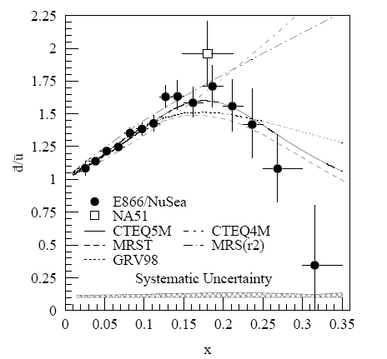
And a (relatively) recent surprise from p+p, p+d collisions
Fermilab Experiment 866 used proton-hydrogen and proton-deuterium collisions to probe nucleon structure via the Drell-Yan process
Would expect anti-up/anti-down ratio of 1 if sea quarks are only generated dynamically by gluon splitting into quark-antiquark pairs
Measured flavor asymmetry in the quark sea, with striking x behavior
Indicates some kind of “primordial” sea quarks!
Hadronic collisions play a complementary role to electron-nucleon scattering and have let us continue to find surprises in the rich linear momentum structure of the proton, even after > 40 years!
PRD64, 052002 (2001)

Slide 10
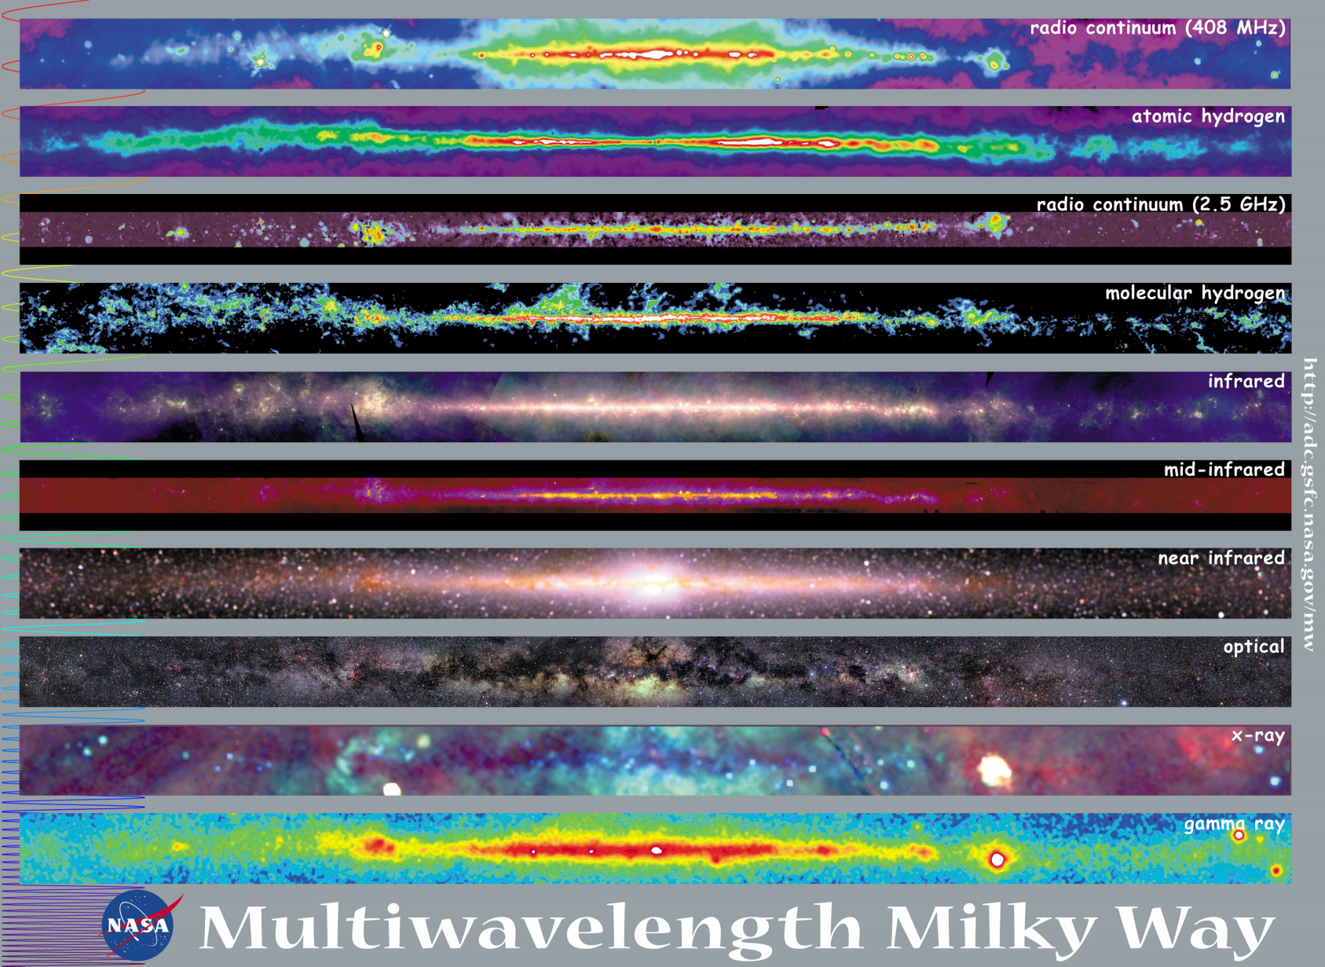
Observations with different probes allow us to learn different things!

Slide 11
Mapping out the proton
What does the proton look like in terms of the quarks and gluons inside it?
Position
Momentum
Spin
Flavor
Color
Theoretical and experimental concepts to describe and access position only born in mid-1990s. Pioneering measurements over past decade.
Vast majority of past four decades focused on
1-dimensional momentum structure! Since 1990s starting to consider transverse components . . .
Polarized protons first studied in 1980s. How angular momentum of quarks and gluons add up still not well understood!
Early measurements of flavor distributions in valence region. Flavor structure at lower momentum fractions still yielding surprises!
Accounted for by theorists from beginning of QCD, but more detailed, potentially observable effects of color have come to forefront in last couple years . . .

Slide 12
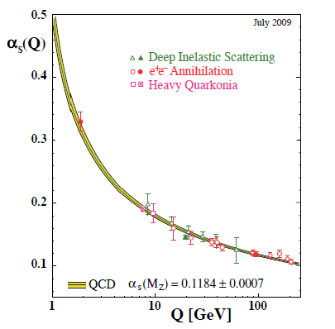
Perturbative QCD
Take advantage of running of the strong coupling constant with energy (asymptotic freedom)—weak coupling at high energies (short distances)
Perturbative expansion as in quantum electrodynamics (but many more diagrams due to gluon self-coupling!!)
Most importantly: Perturbative QCD provides a rigorous way of relating the fundamental field theory to a variety of physical observables!
Notes:
Scattering energy

Slide 13
Predictive power of pQCD
q(x₁)
Hard Scattering Process
X
g(x₂)
“Hard” (high-energy) probes have predictable rates given:
    Partonic hard scattering rates (calculable in pQCD)
    Parton distribution functions (need experimental input)
    Fragmentation functions (need experimental input)
Universal non-perturbative factors

Slide 14
Factorization and universality in perturbative QCD
Need to systematically factorize short- and long-distance physics—observable physical QCD processes always involve at least one long-distance scale (confinement)!
Long-distance (i.e. non-perturbative) functions need to be universal in order to be portable across calculations for many processes
Measure non-perturbative parton distribution functions (pdfs) and fragmentation functions in many colliding systems over a wide kinematic range→constrain by performing
simultaneous fits to world data

Slide 15
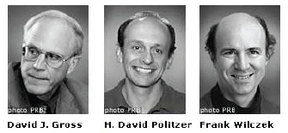
QCD: How far have we come?
QCD is challenging!!
Three-decade period after initial birth of QCD dedicated to “discovery and development”
→ Symbolic closure: Nobel prize 2004 - Gross, Politzer, Wilczek for asymptotic freedom
Now early years of second phase:
quantitative QCD!
Notes:
[While some a generation or so ahead of me have enjoyed very exciting careers [centered on][based around] the discovery and development of QCD, …]

Slide 16
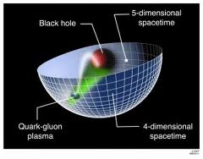
Advancing into the era of quantitative QCD: Theory already forging ahead!
In perturbative QCD, since 1990s starting to consider detailed internal QCD dynamics that parts with traditional parton model ways of looking at hadrons—and perform phenomenological calculations using these new ideas/tools!
  Various resummation techniques
  Non-linear evolution at small momentum fractions
  Non-collinearity of partons with parent hadron
Non-perturbative methods:
  Lattice QCD less and less limited by computing resources—since 2010 starting to perform calculations at the physical pion mass (after 36 years!)
  AdS/CFT “gauge-string duality” an exciting recent development as first fundamentally new handle to try to tackle QCD in decades!

Slide 17
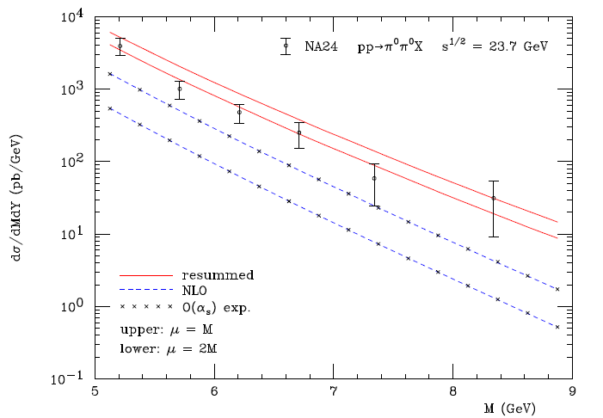
Example: Threshold resummation to extend pQCD to lower energies
For observables with two different energy scales, expand in powers of their ratio and add these terms to the highest-order calculation you’ve managed to do in a simple α_{s} expansion
pp→π⁰π⁰X
M (GeV)
Almeida, Sterman, Vogelsang PRD80, 074016 (2009)

Slide 18
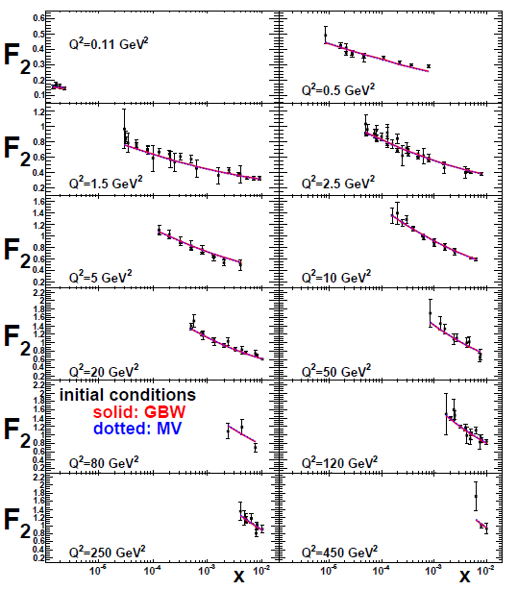
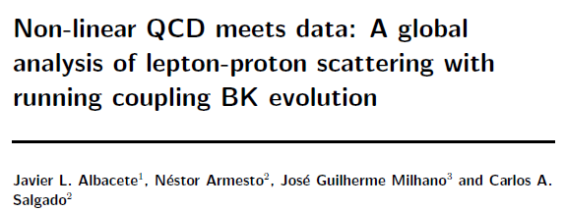
Example: Phenomenological applications of a non-linear gluon saturation regime at low x
Phys. Rev. D80, 034031 (2009)
Basic framework for non-linear QCD, in which gluon densities are so high that there’s a non-negligible probability for two gluons to combine, developed ~1997-2001. But had to wait until “running coupling BK evolution” figured out in 2007 to compare rigorously to data!
Fits to proton structure function data at low parton momentum fraction x.

Slide 19
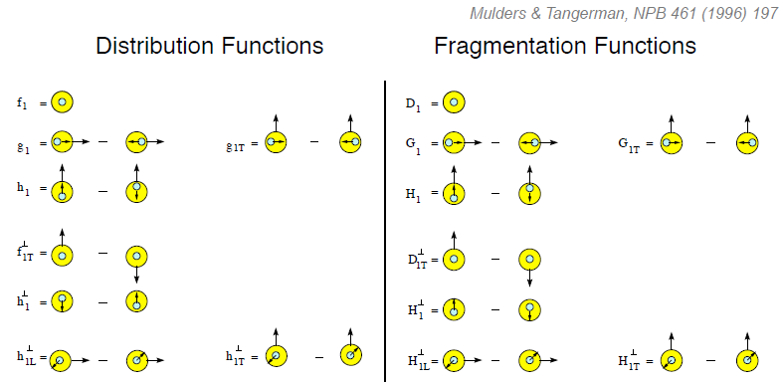
Dropping the simplifying assumption of collinearity: Transverse-momentum-dependent distributions
Collinear
Worm gear
“Modern-day ‘testing’ of (perturbative) QCD is as much about pushing the boundaries of its applicability as about the verification that QCD is the correct theory of hadronic physics.”
– G. Salam, hep-ph/0207147 (DIS2002 proceedings)
Collinear
Transversity
Sivers
Polarizing FF
Boer-Mulders
Pretzelosity
Collins
Worm gear
Many describe spin-momentum correlations: S•(p₁×p₂)

Slide 20
Pushing forward experimentally:
Perform experimental work where quarks and gluons are relevant d.o.f. in the processes studied

Slide 21
Evidence for variety of spin-momentum correlations in proton, and in process of hadronization!
A flurry of new experimental results from semi-inclusive deep-inelastic lepton-nucleon scattering and e+e- annihilation over last ~8 years has revealed large spin-momentum correlation effects
Collinear
Worm gear
Collinear
Transversity
Measured non-zero!
Sivers
Polarizing FF
Boer-Mulders
Pretzelosity
Collins
Worm gear
Spin-momentum correlations: S•(p₁×p₂)

Slide 22
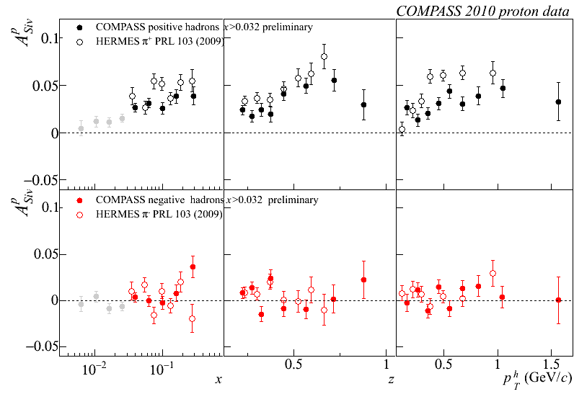
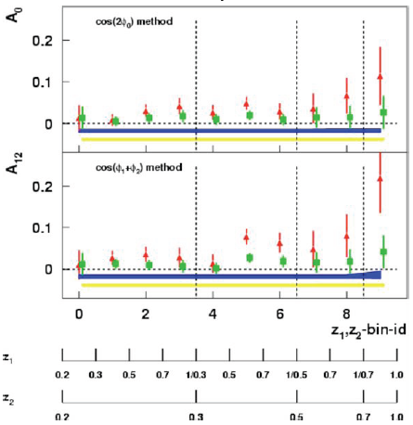
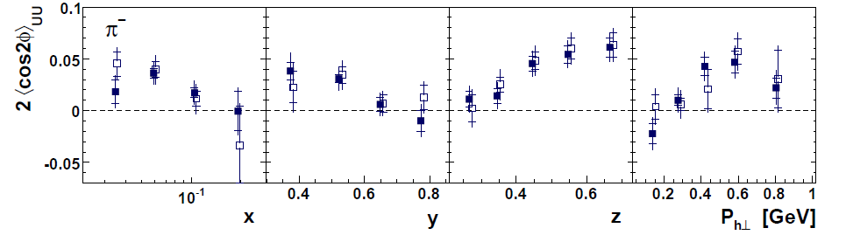
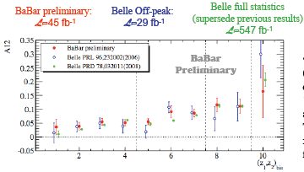
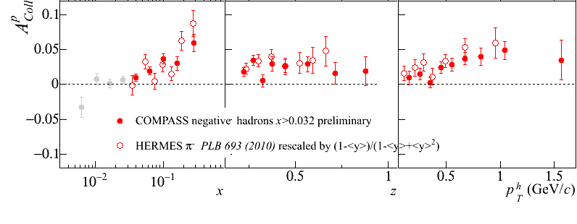
Sivers
e+p
μ+p
BELLE PRL96, 232002 (2006)
Collins x Collins
e⁺e⁻
Boer-Mulders x Collins
e+p
HERMES, PRD 87, 012010 (2013)
BaBar: Released August 2011
Collins x Collins
e⁺e⁻
e+p
μ+p
Transversity x Collins

Slide 23



Single-spin asymmetries and the proton as a QCD “laboratory”
Transversity parton distribution function:
Correlates proton transverse spin and quark transverse spin
Sivers parton distribution function:
Correlates proton transverse spin and quark transverse momentum
Boer-Mulders parton distribution function:
Correlates quark transverse spin and quark transverse momentum
S_{p}-S_{q} coupling
S_{p}-L_{q} coupling
S_{q}-L_{q} coupling

Slide 24
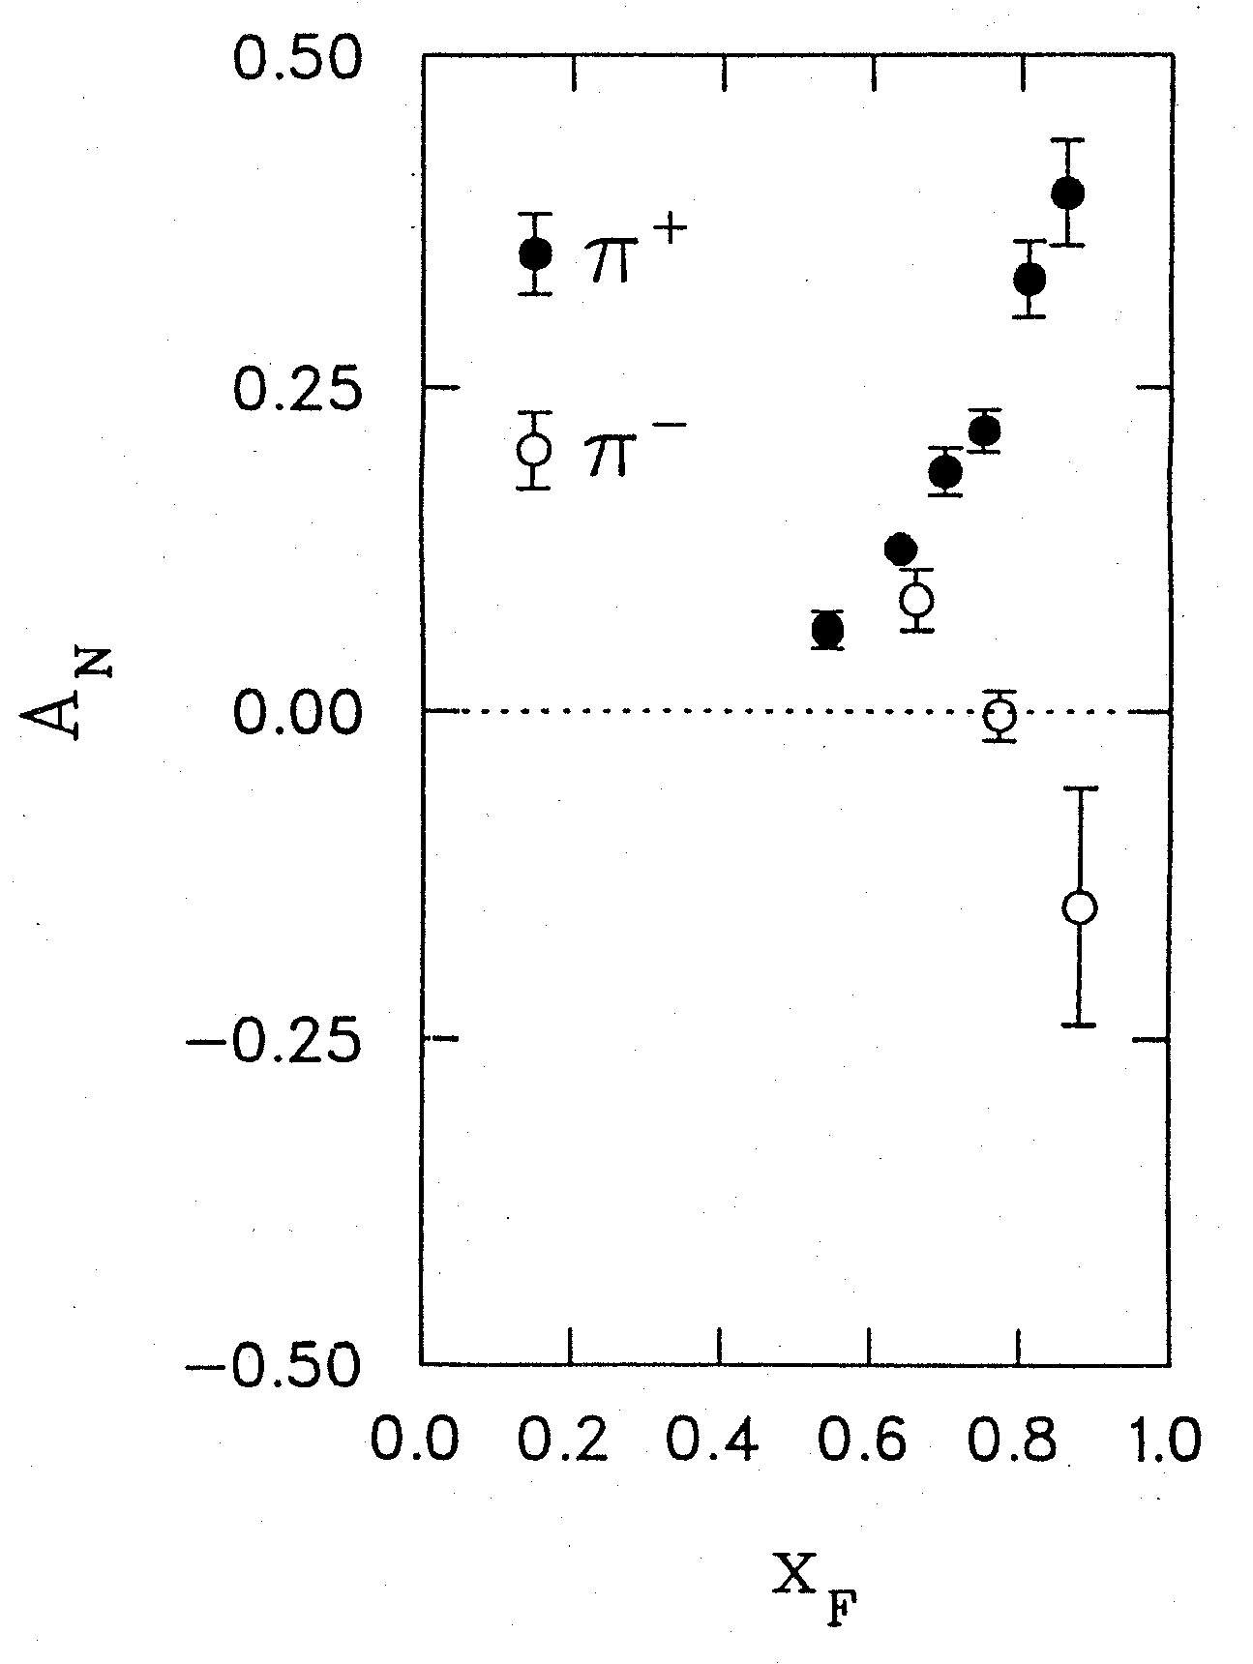
Transversely polarized hadronic collisions:
~40% spin-momentum correlation effects!
Argonne ZGS, p_{beam} = 12 GeV/c
left
right
The data that led (after 14+ years) to the development of transverse-momentum-dependent parton distribution functions
W.H. Dragoset et al., PRL36, 929 (1976)

Slide 25

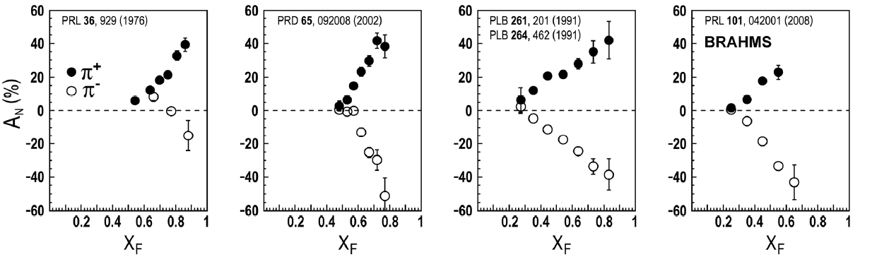
Transverse single-spin asymmetries:
From low to high energies!
ANL
√s=4.9 GeV
BNL
√s=6.6 GeV
FNAL
√s=19.4 GeV
RHIC
√s=62.4 GeV
Effects persist in polarized proton collisions at
Relativistic Heavy Ion Collider energies
→ Can probe this non-perturbative structure of nucleon in a perturbatively calculable regime
left
right

Slide 26
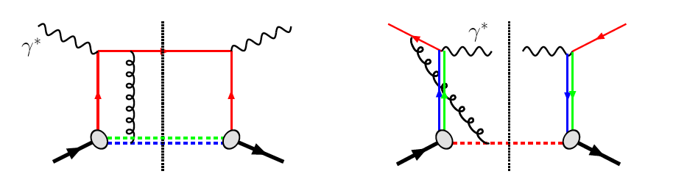
Modified universality of T-odd transverse-momentum-dependent distributions:
Color in action!
Deep-inelastic lepton-nucleon scattering: Attractive final-state interactions
Quark-antiquark annihilation to leptons:
Repulsive initial-state interactions
Still waiting for a polarized quark-antiquark annihilation measurement to compare to existing lepton-nucleon scattering measurements . . .
As a result:
( )
= -
( )
e+p → e+h+X
p+p → μ⁺+μ⁻+X

Slide 27
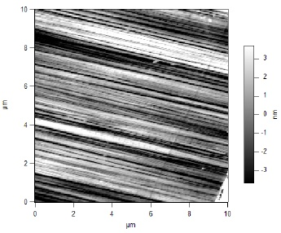
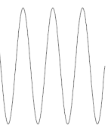
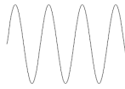
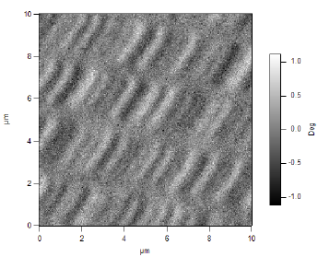
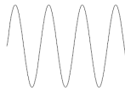
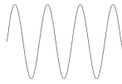
What things “look” like depends on how you “look”!
Slide courtesy of K. Aidala
Magnetic Force Microscopy
Computer Hard Drive
magnetic tip
Topography
Probe interacts with system being studied!
Lift height
Magnetism

Slide 28
The other side of the
“confinement coin”:
Formation of QCD bound states

Slide 29
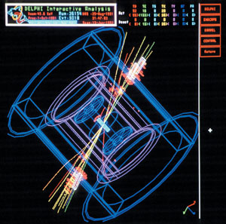
Moving beyond traditional quark and gluon fragmentation functions
For decades only considered the probability of a particular flavor quark “fragmenting” to a particular final-state hadron as a function of the momentum fraction of the quark taken by the produced hadron
Now starting to investigate
  transverse-momentum-dependent fragmentation functions
  spin-momentum correlations in the process of hadronization
  dihadron fragmentation functions
  …
e+e- → 2 “jets” of hadrons

Slide 30
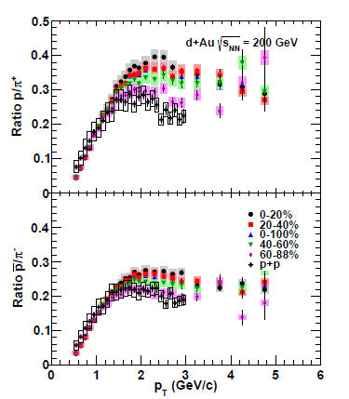

Evidence of other hadronization mechanisms in the presence of additional quarks and gluons
Increased production of baryons (3-quark bound states) compared to mesons (2-quark bound states) in d+Au collisions with respect to p+p collisions
Greater enhancement of 3-quark bound states the more the deuteron and gold nuclei overlap
Suggests new hadron production mechanism enabled by presence of additional quarks/nucleons
  Quark recombination?
PRC88, 024906 (2013)

Slide 31
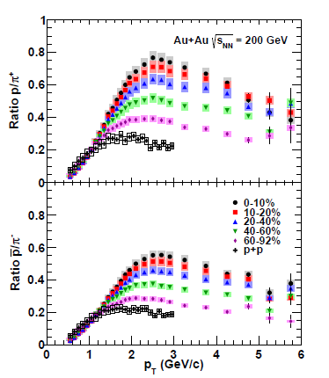
Evidence of other hadronization mechanisms in the presence of additional quarks and gluons
Similar enhancement of 3-quark bound states in Au+Au collisions
Again greater enhancement the more the gold nuclei overlap
PRC88, 024906 (2013)

Slide 32
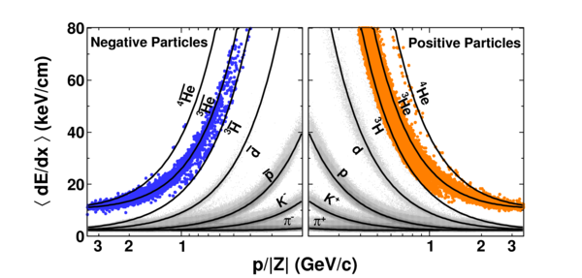
Bound states of QCD bound states:
Creating nuclei (and antinuclei!) in high-energy heavy ion collisions
STAR
Nature 473, 353 (2011)

Slide 33
Physical consequences of a gauge-invariant quantum theory:
Aharonov-Bohm (1959)
Wikipedia:
“The Aharonov–Bohm effect is important conceptually because it bears on three issues apparent in the recasting of (Maxwell's) classical electromagnetic theory as a gauge theory, which before the advent of quantum mechanics could be argued to be a mathematical reformulation with no physical consequences. The Aharonov–Bohm thought experiments and their experimental realization imply that the issues were not just philosophical.
The three issues are:
whether potentials are "physical" or just a convenient tool for calculating force fields;
whether action principles are fundamental;
the principle of locality.”

Slide 34
Physical consequences of a gauge-invariant quantum theory:
Aharonov-Bohm (1959)
Physics Today, September 2009 :
The Aharonov–Bohm effects: Variations on a subtle theme,
by Herman Batelaan and Akira Tonomura.
“Aharonov stresses that the arguments that led to the prediction of the various electromagnetic AB effects apply equally well to any other gauge-invariant quantum theory. In the standard model of particle physics, the strong and weak nuclear interactions are also described by gauge-invariant theories. So one may expect that particle-physics experimenters will be looking for new AB effects in new domains.”

Slide 35
Physical consequences of a gauge-invariant quantum theory:
Aharonov-Bohm effect in QCD!!
See e.g. Pijlman,
hep-ph/0604226 or
Sivers,
arXiv:1109.2521
Deep-inelastic lepton-nucleon scattering: Attractive final-state interactions
Quark-antiquark annihilation to leptons:
Repulsive initial-state interactions
Simplicity of these two processes:
Abelian vs. non-Abelian nature of the gauge group doesn’t play a major qualitative role.
BUT: In QCD expect additional, new effects due to specific non-Abelian nature of the gauge group
As a result:
( )
= -
( )
e+p → e+h+X
p+p → μ⁺+μ⁻+X

Slide 36
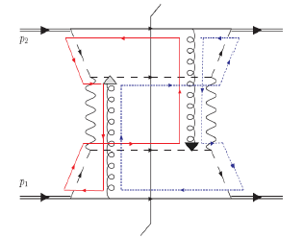
QCD Aharonov-Bohm effect:
Color entanglement
  2010: Rogers and Mulders predict color entanglement in processes involving p+p production of hadrons if quark transverse momentum taken into account
  Quarks become correlated between the two protons before they collide
  Consequence of QCD specifically as a non-Abelian gauge theory!
PRD 81:094006 (2010)
Color flow can’t be described as flow in the two gluons separately. Requires simultaneous presence of both.

Slide 37
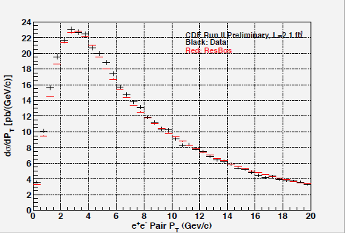
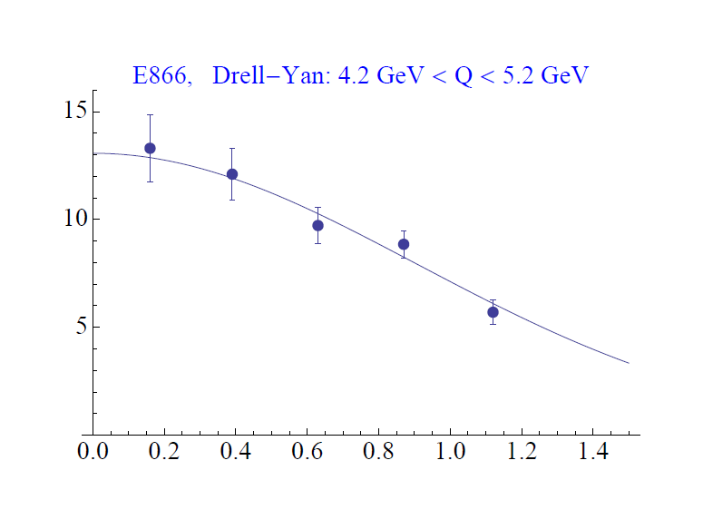
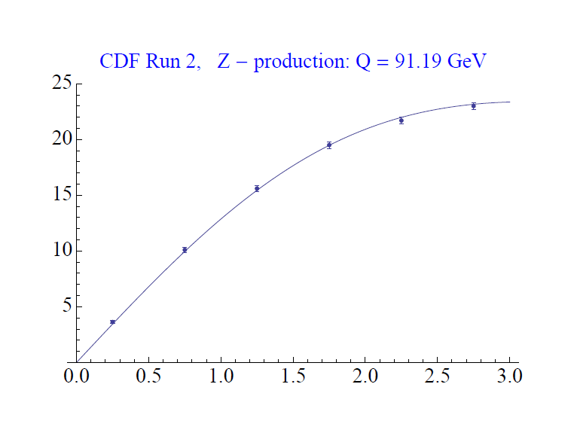
Testing the Aharonov-Bohm effect in QCD as a non-Abelian gauge theory
Don’t know what to expect from color-entangled quarks → Look for contradiction with predictions for the case of no color entanglement
But first need to parameterize (unpolarized) transverse-momentum-dependent parton distribution functions from world data—never looked at before!
Z boson production,
Tevatron CDF
dσ/dp_{T}
C.A. Aidala,
T.C. Rogers, in progress
dσ/dp_{T}
p+p → μ⁺+μ⁻+X
√s = 0.039 TeV
√s = 1.96 TeV
p_{T} (GeV/c)
p_{T} (GeV/c)

Slide 38
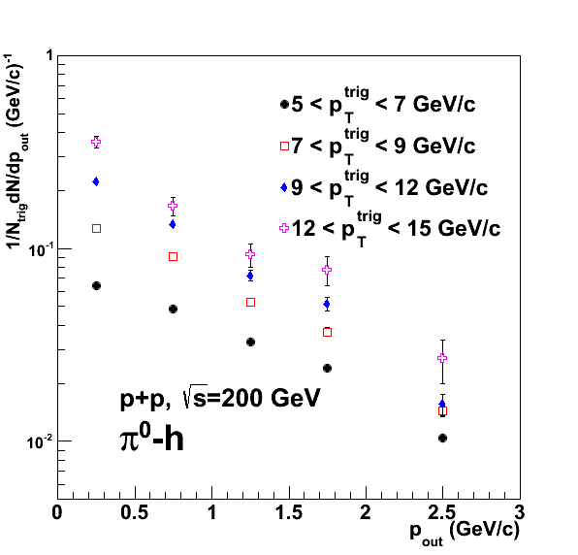
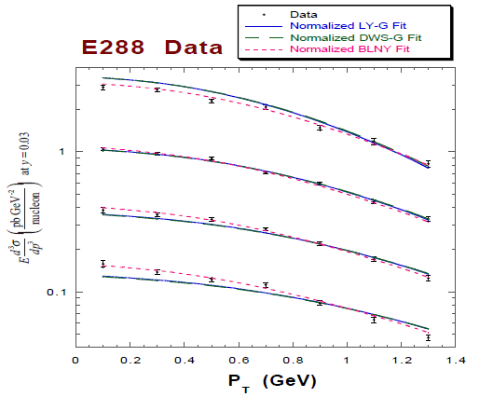
Testing the Aharonov-Bohm effect in QCD as a non-Abelian gauge theory
Will predictions based on fits to data where there should be no entanglement disagree with data from p+p to hadrons sensitive to quark intrinsic transverse momentum?
PRD82, 072001 (2010)
Landry et al., 2002
p+A → μ⁺+μ⁻+X
for different invariant masses
Out-of-plane momentum component
Nearly back-to-back hadron production for different hadron transverse momenta

Slide 39
Consequences of QCD as a non-Abelian gauge theory:
New predictions emerging
2013: Ted Rogers predicts novel spin asymmetries due to color entanglement.
No phenomenology yet, but 38 years after the discovery of huge transverse single-spin asymmetries (as well as spontaneous hyperon polarization in hadronic collisions), I’m hopeful that we may finally be on the right track!
PRL36, 1113 (1976)

Slide 40
Summary and outlook
We still have a ways to go from the quarks and gluons of QCD to full descriptions of the protons and nuclei of the world around us!
The proton as the simplest stable QCD bound state provides a QCD “laboratory” analogous to the atom’s role in the development of QED
Work related to the intrinsic transverse momentum of quarks within the proton has opened up a whole new research area focused on spin-momentum correlations in QCD, and it recently brought to light predictions for the QCD Aharonov-Bohm effect, waiting to be tested experimentally . . .
After an initial “discovery and development” period lasting ~30 years, we’re now taking early steps into an exciting new era of quantitative QCD!

Slide 41
Afterword:
QCD “versus” nucleon structure?
A personal perspective

Slide 42
We shall not cease from exploration
And the end of all our exploring
Will be to arrive where we started
And know the place for the first time.
T.S. Eliot

Slide 43
Extra

Slide 44
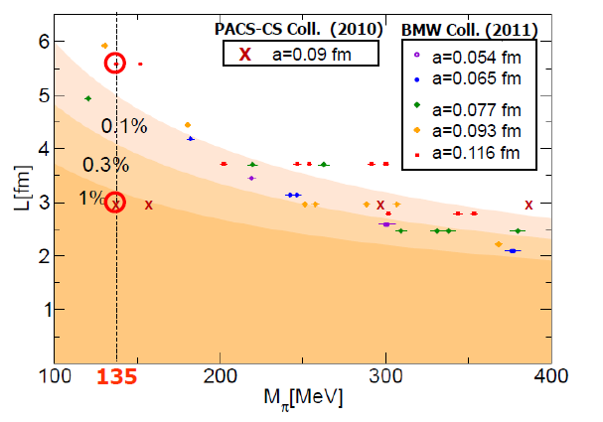
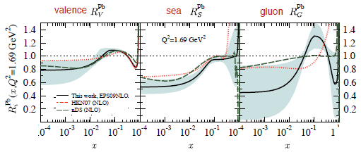
Additional recent theoretical progress in QCD
Renaissance in nuclear pdfs
  EPS09 283 citations!
Progress in non-perturbative methods:
  Lattice QCD just starting to perform calculations at physical point!
  AdS/CFT “gauge-string duality” an exciting recent development as first fundamentally new handle to try to tackle QCD in decades!
PACS-CS: PRD81, 074503 (2010)
BMW: PLB701, 265 (2011)
T. Hatsuda,
PANIC 2011
JHEP 0904, 065 (2009)
Notes:
Lattice calcs at pion mass: hadron spectrum, quark masses, pseudoscalar meson decay constants. Also frameworks to describe jet structure, e.g. “1-jettiness”.

Slide 45
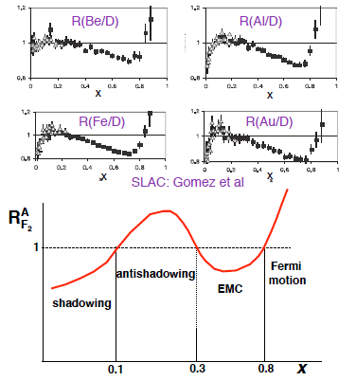

Nuclei: Not simple superpositions of nucleons!
Rich and intriguing differences compared to free nucleons, which vary with the linear momentum fraction probed (and likely transverse momentum, impact parameter, . . .).
Understanding the nucleon in terms of the quark and gluon d.o.f. of QCD does NOT allow us to understand nuclei in terms of the colored constituents inside them! New, collective effects present . . .

Slide 46
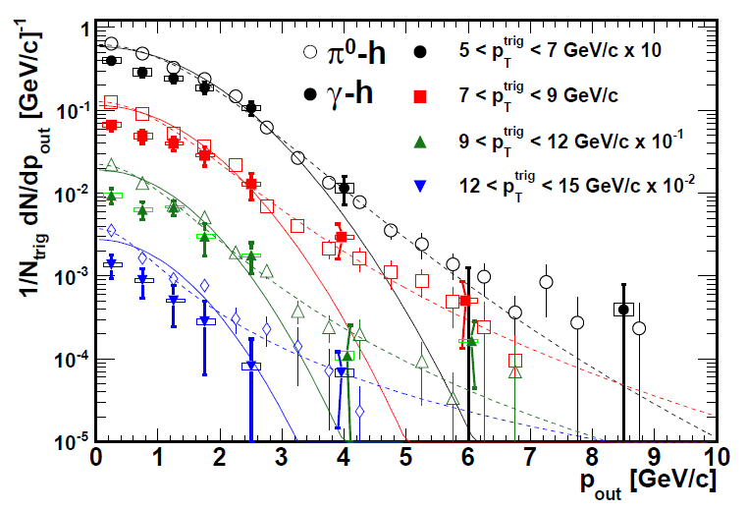
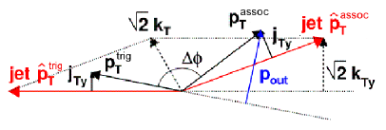
Testing factorization breaking with p+p comparison measurements for heavy ion physics:
Unanticipated synergy between programs!
PHENIX, PRD82, 072001 (2010)
Implications for observables describable using Collins-Soper-Sterman (“Q_{T}”) resummation formalism
Try to test using photon-hadron and dihadron correlation measurements in unpolarized p+p collisions at RHIC
Lots of expertise on such measurements within PHENIX, driven by heavy ion program!
(Curves shown here just empirical parameterizations from PHENIX paper)

Slide 47
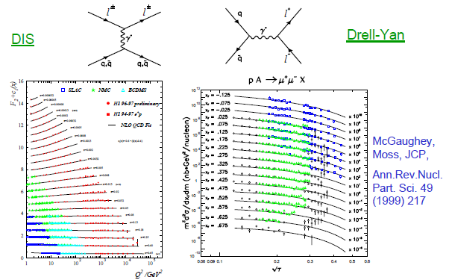
Drell-Yan complementary to DIS

Slide 48
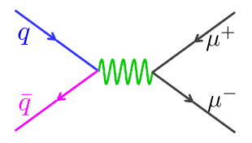
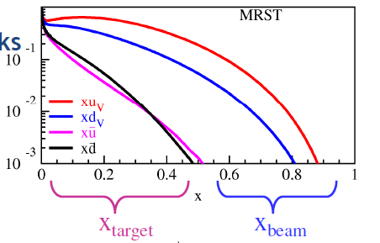
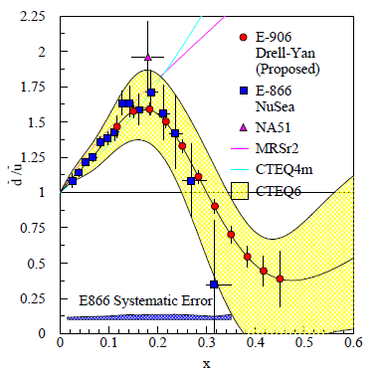
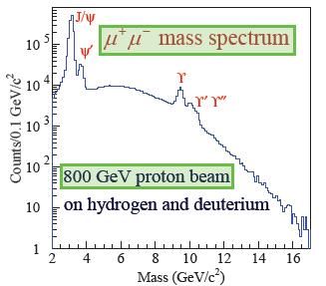
Fermilab E906/Seaquest: A dedicated Drell-Yan experiment
Follow-up experiment to FNAL E866 with main goal of extending measurements to higher x
120 GeV proton beam from FNAL Main Injector (E866: 800 GeV)
  D-Y cross section ~1/s – improved statistics
E906
E866

Slide 49
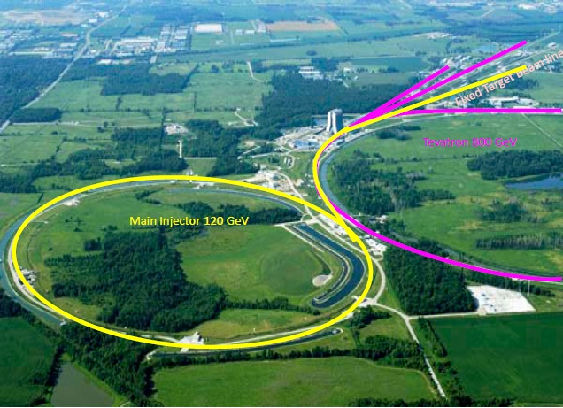

Fermilab E906
Targets: Hydrogen and deuterium (liquid), C, Ca, W nuclei
  Also cold nuclear matter program
Commissioning starts in March, data-taking through ~2013

Slide 50

Azimuthal dependence of unpolarized Drell-Yan cross section
cos2φ term sensitive to correlations between quark transverse spin and quark transverse momentum! → Boer-Mulders TMD
Large cos2φ dependence seen in pion-induced Drell-Yan
ν
NA10 dataa
194 GeV/c
π⁻+W
Q_{T} (GeV)
D. Boer, PRD60, 014012 (1999)

Slide 51


What about proton-induced Drell-Yan?
Significantly reduced cos2φ dependence in proton-induced D-Y
Suggests sea quark transverse spin-momentum correlations small?
Will be interesting to measure for higher-x sea quarks in E906!
E866, PRL 99, 082301
(2007)
E866

Slide 52



Why did we build RHIC?
To study QCD!
An accelerator-based program, but not designed to be at the energy (or intensity) frontier. More closely analogous to many areas of condensed matter research—create a system and study its properties!
What systems are we studying?
  “Simple” QCD bound states—the proton is the simplest stable bound state in QCD (and conveniently, nature has already created it for us!)
  Collections of QCD bound states (nuclei, also available out of the box!)
  QCD deconfined! (quark-gluon plasma, some assembly required!)
Understand more complex QCD systems within
the context of simpler ones
RHIC was designed from the start as a single facility capable of nucleus-nucleus, proton-nucleus, and proton-proton collisions

Slide 53









RHIC as a polarized p+p collider
Absolute Polarimeter (H jet)
RHIC pC Polarimeters
Siberian Snakes
BRAHMS & PP2PP
Siberian Snakes
PHENIX
Spin Flipper
STAR
Spin Rotators
Various equipment to maintain and measure beam polarization through acceleration and storage
Partial Snake
Helical Partial
Snake
Polarized Source
Strong Snake
LINAC
AGS
200 MeV Polarimeter
BOOSTER
Rf Dipole
AGS Internal Polarimeter
AGS pC Polarimeter
53

Slide 54






Spin physics at RHIC
Polarized protons at RHIC 2002-present
Mainly √s = 200 GeV, also 62.4 GeV in 2006, started 500 GeV program in 2009
Two large multipurpose detectors: STAR and PHENIX
  Longitudinal or transverse polarization
One small spectrometer until 2006: BRAHMS
  Transverse polarization only
Transverse spin only
(No rotators)
Longitudinal or transverse spin
Longitudinal or transverse spin

Slide 55

PHENIX detector
Philosophy:
  High rate capability to measure rare probes,
  limited acceptance.
2 central spectrometers
  Track charged particles and detect electromagnetic processes
2 forward muon spectrometers
  Identify and track muons
2 forward calorimeters (as of 2007)
  Measure forward pions, etas
Relative Luminosity
  Beam-Beam Counter (BBC)
  Zero-Degree Calorimeter (ZDC)

Slide 56

Effects persist up to transverse momenta of 7 GeV/c!
Can use tools of perturbative QCD to try to interpret!!

Slide 57


(Not a)
Valence quark effect?
Pattern of pion species asymmetries in the forward direction→ valence quark effect.
But this conclusion confounded by kaon and antiproton asymmetries from RHIC!
Note different scales
PRL 101, 042001 (2008)
K
K
K⁻ asymmetries
underpredicted
200 GeV
62.4 GeV
p
p
Large antiproton asymmetry?!
(No one has attempted calculations yet . . .)
200 GeV
62.4 GeV

Slide 58


Another surprise: Transverse single-spin asymmetry in eta meson production
Further evidence against a valence quark effect!
Larger than the neutral pion!
STAR
Note earlier Fermilab E704 data consistent . . .

Slide 59



pQCD calculations for η mesons recently enabled by first-ever fragmentation function parametrization
Simultaneous fit to world e+e- and p+p data
  e+e- annihilation to hadrons simplest colliding system to study FFs
  Technique to include semi-inclusive deep-inelastic scattering and p+p data in addition to e+e only developed in 2007!
  Included PHENIX p+p cross section in eta FF parametrization
CAA, F. Ellinghaus, R. Sassot, J.P. Seele, M. Stratmann,
PRD83, 034002 (2011)

Slide 60

Consequences of QCD as a non-Abelian gauge theory
2004, 2006: Mulders et al. generalize SIDIS/DY sign flip prediction to production of hadrons in hadronic collisions by including more complicated Wilson lines.
2007: Collins and Qiu show that observations of Mulders et al. correspond to breakdown of the normal steps in the derivation of factorization. So factorization breaking identified, but the possibility for some kind of generalized factorization remains open.
(Some years of debate here. One point that emerges is that the factorization breaking will exist for the unpolarized case just as it does for the original spin-dependent case when TMD distributions are used.)
2010: Rogers and Mulders put the nail in the coffin on generalized factorization and predict color entanglement, as a consequence of QCD specifically as a non-Abelian gauge theory.

