Slide 1
Formulating the Future of a Facility:
Studying QCD in Hadrons Using p+p Collisions at RHIC
Christine Aidala
LANL
PHENIX Collaboration Meeting
January 2011

Slide 2
Isn’t this the “spin” talk??
Strong community with its roots in nucleon structure already invested here—we should aim to create a future that enables us to address whatever the driving questions of the field are in as comprehensive a manner as possible
RHIC a unique facility as the first and only polarized proton collider
But also—a unique facility as the first and only collider built (in part) specifically to study nucleon structure
  (HERA was designed as a HEP machine to search for new physics!)
  RHIC was built by and has attracted a nice community of different institutions and groups interested in understanding the structure of the nucleon
  The “proton spin crisis,” related to the decomposition of the proton’s helicity, was one of the hottest topics in nucleon structure when RHIC was being designed in the 1990s (EMC paper was published 1988!)
  As the field has advanced, other aspects of nucleon structure have risen to the forefront—parton dynamics in the nucleon, the role of color, . . .
Should also be trying to attract community members to our (future) facility from elsewhere!

Slide 3
Why “QCD in hadrons”? Aren’t we studying proton structure?
In my opinion, the most fundamental question we’re trying to address with this part of the RHIC program is how the quarks and gluons of QCD are confined in the colorless bound states we can observe in the world around us
  Protons certainly a convenient QCD bound state to study. Stable, electromagnetically charged (for acceleration), naturally abundant . . .
  Component of everyday matter
QCD in hadrons (how do the quark and gluon d.o.f. of QCD form colorless bound states?)
QCD in nuclei (cold nuclear matter—how is a nucleus different from a mere collection of nucleons?)
QCD unconfined! (QGP—what happens in QCD when it’s too hot for bound states to form?)
And flipping our questions around—from partonic to hadronic—hard scattering/freeze-out→hadronization. . .

Slide 4
If major new investment in RHIC as a facility is tied to adding an electron ring, aren’t e+p collisions better for studying nucleon structure anyway??

Slide 5
Repeating the obvious(?)
(Or saying it out loud for the first time?)
While electrons offer several advantages (interactions easy to calculate, reconstruct kinematics exactly), you can’t learn everything about the proton by probing it with an electron!!
  (Recall the ‘C’ in ‘QCD’ . . .)
Strategy: Develop and propose an integrated, comprehensive program for the future of the facility taking full advantage of both electroweak and hadronic collisions!

Slide 6
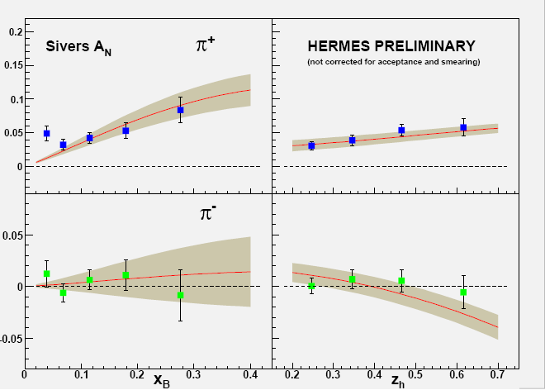

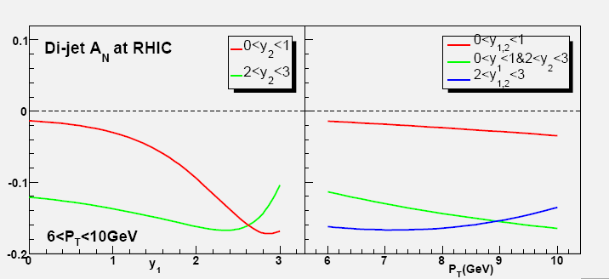
Probing the Sivers function via p+p → dijets vs. DIS:
An Illustrative History
Sivers effect in p+p ⇒ spin-dependent sideways boost to dijets, suggested by Boer & Vogelsang (PRD 69, 094025 (2004))
2005: Prediction by Vogelsang and Yuan for p+p, based on preliminary Sivers moments from HERMES (e+p)
proton spin
y
parton k_{T}^{x}
x
z
Colliding beams
W. Vogelsang and F. Yuan, PRD 72, 054028 (2005).
Notes:
I’d like to close this section of my talk with what I feel is a nice story of the stimulating interplay these years between theory and experiment in transverse spin physics.

Slide 7
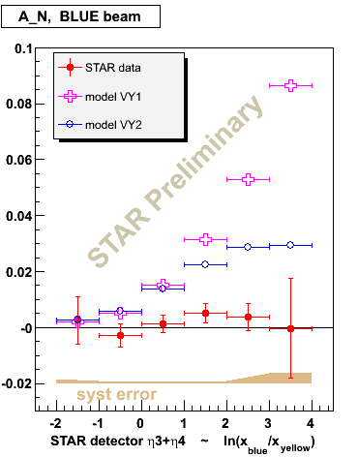
Measured Sivers A_{N} for dijets
(Recall—Sivers function: a transverse-momentum-dependent parton distribution function (TMD) describing the correlation between the k_{T} of a parton and the transverse spin of the parent proton)
STAR
Measured A_{N} consistent with zero ⇒ both quark and gluon Sivers effects much smaller in p+p → dijets than in HERMES semi-inclusive DIS??

Slide 8
Calculations for p+p revisited!
Bomhof, Mulders, Vogelsang, Yuan: PRD75, 074019 (2007)
Prediction for dijet SSA if Sivers contributions were same as for SIDIS (final-state interactions)
Conclusion: Asymmetries observed at STAR not inconsistent with SIDIS results
Initial- and final-state cancellations in p+p → jet+jet found to reduce expected dijet asymmetry at RHIC.
Complex p+p data pushes theorists to think harder (and think again)!
Interplay between DIS and p+p, between theory and experiment.
Prediction for dijet SSA if Sivers contributions were same as for Drell-Yan (initial-state interactions)
STAR
PRL99, 14003 (2007)

Slide 9
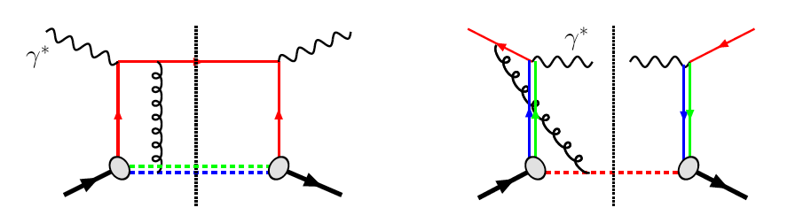
TMDs and universality:
Modified universality of T-Odd TMDs
DIS: attractive FSI
Drell-Yan: repulsive ISI
Some measurements in semi-inclusive DIS already exist. A p+p measurement at RHIC will be a crucial test of our understanding of QCD!
Being able to make detailed measurements in both DIS and p+p at the same facility even more powerful!
As a result:

Slide 10
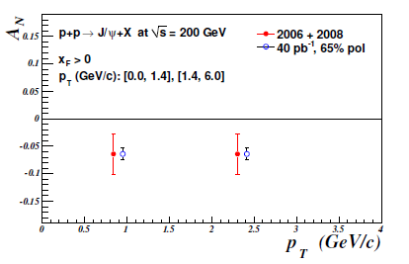
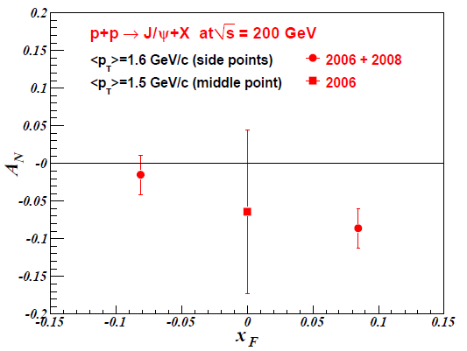
J/Psi A_{N} and gluon correlations with the (transverse) spin of the proton
Other consequences of non-universality of Sivers TMD (and other T-odd TMDs and their collinear, twist-3 cousins) now being realized!
  PRD 78, 014024 (2008)—F. Yuan predicts that J/Psi transverse single-spin asymmetry sensitive to J/Psi production mechanism, with different expectations for p+p vs. SIDIS
PHENIX recently published p+p results
3.3σ negative asymmetry at (slightly) forward rapidity observed.
J/Psi at RHIC produced via gg interactions → sensitive to gluon dynamics in transversely polarized proton.
Will need more data to confirm!
New forward spectrometer would allow measurements over wider kinematic coverage.
Measurements in e+p as well would allow direct comparison of DIS and p+p results, providing further information not only on gluon dynamics but on J/Psi production mechanism!
PRD, 82, 112008 (2010)
J/Psi projections for 40 pb⁻¹, 65% pol, expected by 2015 with current detector. Open heavy flavor also quite interesting—VTX and FVTX will help!

Slide 11
Factorization, color, and hadronic collisions
  Last year, work by T. Rogers, P. Mulders (PRD 81:094006, 2010) claimed pQCD factorization broken in processes involving more than two hadrons total if parton k_{T} taken into account (TMD pdfs and/or FFs)
  “Color entanglement”
  To understand further, useful to be able to compare measurements with 2, 3, and 4 hadrons in different combinations of initial and final state
    SIDIS, Drell-Yan, p+p → photon-hadron and hadron-hadron correlations, . . .
TMDs an exciting sub-field—lots of recent experimental activity, and theoretical questions probing deep issues of both universality and factorization in (perturbative) QCD!

Slide 12
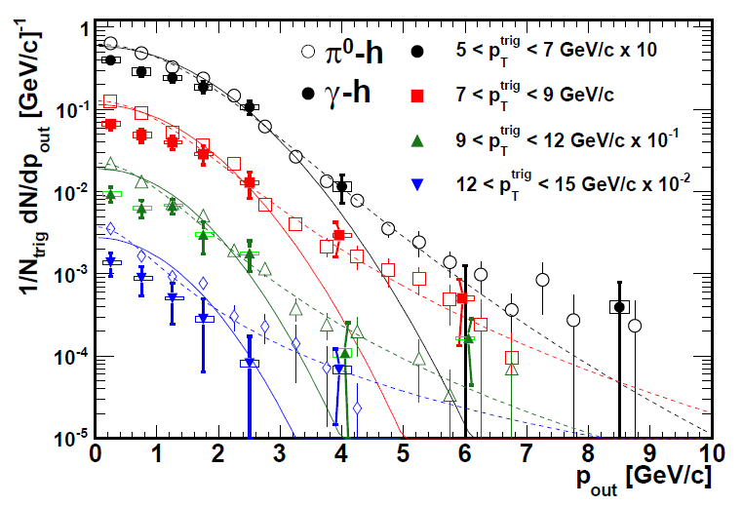
Testing TMD factorization breaking with unpolarized p+p collisions?
PHENIX, PRD82, 072001 (2010)
Discussion after Ted Rogers’ talk at Trento—implications for observables describable using Collins-Soper-Sterman (CSS, or “Q_{T}”) resummation formalism
Would like to test using photon-hadron and dihadron correlation measurements in unpolarized p+p collisions at RHIC
Lots of expertise on such measurements within PHENIX, driven by heavy ion program!

Slide 13
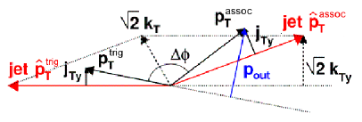
Testing TMD factorization breaking with unpolarized p+p collisions?
PHENIX, PRD82, 072001 (2010)
Rogers working with Mert Aybat to produce calculations of p_{out} distributions assuming factorization works
Take CSS soft factor from parameterizations of Drell-Yan and Z boson measurements
Take (preliminary) TMD FFs from Anselmino et al. for π⁰ – charged hadron case
Will show different shape than data??
Difference between factorized calculation and data will vary for 3-hadron vs. 4-hadron processes??
(Curves shown here just empirical parameterizations from PHENIX paper)

Slide 14
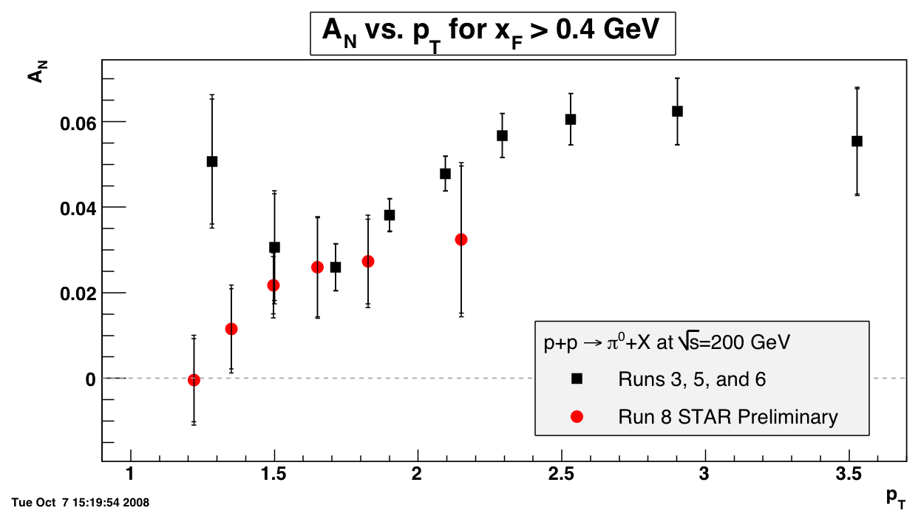
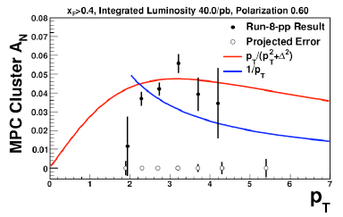

Other inclusive transverse SSA measurements
Predicted turn-over at “high” p_{T} unclear in p+p data. Should be clear within next five years
STAR
π⁰
Preliminary
Black points: PRL 101, 222001 (2008)
Projected uncertainties by 2015

Slide 15

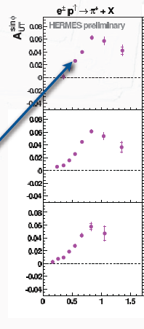
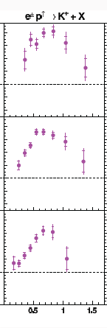
Comparing to DIS: p_{T} dependence of HERMES inclusive(!) hadron data
Inclusive p+p data intriguing enough for a DIS experiment to attempt a similar measurement by giving up measuring their precious scattered electron!!
In this case, clear rise from low p_{T} and turn-over at ~0.8 GeV/c, for both pions and kaons.
Relationship between DIS and p+p measurements not yet understood! Can inclusive hadron measurements in DIS help us to understand the p+p??
π⁺
Κ⁺
0.2 < x_{F} < 1
0.2 < x_{F} < 1
0.08 < x_{F} < 0.2
0.08 < x_{F} < 0.2
-0.1 < x_{F} < 0.08
-0.1 < x_{F} < 0.08
p_{T} (GeV/c)

Slide 16
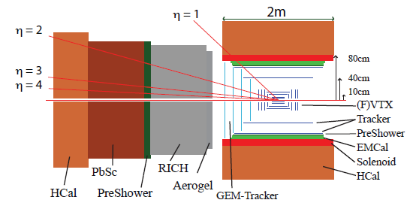
Improved forward detection capabilities
Many of the striking effects related to parton dynamics have been observed at forward rapidities→ Large-acceptance forward spectrometer
Full jet reconstruction capabilities → allow separation of effects (Sivers/Collins)
PID → Study surprising species dependences (e.g. kaons, antiprotons)
Tracking and EMCal → Drell-Yan measurements
Design single detector for hadronic collisions and DIS? Optimal strategy to get the most physics out of the facility still to be worked out.

Slide 17
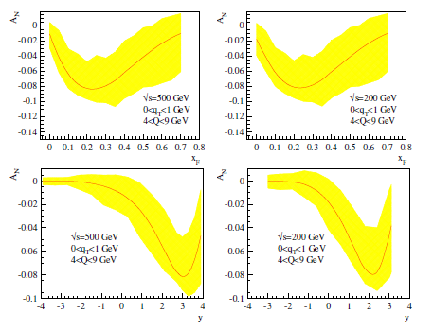
Drell-Yan transverse SSA predictions
x_{F}
x_{F}
y
y

Slide 18
Long-term accelerator prospects
Could go up to energies as high as sqrt(s)=650 GeV with new DX magnets
  Should know much more about prospects for polarization with higher beam energies after imminent long 500 GeV run
  W cross section ~2x higher
Polarized He³ beams?
  R&D for polarized He³ source starting now

Slide 19
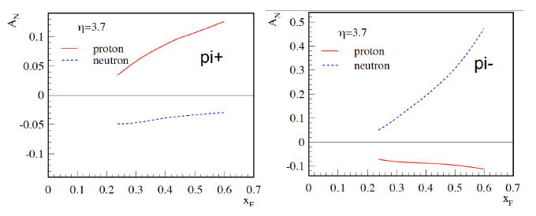
Example:
Flavor separation of TMDs using He³
Zhongbo
Kang
With polarized He³ as well as proton beams at RHIC, new handles on flavor separation of various transverse spin observables possible
  What will the status of the (non-)valence quark puzzle be by then??

Slide 20
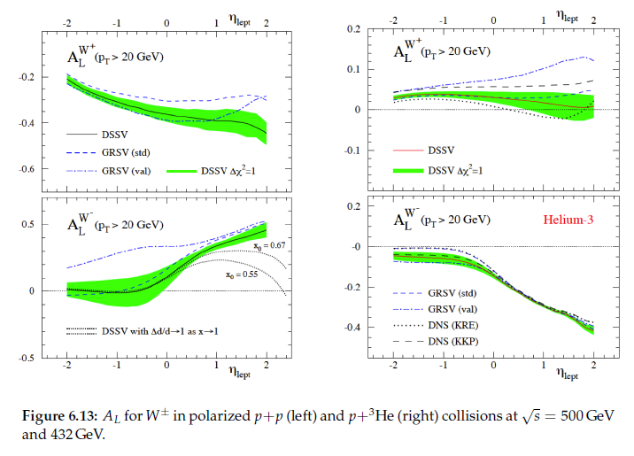
Full flavor separation of light quark helicity distributions with p+p and p+He³

Slide 21
So . . .Why use hadronic collisions to study QCD in hadrons?
Complementary information can be learned from hadronic collisions vs. DIS, and there’s an interplay between the two—having the ability to do both here at RHIC would make for a formidable facility!
Unique handles on antiquarks – Drell-Yan, W production
Unique handles on gluons
Different color interactions compared to DIS!!
  Going beyond collinear, leading-twist pdfs has been probing deep issues of universality, factorization, and color interactions in (perturbative) QCD
And hadronic collisions will be increasingly tractable through upcoming years
  As more is learned from the simpler systems of DIS and e+e-
  As the limits of applicability of pQCD are pushed ever further
If you can’t understand p+p collisions, your work isn’t done yet in understanding QCD in hadrons!

Slide 22
Afterthought (Reminder?):
Is this really a decadal plan we’ve been talking about??
Not really. We’re talking about how we could, by 2020, be starting to embark on a new longer-term program here at RHIC, with both electron-hadron and hadron-hadron collisions available to us, and with major new detection capabilities designed to allow us to pursue a comprehensive QCD program!

Slide 23
Formulating the Future of a Facility:
Studying QCD in Hadrons Using p+p Collisions at RHIC
x
^and e+p
Formulating the Future
of a Facility:
Studying QCD in Hadrons Using
p+p Hadronic and Electroweak Collisions at RHIC

Slide 24
Extra

Slide 25


A Proton’s a Proton
But we won’t be able to understand all there is to know by examining it in just one way!

Slide 26
Collinear factorization in pQCD:
Long history, relatively well tested
Origins ~30 years ago
Wealth of data on linear momentum structure of the nucleon that can be described in terms of twist-2, collinear pdf’s
  Less experimental data for the polarized case, but (most) theoretical concepts for the polarized twist-2, collinear distributions shared the same origin as in the unpolarized case
Realm in which the ΔG and W helicity programs at RHIC exist
Everything described as a function of linear momentum fraction
If want to access QCD dynamics, need to go beyond the twist-2, collinearly factorized picture.
Dynamics ↔ (transverse) SSA’s ~ S•(p₁×p₂)

Slide 27
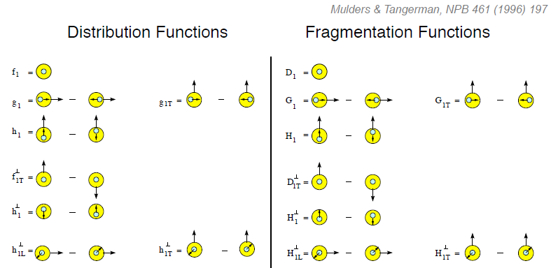
Twist-two pdf’s and FF’s, including TMD’s
Transversity
Measured non-zero
Sivers
Polarizing FF
Boer-Mulders
Pretzelosity
Collins
N.B. Also experimental evidence for non-zero collinear “interference” or “di-hadron” FF.
Only single-hadron FF’s shown here.

Slide 28
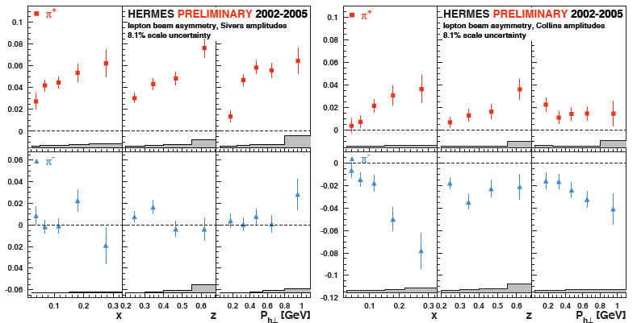
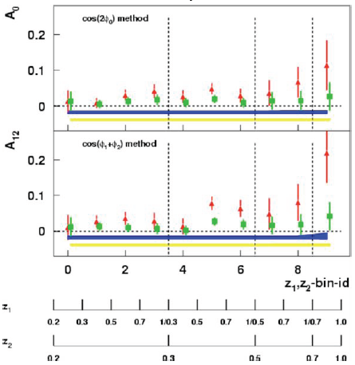
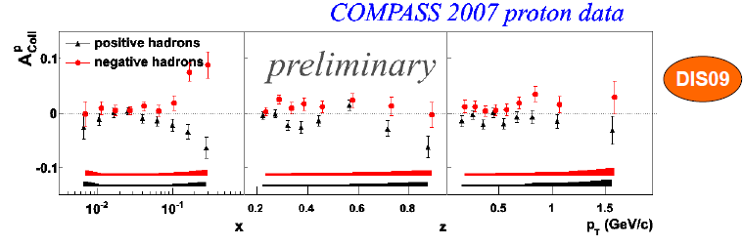
Sivers
Collins
BELLE Collins: PRL96, 232002 (2006)
Collins

Slide 29
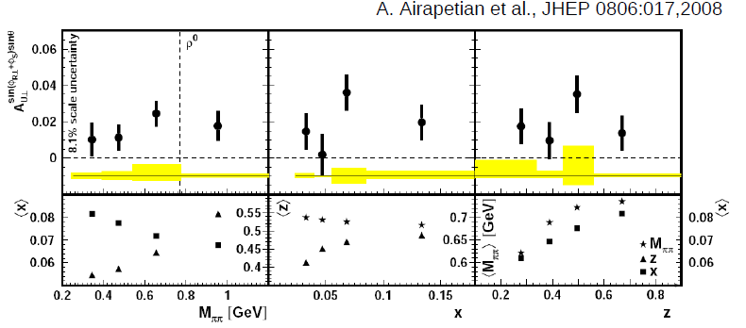
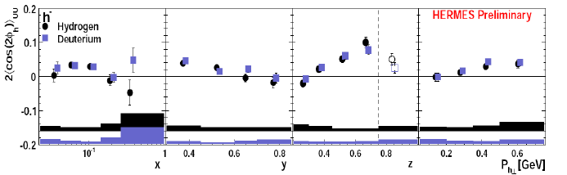
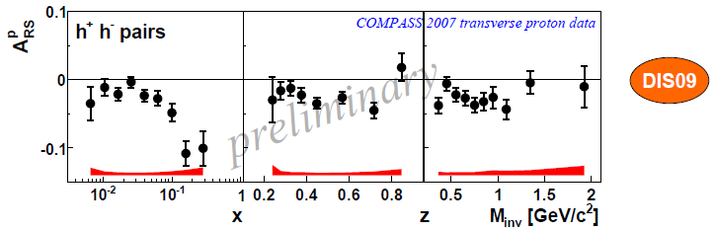
Interference FF
HERMES
Boer-Mulders
SPIN2008
A flurry of new experimental results from semi-inclusive DIS and e+e- over last ~7 years
Interference FF

Slide 30
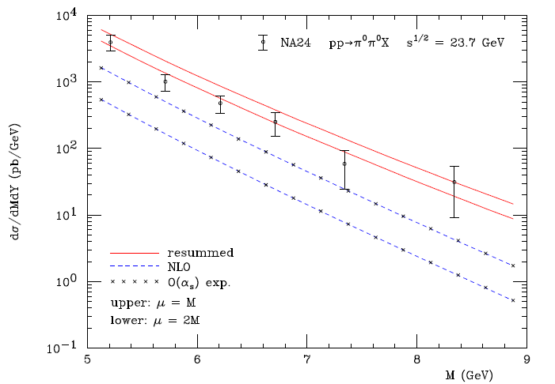
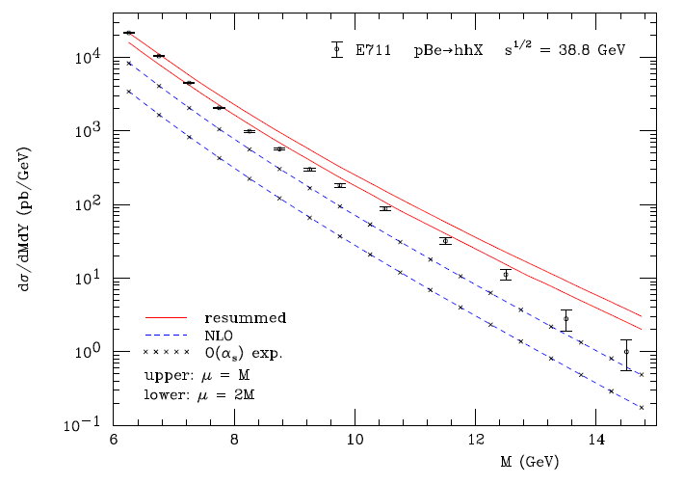
Other progress in pQCD calculational techniques
“Modern-day ‘testing’ of (perturbative) QCD is as much about pushing the boundaries of its applicability as about the verification that QCD is the correct theory of hadronic physics.”
– G. Salam, hep-ph/0207147 (DIS2002 proceedings)
One recent example:
Almeida, Sterman, Vogelsang PRD80, 074016 (2009)
Cross section for dihadron production vs. invariant mass at sqrt(s)~20-40 GeV using threshold resummation (rigorous method for implementing p_{T} and rapidity cuts on hadrons to match experiment)

Slide 31


Transverse single-spin asymmetries persist at RHIC energies
ANL ZGS
√s=4.9 GeV
BNL AGS
√s=6.6 GeV
FNAL
√s=19.4 GeV
RHIC
√s=62.4 GeV
RHIC
√s=200 GeV!
Effects persist to RHIC energies
→ Can probe this non-perturbative structure of nucleon in a calculable regime!
π⁰
left
STAR
right

Slide 32
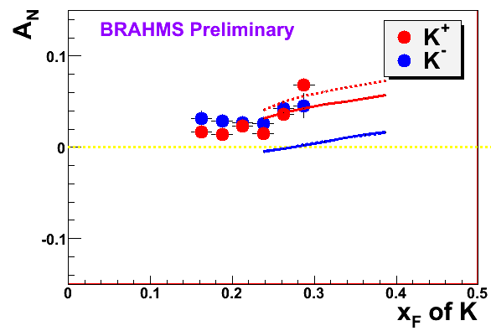
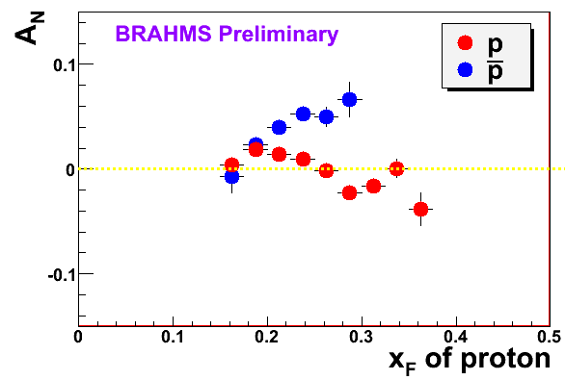
Hadron collider as a discovery machine . . .
K
Note different scales
K
Charged kaon asymmetries same sign and magnitude!
200 GeV
62.4 GeV
p
p
Large antiproton but zero proton SSA?
Polarizing FF?? Unfortunately no 62.4 GeV measurement
200 GeV
62.4 GeV

