Slide 1
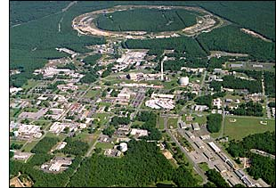
PHENIX Future:
Entering the Era of Electron Endeavors at RHIC
e-
Christine A. Aidala
LANL
PHENIX 20th Anniversary Celebration
December 2011

Slide 2
How does the program enabled by adding an electron beam fit into the science of RHIC?

Slide 3
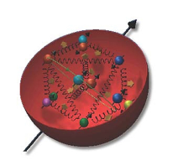
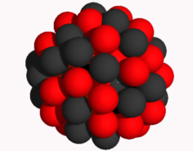
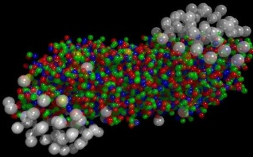
Well, why did we build RHIC in the first place?
To study QCD!
An accelerator-based program, but not designed to be at the energy (or intensity) frontier. More closely analogous to many areas of condensed matter research—create a system and study its properties!
What systems are we studying?
  “Simple” QCD bound states—the proton is the simplest stable bound state in QCD (and conveniently, nature has already created it for us!)
  Collections of QCD bound states (nuclei, also available out of the box!)
  QCD deconfined! (quark-gluon plasma, some assembly required!)
Understand more complex QCD systems within
the context of simpler ones
RHIC was designed from the start as a single facility capable of A+A, d/p+A, and p+p collisions

Slide 4
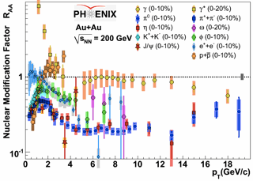
Calibration using different probes
Electroweak probes of the hot, dense matter in the A+A final state already exploited
  Direct photons, internal conversions of thermal photons, Z bosons
Learn by comparing to a variety of strongly interacting probes
  Light mesons as proxies for light quarks—various potential means of in-medium energy loss
  Charm and bottom mesons as proxies for heavy quarks—less affected by radiative energy loss
d+A allows us instead to use strong probes of the initial state
e+A will enable electroweak probes of the initial state for the first time!

Slide 5
Quarks and gluons: The d.o.f. in our fundamental field theory, QCD
sPHENIX emphasis on jets and more hermetic detectors→Try to access parton kinematics
  Jets and dijets are the handles available in hadronic collisions
In e+p/A collisions, access parton kinematics by measuring energy and angle of scattered electron
To continue advancing in QCD, critical to perform experimental work where quarks and gluons are relevant d.o.f. in the processes studied!
High enough energies
Detectors capable of measuring observables sensitive to parton kinematics (in the collision system being studied)
Notes:
Starting to drop simplifying assumptions and approximations,
[deeper levels of understanding],. . .
Compare, contrast, provide different handles

Slide 6
We spend a lot of time at RHIC trying to understand our various cold and hot QCD systems in terms of the partons inside them, but what about the other side of the “confinement coin”:
How do individual partons become hadrons??

Slide 7
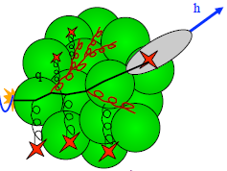
Hadronization: A lot to learn, from a variety of collision systems
What are the ways in which partons can turn into hadrons?
Spin-momentum correlations in hadronization?
  Correlations now measured definitively in e+e-! (BELLE, BABAR)
Gluons vs. quarks?
  Gluon vs. quark jets a hot topic in the LHC p+p program right now
  Go back to clean e+e- with new jet analysis techniques in hand?
In “vacuum” vs. cold nuclear matter vs. hot + dense QCD matter?
  Use path lengths through nuclei to benchmark hadronization times → e+A
Hadronization via “fragmentation” (what does that really mean?), “freeze-out,” “recombination,” . . .?
  Soft hadron production from thermalized quark-gluon plasma—different mechanism than hadronization from hard-scattered q or g?
Light atomic nuclei and antinuclei also produced in heavy ion collisions at RHIC!
  How are such “compound” QCD systems formed from partons? Cosmological implications??
…
In my opinion, hadronization has been a largely neglected area over the past decades of QCD—lots of progress to look forward to in upcoming years, with e+A, p+p, and A+A all playing a role along with e⁺e⁻!
Notes:
Baryon anomaly

Slide 8
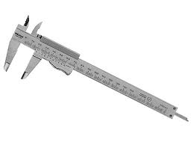
The future of RHIC:
Precision measurements
With RHIC’s unprecedented flexibility extended further, even more comparisons and complementarities to learn from!
  e↑+p↑, p↑+p↑, p↑+a↑, e↑+a↑, e+A, p/d+A, a+a, a+A, A+A
  All with higher luminosities than currently available at RHIC or earlier facilities
Electroweak and colored probes available in both the initial and final states!
Control over parton kinematics
  e+A, e+p, fully reconstructed jets, more hermetic detectors
Controlled experiments in hadronization
Notes:
Starting to drop simplifying assumptions and approximations,
[deeper levels of understanding],. . .
Compare, contrast, provide different handles

Slide 9
Precision experimental measurements in QCD are nice, but will we be ready to really learn and extract physics from them??

Slide 10
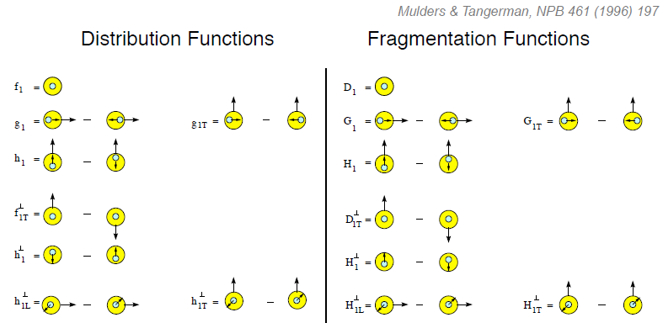
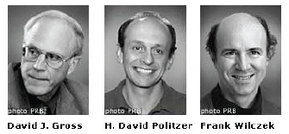
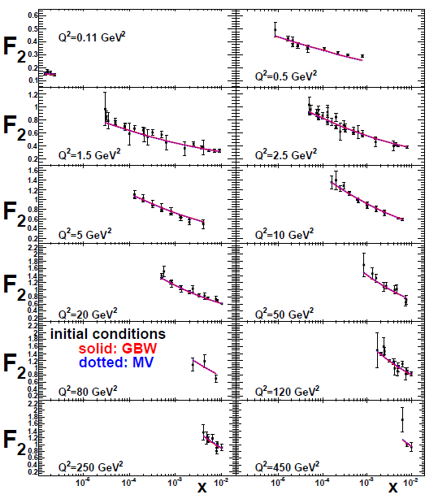
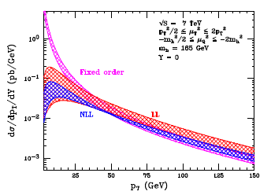
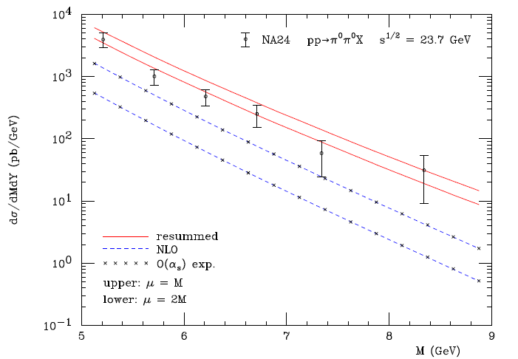
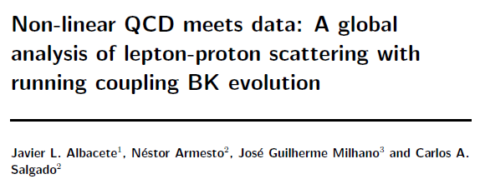
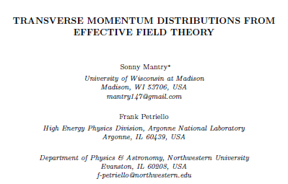
The nascent era of quantitative QCD!
Transverse-Momentum-Dependent
QCD: Discovery and development
  1973 → ~2004
Since 1990s starting to consider detailed internal QCD dynamics that parts with traditional parton model ways of looking at hadrons—and perform phenomenological calculations using these new ideas/tools!
  Various resummation techniques
  Non-collinearity of partons with parent hadron
  Various effective field theories, e.g. Soft-Collinear Eff. Th.
  Non-linear evolution at small momentum fractions
Higgs vs. pT
Mulders & Tangerman, NPB 461, 197 (1996)
Collinear
Worm gear
arXiv:1108.3609
Almeida, Sterman, Vogelsang
PRD80, 074016 (2009)
Transversity
PRD80, 034031 (2009)
pp→π⁰π⁰X
Sivers
Boer-Mulders
M (GeV)
Pretzelosity
Worm gear

Slide 11
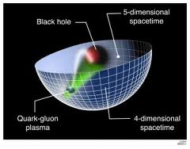
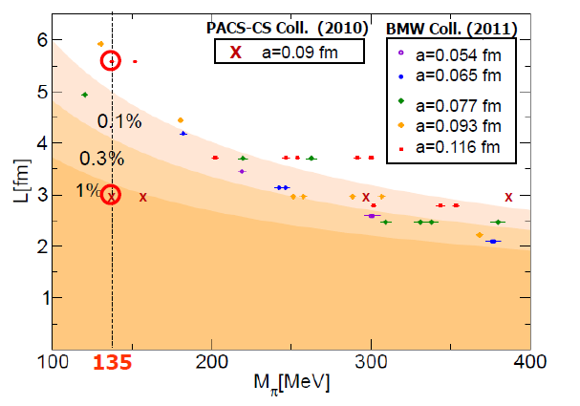
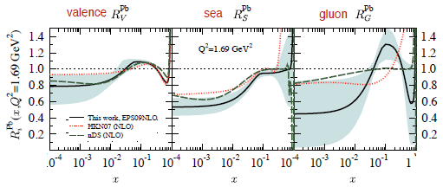
Additional recent theoretical progress in QCD
Renaissance in nuclear pdfs
  EPS09 115 citations!
Progress in non-perturbative methods:
  Lattice QCD just starting to perform calculations at physical point!
  AdS/CFT “gauge-string duality” an exciting recent development as first fundamentally new handle to try to tackle QCD in decades!
So yes! I believe this is the right time for such a flexible, multipurpose QCD facility!
Bring the data on!!
PACS-CS: PRD81, 074503 (2010)
BMW: PLB701, 265 (2011)
T. Hatsuda,
PANIC 2011
JHEP 0904, 065 (2009)
Notes:
Hadron spectrum, quark masses, pseudoscalar meson decay constants

Slide 12
So how do we get started with an electron beam?
Timescale—early 2020s
Initial beam energy 5 GeV, to be upgraded over time to 30 GeV
Focus first on inclusive and some semi-inclusive measurements, which require less luminosity and less detector coverage
  Inclusive—measure only energy and angle of scattered electron
  Semi-inclusive—measure scattered electron as well as at least one hadron in the final state
  (Exclusive—measure all final-state particles)

Slide 13
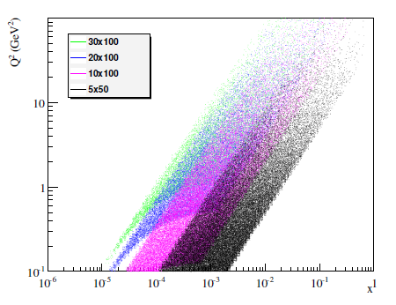
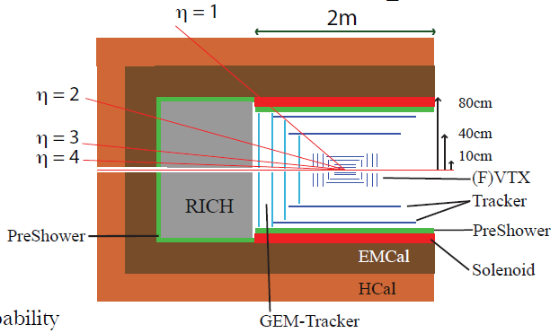
Use sPHENIX forward spectrometer to measure scattered electron?
Measure electron within
-4 < η < +1
5 GeV e beam
Q²>1 GeV²
Would need to plan accordingly—low-mass tracking, energy and angular resolutions, . . .
Notes:
Decadal Plan p. 195

Slide 14

Example: Nuclear modification of pdfs
5 GeV x 100 GeV, electron within -4 < η < +1
JHEP 0904, 065 (2009)
Lower limit with 5 GeV electron beam at RHIC

Slide 15
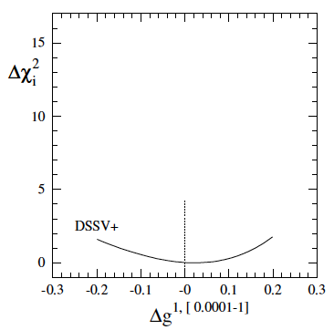
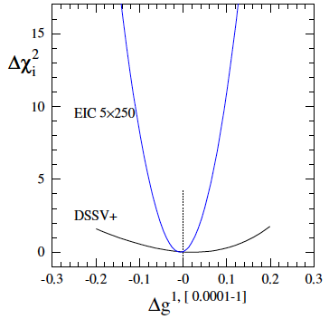
Example: Pinning down Δg and its functional form
5 GeV x 250 GeV, electron within -4 < η < +1
~1 month running
5x250 GeV²
χ² profile significantly
narrower already
for one month of running
with 5 GeV x 250 GeV, simply based on inclusive measurements!
EIC projected uncertainty
DSSV: PRL 101, 072001 (2008); PRD 80, 034030 (2009)
Notes:
Mark all golden measurements or none

Slide 16
sPHENIX forward spectrometer: Concepts
Many of the striking effects related to parton dynamics have been observed at forward rapidities→ Large-acceptance forward spectrometer
  Spin-momentum correlations
  Gluon saturation
Full jet reconstruction capabilities → access parton kinematics, allow separation of effects (e.g. Sivers/Collins)
PID → Investigate surprises from earlier RHIC data, study hadronization
Tracking and EMCal → Drell-Yan measurements

Slide 17
What’s the latest conceptual design for an e+p/A optimized detector?
Designs similar because many physics goals are similar!
Large detector acceptance:
|η| < ~5
Low radiation length critical
→ low electron energies
Precise vertex reconstruction
→ separate b and c
DIRC/RICH → π, K, p hadron ID
Forward detectors to tag proton in exclusive reactions
But see Abhay’s talk tomorrow for more practical considerations . . .
Hadron-going-direction spectrometer similar to sPHENIX forward spectrometer, conceived for p+p and p+A . . .
Notes:
Designs similar because physics is similar!

Slide 18
Final remarks
Heavy ion physics and nucleon structure communities came together at RHIC in the 1990s not because they identified common physics interests, but because the capabilities of RHIC as an accelerator facility offered valuable opportunities to both
QCD subfields studied at RHIC (and elsewhere) are at different points in terms of our present level of understanding, but after a long haul since first writing down the QCD Lagrangian, everything moving in the same direction to (finally!) become more quantitative
As the various subfields in QCD mature, the power they have to strengthen and inform one another is ever increasing!
Thus as we talk now, 20 years into PHENIX, about how to extend further the capabilities of our celebrated facility in the years to come, we’re in a position to build an even stronger, more comprehensive, and more integrated QCD program than ever . . .

Slide 19
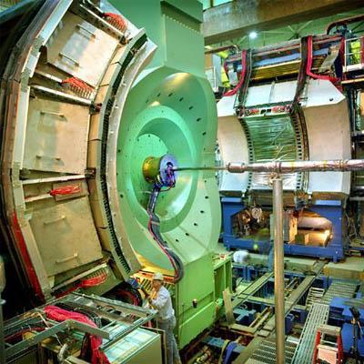

Happy 20th birthday, PHENIX!!!

Slide 20
Extra

Slide 21
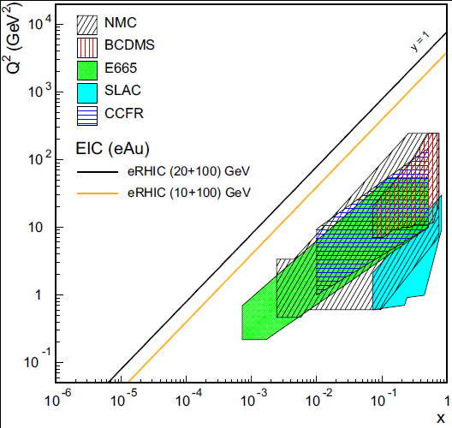
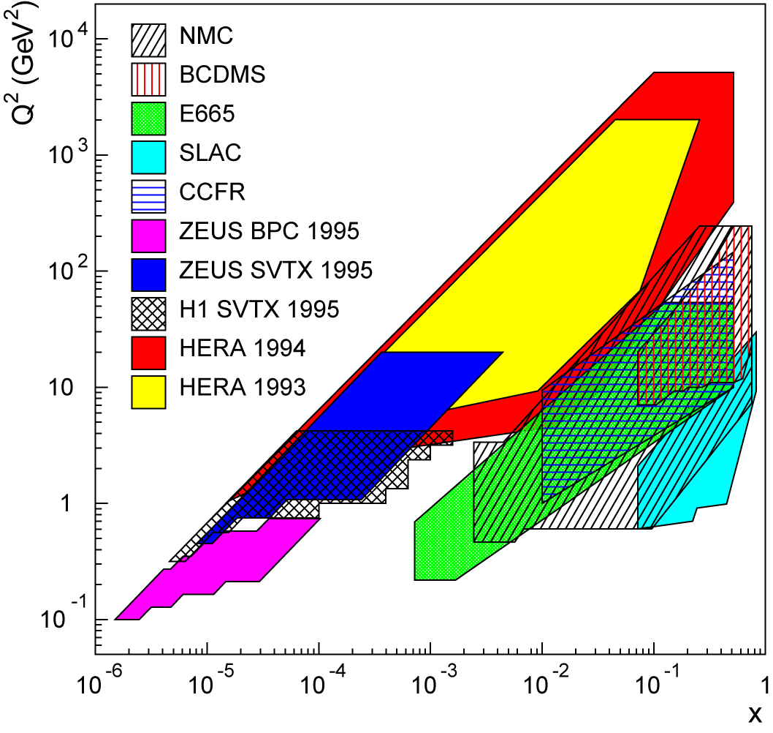
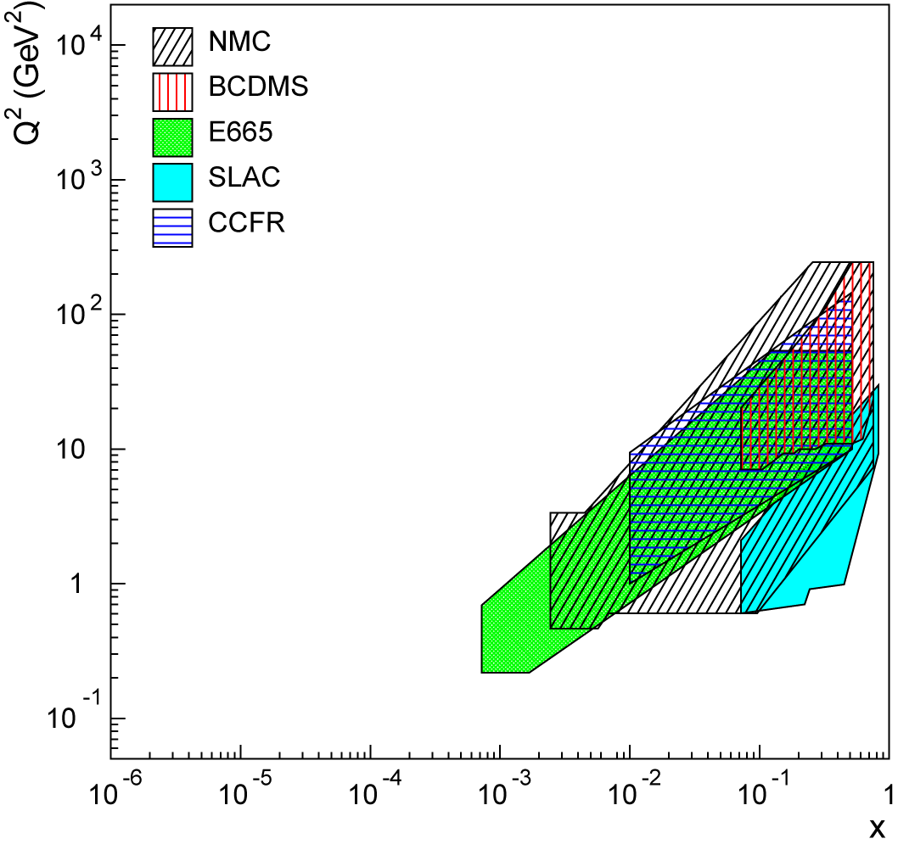
Lots of ground to cover in e+A!
Existing data over wide kinematic range for (unpolarized) lepton-proton collisions.
Not so for lepton-nucleus collisions!
EIC (20x100) GeV
EIC (10x100) GeV

Slide 22
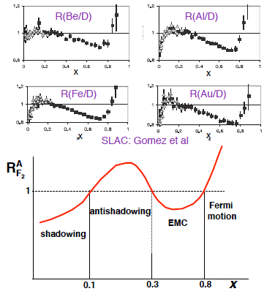
Nuclei: Not simple superpositions of nucleons!
Rich and intriguing differences compared to free nucleons, which vary with the linear momentum fraction probed (and likely transverse momentum, impact parameter, . . .).
Understanding the nucleon in terms of the quark and gluon d.o.f. of QCD does NOT allow us to understand nuclei in terms of the colored constituents inside them!

Slide 23
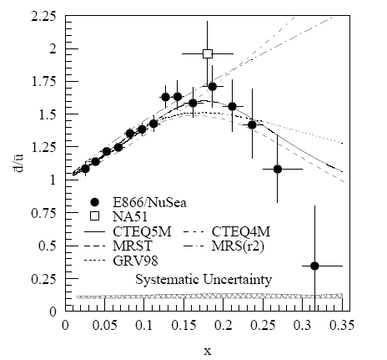
Complementarity of DIS and hadronic collisions: A(relatively) recent surprise
Fermilab Experiment 866 used proton-hydrogen and proton-deuterium collisions to probe nucleon structure via the Drell-Yan process
Anti-up/anti-down asymmetry in the quark sea, with an unexpected x behavior!
Indicates “primordial” sea quarks, in addition to those dynamically generated by gluon splitting!
Hadronic collisions play a complementary role to DIS and have let us continue to find surprises in the rich linear momentum structure of the proton, even after > 40 years!
PRD64, 052002 (2001)

Slide 24
Recall the ‘C’ in ‘QCD’ . . .
While electrons offer several advantages (interactions easy to calculate, reconstruct kinematics exactly), you can’t learn everything about a hadron or nucleus by probing it with an electron!!

Slide 25
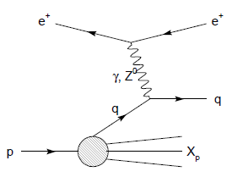
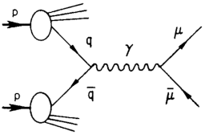
Modified universality of T-odd transverse-momentum-dependent distributions:
Color in action!
DIS: attractive final-state int.
Drell-Yan: repulsive initial-state int.
Some DIS measurements already exist. A polarized Drell-Yan measurement at RHIC will be a crucial test of our understanding of QCD!
Being able to make detailed measurements in both DIS and p+p at the same facility even more powerful!
As a result:

Slide 26
Factorization, color, and hadronic collisions
  Last year, work by T. Rogers, P. Mulders (PRD 81:094006, 2010) claimed pQCD factorization broken in processes involving more than two hadrons total if parton k_{T} taken into account (TMD pdfs and/or FFs)
  “Color entanglement”
  To understand further, useful to be able to compare measurements with 2, 3, and 4 hadrons in different combinations of initial and final state
    SIDIS, Drell-Yan, p+p → photon-hadron and hadron-hadron correlations, . . .
TMDs an exciting subfield—lots of recent experimental activity, and theoretical questions probing deep issues of both universality and factorization in (perturbative) QCD!

Slide 27
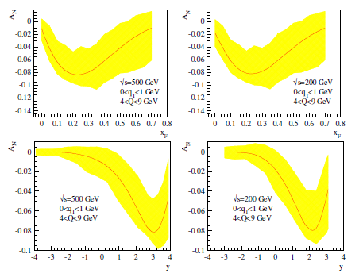
Drell-Yan transverse SSA predictions
x_{F}
x_{F}
y
y

Slide 28
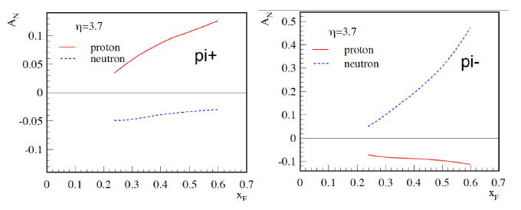
He³ example:
Flavor separation of TMDs
Zhongbo
Kang
With polarized He³ as well as proton beams at RHIC, new handles on flavor separation of various transverse spin observables possible
  What will the status of the (non-)valence quark puzzle be by then??

Slide 29
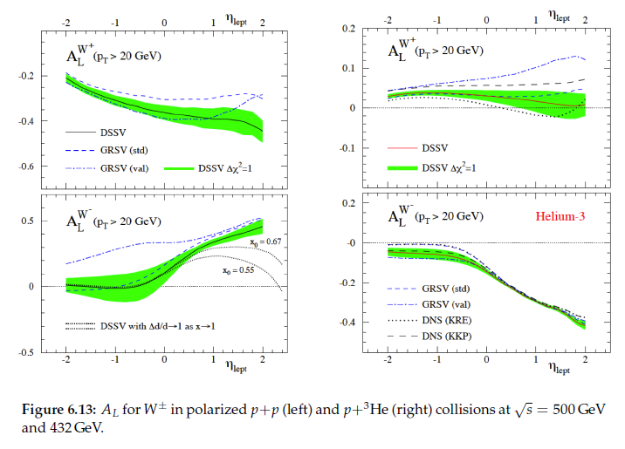
Full flavor separation of light quark helicity distributions with p+p and p+He³

