Slide 1


PHENIX Highlights
Stefan Bathe, QM2011

Slide 2
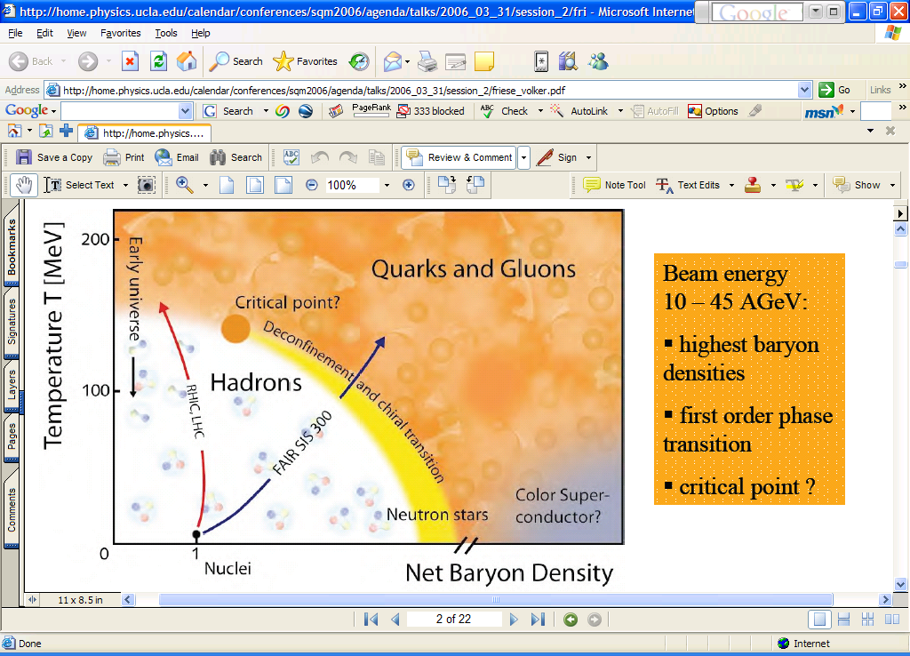
Measuring the Properties of the QGP
Conditions
Properties
μ
Screening length
T_{i}
η/s
CNM
effects
dE/dx
Initial
State

Slide 3
What I will show you today
v₂ of thermal direct photons
  Constrains T_{i} and τ₀
CNM effects in d+Au
  Density dependence of shadowing from J/ψ
  Reconstructed jets
  Low-x suppression from forward di-hadron correlations
v₃
  Disentangle initial state from η/s
  Implications for 2-particle correlations
E loss
  Path-length dependence
Results from energy scan

Slide 4
Measuring the Properties of the QGP
Conditions
Properties
μ ~ 0
Screening length
T_{i}
η/s
CNM
effects
dE/dx
Initial
State

Slide 5
Measuring the Properties of the QGP
Conditions
Properties
μ ~ 0
Screening length
T_{i}
η/s
CNM
effects
dE/dx
Initial
State

Slide 6
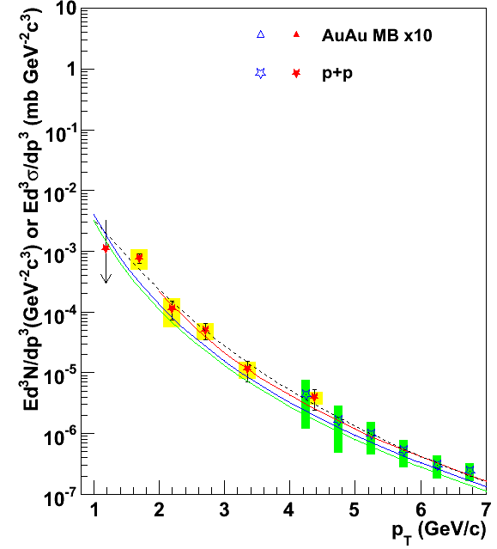
Direct Photon Excess in Au+Au
NLO Vogelsang
√sNN = 200 GeV
yield
p+p
PRL 104, 132301 (2010)

Slide 7
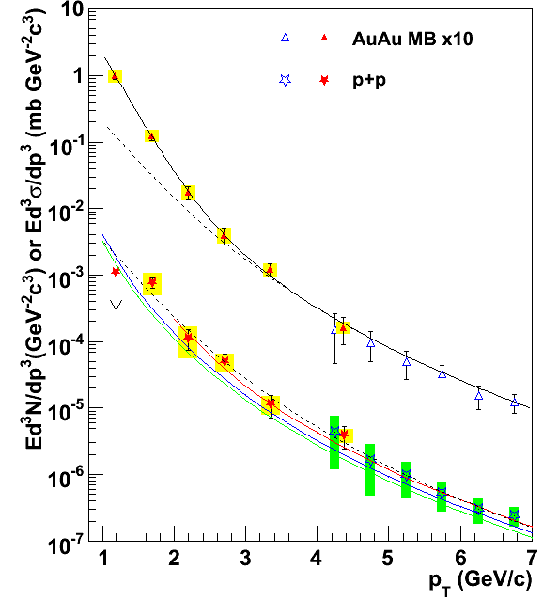
Direct Photon Excess in Au+Au
NLO Vogelsang
√sNN = 200 GeV
Direct photon excess above p+p spectrum
Exponential (consistent with thermal)
Inverse slope = 220 ± 20 MeV
T_{i} from hydro
  300 . . . 600 MeV
  Depending on thermalization time
Au+Au
min. bias
yield
p+p
PRL 104, 132301 (2010)

Slide 8
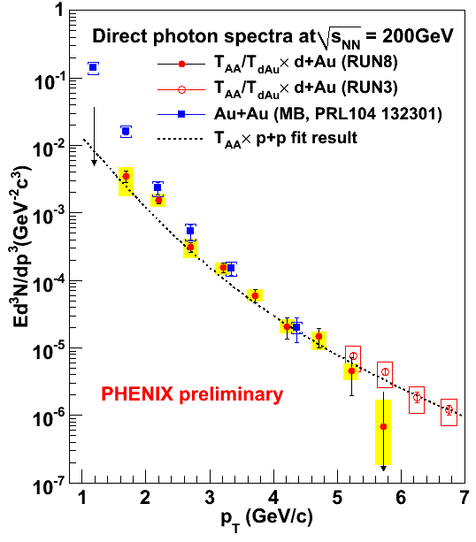
Critical d+Au Check
New:
  no exponential excess in d+Au
  Poster: Y. Yamaguchi

Slide 9
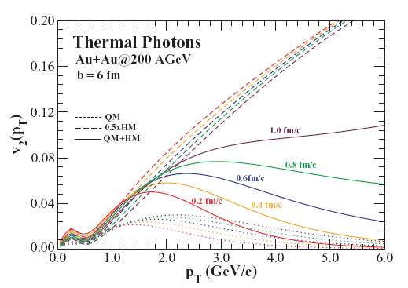
Direct photon v₂ further constrains T_{i}
Hydro after τ₀
expected v₂ :
  prompt photons: 0 (time zero)
  thermal photons
early
late
    small
    (flow not built up)
    large
    (like hadrons)
Chatterjee, Srivastava
PRC79, 021901 (2009)

Slide 10
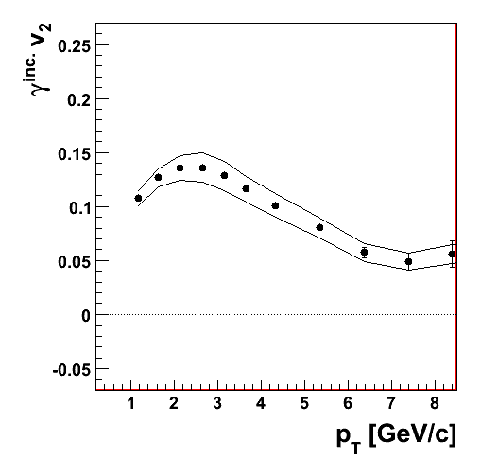
Direct Photon v₂
Au+Au@200 GeV
minimum bias
Statistical subtraction
inclusive photon v₂
- decay photon v₂
= direct photon v₂
preliminary
inclusive photon v₂

Slide 11
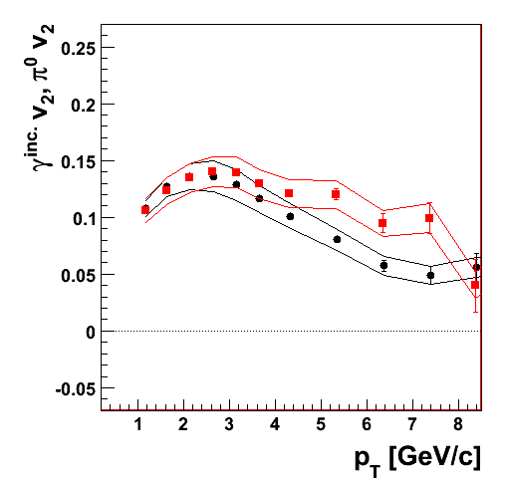
Direct Photon v₂
Au+Au@200 GeV
minimum bias
π⁰ v₂ similar to inclusive photon v₂
Two possibilities
  A: there are no direct photons
  B: direct photon v₂ similar to inclusive photon v₂
Key: precise measurement of direct photon excess
preliminary
π⁰ v₂
inclusive photon v₂

Slide 12
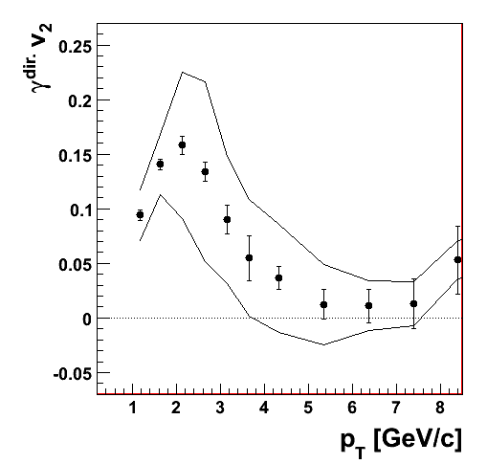
Direct Photon v₂
Au+Au@200 GeV
minimum bias
direct photon v₂ large (~15 %) at p_{T} =2.5 GeV
v₂ → 0 where prompt photons dominate
Direct photon v₂
preliminary

Slide 13
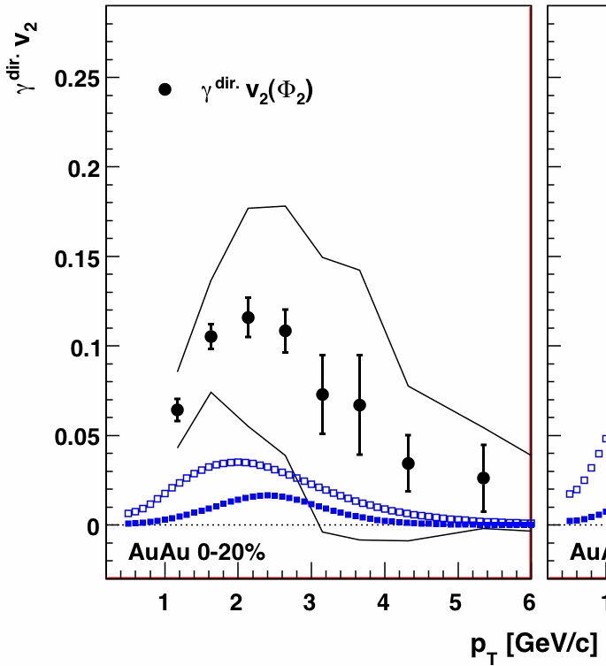
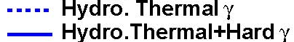
Theory Comparison: Direct Photon v₂
Theory calculation:
Holopainen, Räsänen, Eskola
arXiv:1104.5371v1
preliminary
Models under-predict direct photon v₂
Measurement further constrains T_{i} andτ_{i}
Challenge to theorists
  Plenary: S. Esumi (flow), Tue
  Parallel: E. Kistenev (direct photons) Thu

Slide 14
Measuring the Properties of the QGP
Conditions
Properties
μ ~ 0
Screening length
T_{i} =300-600 MeV
η/s
CNM
effects
dE/dx
Initial
State

Slide 15
Measuring the Properties of the QGP
Conditions
Properties
μ ~ 0
Screening length
T_{i} =300-600 MeV
η/s
CNM
effects
dE/dx
Initial
State

Slide 16
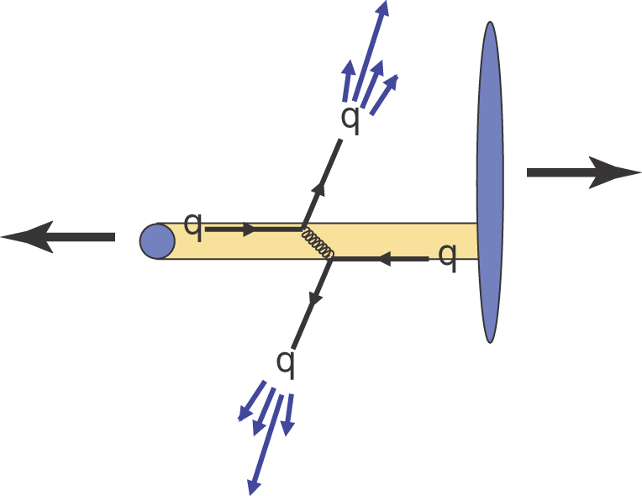
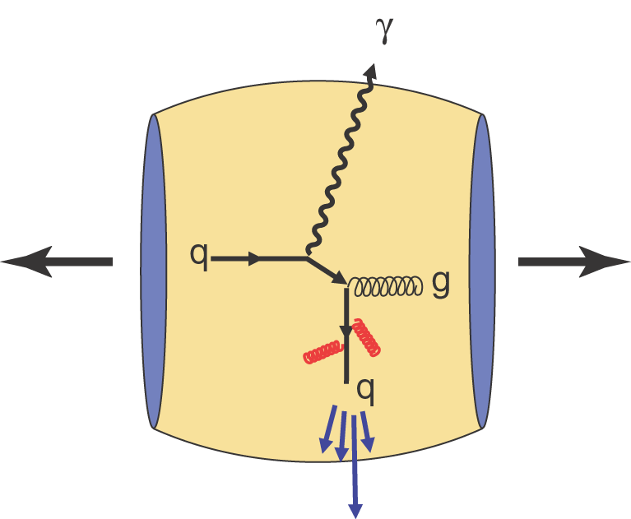
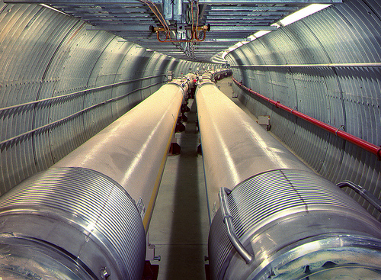
Cold Nuclear Matter Effects
Important for interpretation of HI data
  Measure Cold Nuclear Matter (CNM) effects in d+Au collisions
RHIC versatile
  Can collide any nuclear species on any other

Slide 17
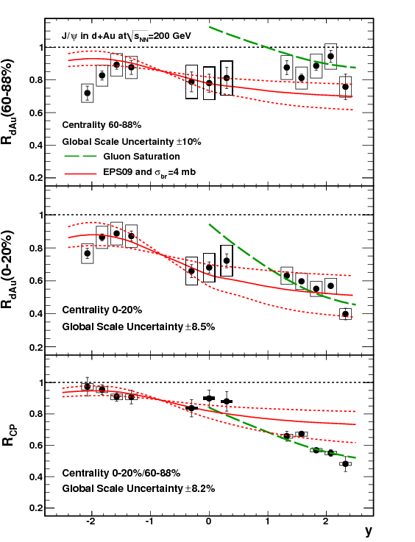
J/ψ in d+Au: Shadowing non-linear
EPS09 shadowing with linear dependence on nuclear thickness matches for central collisions
Overpredicts suppression for peripheral collisions
R_{CP} shows this clearly
Thickness (impact parameter) dependence of shadowing is non-linear!
arXiv:1010.1246
1010.1246
  Plenary: C. Luiz da Silva (heavy flavor), Fri
  Parallel: A. Sen (quarkonia) Tue
Theory calculations:
Eskola, Paukkunen, Salgado, JHEP04, 065
Vogt, PRC71, 054902
Kharzeev , Tuchin, NPA770, 40
Kharzeev ,Tuchin, NPA735, 248

Slide 18
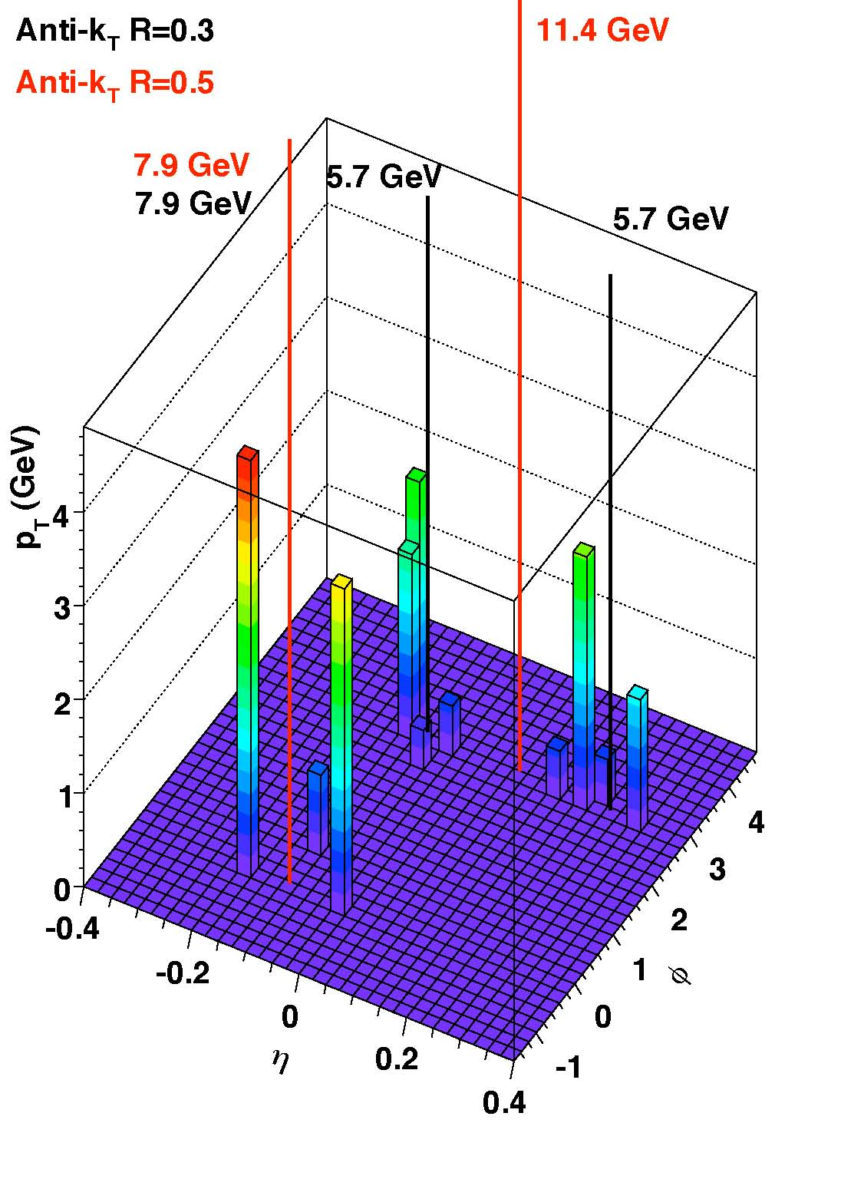
Reconstructed Jets in d+Au

Slide 19
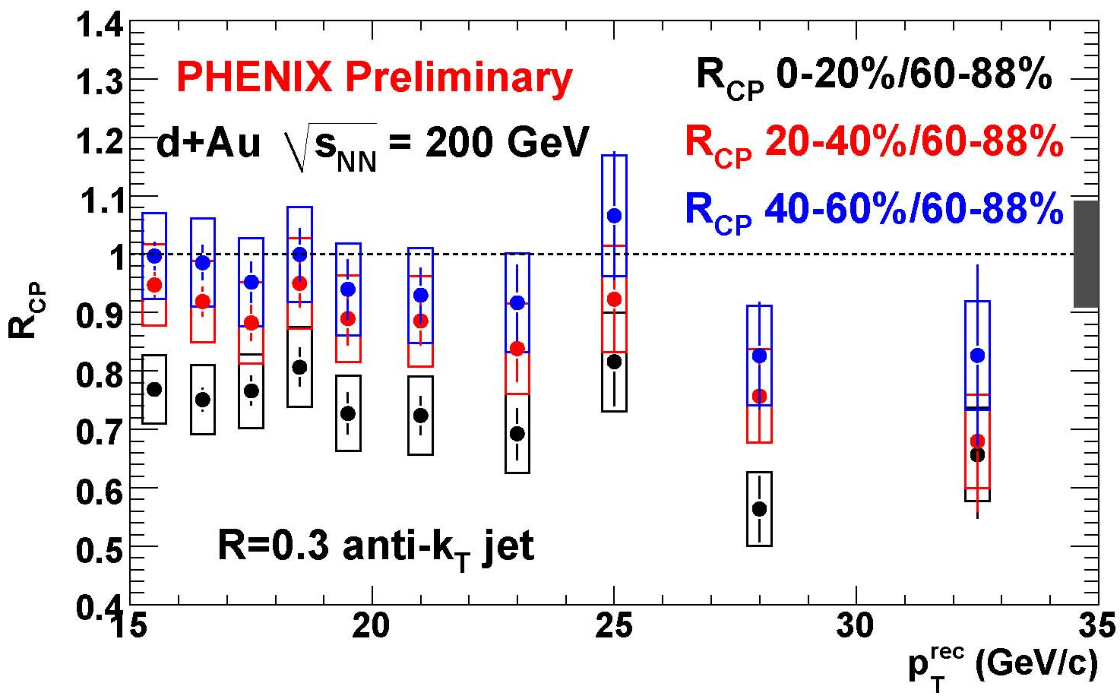
Reconstructed Jets in d+Au
at the p+p uncorrected scale
Jet R_{cp} in central d+Au modified
- caution: this is not R_{dA}!
consistent with π⁰ R_{cp}
anti-shadowing?
  Parallel: N. Grau (gamma-hadron, jets) Tue
  Poster: D. Perepelitsa (jets in dAu)

Slide 20
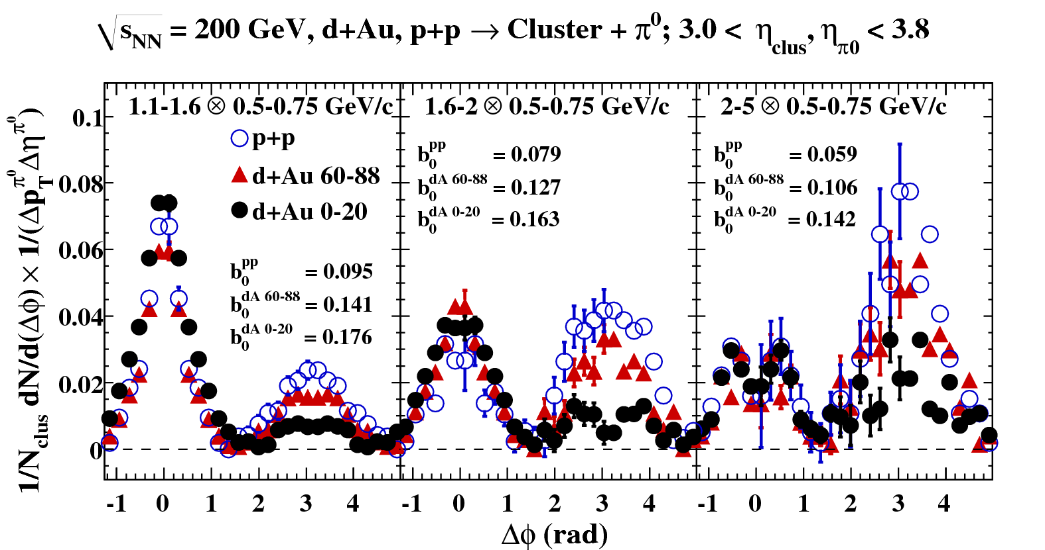
Forward di-hadron correlations
Color Glass Condensate?
new forward
EM calorimeter
|η| = 3.0-3.8
Pocket formula:

Slide 21
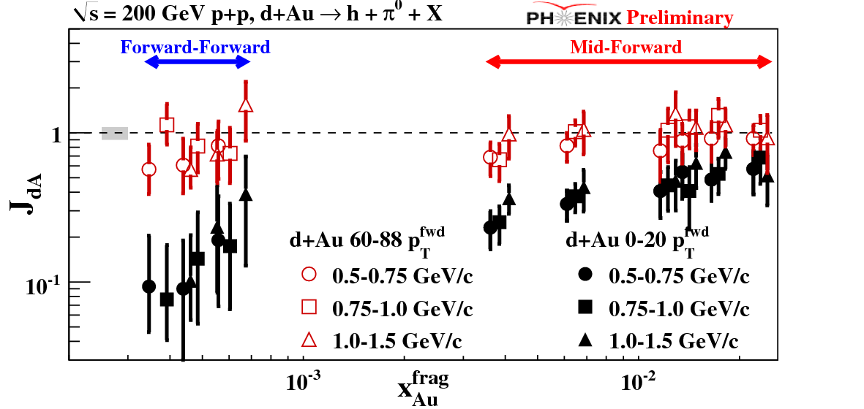
Initial state low-x gluon suppression
Di-hadron
suppression
factor
peripheral
central
smaller x

Slide 22
Initial state low-x gluon suppression
Di-hadron
suppression
factor
peripheral
central
smaller x
Di-hadrons suppressed at low x
Important for interpretation of HI results
  Parallel: M. Chiu (small x dAu correl) Thu
  Poster: Z. Citron (small x dAu correlations)

Slide 23
Measuring the Properties of the QGP
Conditions
Properties
μ ~ 0
Screening length
T_{i} =300-600 MeV
η/s
CNM
effects
non-linear shadowing
low-x suppression
anti-shadowing?
dE/dx
Initial
State

Slide 24
Measuring the Properties of the QGP
Conditions
Properties
μ ~ 0
Screening length
T_{i} =300-600 MeV
η/s
CNM
effects
non-linear shadowing
low-x suppression
anti-shadowing?
dE/dx
Initial
State

Slide 25
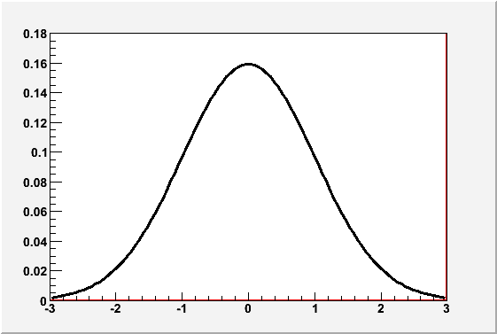
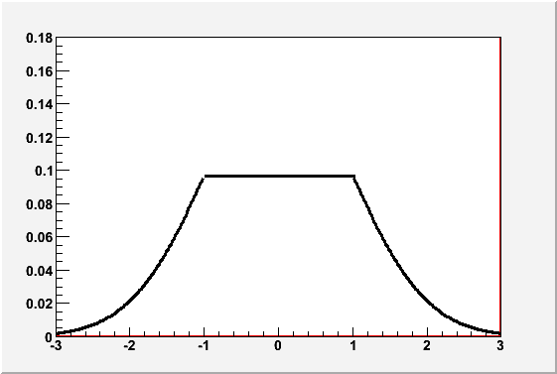
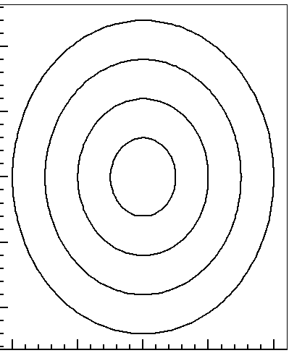
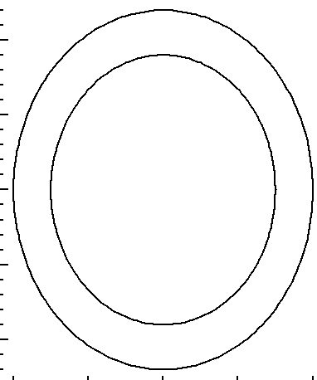
Initial State determines flow strength
Glauber
CGC
Radial gluon distribution
2-D density profile
Initial state determines v₂ strength
(largest uncertainty)
Smaller eccentricity
larger eccentricity
Disentangle initial conditions
from flow strength

Slide 26
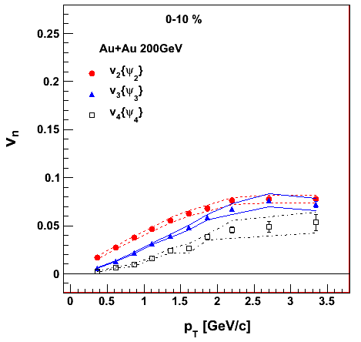
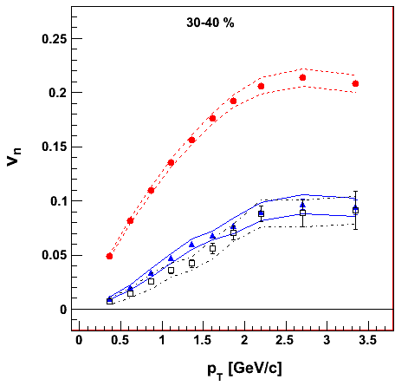
v₃ has fluctuations origin
arXiv:1105.3928
arXiv:1105.3928
central:
v₃ = v₂
mid-central:
v₃ < v₂
weak centrality dependence of v₃ => fluctuations origin

Slide 27
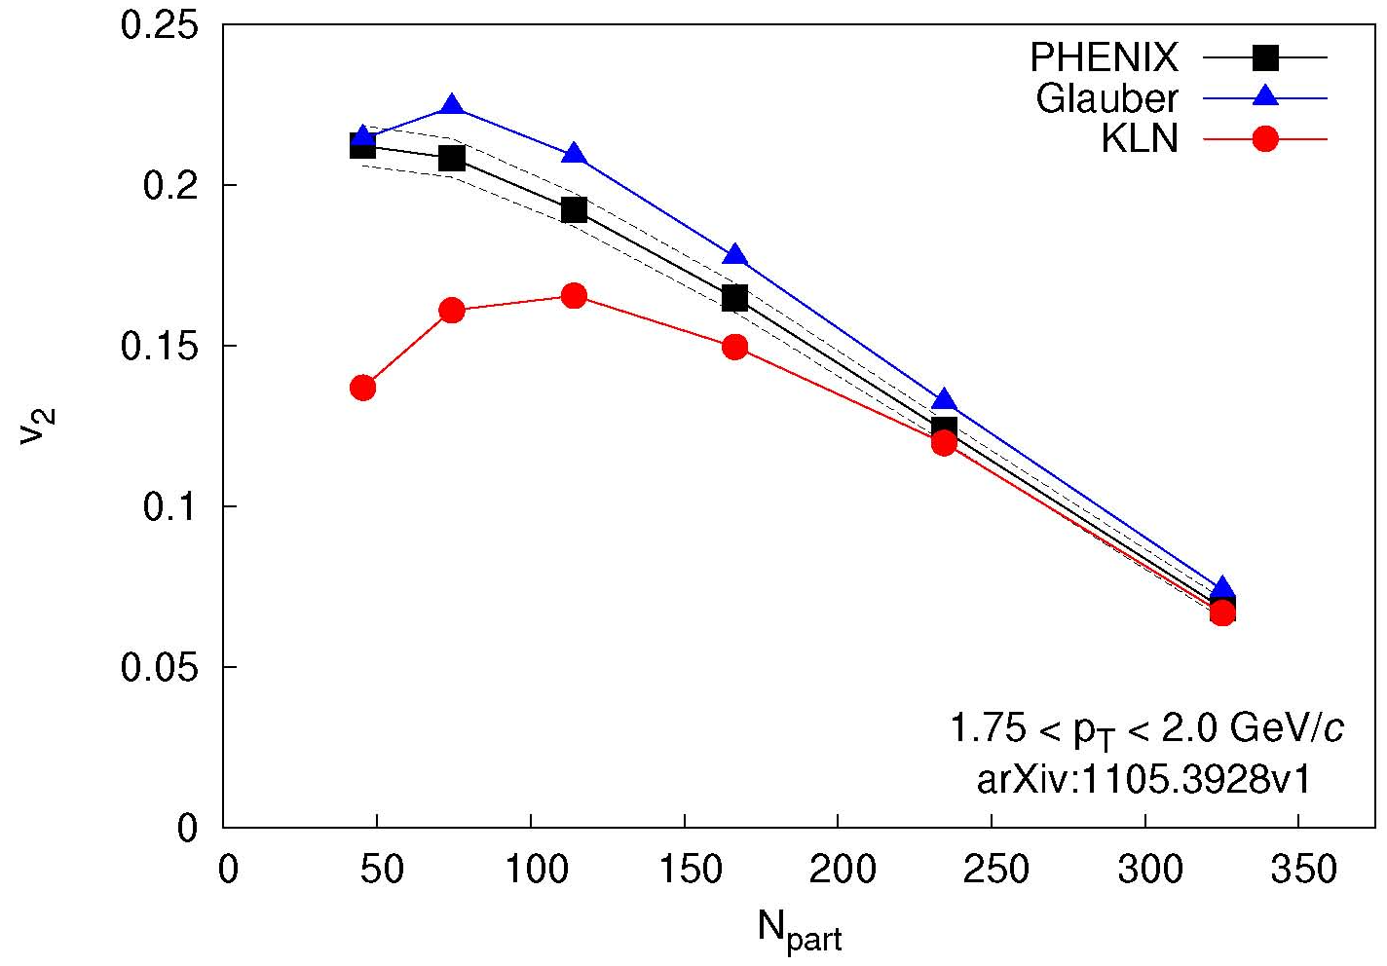
v₃ disentangles initial state and η/s
v₂ described by Glauber and CGC
Theory calculation:
Alver et al.
PRC82,034913
arXiv:1105.3928
Glauber
  Glauber initial state
  η/s = 1/4π
KLN
  CGC initial state
  η/s = 2/4π
Two models

Slide 28
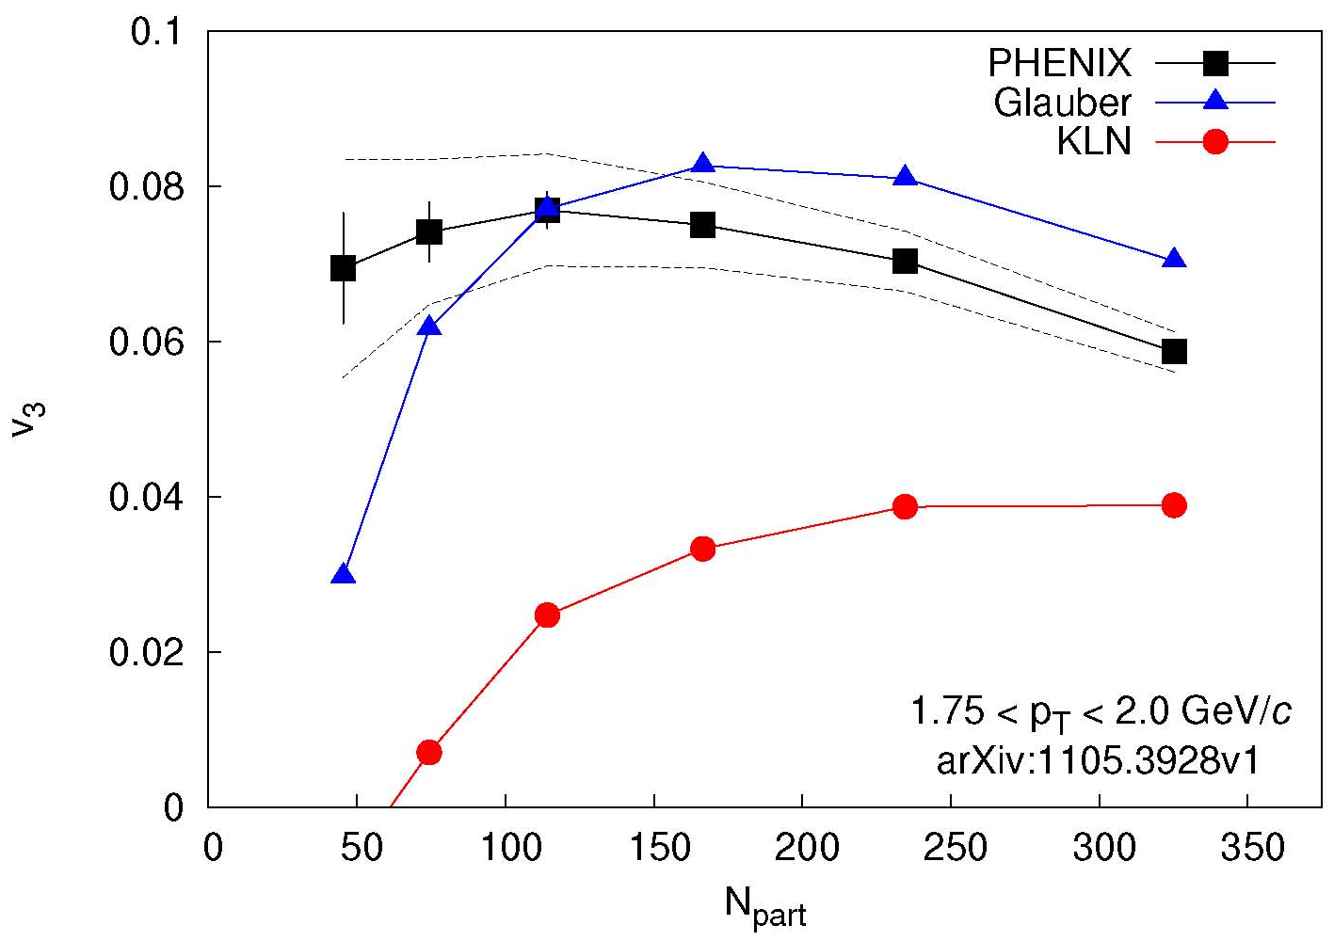
v₃ disentangles initial state and η/s
v₂ described by Glauber and CGC
v₃ described only by Glauber
Theory calculation:
Alver et al.
PRC82,034913
arXiv:1105.3928
arXiv:1105.3928
Theory calculation:
Alver et al.
PRC82,034913
Lappi, Venugopalan, PRC74, 054905
Drescher, Nara, PRC76, 041903
Glauber
  Glauber initial state
  η/s = 1/4π
MC-KLN
  CGC initial state
  η/s = 2/4π
Two models

Slide 29
v₃ disentangles initial state and η/s
v₂ described by Glauber and CGC
v₃ described only by Glauber
Theory calculation:
Alver et al.
PRC82,034913
arXiv:1105.3928
arXiv:1105.3928
Theory calculation:
Alver et al.
PRC82,034913
favored
Lappi, Venugopalan, PRC74, 054905
Drescher, Nara, PRC76, 041903
Glauber
  Glauber initial state
  η/s = 1/4π
MC-KLN
  CGC initial state
  η/s = 2/4π
Two models
  Plenary: S. Esumi, Tue
  Parallel: R. Lacey (v3, jet shape) Mon

Slide 30
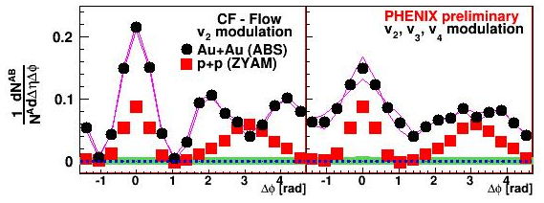
v₃ explains double-hump
correction
v₂ correction only
  double-hump

Slide 31
v₃ explains double-hump
correction
correction
v₂ correction only
  double-hump
v₂, v₃, v₄ correction
  double-hump disappeared
  Peak still broadened
  Plenary: S. Esumi, Tue
  Parallel: R. Lacey (v3, jet shape) Mon

Slide 32
Measuring the Properties of the QGP
Conditions
Properties
μ ~ 0
Screening length
?
T_{i} =300-600 MeV
η/s→1/4π
CNM
effects
non-linear shadowing
low-x suppression
anti-shadowing?
dE/dx
Initial State
→Glauber
?
?

Slide 33
Measuring the Properties of the QGP
Conditions
Properties
μ ~ 0
Screening length
T_{i} =300-600 MeV
η/s→1/4π
CNM
effects
non-linear shadowing
low-x suppression
anti-shadowing?
dE/dx
Initial State
→Glauber
?

Slide 34
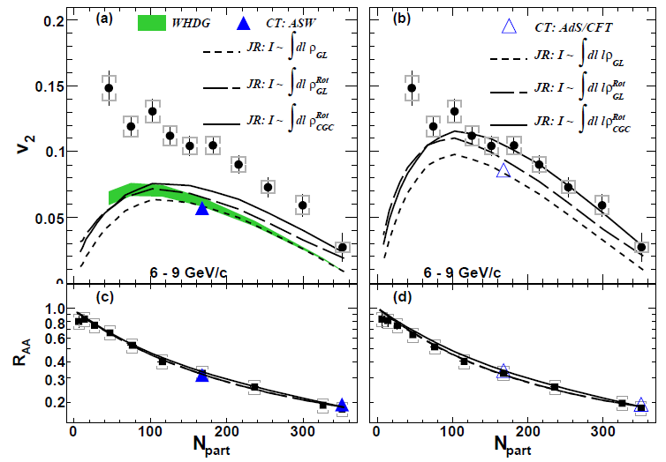
Path-length dependence of E loss
v₂ not explained
by pQCD
(even with
fluctuations &
saturation)
pQCD
PRL 105, 142301
pQCD
AdS/CFT
Theory calculations:
Wicks et al., NPA784, 426
Marquet, Renk, PLB685, 270
Drees, Feng, Jia, PRC71, 034909
Jia, Wei, arXiv:1005.0645
R_{AA} explained by both models

Slide 35
Path-length dependence of E loss
v₂ not explained
by pQCD
(even with
fluctuations &
saturation)
V2 explained by
cubic path length
dependence
(AdS/CFT)
AdS/CFT
pQCD
PRL 105, 142301
pQCD
AdS/CFT
Theory calculations:
Wicks et al., NPA784, 426
Marquet, Renk, PLB685, 270
Drees, Feng, Jia, PRC71, 034909
Jia, Wei, arXiv:1005.0645
R_{AA} explained by both models

Slide 36
Path-length dependence of E loss
v₂ not explained
by pQCD
(even with
fluctuations &
saturation)
v₂ explained by
cubic path length
dependence
(like AdS/CFT)
AdS/CFT
pQCD
PRL 105, 142301
pQCD
AdS/CFT
Theory calculations:
Wicks et al., NPA784, 426
Marquet, Renk, PLB685, 270
Drees, Feng, Jia, PRC71, 034909
Jia, Wei, arXiv:1005.0645
R_{AA} explained by both models

Slide 37
Path-length dependence of E loss
v₂ not explained
by pQCD
(even with
fluctuations &
saturation)
v₂ explained by
cubic path length
dependence
(like AdS/CFT)
AdS/CFT
pQCD
v₂ data favors dE/dx ~ l³ (like AdS/CFT)
PRL 105, 142301
pQCD
AdS/CFT
Theory calculations:
Wicks et al., NPA784, 426
Marquet, Renk, PLB685, 270
Drees, Feng, Jia, PRC71, 034909
Jia, Wei, arXiv:1005.0645
  Plenary: M. Purschke (R_AA) Wen
  Parallel: N. Grau (gamma-hadron, jets) Tue
  Parallel: D. Sharma (light vector mesons) Mon
  Poster: M. Tannenbaum (E loss RHIC vs. LHC)
R_{AA} explained by both models

Slide 38
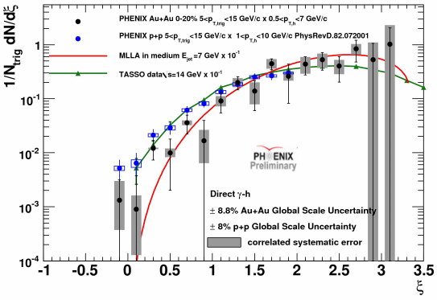

γ-h: fragmentation function in Au+Au
Tasso:
Braunschweig et al. , Z. Phys. 320 C47, 187
MLA:
Borghini, Wiedemann, hep-ph/0506218
p+p consistent with e⁺+e⁻
Au+Au consistent with E loss model
γ
hadrons
  Parallel: N. Grau (gamma-hadron, jets) Tue
  Poster: M. Tannenbaum (E loss RHIC vs. LHC)

Slide 39
Measuring the Properties of the QGP
Conditions
Properties
μ ~ 0
Screening length
?
T_{i} =300-600 MeV
η/s→1/4π
CNM
effects
non-linear shadowing
low-x suppression
anti-shadowing?
dE/dx → l³
Initial State
→Glauber
?

Slide 40
Measuring the Properties of the QGP
Conditions
Properties
μ ~ 0
Screening length
?
T_{i} =300-600 MeV
η/s→1/4π
CNM
effects
non-linear shadowing
low-x suppression
anti-shadowing?
dE/dx → l³
Initial State
→Glauber
?

Slide 41
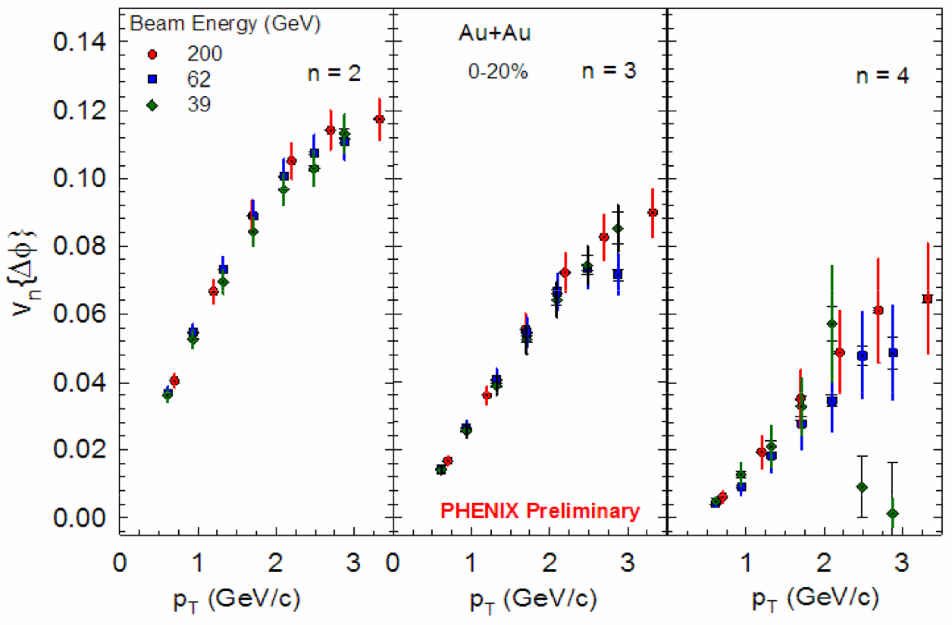
v₂, v₃, v₄ independence of √s_{NN} (for 39, 62, 200 GeV)
v₂, v₃, v₄ independence of √s_{NN} for 39, 62.4, 200 GeV
Just like at 200 GeV, disentangle initial state and η/s

Slide 42
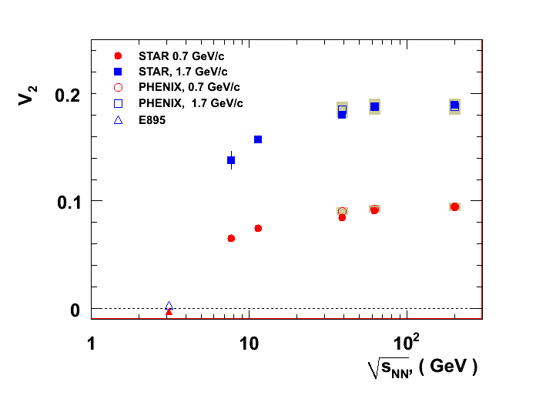

v₂ saturation with √s_{NN}
Preliminary, STAR, PHENIX and E895 data
ALICE
p_{T} = 1.7 GeV
v₂ saturation 39 GeV
p_{T} = 0.7 GeV
  Plenary: S. Esumi, Tue
  Parallel: R. Lacey (v3, jet shape) Mon
  Parallel: X. Gong (energy scan: bulk) Fri
  Poster: S. Mizuno (PID v3)
[PHENIX] Phys.Rev.Lett.94:232302,2005
Need updated plot from Arkadij
10³
10⁴

Slide 43
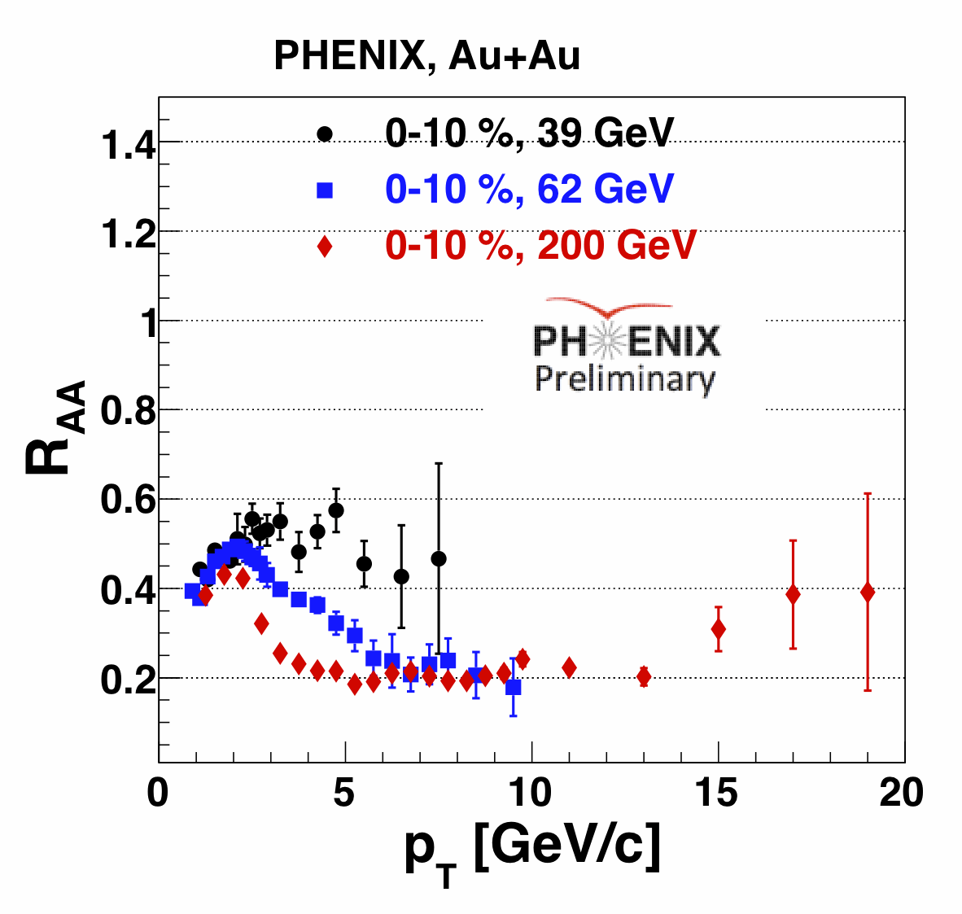
√s_{NN} dependence of energy loss
preliminary
PRL101, 232301
  Plenary: M. Purschke (R_AA) Wen
  Parallel: N. Novitsky (energy scan) Fri
  Poster: O. Chvala (RAA in 39 and 62 GeV)
R_{AA} suppressed also at 39 GeV
R_{AA} at 62 GeV approaches 200 GeV level at high p_{T}

Slide 44
Measuring the Properties of the QGP
Conditions
Properties
μ ~ 0
Screening length
?
T_{i} =300-600 MeV
η/s→1/4π
CNM
effects
non-linear shadowing
low-x suppression
anti-shadowing?
dE/dx → l³
Initial State
→Glauber
?

Slide 45
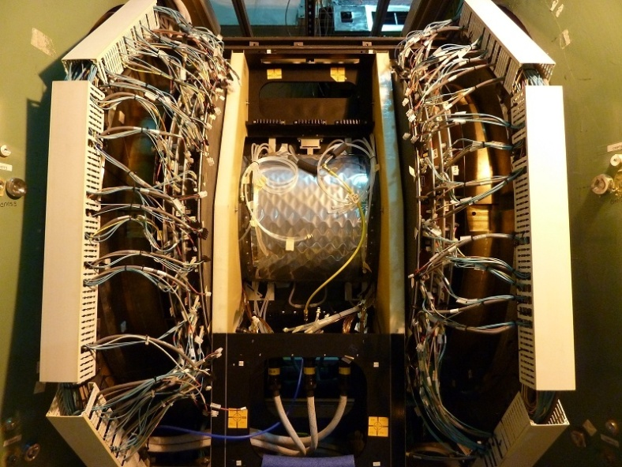
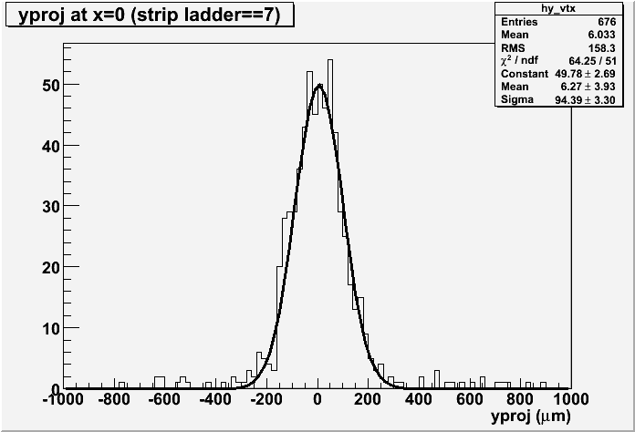
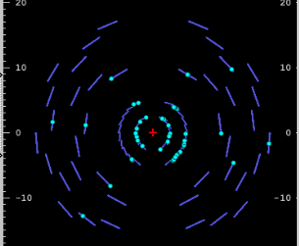
Near-Term Future: Silicon Vertex Detector
VTX successfully commissioned in 2011 p+p run
VTX taking data in Au+Au now!
R_{AA} of c, b separately
v₂ of c, b separately
Jet tomography (di-hadron, γ-h, c-h, c-c)
Status
Data: p+p@500 GeV, 2011
beam
profile
σ ~ 100μm
Physics
-

Slide 46
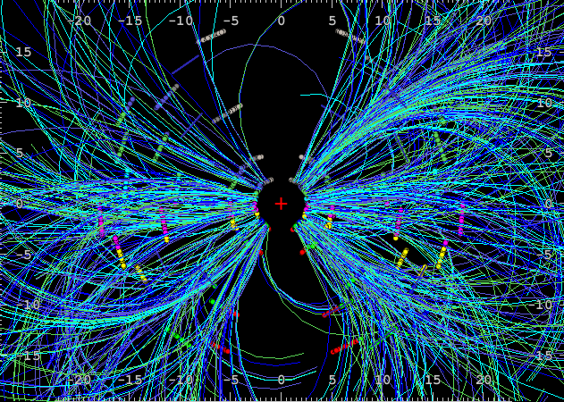
Near-Term Future: Silicon Vertex Detector
VTX successfully commissioned in 2011 p+p run
VTX taking data in Au+Au now!
R_{AA} of c, b separately
v₂ of c, b separately
Jet tomography (di-hadron, γ-h, c-h, c-c)
Status
Data: Au+Au@200 GeV, 2011
beam
profile
σ ~ 100μm
  Parallel: A. Sickles (Decadal Plan) Thu
  Poster: M. Chiu (Fast TOF, 10 ps)
  Poster: M. Kurosawa (VTX (pixel))
  Poster: T.Hachiya (VTX (pixel))
  Poster: R. Akimoto (VTX (pixel))
Physics
-

Slide 47
What I could not cover in this talk
T_{i}
  Plenary: S. Esumi, Tue
  Parallel: E. Kistenev (direct photons) Thu
  Poster: Y. Yamaguchi (direct photons dAu)
v₃, jet shape, η/s
  Plenary: S. Esumi, Tue
  Parallel: R. Lacey (v3, jet shape) Mon
  Parallel: X. Gong (energy scan: bulk) Fri
  Poster: S. Mizuno (PID v3)
Chiral Symmetry
  Parallel: M. Makek (Results from HBD) Thu
Heavy Flavor
  Plenary: C. Luiz da Silva, Fri
  Parallel: A. Sen (quarkonia) Tue
  Parallel: M. Durham (open heavy flavor) Fri
  Poster: S. Whitaker (Upsilon RAA)
  Poster: A. Takahara (J/psi photoproduction)
  Poster: H. Thewman (high p_{T} single e in p+p)
Energy Loss
  Plenary: M. Purschke (R_AA) Wen
  Parallel: N. Grau (gamma-hadron, jets) Tue
  Parallel: N. Novitsky (energy scan) Fri
  Parallel: D. Sharma (light vector mesons) Mon
  Poster: M. Tannenbaum (E loss RHIC vs. LHC)
  Poster: O. Chvala (RAA in 39 and 62 GeV)
  Parallel: D. Sharma (light vector mesons) Mon
Cold nuclear matter
  Parallel: M. Chiu (small x dAu correl) Thu
  Parallel: J. Kamin (dAu dileptons) Fri
  Poster: Z. Citron (small x dAu correlations)
  Poster: D. Perepelitsa (jets in dAu)
Future
  Parallel: A. Sickles (Decadal Plan) Thu
  Poster: M. Chiu (Fast TOF, 10 ps)
  Poster: M. Kurosawa (VTX (pixel))
  Poster: T.Hachiya (VTX (pixel))
  Poster: R. Akimoto (VTX (pixel))

Slide 48
Conclusions
v₂ of thermal direct photons large
  Further constrains T_{i} and τ₀
CNM effects in d+Au
  Non-linear density dependence of shadowing from J/ψ
  Reconstructed jet R_{cp} modified
  Low-x suppression from forward di-hadron correlations
v₃
  Disentangle initial state from η/s
  Double-hump disappears in 2-particle correlations
Energy loss
  Cubic path-length dependence
Energy Scan
  v₂ saturation 39 GeV
  R_{AA} suppressed also at 39 GeV
Thank you!

Slide 49
Backup

Slide 50
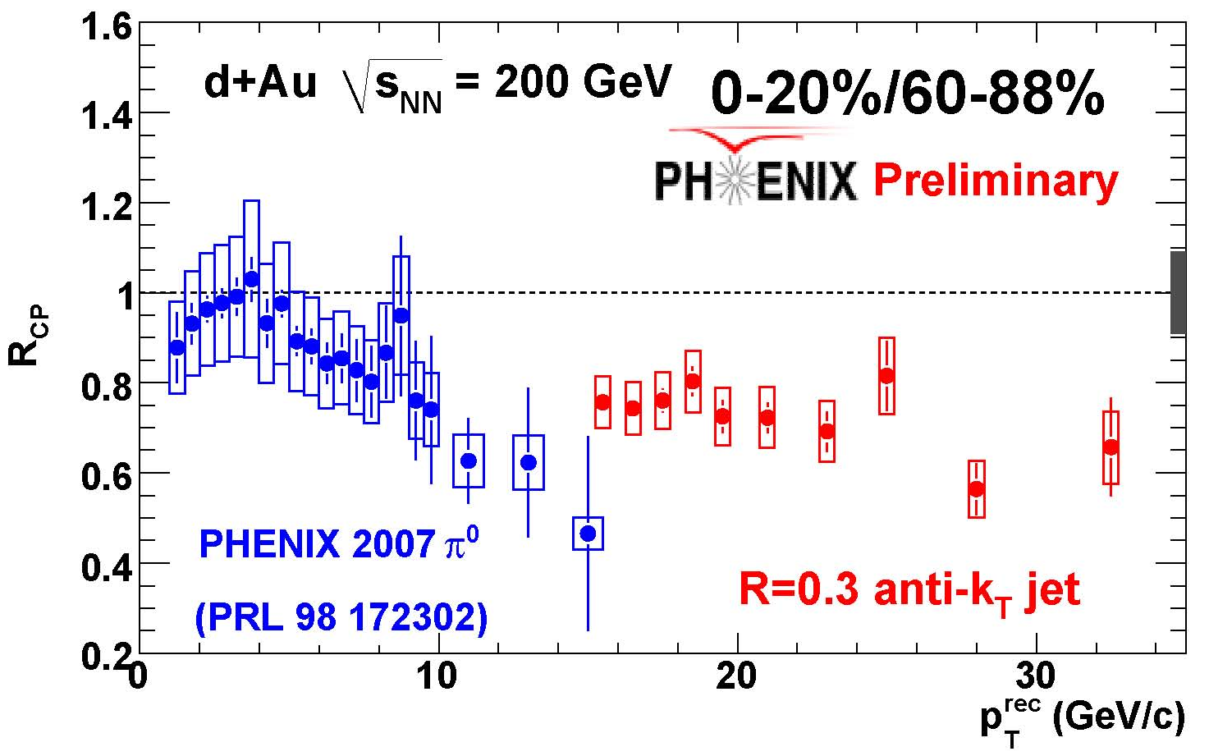
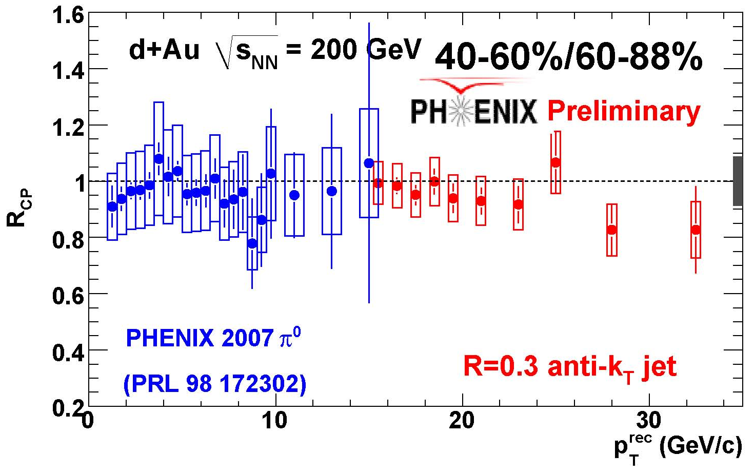
Jet-π⁰ comparison d+Au
π⁰ R_{cp} calculated from published R_{dA}
Consistent in overlapping p_{T} range

Slide 51
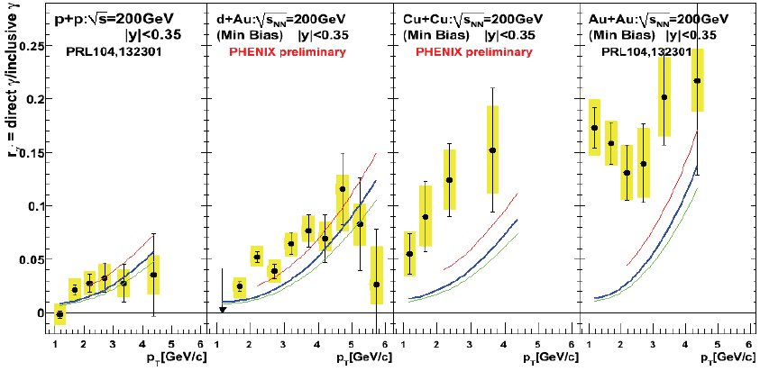
Confirmation from d+Au and Cu+Cu
Fraction of direct photons compared to pQCD
Excess also in Cu+Cu
No excess in d+Au
(no medium)

Slide 52
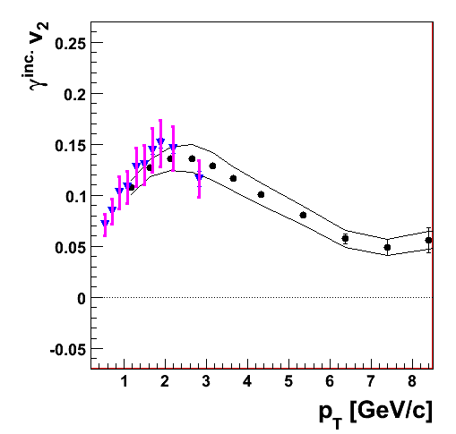
Inclusive Photon v₂
Measured with EMCal
Issue:
  Hadronic contamination at low pT
    Hadrons deposit only fraction of energy
    depends on hadron species
    Difficult to estimate
Confirmed with external conversion
  No hadronic contamination
External
conversions
EMCal

Slide 53
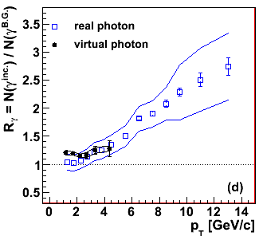
Direct photon excess R_{γ}
Key to this analysis
  Precise measurement of R_{γ} through internal conversion
20 % direct photon fraction
=> direct photon similar to inclusive photon v₂ (or π⁰ v₂)

Slide 54
Correlations at Forward Rapidity
JdA=RdA*IdA
J_{dA} suppressed in central d+Au
Caveat:
  Double parton interactions (DPI) enhanced in d+Au
    may be dominant process for large forward rapidity (rather than 2->2 process)
    M. Strikman and W. Vogelsang, arXiv:1009.6123
  Then xfrag not sensitive to rapidity
Pocket formula:

Slide 55
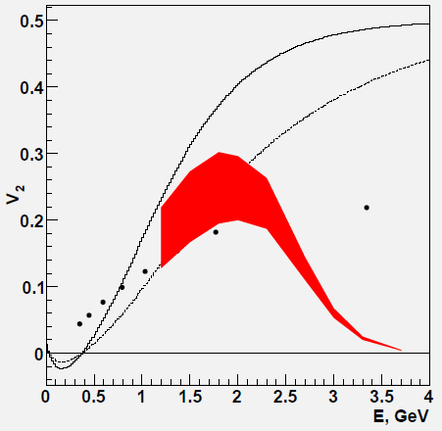
Direct photon flow calculation
30-35 % most central
Au+Au@200 GeV
thermal only
upper curve:
m_{q}=0.1 GeV
lower curve:
m_{q}=0.3 GeV
V. Pantuev, arXiv:1105.NNNN
-expanding fireball in longitudinal and
radial direction
photons are produced from matter
which flows
- Doppler
Hadrons
PHENIX
PRL98,
162301
thermal
+prompt

Slide 56
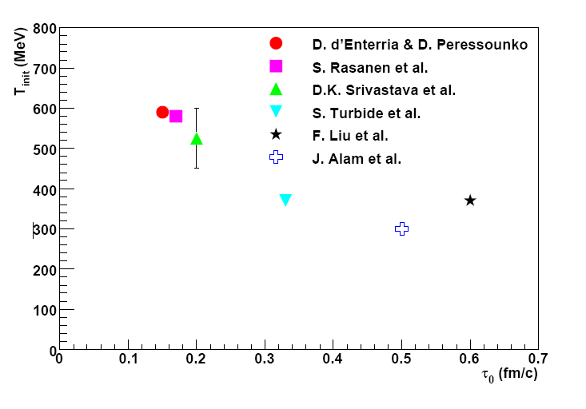
T_{i} from hydro
T_{i} from hydro
  300 . . . 600 MeV
  Depends on thermalization time, τ₀
  anti-correlation: T_{i} ⬄ τ₀
Phys. Rev. C 81, 034911 (2010)
Theory calculations:
d’Enterria, Peressounko, EPJ46, 451
Huovinen, Ruuskanen, Rasanen, PLB535, 109
Srivastava, Sinha, PRC 64, 034902
Turbide, Rapp, Gale, PRC69, 014903
Liu et al., PRC79, 014905
Alam et al., PRC63, 021901(R)

Slide 57
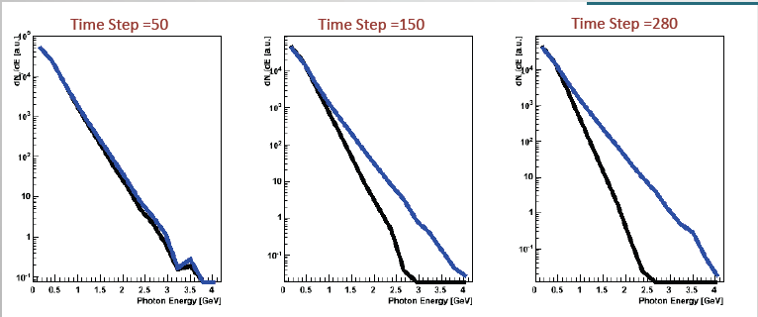
What is the initial Temperature, T_{i}?
time
integrate over space-time evolution
Early photons
  large temperature
    large inverse slope
Late photons
  Low temperature, but large velocity boost
    also large inverse slope
=> need model for quantitative answer
with boost
w/o
boost
figures: K. Mendoza, U. Colorado

Slide 58
Measuring the Properties of the QGP
Conditions
Properties
μ ~ 0
Screening length
T_{i} =300-600 MeV
η/s
CNM
effects
dE/dx
Initial
State

Slide 59
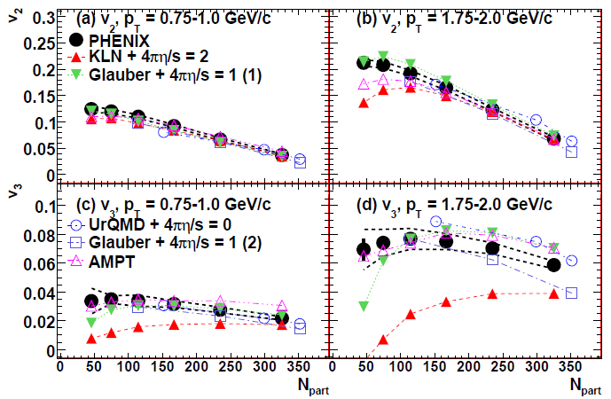
Factorizing initial state and viscosity
v₂ described by both models
  Glauber
    Glauber initial state
    η/s = 1/4π
  KLN
    CGS initial state
    η/s = 2/4π
v₃ described by only one model
  Glauber
    Glauber initial state
    η/s = 1/4π
Data:
PHENIX, arXiv:
Models:
B. Alver et al., Phys. Rev. C82, 034913 (2010).
B. Schenke et al., Phys. Rev. Lett. 106, 042301 (2011).
H. Petersen et al., Phys. Rev. C82, 041901 (2010).
S. A. Bass et al., Prog. Part. Nucl. Phys. 41, 255 (1998).
M. Bleicher et al., J. Phys. G25, 1859 (1999).
]G.-L. e. a. Ma (2010), 1011.5249.

