Slide 1

Parton Energy Loss in the Quark-Gluon Plasma
Stefan Bathe, RBRC Review, 21Oct2009

Slide 2
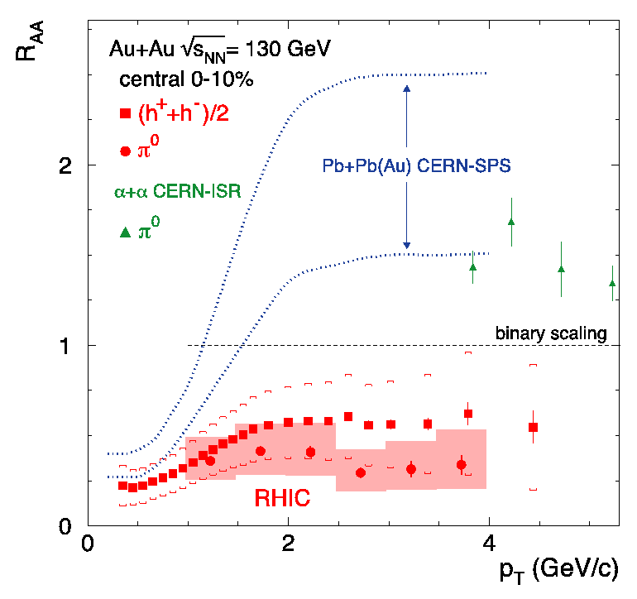
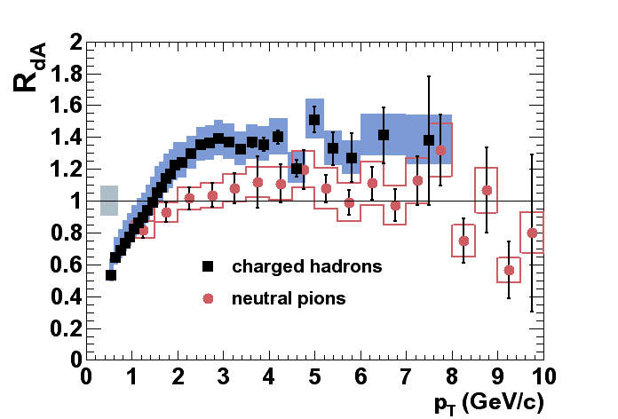
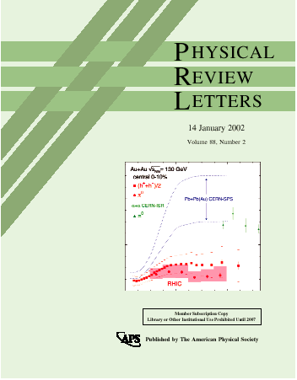
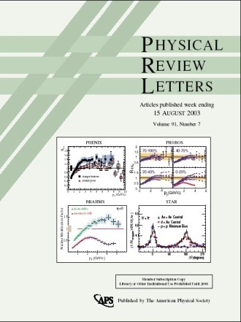
Hard Scattering Results in PHENIX
Phys.Rev.Lett. 88, 022301 (2002)
Phys. Rev. Lett. 91, 072303 (2003)
Most cited paper from RHIC
520 citations to date
One of six ‘famous’ PHENIX
papers with > 250 citations

Slide 3
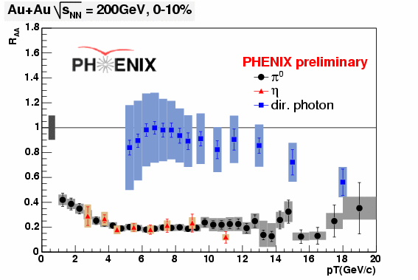
High p_{T} π⁰ And Direct Photons Today
Indication for same R_{AA} for direct γ and π⁰ at high p_{T}
If true, then no E loss at hight p_{T}
LHC would have nothing to measure!
In general interesting to quantify E loss at high p_{T}

Slide 4
High p_{T} π⁰ And Direct Photons Today
Indication for same R_{AA} for direct γ and π⁰ at high p_{T}
If true, then no E loss at hight p_{T}
LHC would have nothing to measure!
In general interesting to quantify E loss at high p_{T}
Extended p_{T} range
Have high statistics (factor 3) data set (2007)
Also, have
high statistics (factor 30) d+Au data set (2008)

Slide 5
High p_{T} π⁰ And Direct Photons Today
Indication for same R_{AA} for direct γ and π⁰ at high p_{T}
If true, then no E loss at hight p_{T}
LHC would have nothing to measure!
In general interesting to quantify E loss at high p_{T}
Extended p_{T} range
?
?
?
?
Have high statistics (factor 3) data set (2007)
Also, have
high statistics (factor 30) d+Au data set (2008)

Slide 6
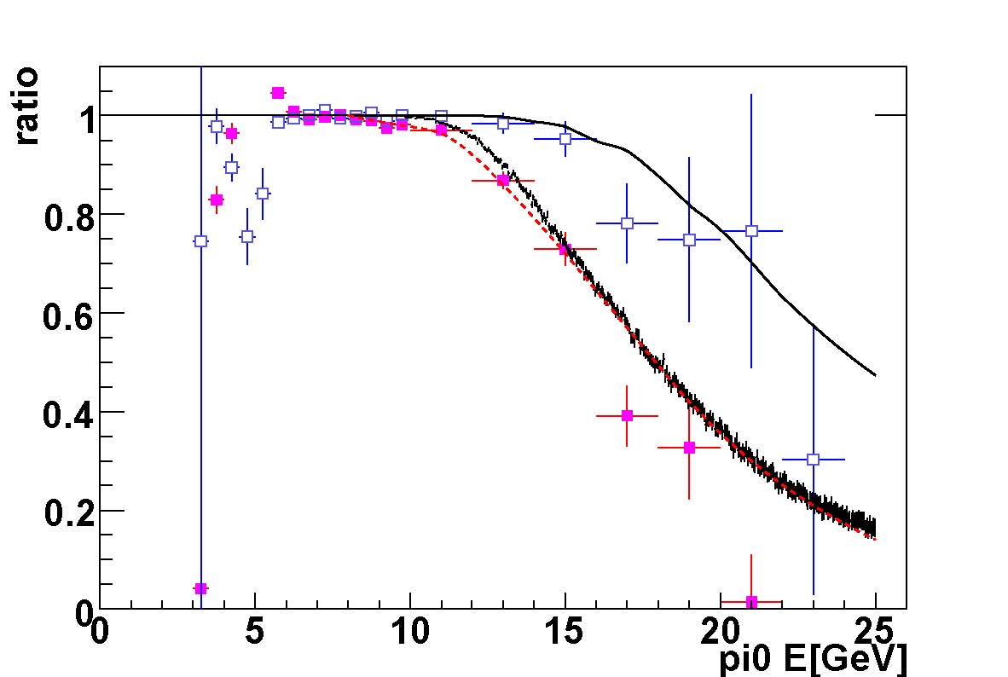
High p_{T} π⁰and direct γ: Outlook
EMCal calibration has been major preparation work
Next analysis steps straightforward (largely repeat of previous analyses)
Understanding merging systematics only challenge
Simulations and previous studies provide guidance
Goal: have result in spring 2010
PbGl
MC1
MC2
π⁰
data
PbSc
PHENIX Analysis Note 734

Slide 7
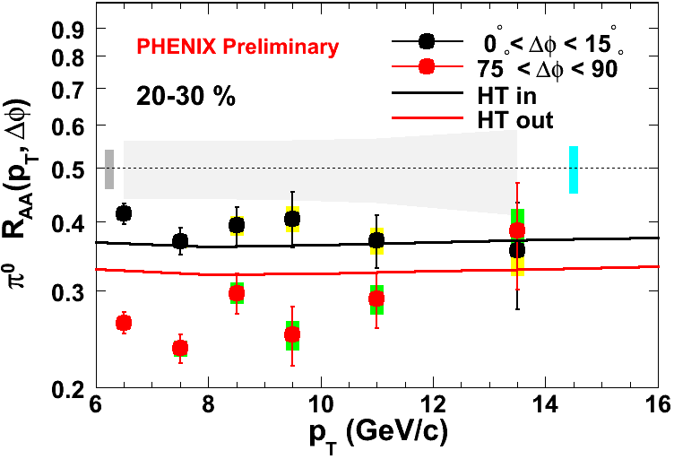
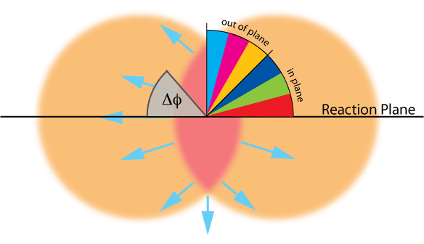
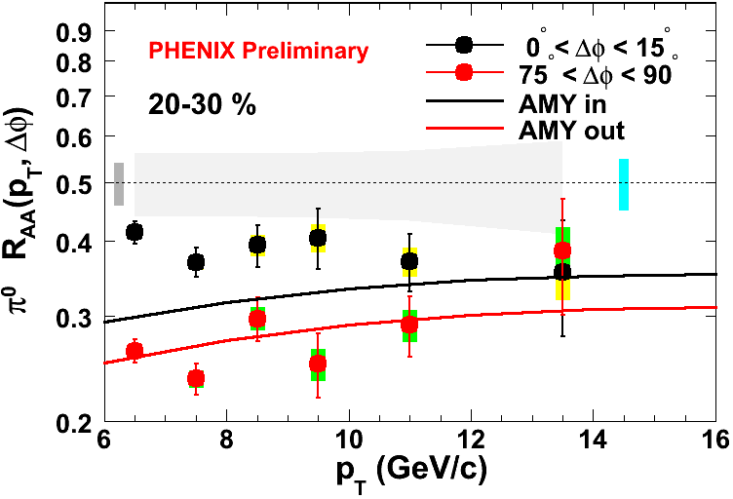
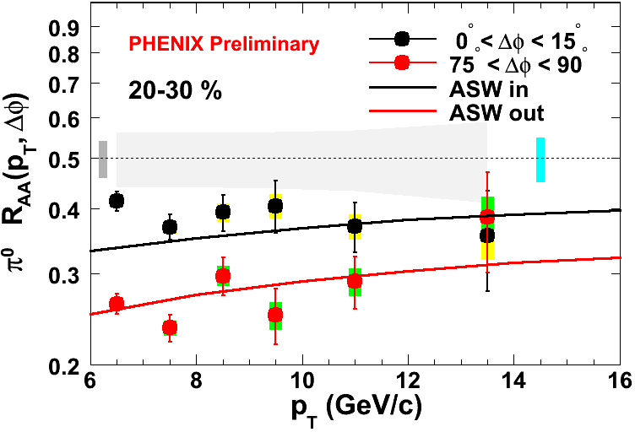
Progress since last year
Azimuthal anisotropy of RAA
  Provides more differential model comparison than RAA
  Allows determination of medium transport coefficient qhat
Calculation by S.Bass et al.
arXiv:0808.0908

Slide 8
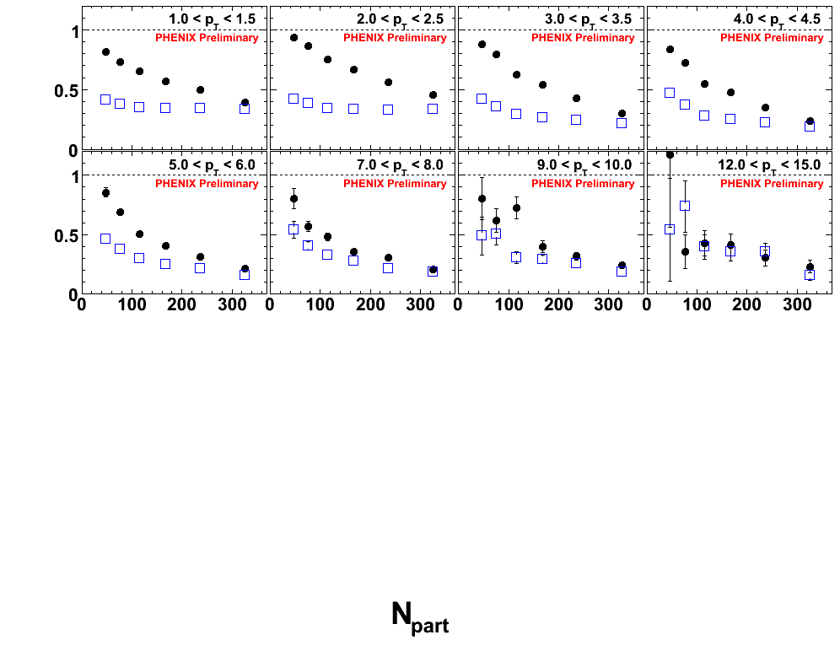
Centrality Dependence
p_{T}
π/2
R_{AA}
0
Indication for saturation of R_{AA} at certain path length

Slide 9
Use η instead of π⁰ ?
η
Mass: 0.5479 MeV/c²
Γ(η→γγ)/ Γ(η→X): 0.393
Wave function:
  (uubar+ddbar)/2+ssbar/√2
π⁰
Mass: 0.1350 MeV/c²
Γ(π →γγ)/ Γ(π →X): 0.988
Wave function:
  (uubar-ddbar)/√2
η/π⁰ = ~0.5 (measured at high pT)
Probability of detecting two γ’s from π⁰
η yield exceeds π⁰ yield above pT~23GeV/c.
Systematic error on η yield should be much smaller for pT>12GeV/c
  Because we don’t need to take care of merging effect
PbGl
MC1
MC2
η probability
0.393*0.5=0.1965
π⁰
data
PbSc
PHENIX Analysis Note 734

Slide 10
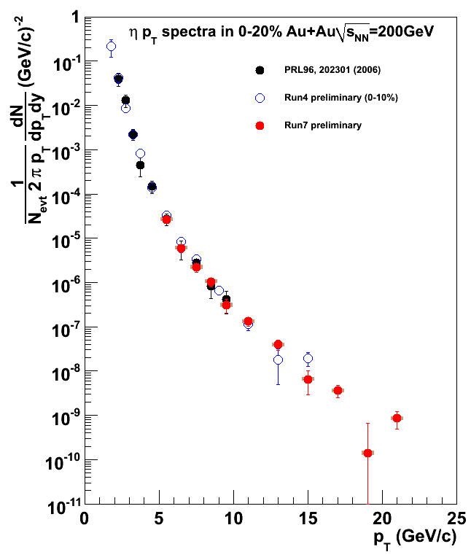
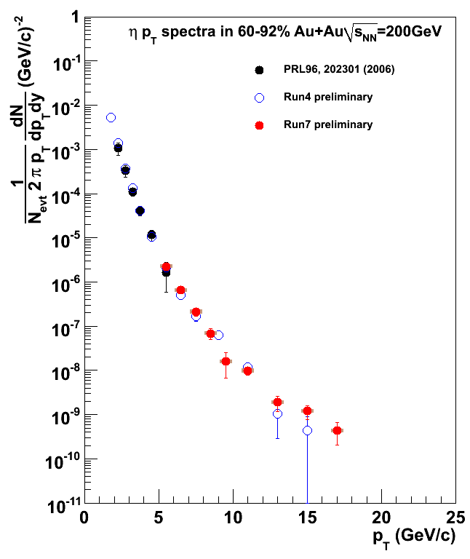
η invariant yield
η 0-20% most central
η 60-92% most central
Run-2 PRL 96, 202301 (06)
Run-4 preliminary
Run-7 preliminary
Run-2 PRL 96, 202301 (06)
Run-4 preliminary
Run-7 preliminary
Problem:
  While η wins over π⁰ (in terms of statistics) at 23 GeV, statistics runs out earlier
PHENIX preliminary
However
  η still provides cross check of π⁰ with independent systematics for 13 GeV < p_{T} < 23 GeV, where merging effect is significant

Slide 11
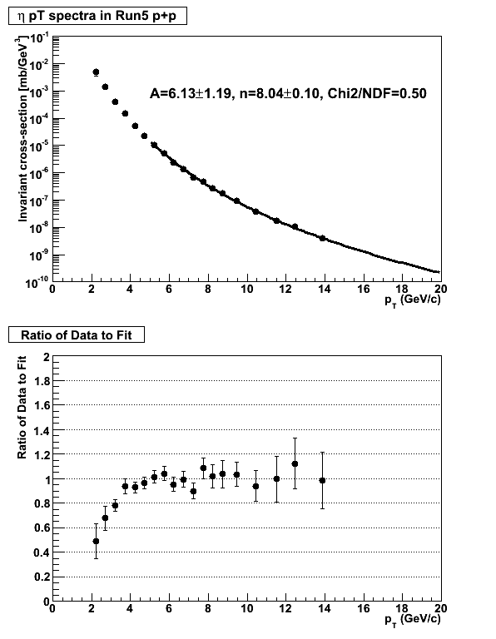
p+p Reference
η Run-5 p+p
Current p+p data (Run-5) run out at 14 GeV
Relying on fit to extrapolate to higher p_{T}
Alternative
  Use π⁰ as reference (correcting for η/π⁰ ratio)
  Problem: π⁰ suffers from merging → introduces systematic uncertainty
Also:
  have ~7x p+p statistics in can from Runs 6,9
ratio data/fit

Slide 12
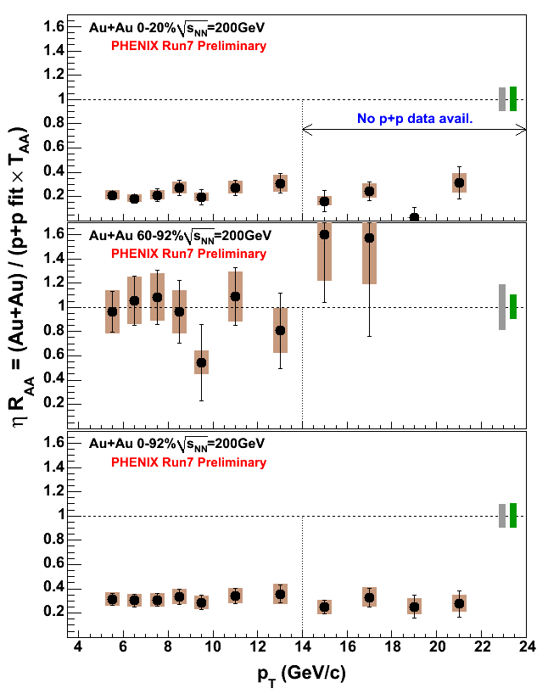
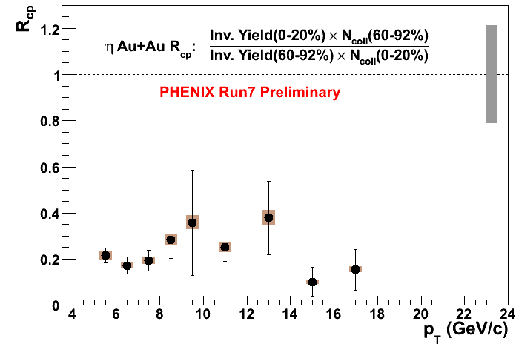
η R_{AA}, R_{cp}
Independently confirms π⁰ R_{AA}
Like π⁰:
  Use π⁰ as reference (correcting for η/π⁰ ratio)
  consistent with constant p_{T} dependence
  But rise with p_{T} cannot be excluded
systematic errors not shown

Slide 13
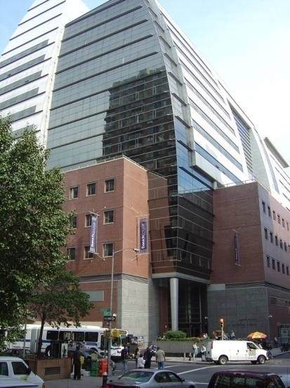
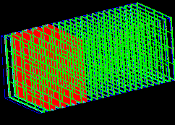
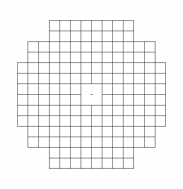
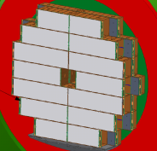
The Future
Joining faculty of Baruch College, CUNY, as tenure track professor in February 2010
  Joint with RBRC fellowship for first 5 years
Starting experimental nuclear physics group
  Two nuclear theorists already there: Adrian Dumitru (RBRC fellow) and Jamal Jalilian-Marian
Applying for research grant
Looking for:
  new hardware project in PHENIX
    Possibly FOCAL
  students and postdocs to work with
Baruch College,
Manhattan
6cm
17 cm
85 cm
FOCAL

