Slide 1
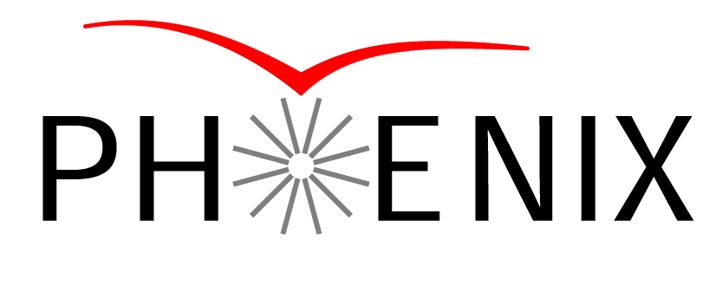

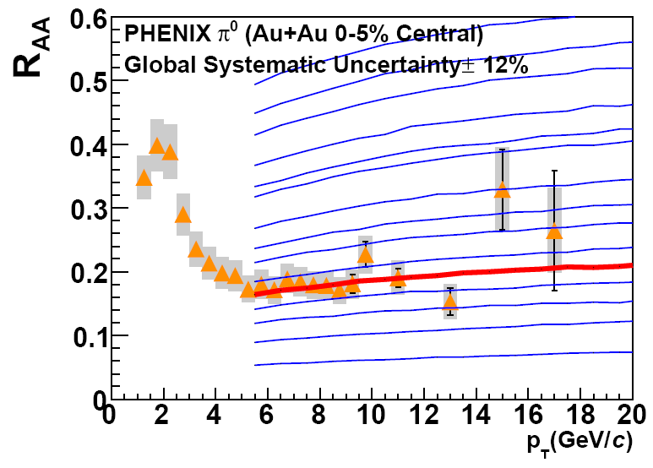
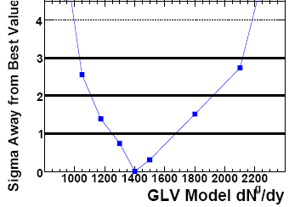
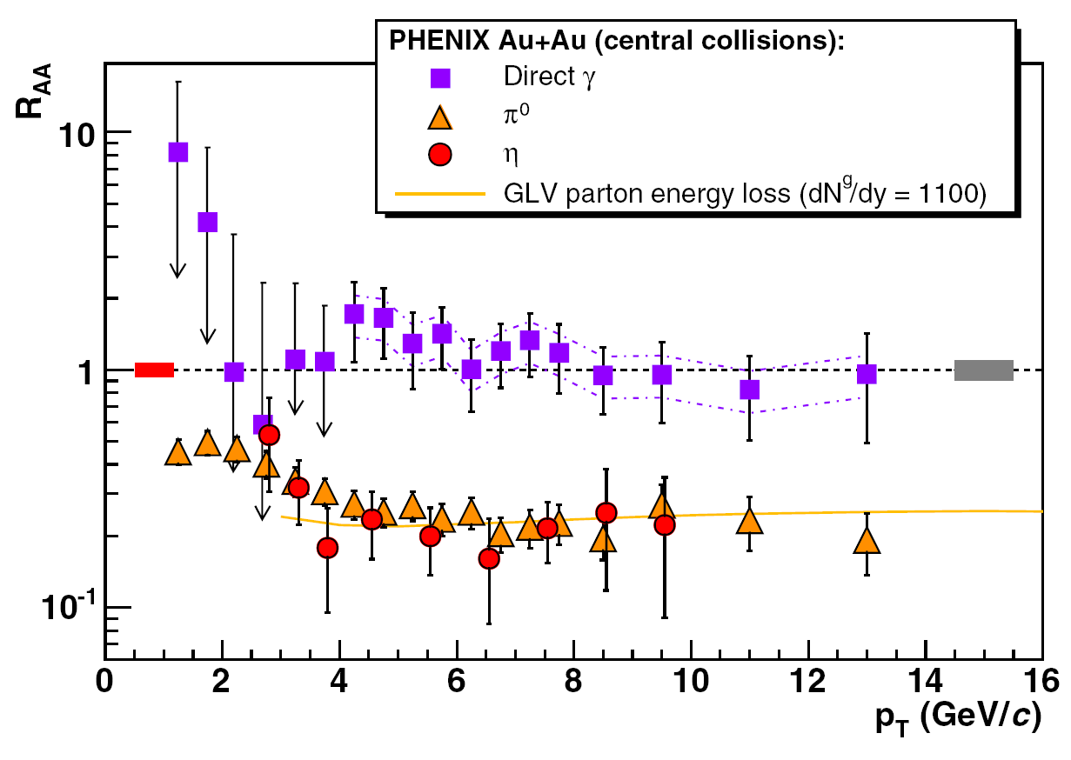
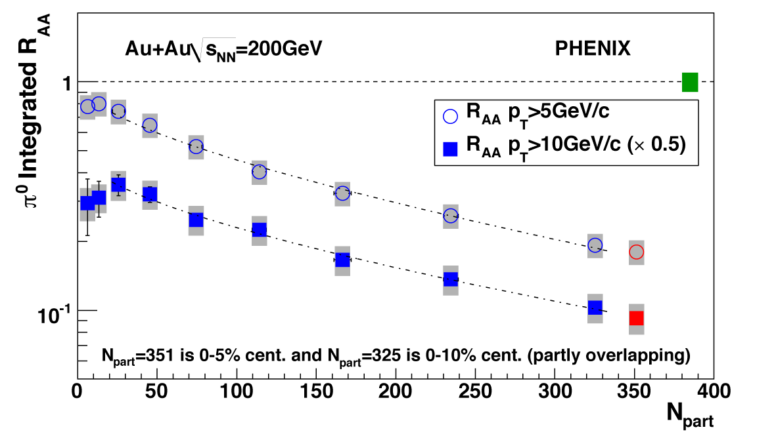
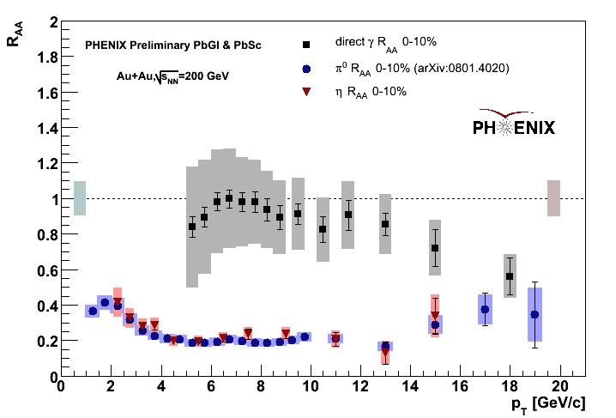
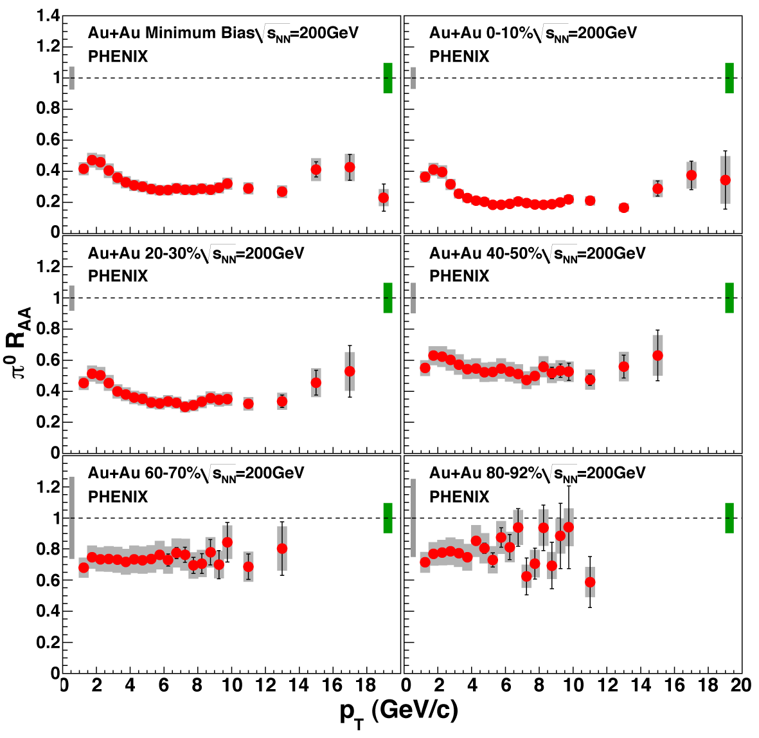
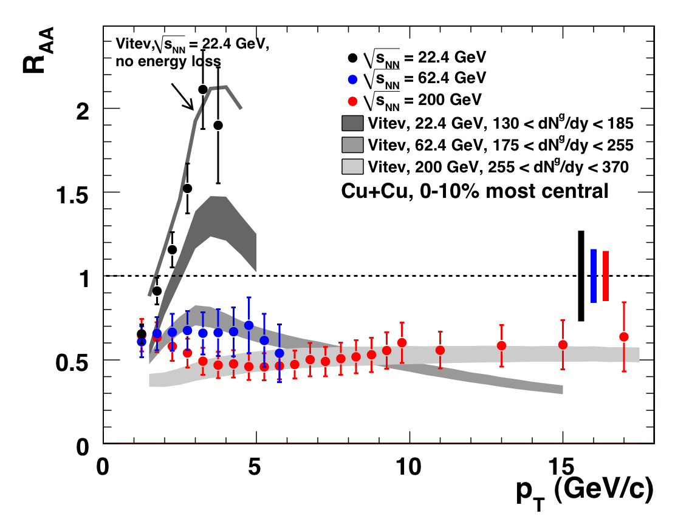
High p_{T} particle production in PHENIX
Stefan Bathe for the PHENIX Collaboration
RIKEN-BNL Research Center
Introduction
N_{part} dependence
Quantitative model comparisons
Conclusions after first three years of RHIC
Hadrons are suppressed, photons are not
Evidence for parton energy loss
R_{AA} constrains medium properties
Models predict behavior of energy loss:
Fit of model to data taking experimental uncertainties correctly into account
PHENIX, arXiv:0801.1655 [nucl-ex]
Type A: point-by-point
Type B: p_{T} correlated
Type C: normalization
PHENIX, Phys. Rev. Lett. 96, 202301 (2006)
But is parton energy loss really the correct explanation?
PHENIX, arXiv:0801.4020 [nucl-ex]
π⁰ R_{AA} not fragile, but in fact quite sensitive to opacity
Models uncertainties not considered though
Test as many predictions as possible
p_{T}, N_{part}, √s_{NN} dependence
Quantitative model comparisons
Comparison to direct photons
Fit with:
results in: α = 0.58 ± 0.07 for p_{T} > 5 GeV/c
α = 0.56 ± 0.10 for p_{T} > 10 GeV/c
No saturation of energy loss with N_{part}
Centrality dependence consistent with parton energy loss
Comparison to direct photons
π⁰ and direct γ in Au+Au at 200 GeV
p_{T} dependence
π⁰ in 200 GeV Au+Au from Run-4
R_{AA} now measured up to 20 GeV/c
R_{AA} constant (=0.2) up to highest p_{T} (5 < p_{T} < 20 GeV/c)
Common power law behavior in p+p and Au+Au
Motivates description in terms of fractional energy loss:
√s_{NN} dependence
π₀ spectra in Cu+Cu at 22.4, 62.4, and 200 GeV
Same suppression pattern for π⁰ and η
Consistent with parton energy loss and vacuum fragmentation
Direct γ R_{AA} < 1 at highest p_{T}
Caused by isospin, EMC effect, or suppression of fragmentation photons?
Systematic study in high-statistics Run-7 data set forthcoming
PHENIX, arXiv:0801.4020 [nucl-ex]
PHENIX, arXiv:0801.4555 [nucl-ex]
Conclusions
62.4 and 200 GeV
Suppression consistent with parton energy loss
Three new PHENIX precision high-p_{T} papers
22.4 GeV
No suppression
Enhancement consistent with calculation that describes Cronin enhancement in p+A
π⁰ R_{AA} in 200 GeV Au+Au ~ constant up to 20 GeV
No saturation of energy loss with N_{part}
π⁰ R_{AA} in 22.4 GeV Cu+Cu described without E_{loss}
π⁰ R_{AA} sensitive to opacity → model constraints
Indication of modification of direct γ
Parton energy loss starts to prevail over Cronin enhancement between 22.4 and 62.4 GeV
Stay tuned for Run-7 results (better stat./sys., RxNP)

