Slide 1


The Quark-Gluon Plasma
Stefan Bathe

Slide 2
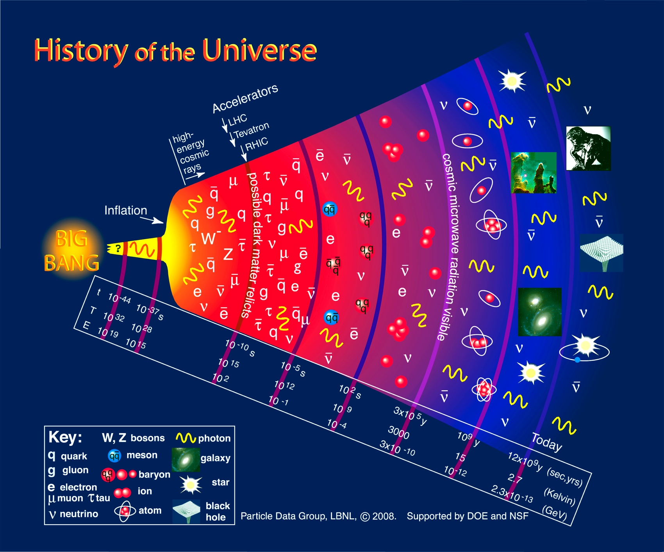
The Quark-Gluon Plasma (QGP) was the primordial state
that lasted for a few microseconds after the Big Bang.

Slide 3
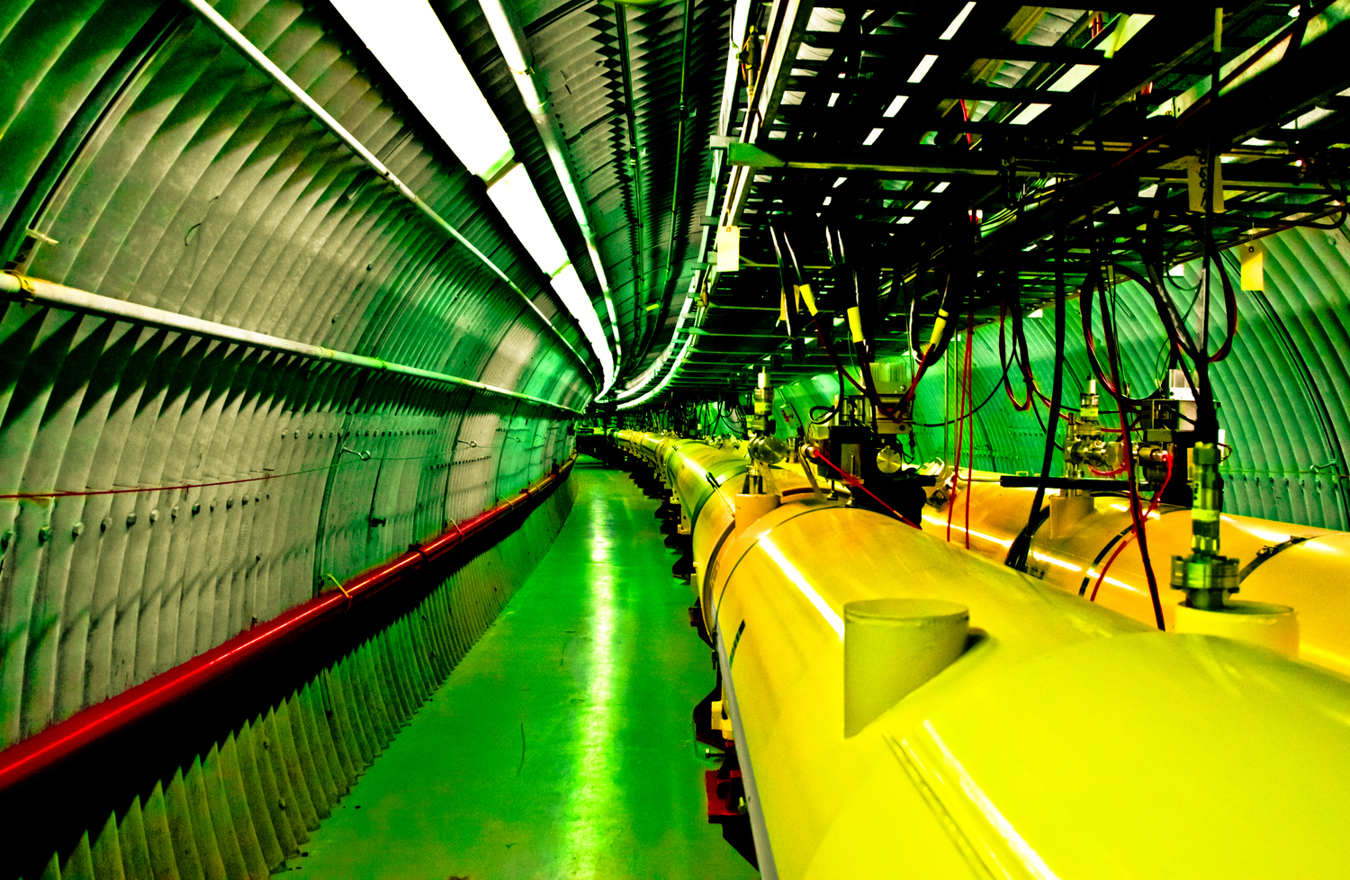
Experimentally the QGP can be created in ultra-relativistic collisions of heavy nuclei as here at the Relativistic Heavy Ion Collider (RHIC) of Brookhaven National Laboratory (BNL) on Long Island. (Photo art by Korrigan Clark)

Slide 4
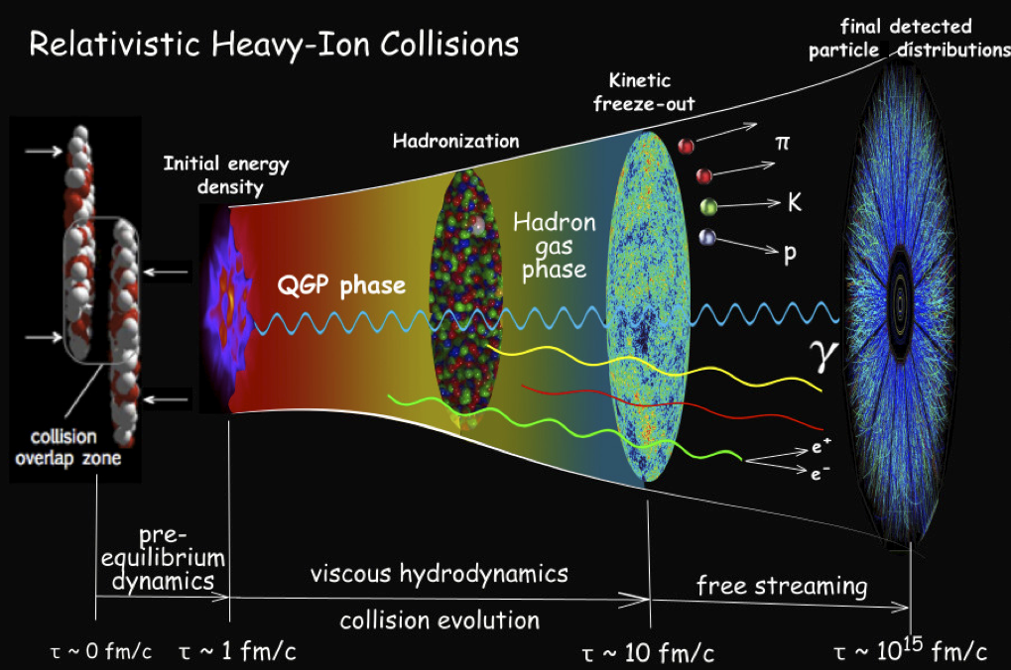
Time evolution of a heavy ion collision.

Slide 5
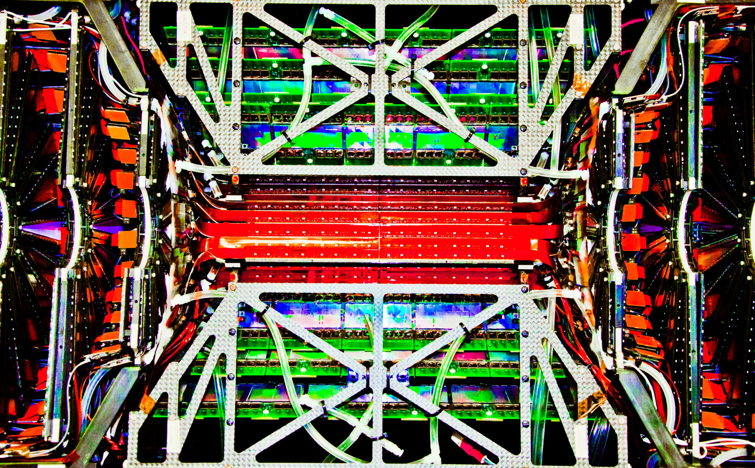
The Silicon Vertex Detector of the PHENIX experiment at RHIC. (Photo art by Korrigan Clark)

Slide 6
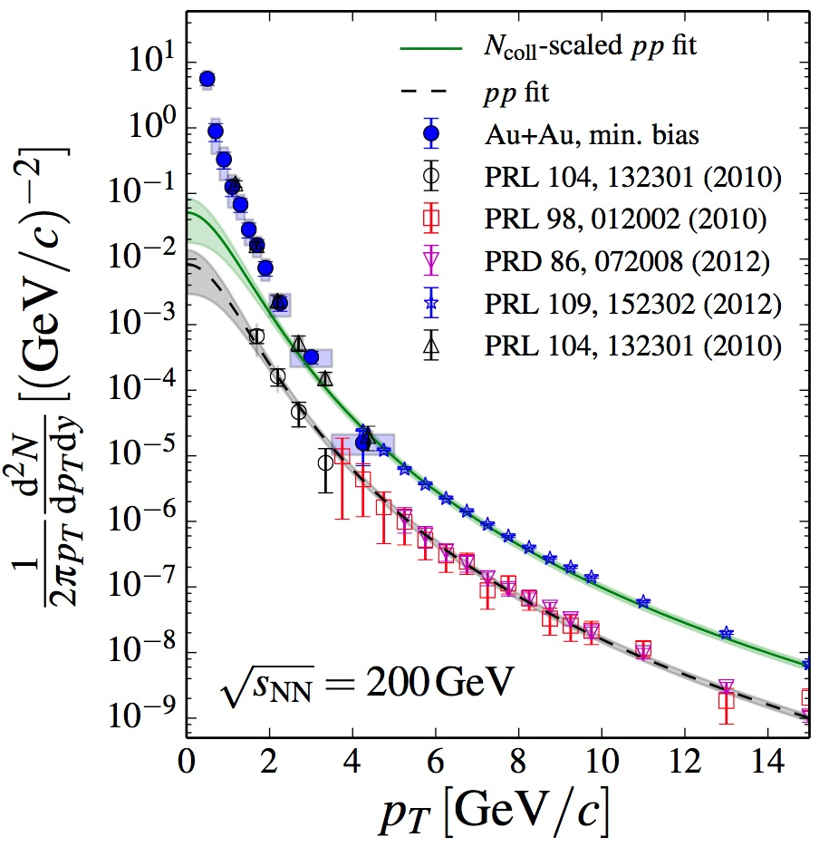
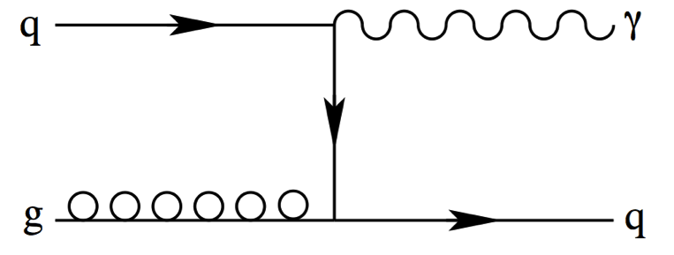
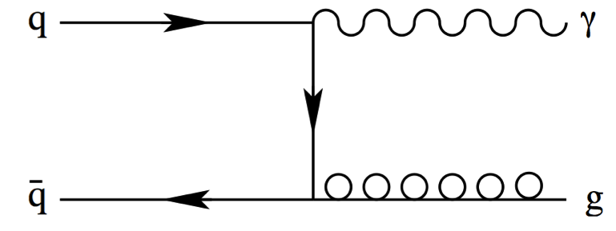
LO Feynman diagrams for direct photon production.
LO Feynman diagrams for direct photon production.
Thermal photon radiation from the QGP indicating a temperature of 4 trillion K. (PHENIX, Phys.Rev. C91 (2015) 064904)

Slide 7
Baruch Physics Faculty:
Stefan Bathe
Etan Burkoff
Sultan Catto
Adrian Dumitru
Jamal Jalilian-Marian
Ramzi Khuri
Peter Orland
Graduate Students:
Jason Bryslawskyj
Zachary Rowan

