Slide 1


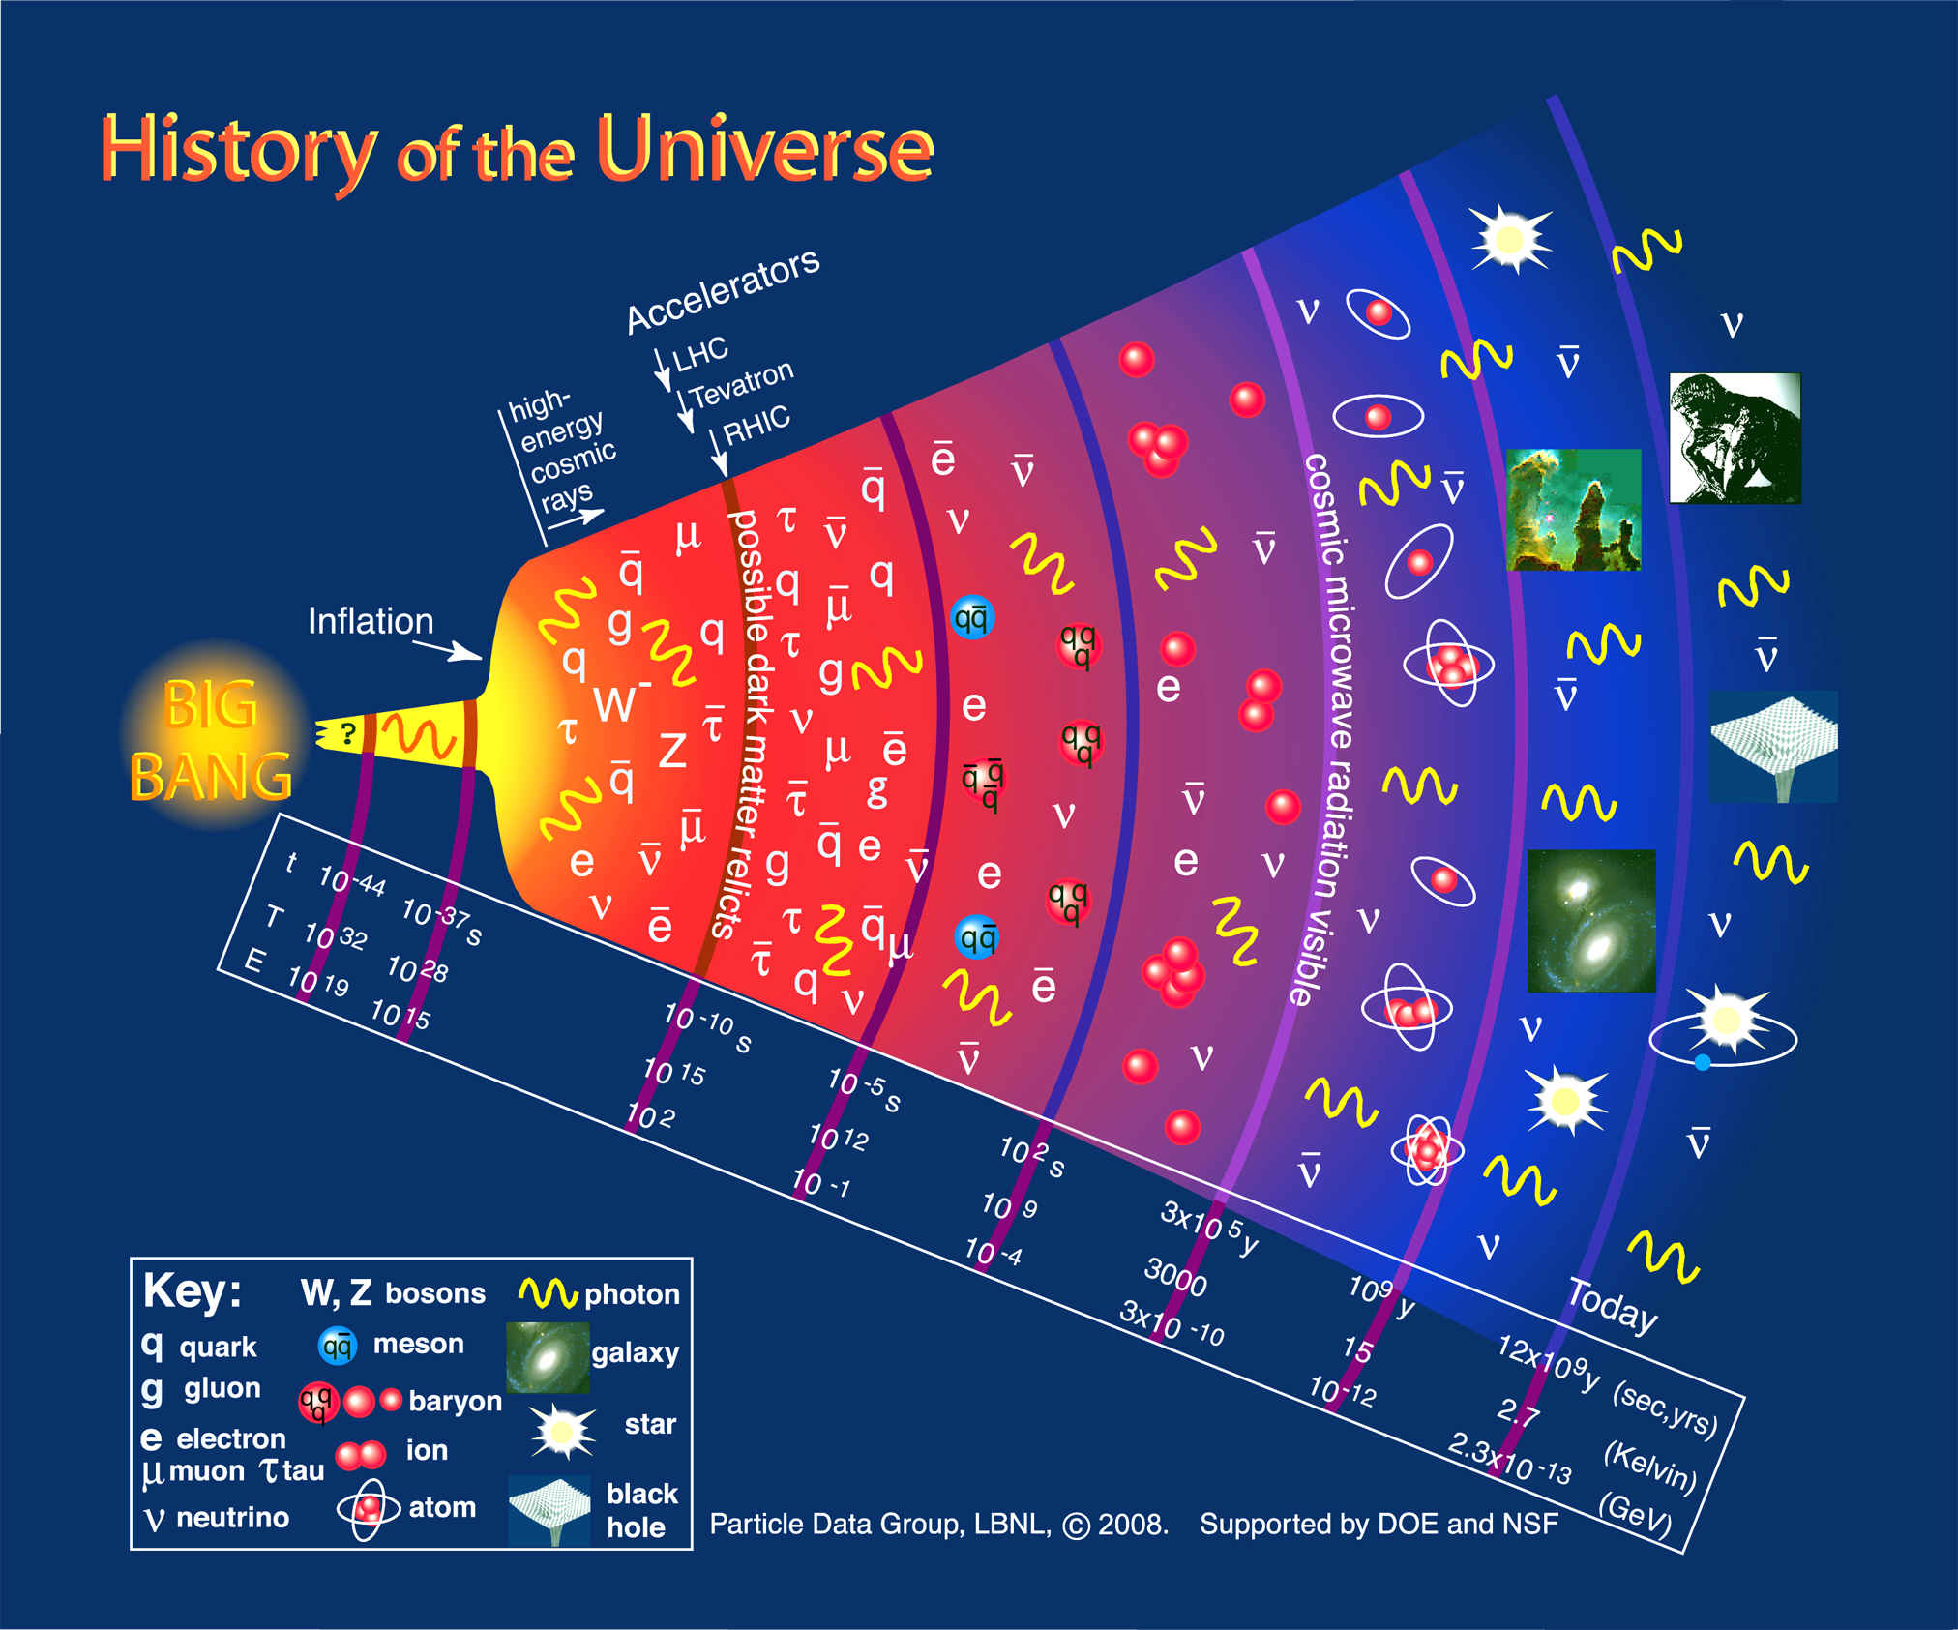
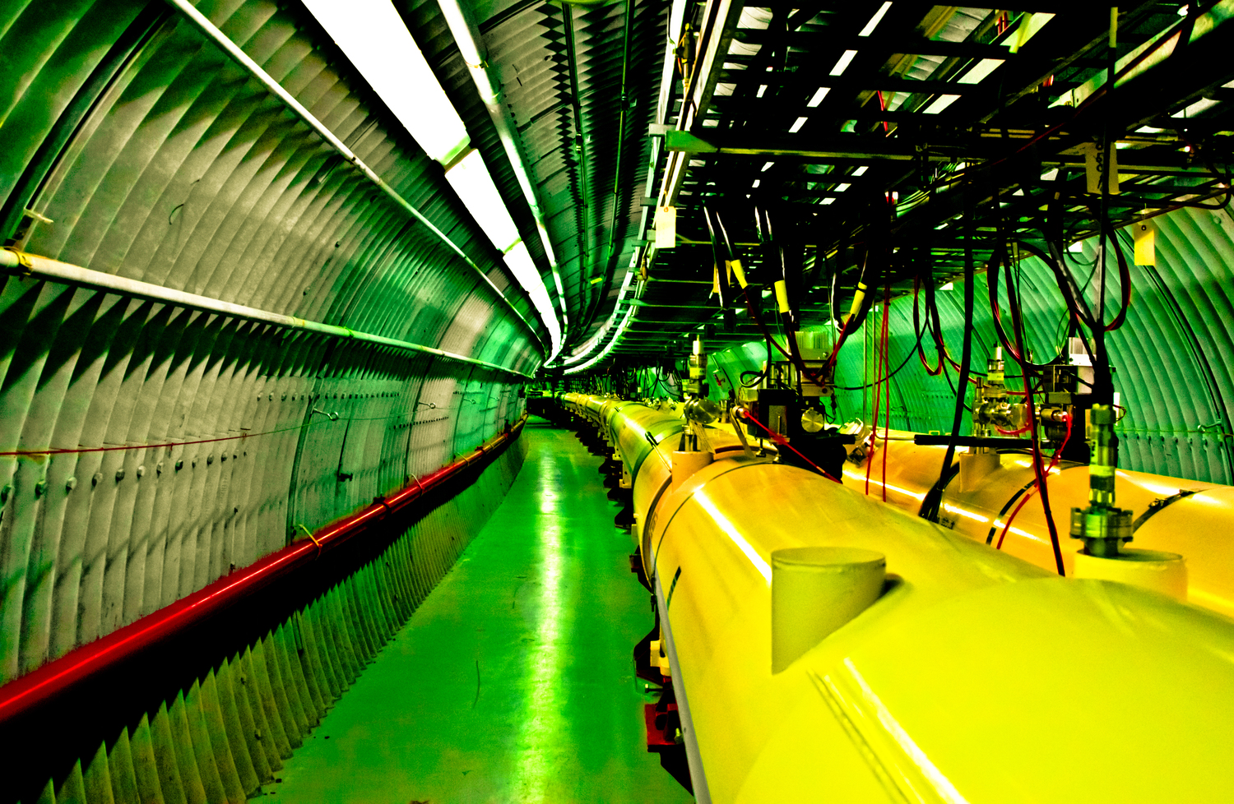
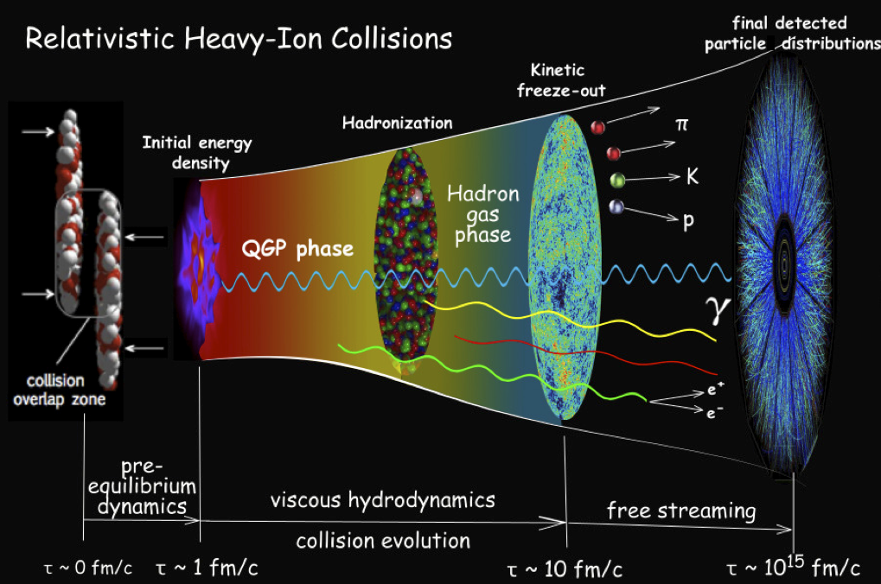
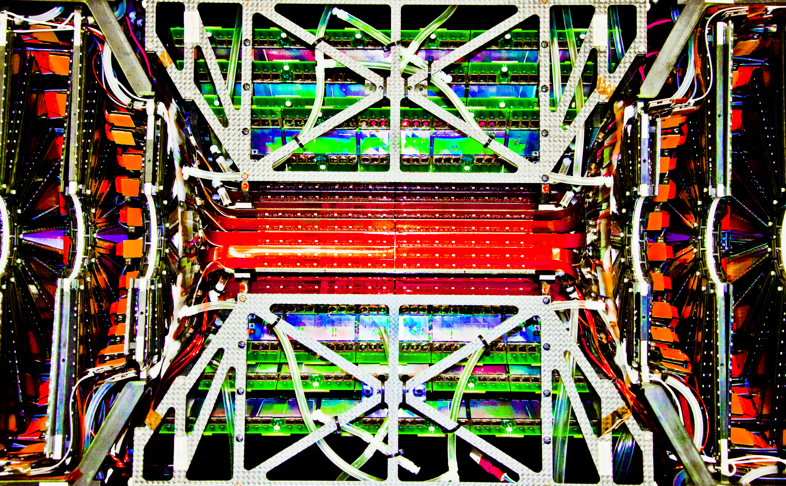
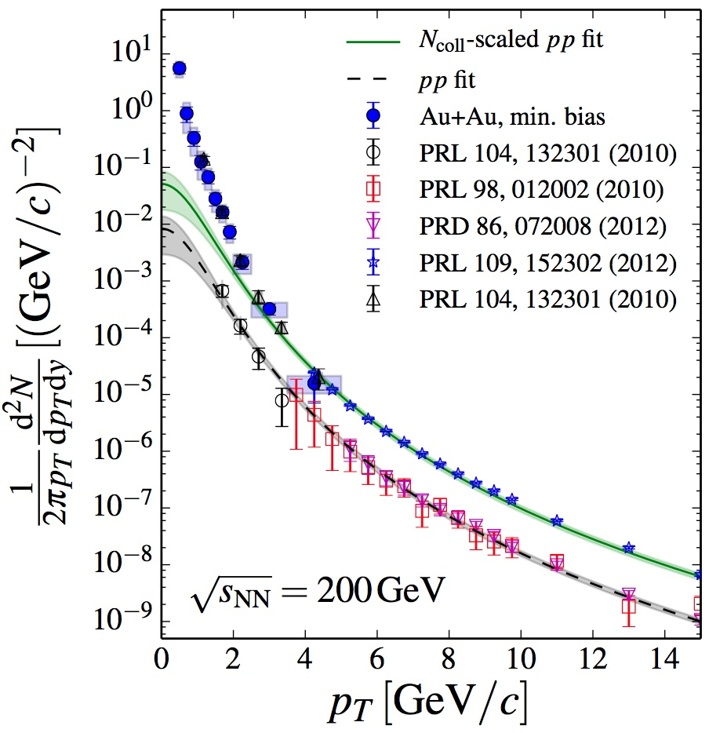
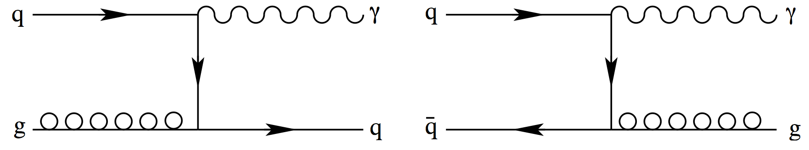
The Quark-Gluon Plasma
Stefan Bathe
The Quark-Gluon Plasma (QGP) was the primordial state
that lasted for a few microseconds after the Big Bang.
Experimentally the QGP can be created in ultra-relativistic collisions of heavy nuclei as here at the Relativistic Heavy Ion Collider (RHIC) of Brookhaven National Laboratory (BNL) on Long Island. (Photo art by Korrigan Clark)
Time evolution of a heavy ion collision.
The Silicon Vertex Detector of the PHENIX experiment at RHIC. (Photo art by Korrigan Clark)
LO Feynman diagrams for direct photon production.
Baruch Physics Faculty:
Stefan Bathe
Etan Bourkoff
Sultan Catto
Adrian Dumitru
Jamal Jalilian-Marian
Ramzi Khuri
Peter Orland
Graduate Students:
Jason Bryslawskyj
Zachary Rowan
Thermal photon radiation from the QGP indicating a temperature of 4 trillion K. (PHENIX, PRC91(2015)064904)

