Slide 1
Electron lens main solenoid #1
straight beam pipe (Y-pipes not ready)
allows for commissioning of all solenoid magnets
does not allow for electron beam commissioning
IP10
outside ring
inside ring
EBIS spare solenoid
allows for electron transport from gun to collector with 2 Tm integrated strength
does not allow for beam-beam compensation (field lines not straight enough)

Slide 2
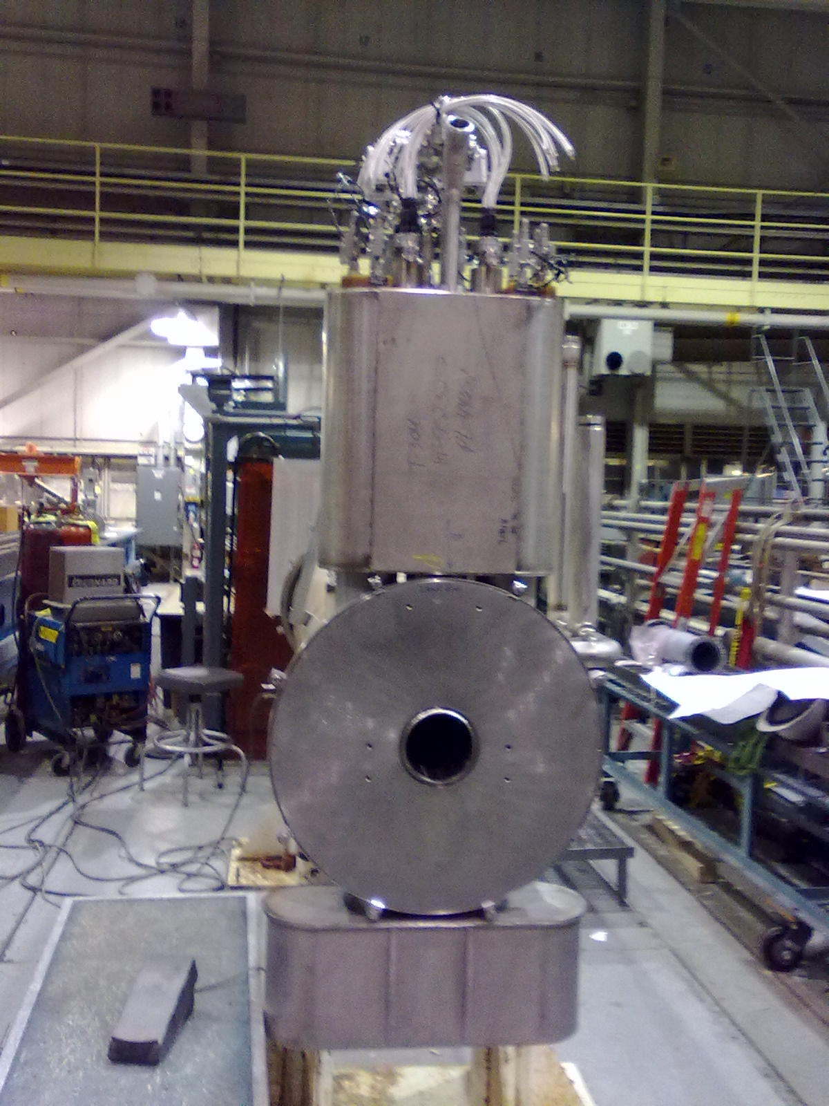
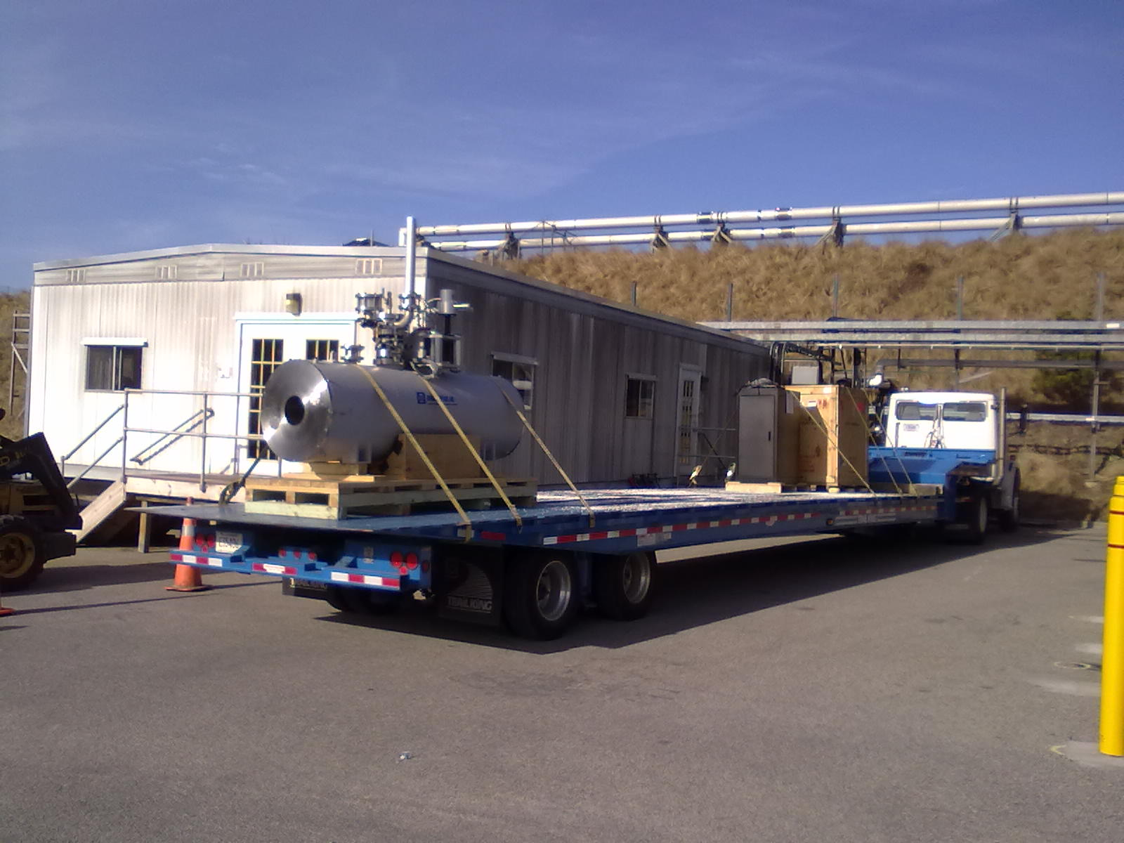
Completed solenoid #1 in SMD
(01/07/13)
EBIS spare solenoid arriving (01/03/13)

Slide 3
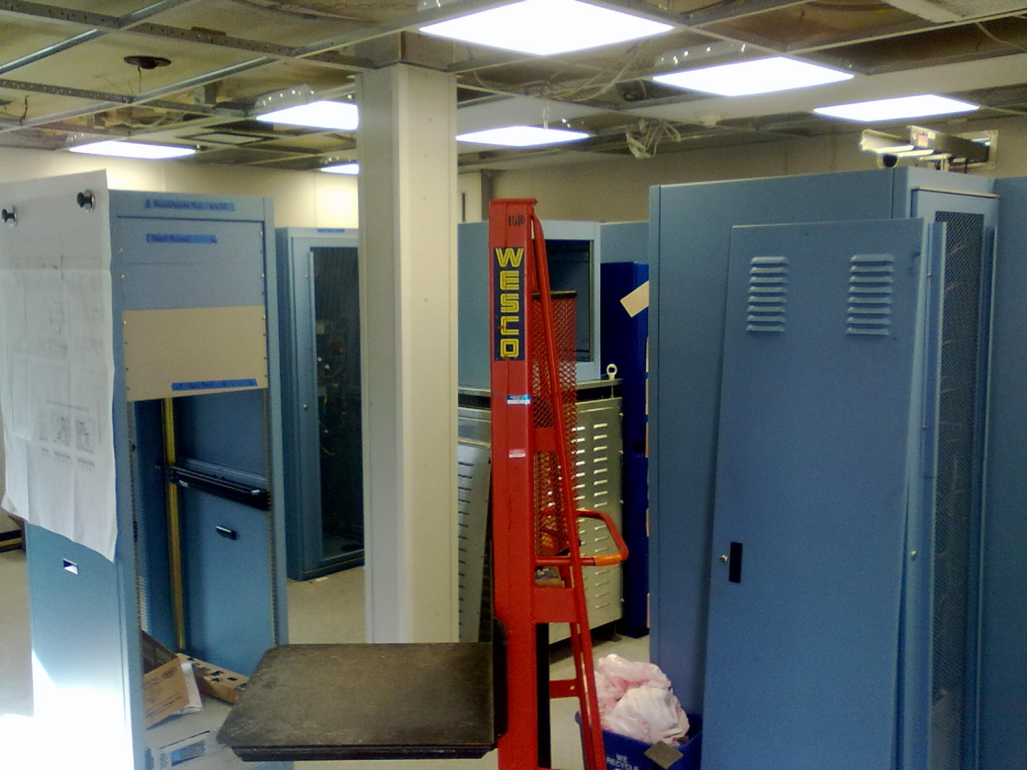
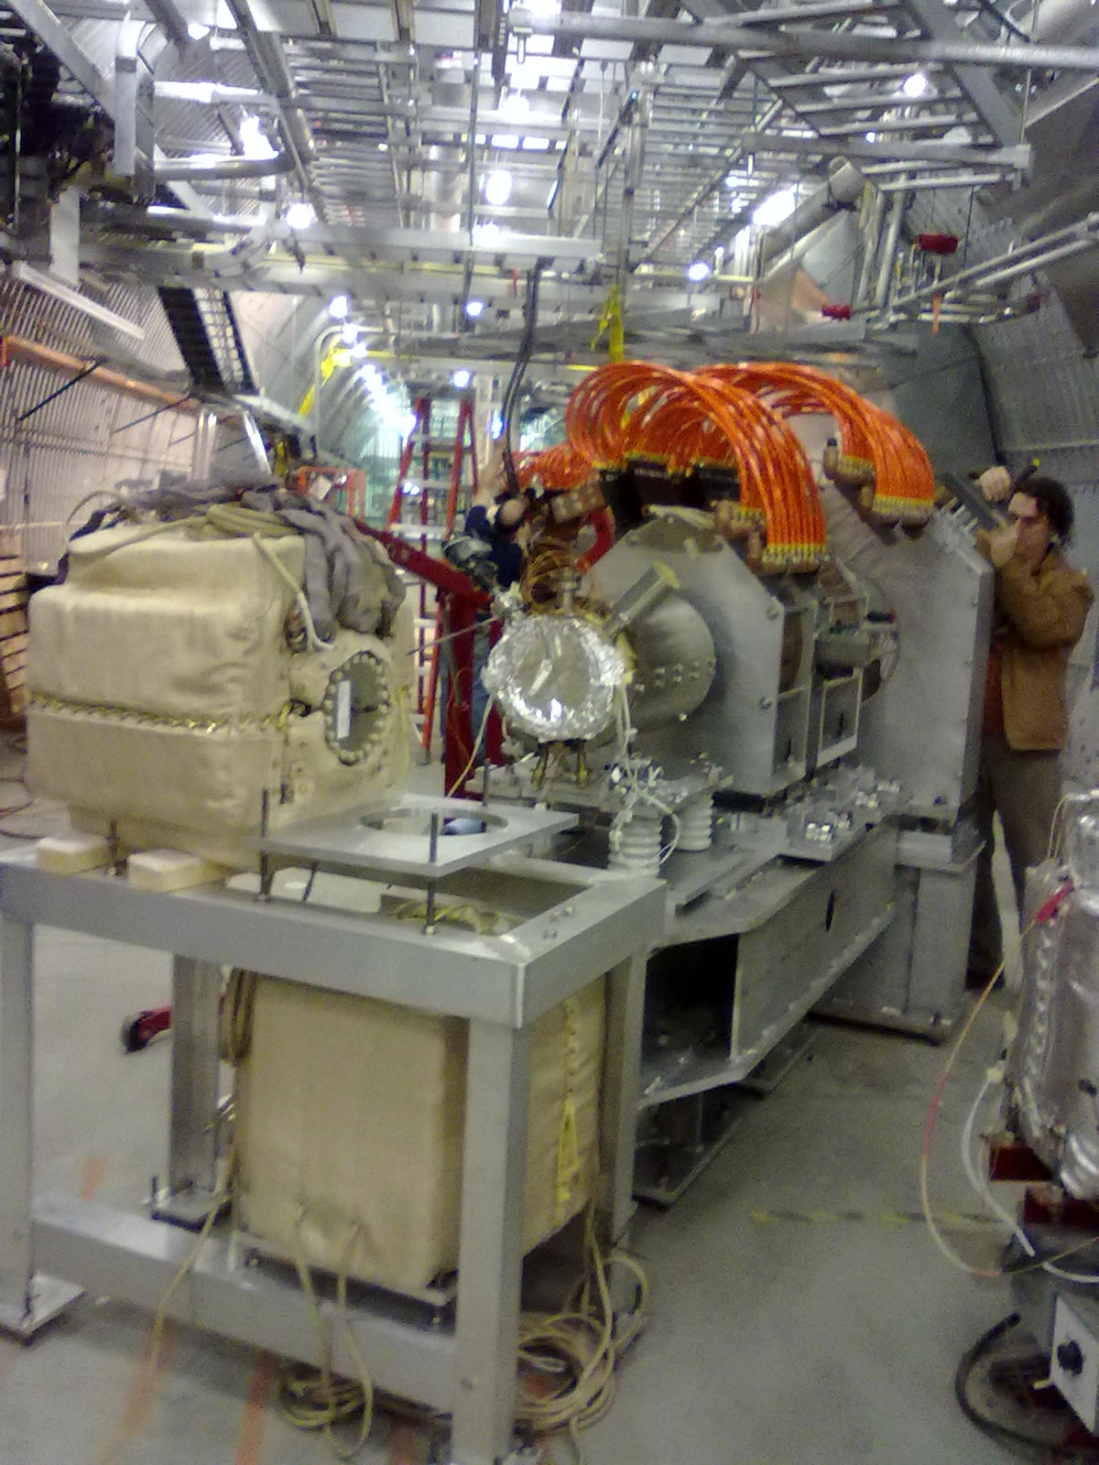
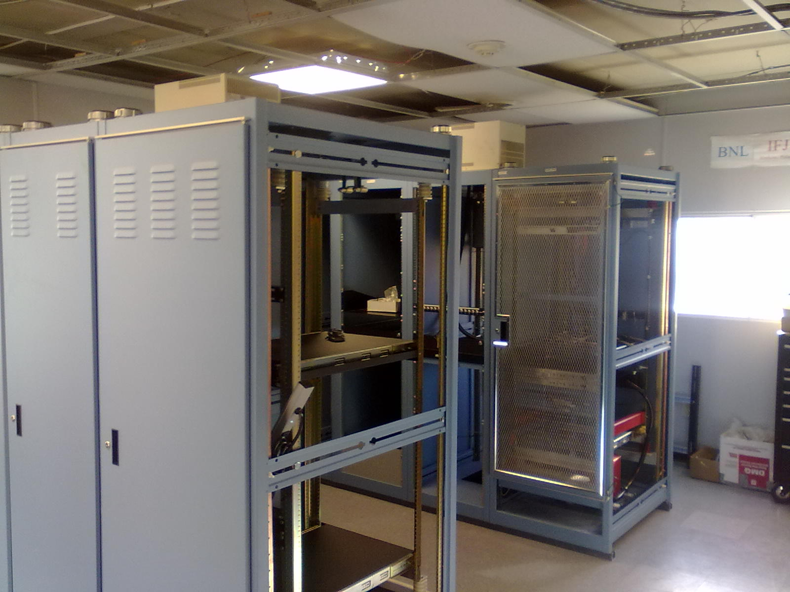
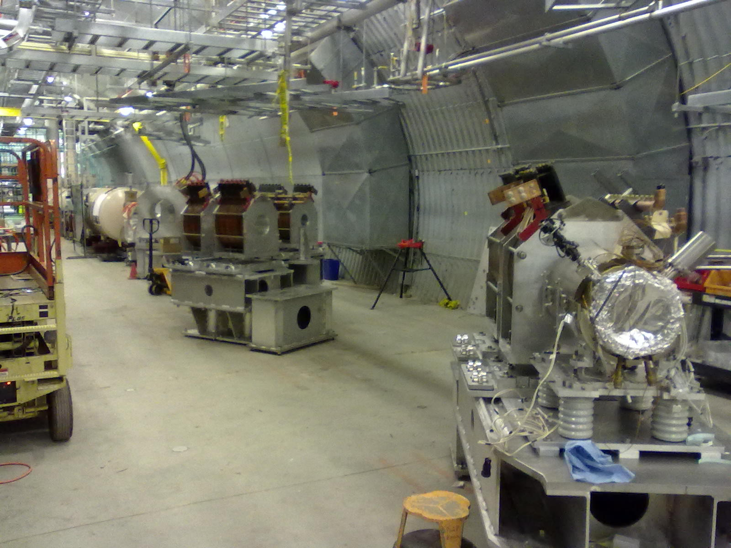

Slide 4
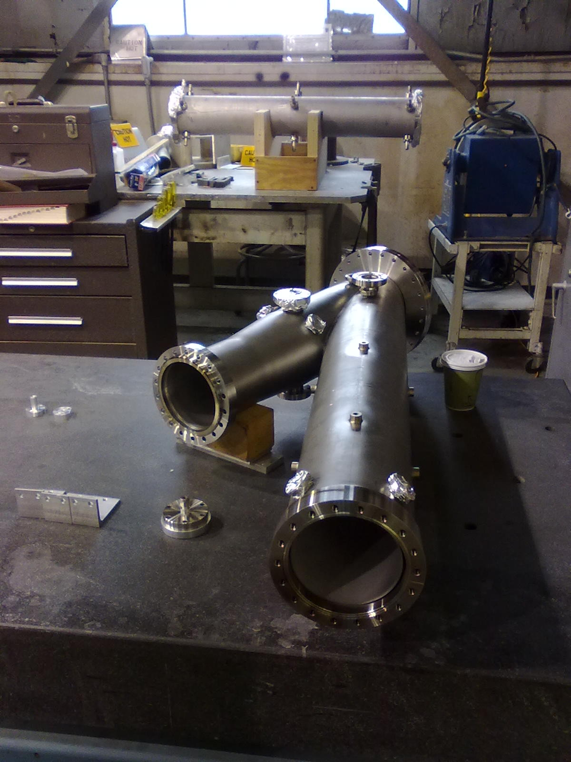
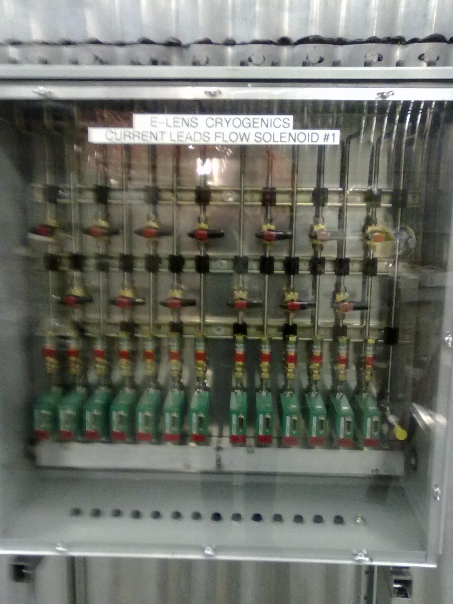
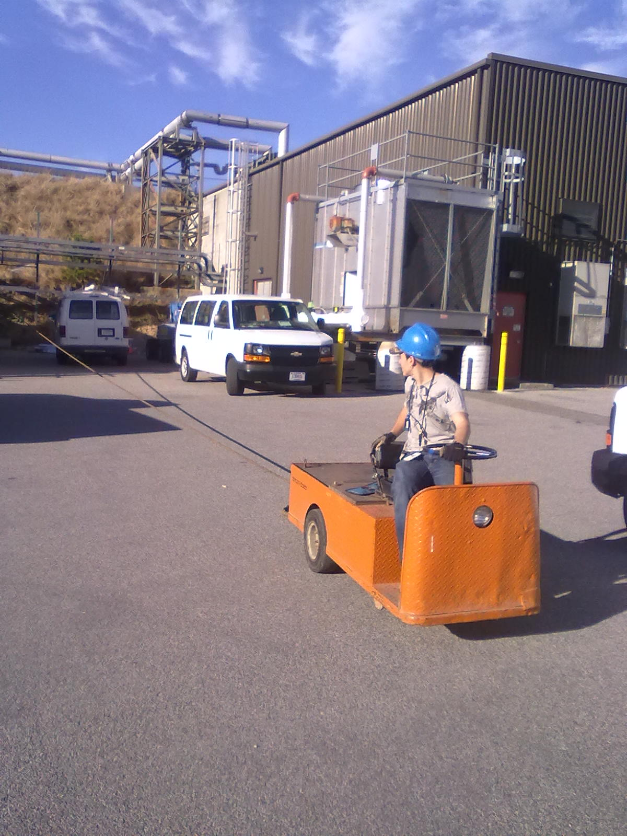

Slide 5
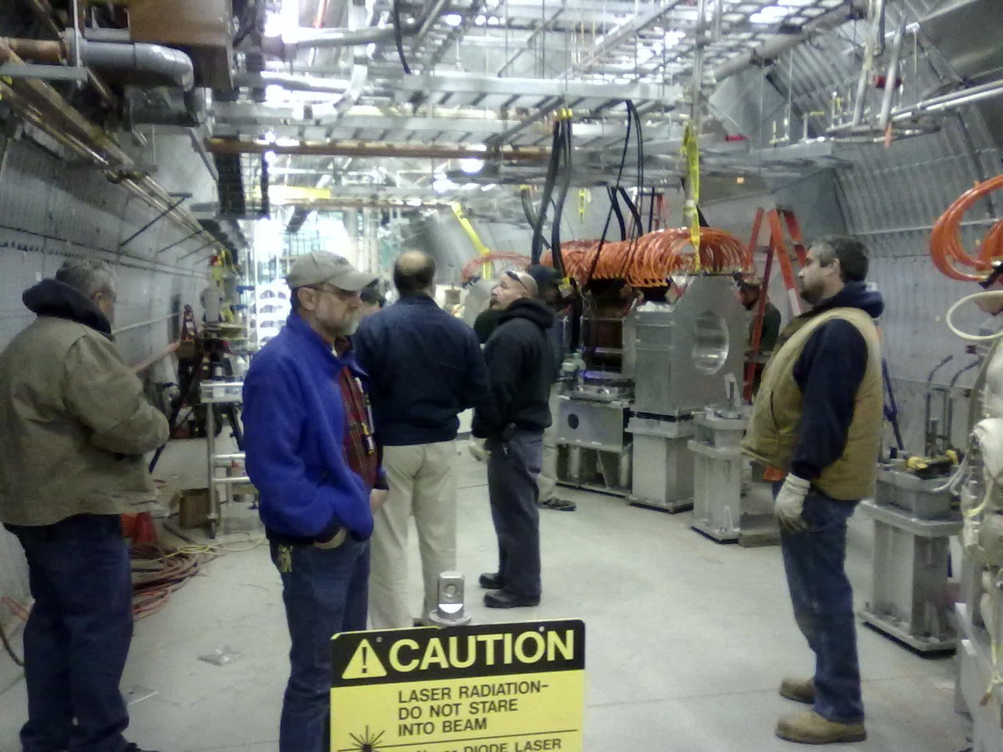

Slide 6
Bunch pattern
Would like to remove Yellow bunches in buckets 88 and 91 (then last 2 Blue bunches have no partner in IP10 – allows for commissioning of e-lens BPMs)
What spin pattern selection? (pattern then gap, or gap then pattern)

