Slide 1
AGS Status
Haixin Huang
RSC Meeting
April 6, 2012

Slide 2
Status
Continued to provide pp beam for RHIC physics program.
During the setup for Au beam in Booster, a radius wobbling was eliminated. The injection instability with beam intensity higher than 5.3*10^11 disappeared. We can continue to use the regular Booster scraping, instead of shift it earlier in the cycle (did not quite work).
Frequent sudden lurch of vertical dipole correctors in AGS was first noticed last Saturday. It was traced back to start after maintenance day. After several attempts to remove it, it disappeared but not correlated with the changes we made.
Tried shorter AGS cycle to fill RHIC twice. One jump quad tripped due to high temperature often in the faster cycle. We managed to fill RHIC twice but both ramps failed before rotator ramp. Keep running in this mode is kind of risky. So we backed off and waiting for possible P/S cooling improvement.
Lower polarization at AGS extraction. Correlated to lower input intensity (less Booster scraping).
We also observed irregular spin sign during AGS polarization measurements.

Slide 3
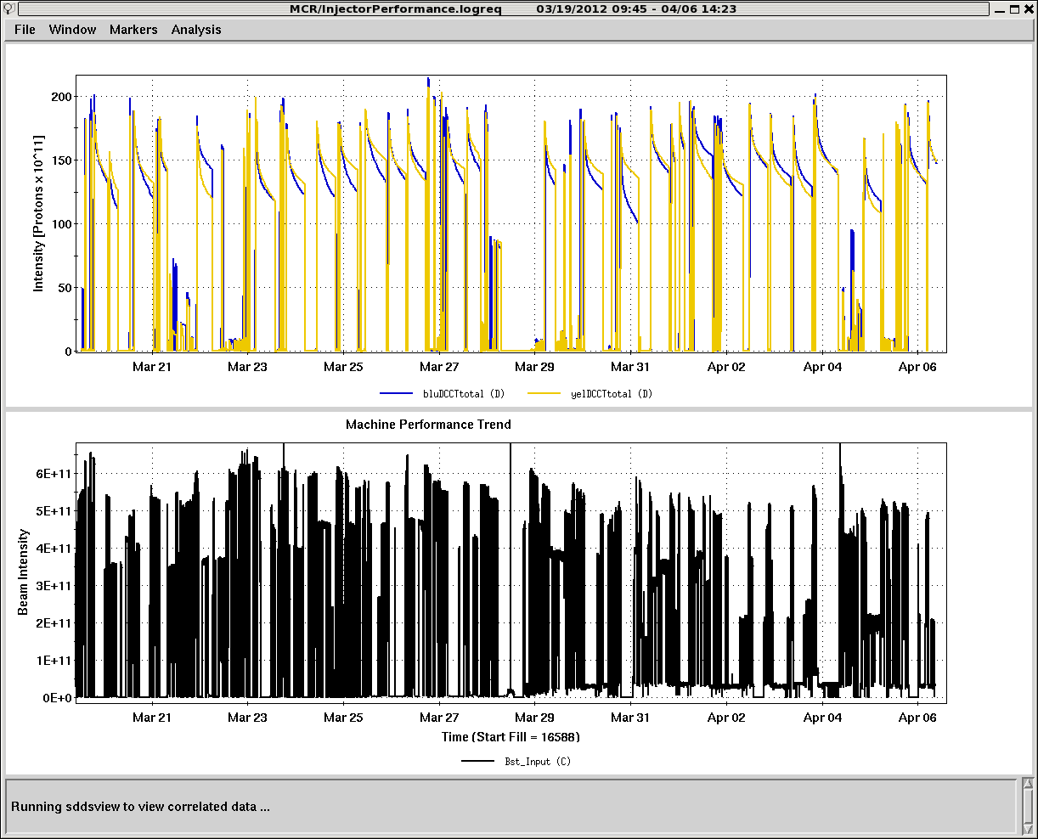
Booster Input Intensity and RHIC Intensity
Lower Booster input intensity since Maintenance day (Mar. 28)

Slide 4
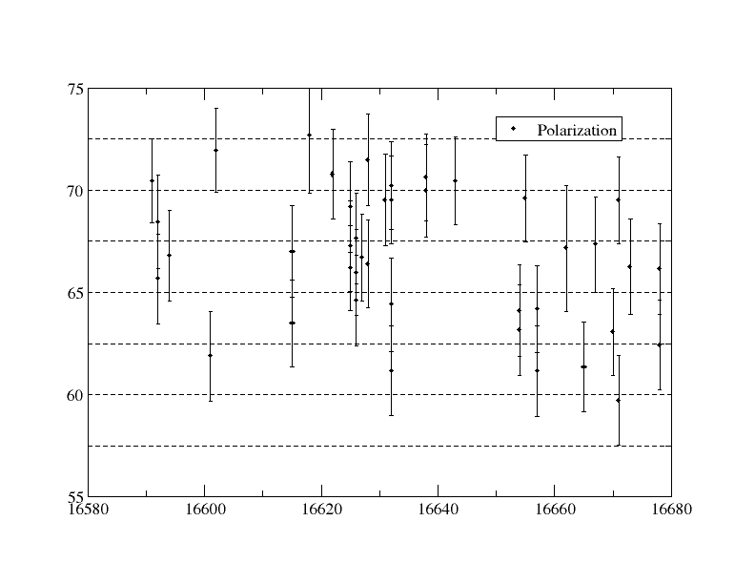
AGS Polarization for RHIC Fills

Slide 5
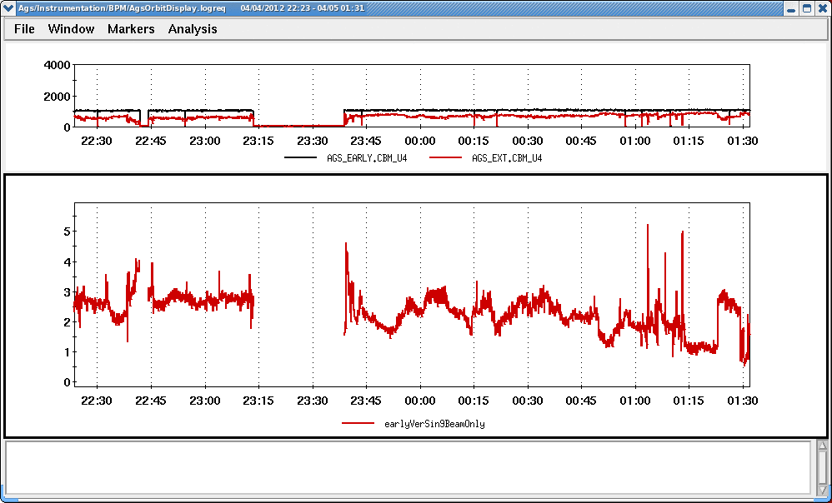
AGS Intensity and sin9v Amplitude
(bad state)

Slide 6
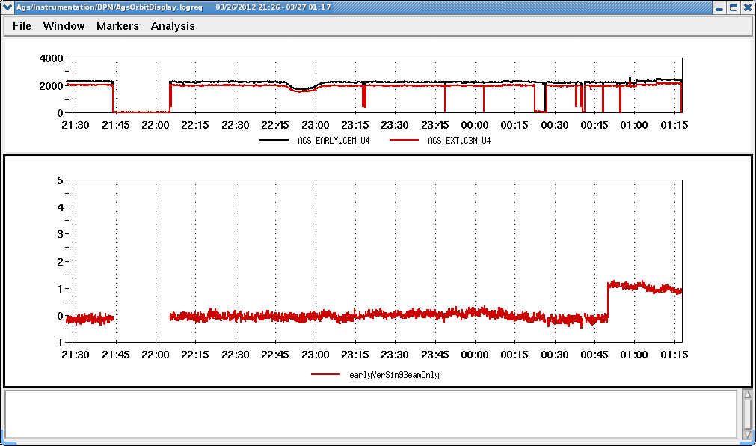
AGS Intensity and sin9v Amplitude(2)
(good state)

Slide 7
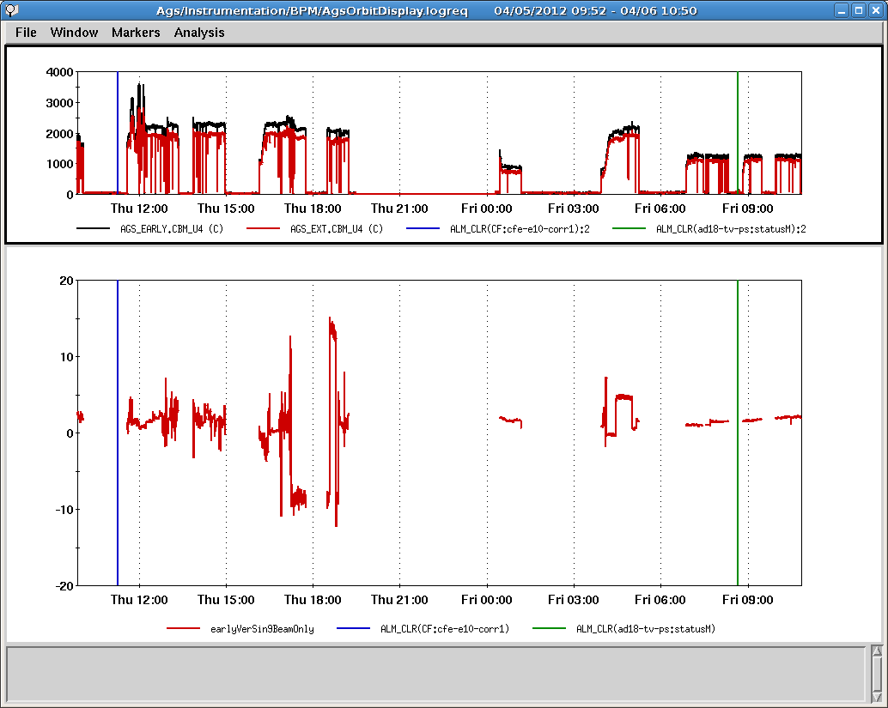
AGS Intensity and sin9v Amplitude (3)
The improvement did not lined with function generator change (blue) and P/S change (green) but the switch from Uranium user. Remains as mystery.

Slide 8
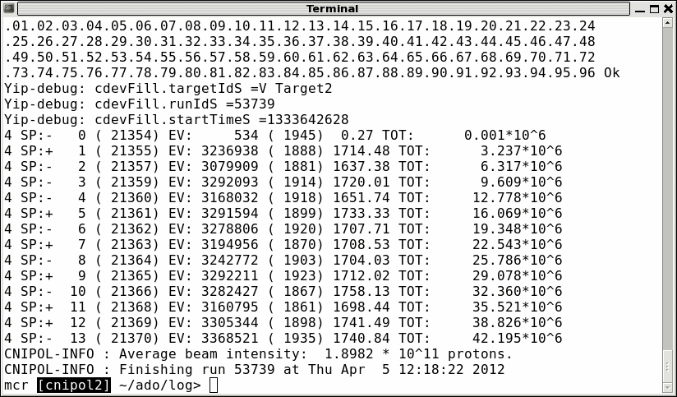
Spin Sign Misbehavior
It is under investigation, hope it does not affect RHIC injection.

Slide 9
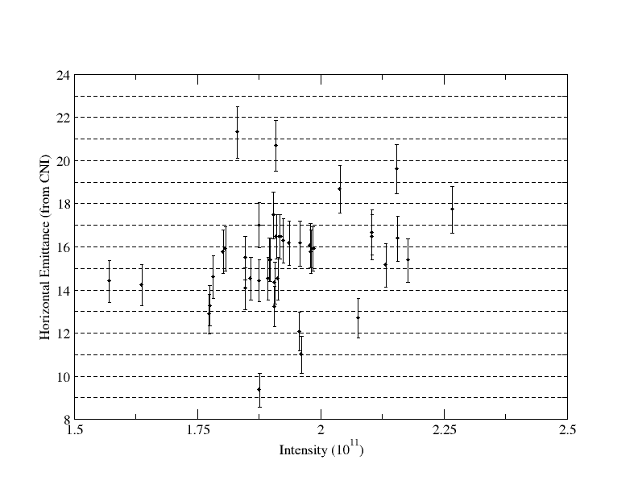
AGS Horizontal Emittance for RHIC Fills

Slide 10
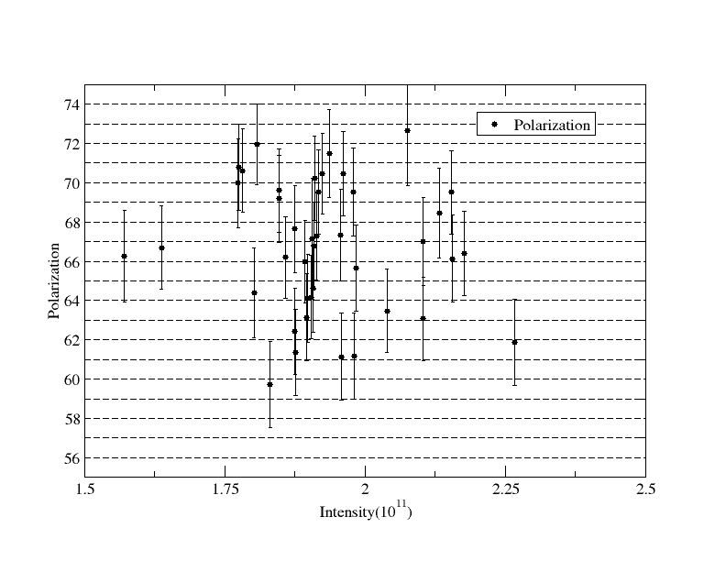
AGS Polarization for RHIC Fills (255GeV)

