Slide 1
AGS Status
Haixin Huang
RSC Meeting
March 23, 2012

Slide 2
Status
Continued to provide pp beam for RHIC physics program.
Sweep polarization measurements have been taken in the AGS to derive the polarization profile information in both vertical and horizontal. Some preliminary results on horizontal profiles
Not strong intensity dependence on intensity up to 2*10^11.
Plan to reduce the AGS cycle time from 4 sec to 3 sec to reduce injection time (emittance growth issue).

Slide 3
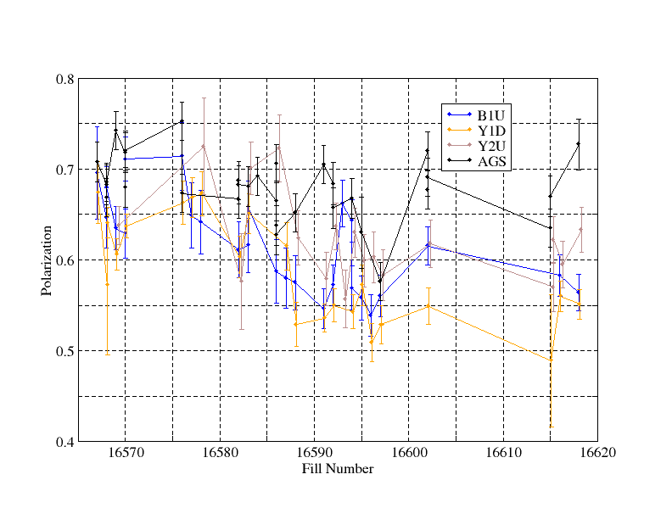
AGS/RHIC Polarization for 255GeV Fills

Slide 4
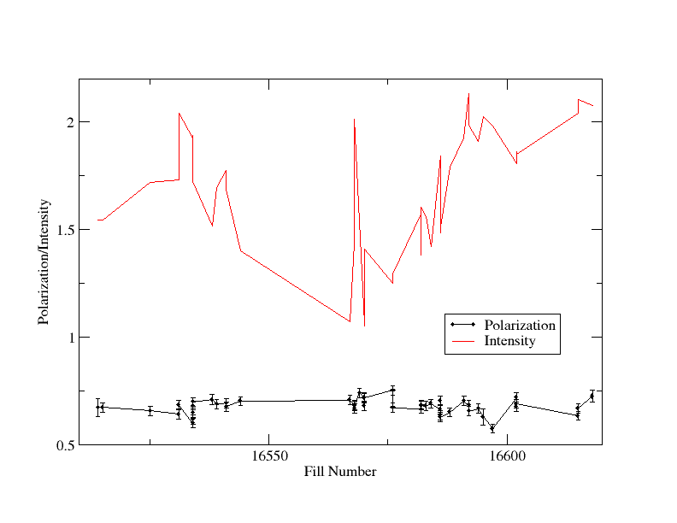
AGS Polarization and Intensity for RHIC Fills
255GeV

Slide 5
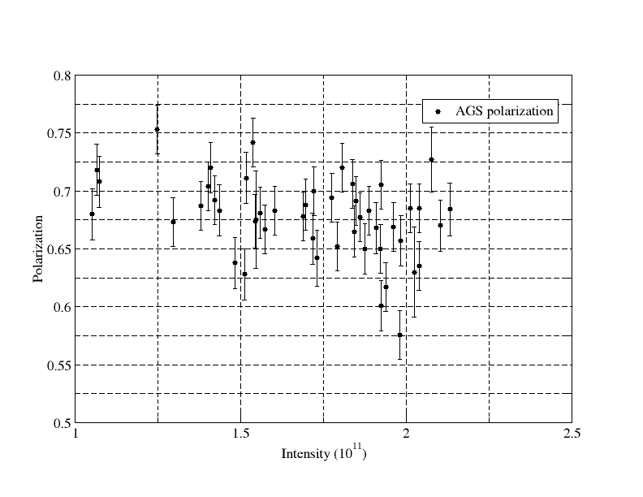
AGS Polarization for RHIC Fills

Slide 6
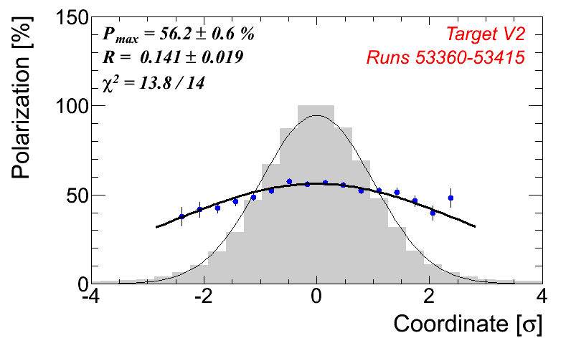
AGS Horizontal Polarization Profile
(Andrei)
Preliminary
(Jump Quads off)

Slide 7
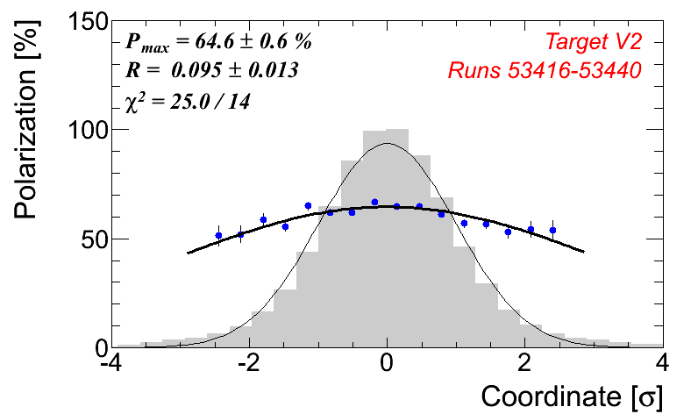
AGS Horizontal Polarization Profile
(Andrei)
Preliminary
(Jump Quads on)

Slide 8
AGS Simulation with ZGOUBI
(Yann Dutheil and Francois Meot)

