Slide 1
RHIC Status
RHIC Spin Collaboration
V. Schoefer
2/24/12

Slide 2
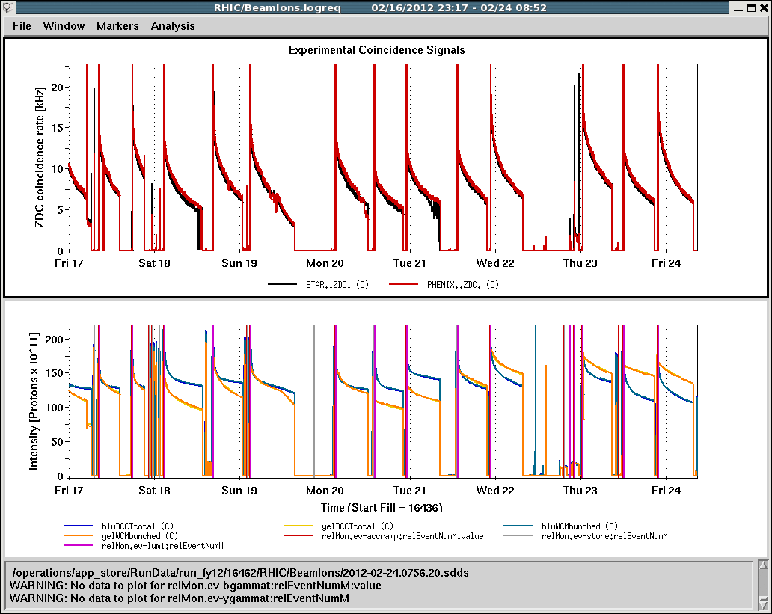
Status: 100 GeV
Last week→
Continuous physics mode
Incremental changes to tweak injection and store lifetimes
Otherwise running well

Slide 3
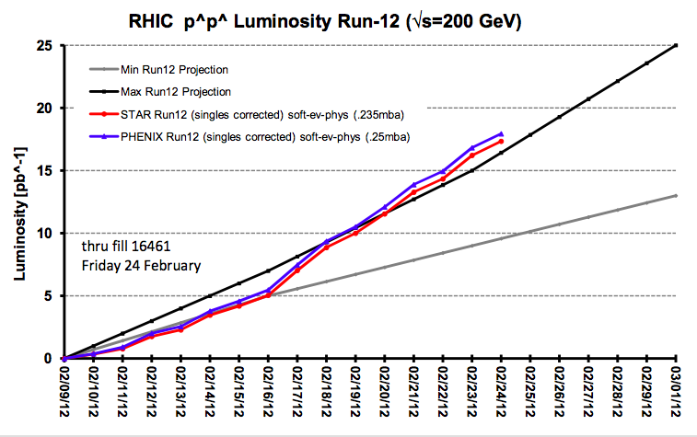
May still change on the order of 10-15% based on revised cross sections

Slide 4
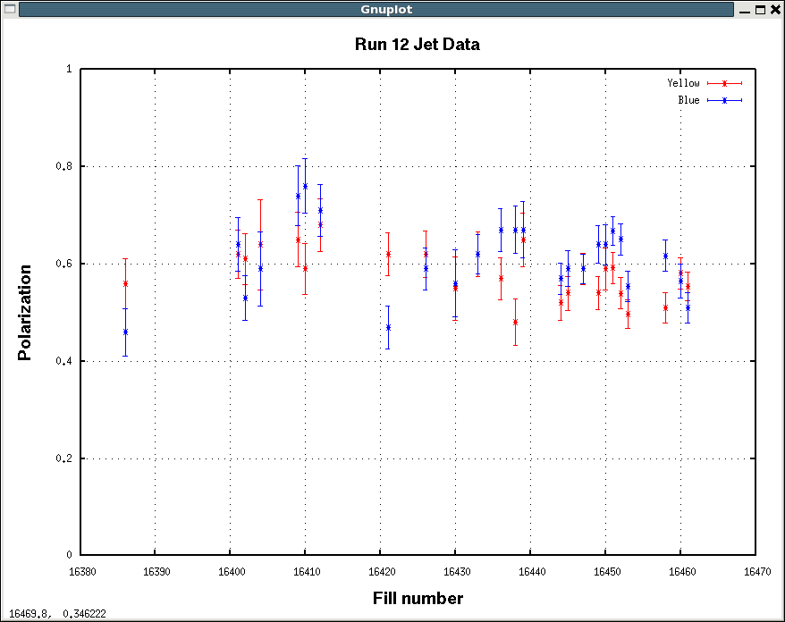

Slide 5
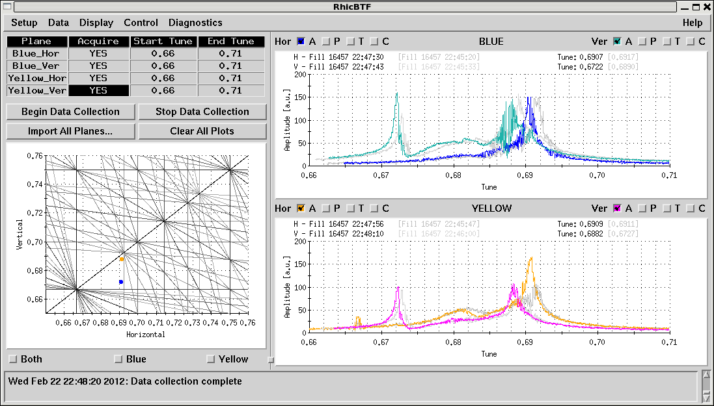
Development: Suppresion of coherent modes

Slide 6
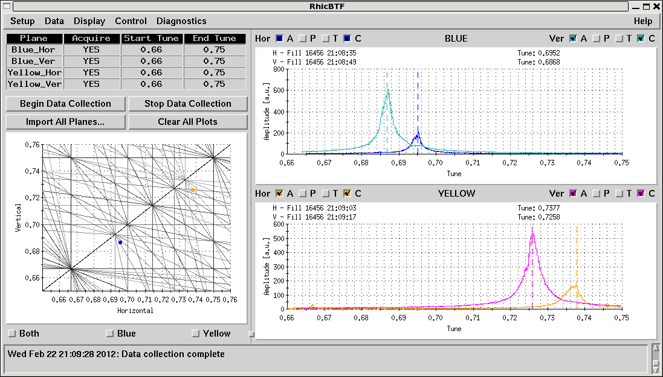
Development: Suppresion of coherent modes

Slide 7
Planning for 250 GeV
Will train DX magnets to 255 GeV
1-3 shifts to get training done
Will do part of the work on next maintenance day if compatible with work for 100 GeV operation

