Slide 1
PHENIX Report
John Koster RBRC RSC Meeting 2012/02/24

Slide 2
Local polarimetry
Local pol. team: Ciprian Gal, Sanghwa Park, Josh Perry will give a dedicated talk at the next RSC meeting.
We are running two analyses in near-real time:
Offline analysis of 200 Hz, “Traditional” analysis. Using offline reconstruction.
Online analysis using SMD scaler data.
Next slide shows scaler analysis
Data from ~3 AM today
Beams are vertical at 1008
Up/Down A_{N} consistent with zero
Left/Right A_{N} non zero
We will confirm polarization direction of beams with new tune working point.

Slide 3
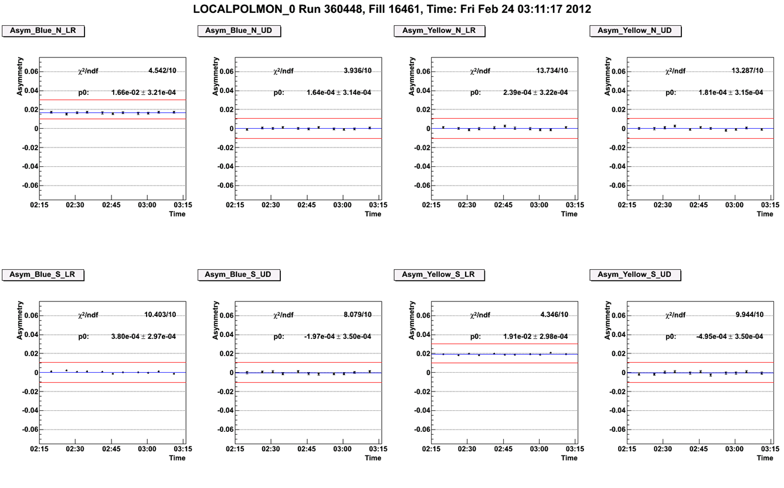
Online Scaler Analysis: 3 AM Today
Left/Right
Up/Down
Left/Right
Up/Down
FORWARD
FORWARD
BACKWARD
BACKWARD
Left/Right
Up/Down
Left/Right
Up/Down
BACKWARD
BACKWARD
FORWARD
FORWARD

Slide 4
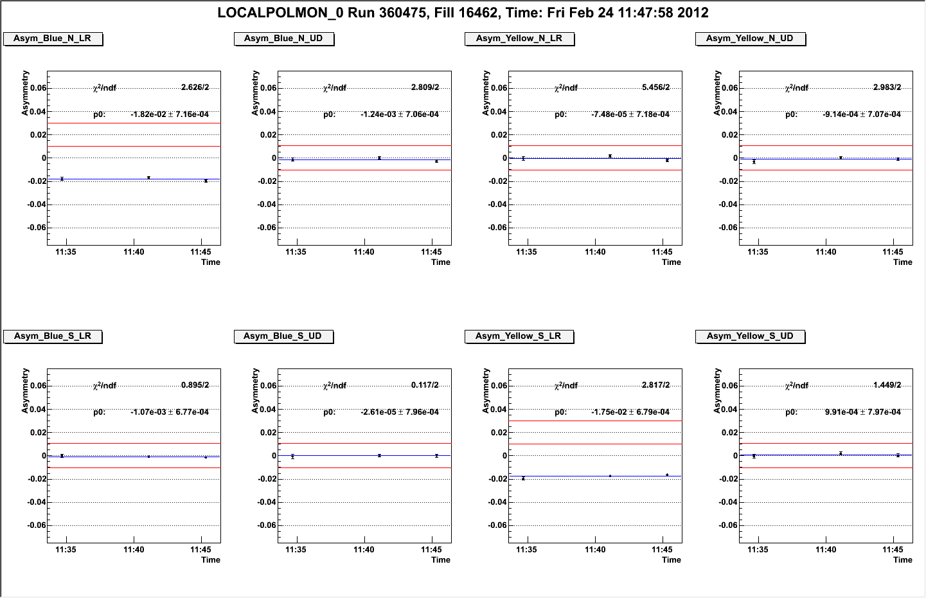
Online Scaler Analysis: Noon Today
Left/Right
Up/Down
Left/Right
Up/Down
FORWARD
FORWARD
BACKWARD
Expected sign is flipped
Left/Right
Up/Down
Left/Right
Up/Down
BACKWARD
BACKWARD
FORWARD
FORWARD

Slide 5
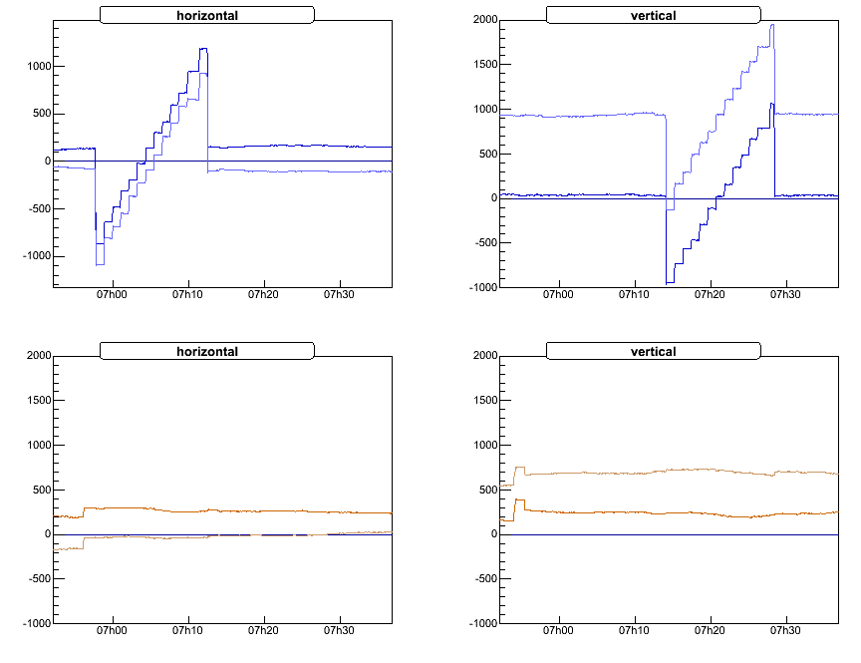
Vernier Scan
BPM Data
Typo?
First scan for the experiments: 02/18/2012
Scan successful
Analysis started
Would like 1 scan / week
Plot from Oleg Eyser

Slide 6
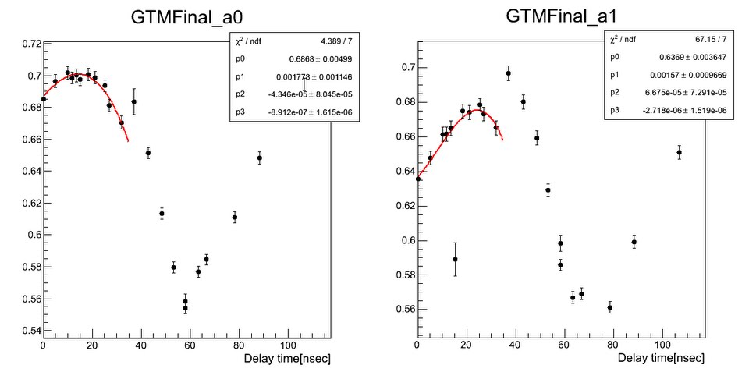
Upgrades: Muon Trigger
Planned to be functioning for 500 GeV running.
New RPC1 Stations installed for this run.
HV at operating HV for nearly 100% of modules.
Final timing tune for better efficiency is ongoing.
MuTr Trigger Fee Timing Scan
Plot from Yoshimitsu Imazu and Sanghwa Park

Slide 7
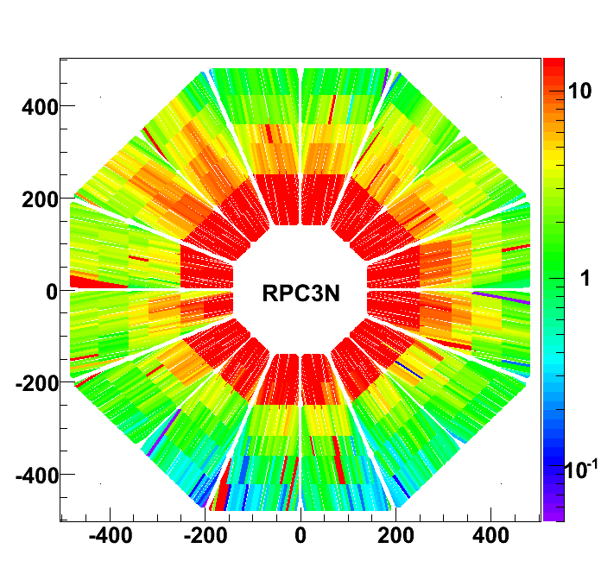
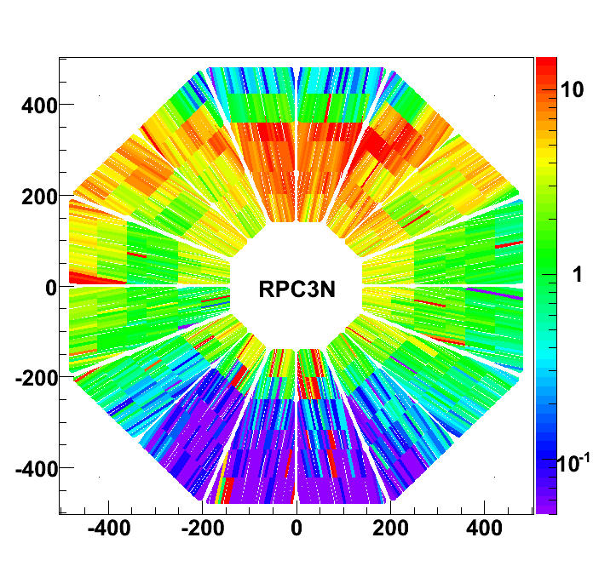
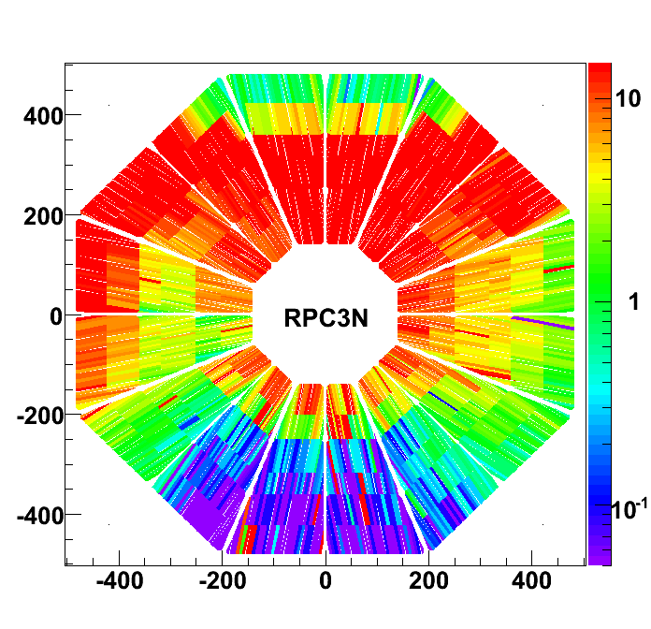
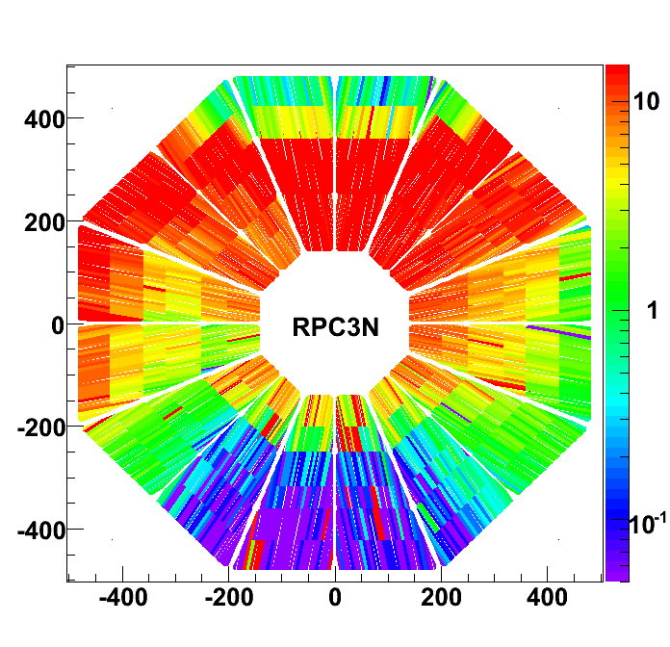
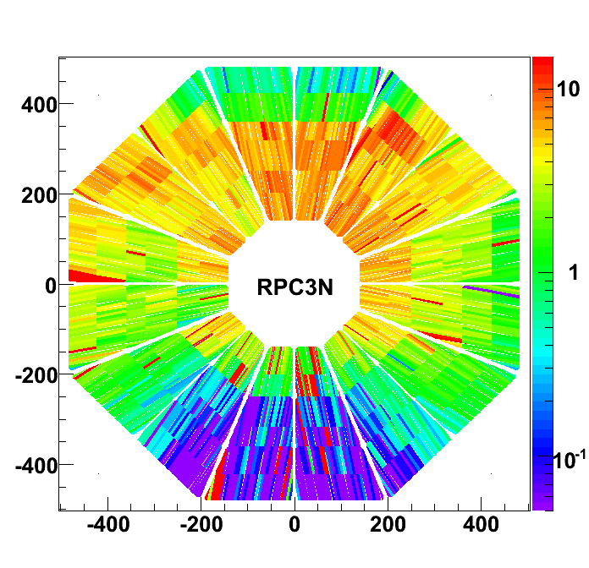
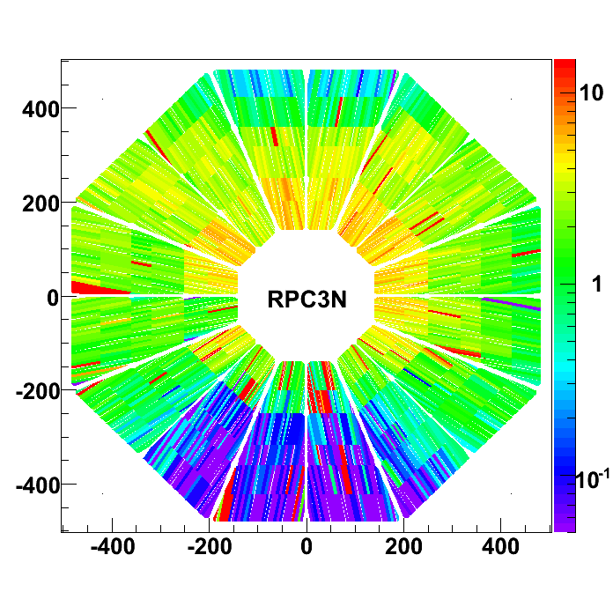
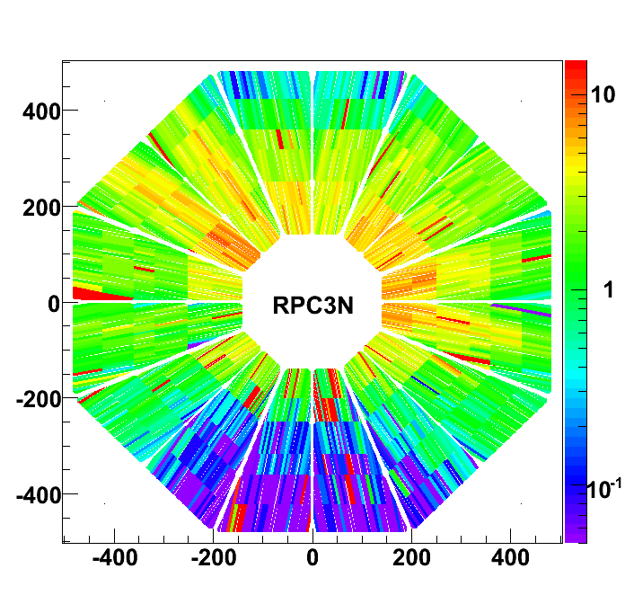
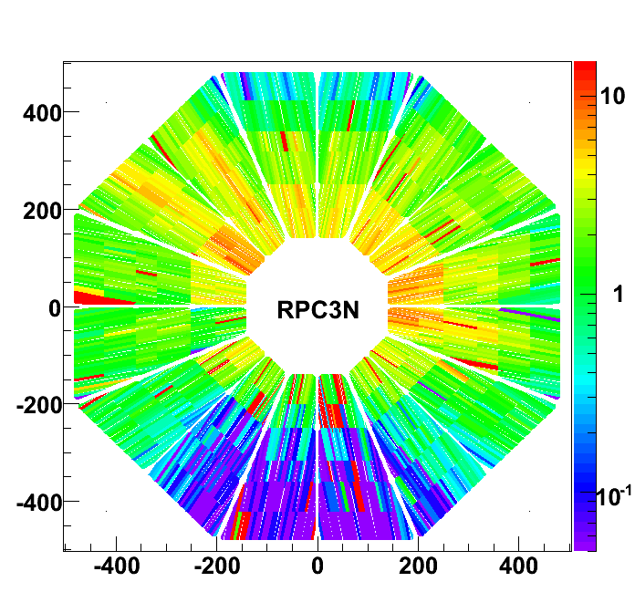
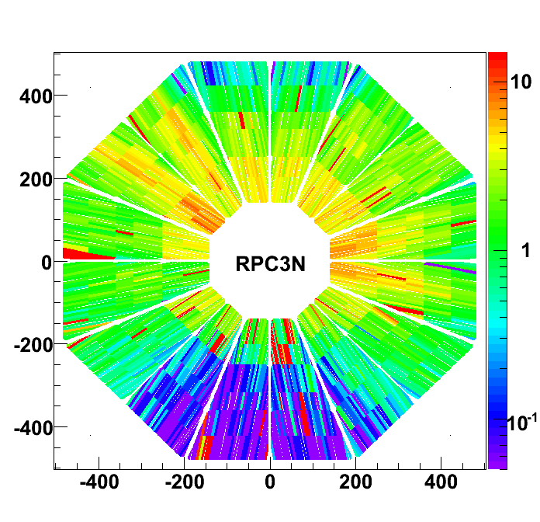
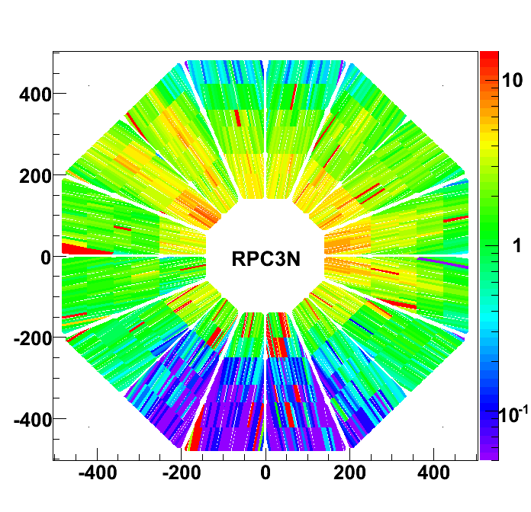
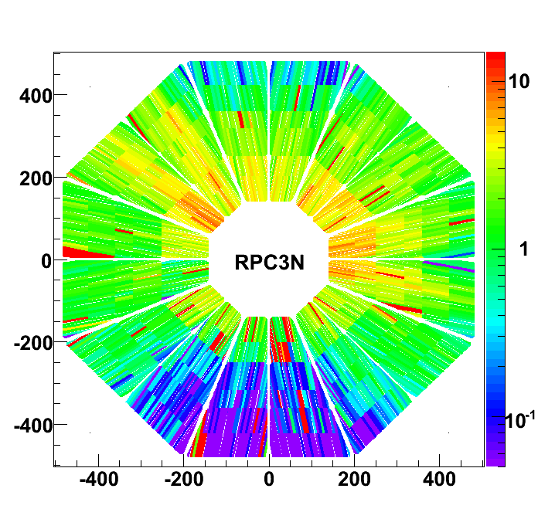
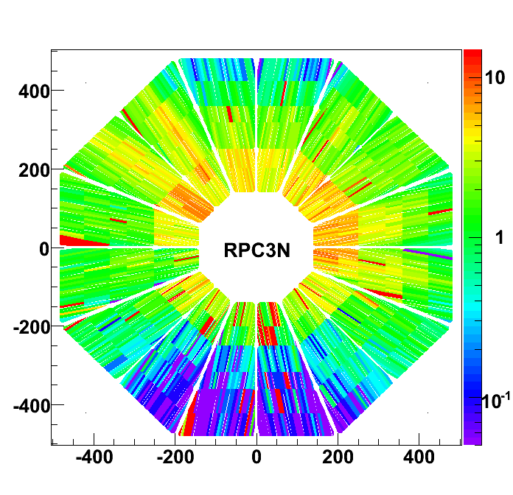
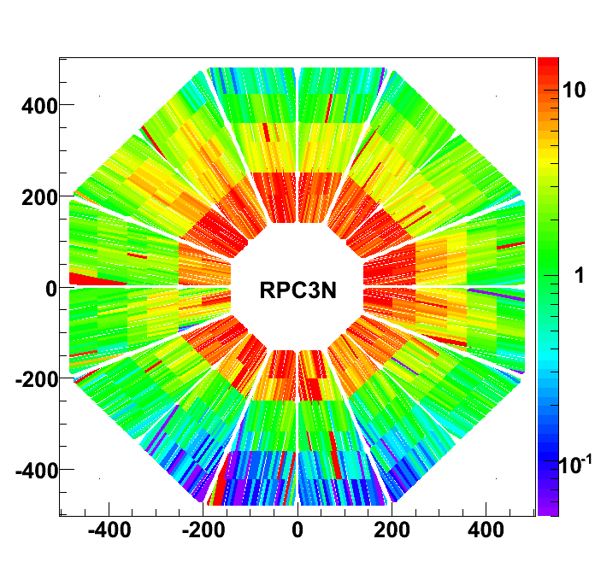
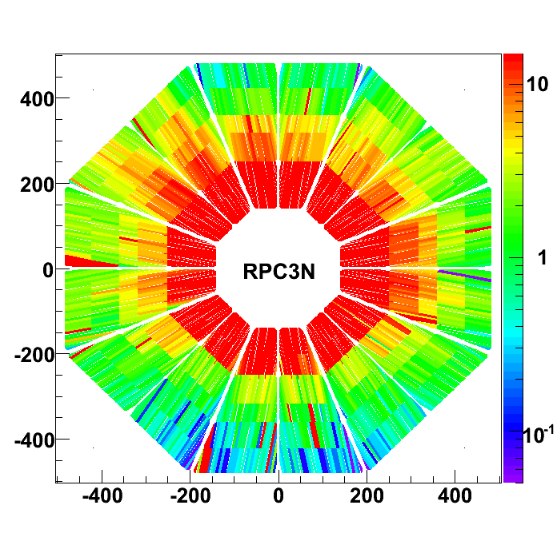
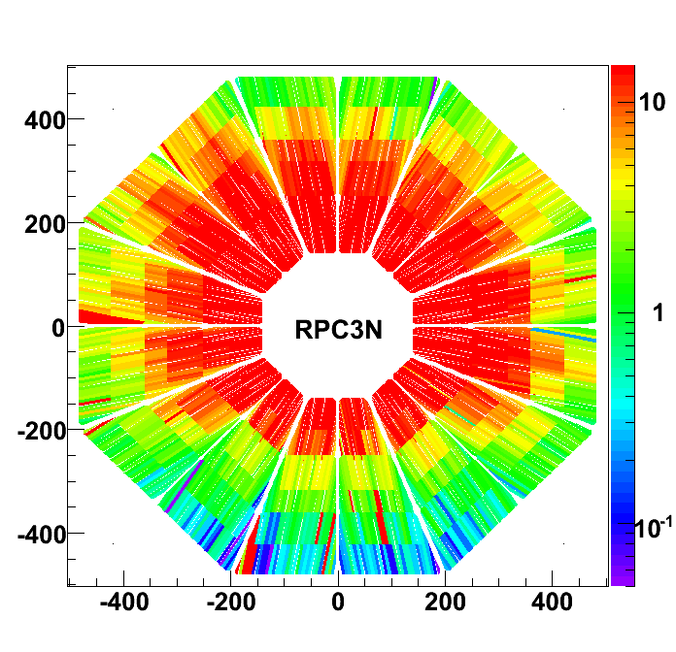
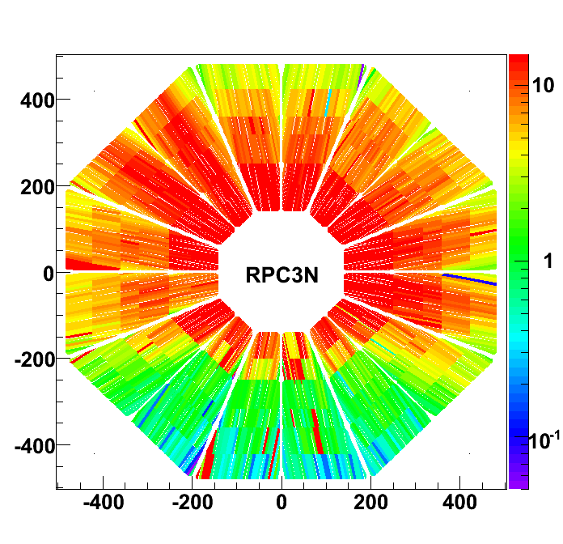
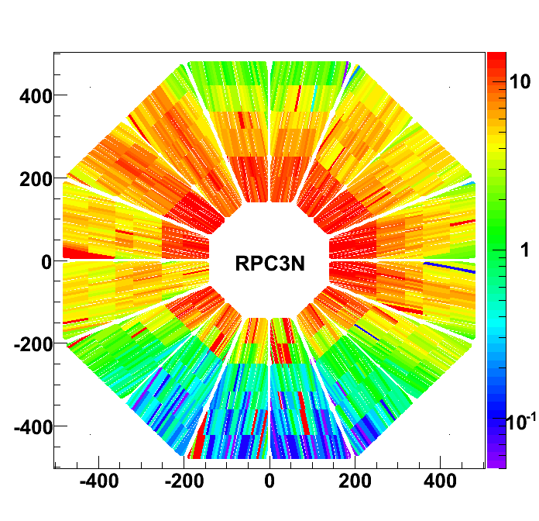
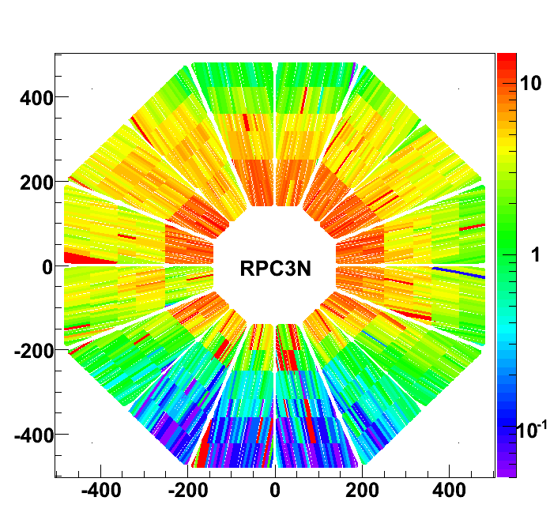
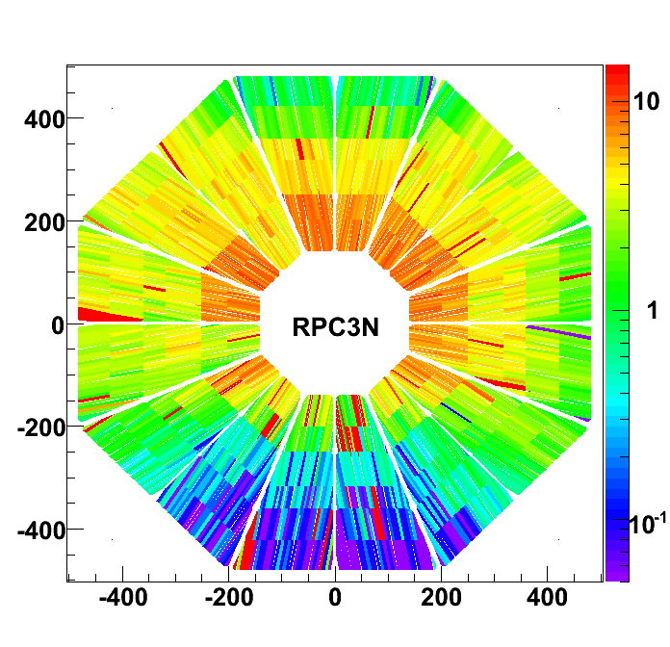
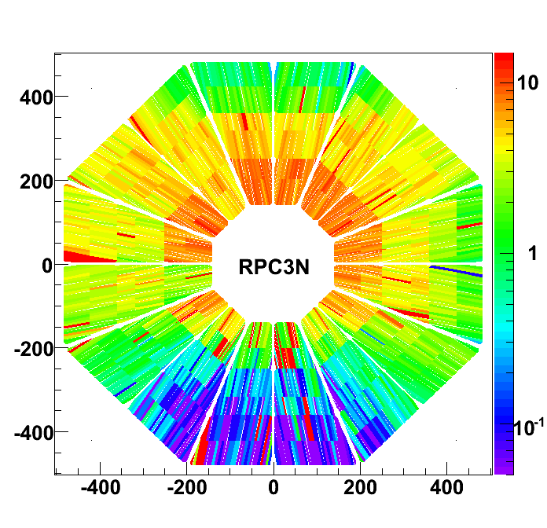
RPC3 North Hits vs Time in 4.5ns Steps
Plots from IhnJea Choi
Incoming
Beam Background
“Desert” between
passing bunches
Collision Related
Hits
Outgoing
Beam Background
Run11 data. Similar Run12 analysis in progress. Initial look: new garage shielding helping.

Slide 8
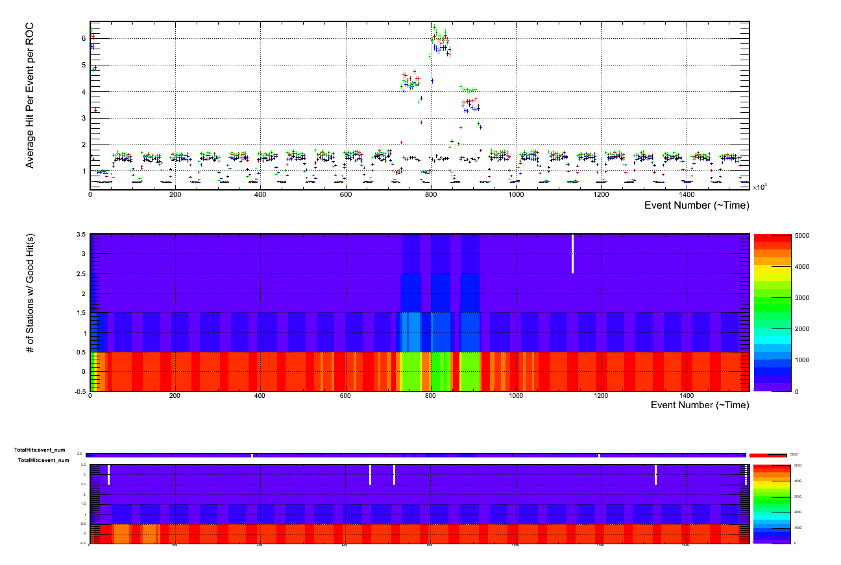
Updates: FVTX
Number of hit per event
Coincidence Peak @ 11!
Four independent data sets in color coding
Each include 16 wedges in one ROC
FEM Timing offset
0 1 2 3 4 5 6 7 …
Number of Stations with good hit(s)
Plot from Jin Huang

Slide 9
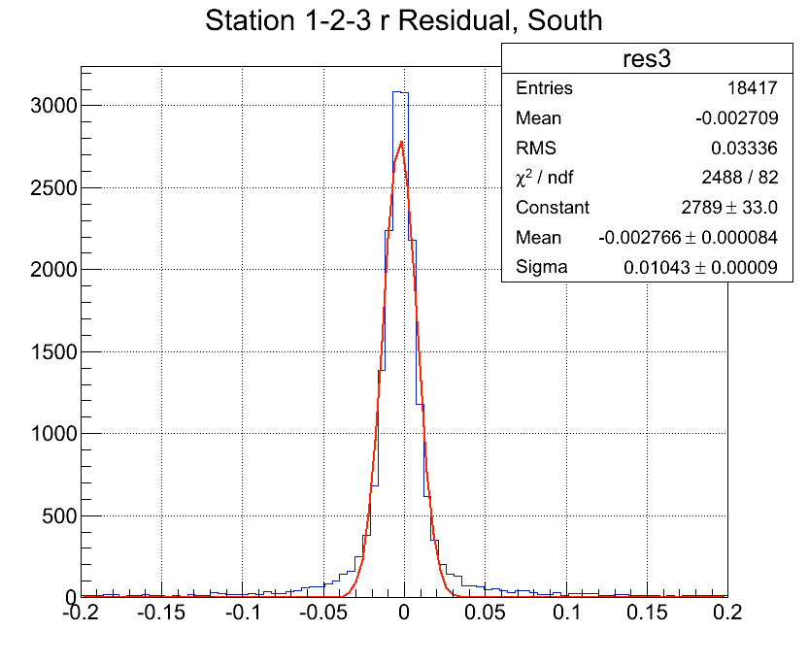
Upgrades: FVTX
Counts
Simple residual for tracking (cm)
PHENIX Trigger, 200 GeV data
Reached 100um residual without alignment yet
Plot from Melynda Brooks

Slide 10
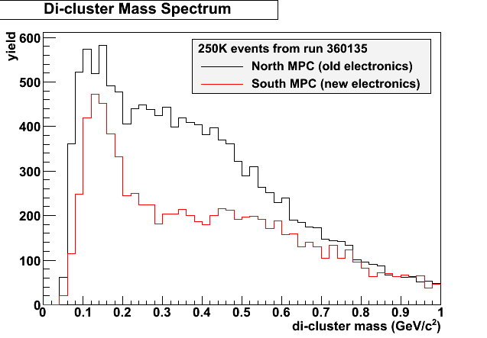
Upgrades: MPC (Forward EMC) Electronics
Working in South
North will be installed between 200 & 500 GeV run.
Two Photon Mass Distribution from Scott Wolin, Mickey Chiu

Slide 11
Conclusion
Local polarimetry is in full swing.
Vernier scan needs a tweak on Angelika’s side before the next one
Reminder: we want the angled beam study but we still need some time to setup our scalers.
Upgrades making encouraging progress.

Slide 12
Backup

Slide 13
RPC Run12 Data
Slides from Ralf Seidl

Slide 14
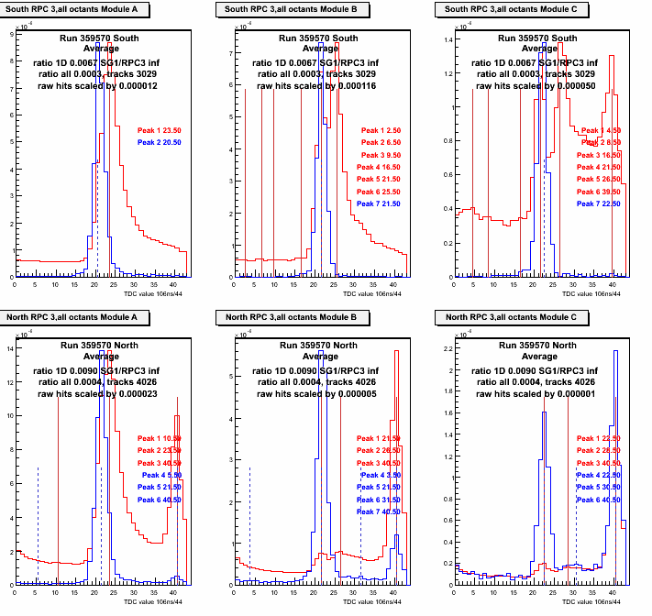
Current situation
Still large incoming background in yellow beam,
Blue beam relatively clean
DX backscatter still visible but not as prominent

Slide 15
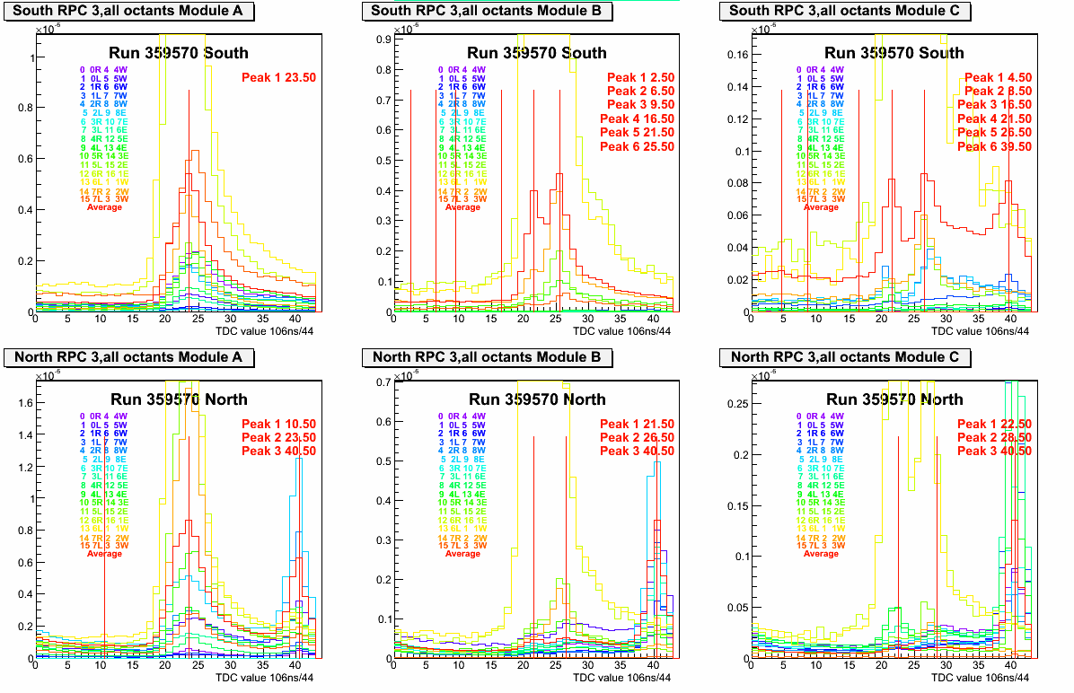
Octant dependence

