Slide 1
RHIC Status
RHIC Spin Collaboration
V. Schoefer
2/10/12

Slide 2
Startup Summary
1/21: Blue injection
1/24: 9 MHz ARC EVENT
1.5 Shifts of beam lost
1/25:
Circulating beam and operational instrumentation reach very quickly. Great improvement in global timing setup.
LLRF capture in both rings ahead of schedule
1/27: Power supplies ready for 100 GeV
1/29: LLRF ready for ramps
Blue beam to flattop in one ramp
1/30:
Both beams to flattop on fourth attempt
1/31-2/2
Ramp setup, 9 MHz vacuum pulls begin
2/2-2/4
Rebucketing setup: Longer than expected
2/5-2/7
Intensity ramp up
2/8
Beam conditioning of 9 MHz vacuum, no trips since then
Able to increase bunch number after this
2/9-2/10
Bunch number increase, regular stores

Slide 3
Current Status
Successful rebucketed store at 96x96, 1.1e11 (injected)
Vernier scan planned soon to measure cross section
Problems
BBQ system for tune feedback is locking across rings (yellow system measures blue vertical tune)
Responsible for many lost fills last night
Polarimeter sees noise
Associated with the 197 MHz storage cavities

Slide 4
Horizontal tunes
Vertical tunes
Blue
Yellow

Slide 5
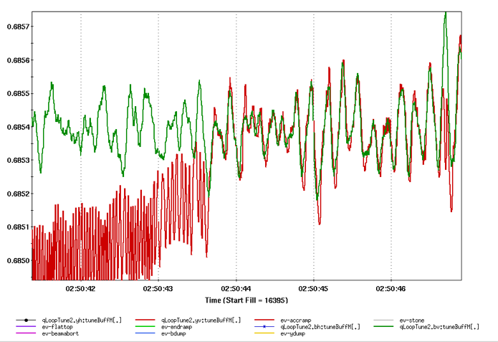
Agreement down to the noise
Separating the tunes on the ramp a small amount seems to work as a stopgap

Slide 6
Polarization lifetime
Horizontal store tunes are drifting high during the store toward 0.7 spin resonance
Will adjust incrementally

Slide 7
Plan
Run continuously for the weekend
Vernier scan at end of store
Some beam development left for day shift next week (Monday, 1-2 dedicated low intensity ramps)
Beta* measurements
Linear optics

