Slide 1
Jet Operations and Preparations

Slide 2
Jet intensity
Overall the Jet intensity seems to come up to maximum fairly quickly after cleaning
The cleaning process is fairly quick and requires ½ hr. access (Controlled)
The first time we ran the nozzle plugged up after 5 days
The next time it was a little better 6+ days
This time we decided to reduce the oxygen flow after attaining maximum intensity in order to reduce the icing building up on the nozzle. So far so good!!

Slide 3
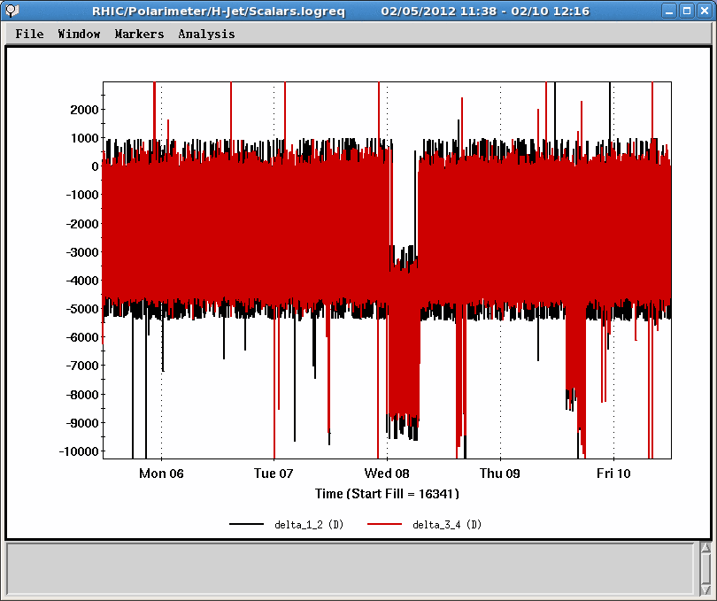
Jet Intensity

Slide 4
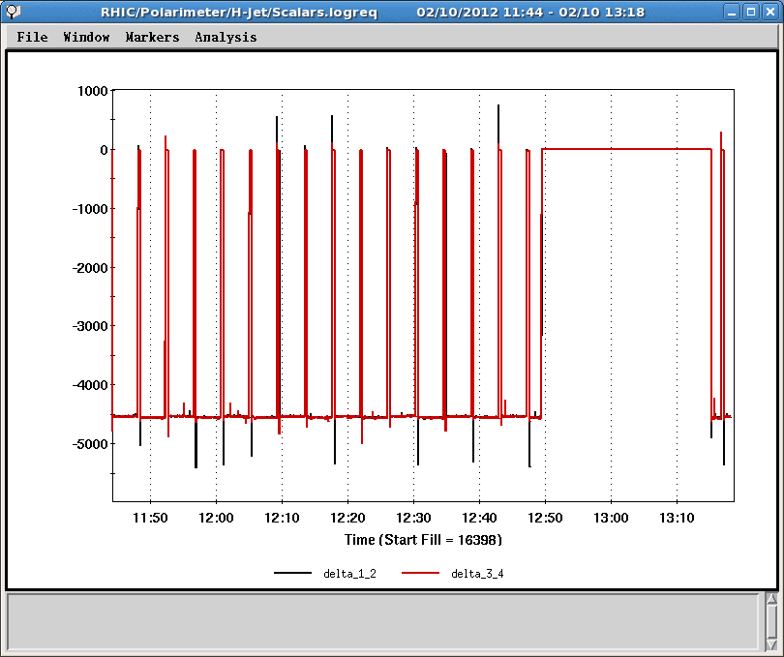
Intensity a little closer

Slide 5
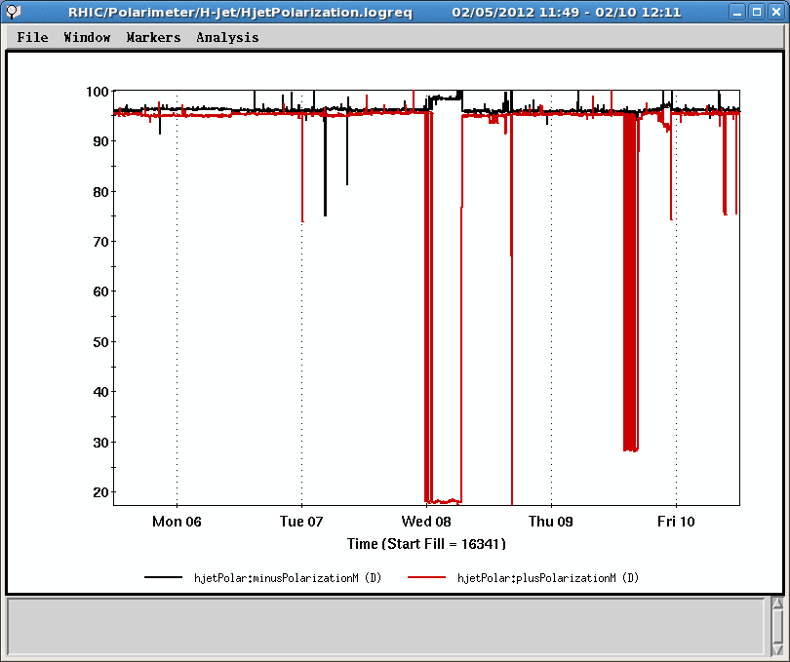
Jet Polarization

Slide 6
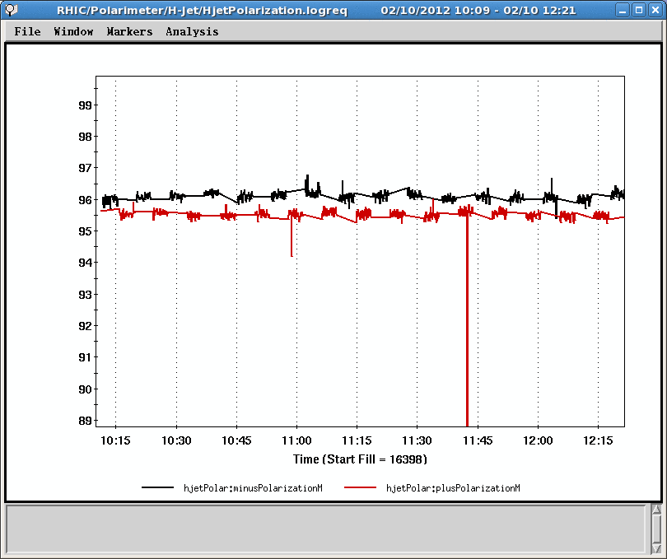
Polarization

Slide 7
Next
Currently the Jet is positioned assuming the BPMs are the same as last year
Scan the jet base for Blue and Yellow separately
Scan the beams vertically and then separate by 2.8 mm
Finish the calibration and online timing adjustments
Regardless, the data can be managed offline independently

