Slide 1
AGS PP Status
Haixin Huang
RSC Meeting
February 10, 2012

Slide 2
Status
Gain polarization after Ggamma=3 harmonic scan done at AGS injection with CNI polarimeter. This is the first time we can use CNI polarimeter at injection reliably. Compared to the past, the injection asymmetry (polarization) is higher this year.
The timing alignment of the two jump quads have been adjusted based on the field measurement. The accumulated error of jump quad timing have also been found and corrected. These are benefited from the field measurement initiated by Peter Thieberger.
AGS setup is stable over past one week. Polarization is around 70% at extraction with nominal intensity (1-1.5*10^11).
With same Booster input(4.1*10^11), the AGS extraction intensity can reach 2.8*10^11. This is after tuning out beam loss at 98ms in the Booster. AGS IPM reports 17.5 (H) and 19(V) pi (flattop, rf off).
The emittance is smaller at AGS extraction as measured by IPM. The BtA emittance does not show much difference from last year (comparing the case without Booster scraping).
More intensity from source this year allows heavier booster scraping.

Slide 3
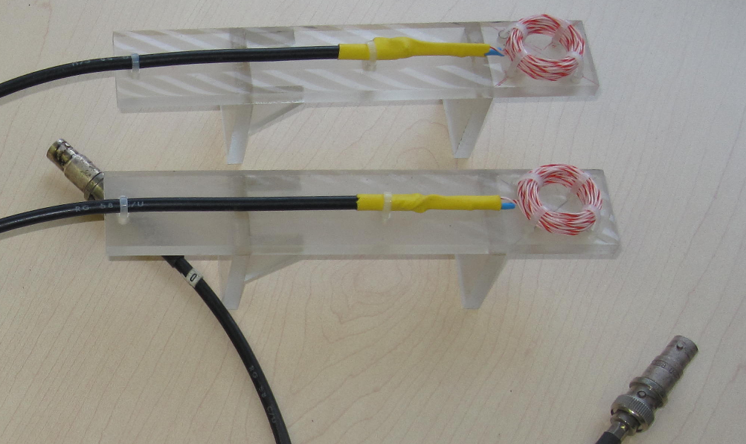
dB/dt pickup coils that have been locate in the fringe fields of both jump quads
(Peter Thieberger)

Slide 4
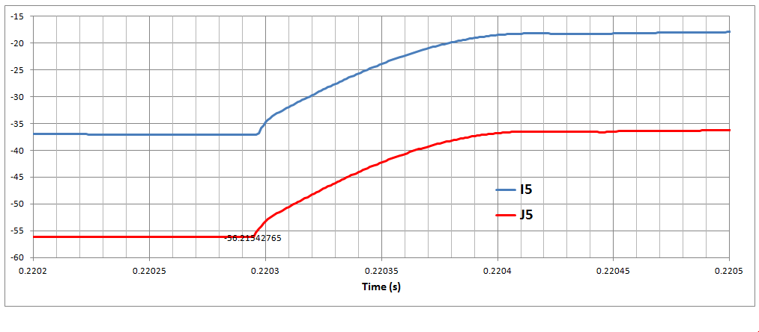
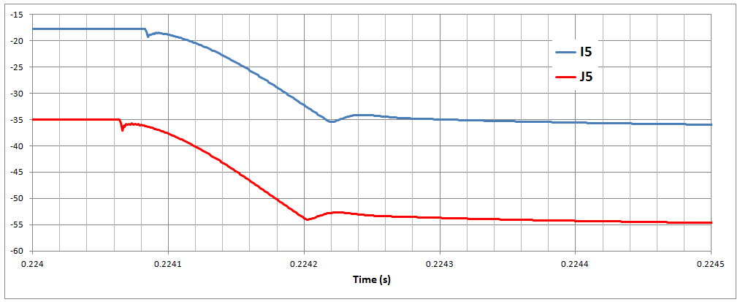
The trailing edges of the I5 pulses are delayed by ~18 μs with respect to J5
Δt ~ 18 μs

Slide 5
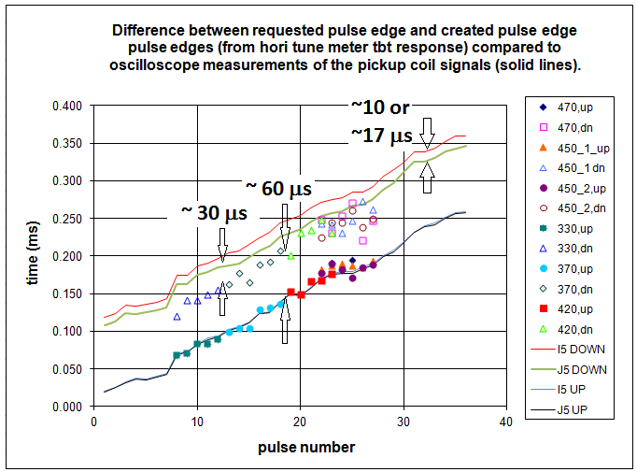
Note: the ~30 μs are due to pulse mid-point vs. edge timing
(Leif, John Morris)

Slide 6
Vertical Beta Function at Vertical IPM
Near injection, beta_y is about half of the nominal value of 22m.
The high values are contaminated by JQ.

Slide 7
Emittances on the Ramp of Run11 and Run12
Left: Run12; right: Run11
Horizontal
Horizontal
Vertical
Vertical

Slide 8
AGS Injection Polarization Measurements
Date Time Asymmetry Error Pol(200MeV) Normalized Asym.
2/15/2008 61.4 0.20 76.0 64.63
2/5/2011 63.8 1.10 79.1 64.52
1/23-27/2012 68.0 0.46 79.6 68.34
Injection polarization is higher this year by a few percent. The gain vs. last year could be due to different Booster harmonic correction.
200MeV polarimeter had background issue before run9, but I ignored them here and assume the values are correct.
Many thanks to Dave Underwood, Hal Spinka and Steve Gliske who worked on e880 polarimeter after their STAR shifts.

Slide 9
Flip Booster Ggamma=3?
This will requires almost full current for sin3v, from 25A power supply.

Slide 10
Intensity Scans of Run11 and Run12
Higher polarization this year for various intensities. With narrower targets, polarization is higher (not shown here), which indicates part of the slope is due to polarimeter rate effect.

Slide 11
Remaining Job List
Need spin tracking for AGS with JQ on/off to see if we deserve more polarization or not.
Understand the polarization sensitivity to optics around 0+.
Understand the emittance difference in the AGS.
RF h=6 test in AGS (h=12 now).
Polarization profiles with JQ on and off as of now.
With last JQ pulse on/off comparison.
Beta function measurement at vertical IPM.
Multi-wire tbt readout.
Check polarization with high brightness beam into AGS (high source intensity, same emittance?)
Compare polarization with same intensity and different emittance (including longitudinal).
Down ramp without jump quads to estimate the polarization loss on the up ramp. The challenge is to keep intensity through transition.

