Slide 1
AGS FY11 Summary
RHIC Spin Collaboration Meeting
5/6/11

Slide 2
Overview
Optics/survey
  Beta function improvement
  Orbit stability
Polarization
  Steeper horizontal profile (no jump quads) than historically
  Profile and average improve with jump quads
  Apparent appearance of vertical profile towards end of run
  Coupling on the flattop
Emittance
  Very sensitive to vertical chromaticity
  Vertical increases 10-15% with jump quads on at about 1.5e11 intensity at extraction
  No comparison at the higher intensities (2e11)

Slide 3
Optics
Significant improvement in beta function from survey, but still large residual beating, source as yet undetermined
Vertical beta function ratio at the jumps quads much closer to unity
Orbit stability much improved (changes on the scale of days, not hours)
Further correction attempts using orbit distortions and trim coils on tune quads has not yielded any improvement to emittance growth
We only resurveyed 9 main magnets and a small subset of the sextupoles. Do we want to do a full realignment?

Slide 4
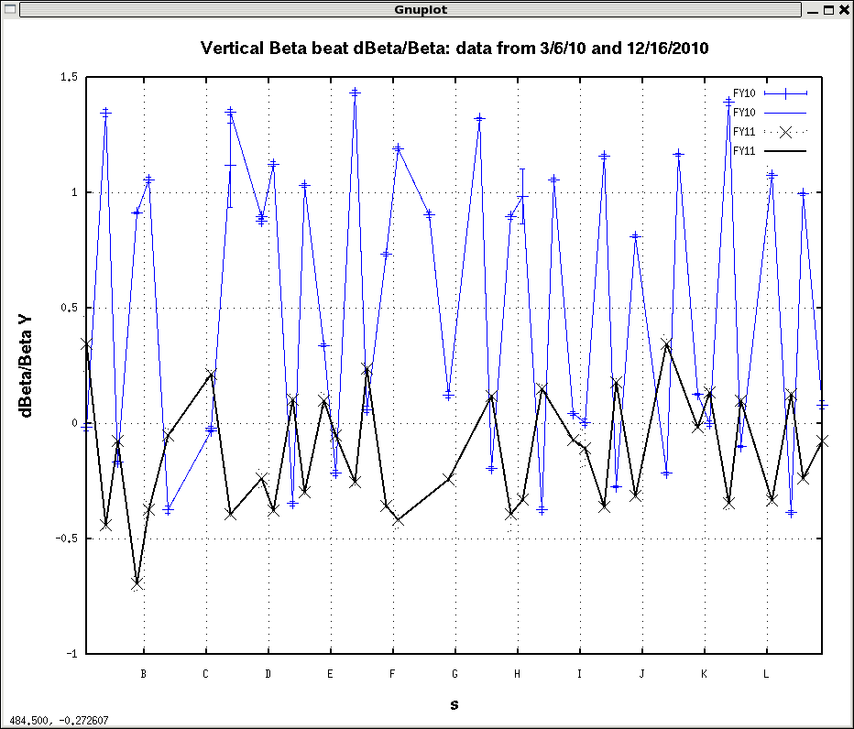

Slide 5
Polarization
Overall jump quads improve average polarization by ~ 5%
Mistiming of the quads does not recover the original ‘quad off’ profile, implying that there may still be improvement to be had
  Especially at higher intensity where the horizontal emittance is larger
There are appreciable coupling driving terms on the flattop (and presumably also at 36+), dQmin = 0.02 on the flattop.
  Do these contribute to polarization loss on the ramp?
  Do they introduce systematics into the polarization measurements?
  The extracted beam may be coupled (~independent of circulating beam coupling). Could this explain the different between RHIC injection profiles and AGS extraction profiles?
Can we calibrate the jump quad timing better?
  Use the jump quads to jump the vertical tune quickly out of the spin tune gap before and after the location of a vertical intrinsic (36-)

Slide 6
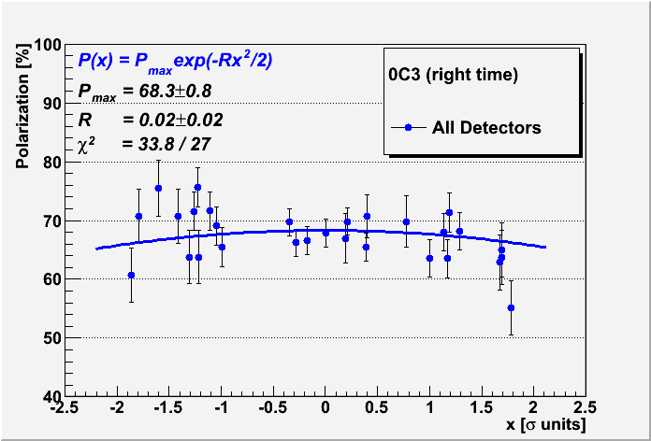
Pavg = Pmax/sqrt(1+R) = 67.62 +/- 1

Slide 7
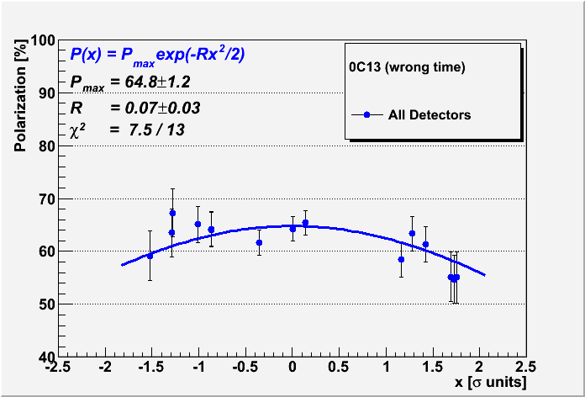
Pavg = Pmax/sqrt(1+R) = 62.9 +/- 1.5

Slide 8
Emittance
Vertical emittance 10-15% larger than in previous years, largely owing to jump quads (although it was generally difficult to minimize, even pre-jump quad)
VERY sensitive to vertical chromaticity, has to be very near zero, a few units yields growth to 100pi or worse.
Growth, especially of ‘tails’, very clear on multiple devices (CNI, IPM, AtR flags)
Clearly helped with the transverse dipole damper
Coherence at the time of jumps could not be entirely eliminated with vertical harmonic steering (coupling from horizontal?)
Can we measure the quadrupole oscillations of the beam envelope at the tune jumps?
  Having measured them, can we develop a damper?
  Probably worth specifying the parameters

Slide 9
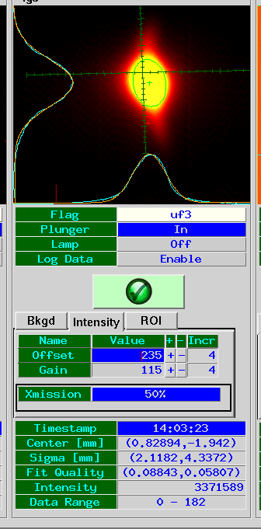
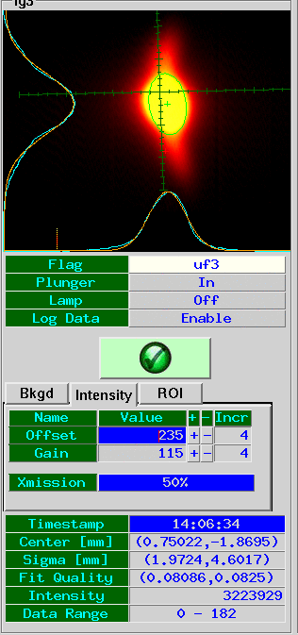
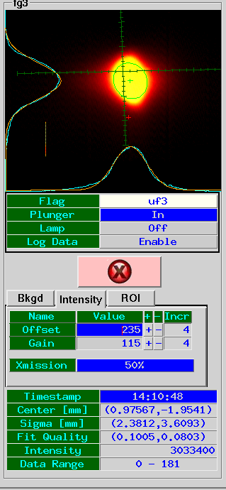
AtR Flag Profiles
JQ on, damper on
Turn off damper
Turn off jump quads

Slide 10
Summary
Run 11 was very good for the AGS. The jump quads are effective at increasing the polarization BUT:
They introduce new challenges
  Measurements have been proposed to calibrate the timing more effectively
  If the quad kicks from the two quads cannot be matched, perhaps we can build a damper
What is the effect of the AGS coupling on actual polarization and our measurements of it (in particular of the profiles)?
  What is the effect of coupling on the transfer to RHIC?
We have 1 week of development time during the 100 GeV Au run to address some of these issues. Will probably dedicate a lot of time to profile measurements in a with a well-decoupled flattop

